Slide 1
Social Networks
Gautam Srivastava

Slide 2
Social Networks
have become prominent through the use of social networks to help connect us online
a social network is a social structure made up of individuals that are tied by one or more interdependencies

Slide 3
Interdependencies
Friendship
Kinship
Common Interest
Financial Exchange
Beliefs
Career

Slide 4
Social Network Topology
We can view a Social network as a graph
Nodes/Vertices represent people
Edges represent relationships

Slide 5
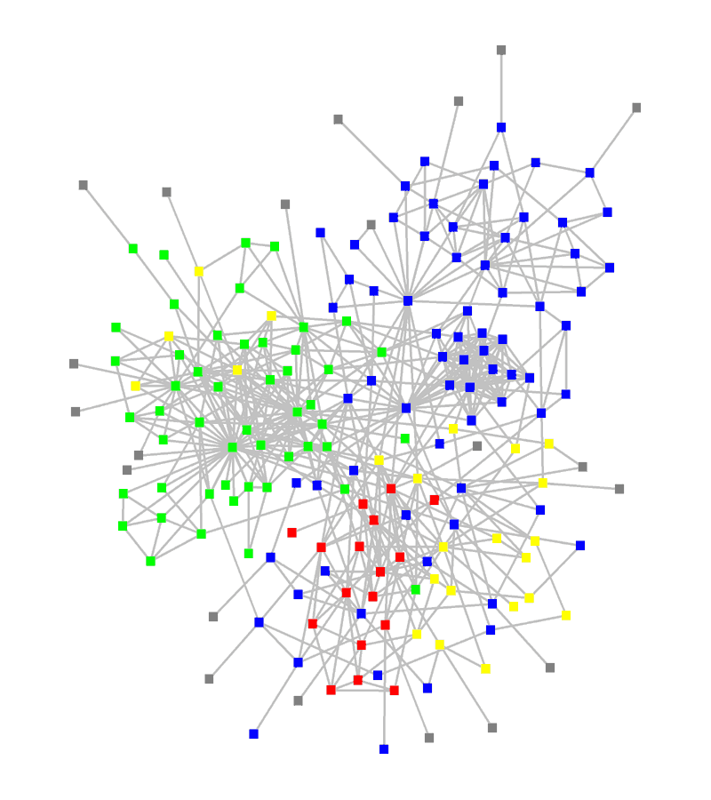
Social Network

Slide 6
Properties of Social Networks
Power Law
Triadic Closure
Clustering
APL – Six Degrees of Seperation

Slide 7
Power Law
Degree Distribution – The amount of friends of each node
In Social Networks, we see a known trend called Power Law
There are a few nodes of HIGH degree, and then many nodes of LOW degree

Slide 8
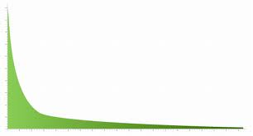
Power Law Graph

Slide 9
Triadic Closure
If two people in a social network are friends, then there is an increased likelihood that they will become friends

Slide 10
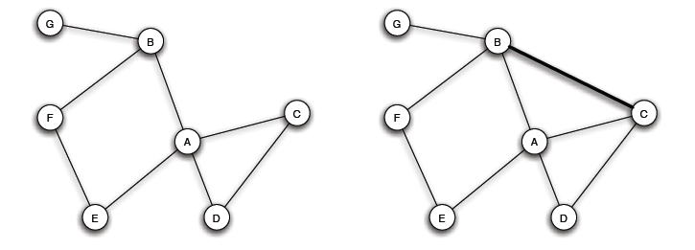
Triadic Closure

Slide 11
Clustering
Phenomena in social networks where we see really densely populated areas in the network
Usually follows geographical patterns

Slide 12
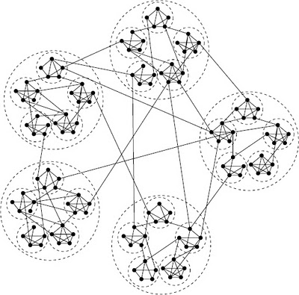
Clustering

Slide 13
Average Path Length
Measures the distance on average between all nodes in the Network
We find on large networks that this length to be quite small
Six degrees of Seperation

Slide 14
Types of Social Networks
Online Social Networks – networks based on social network platforms (Facebook) where we make relationships through the Internet
Offline Social Networks – describes real world social networks that we create through our everyday lives

Slide 15
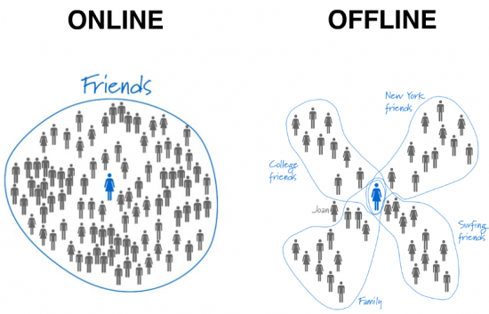
Social Network Types

Slide 16
Online Social Networks
We define online social network sites as web-based services that allow individuals to
(1) construct a public or semi-public profile within a bounded system
(2) articulate a list of other users with whom they share a connection, and
(3) view and traverse their list of connections and those made by others within the system. The nature and nomenclature of these connections may vary from site to site.

Slide 17
History
First Known Online Social Network 1997
SixDegrees.com
2001
Ryze.com

Slide 18
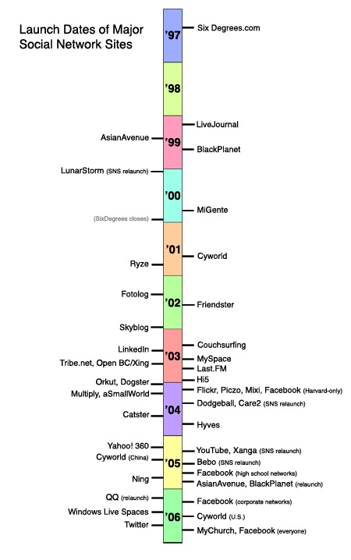

Slide 19
Rise and Fall
So why did some of these Fail and others succeeded?

Slide 20
Friendster
Good example of Rise and Fall of a Social Network
designed to compete with Match.com
gained popularity through bloggers, Burning Man
grew to 300,000 users
difficulties arose in infrastructure of the network
limitations in access to profiles created Fakesters

Slide 21
Show me the Money
So how do Social Networks make money?

