Slide 1
Mustafa
•
Added $8M ARR with Motive’s Engine Immobilizer
•
Shipped a FERPA-compliant recruitment platform in under two weeks
Product designer who codes.
•
Led Educative’s first design system across B2C and B2B
I design systems, products, and interfaces, then stay close enough to the code to help ship them.
Notes:
Open with the throughline: product design depth plus the ability to ship in code.
[Sources]
- User-provided Pitch deck, slide 1: https://pitch.com/v/slide-deck-jq3j7w
- User-provided Pitch deck, slide 19: https://pitch.com/v/slide-deck-jq3j7w
- User-provided Pitch deck, slide 24: https://pitch.com/v/slide-deck-jq3j7w
- User-provided Engine Immobilizer case study: /Users/mustafa/paper/engine-immobilizer.html

Slide 2
SELECTED WORK
Three projects, one throughline
01
Engine Immobilizer
Automotive hardware and fleet safety
02
Workflows
Product strategy and interaction design
03
Capstone Matchmaker
Design and full-stack development
Notes:
Set expectations without slide numbers or false section parity.
[Sources]
- User-provided Pitch deck, slide 2: https://pitch.com/v/slide-deck-jq3j7w
- User-provided Engine Immobilizer case study: /Users/mustafa/paper/engine-immobilizer.html

Slide 3
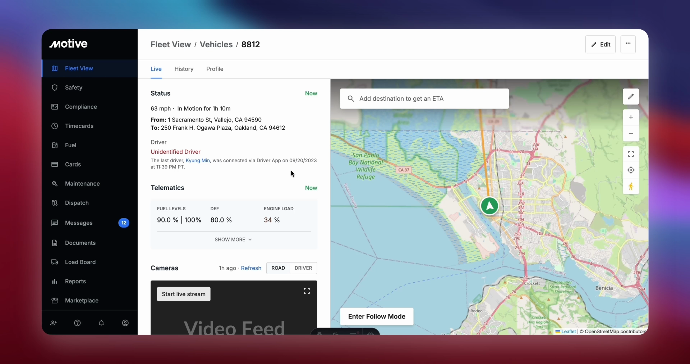
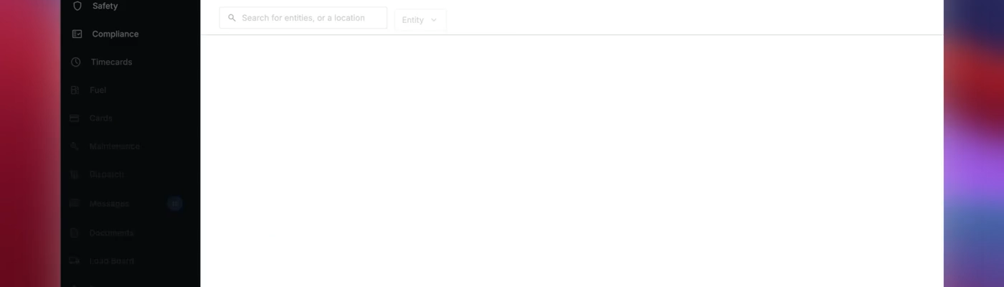
ENGINE IMMOBILIZER
Remote immobilization was the only core capability missing for Mexico.
Sales Engineers said 90% of prospects asked for it. Motive had already lost a significant prospect, and the Q1 launch was at risk.
Notes:
Lead with the business constraint: Mexico expansion was blocked by one missing fleet-safety capability.
[Sources]
- User-provided case study: /Users/mustafa/paper/engine-immobilizer.html
- User-provided demo: /Users/mustafa/paper/case-media/engine/hero.mp4

Slide 4
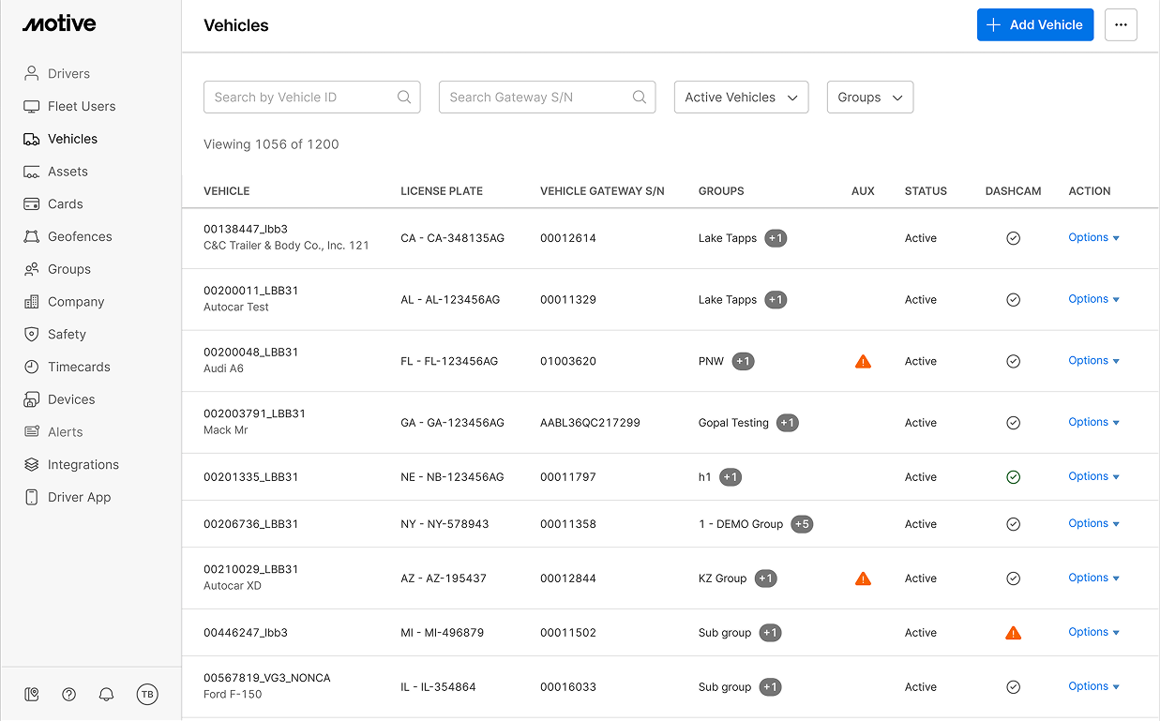
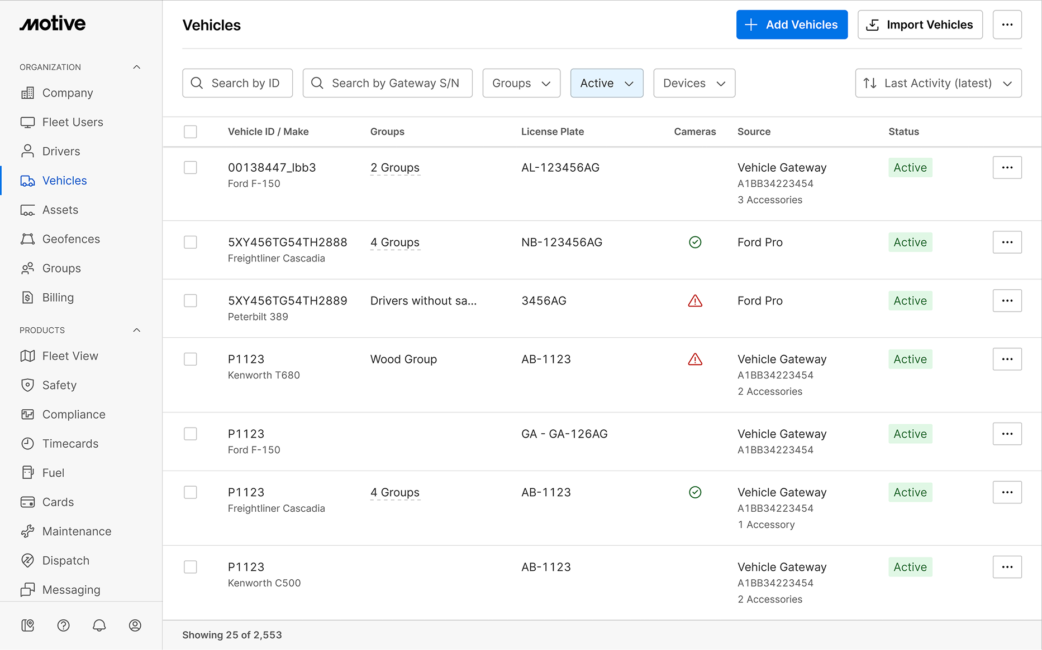
SYSTEM COMPLEXITY
One command. Three systems.
The design had to account for
•
Legacy and future admin states
•
Third-party device pairing
Admin was moving from 1.0 to 2.0, Fleet View was changing, and Motive was sourcing its first third-party hardware. I designed for launch without creating throwaway work.
•
Dead zones and command retries
•
Tamper and jammer alerts
Notes:
Explain that the product had to launch across legacy and future admin states, Fleet View, and Motive’s first third-party hardware.
[Sources]
- User-provided case study: /Users/mustafa/paper/engine-immobilizer.html
- User-provided images: /Users/mustafa/paper/case-media/engine/admin1.0.png; /Users/mustafa/paper/case-media/engine/Admin2.0.png

Slide 5
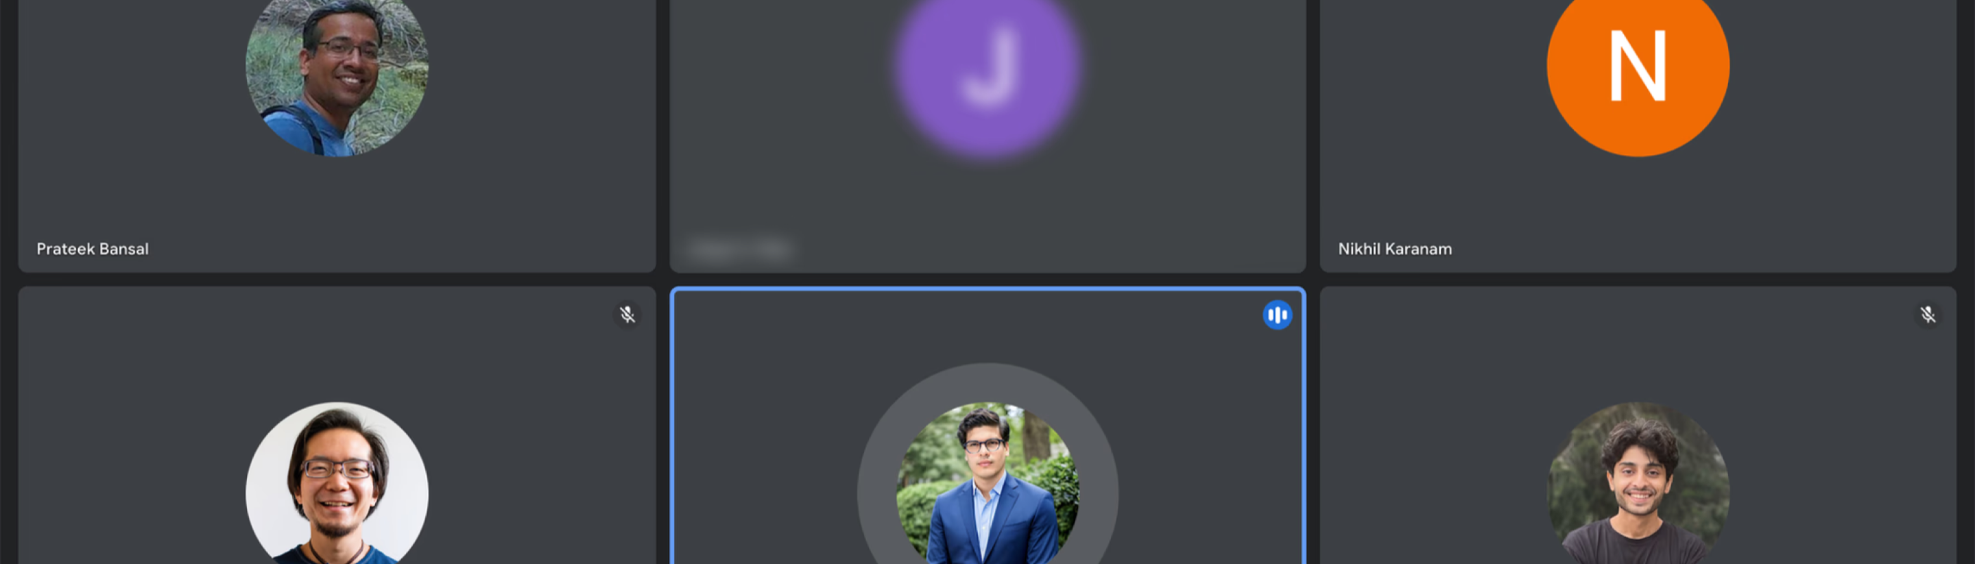
CUSTOMER RESEARCH
Fleet managers—not drivers—owned the action.
They used it after theft attempts or drunk driving. Dead zones and cut wiring made fallback states essential.
Notes:
Emphasize the ownership decision and the reliability constraints learned from fleet managers.
[Sources]
- User-provided case study: /Users/mustafa/paper/engine-immobilizer.html
- User-provided image: /Users/mustafa/paper/case-media/engine/customer-call.png

Slide 6
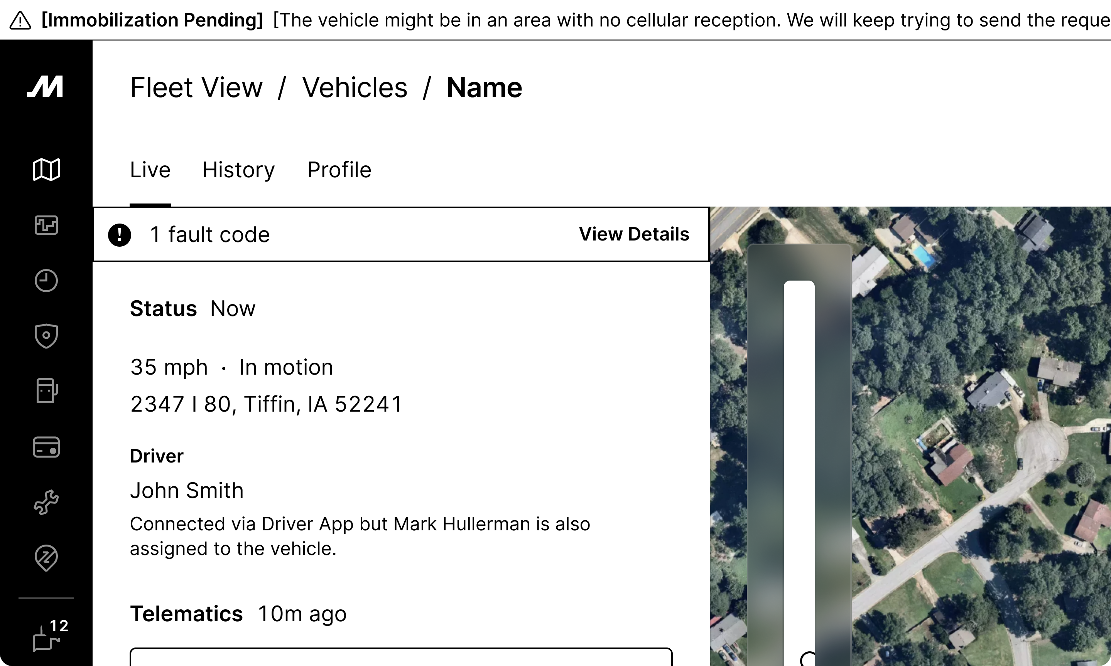
SAFETY MODEL
A dangerous action had to be deliberate and recoverable.
•
Fleet manager-only control
•
The vehicle had to be stopped
•
Confirmation, command status, and audit trail
•
Tamper, jammer, and dead-zone fallbacks
Notes:
Frame the solution as a safety model, not a single button: permission, preconditions, confirmation, status, auditability, and fallback.
[Sources]
- User-provided case study: /Users/mustafa/paper/engine-immobilizer.html
- User-provided image: /Users/mustafa/paper/case-media/engine/iteration-final.png

Slide 7
IMPACT
Added $8M
to ARR
Engine Immobilizer gave Sales the last core capability needed for Mexico.
It also supported lower insurance premiums and reduced cargo-theft risk.
Notes:
Close the case study on business and customer impact before transitioning to Workflows.
[Sources]
- User-provided case study: /Users/mustafa/paper/engine-immobilizer.html

Slide 8
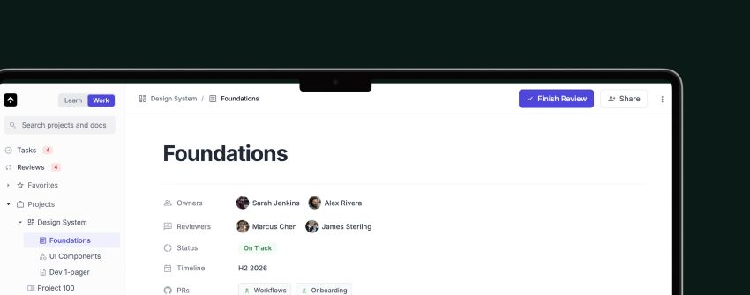
WORKFLOWS
At Educative, the collaboration became a blocker when we scaled.
Pagers waited on approvals, work was getting delayed, and our existing stack didn’t help with that.
Notes:
Introduce the company scale before the product.
[Sources]
- User-provided Pitch deck, slide 3: https://pitch.com/v/slide-deck-jq3j7w

Slide 9
RESEARCH
I spoke with 18 engineering managers and 13 engineers.
Goal: Understand the problem space
Assumptions
Findings
The tooling was broken.
The workflow was not optimized for us
•
Standardize content
•
Content was searchable but scattered
•
Fix the journey
•
Lack of updates, lots of things remained stale
•
Add more process
•
Existing tools worked for separate teams, but not when collaborating
Notes:
State the research insight as a diagnosis, not a list of bullets.
[Sources]
- User-provided Pitch deck, slide 6: https://pitch.com/v/slide-deck-jq3j7w

Slide 10
PROBLEM FRAMING
I classified the problem into two parts: foundation and visibility
First-order problem
Second-order problem
How might we organize the work?
How might we make progress visible?
To make the progress visible, we needed to have a solid foundation to start first. Existing tools were opinionated. We wanted something that worked for all of our teams.
Notes:
Explain the order of operations clearly.
[Sources]
- User-provided Pitch deck, slide 5: https://pitch.com/v/slide-deck-jq3j7w
- User-provided Pitch deck, slide 7: https://pitch.com/v/slide-deck-jq3j7w

Slide 11
PRODUCT DIRECTION
I designed the product according to how we worked
•
A self-contained knowledge base
•
A multiplayer editor for tasks and comments
•
A review system modeled on pull requests
•
A shared hierarchy from groups to subtasks
Notes:
Connect the feature set to the working model uncovered in research.
[Sources]
- User-provided Pitch deck, slide 8: https://pitch.com/v/slide-deck-jq3j7w

Slide 12
BUILD TIMELINE
I shipped a barebones MVP in one week and spent 8 months turning it into a 0 to 100 platform
Week 1
Months 2–4
Month 8
MVP shipped
Learned and rebuilt
Platform shipped
Shipped fast, broke things, learned a lot
Feedback tools like Userback, and analytics informed a few decisions
Planning, review, and docs connected
Notes:
Resolve the apparent conflict between one week and eight months.
[Sources]
- User-provided Pitch deck, slide 8: https://pitch.com/v/slide-deck-jq3j7w
- User-provided Pitch deck, slide 10: https://pitch.com/v/slide-deck-jq3j7w

Slide 13
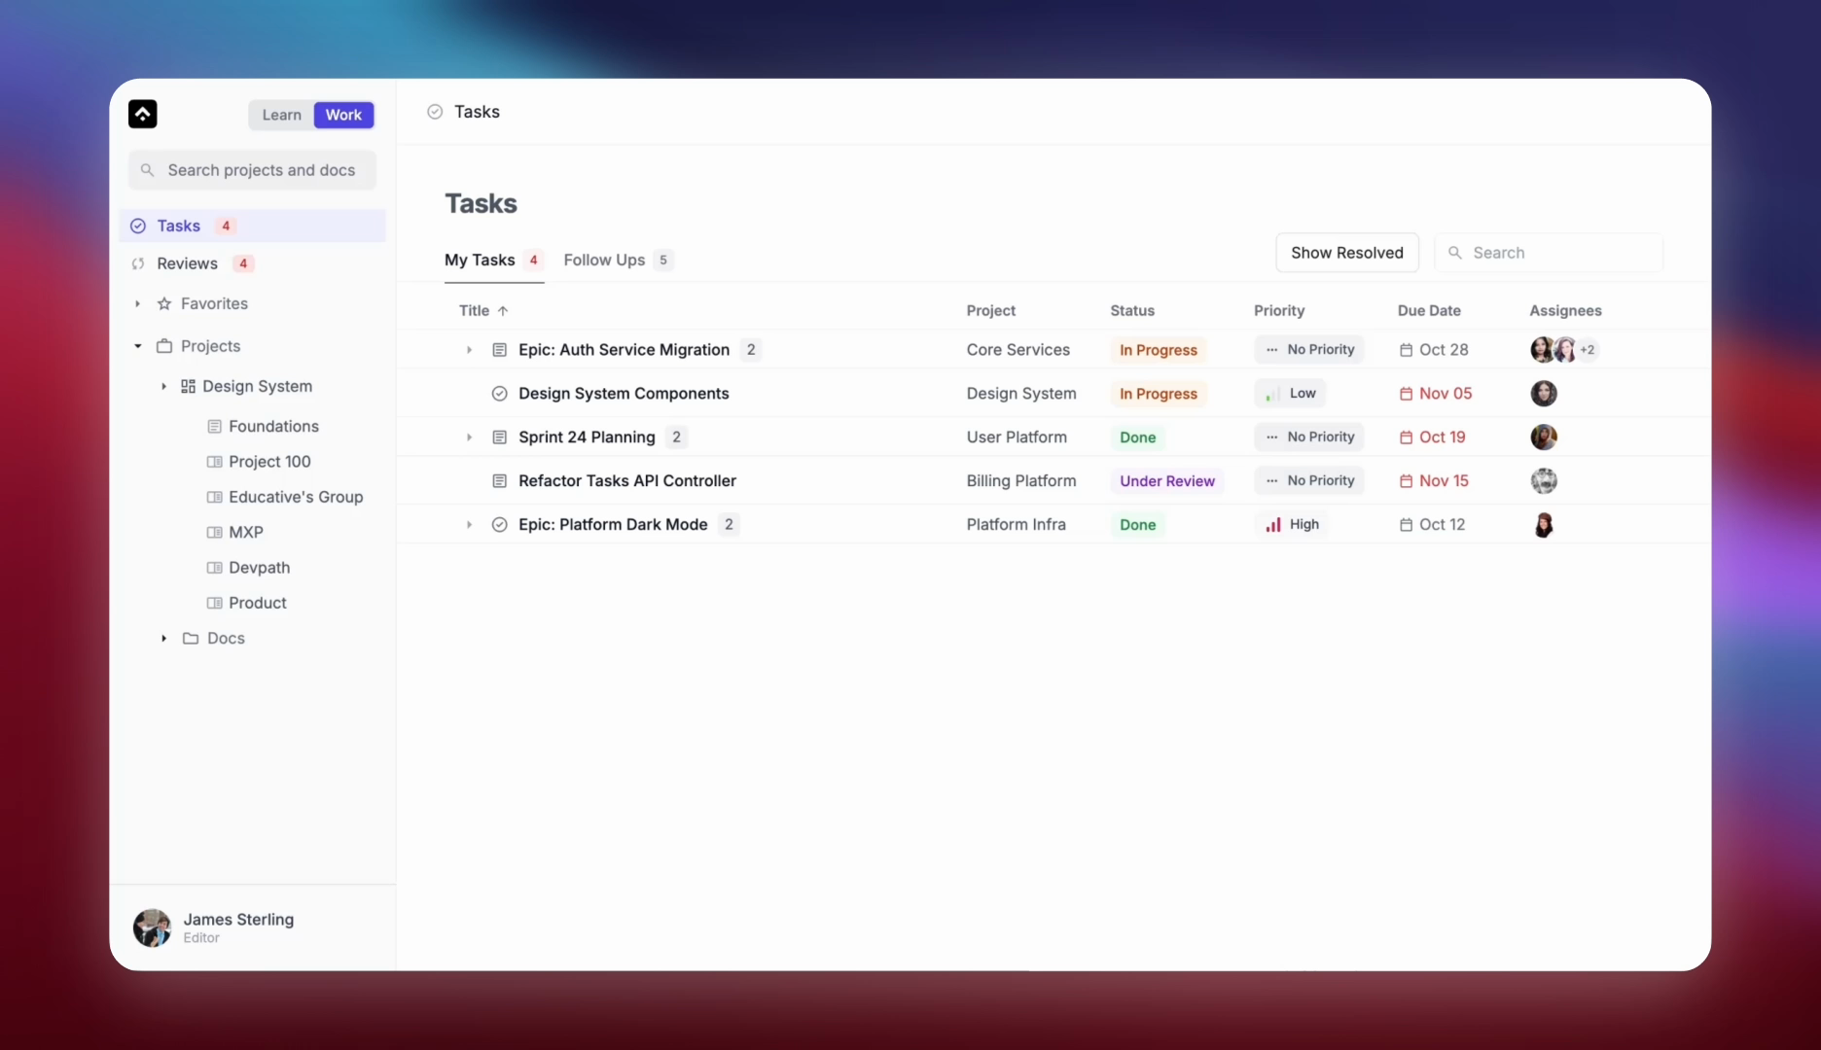
WHAT SHIPPED
Task hub
Notes:
Use this as the product synthesis slide, not four separate reveals.
[Sources]
- User-provided Pitch deck, slide 14: https://pitch.com/v/slide-deck-jq3j7w
- User-provided Pitch deck, slide 15: https://pitch.com/v/slide-deck-jq3j7w
- User-provided Pitch deck, slide 16: https://pitch.com/v/slide-deck-jq3j7w
- User-provided Pitch deck, slide 17: https://pitch.com/v/slide-deck-jq3j7w

Slide 14
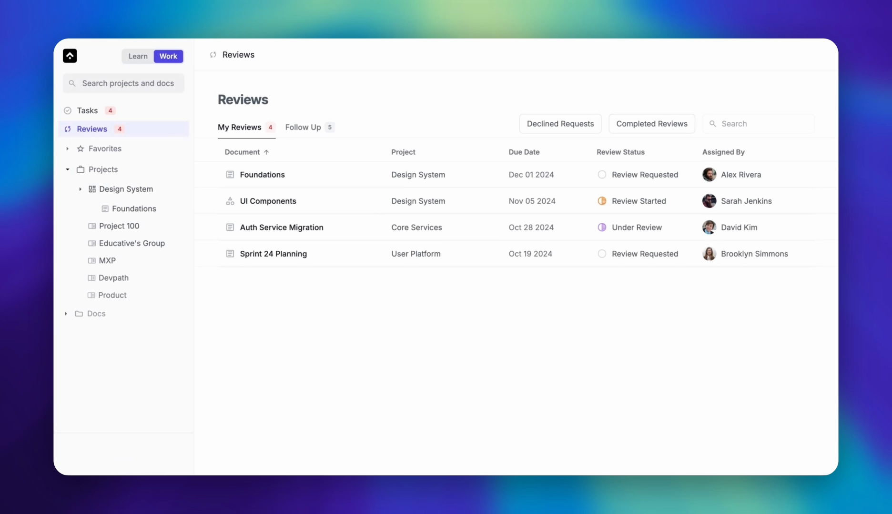
WHAT SHIPPED
Review hub
Notes:
Use this as the product synthesis slide, not four separate reveals.
[Sources]
- User-provided Pitch deck, slide 14: https://pitch.com/v/slide-deck-jq3j7w
- User-provided Pitch deck, slide 15: https://pitch.com/v/slide-deck-jq3j7w
- User-provided Pitch deck, slide 16: https://pitch.com/v/slide-deck-jq3j7w
- User-provided Pitch deck, slide 17: https://pitch.com/v/slide-deck-jq3j7w

Slide 15
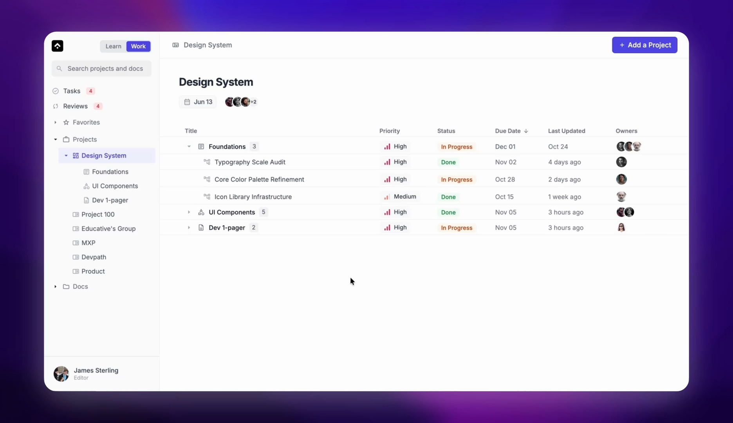
WHAT SHIPPED
Projects
Notes:
Use this as the product synthesis slide, not four separate reveals.
[Sources]
- User-provided Pitch deck, slide 14: https://pitch.com/v/slide-deck-jq3j7w
- User-provided Pitch deck, slide 15: https://pitch.com/v/slide-deck-jq3j7w
- User-provided Pitch deck, slide 16: https://pitch.com/v/slide-deck-jq3j7w
- User-provided Pitch deck, slide 17: https://pitch.com/v/slide-deck-jq3j7w

Slide 16
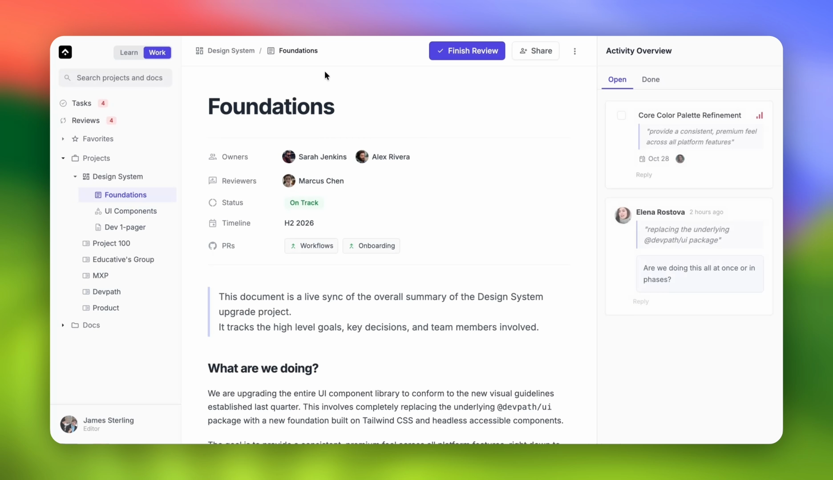
WHAT SHIPPED
Document editor
Notes:
Use this as the product synthesis slide, not four separate reveals.
[Sources]
- User-provided Pitch deck, slide 14: https://pitch.com/v/slide-deck-jq3j7w
- User-provided Pitch deck, slide 15: https://pitch.com/v/slide-deck-jq3j7w
- User-provided Pitch deck, slide 16: https://pitch.com/v/slide-deck-jq3j7w
- User-provided Pitch deck, slide 17: https://pitch.com/v/slide-deck-jq3j7w

Slide 17
IMPACT
$100k deal closed
Workflows helped Educative close its biggest customer yet.
The outcome tied the product directly to enterprise growth.
Notes:
Be precise about what the source deck claims: a six-figure deal and the biggest customer yet.
[Sources]
- User-provided Pitch deck, slide 18: https://pitch.com/v/slide-deck-jq3j7w

Slide 18

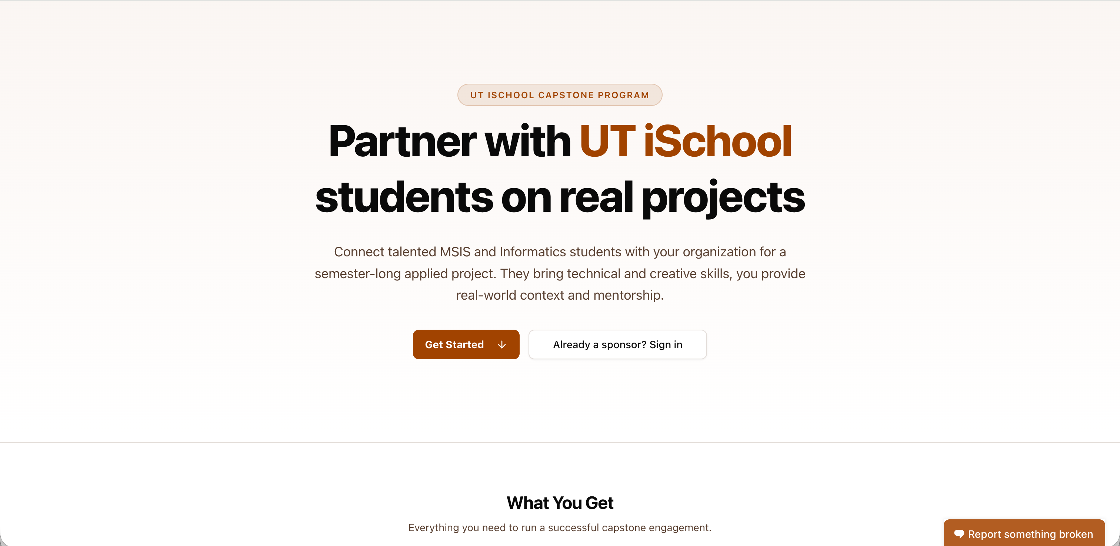
CAPSTONE MATCHMAKER
A FERPA-compliant recruitment platform, shipped in under two weeks.
I designed and built the SaaS product end to end with Next.js, PostgreSQL, and AWS EC2.
Notes:
Lead with the product and constraint, not the stack or AI credits.
[Sources]
- User-provided Pitch deck, slide 1: https://pitch.com/v/slide-deck-jq3j7w
- User-provided Pitch deck, slide 19: https://pitch.com/v/slide-deck-jq3j7w

Slide 19
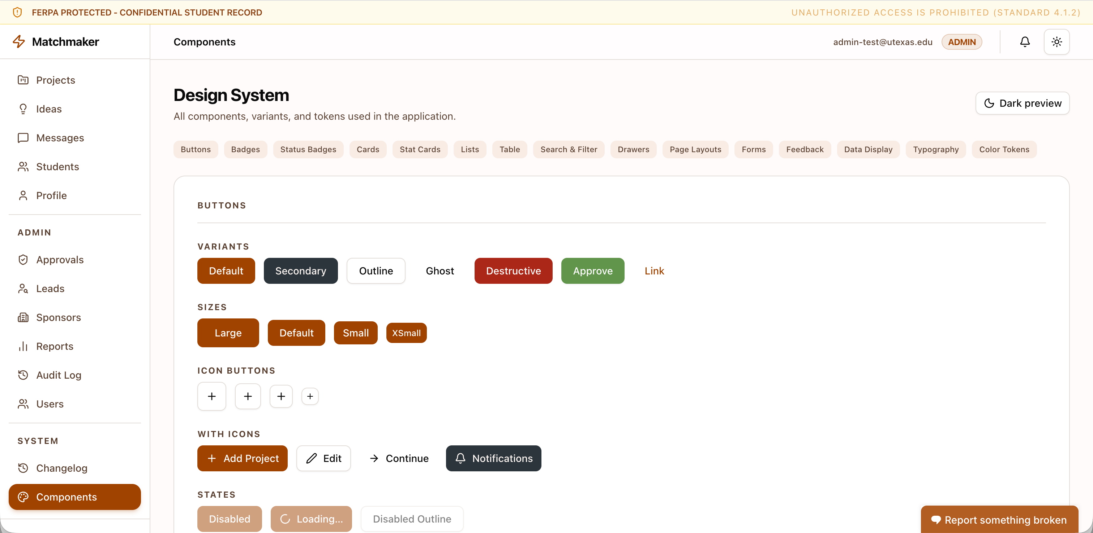
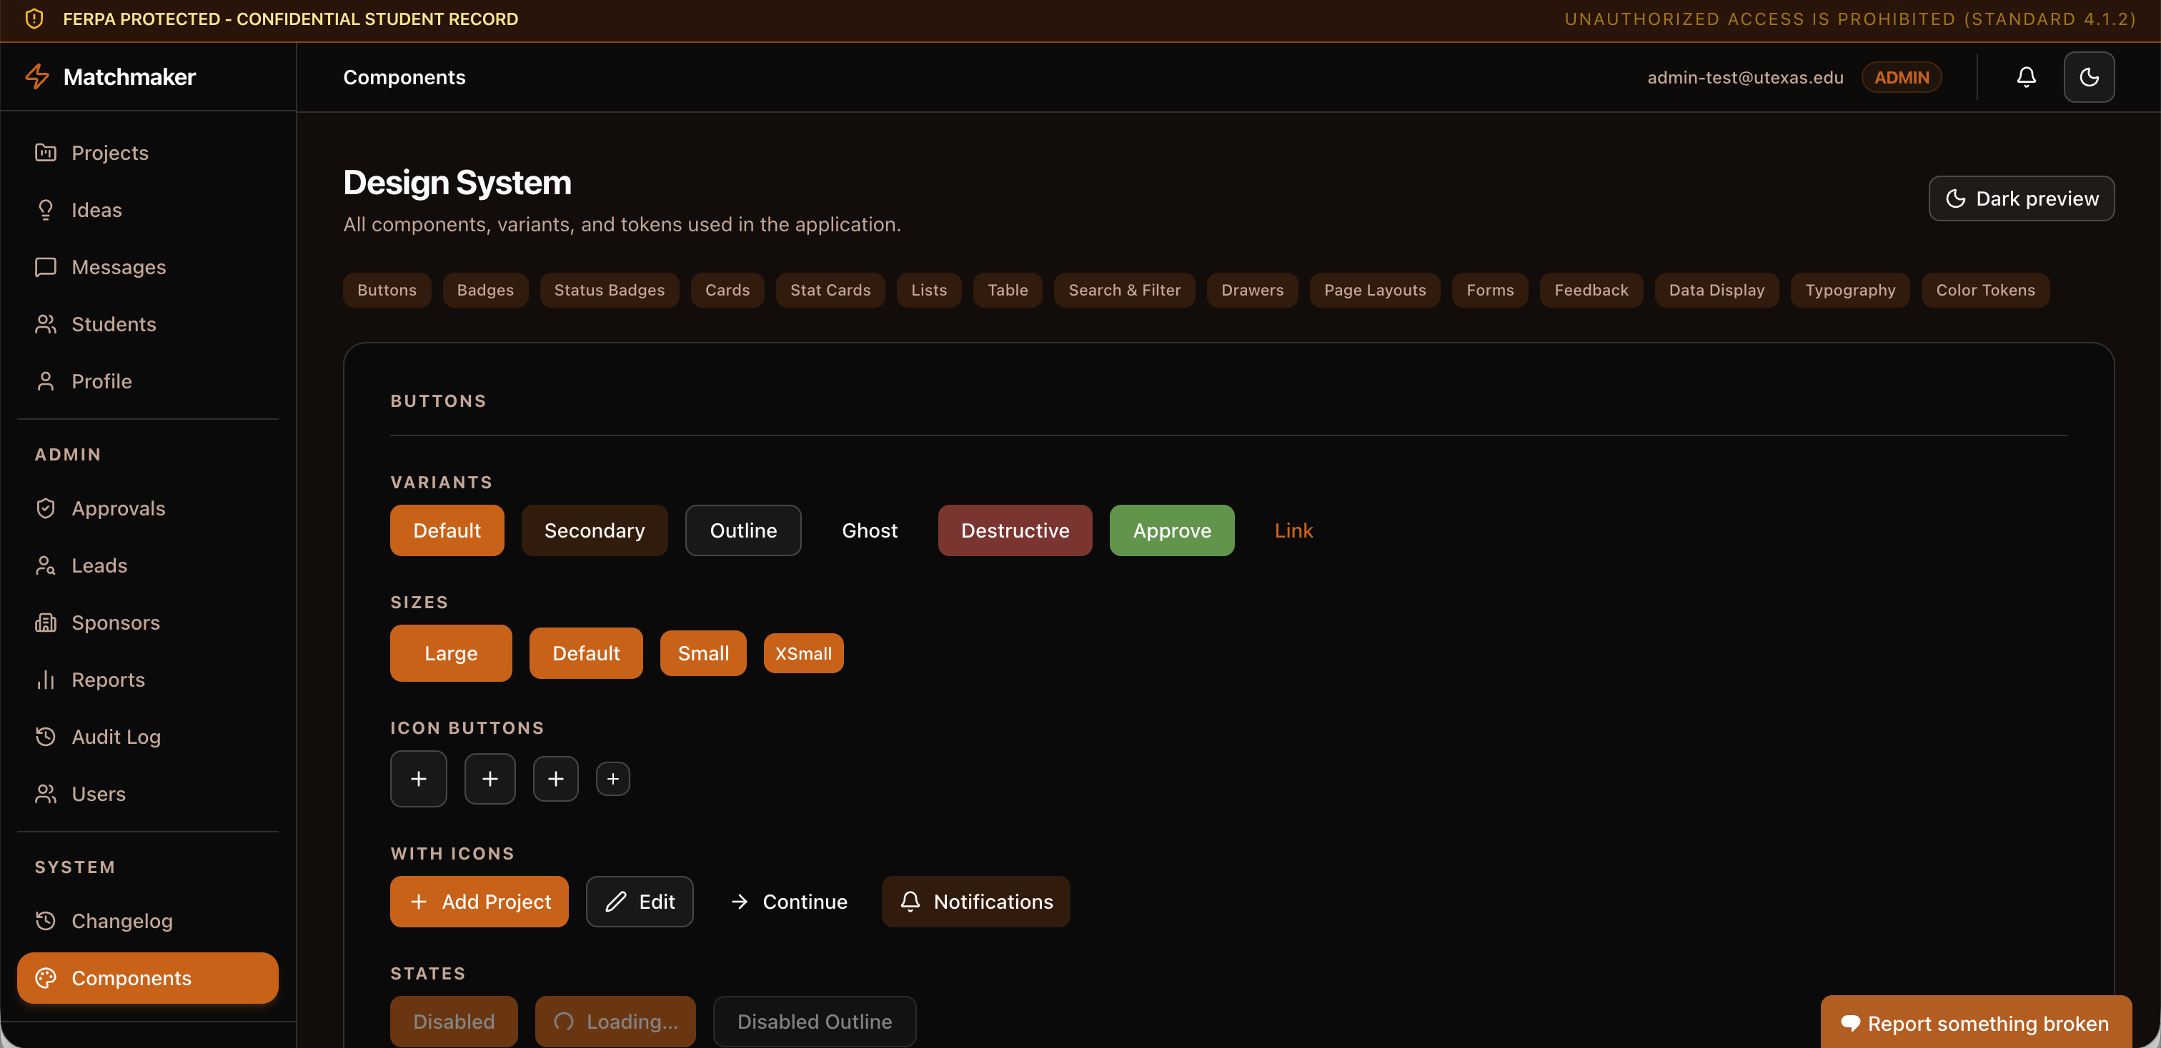
BUILD APPROACH
Code-first kept the build focused.
I owned the design end to end including
•
Product decisions
•
Information architecture
I moved from design intent to working components with Radix UI and shadcn/ui, using AI-assisted development to accelerate implementation.
•
Interaction model
•
Quality bar
Notes:
Explain code-first as a product decision, not a shortcut.
[Sources]
- User-provided Pitch deck, slide 20: https://pitch.com/v/slide-deck-jq3j7w
- User-provided Pitch deck, slide 21: https://pitch.com/v/slide-deck-jq3j7w
- User-provided Pitch deck, slide 22: https://pitch.com/v/slide-deck-jq3j7w

Slide 20
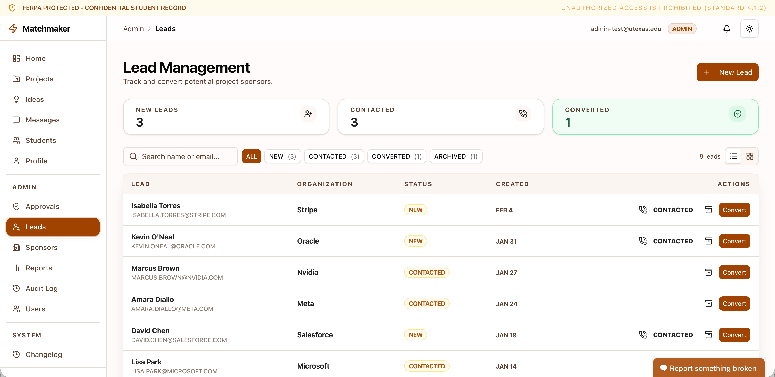
SHIPPED PRODUCT
All 5 personas have actionable dashboards.
I discovered the problems that surfaced throughout the capstone process, and after rigorous prioritization with team, I built dashboards to unblock each user persona.
Notes:
Show the outcome of the code-first build.
[Sources]
- User-provided Pitch deck, slide 23: https://pitch.com/v/slide-deck-jq3j7w

Slide 21
DESIGN SYSTEM
Educative’s first design system unified B2C and B2B products.
I led the design and implementation from foundations through reusable patterns.
Notes:
State the system’s scope without the redundant phrase 'first design system redesigned.'
[Sources]
- User-provided Pitch deck, slide 24: https://pitch.com/v/slide-deck-jq3j7w

Slide 22
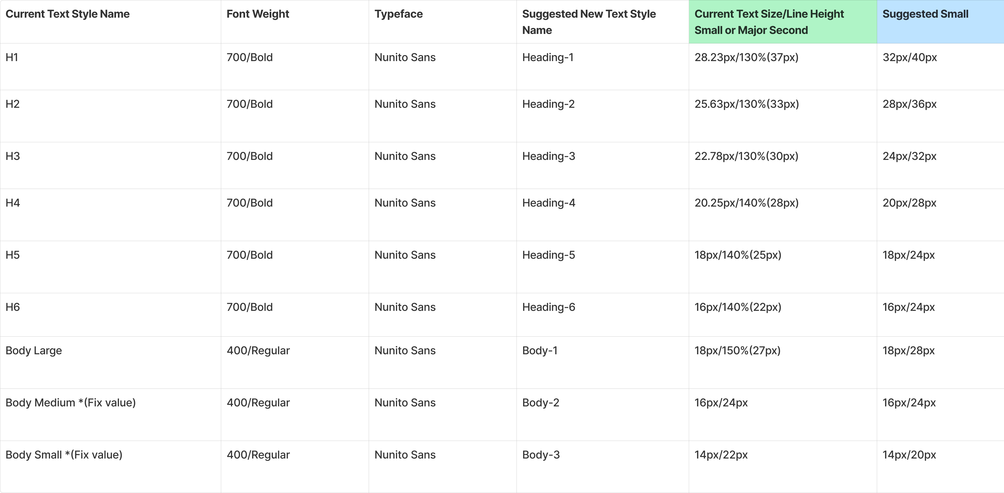
FOUNDATIONS
The system documented the decisions every product shared.
•
Type hierarchy
•
Color and contrast
•
Accessibility
•
Elevation and shadows
Notes:
Describe what the foundation artifact contains before moving to motion.
[Sources]
- User-provided Pitch deck, slide 25: https://pitch.com/v/slide-deck-jq3j7w

Slide 23
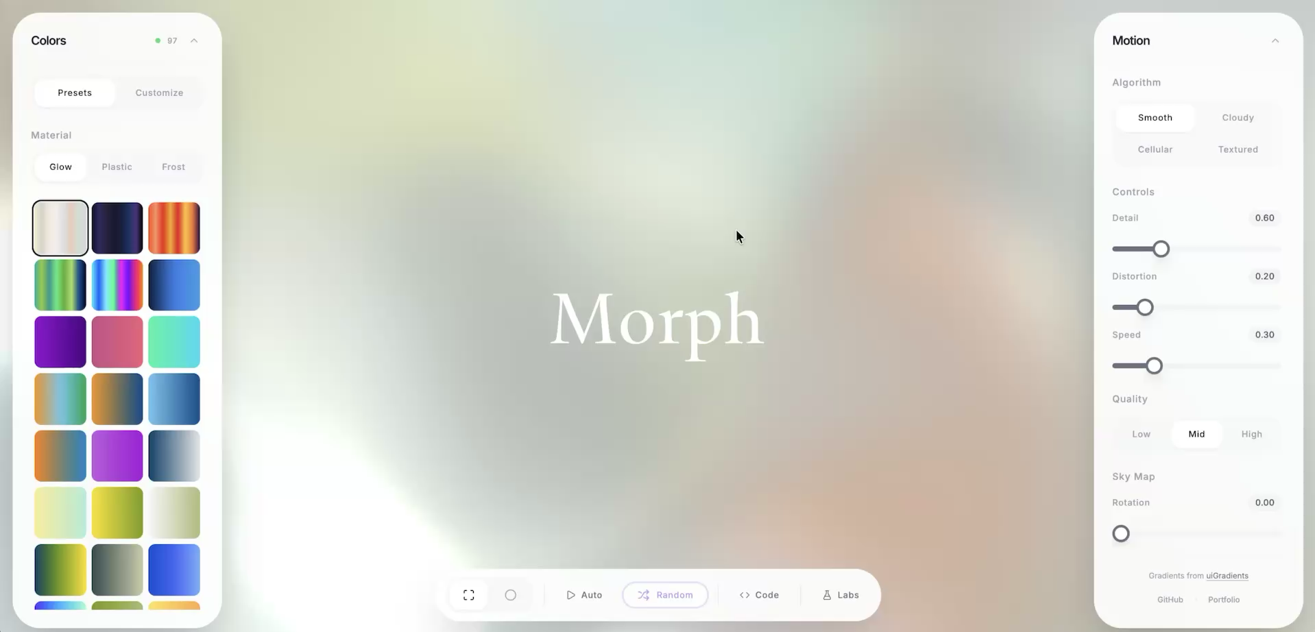
Side Project
A Three.js and GLSL based gradient generator
Notes:
Connect motion back to the design system rather than presenting it as a separate gallery.
[Sources]
- User-provided Pitch deck, slide 26: https://pitch.com/v/slide-deck-jq3j7w

Slide 24
MUSTAFA
Questions?
Product design, systems, and code.
Email
Phone
hello@mstf.work
+1 737 389 0364
Notes:
Close by returning to the positioning from slide one.
[Sources]
- User-provided Pitch deck, slide 27: https://pitch.com/v/slide-deck-jq3j7w

