Slide 1
Mustafa
•
Built the core platform for Educative’s B2B offerings
•
Shipped a FERPA-compliant recruitment platform in under two weeks
Product designer who codes.
•
Led Educative’s first design system across B2C and B2B
I design systems, products, and interfaces, then stay close enough to the code to help ship them.
Notes:
Open with the throughline: product design depth plus the ability to ship in code.
[Sources]
- User-provided Pitch deck, slide 1: https://pitch.com/v/slide-deck-jq3j7w
- User-provided Pitch deck, slide 19: https://pitch.com/v/slide-deck-jq3j7w
- User-provided Pitch deck, slide 24: https://pitch.com/v/slide-deck-jq3j7w

Slide 2
SELECED WORK
Three projects, one throughline
01
Workflows
Product strategy and interaction design
02
Capstone Matchmaker
Design and full-stack development
03
Design System + Motion
Foundations, components, and behavior
Notes:
Set expectations without slide numbers or false section parity.
[Sources]
- User-provided Pitch deck, slide 2: https://pitch.com/v/slide-deck-jq3j7w

Slide 3
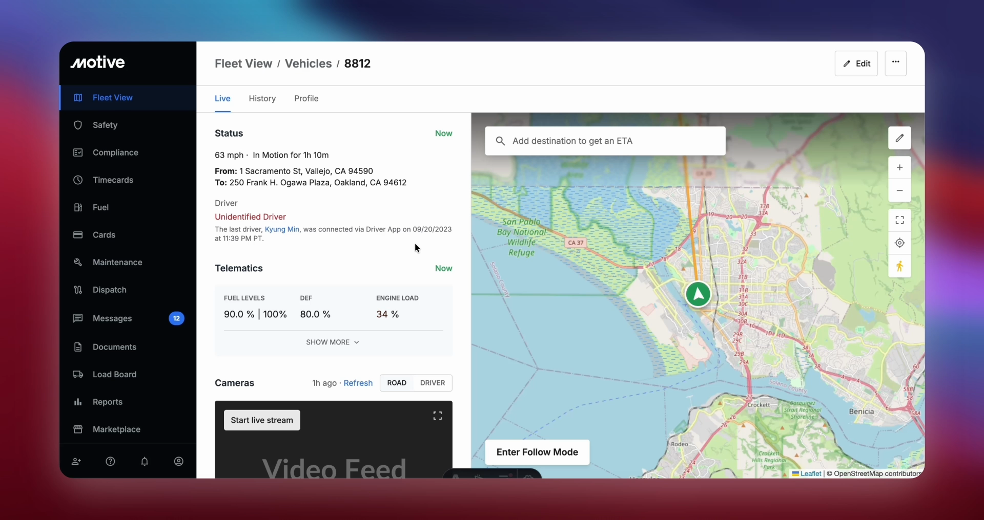
WORKFLOWS
At Educative, the collaboration became a blocker when we scaled.
Pagers waited on approvals, work was getting delayed, and our existing stack didn’t help with that.
Notes:
Introduce the company scale before the product.
[Sources]
- User-provided Pitch deck, slide 3: https://pitch.com/v/slide-deck-jq3j7w

Slide 4

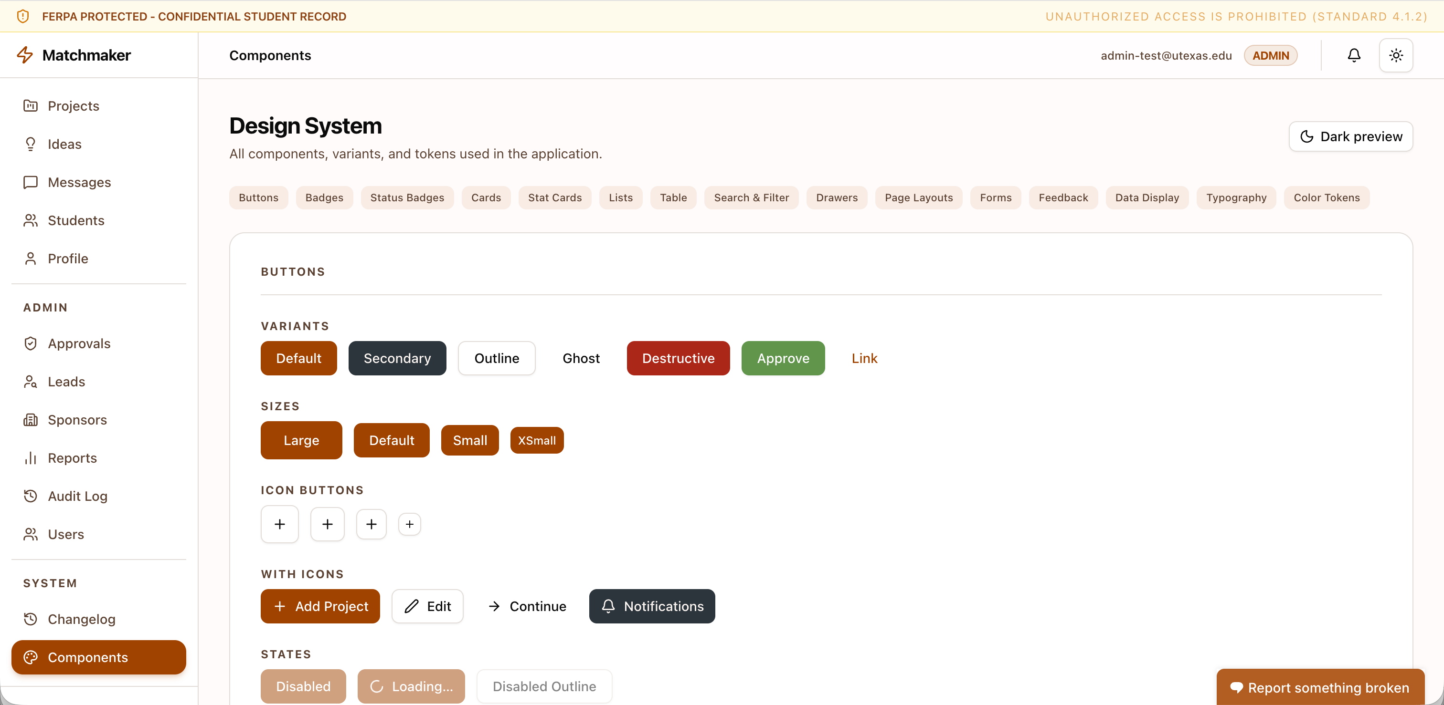
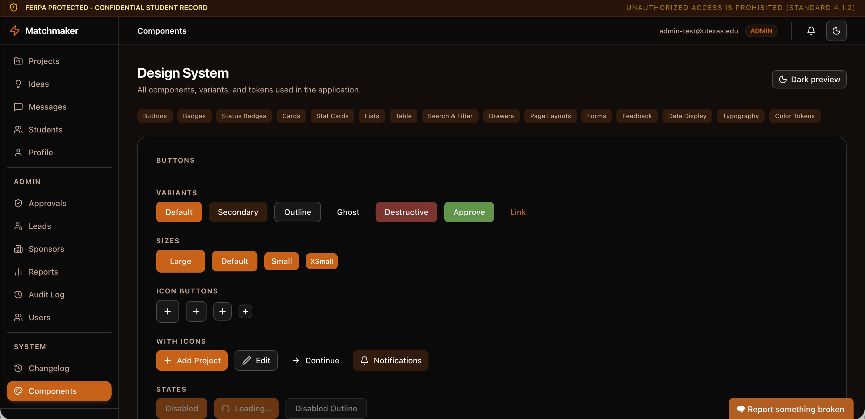
BUILD APPROACH
Code-first kept the build focused.
I owned the design end to end including
•
Product decisions
•
Information architecture
I moved from design intent to working components with Radix UI and shadcn/ui, using AI-assisted development to accelerate implementation.
•
Interaction model
•
Quality bar
Notes:
Explain code-first as a product decision, not a shortcut.
[Sources]
- User-provided Pitch deck, slide 20: https://pitch.com/v/slide-deck-jq3j7w
- User-provided Pitch deck, slide 21: https://pitch.com/v/slide-deck-jq3j7w
- User-provided Pitch deck, slide 22: https://pitch.com/v/slide-deck-jq3j7w

Slide 5
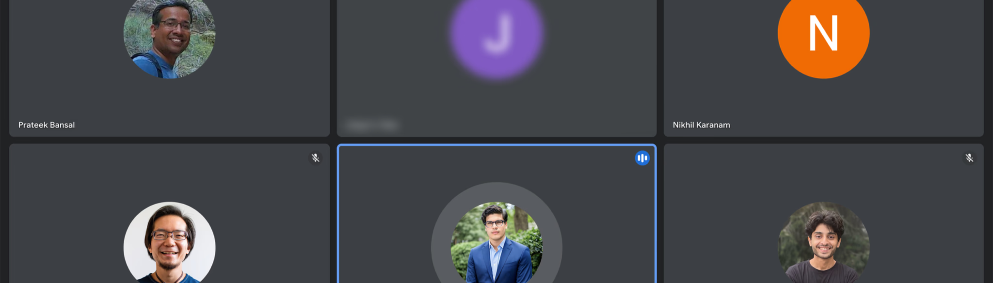
WORKFLOWS
At Educative, the collaboration became a blocker when we scaled.
Pagers waited on approvals, work was getting delayed, and our existing stack didn’t help with that.
Notes:
Introduce the company scale before the product.
[Sources]
- User-provided Pitch deck, slide 3: https://pitch.com/v/slide-deck-jq3j7w

Slide 6
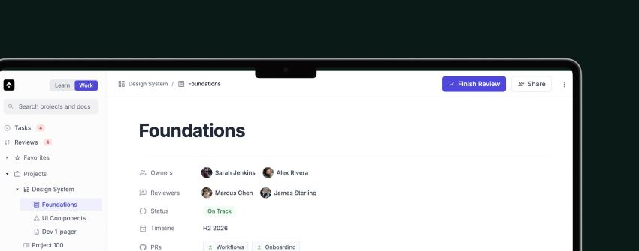
PRODUCT DIRECTION
I designed the product according to how we worked
•
A self-contained knowledge base
•
A multiplayer editor for tasks and comments
•
A review system modeled on pull requests
•
A shared hierarchy from groups to subtasks
Notes:
Connect the feature set to the working model uncovered in research.
[Sources]
- User-provided Pitch deck, slide 8: https://pitch.com/v/slide-deck-jq3j7w

Slide 7
IMPACT
$100k deal closed
Workflows helped Educative close its biggest customer yet.
The outcome tied the product directly to enterprise growth.
Notes:
Be precise about what the source deck claims: a six-figure deal and the biggest customer yet.
[Sources]
- User-provided Pitch deck, slide 18: https://pitch.com/v/slide-deck-jq3j7w

Slide 8
WORKFLOWS
At Educative, the collaboration became a blocker when we scaled.
Pagers waited on approvals, work was getting delayed, and our existing stack didn’t help with that.
Notes:
Introduce the company scale before the product.
[Sources]
- User-provided Pitch deck, slide 3: https://pitch.com/v/slide-deck-jq3j7w

Slide 9
RESEARCH
I spoke with 18 engineering managers and 13 engineers.
Goal: Understand the problem space
Assumptions
Findings
The tooling was broken.
The workflow was not optimized for us
•
Standardize content
•
Content was searchable but scattered
•
Fix the journey
•
Lack of updates, lots of things remained stale
•
Add more process
•
Existing tools worked for separate teams, but not when collaborating
Notes:
State the research insight as a diagnosis, not a list of bullets.
[Sources]
- User-provided Pitch deck, slide 6: https://pitch.com/v/slide-deck-jq3j7w

Slide 10
PROBLEM FRAMING
I classified the problem into two parts: foundation and visibility
First-order problem
Second-order problem
How might we organize the work?
How might we make progress visible?
To make the progress visible, we needed to have a solid foundation to start first. Existing tools were opinionated. We wanted something that worked for all of our teams.
Notes:
Explain the order of operations clearly.
[Sources]
- User-provided Pitch deck, slide 5: https://pitch.com/v/slide-deck-jq3j7w
- User-provided Pitch deck, slide 7: https://pitch.com/v/slide-deck-jq3j7w

Slide 11
PRODUCT DIRECTION
I designed the product according to how we worked
•
A self-contained knowledge base
•
A multiplayer editor for tasks and comments
•
A review system modeled on pull requests
•
A shared hierarchy from groups to subtasks
Notes:
Connect the feature set to the working model uncovered in research.
[Sources]
- User-provided Pitch deck, slide 8: https://pitch.com/v/slide-deck-jq3j7w

Slide 12
BUILD TIMELINE
I shipped a barebones MVP in one week and spent 8 months turning it into a 0 to 100 platform
Week 1
Months 2–4
Month 8
MVP shipped
Learned and rebuilt
Platform shipped
Shipped fast, broke things, learned a lot
Feedback tools like Userback, and analytics informed a few decisions
Planning, review, and docs connected
Notes:
Resolve the apparent conflict between one week and eight months.
[Sources]
- User-provided Pitch deck, slide 8: https://pitch.com/v/slide-deck-jq3j7w
- User-provided Pitch deck, slide 10: https://pitch.com/v/slide-deck-jq3j7w

Slide 13
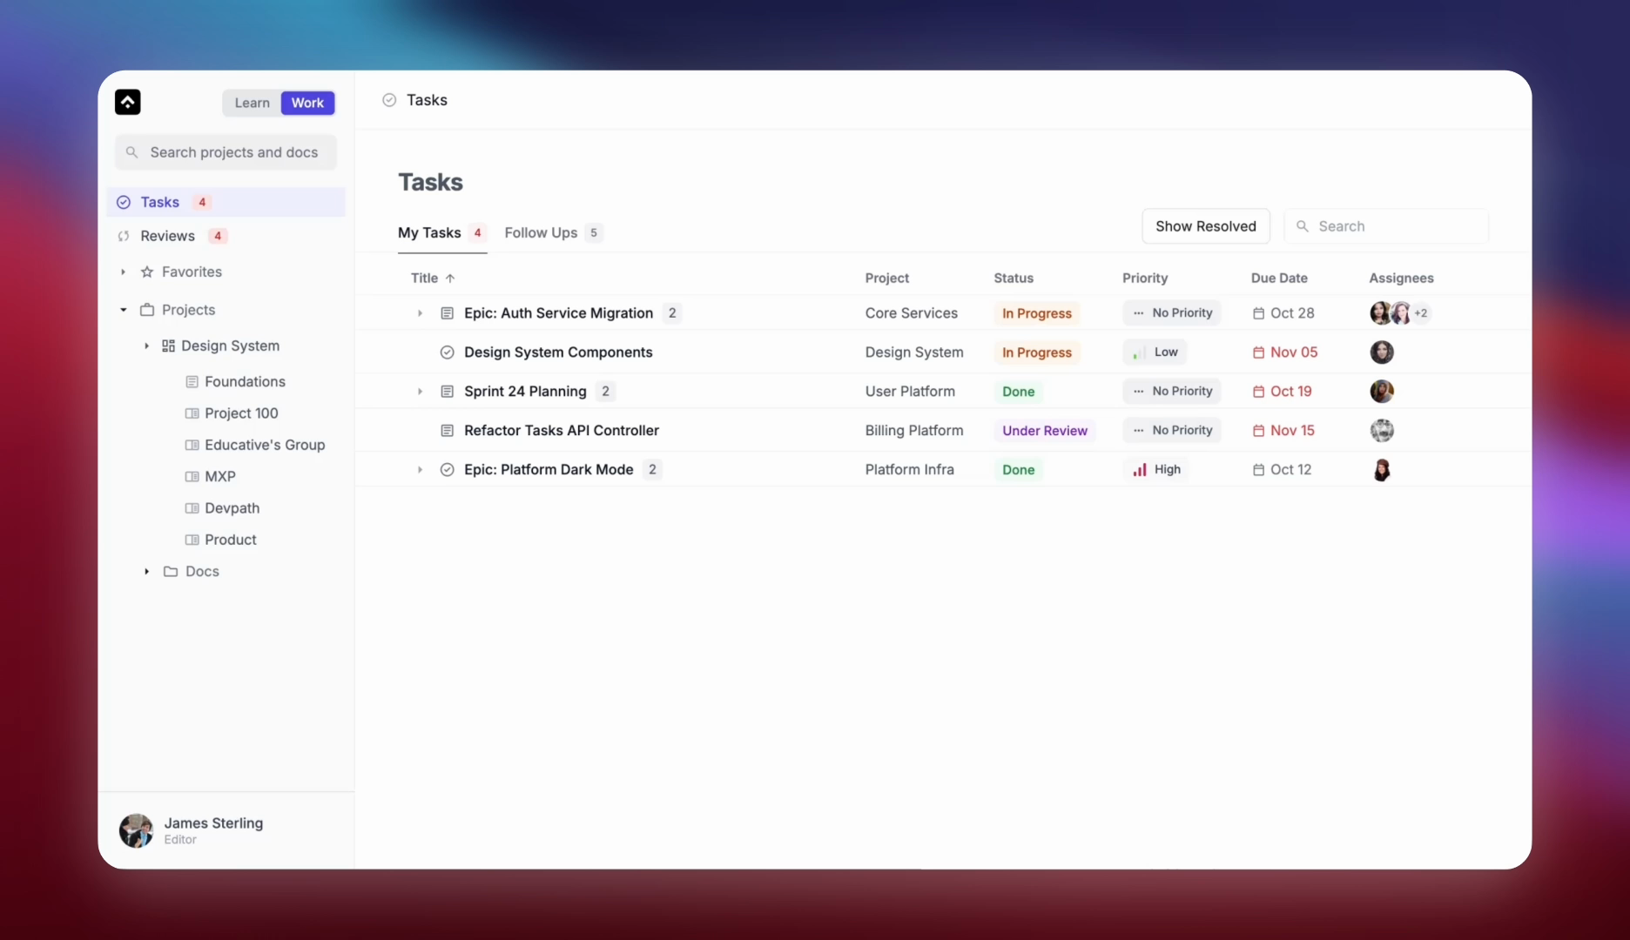
WHAT SHIPPED
Task hub
Notes:
Use this as the product synthesis slide, not four separate reveals.
[Sources]
- User-provided Pitch deck, slide 14: https://pitch.com/v/slide-deck-jq3j7w
- User-provided Pitch deck, slide 15: https://pitch.com/v/slide-deck-jq3j7w
- User-provided Pitch deck, slide 16: https://pitch.com/v/slide-deck-jq3j7w
- User-provided Pitch deck, slide 17: https://pitch.com/v/slide-deck-jq3j7w

Slide 14
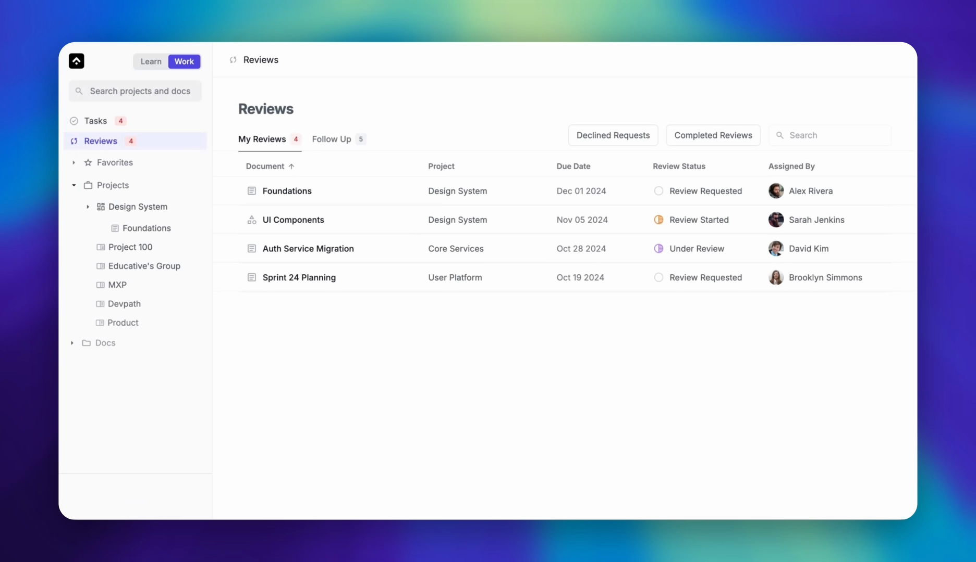
WHAT SHIPPED
Review hub
Notes:
Use this as the product synthesis slide, not four separate reveals.
[Sources]
- User-provided Pitch deck, slide 14: https://pitch.com/v/slide-deck-jq3j7w
- User-provided Pitch deck, slide 15: https://pitch.com/v/slide-deck-jq3j7w
- User-provided Pitch deck, slide 16: https://pitch.com/v/slide-deck-jq3j7w
- User-provided Pitch deck, slide 17: https://pitch.com/v/slide-deck-jq3j7w

Slide 15
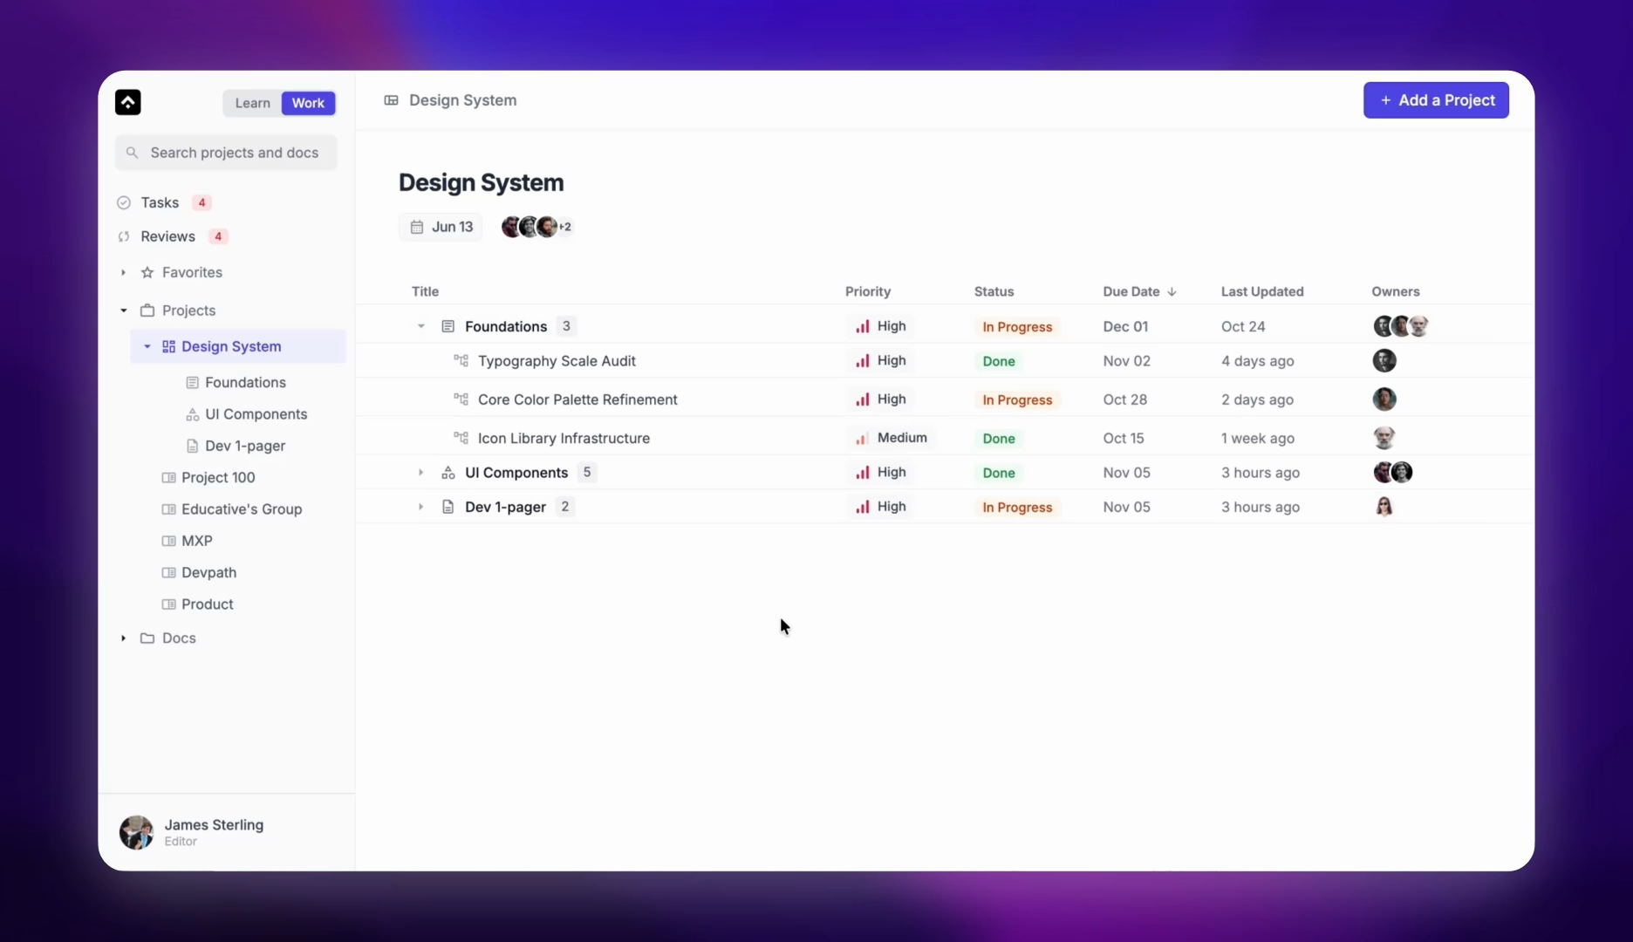
WHAT SHIPPED
Projects
Notes:
Use this as the product synthesis slide, not four separate reveals.
[Sources]
- User-provided Pitch deck, slide 14: https://pitch.com/v/slide-deck-jq3j7w
- User-provided Pitch deck, slide 15: https://pitch.com/v/slide-deck-jq3j7w
- User-provided Pitch deck, slide 16: https://pitch.com/v/slide-deck-jq3j7w
- User-provided Pitch deck, slide 17: https://pitch.com/v/slide-deck-jq3j7w

Slide 16
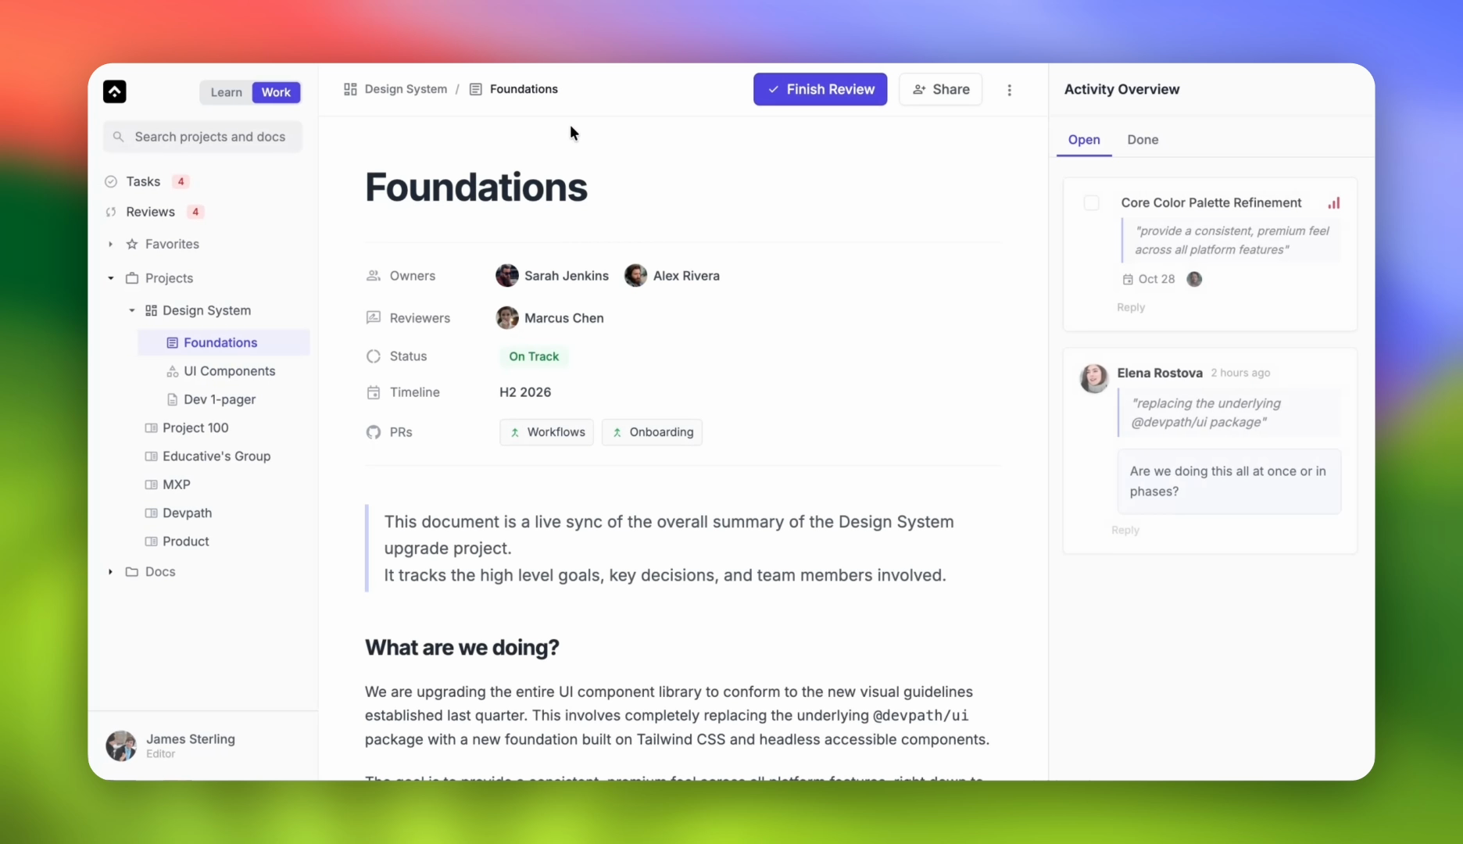
WHAT SHIPPED
Document editor
Notes:
Use this as the product synthesis slide, not four separate reveals.
[Sources]
- User-provided Pitch deck, slide 14: https://pitch.com/v/slide-deck-jq3j7w
- User-provided Pitch deck, slide 15: https://pitch.com/v/slide-deck-jq3j7w
- User-provided Pitch deck, slide 16: https://pitch.com/v/slide-deck-jq3j7w
- User-provided Pitch deck, slide 17: https://pitch.com/v/slide-deck-jq3j7w

Slide 17
IMPACT
$100k deal closed
Workflows helped Educative close its biggest customer yet.
The outcome tied the product directly to enterprise growth.
Notes:
Be precise about what the source deck claims: a six-figure deal and the biggest customer yet.
[Sources]
- User-provided Pitch deck, slide 18: https://pitch.com/v/slide-deck-jq3j7w

Slide 18
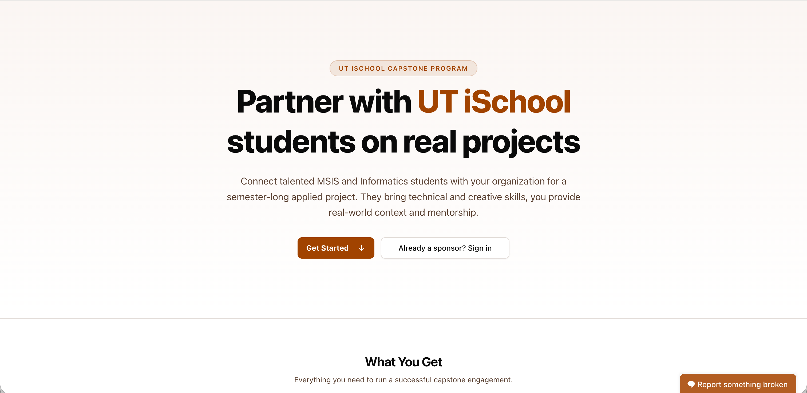
CAPSTONE MATCHMAKER
A FERPA-compliant recruitment platform, shipped in under two weeks.
I designed and built the SaaS product end to end with Next.js, PostgreSQL, and AWS EC2.
Notes:
Lead with the product and constraint, not the stack or AI credits.
[Sources]
- User-provided Pitch deck, slide 1: https://pitch.com/v/slide-deck-jq3j7w
- User-provided Pitch deck, slide 19: https://pitch.com/v/slide-deck-jq3j7w

Slide 19
BUILD APPROACH
Code-first kept the build focused.
I owned the design end to end including
•
Product decisions
•
Information architecture
I moved from design intent to working components with Radix UI and shadcn/ui, using AI-assisted development to accelerate implementation.
•
Interaction model
•
Quality bar
Notes:
Explain code-first as a product decision, not a shortcut.
[Sources]
- User-provided Pitch deck, slide 20: https://pitch.com/v/slide-deck-jq3j7w
- User-provided Pitch deck, slide 21: https://pitch.com/v/slide-deck-jq3j7w
- User-provided Pitch deck, slide 22: https://pitch.com/v/slide-deck-jq3j7w

Slide 20
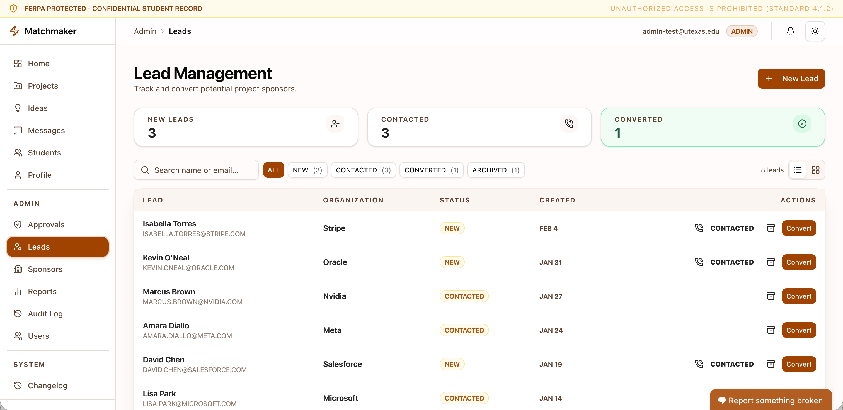
SHIPPED PRODUCT
All 5 personas have actionable dashboards.
I discovered the problems that surfaced throughout the capstone process, and after rigorous prioritization with team, I built dashboards to unblock each user persona.
Notes:
Show the outcome of the code-first build.
[Sources]
- User-provided Pitch deck, slide 23: https://pitch.com/v/slide-deck-jq3j7w

Slide 21
DESIGN SYSTEM
Educative’s first design system unified B2C and B2B products.
I led the design and implementation from foundations through reusable patterns.
Notes:
State the system’s scope without the redundant phrase 'first design system redesigned.'
[Sources]
- User-provided Pitch deck, slide 24: https://pitch.com/v/slide-deck-jq3j7w

Slide 22
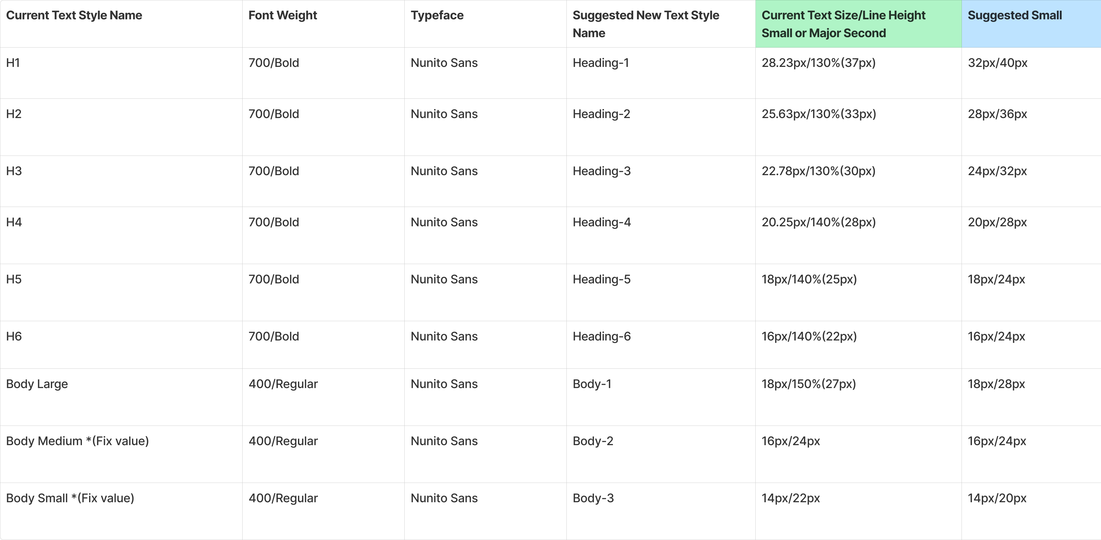
FOUNDATIONS
The system documented the decisions every product shared.
•
Type hierarchy
•
Color and contrast
•
Accessibility
•
Elevation and shadows
Notes:
Describe what the foundation artifact contains before moving to motion.
[Sources]
- User-provided Pitch deck, slide 25: https://pitch.com/v/slide-deck-jq3j7w

Slide 23
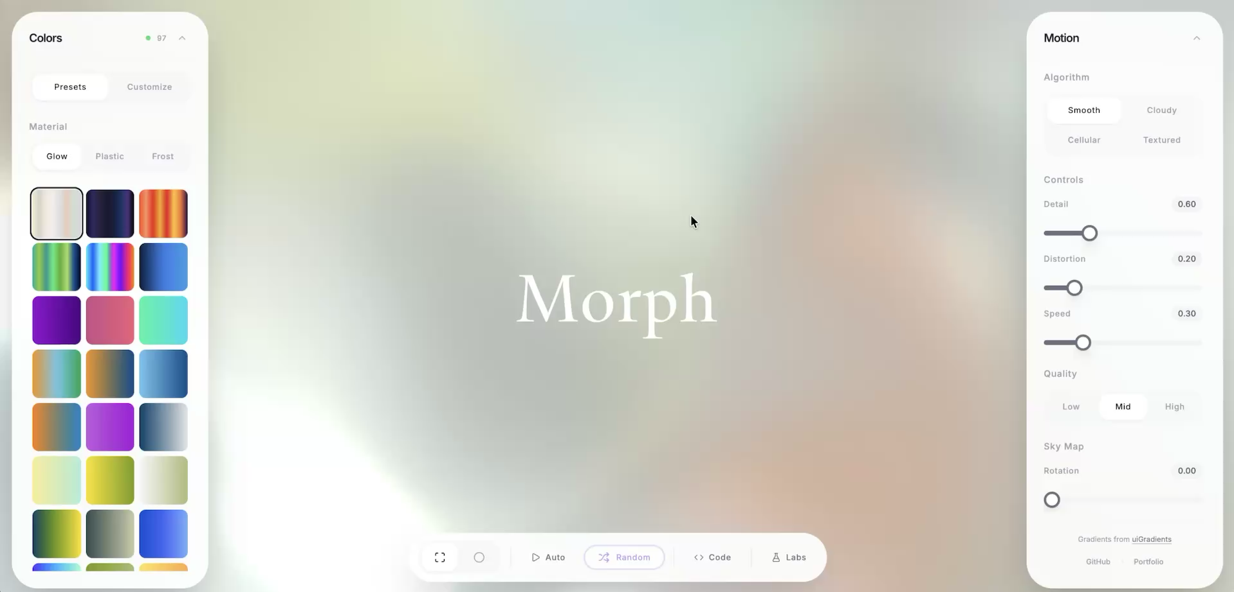
Side Project
A Three.js and GLSL based gradient generator
Notes:
Connect motion back to the design system rather than presenting it as a separate gallery.
[Sources]
- User-provided Pitch deck, slide 26: https://pitch.com/v/slide-deck-jq3j7w

Slide 24
MUSTAFA
Questions?
Product design, systems, and code.
Email
Phone
hello@mstf.work
+1 737 389 0364
Notes:
Close by returning to the positioning from slide one.
[Sources]
- User-provided Pitch deck, slide 27: https://pitch.com/v/slide-deck-jq3j7w

