Slide 1
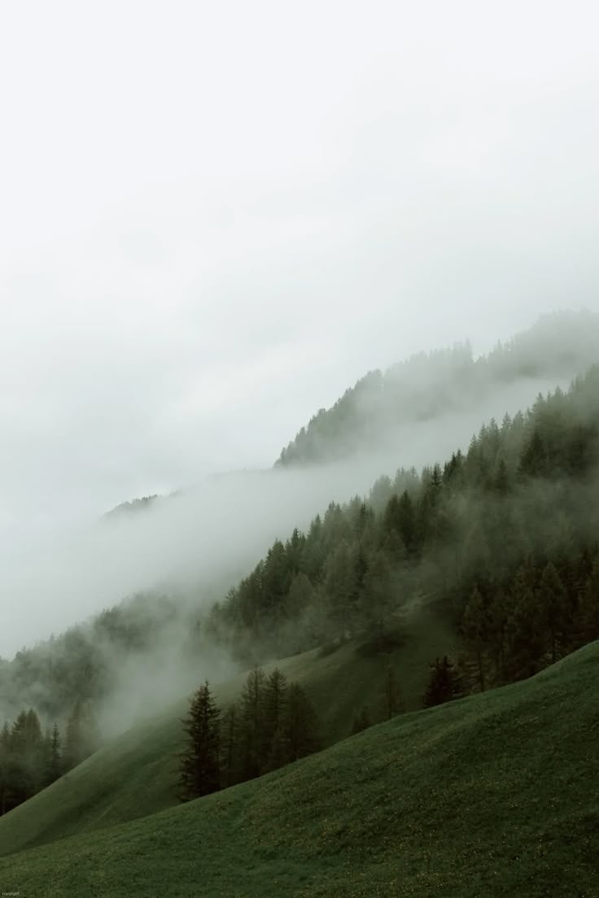

Peak Motion
Monti
Alex Trifonov
Desislav Adamov
Hristiyan Denkov
Martin Georgiev
Velislav Pachamoaov
Yordan Mandevski
1

Slide 2
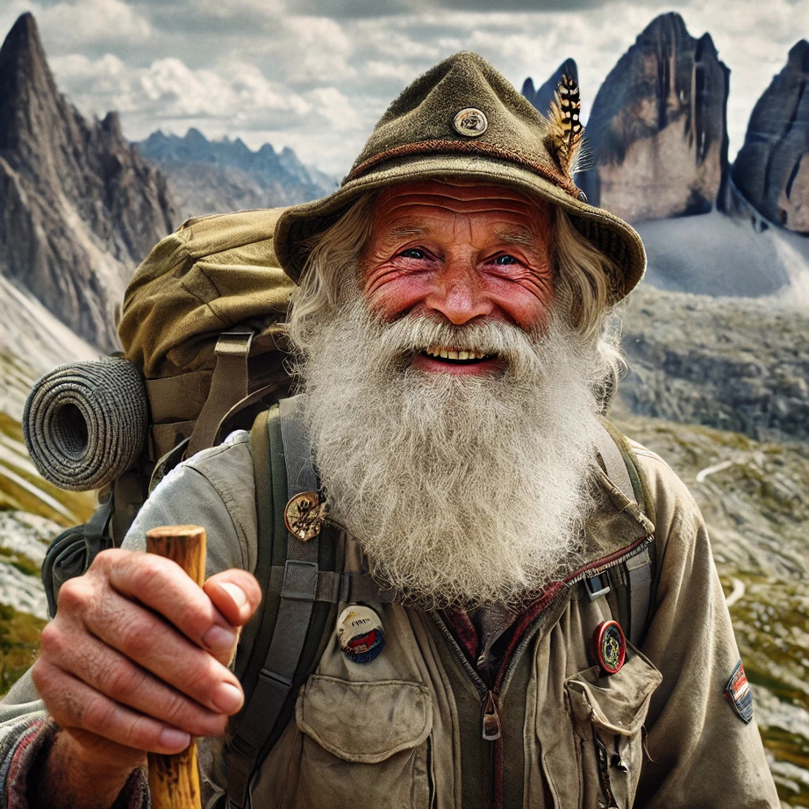

Meet Monti 😄
YOUR ADVENTURE COMPANION
Energetic, wise, knowledgable
Knows every trail, mountain, cave
Wants YOU to explore the beauty of nature
Peak Motion
2

Slide 3

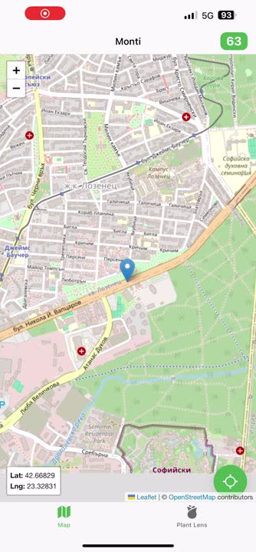
Suggests areas to explore 🗺
Teaches you about nature 🌿
Rewards your desire for adventure 🧗‍♂️
WHAT
DOES
MONTI
DO?
Peak Motion

Slide 4
LIVE
DEMO
Peak Motion
4

Slide 5










Our Tech Stack
Java
Python
Angular
Spring
Capacitor by Ionic
Kafka
FastApi
Docker
AWS
Pl@ntNet API
OpenAI API
Peak Motion
5

Slide 6
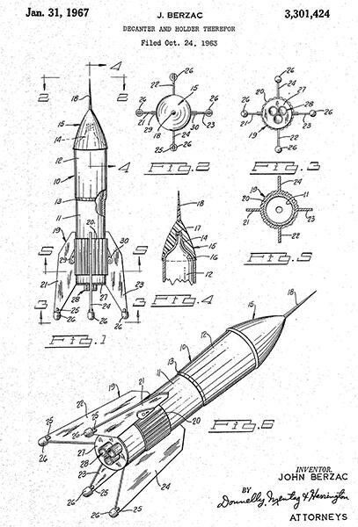
Future milestones
Gamification
Hike groups
Weak connection mode
More places of interest
Animal recognition
Peak Motion

Slide 7
Q&A
Peak Motion
7

