Slide 1
Grid Infrastructure
Network Security Essentials
Lakshmi Sastry
l.sastry@cranfield.ac.uk

Slide 2
Overview
Grid Security – what it is
How does current security works
Authentication
Authorization
RSA algorithm

Slide 3
Password based Authentication
User enters a user name and password.
User name and password sent through
network to server.
Server validates name and password
and responds.
The allocation of user name and password process authorizes the use of the resource.

Slide 4
Security of Name and Password mechanism
Since name and password sent in plain
text, vulnerable to interference and
being stolen.
Need a system in which one can be
sure of sender.

Slide 5
Grid Security
A concise definition of Grid Computing is “distributed computing performed transparently over multiple administrative domains” (Coveney 2005).
In other words, the Grid problem is to enable “coordinated resource sharing and problem solving in dynamic, multi-institutional virtual organizations.”
So Grid Security is security to enable VOs
What is needed in terms of security for a VO?

Slide 6
Why Grid Security is Hard (Courtesy Globus Grid Forum)
Interactions are not just client/server, but service-to-service on behalf of the user
Requires delegation of rights by user to service
Services may be dynamically instantiated
Standardization of interfaces to allow for discovery, negotiation and use
Implementation must be broadly available & applicable
Standard, well-tested, well-understood protocols; integrated with wide variety of tools
Policy from sites, VO, users need to be combined
Varying formats
Want to hide as much as possible from applications!

Slide 7
Trust
Between organization and organization is difficult to achieve because
  Resources are distributed
  Non trivial QoS (Quality of Service), QoP (Quality of Protection), AUP (Acceptable Use Policy)
  Users and their needs differ

Slide 8
Grid Trust (Courtesy Globus Grid Forum)
Instead of setting up trust relationships at the organizational level (lots of overhead, possible legalities -expensive!) set up trust at the user/resource level
Virtual Organizations (VOs) for multi-user collaborations
Federate through mutually trusted services
Local policy authorities rule
Users able to set up dynamic trust domains
Personal collection of resources working together based on trust of user

Slide 9
Additional Factors
Authorization - The process of deciding
whether a particular identity can access
a particular resource. Who accesses
what?
Access control - broader aspect of
authorization and controlling specific
types of access.

Slide 10
Two aspects:
Send information in an encrypted form.
Have a trusted third party or some safe
way of proving identity.

Slide 11
Key requirements for ensuring a secure connection
Data Confidentiality - information exchange needs
to be protected against eavesdroppers.
Authentication - access needs to be restricted to
those (humans or systems) that can provide proof
of identity.
Data Integrity - need to assure that message was not modified in transit (intentionally or by
accident).
Non-repudiation - guarantees that sender cannot
deny that he/she sent message. Similarly receiver not deny receiving message.

Slide 12
Two levels of Security
Transport level security
  Prevents evesdropping
  Prevents man-in-the loop tampering
  SSL & TSL are the methods used
Message level security
  Secures integrity of the message
  Confidentiality is secured
  SAML, Kerberos, X509 digital certificates

Slide 13
Kherberos
Between networked computer systems
Mutual authentication
Uses trusted third party
Uses symmetric key cryptography
For prevention of eavesdropping and replay attacks (TLS)

Slide 14

SSL (Secure Socket Layer) Protocol
Uses public/private keys.
Introduced by Netscape and widely
adopted.
Supported by both Netscape and Microsoft
Internet Explorer browser.
TLS (Transport Layer Security) newer but
similar.

Slide 15
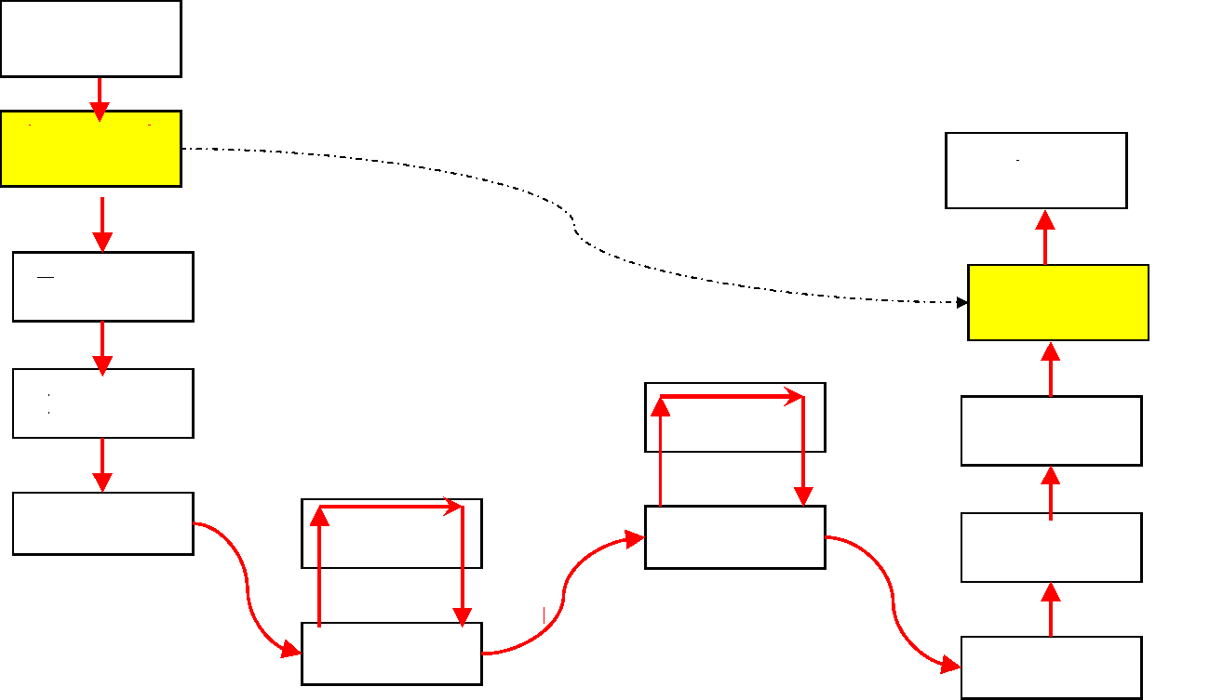
Message’s origin
Application
Message’s destination
Security &
authentication
Secure communication
Application
Transport
Security &
authentication
Internet
Internet
Transport
Data Link
Data Link
Internet
Internet
Physical
Physical Physical
Data Link
Data Link
Example: SSL (Secure Socket Layer)

Slide 16
• The client contacts the server and sends the
first message. The first message causes the
client and server to exchange a few
messages to negotiate the encryption
algorithm to use and to pick an encryption
key to use for this connection. Then the
client's data is sent to the server. After this is
done the client and the server can exchange
information at will.

Slide 17
• The server must have an SSL certificate and
the private key associated with that
certificate.
An SSL certificate contains the
public key for the RSA encryption algorithm.
This public key is sent to the client when it
connects. The client will use the public key to
encrypt a value and send it to the server. The
server must then have the corresponding
RSA private key so it can decode the client's
message.

Slide 18
• Requires several message to be
exchanged between client and server
There are 4 phases
.

Slide 19
Phase 1
• Client starts handshake and sends:
– a random number, X.
– list of supported ciphers and compression
algorithms

Slide 20
Phase II
• Server selects cipher and compression
algorithm, and notifies client. Then it
sends:
– another random number, Y.
– a server certificate which includes the
server’s public key

Slide 21
Phase III
• Client sends:
– a “premaster” secret
– encrypting it with server public key
– possibly a client certificate

Slide 22
Phase IV
Handshake finished. Message sent to
inform client.
Server and client each generate a master
secret by combining random numbers X
and Y, and the premaster secret.
key generated from the master secret, to
encrypt the data.
Encrypted data then sent to client.

Slide 23
After Phase IV
• After this is done the client and the
server can exchange information at will.

Slide 24
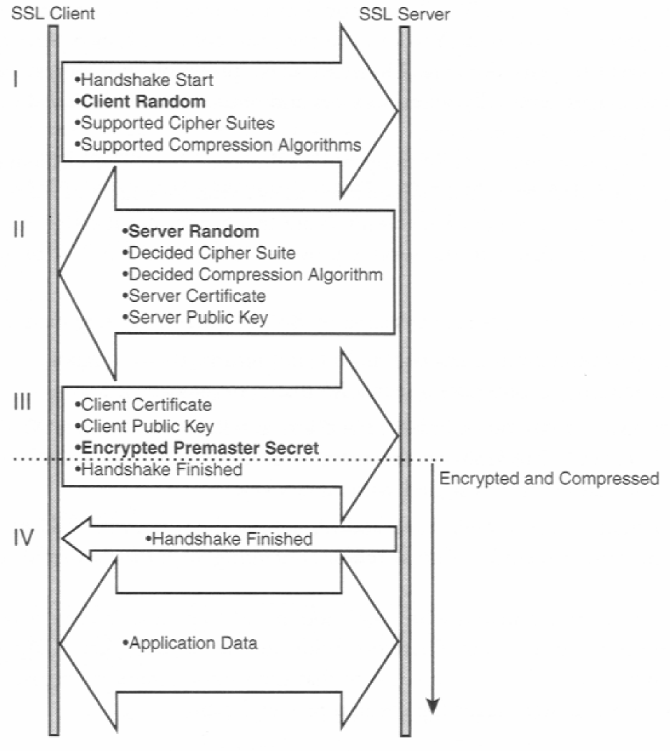

Slide 25
SSL
Ensures:
Authentication (by verifying certificates)
Confidentiality ((by encrypting data with
secret key)
Integrity (by digesting data)
Non-repudiation not ensured because
Message Authentication Code (MAC) of
transmitted data calculated with common
secret key.

Slide 26
Summary of SSL
SSL is a sophistication encryption scheme that does not require
the client and the server to arrange for a secret key to be
exchanged between the client and server BEFORE the
transaction is started. SSL uses public/private keys to provide a
flexible encryption scheme that can be setup at the time of the
secure transaction.
In typical encryption schemes the client and server would be
required to use a secret key that has been preconfigured in the
client and the server machines. In such a scheme, the client
would use the secret key to encrypt the data. The server would
use the same secret key to decrypt the data. Same logic applies in the server to client direction. This type of preconfigured secret keys are not suitable for Web based secure services that involve millions of users who have no prior secret key arrangement with the secure server.

Slide 27
SSL = Symmetric encryption +
asymmetric encryption

Slide 28
• A secret key can be sent by the client as data that has been
encrypted using the public key. This secret key can be
decrypted only by the server. Once the server gets the key, the
client and the server are able to communicate using this secret
key.
The public/private key based encryption is used only for
handshaking and secret key exchange. Once the keys have
been exchanged the symmetric secret keys are used. This is
done for two reasons:
(1)Public/private key based encryption techniques are
computationally very expensive thus their use should be
minimized.
(2) The secret key mechanism is needed for server to client
communication.

Slide 29
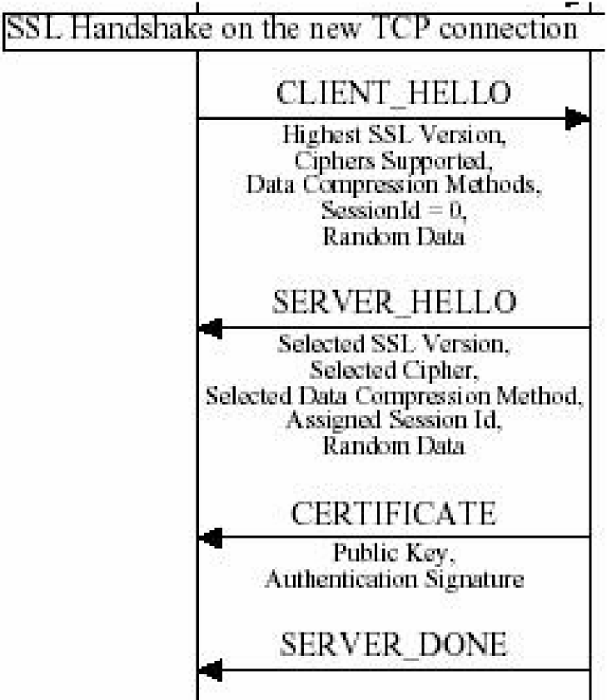
Client Server
The client sends a CLIENT_HELLO command to the server, which includes: The highest SSL and TLS version supported by the client. Ciphers supported by the client. The ciphers are listed in order of
preference. Data compression methods that are supported by the client. The session ID. If the client is starting a new SSL session, the session ID is 0. Random data that is generated by the client for use in the key generation process.
The server sends a SERVER_HELLO command to the client, which includes:
The SSL or TLS version that will be used for the SSL session. The cipher that will be used for the SSL session. Data compression method that will be used for the SSL session. SSL Version 3 and TLS have no compression algorithms defined at this time. The session ID for the SSL session. Random data that is generated by the server for use in the key generation process.
The server sends the CERTIFICATE command. This command includes the server's certificate and, optionally, a chain of certificates beginning with the certificate of the certificate authority (CA) that assigned the server's certificate.
The server sends the SERVER_DONE command. This command indicates that the server has
completed this phase of the SSL handshake. If client authentication will be performed, additional commands flow between the client and the server following the

Slide 30
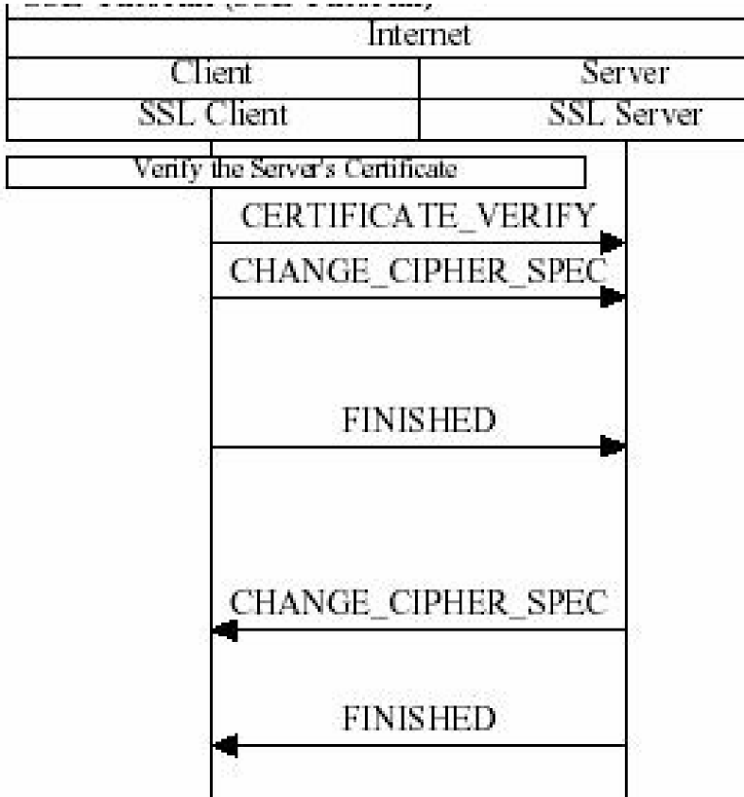
Client informs the server that it has verified the server's certificate
The client sends the CHANGE_CIPHER_SPEC command. This command indicates that the contents of subsequent SSL record data sent by the client during the SSL session will be encrypted. The 5-byte SSL record headers are never encrypted.
The client sends the FINISHED command. This command includes a digest of all the SSL handshake commands that have flowed between the client and the server up to this point. This command is sent to validate that none of the commands sent previously, which flow between the client and the server unencrypted, were altered in flight.
The server sends the CHANGE_CIPHER_SPEC command. This command indicates that all subsequent data sent by the server during the SSL session will be encrypted.
The server sends the FINISHED command. This command includes a digest of all the SSL handshake commands that have flowed between the server and the client up to this point.

Slide 31
HTTPS
• SSL, an open, non-proprietary protocol
designed by Netscape, is perhaps the most
common way of providing encrypted
transmission of data between web browsers
and web servers (HTTP-S is the runner up).
Built upon private key encryption technology,
SSL provides data encryption, server
authentication, message integrity, and client
authentication for any TCP/IP connection.

Slide 32
Three network security models

Slide 33
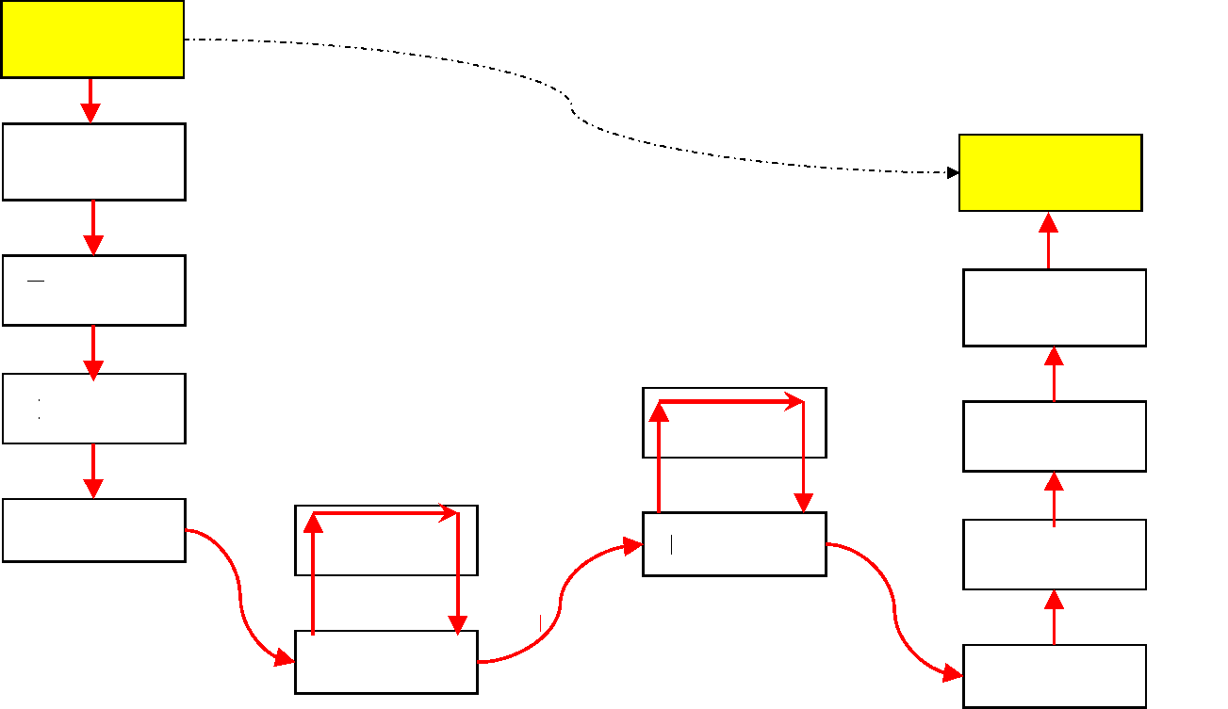
Message’s origin
Security &
authentication
Message’s destination
Secure communication
Application
Security &
authentication
Transport
Application
Internet
Internet
Transport
Data Link
Internet
Data Link
Internet
Physical
Physical Physical
Data Link
Data Link
Example: PGP

Slide 34
PGP is a complete email security package that provides
privacy, authentication, digital signature, and
compression.
• PGP (Pretty Good Privacy) is a digital data encryption program
created by Phil Zimmermann, a special director of Computer
Professionals for Social Responsibility (CPSR) from 1997-2000.
He created PGP to promote awareness of the privacy issue in a
digital age. Protecting one's privacy is nothing new. It has,
however, become more urgent today because of the ease with
which digital data (information in databases, e-mail, and so
forth) can be accessed, intercepted and monitored. It is also not
unusual for sensitive information, transmitted or stored in digital
form, to accidentally become public knowledge. Once data is in
digital form, it's a bit like a greased pig. You can get your hands
on it, but you can't hold onto it because digital data is so easily
duplicated and shared. This is why more and more
organizations are looking to encrypt all their information.

Slide 35
Message’s origin
Application
Message’s destination
Security &
authentication
Application
Secure
communication
Transport
Security &
authentication
Internet
Transport
Internet
Data Link
Internet
Data Link
Internet
Physical
Physical Physical
Data Link
Data Link
Example: SSL (Secure Socket Layer)

Slide 36

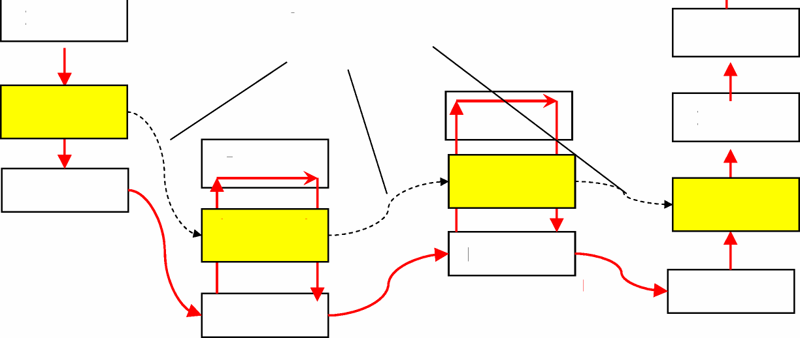
Message’s origin
 | Application |  |  | Message’s destination
Transport
 |  |  |  |  |  | Application
Internet
Secure communication
Transport
Security &
authentication
Internet
Internet
Data Link
Internet
Security &
authentication
Security &
authentication
Physical
Security &
authentication
Data Link
Physical
Physical
Data Link
Data Link

Slide 37
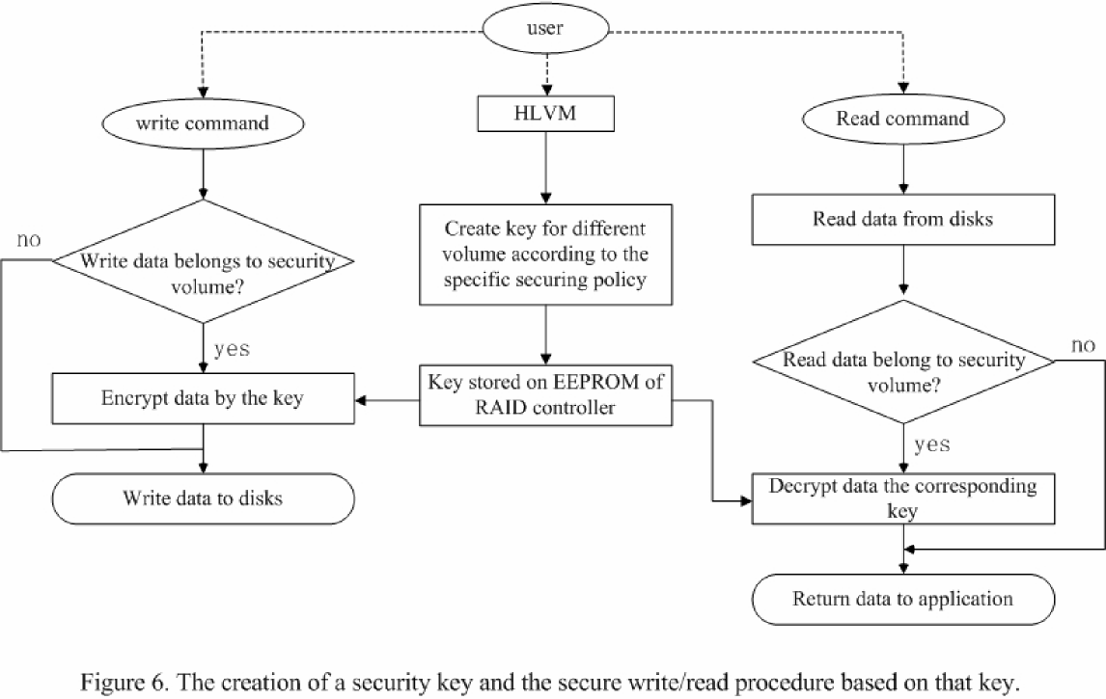

Slide 38

Globus
Grid Security Infrastructure(GSI)

Slide 39
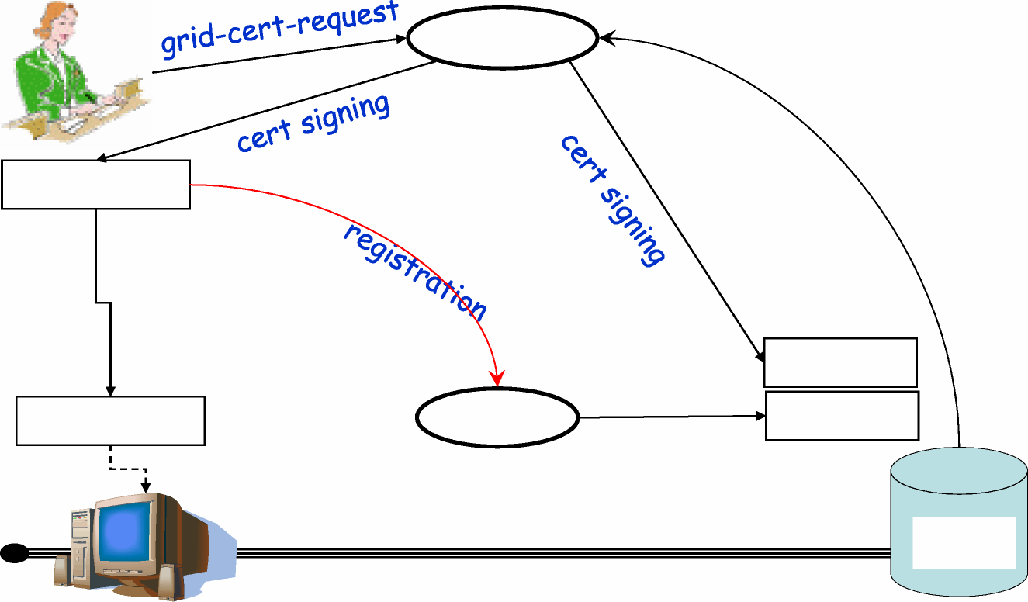
Simple-CA
certificate
grid-cert-request
grid-proxy-init
host-cert
proxy-cert
VO-LDAP
mkgridmap
gridmap
Grid
Server
host/proxy certs exchanged

Slide 40
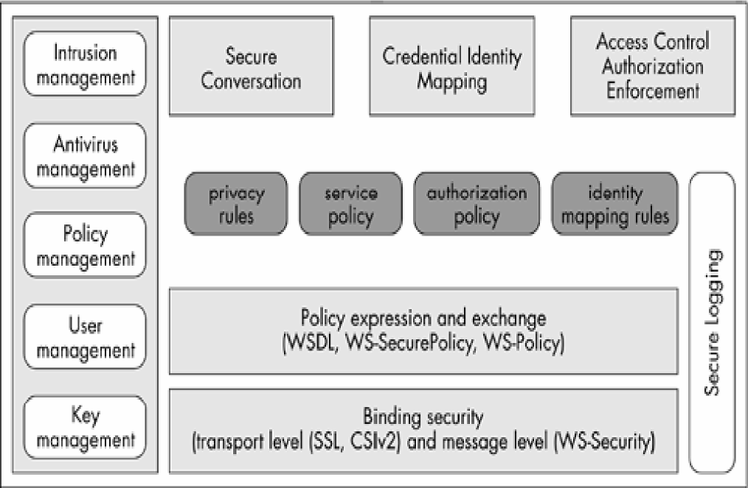
The OGSA security architecture.
4

Slide 41
• Uses public key cryptography
Secure communication for authentication
etc.
Task communication can be encrypted with
shared key if required
Security across organizational boundaries
(how?)
Proxies provide “single sign-on”

Slide 42
Certificates
Every user and service on grid identified
with a certificate
X.509 format
Certified by a Certificate Authority -
Globus provides one, “Simple CA”.

Slide 43
“Single sign-on”
to enable user and it’s agents to acquire
additional resources without repeated
authentication (passwords)
Achieved with “proxies”

Slide 44
Proxy
Consists of a new certificate with new
public, private keys, and owner’s identity
(/CN=proxy added to name).
Certificate signed by owner (not CA)
Proxy given limited lifetimes
Proxy’s private key does not need to be
kept as secure as owner’s private key -
setting file permissions usually sufficient

Slide 45
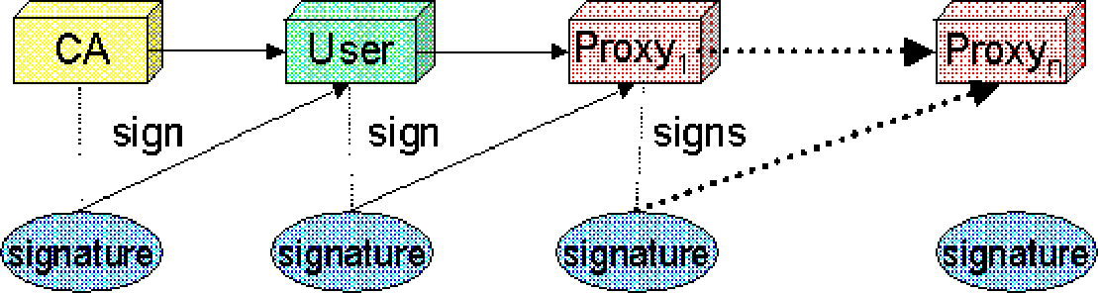
Additional Proxies
From “Overview of the Grid Security Infrastructure” http://www.globus.org/security/overview.htm

Slide 46
Mutual Authentication with
Proxies
Remote party receives owner’s certificate
and owner’s proxy certificate.
Chain of trust
Owner’s public key from owner’s certificate
used to validate proxy signature on proxy
certificate
Certificate authority (CA) public key used to
validate owner’s signature on owner’s
certificate

Slide 47
More Information
On-line
“Deploying a Public Key Infrastucture,” IBM
Redbooks,www.redbooks.ibm.com, 2000,
SG24-551 2-00.
For SSL protocol:
http://developer.netscape.com/docs/manuals/secu
rity/sslin/index.html
Digital signatures:
http://www.youdzone.com/signature.html

Slide 48
Use of Public Key Infrastructure
(PKI)
Several network protocols have embedded
public key and/or secret key cryptographic
algorithms.
Most notable is SSL, which can be added on
top of protocols such as http (i.e. https), FTP
(sftp), and telnet.

Slide 49
Others include:
For secure email - S/MIME (Secure
Multipurpose Internet Mail Extensions)
developed by RSA Data Security Inc, see:
http://www.rsa.com/smime
For secure e-commerce - SET (Secure
Electronic Transaction), developed jointly by
Visa, Mastercard, IBM , and other
companies, for secure credit card
transactions over the Internet, see:
http://www.setco.org

Slide 50
Certificate Authorities
Commercial Certificate Authorities exist,
such as:
– VeriSign Inc.
– Entrust Technologies Inc.,
Web browsers have built-in recognition such
trusted CAs, allowing SSL and other secure
connections.

Slide 51
Certificate Repository
• Used to store:
– Issued certificates
– Revoked certificates (CRLs - Certificate
Revocation List)
– Might be accessed through LDAP
(Lightweight Directory Access Protocol)

Slide 52
Registration Authority
Acts for CA for some management
functions (see IBM Redbooks).
Not strictly necessary as CA could do all
functions.

Slide 53
Using a signed certificate to
send a secure message
One can attached it to your message.
Alternatively, the message is sent without a certificate and the receiver has to retrieve
the certificate from a public place.
Either way, the receiver checks the
signature. It has to be CA it can trust.

Slide 54
Certificate
Lifetime
Certificates have a limited lifetime for
security purposes, i. e. certificates are
issued with an expiration date.
Have a renewal process but user will
normally have same public/private key pair.

Slide 55
GSI Authentication/Authorization Functions
Communicating from Host A to Host B
• From host A to host B:
– Host A send its certificate to Host B
– Host B gets Host A’s public key and name using
CA’s public key.
– Host B creates a random number and sends it
to Host A.
– Host A encrypts random number with its private
key and sends it to host B.
– Host B decrypts number and checks number. If
correct, Host B authenticates host A’s
certificate.

Slide 56
Proxies
Proxy needed to delegate authority to
another host, say host C through host
B, where the proxy will act on your
behalf.
Rather a large number of steps.

Slide 57
WS-Security & WS-Trust
Protocol specifies how to include
  Message level security
  Use of SAML, Kerberos and X509
  Signatures, encryption, security tokens and tickets into SOAP headers
Between security domains of
  Identity provider (trusted third party)
  Identity consumer (service provider)
WS-Trust deals with security tokens
    Issue & renewal
    Validation
    Establishing trust mechanism between VOs

Slide 58
SAML & XACML
Security Assertion Markup Language
  XML, XML Schema, XML encoded signature, encryption
  Uses HTTP & SOAP for communication
  Has assertions and queries for
    Authentication
    Attributes
    Authorization decisions
XACML provides finer expressions for authorization decisions

Slide 59
RSA Algorithm
Choose two very large prime numbers, p & q
Calculate n= pq, n is very large and is used as the base modulus
Calculate Euler’s totient function ø(n) = (p-1)(q-1)
Select a number e such that 1 < e < ø(n) and e and ø(n) are coprime
Use e as public key exponent
Calculate the number d such that ed ≡ 1 (mod ø(n)) and keep it as private key exponent
Send e and n as public key to your colleague, Bob
Bob encrypts his message as a cipertext c = m^{e}(mod n) where m such that 0 < m < n
You receive this c and decrypt the message using m = c^{d} (mod n)
Both of you will also be using padding and blocks that have been agreed upon
Both of these calculations can be computed efficiently using the square-and-multiply algorithm for modular exponentiation.

Slide 60
Question
Why usually does the CA not generate the
public/private key pair for the requester?
Answer
Because it would require the private key to
be sent to the requester. If the requester generates the private key, it is more secure as it does not leave requester.

