Slide 1
KV Cache Quantization
Dongwon Lee
April, 14

Slide 2
Last Week
Action Items
Last Meeting Summary
A White Paper on Neural Network Quantization 전반부(~Range Setting), PTQ~
SnapKV
Action Items
A White Paper on Neural Network Quantization 보완
Multimodal KV cache quantization 관련 Paper

Slide 3
Agenda
Post Training Quantization(PTQ)
Multimodal KV Cache Quantization

Slide 4
Post Training Quantization(PTQ)

Slide 5
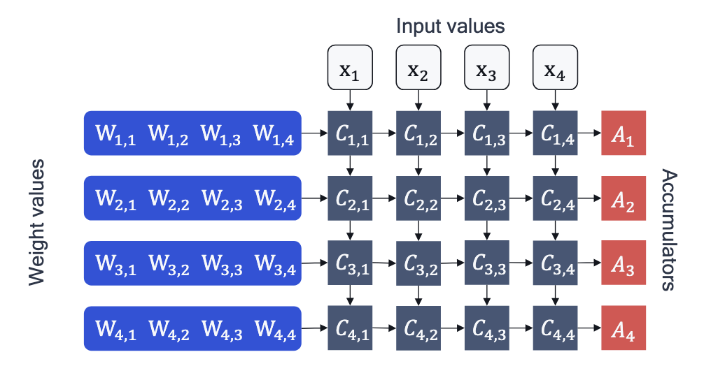
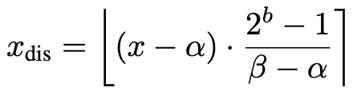
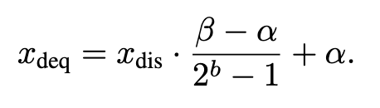
Quantization Fundamentals
Quantization, Round-to-nearest
Matrix-multiply logic in neural network accelerator hardware
Uniform affine Quantization
Mapped to discrete integer
Dequantization

Slide 6
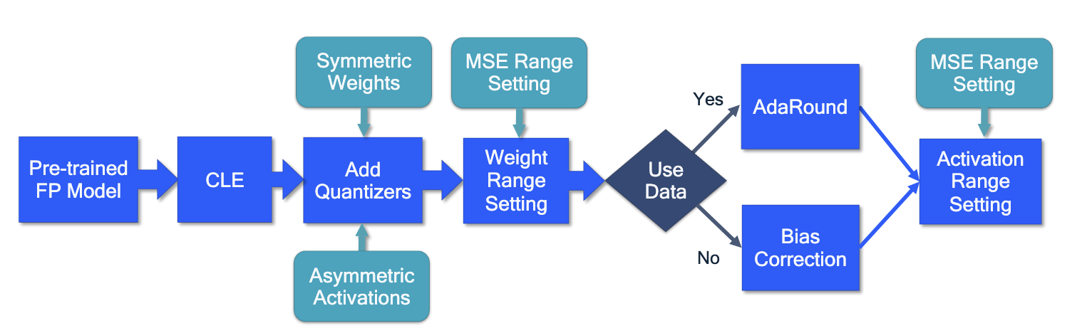
Post Training Quantization(PTQ)
Pipeline

Slide 7


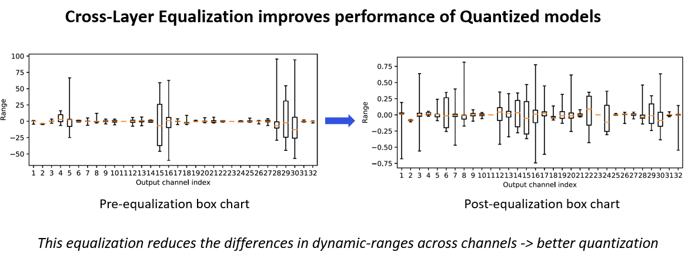
Cross-Linear Equalization (CLE)
Post Training Quantization(PTQ)
Goal: Better weight distribution before quantization
Reduced dynamic range
Method: Reshaping Weight Distribution
Equalizing dynamic ranges across consecutive layers
Qualcomm AIMET(AI Model Efficiency Toolkit) Docs

Slide 8

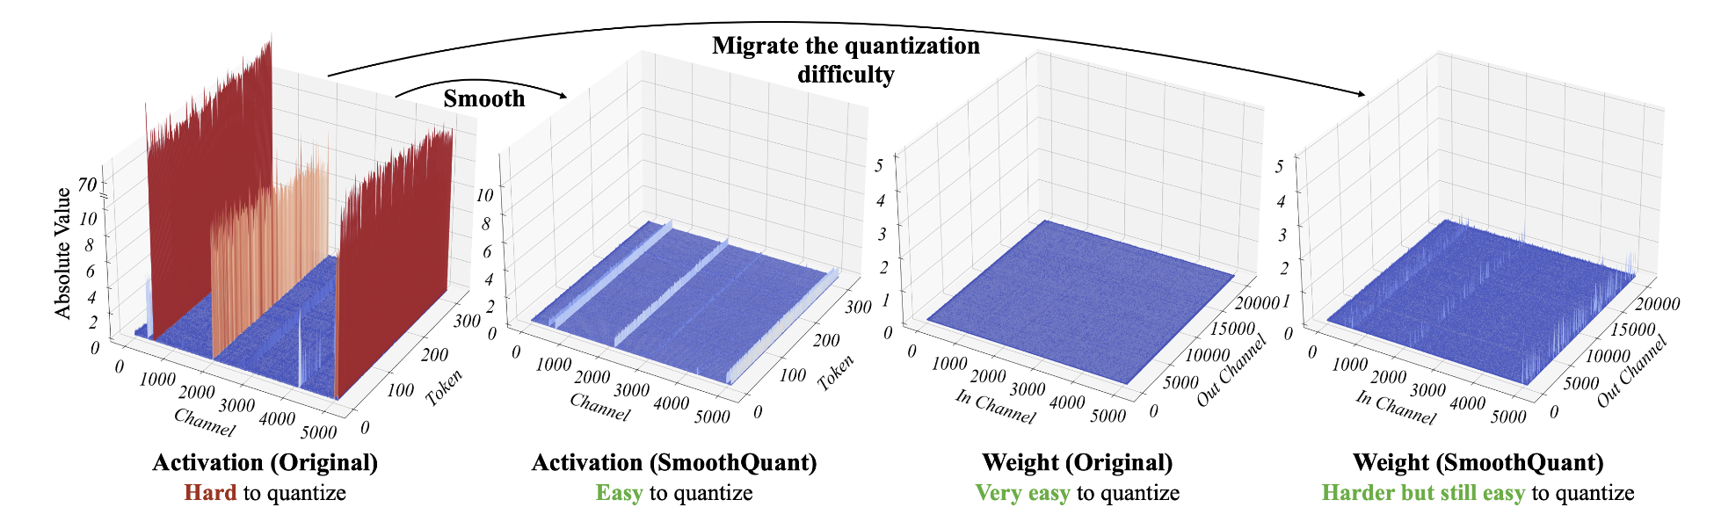
SmoothQuant (W8A8)
SmoothQuant: Accurate and Efficient Post-Training Quantization for Large Language Models
Problem:
Activation Outliers -> quantization error
per-channel is infeasible, system implementation difficult
Method: Activation-weight equalization (Migrating Difficulty from Activations to Weights)
Result: Better distribution for activation quantization
Limitation: grid search a(hyperparameter), outlier is not solved(just migrated)
…
Notes:
outlier이 weigh에 전이한 것에 불과. Outlier이 근본적으로 해결되지 않음.

Slide 9
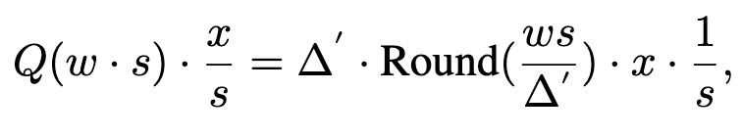
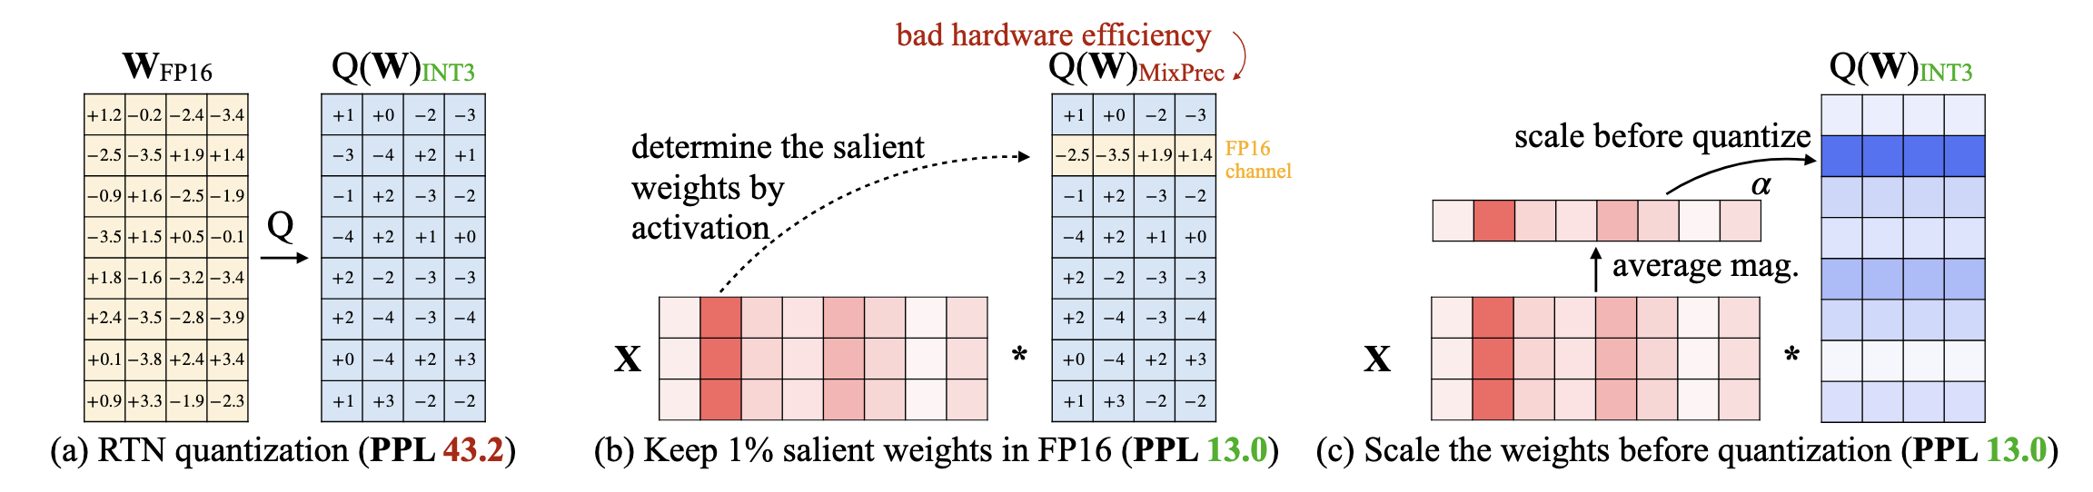
AWQ for Low-bit Weight-only Quantization
AWQ: Activation-aware Weight Quantization for LLM Compression and Acceleration
Goal: mitigate weight quantization error (W4A16)
Idea: weights are not equally important, larger activations are generally more important
Method: Activation-aware weight protection
Channel-wise, scale up salient weight channels
Effect:
Robust to calibration set size and domain shift
Prevents over-fittingl — grid search over α
No backpropagation, no weight update — grid search over α
Generalize to different domains and modalities
Limitation: weight-only, not activation
Notes:
skipping quantize salient weights – implementation is hard
(if ∆ = max(|w| is changed)
, can not migrate to KV

Slide 10
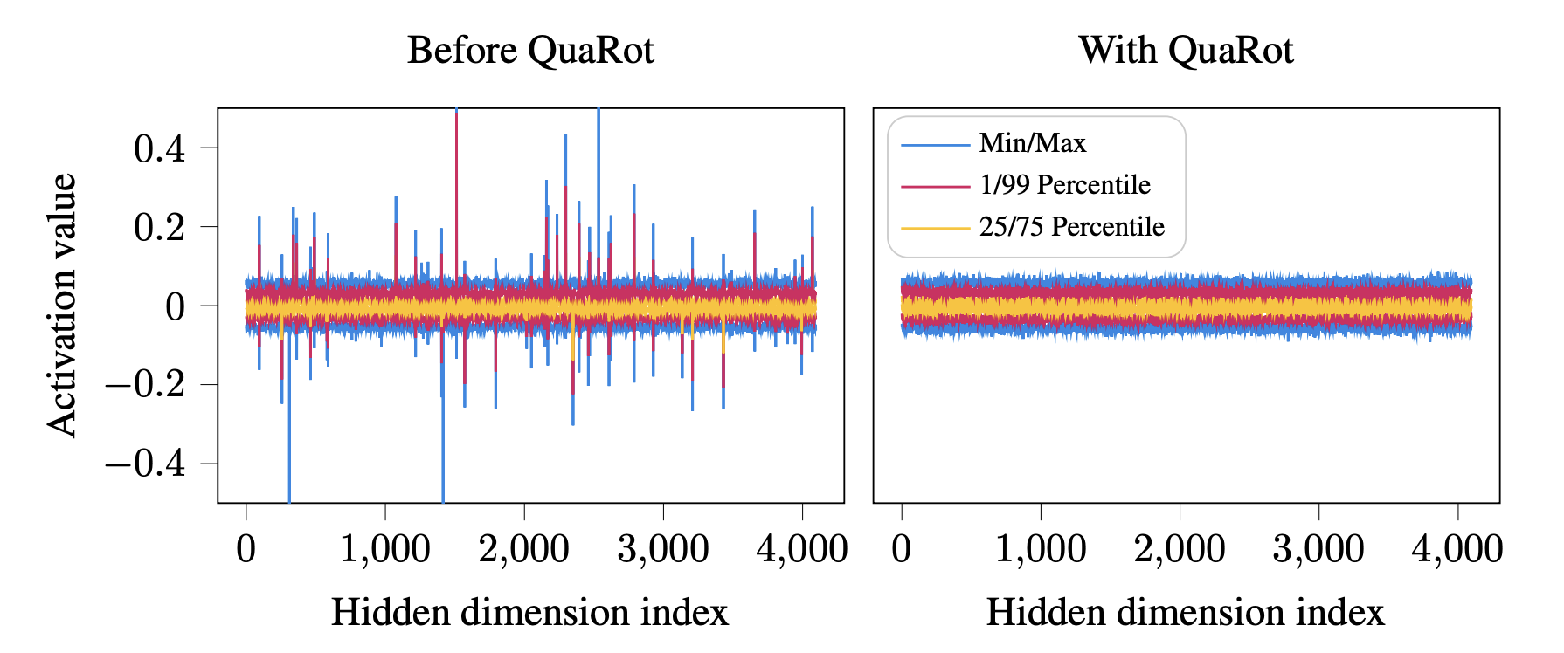
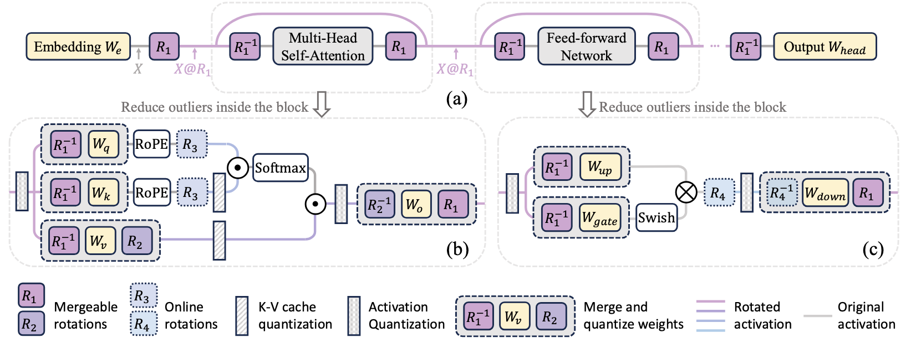
QuaRot / SpinQuant
Quarot: Outlier-free 4-bit inference in rotated llms / SpinQuant: LLM quantization with learned rotations
Goal: Mitigate activation outliers for low-bit quantization (W4A4)
Method: Rotation-based quantization
QuaRot: Hadamard rotation
SpinQuant: Learn the optimal rotation on the Stiefel manifold
Effect:
Removes the channel-aligned outlier
Enables Outlier-free 4-bit inference
Preserves accuracy under low-bit quantization
no runtime overhead - rotations are absorbed into the weights
Notes:
Method: Hadamard rotation
destroys the channel-aligned outlier structure itself
Computational invariance: rotations absorbed into weights, no runtime cost
SpinQuant learns the rotation on the Stiefel manifold instead of fixing it
Climax of Axis 1: the previous three move outliers; this removes the coordinate system in which they existed
가중치는 GPTQ로 양자화
QuaRot
Hardmard는 +1, -1로만 이루어져 있고, 행들이 orthogonal
고정되어 있기 때문에, 이상치가 완화되지 않을 수도 있음.
SpinQuant
Weight의 특징별로 서로 다른 rotation matrix를 적용.
Calibration data에 맞게 학습. 조건: 학습 중에도 orthogonal
문제: gradient descent 과정에서 orthogonal 깨짐.
해결: CaleySGD로 학습.: 원 위에서만 움직이도록. (고차원에서 Stiefel manifold)
Details
Computational invariance: rotations are absorbed into the weights, introducing no runtime overhead.
Weight quantization is performed using GPTQ

Slide 11
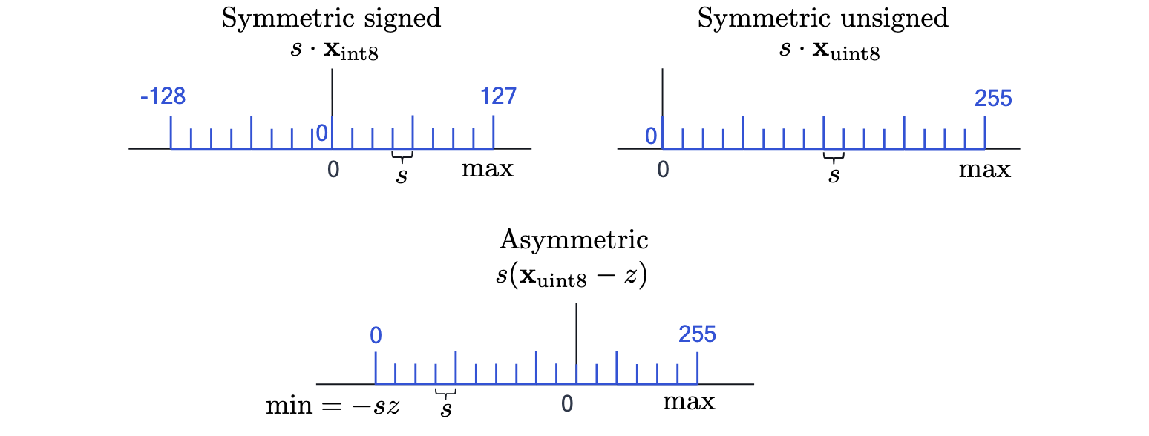
Symmetric v.s. Asymmetric
Quantizaer
Symmetric Quntization
Weights are zero-centered
Asymmetric Quntization
Activations are not necessarily zero-centered(activation function)
Common for activations in CNNs
Most KV Cache(KIVI, CalibQuant, VidKV, …
Exceptional: 1bit
Notes:
Key: approximately zero-centered after RMSNorm/LayerNorm

Slide 12
Granularity
Quantization
Per-Tensor
Per-Group
Per-Channel
Per-Token
d₁
d₂
d₃
d₄
d₅
d₆
d₇
d₈
d₁
d₂
d₃
d₄
d₅
d₆
d₇
d₈
Token 1
Token 1
Token 2
Token 2
Token 3
Token 3
Token 4
Token 4
Token 5
Token 5
Token 6
Token 6
d1
d2
d3
d4
d5
d6
d7
d8
d₁
d₂
d₃
d₄
d₅
d₆
d₇
d₈
Token 1
Token 1–2
Token 2
Token 3
Token 3–4
Token 4
Token 5
Token 5–6
Token 6
Notes:
Outlier을 제한시키는 단위. 예를 들면 다른 channel의 quantization range를 망치기

Slide 13
Range Setting
Post Training Quantization(PTQ)
Min–Max
MSE-based Range
Δ = (xₘₐₓ − xₘᵢₙ) / (2ᵇ − 1)
(qₘᵢₙ, qₘₐₓ) =
arg min
‖x − x̂‖²₂
qₘᵢₙ, qₘₐₓ
z = xₘᵢₙ
Select the clipping range that minimizes reconstruction error
q = round((x − z) / Δ)
PROS
• No clipping error • Simple and efficient
PROS
• Reduces the impact of outliers • Better reconstruction quality
CONS
• Highly sensitive to outliers
CONS
• Introduces clipping • Activation range is data-dependent
Clipping Error ↔ Rounding Error
Notes:
중요도 낮아짐
기존: 주어진 분포 안에서 최적의 quantization range를 찾는 문제
LLM: activation outlier이 중요 -> range 중요도 low. 분포 자체를 quantization-friendly하게 바꾸는 문제로 shift
Low-bit rounding error
Channel-wise dynamic range imbalance

Slide 14
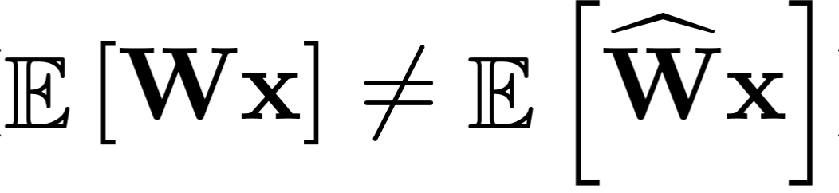
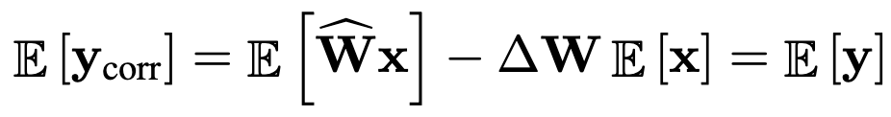
Bias Correction
Post Training Quantization(PTQ)
Problem: Quantization Error(rounding error/clipping error) -> Mean Shift
Method
Analytic (BN statistics) vs. empirical (calibration data)
Essentially zero cost, non-trivial gain — the cheapest compensation available
Notes:
—
Adaround가 bias correction 상당 부분을 흡수.
Quantization 이후, PTQ 후반부에 위치. 후처리로 보정
Deprecated!
기존: 주어진 분포 안에서 최적의 quantization range를 찾는 문제
LLM: activation outlier이 중요 -> range 중요도 low. 분포 자체를 quantization-friendly하게 바꾸는 문제로 shift
Low-bit rounding error
Channel-wise dynamic range imbalance
GPTQ: Hessian based output reconstruction

Slide 15
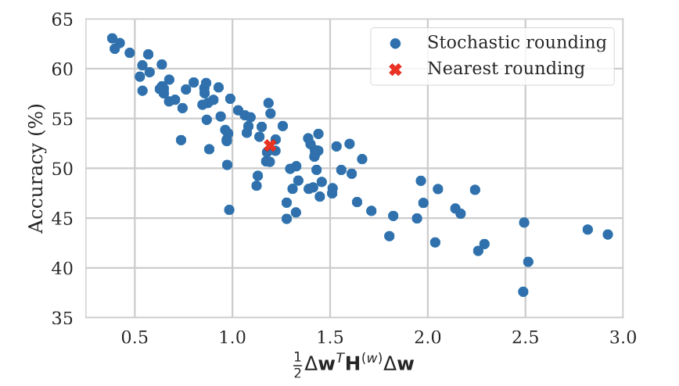
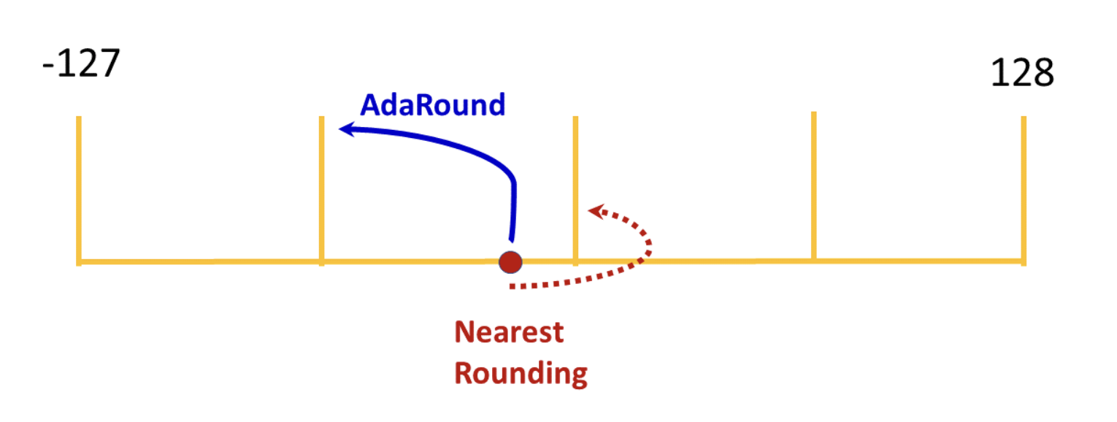
AdaRound
Post Training Quantization(PTQ)
Problem: round-to-nearest is not optimal
Method: Learns whether to round each weight up or down using calibration set
Layer-wise optimization
Optimize a reconstruction loss, no backpropagation

Slide 16
Comparison
PTQ - White Paper v.s. LLM
White Paper | LLM
Cross-Layer Equalization(CLE) | SmoothQuant, AWQ, SpinQuant, QuaRot
Range Setting | -
Bias Correction | -
Adaround | GPTQ
- | KV Cache - KIVI

Slide 17
KV Cache Quantization

Slide 18
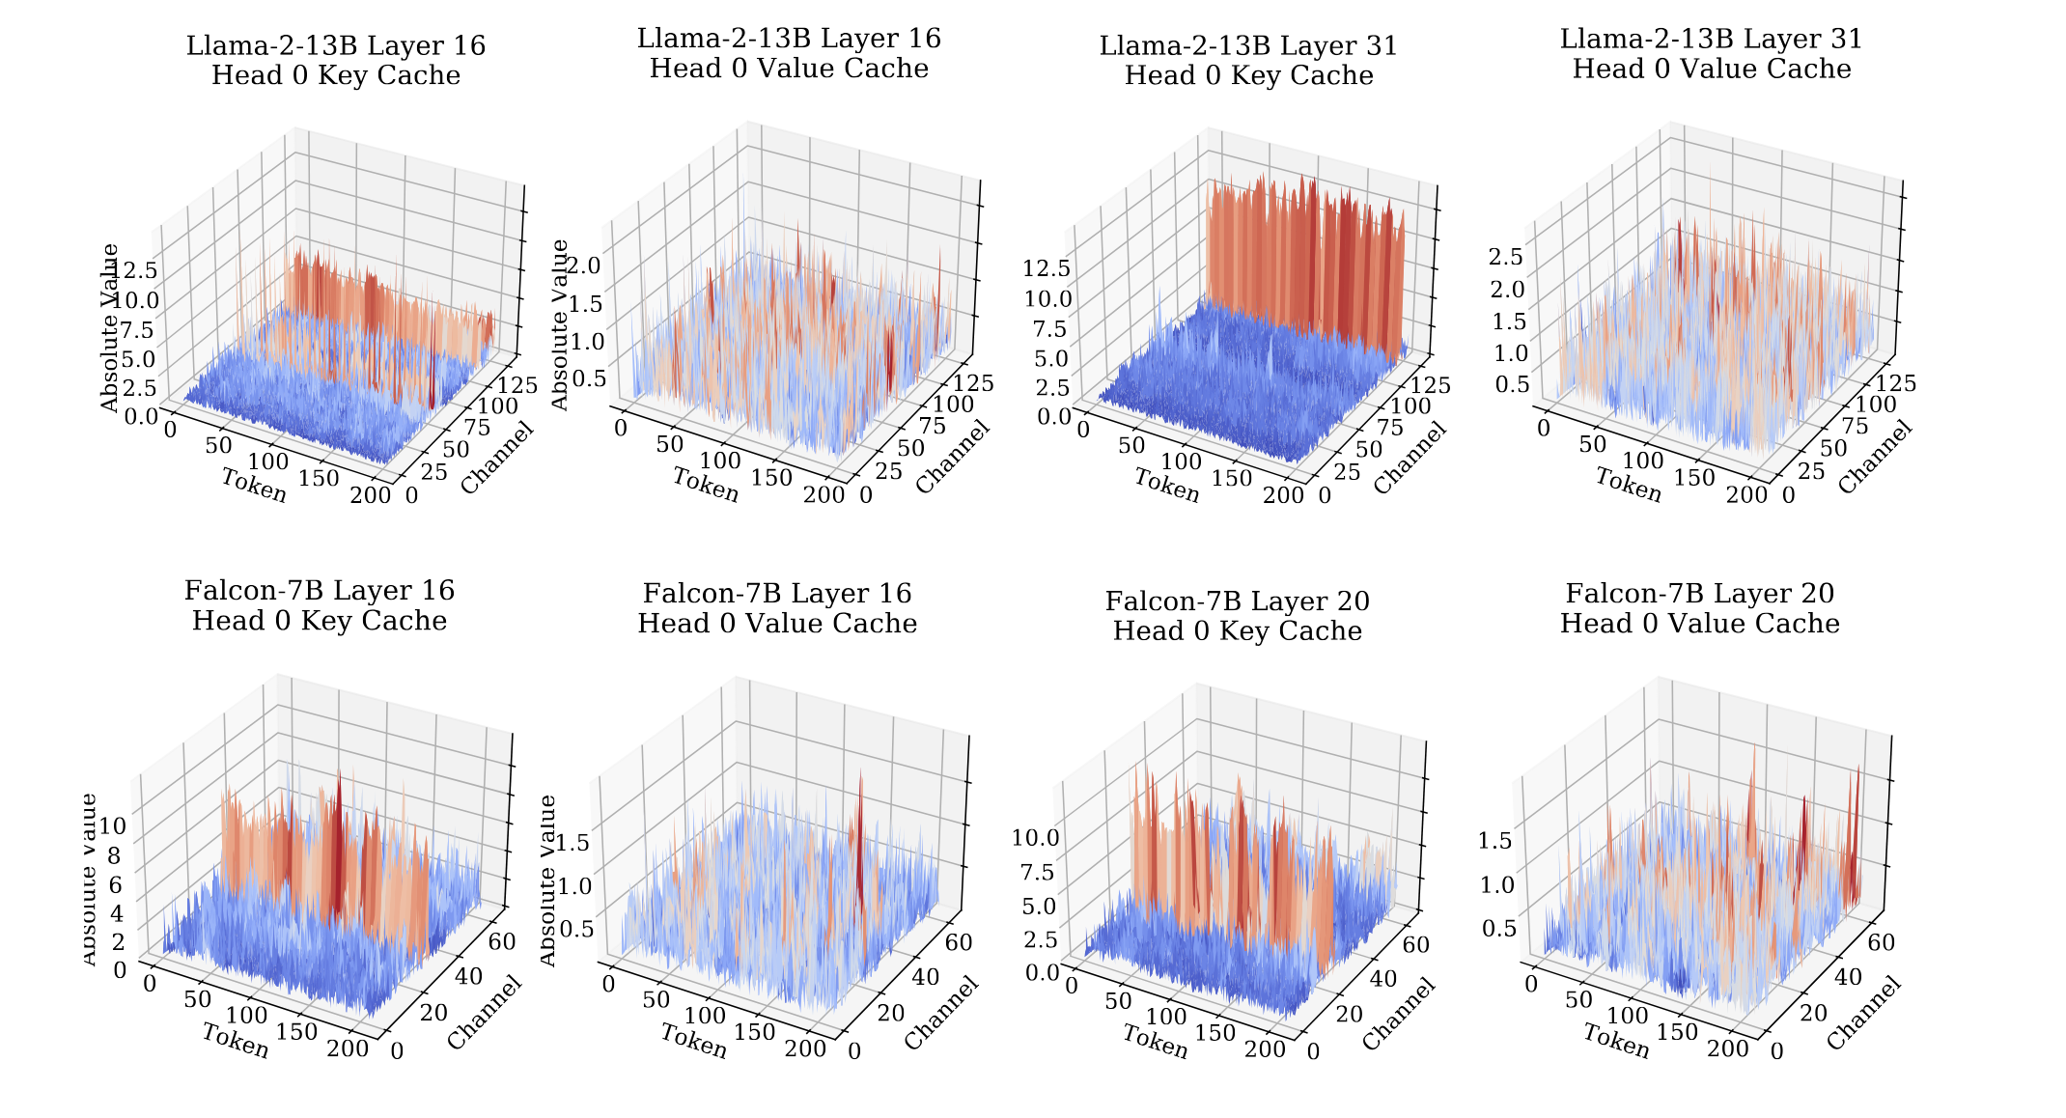
KIVI
KIVI: A Tuning-Free Asymmetric 2bit Quantization for KV Cache
Previous works:
lack of exploring element distribution of KV cache
Method:
Key: per-channel, few fixed channels whose magnitudes are very large
Value: per-token. no obvious outlier pattern -> quantized per token
Results: Peak memory, batch size, throughput
Limitation: group scale overhead
Notes:
GPTQ(optimization-based method): unsuitable for quantizing KV cache due to the overhead
Previous: Streaming KV Cache: apply per-token quantization to both key and value cache since the newly quantized KV cache can be naively added to the existing quantized one along the token dimension
A streaming residual buffer reconciles per-channel keys with autoregressive decoding
Reaches 2-bit using Axis 2 alone — Axis 3 never enters

Slide 19
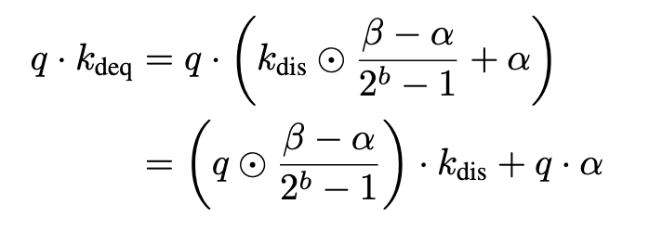
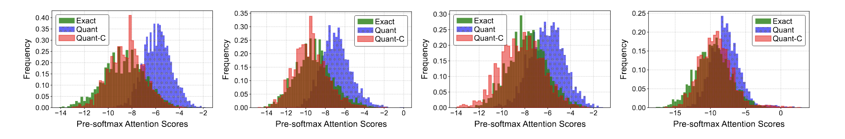

CalibQuant
CalibQuant: 1-Bit KV Cache Quantization for Multimodal LLMs
Previous Works: general LLM
-> MLLM visual token
Method:
visual KV cache low-bit quantization (1, 2 bit)
Channel-wise: Key - per-channel, Value - per-channel
Post-scaling: decode 시 q는 1토큰 → dequant를 query 쪽으로
Calibration: 1-bit면 값이 $\left\{α , β\right\}$으로 인한 pre-softmax 분포 왜곡 -> affine map $g:\left[γ , δ\right]→\left[γ , −τ_{1}δ−τ_{2}\right]$, $τ∈\left\{0 , 1 , 2 , 3\right\}$ grid search
Notes:
Low-bit restore
Limitation: 1-bit generalization

Slide 20
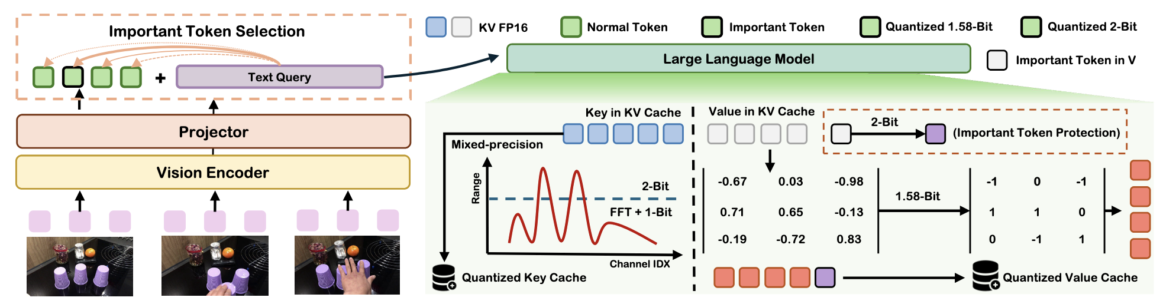
VidKV
PLUG-AND-PLAY 1.x-Bit KV CACHE QUANTIZATION FOR VIDEO LARGE LANGUAGE MODELS
separate bit budgets for keys and values in video LLMs, importance-driven mixed precision
Idea: High redundancy of video tokens -> low-bit quantization
Method:
Key: Mixed precision per channel(2-bit: anormal channel, 1-bit: normal)
Value: 1.58-bit quantization(mapping {-1, 0, 1} based on a & selectively filtering semantically salient visual tokens(import token – 2bit)
per-channel( <-> KIVI: per-token)
Notes:
Method:
Key:
the frequency domain via the Fast Fourier Transform (FFT) - convert time to frequency -> restore inverse FFT
Value:
System + visual + text 에서 visual X token cross-modal attention score구해서 이중 n = pl개 선정.
Mapping set to {-1, 0, 1} -> Value * attention matmul -> addition => reducing computation
token protection based on their semantic relevance - preserved at 2-bit precision
Experiment:
Effect: KV cache to 1.5-bit and 1.58-bit precision with almost no performance drop compared to the FP16 counterparts. reducing the KV cache size by 80%

Slide 21
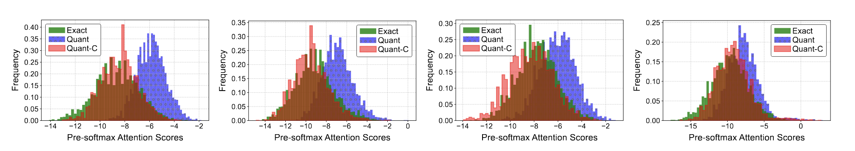
Discussion
Plan
KV Cache Quantization 자체는 llm에서 saturated 거의 안 바뀜.
아키텍쳐에서 해결
MHA(multi-head-attention) -> KV Cache DeepSeek-V2
LLM에서 KIVI 구조를 크게 벗어나지 않음. (2024~)
K, V모두 channel-wise
HW: NVFP4
Multimodal or Edge에 집중…
---
Track 1: ???-aware quantization(e.g. modality-aware quantization, video내 distribution/statistical patterns 고려) -> granularity 다양하게, saliency가 다양하게 가능.
VidKV: Text, Image
KIVI: K, V 다른 granularity로 quantize
각 분포 visualization -> modality aware quantization
KIVI가 K, V element distribution 조사한 것처럼…
Track 2: 대부분의 연구에서 kernel, channel-wise
Granularity를 다르게 하거나, salient channel을 다르게 하고 싶으면 kernel 공부 필요.

Slide 22
Thank You!

