Slide 1
Lab. 03
Logic Design Lab.
Fall 2019
Prof. Sungjoo Yoo
(yeonbin@snu.ac.kr)
TA. Hyunsu Kim
(gustnxodjs@gmail.com)
TA. Hyunyoung Jung
(gusdud1500@gmail.com)

Slide 2
Contents
Two-bit comparator
Module & Test bench
Xilinx ISE
Lab

Slide 3
Two-bit Comparator

Slide 4
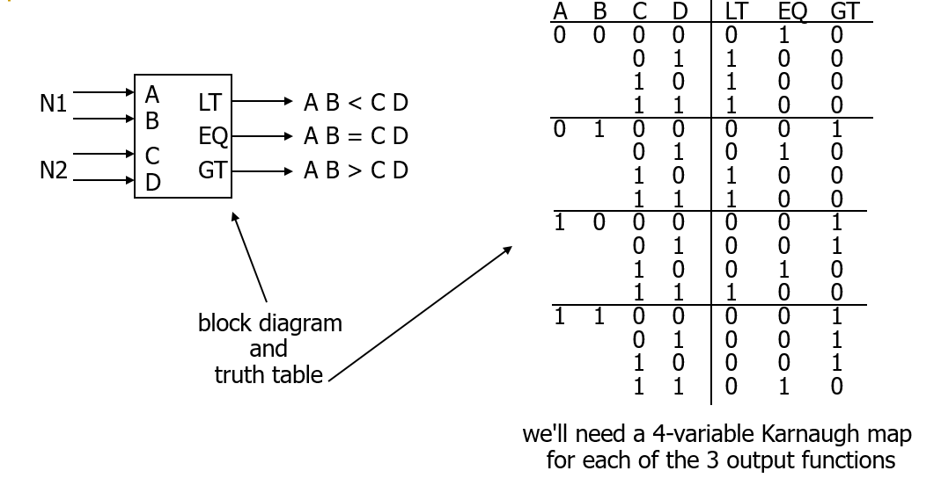
Block Diagram & Truth Table

Slide 5
Karnaugh Map for EQ
A
1 0
0 1
0 0
0 0
A' B' C' D' + A' B C' D + A B C D + A B' C D’
D
0 0
0 0
1 0
0 1
= (A xnor C) • (B xnor D)
C
B
K-map for EQ

Slide 6
Design Example
A B C D
two alternative
implementations of EQ
with and without XOR
EQ
XNOR is implemented with at least 3 simple gates
EQ

Slide 7
Module & Test bench

Slide 8
Remember?
Hierarchy of digital system design

Slide 9
Module & test bench
We will design our own module with logic gates
Input A
Our
Module
Output X
Input B
Output Y
Input …
Output …

Slide 10
Module & test bench
We will design our own module with logic gates
And we will test it
Breadboard
Our
module

Slide 11

Module & test bench
We will design our own module
And we will test it by simulation!
Test bench
Our
module
1
0
0
0
1
1

Slide 12
Module & test bench
In case of Full adder,
We have to design full adder as a module
A
Full
Adder
Sum
B
Cout
Cin

Slide 13
Module & test bench
In case of Full adder,
We have to design full adder as a module
And check outputs for every possible input!
Test bench
A
Full
Adder
Sum
1
B
0
0
Cout
Cin
1
1

Slide 14
Xilinx ISE

Slide 15
Xilinx ISE
Project setting
Module design
Test bench design

Slide 16

Xilinx ISE Design Suite
Integrated Synthesis Environment
Release 14.7, 2013
What it can do
Synthesis(compile) and analysis of HDL designs
Timing analysis, RTL diagram
Xilinx FPGA programmer

Slide 17
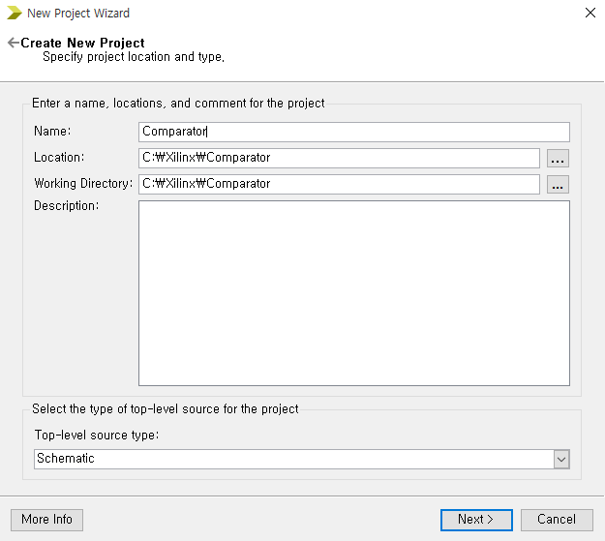
Creating New Project
Select File -> New Project
Specify Name, Location, Working Directory. Select Top-level source type as Schematic

Slide 18
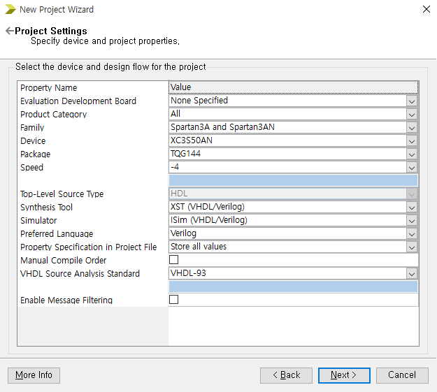
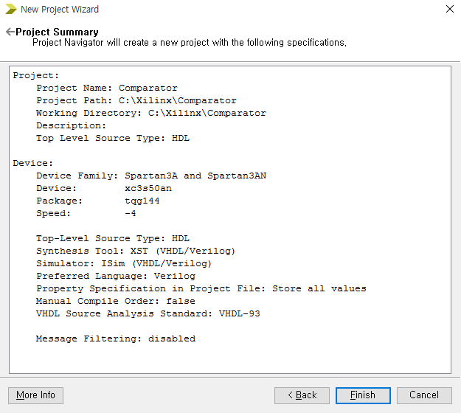
Project Settings
Set Project Settings as above
Click Next → Finish

Slide 19
Xilinx ISE
Project setting
Module design
Test bench design

Slide 20
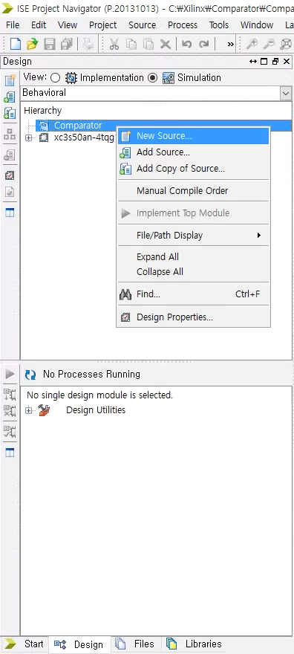
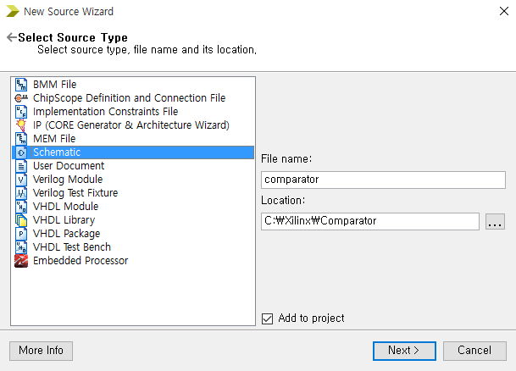
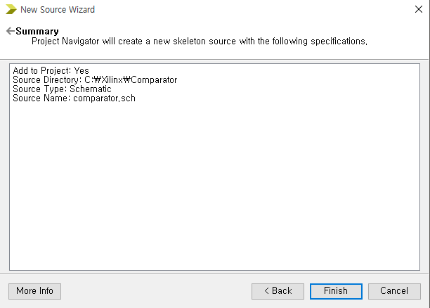
Creating Schematic
Right-Click anywhere in Hierarchy in Design tab, select New Source
A New Source Wizard window appears. In this Select Source Type window, select Schematic and type the File name. Ensure Add to project is checked.

Slide 21
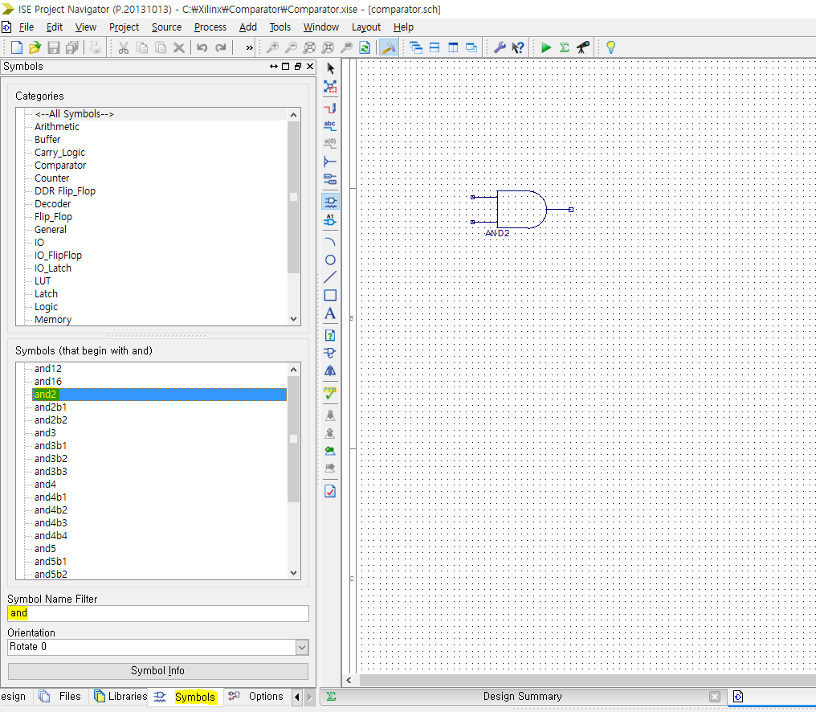
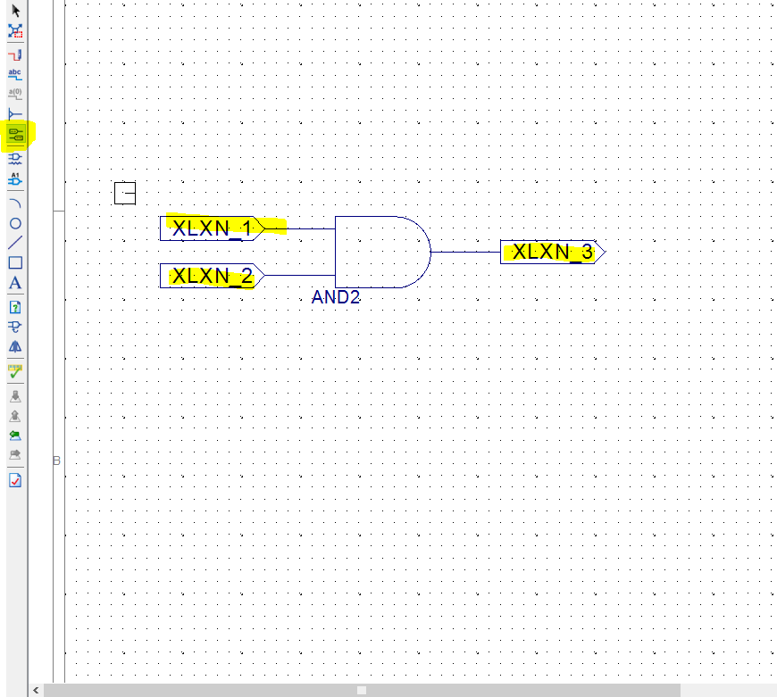
2-input-AND gate circuit (1)
In Symbols tab, type “and” under Symbol Name Filter.
Select and2 under Symbols, and place it on board.
Click I/O Marker button and you can add input/output markers to your circuit.

Slide 22
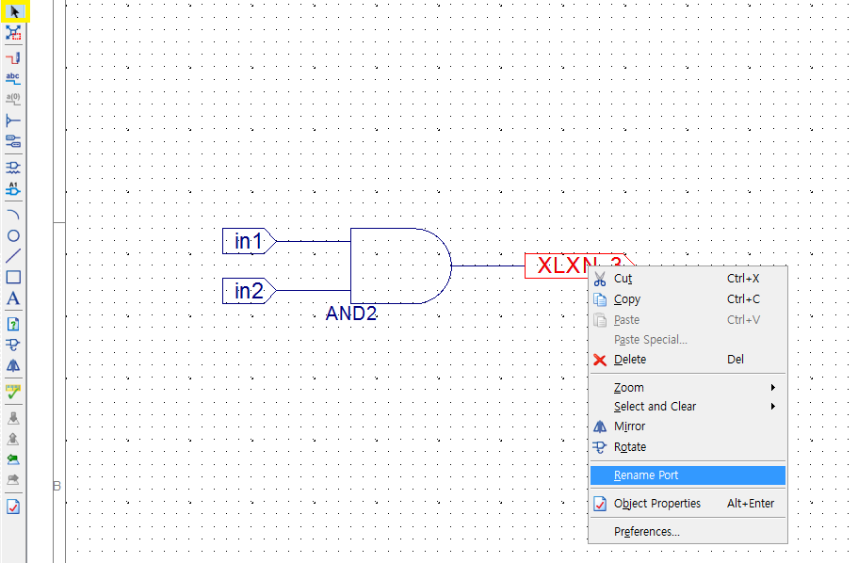
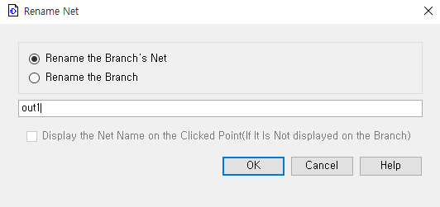
2-input-AND gate circuit (2)
Change the names of input/output symbols
Save to apply changes
Now, we finished our module design

Slide 23
Xilinx ISE
Project setting
Module design
Test bench design

Slide 24
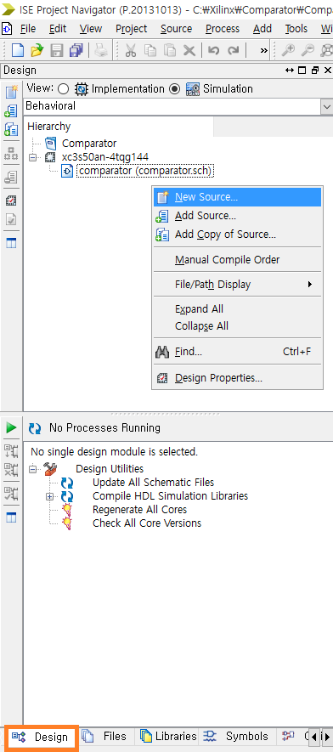
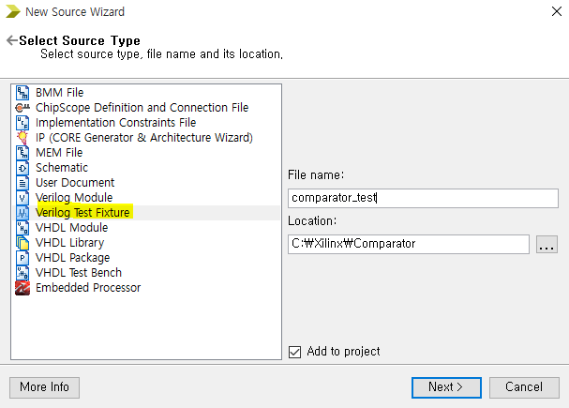
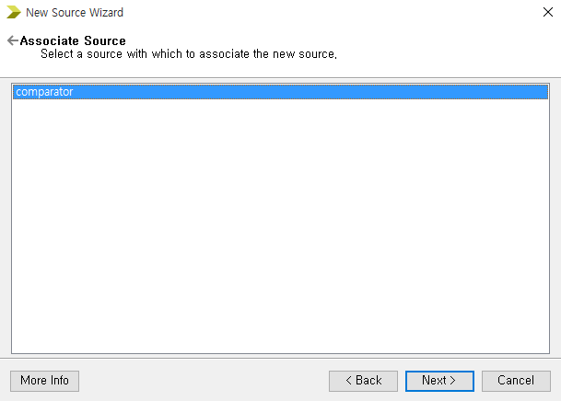
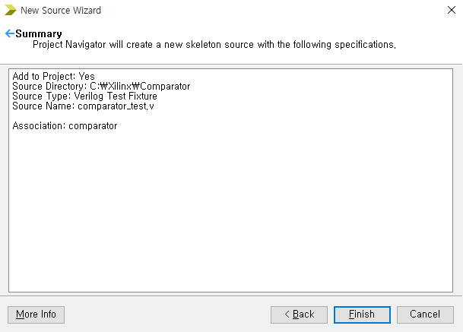
Creating Verilog Test Bench
Select New Source by right clicking inside Design tab.
Select Verilog Test Bench. Type the file name as above.

Slide 25
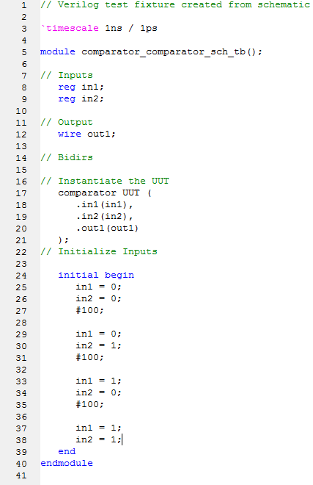
Schematic Simulation Code
For now, we will ignore syntax of test bench code
guess the meaning of each part !
UUT = Unit Under Test

Slide 26
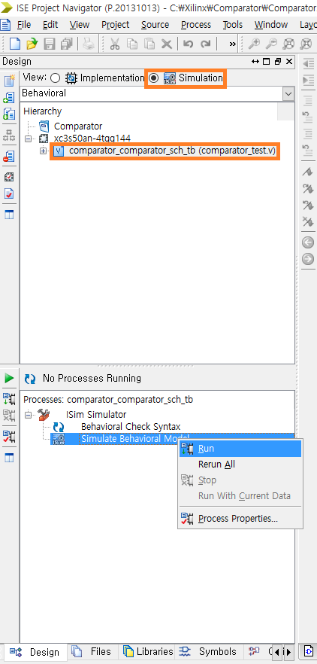
Simulate Behavioral Model
Save the project by selecting File -> Save.
Double click Behavioral Check Syntax to verify the Verilog code syntax.
Ensure Design tab is selected, View is set to Simulation.
Ensure the Behavioral Check Syntax is correct.
Select test model you just created.
Double click Simulate Behavioral Model.

Slide 27
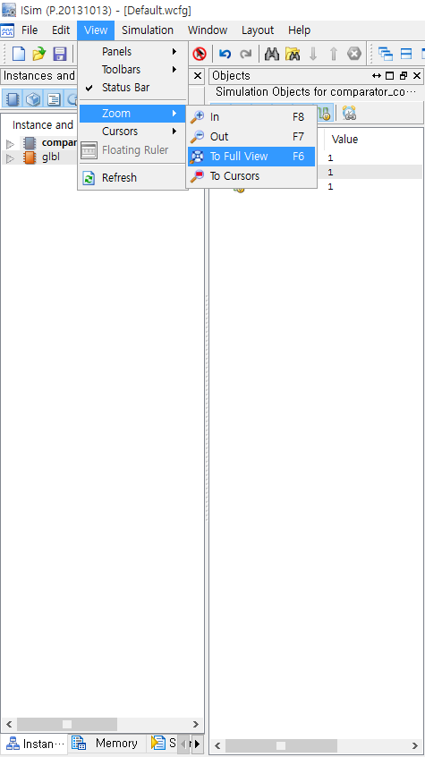
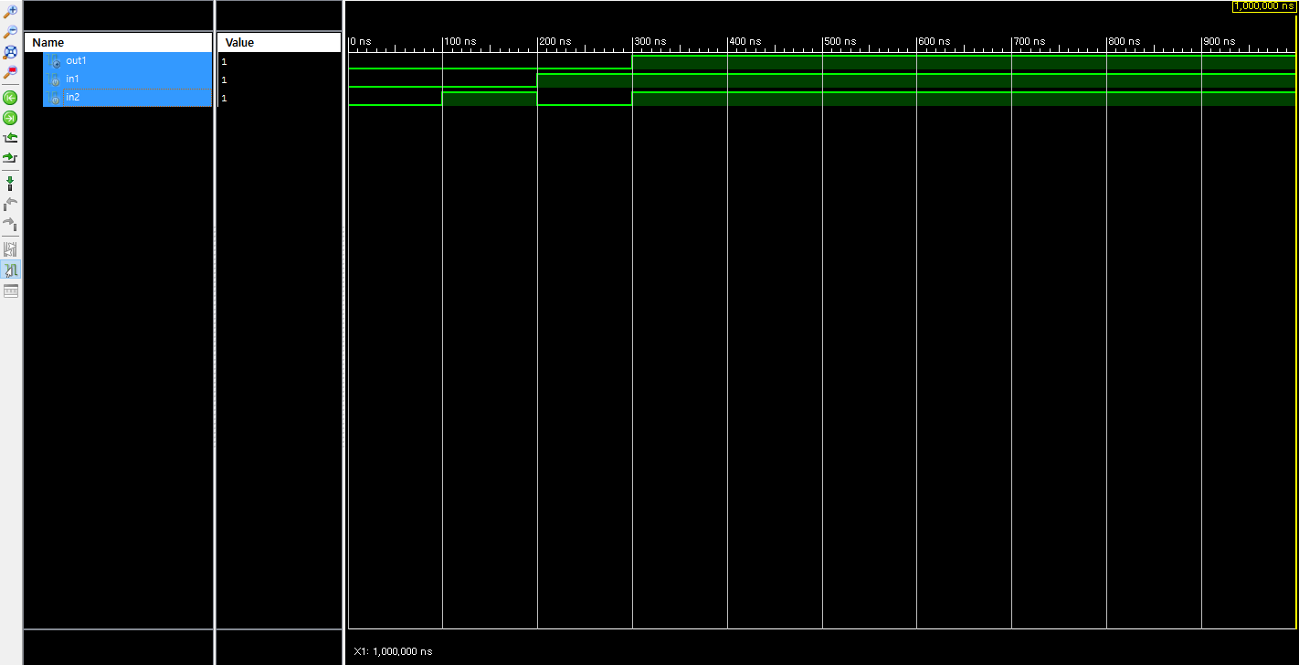
Simulation Result
To adjust the view, select View -> Zoom -> To Full View.

Slide 28
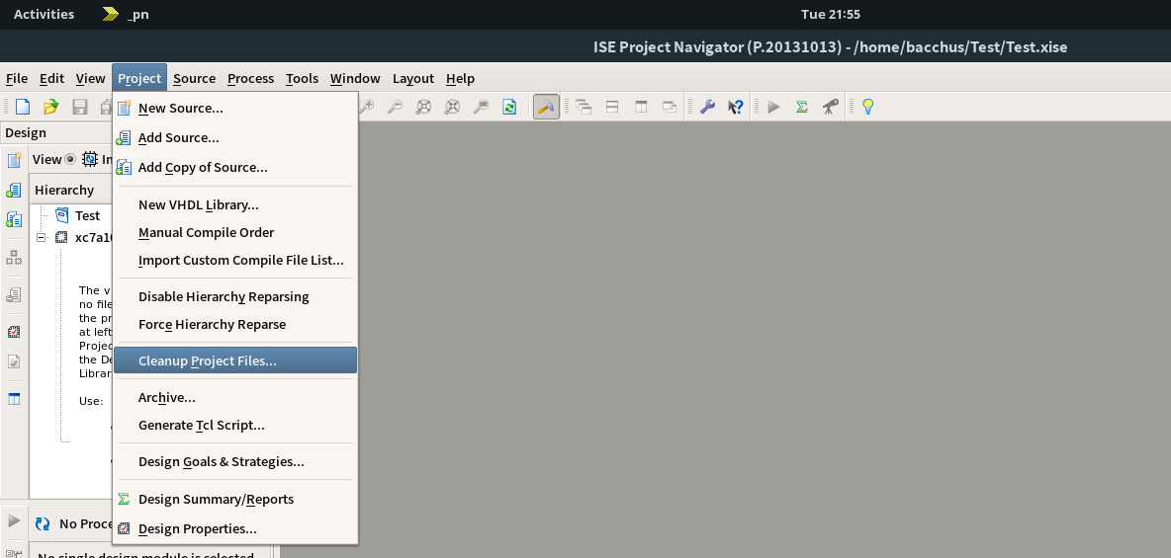
Before logging out,
To speed up your login,
Every time you finished your work with your current project, you should do Project-Cleanup Project Files...

Slide 29
Lab

Slide 30
Today
Implement 2-bit comparator LT, EQ, GT using Xilinx ISE Schematic
And test your module for every possible input

Slide 31
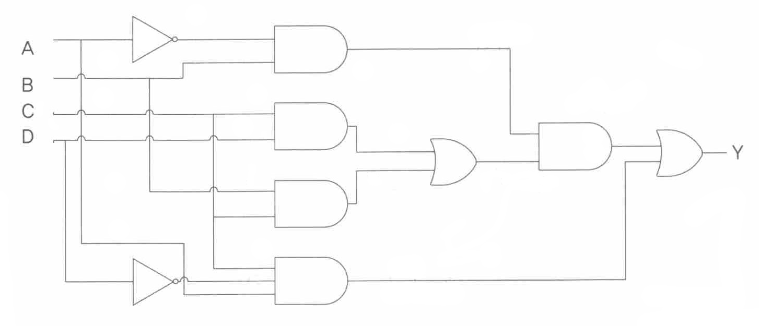
Homework
1. For the given circuit, minimize it using ONLY:
inverters, 3-input AND gates, 2-input OR gates
(2) 2-input NAND gates (without inverters)
For both case, draw schematics using Xilinx ISE, and simulate its behavior under every possible input.

Slide 32
Homework
2. Explain ‘Multiplexer’, ‘Demultiplexer’
3. Explain ‘Encoder’, ‘Decoder’
Refer your textbook

Slide 33
Report
Write a report
Either in Korean or in English
Must include the result and discussion of the practice
# of pages doesn’t matter
Due : 30 Sep., 7:00 pm (Before class, on eTL)

