Slide 1
Chapter 4.
Combinational logic technologies

Slide 2
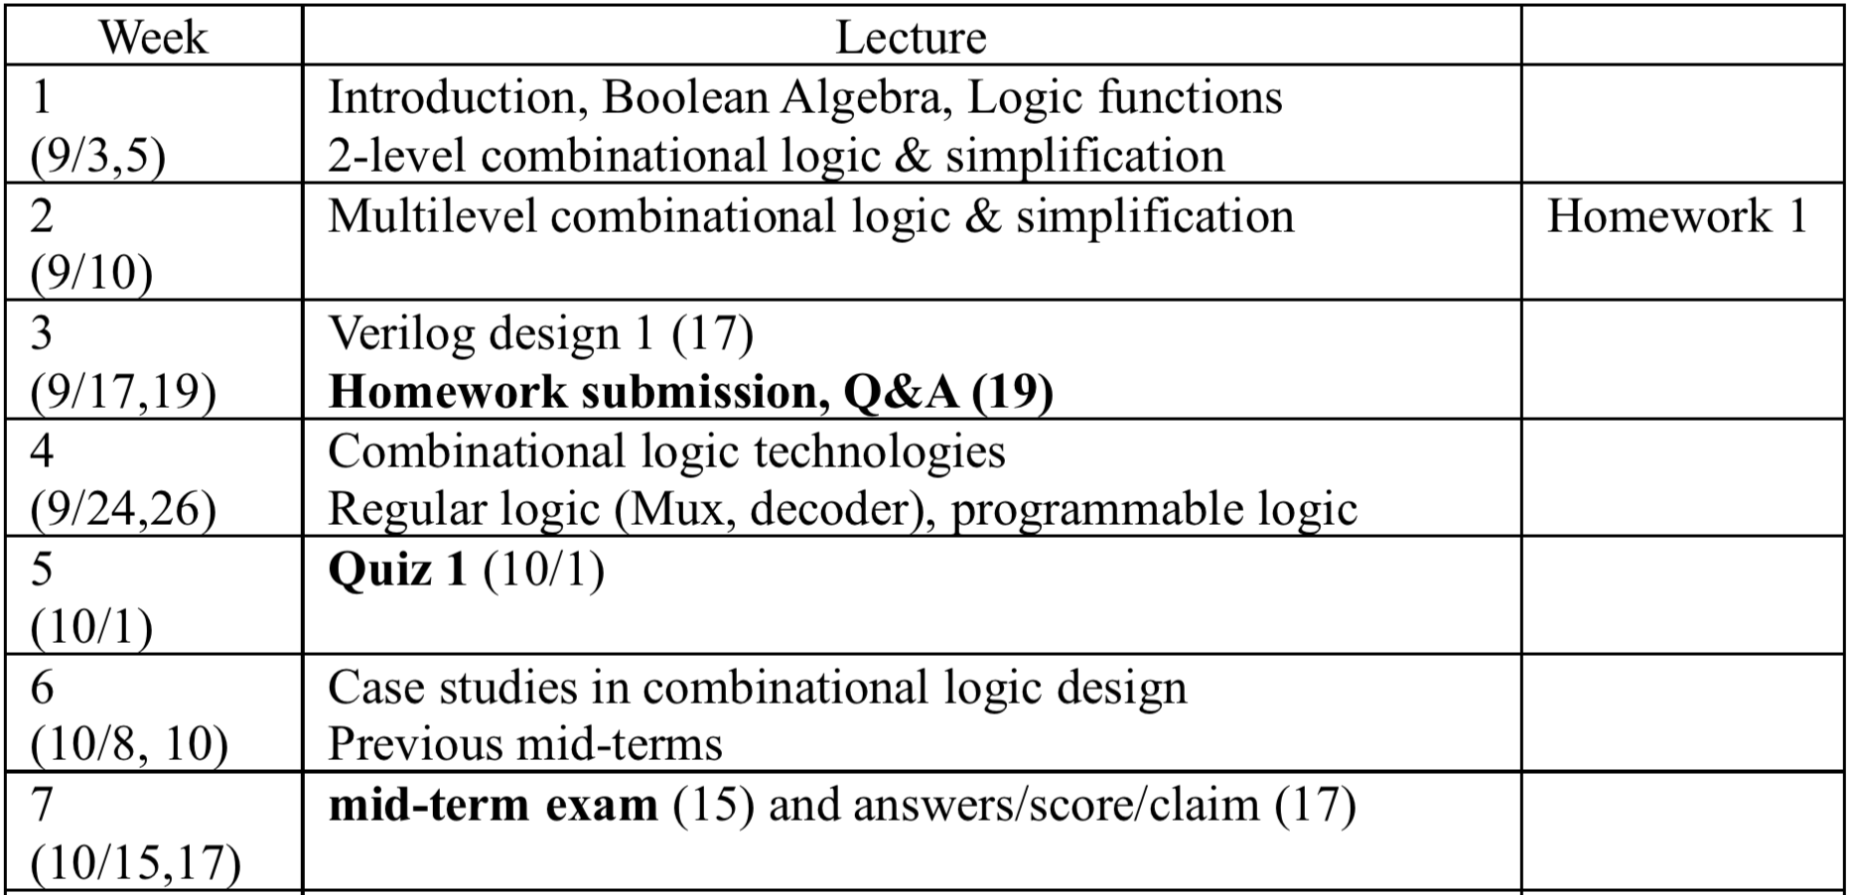
Schedule (by Mid-term Exam)

Slide 3
Review: Chapters 1 ~ 3

Slide 4
General design procedure for combi. logic
1. Understand the problem
  what is the circuit supposed to do?
  write down inputs (data, control) and outputs
  draw block diagram or other picture
2. Formulate the problem using a suitable design representation
  truth table or waveform diagram are typical
  may require encoding of symbolic inputs and outputs
3. Choose implementation target
  ROM, PAL, PLA
  mux, decoder and OR-gate
  discrete gates (fixed logic)
4. Follow implementation procedure
  K-maps for two-level, multi-level
  design CAD tools and hardware description language (e.g., Verilog)
Typically, we have to separate the I/O variables and system internals to understand the problem. Step 2 is abstract representation while steps 3 and 4 are H/W implementation dependent

Slide 5
Agenda
Truth table to SoPs
QM method
Hazard-free circuit design
Implementation methods: MUX, PLA, …
Number system and 4-bit/16-bit adder

Slide 6
Design example: BCD increment by 1
I8 I4 I2 I1 O8 O4 O2 O1
0 0 0 0 0 0 0 1
0 0 0 1 0 0 1 0
0 0 1 0 0 0 1 1
0 0 1 1 0 1 0 0
0 1 0 0 0 1 0 1
0 1 0 1 0 1 1 0
0 1 1 0 0 1 1 1
0 1 1 1 1 0 0 0
1 0 0 0 1 0 0 1
1 0 0 1 0 0 0 0
1 0 1 0 X X X X
1 0 1 1 X X X X
1 1 0 0 X X X X
1 1 0 1 X X X X
1 1 1 0 X X X X
1 1 1 1 X X X X
I1
I2
I4
I8
O1
O2
O4
O8
block diagram
and
truth table
4-variable K-map for each of
the 4 output functions

Slide 7
Design example: BCD increment by 1 (cont’d)
I8
I8
O8
O4
0 0
0 0
X 1
X 0
0 1
0 1
X 0
X 0
I1
O8 = I4 I2 I1 + I8 I1'
O4 = I4 I2' + I4 I1' + I4’ I2 I1
O2 = I8’ I2’ I1 + I2 I1'
O1 = I1'
I1
0 1
0 0
X X
X X
1 0
0 1
X X
X X
I2
I2
I4
I4
I8
O2
I8
O1
0 0
1 1
X 0
X 0
1 1
0 0
X 1
X 0
I1
I1
0 0
1 1
X X
X X
0 0
1 1
X X
X X
I2
I2
I4
I4
In O8, we will interpret a don’t care (DC) term as 1 if it helps to minimize the number of literals for the elements of the ON-set. The other DC terms will be treated as 0. To minimize the number of literals, we have to find out the maximum size subcube.

Slide 8
Definition of terms for two-level simplification
Implicant
  single element of ON-set or DC-set or any group of these elements that can be combined to form a subcube (or an adjacent group)
Prime implicant (PI)
  implicant that can't be combined with another to form a larger subcube
Essential prime implicant
  prime implicant is essential if it alone covers an element of ON-set
  will participate in ALL possible covers of the ON-set
  DC-set used to form prime implicants but not to make implicant essential
Objective:
  grow implicant into prime implicants
  (to minimize literals per term)
  cover the ON-set with as few prime implicants as possible
  (to minimize number of product terms)
So far we have examined a few examples of logic design simplification
From now on, we will try to perform simplification in a systematic or algorithmic way. To do so, we first have to define some terminologies.

Slide 9
Examples to illustrate terms
A
6 prime implicants:
A'B'D, BC', AC, A'C'D, AB, B'CD
0 X
1 1
1 0
1 0
D
essential
1 0
0 0
1 1
1 1
C
minimum cover: AC + BC' + A'B'D
B
A
5 prime implicants:
BD, ABC', ACD, A'BC, A'C'D
0 0
1 1
1 0
1 0
D
essential
0 1
0 1
1 1
0 0
C
minimum cover: 4 essential implicants
B
First of all, we have to find out all the possible prime implicants. Then we first transform the essential prime implicants to boolean expressions. Then we will try to find the minimum set of prime implicants to cover the entire on-set, called minimum cover.

Slide 10
Algorithm for two-level simplification
Algorithm: minimum sum-of-products expression from a Karnaugh map
  Step 1: choose an element of the ON-set
  Step 2: find "maximal" groupings of 1s and Xs adjacent to that element
    consider top/bottom row, left/right column, and corner adjacencies
    this forms prime implicants (number of elements always a power of 2)
  Repeat Steps 1 and 2 to find all prime implicants
  Step 3: revisit the 1s in the K-map
    if covered by single prime implicant, it is essential, and participates in final cover
    1s covered by essential prime implicant do not need to be revisited
  Step 4: if there remain 1s not covered by essential prime implicants
    select the smallest number of prime implicants that cover the remaining 1s

Slide 11
Algorithm for two-level simplification (example)
A
A
A
X 1
0 1
0 1
1 1
X 1
0 1
0 1
1 1
X 1
0 1
0 1
1 1
D
D
D
0 X
0 1
X 0
0 1
0 X
0 1
X 0
0 1
0 X
0 1
X 0
0 1
C
C
C
B
B
B
2 primes around A'BC'D'
2 primes around ABC'D
A
A
A
A
X 1
0 1
0 1
1 1
X 1
0 1
0 1
1 1
X 1
0 1
0 1
1 1
X 1
0 1
0 1
1 1
D
D
D
D
0 X
0 1
X 0
0 1
0 X
0 1
X 0
0 1
0 X
0 1
X 0
0 1
0 X
0 1
X 0
0 1
C
C
C
C
B
B
B
B
3 primes around AB'C'D'
2 essential primes
minimum cover (3 primes)
For all 1s, check the PIs that include the 1. The PIs should be considered for all the 1s and DCs around that can be united. Then we first choose essential PIs and then find out the minimum cover, the minimum number of PIs that cover the remaining 1s.

Slide 12
Agenda
Truth table to SoPs
QM method
Hazard-free circuit design
Implementation methods: MUX, PLA, …
Number system and 4-bit/16-bit adder

Slide 13
3.2.1 Q-M Method
Quine-McCluskey Method
an exact algorithm that reduces a minterm expression to a min. form.
can be programmed for a digital computer.
can handle more variables than K-map.
Two major steps ( a general logic minimization procedure)
  Step 1. Find all PI’s of the given minterm expression
  by repeatedly applying XY + XY’ = X
  (algebraic simplification).
  Step 2. Select a min. set of PI’s using a PI chart.
    2.1 Select EPI’s
    2.2 Select a min. # of additional non-EPIs covering the remaining 1’s.

Slide 14
3.2.1 Q-M Method
Step 1: Find all prime implicants
For convenience, we divide product terms in groups according to the number of 1’s in each term
group i: product terms with i 1’s.
Product terms in group i are candidates to be combined with product terms in group (i±1).
3 variables
group ABC Decimal
0 0 0 0 0
1 0 0 1 1
0 1 0 2
1 0 0 4
2 0 1 1 3
1 0 1 5
1 1 0 6
3 1 1 1 7
Can be combined. Futher check necessary.
Cannot be combined.

Slide 15
3.2.1 Q-M Method
Example: F(A,B,C,D) = Σm(0,1,2,5,6,7,8,9,10,14)
COL 1 COL II COL III
0 0000
1 0001
2 0010
8 1000
5 0101
6 0110
9 1001
10 1010
7 0111
14 1110
A
0 4
1 5
12 8
13 9
D
3 7
2 6
15 11
14 10
C
B
A
1 0
1 1
0 1
0 1
D
0 1
1 1
0 0
1 1
C
B

Slide 16
3.2.1 Q-M Method
Example: F(A,B,C,D) = Σm(0,1,2,5,6,7,8,9,10,14)
COL 1 COL II COL III
0 0000 V (0,1) 000-
1 0001 V
2 0010
8 1000
5 0101
6 0110
9 1001
10 1010
7 0111
14 1110
A
(0,2) 00-0
0 4
1 5
12 8
13 9
D
V
3 7
2 6
15 11
14 10
C
B
A
1 0
1 1
0 1
0 1
D
0 1
1 1
0 0
1 1
C
B

Slide 17
3.2.1 Q-M Method
Example: F(A,B,C,D) = Σm(0,1,2,5,6,7,8,9,10,14)
COL 1 COL II COL III
0 0000 V (0,1) 000-
(0,2) 00-0
(0,8) -000
1 0001 V
2 0010 V
8 1000 V
5 0101
6 0110
9 1001
10 1010
7 0111
14 1110
Positions of ‘–’ must be same.
Two products with one-bit difference can be combined..
X
The same process can be repeated until no more combinations are possible

Slide 18

3.2.1 Q-M Method
Example: F(A,B,C,D) = Σm(0,1,2,5,6,7,8,9,10,14)
COL 1 COL II COL III
0 0000 V (0,1) 000-
(0,2) 00-0
1 0001 V (0,8) -000
2 0010 V
8 1000 V (1,5) 0-01
(1,9) –001
5 0101 V (2,6) 0-10
6 0110 V (2,10) -010
9 1001 V (8,9) 100-
10 1010 V (8,10) 10-0
7 0111 V (5,7) 01-1
14 1110 V (6,7) 011-
(6,14) -110
(10,14) 1-10
V
(0,1,8,9) -00-
A
1 0
1 1
0 1
0 1
D
0 1
1 1
0 0
1 1
C
B

Slide 19
3.2.1 Q-M Method
Example: F(A,B,C,D) = Σm(0,1,2,5,6,7,8,9,10,14)
COL 1 COL II COL III
0 0000 V (0,1) 000-
(0,2) 00-0
1 0001 V (0,8) -000
2 0010 V
8 1000 V (1,5) 0-01
(1,9) –001
5 0101 V (2,6) 0-10
6 0110 V (2,10) -010
9 1001 V (8,9) 100-
10 1010 V (8,10) 10-0
7 0111 V (5,7) 01-1
14 1110 V (6,7) 011-
(6,14) -110
(10,14) 1-10
V
(0,1,8,9) -00-
A
1 0
1 1
0 1
0 1
Cube is Expanded!
D
0 1
1 1
0 0
1 1
C
B

Slide 20
3.2.1 Q-M Method
Example: F(A,B,C,D) = Σm(0,1,2,5,6,7,8,9,10,14)
COL 1 COL II COL III
0 0000 V (0,1) 000- V (0,1,8,9) -00-
(0,2) 00-0 V (0,2,8,10) -0-0
1 0001 V (0,8) -000 V (0,8,1,9) -00-
2 0010 V (0,8,2,10) -0-0
8 1000 V (1,5) 0-01
(1,9) –001 V (2,6,10,14) - -10
5 0101 V (2,6) 0-10 V (2,10,6,14) - -10
6 0110 V (2,10) -010 V
9 1001 V (8,9) 100- V
10 1010 V (8,10) 10-0 V
7 0111 V (5,7) 01-1
14 1110 V (6,7) 011-
(6,14) -110 V
(10,14) 1-10 V
A
1 0
1 1
0 1
0 1
D
0 1
1 1
0 0
1 1
C
B

Slide 21
3.2.1 Q-M Method
Example: F(A,B,C,D) = Σm(0,1,2,5,6,7,8,9,10,14)
COL 1 COL II COL III
0 0000 V (0,1) 000- V (0,1,8,9) -00-
(0,2) 00-0 V (0,2,8,10) -0-0
1 0001 V (0,8) -000 V (0,8,1,9) -00-
2 0010 V (0,8,2,10) -0-0
8 1000 V (1,5) 0-01
(1,9) –001 V (2,6,10,14) - -10
5 0101 V (2,6) 0-10 V (2,10,6,14) - -10
6 0110 V (2,10) -010 V
9 1001 V (8,9) 100- V
10 1010 V (8,10) 10-0 V
7 0111 V (5,7) 01-1
14 1110 V (6,7) 011-
(6,14) -110 V
(10,14) 1-10 V
-00-
-0-0
redundant
redundant
0-01
- -10
redundant
01-1
011-

Slide 22
3.2.1 Q-M Method
5. Mark product terms that were combined to reduce.
These are not PI’s.
6. - represents a disappeared variable.
7. When COL II → COL III, two terms cannot be combined if they
have ‘-’ at different positions. Ex: 000- + 0-10 → A’B’C’ + A’CD’
8. Remaining unmarked product terms are PI’s: 6 PI’s.
COL III COL II
  F = B’C’ + B’D’ + CD’ + A’C’D + A’BD + A’BC
9. Above expression is not a min. form, but a collection of PI’s.
  Min. form : F = B’C’ + CD’ + A’BD
  We use a prime implicant chart to find EPI’s from the above PI’s.

Slide 23
3.2.1 Q-M Method
A
0 4
1 5
12 8
13 9
D
  Step 2: Select a min. set of PI’s using a Prime Implicant Chart
3 7
2 6
15 11
14 10
C
  6 PI’s: B’C’ + B’D’ + CD’ + A’C’D + A’BD + A’BC
B
Prime Minterms
Implicants 0 1 2 5 6 7 8 9 10 14
0,1,8,9 B’C’ x x x x
0,2,8,10 B’D’ x x x x
2,6,10,14 CD’ x x x x
1,5 A’C’D x x
5,7 A’BD x x
6,7 A’BC x x
1st column = prime implicants
Other columns = ON-set elements covered by each PI

Slide 24
3.2.1 Q-M Method
Step 2: Select a min. set of PI’s using a Prime Implicant Chart
  Method 1: Find EPI, remembering that, if a minterm is covered by only one PI, that PI is EPI.
Prime Minterms
Implicants 0 1 2 5 6 7 8 9 10 14
0,1,8,9 B’C’ x x x x
0,2,8,10 B’D’ x x x x
2,6,10,14 CD’ x x x x
1,5 A’C’D x x
5,7 A’BD x x
6,7 A’BC x x
B’C’
distinguished 1-cell
EPI=Essential Prime Implicant
distinguished 1-cell

Slide 25
3.2.1 Q-M Method
Step 2: Select a min. set of PI’s using a Prime Implicant Chart
  Method 1: Find EPI, remembering that, if a minterm is covered by only one PI, that PI is EPI.
Prime Minterms
Implicants 0 1 2 5 6 7 8 9 10 14
0,1,8,9 B’C’ x x x x
0,2,8,10 B’D’ x x x x
2,6,10,14 CD’ x x x x
1,5 A’C’D x x
5,7 A’BD x x
6,7 A’BC x x
B’C’
CD’
A’BD
EPI=Essential Prime Implicant
distinguished 1-cell
distinguished 1-cell
The min. form, F = B’C’ + CD’ + A’BD

Slide 26
3.2.1 Q-M Method
Don’t care terms
  We can handle don’t care terms as if we handle them on a K-map.
Q-M method with Don’t cares
Step 1: Finding all PI’s (as usual)
Step 2: Selecting a minimum number of PI’s covering all minterms.
  Hide don’t cares on the PI chart
  Do as usual
A
A
1 0
1 1
0 1
0 1
1 0
1 1
0 X
0 1
D
D
0 1
1 1
0 0
1 1
0 X
1 X
0 0
1 1
C
C
B
B
Notes:
Ana’logous

Slide 27
3.2.1 Q-M Method
Prime Implicant Chart with don’t care terms
Assume that minterms 6, 7, and 8 are don’t care terms.
  We don’t need to show them on a PI chart, and they can be hidden.
Minterms
0 1 2 5 6 7 8 9 10 14
0,1,8,9 B’C’ x x x x
0,2,8,10 B’D’ x x x x
2,6,10,14 CD’ x x x x
1,5 A’C’D x x
5,7 A’BD x x
6,7 A’BC x x

Slide 28
3.2.1 Q-M Method
Prime Implicant Chart with don’t care terms
Assume that minterms 6, 7, and 8 are don’t care terms.
  We don’t need to show them on a PI chart, and they can be hidden.
Minterms
0 1 2 5 6 7 8 9 10 14
0,1,8,9 B’C’ x x x x
0,2,8,10 B’D’ x x x x
2,6,10,14 CD’ x x x x
1,5 A’C’D x x
5,7 A’BD x x
6,7 A’BC x x

Slide 29
3.2.1 Q-M Method
Prime Implicant Chart with don’t care terms
Assume that minterms 6, 7, and 8 are don’t care terms.
  We don’t need to show them on a PI chart, and they can be hidden.
Minterms
0 1 2 5 6 7 8 9 10 14
0,1,8,9 B’C’ x x x x
0,2,8,10 B’D’ x x x x
2,6,10,14 CD’ x x x x
1,5 A’C’D x x
5,7 A’BD x x
6,7 A’BC x x
The min. form, F = B’C’ + CD’ + A’BD

Slide 30
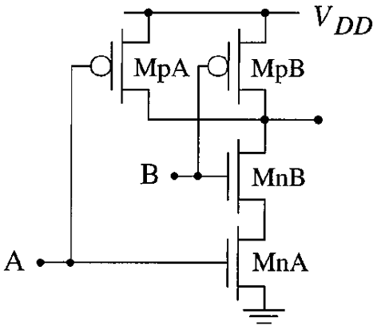
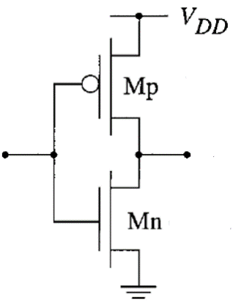

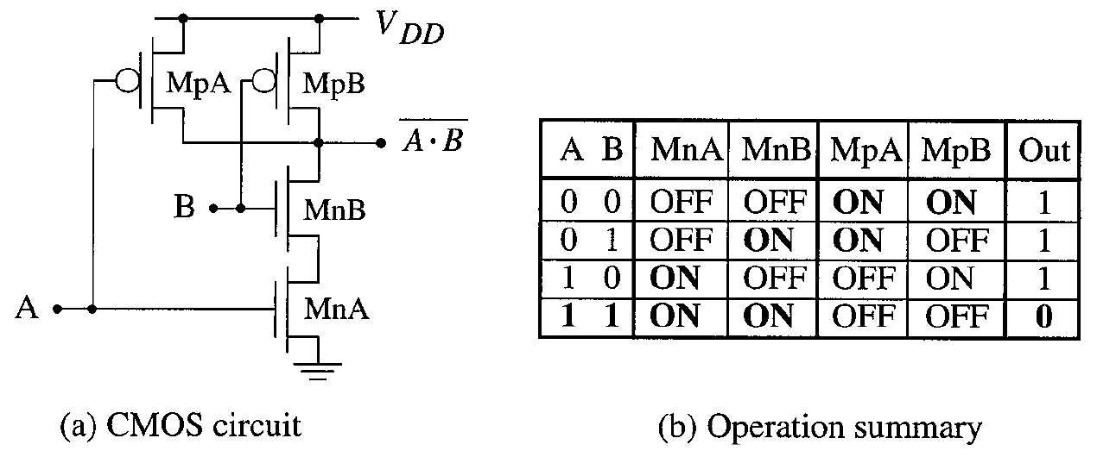
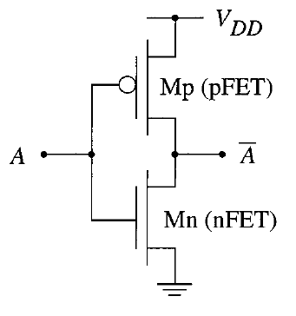
2-input AND Gate is More Expensive than 2-input NAND Gate
2-input AND gate
A
Out
Out
B
2-input NAND gate
Inverter

Slide 31
Two-level logic using NAND gates (cont’d)
OR gate with inverted inputs is a NAND gate
  de Morgan’s: A’ + B’ = (A • B)’
Two-level NAND-NAND network
  inverted inputs are not counted
  in a typical circuit, inversion is done once and signal distributed
Recall de Morgan’s Law. When inverters are passing through a gate, the gate should be changed from OR to AND and vice versa.

Slide 32
Agenda
Truth table to SoPs
QM method
Hazard-free circuit design
Implementation methods: MUX, PLA, …
Number system and 4-bit/16-bit adder

Slide 33
3.5 Time Response in Combinational Networks
1
1
Static
Static 1-Hazard
1-hazard
0
Without the notion of time, we can safely A+A’=1
Static 1-Hazard happens as A+A’ ≠ 1 momentarily.
I.e., A=A’=0 momentarily.
IMPORTANT: When do we have the term (A+A’) in an expression?
  Normally, it can occur in the S-O-P (AND-OR) implementation.
    F = (XXXXA) + (YYYYA’) = A+A’
1 1
Don’t use A+A’=1, when investigating the static 1-hazard. (For this purpose, A and A’ are independent variables.)
Two necessary conditions of glitch:
multiple paths and different path delay
Notes:
In the properly designed SOP, XX.. is not in the form of AA’… Thus, in SOP, no static 0-hazard…
In the properly designed POS, X+X.. is not in the form of A+A’… Thus, in POS, no static 1-hazard…

Slide 34
3.5 Time Response in Combinational Networks
1
Static 0-Hazard
0
0
Static
0-hazard
Without the notion of time, we can safely AA’=0
Static 0-Hazard happens as AA’ ≠ 0 momentarily.
I.e., A=A’=1 momentarily.
IMPORTANT: When do we have the term (AA’) in an expression?
  Normally, it can occur in the P-O-S (OR-AND) implementation.
    F = (X+X+X+A) (Y+Y+Y+A’) = AA’
0 0
Don’t use AA’=0, when investigating the static 0-hazard. (For this purpose, A and A’ are independent variables.)
Notes:
In the properly designed SOP, XX.. is not in the form of AA’… Thus, in SOP, no static 0-hazard…
In the properly designed POS, X+X.. is not in the form of A+A’… Thus, in POS, no static 1-hazard…

Slide 35
3.5 Time Response in Combinational Networks
Static 1-Hazard (AND-OR circuit)
Min. S-O-P : F = A’D + AC’
AB
CD
00
01
11
10
CASE 1 (↓)
Input change within product term
e.g., 1100 → 1101
  D: 0 → 1
00
0
0
1
1
01
1
1
1
1
11
1
1
0
0
10
0
0
0
0
A
1
1
1
1
A
\C
1
1
\C
1
1
0
F
0
F
\A
\A
D
0
0
D
1
0
ABCD = 1100
ABCD = 1101
Observation: F remains at ‘1’, and no glitch is generated.
It is because signal changes on a single path from input to output

Slide 36
3.5 Time Response in Combinational Networks
AB
Static 1-Hazard: F = A’D + AC’
CD
00
01
11
10
CASE 2 (←)
Input change that spans product terms,
e.g, 1101 → 0101
00
0
0
1
1
01
1
1
1
1
11
1
1
0
0
  A: 1 → 0
A and A’:
  Assume that A changes earlier than A’
10
0
0
0
0
A
1
1
A
0
0
A
0
0
\C
1
1
F
\C
1
0
F
\C
1
1
F
\A
0
\A
0
\A
1
D
1
0
D
1
0
D
1
1
ABCD = 1101
(A=1, A’=0)
ABCD = 0101
(A=0,A’=0)
ABCD = 0101
(A=0,A’=1)
Observation: A glitch is generated (static 1-hazard).
It satisfies two necessary conditions of glitch: multiple paths and different path delay
Notes:
A가 바뀌고 A’이 늦게 바뀜

Slide 37
3.5 Time Response in Combinational Networks
Glitch elimination methods
AB
A
CD
00
01
11
10
1. Path delay adjustment/matching can eliminate glitches.
2. However,
General Strategy: add redundant terms.
00
0
0
1
1
01
1
1
1
1
D
11
1
1
0
0
C
10
0
0
0
0
B
In order to eliminate the static 1-hazard,
  we need to implement F = A'D + AC' + C'D
  instead of F = A'D + AC'.
This one is not satisfied
due to C’D
Two necessary conditions of glitch: multiple paths and different path delay
+ early changing input needs to change the output
Notes:
Why hazard free by adding C’D?
C’=D=1때만 1-0-1 glitch 가능. 하지만 이때 last term makes F=1.
Two adjacent minterms must be covered by the same product.

Slide 38
Schedule (by Mid-term Exam)

Slide 39
General design procedure for combi. logic
1. Understand the problem
  what is the circuit supposed to do?
  write down inputs (data, control) and outputs
  draw block diagram or other picture
2. Formulate the problem using a suitable design representation
  truth table or waveform diagram are typical
  may require encoding of symbolic inputs and outputs
3. Choose implementation target
  ROM, PAL, PLA
  mux, decoder and OR-gate
  discrete gates (fixed logic)
4. Follow implementation procedure
  K-maps for two-level, multi-level
  design CAD tools and hardware description language (e.g., Verilog)
Typically, we have to separate the I/O variables and system internals to understand the problem. Step 2 is abstract representation while steps 3 and 4 are H/W implementation dependent

Slide 40
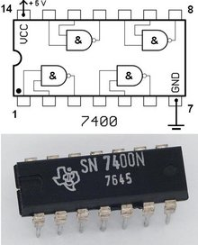
Combinational Logic Technologies
Standard gates (random logic)
  gate packages
  cell libraries
Regular logic
  multiplexers
  decoders
Two-level programmable logic
  PALs
  PLAs
  ROMs
The simplest way to implement logic circuits would be using standard gates. However, as more complicated and diverse logic systems are getting required, a wealth of implementation techniques are proposed. There are three major categories in logic implementation technologies.

Slide 41
Random logic
Transistors quickly integrated into logic gates (1960s)
Catalog of common gates (1970s)
  Texas Instruments Logic Data Book – the yellow bible
  all common packages listed and characterized (delays, power)
  typical packages:
    in 14-pin IC: 6-inverters, 4 NAND gates, 4 XOR gates
Today, very few parts are still in use
However, parts libraries exist for chip design
  designers reuse already characterized logic gates on chips
Again it is easy and simple to use standard gates such as NAND and AND, called random logic. Since a single gate is not good to sell and buy, a few or several gates are packed into a package. Right now, it is not widely used for economical reasons since there are a lot of IC packages in the catalog.

Slide 42
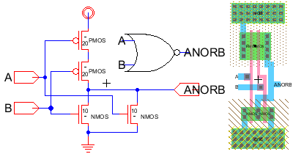
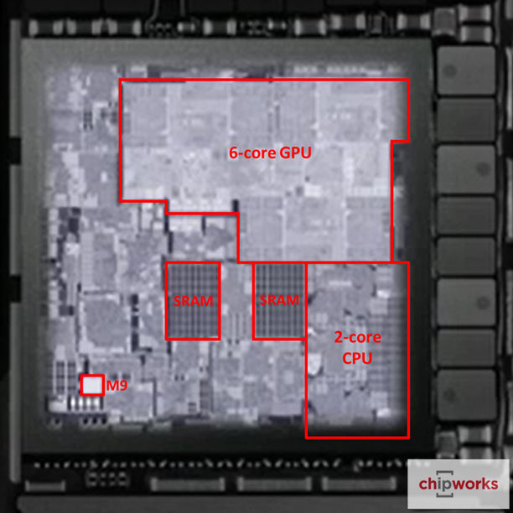
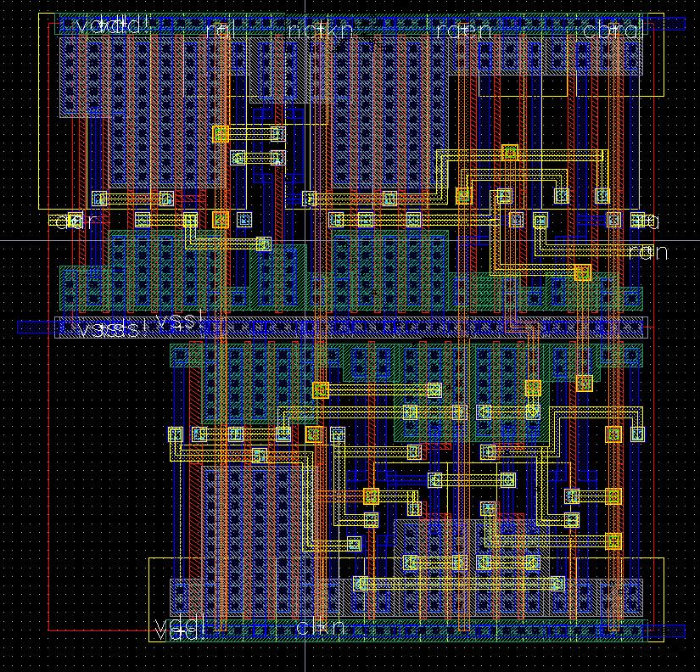
State-of-the-Art Logic Design down to Chip

Slide 43
Regular logic
Need to make design faster
Need to make engineering changes easier to make
MUX and DEMUX
Unlike random logic, regular logic refers to a flexible component that performs a specific high-level function compared to primitive logic gates. Design becomes easier with these regular logic components since each component performs a specific function. Sometimes we can flexibly exploit the regular logic components for other purposes than its original one.

Slide 44
Making connections
Direct point-to-point connections between gates
  wires we've seen so far
Route one of many inputs to a single output - multiplexer (MUX)
Route a single input to one of many outputs - demultiplexer (DEMUX)
control
control
multiplexer
demultiplexer
4x4 switch
Two popular regular logic components are MUX and DEMUX. A MUX selects one of its data inputs to the output by the control inputs; a MUX is also called a selector. The diagram on the left shows a 4-input MUX. Can you guess the relation between the number of data inputs and the number of control lines? A DEMUX performs the reverse function, often called a decoder. We can clearly see that these components perform higher-level functions compared to logic gates

Slide 45
Mux and demux
Switch implementation of multiplexers and demultiplexers
  can be composed to make arbitrary size switching networks
  used to implement multiple-source/multiple-destination interconnections
A
Y
A
Y
B
Z
B
Z
When we combine MUXs and DEMUXs, a switching network can be implemented. Note that control lines are skipped here.
In this slide, there are 2X2 switching networks. By using control variables (which are skipped), A and B can be routed to either Y or Z.

Slide 46
Mux and demux (cont'd)
Uses of multiplexers/demultiplexers in multi-point connections
A0
A1
B0
B1
Sa
MUX
MUX
Sb
multiple input sources
A
B
Sum
Ss
DEMUX
multiple output destinations
S0
S1
Let’s see how MUX and DEMUX can be used for a logic system design. Here is a 1-bit adder, a V-shape polygon. There are two sources for each input and two destinations for the resulting sum. So there are total three control variables.

Slide 47
Multiplexers (MUXs)/selectors
Multiplexers/selectors: general concept
  2^{n} data inputs, n control inputs (called "selects"), 1 output
  used to connect 2^{n} points to a single point
  control signal pattern forms binary index of input connected to output
I₁ I₀ A Z
0 0 0 0
0 0 1 0
0 1 0 1
0 1 1 0
1 0 0 0
1 0 1 1
1 1 0 1
1 1 1 1
A Z
0 I₀
1 I₁
Z = A' I₀ + A I₁
functional form
two alternative forms
for a 2:1 Mux truth table
logical form
Let’s look at how a MUX function can be described as a boolean expression or a truth table. We will start with the simplest one, 2:1 MUX. There are two inputs I0 and I1 and the control input is A. Then Z will select I0 or I1 depending on A’s value. If we tabulate all the cases of I0 and I1, the final truth table is the one on the right.

Slide 48
Multiplexers/selectors (cont'd)
2:1 mux: Z = A'I₀ + AI₁
4:1 mux: Z = A'B'I₀ + A'BI₁ + AB'I₂ + ABI₃
8:1 mux: Z = A'B'C'I₀ + A'B'CI₁ + A'BC'I₂ + A'BCI₃ +
AB'C'I₄ + AB'CI₅ + ABC'I₆ + ABCI₇
In general: Z = Σ (m_{k}I_{k})
  in minterm shorthand form for a 2^{n}:1 Mux
n
I0
I1
I2
I3
I4
I5
I6
I7
2 -1
k=0
8:1
mux
Z
I0
I1
I2
I3
4:1
mux
Z
I0
I1
2:1
mux
Z
A B C
A
A B
How can we express the output in a general form, regardless of the # of inputs? First of all, n is the # of control wires. So there are total 2**n inputs. Here m_k is the k-th minterm from the control variables.

Slide 49
Gate level implementation of muxes
2:1 mux
4:1 mux
At the top left, an AND-OR realization of a 2:1 MUX is shown. What are the 2 data inputs and what is the control input?

Slide 50
Cascading multiplexers
Large multiplexers can be made by cascading smaller ones
I0
I1
I2
I3
8:1
mux
alternative
implementation
4:1
mux
I0
I1
2:1
mux
8:1
mux
2:1
mux
Z
I4
I5
I6
I7
I2
I3
2:1
mux
4:1
mux
4:1
mux
Z
I4
I5
2:1
mux
B C
A
I6
I7
2:1
mux
control signals B and C simultaneously choose
one of I0, I1, I2, I3 and one of I4, I5, I6, I7
control signal A chooses which of the
upper or lower mux's output to gate to Z
C
A B
You can build a large scale MUX in two ways. One option is just to use a single conventional MUX for 2**n inputs and n control lines. Or you can combine small scale MUXs. This slide shows two cases of building an 8:1 MUX from small scale MUXs.

Slide 51
Multiplexers as general-purpose logic
A 2^{n}:1 multiplexer can implement any function of n variables
  with the variables used as control inputs and
  the data inputs tied to 0 or 1
  in essence, a lookup table
Example:
  F(A,B,C) = m0 + m2 + m6 + m7
  = A'B'C' + A'BC' + ABC' + ABC
1
0
1
0
0
0
1
1
0
1
2
3
4
5
6
7
Z
8:1 MUX
F
  = A'B'C'(1) + A'B'C(0)
  + A'BC'(1) + A'BC(0)
  + AB'C'(0) + AB'C(0)
  + ABC'(1) + ABC(1)
S2
S1
S0
A
B
C
F = A'B'C'I₀ + A'B'CI₁ + A'BC'I₂ + A'BCI₃ + AB'C'I₄ + AB'CI₅ + ABC'I₆ + ABCI₇
This slide is very important. Actually a MUX can do more than just selection. Suppose each input wire (one of 2**n inputs) is fixed to either 0 or 1. Depending on the control inputs (here A,B,C), the corresponding bit will be popped up to F. This is kind of a lookup table.
Now look at the system with a different viewpoint. Forget this is a MUX. Suppose A,B,C are the input variables of a logic function F. When will F be true?

Slide 52
Multiplexers as general-purpose logic (cont’d)
A 2^{n-1}:1 multiplexer can implement any function of n variables
  with n-1 variables used as control inputs and
  the data inputs tied to the last variable or its complement
Example:
  F(A,B,C) = m0 + m2 + m6 + m7
  = A'B'C' + A'BC' + ABC' + ABC
  = A'B' (C') + A'B (C') + AB' (0) + AB (1)
1
0
1
0
0
0
1
1
0
1
2
3
4
5
6
7
A B C F
0 0 0 1
0 0 1 0
0 1 0 1
0 1 1 0
1 0 0 0
1 0 1 0
1 1 0 1
1 1 1 1
C'
C'
0
1
C'
C'
0
1
0
1
2
3
8:1 MUX
F
F
4:1 MUX
S1
S0
S2
S1
S0
A
B
A
B
C
The reality is that a MUX can implement any function of n variables. Here is another example of implementing the same logic function in a simplified way. In this variation, one of the control variable is used as a data input of a 4:1 MUX. Now we have two control variables A and B. Meanwhile C becomes some of the data inputs. Overall, we have 4 cases instead 8 cases by considering F as a function of C

Slide 53
Multiplexers as general-purpose logic (cont’d)
I₀ I₁ . . . I_{n-2} I_{n-1} F
. . . . 0 0 0 1 1
. . . . 1 0 1 0 1
0 I_{n-1} I_{n-1}' 1
four possible
configurations
of truth table
rows can be
expressed as
a function of I_{n-1}
Generalization
Example:
G(A,B,C,D)
can be realized
by an 8:1 MUX
n-1 mux control
variables
  single mux data
  variable
A B C D G
0 0 0 0 1
0 0 0 1 1
0 0 1 0 0
0 0 1 1 1
0 1 0 0 0
0 1 0 1 0
0 1 1 0 1
0 1 1 1 1
1 0 0 0 1
1 0 0 1 0
1 0 1 0 0
1 0 1 1 1
1 1 0 0 1
1 1 0 1 0
1 1 1 0 1
1 1 1 1 0
1
D
0
1
D'
D
D’
D’
1
D
0
1
D’
D
D’
D’
0
1
2
3
4
5
6
7
8:1 MUX
choose A,B,C as
control variables
S2
S1
S0
A
B
C
Here is the generalized n-input logic function by a (n-1)-input MUX.
Depending on the output of two cases of the singled-out variable, a different data input is attached to each minterm of the (n-1) input MUX. Reducing the MUX size is economical.

Slide 54
Multiplexers as general-purpose logic (cont’d)
Practice:
Realize G(A,B,C,D) with an 8:1 MUX choosing A,B,C as control variables
A B C D G
0 0 0 0 1
0 0 0 1 0
0 0 1 0 0
0 0 1 1 0
0 1 0 0 1
0 1 0 1 0
0 1 1 0 0
0 1 1 1 0
1 0 0 0 0
1 0 0 1 1
1 0 1 0 1
1 0 1 1 1
1 1 0 0 1
1 1 0 1 1
1 1 1 0 0
1 1 1 1 1
0
1
2
3
4
5
6
7
8:1 MUX
S2
S1
S0
A
B
C

Slide 55
Demultiplexers (DEMUXs)/decoders
Decoders/demultiplexers: general concept
  single data input, n control inputs, 2^{n} outputs
  control inputs (called “selects” (S)) represent binary index of output to which the input is connected
  data input usually called “enable” (G)
1:2 Decoder:
O0 = G • S’
O1 = G • S
3:8 Decoder:
O0 = G • S2’ • S1’ • S0’
O1 = G • S2’ • S1’ • S0
O2 = G • S2’ • S1 • S0’
O3 = G • S2’ • S1 • S0
O4 = G • S2 • S1’ • S0’
O5 = G • S2 • S1’ • S0
O6 = G • S2 • S1 • S0’
O7 = G • S2 • S1 • S0
2:4 Decoder:
O0 = G • S1’ • S0’
O1 = G • S1’ • S0
O2 = G • S1 • S0’
O3 = G • S1 • S0
There is only one data input in DEMUXs, often denoted by G, which will be carried to one of the outputs. The control inputs are often denoted by S and the index of the control wires. Again, for n control inputs, we have 2**n outputs.

Slide 56
Gate level implementation of demultiplexers
1:2 decoders
2:4 decoders
active-high
enable
active-low
enable
G
O0
\G
O0
S
S
O1
O1
G
O0
\G
O0
active-high
enable
active-low
enable
O1
O1
O2
O2
O3
O3
S1
S0
S1
S0
This slide shows a few DEMUXs implemented by logic gates. We can add two bubbles for each input. The reason for inserting two bubbles is to implement the DEMUX by NOR gates

Slide 57
Demultiplexers as general-purpose logic
A n:2^{n} decoder can implement any function of n variables
  with the variables used as control inputs
  the enable input is tied to 1 and
  the appropriate minterms summed to form the function
0
1
2
3
4
5
6
7
A'B'C'
A'B'C
A'BC'
A'BC
AB'C'
AB'C
ABC'
ABC
demultiplexer generates appropriate
minterm based on control signals
(it "decodes" control signals)
“1”
3:8 DEC
S2
S1
S0
A
B
C
Like a MUX, a DEMUX can also perform a logic function of n variables. Here n variables are used for the control wires of the DEMUX. Depending on the values of control wires, a specific minterm will be asserted. Then what we need to do is ORing the relevant minterms for each output function F.

Slide 58
Demultiplexers as general-purpose logic (cont’d)
F1 = A'BC'D + A'B'CD + ABCD
F2 = ABC'D' + ABC
F3 = (A' + B' + C' + D')
0 A'B'C'D'
1 A'B'C'D
2 A'B'CD'
3 A'B'CD
4 A'BC'D'
5 A'BC'D
6 A'BCD'
7 A'BCD
8 AB'C'D'
9 AB'C'D
10 AB'CD'
11 AB'CD
12 ABC'D'
13 ABC'D
14 ABCD'
15 ABCD
F1
4:16
DEC
Enable
F2
DEMUX is a minterm generator!
F3
A
B
C
D
By using a single 4:16 DEMUX, we can implement three functions of 4 variables, with a few more gates.

Slide 59
Cascading decoders
5:32 decoder
  1 x 2:4 decoder
  4 x 3:8 decoders
0 A'B'C'D'E'
1
2
3
4
5
6
7
0
1
2 A'BC'DE'
3
4
5
6
7
3:8 DEC
3:8 DEC
S2
S1
S0
S2
S1
S0
0
1
2
3
F
2:4 DEC
S1
S0
0
1
2
3
4
5
6
7 ABCDE
0 AB'C'D'E'
1
2
3
4
5
6
7 AB'CDE
A
B
3:8 DEC
3:8 DEC
S2
S1
S0
S2
S1
S0
C
D
E
C
D
E
By combining small scale decoders or demuxes, we can build a larger-scale demux.
Here, we have 5 control lines (A,B,C,D,E) to route the enable line, F, to one of 32 output lines

Slide 60
Programmable logic arrays (PLAs)
Pre-fabricated building block of many AND/OR gates
  actually NOR or NAND
  "personalized" by making/breaking connections among the gates
  programmable array block diagram for sum of products form
• • •
inputs
Sum of
AND
array
OR
array
product
terms
products
outputs
• • •
A PLA is a general implementation of sum of products of a logic function. We first implement each product term (not necessarily minterm). Then the product terms will be Ored in the next stage. So we have two generic logic arrays. Programming means configuring connections in two arrays.

Slide 61
Enabling concept
Shared product terms among outputs
F0 = A + B' C'
F1 = A C' + A B
F2 = B' C' + A B
F3 = B' C + A
example:
input side:
personality matrix
1 = uncomplemented in term
0 = complemented in term
– = does not participate
product inputs outputs
term A B C F0 F1 F2 F3
AB 1 1 – 0 1 1 0
B'C – 0 1 0 0 0 1
AC' 1 – 0 0 1 0 0
B'C' – 0 0 1 0 1 0
A 1 – – 1 0 0 1
output side:
1 = term connected to output
0 = no connection to output
reuse of terms
Let’s take some logic functions for example to illustrate how we can use an PLA for logic implementation. There are 4 functions of three input variables. To use an PLA systematically, it is good to write a personality matrix. The middle section indicates how input variables are combined in the AND array and the right section shows how those product terms are combined in the OR array.

Slide 62
Before programming
All possible connections are available before "programming"
  in reality, all AND and OR gates are NANDs
A
B
C
AB
We have to look at two cross-connects: one is between inputs and AND gates and the other is between AND gates and OR gates. We can make or break connections in those two cross-connects.

Slide 63
After programming
Unwanted connections are "blown"
  fuse (normally connected, break unwanted ones)
  anti-fuse (normally disconnected, make wanted connections)
A
B
C
AB
B'C
AC'
B'C'
A
F0
F1
F2
F3
Then we have to do programming, which is the process of enabling or disabling each cross-point. If fuses are used for each cross point, we break unwanted ones. If anti-fuses are used, we enable the wanted ones.

Slide 64
Alternate representation for high fan-in structures
Short-hand notation so we don't have to draw all the wires
  x signifies a connection is present and perpendicular signal is an input to gate
notation for implementing
F0 = A B + A' B'
F1 = C D' + C' D
A
B
C
D
AB
A'B'
CD'
C'D
AB+A'B'
CD'+C'D
For simplicity, let’s assume fuses for each crosspoint, denoted by x. Before programming, the PLA will look like the one on the left. After programming for the required functions, the PLA will become the one on the right. All the unwanted crosspoints are broken.

Slide 65
PLA example
Multiple functions of A, B, C
  F1 = A B C
  F2 = A + B + C
  F3 = A' B' C'
  F4 = A' + B' + C'
  F5 = A xor B xor C
  F6 = A xnor B xnor C
full decoder as for memory address
bits stored in memory
A
B
C
A'B'C'
A'B'C
A'BC'
A'BC
AB'C'
AB'C
ABC'
ABC
A B C F1 F2 F3 F4 F5 F6
0 0 0 0 0 1 1 0 0
0 0 1 0 1 0 1 1 1
0 1 0 0 1 0 1 1 1
0 1 1 0 1 0 1 0 0
1 0 0 0 1 0 1 1 1
1 0 1 0 1 0 1 0 0
1 1 0 0 1 0 1 0 0
1 1 1 1 1 0 0 1 1
F1
F2
F3
F4
F5
F6
Here are the six functions of three variables.
As there are three variables, total 8 minterms exist. Then all the relevant minterms of each function will be connected to its OR gate.

Slide 66
PALs and PLAs
Programmable logic array (PLA)
  unconstrained fully-general AND and OR arrays
Programmable array logic (PAL)
  constrained topology of the OR array
  faster and smaller OR plane
a given column of the OR array
has access to only a subset of
the possible product terms
A little bit less programmable but faster version is PAL. In PALs, the cross-connects between AND gates and OR gates are already fixed; the transistor logic is much simpler. What we can control is the cross-connects between inputs and AND gates, denoted by x. So, there is less flexibility in PALs compared to PLAs.

Slide 67
PALs and PLAs: design example
BCD to Gray code converter
A
A
A B C D W X Y Z
0 0 0 0 0 0 0 0
0 0 0 1 0 0 0 1
0 0 1 0 0 0 1 1
0 0 1 1 0 0 1 0
0 1 0 0 0 1 1 0
0 1 0 1 1 1 1 0
0 1 1 0 1 0 1 0
0 1 1 1 1 0 1 1
1 0 0 0 1 0 0 1
1 0 0 1 1 0 0 0
1 0 1 – – – – –
1 1 – – – – – –
0 0 X 1
0 1 X 1
0 1 X X
0 1 X X
0 1 X 0
0 1 X 0
0 0 X X
0 0 X X
D
D
C
C
B
B
K-map for W
K-map for X
A
A
0 1 X 0
0 1 X 0
1 1 X X
1 1 X X
0 0 X 1
1 0 X 0
0 1 X X
1 0 X X
D
D
C
C
B
B
K-map for Y
K-map for Z
Suppose we have to design a BCD to GRAY code converter. And simplified functions are shown in the above. Unfortunately, there are no common product terms among outputs.

Slide 68
PALs and PLAs: design example
BCD to Gray code converter
A B C D W X Y Z
0 0 0 0 0 0 0 0
0 0 0 1 0 0 0 1
0 0 1 0 0 0 1 1
0 0 1 1 0 0 1 0
0 1 0 0 0 1 1 0
0 1 0 1 1 1 1 0
0 1 1 0 1 0 1 0
0 1 1 1 1 0 1 1
1 0 0 0 1 0 0 1
1 0 0 1 1 0 0 0
1 0 1 – – – – –
1 1 – – – – – –
minimized functions:
W = A + BD + BC
X = BC'
Y = B + C
Z = A'B'C'D + BCD + AD' + B'CD'
Suppose we have to design a BCD to GRAY code converter. And simplified functions are shown in the above. Unfortunately, there are no common product terms among outputs.

Slide 69
PALs and PLAs: design example (cont’d)
Code converter: programmed PLA
A B C D
minimized functions:
W = A + BD + BC
X = B C'
Y = B + C
Z = A'B'C'D + BCD + AD' + B'CD'
A
BD
BC
BC'
B
C
A'B'C'D
BCD
AD'
BCD'
not a particularly good
candidate for PLA
implementation since no terms
are shared among outputs
however, much more compact
and regular implementation
when compared with discrete
AND and OR gates
W X Y Z
Here, 4 functions are implemented by a single PLA. Total 10 product terms are needed to be represented. In this case, there is no common product term that can be shared by multiple outputs, which means PLA is not an attractive option.

Slide 70
PALs and PLAs: Practice
Magnitude comparator (AB vs. CD)
A B C D EQ NE LT GT
0 0 0 0
0 0 0 1
0 0 1 0
0 0 1 1
0 1 0 0
0 1 0 1
0 1 1 0
0 1 1 1
1 0 0 0
1 0 0 1
1 0 1 0
1 0 1 1
1 1 0 0
1 1 0 1
1 1 1 0
1 1 1 1
K-map for EQ
K-map for NE
K-map for LT
K-map for GT

Slide 71
PALs and PLAs: Practice
Magnitude comparator
A B C D
Minimized functions
A'B'C'D'
A'BC'D
ABCD
AB'CD'
AC'
A'C
B'D
BD'
A'B'D
B'CD
ABC
BC'D'
EQ NE LT GT

Slide 72
PALs and PLAs: (cont’d)
A B C D
A
BD
BC
0
BC'
0
0
0
B
C
0
0
A'B'C'D
BCD
AD'
B'CD'
Code converter: programmed PAL
Could be a limiting factor
4 product terms
per each OR gate
Let’s consider a PAL where exactly 4 AND gates
are ORed for each function. Note that the maximum # of product terms of outputs is 4
W X Y Z
As there are 4 functions, total 16 AND gates are required. For some functions, they don’t need up to 4 product terms. Then, a FALSE term is connected to surplus AND gates. To make a false term, just leave all the fuses intact.

Slide 73
Activity
Map the following functions to the PLA below:
  W = AB + A’C’ + BC’
  X = ABC + AB’ + A’B
  Y = ABC’ + BC + B’C’
A
B
C
W
X
Y

Slide 74
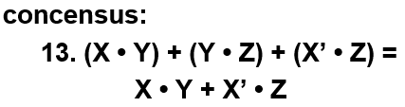
Activity (cont’d)
9 terms won’t fit in a 7 term PLA
  can apply concensus theorem
  to W to simplify to:
  W = AB + A’C’ + BC’ = AB + A’C’
8 terms wont’ fit in a 7 term PLA
  observe that AB = ABC + ABC’
  can rewrite W to reuse terms:
  W = ABC + ABC’ + A’C’
Now it fits
  W = ABC + ABC’ + A’C’
  X = ABC + AB’ + A’B
  Y = ABC’ + BC + B’C’
This is called technology mapping
  manipulating logic functions
  so that they can use available
  resources
A
B
C
ABC
ABC’
A’C’
AB’
A’B
BC
B’C’
W
X
Y

Slide 75
Read-only memories (ROMs)
Two dimensional array of 1s and 0s
  entry (row) is called a "word"
  width of row = word-size
  index is called an "address"
  address is input
  selected word is output
word lines (only one
is active – decoder is
just right for this)
1
1
1
1
n
2 -1
i
word[i] = 0011
word[j] = 1010
decoder
j
internal organization
0
0 n-1
  Address
bit lines (normally pulled to 1 through
resistor – selectively connected to 0
by word line controlled switches)
Let’s look at the simplified structure of a ROM. A ROM is just like a look-up table whose structure is similar to that of a DEMUX. Actually, all the minterms are present in ROMs. Instead of the enable wire, the bits for outputs are programmed. When an address is coming in, its stored data (bits) should be brought up. An address to retrieve each stored word is equal to a minterm in the decoder.

Slide 76
ROMs and combinational logic
Combinational logic implementation (two-level canonical form) using a ROM
F0 = A' B' C + A B' C' + A B' C
F1 = A' B' C + A' B C' + A B C
F2 = A' B' C' + A' B' C + A B' C'
F3 = A' B C + A B' C' + A B C'
A B C F0 F1 F2 F3
0 0 0 0 0 1 0
0 0 1 1 1 1 0
0 1 0 0 1 0 0
0 1 1 0 0 0 1
1 0 0 1 0 1 1
1 0 1 1 0 0 0
1 1 0 0 0 0 1
1 1 1 0 1 0 0
ROM
8 words x 4 bits/word
A B C F0 F1 F2 F3
address
outputs
truth table
block diagram
So, a number of functions can be implemented together by using a single ROM. Here, total 32 bits are stored and 4 bits constitute a word. Actually, we don’t need those boolean expressions. We just need to fill in the ROM by the truth table and that’s it.

Slide 77
ROM structure
Similar to a PLA structure but with a fully decoded AND array
  completely flexible OR array (unlike PAL)
n address lines
• • •
inputs
memory
array
(2^{n} words
by m bits)
decoder
2^{n} word
lines
outputs
• • •
m data lines
A ROM is similar to a PLA, but for n inputs, there are always 2**n AND gates. Depending on the output values, what we need to do is to control transistors of crosspoints (or bits)

Slide 78
Combinational logic technology summary
Random (fixed) logic
  Single gates or in groups
  conversion to NAND-NAND and NOR-NOR networks
  transition from simple gates to more complex gate building blocks
  reduced gate count, fan-ins, potentially faster
  more levels, harder to design
Time response in combinational networks
  gate delays and timing waveforms
  hazards/glitches (what they are and why they happen)
Regular logic
  multiplexers/decoders
  ROMs
  PLAs/PALs
  advantages/disadvantages of each
In chapter 4, we looked at a few programmable structures that facilitate the implementations of two-level logic functions. Each structure has its own pros and cons.

