Slide 1
Chapter 5
Case studies in combinational logic design
Now we have gone through every part of combinational logic system design.
In this chapter, the final chapter of combination logic, we will look at some examples and elaborate on the whole design process.

Slide 2
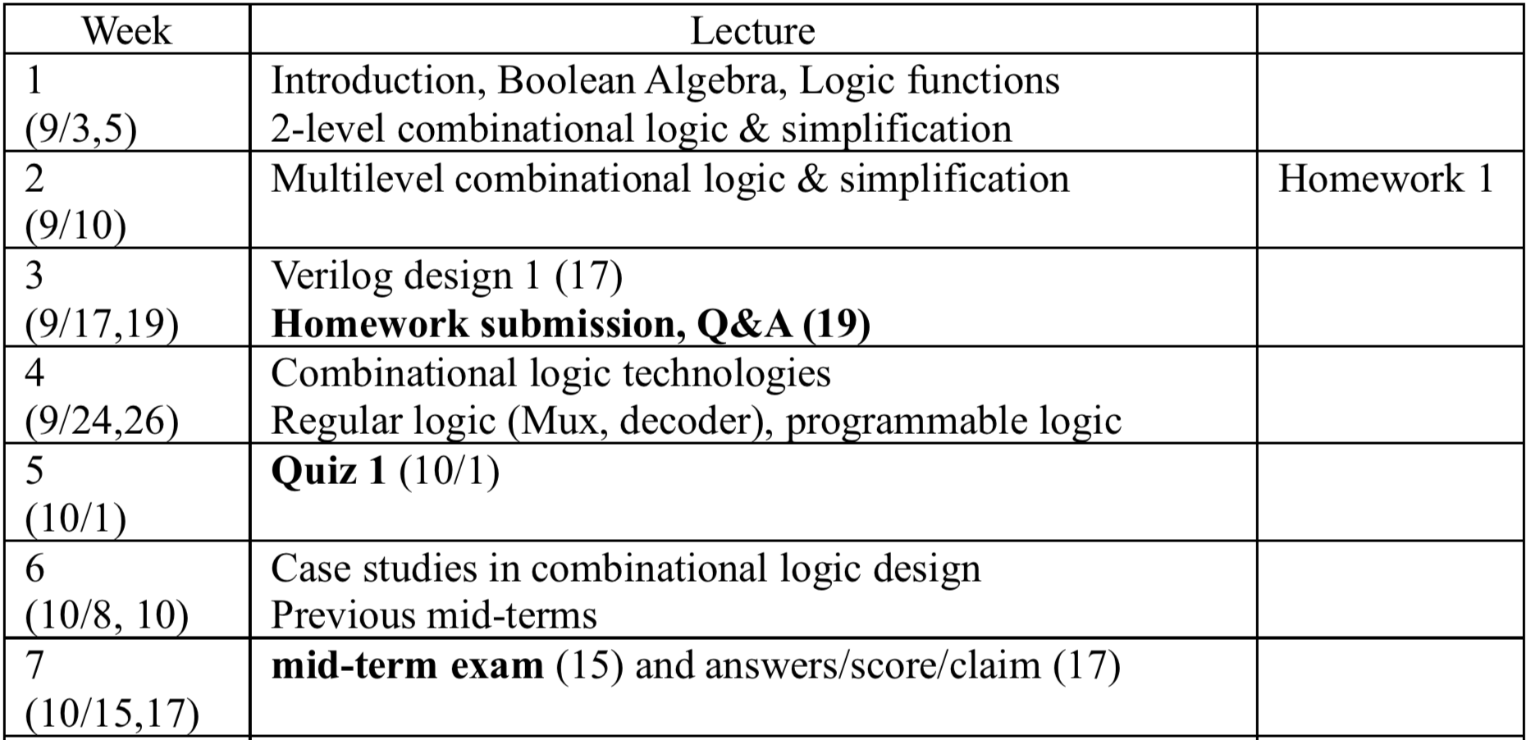
Schedule (by Mid-term Exam)

Slide 3
Combinational logic design case studies
General design procedure
Case studies
  BCD to 7-segment display controller
  logical function unit
  process line controller
  calendar subsystem
Arithmetic circuits
  integer representations
  addition/subtraction
  arithmetic/logic units
I will talk about the steps of a general procedure to design a combinational logic system first and then take some examples.

Slide 4
General design procedure for combi. logic
1. Understand the problem
  what is the circuit supposed to do?
  write down inputs (data, control) and outputs
  draw block diagram or other picture
2. Formulate the problem using a suitable design representation
  truth table or waveform diagram are typical
  may require encoding of symbolic inputs and outputs
3. Choose implementation target
  ROM, PAL, PLA
  mux, decoder and OR-gate
  discrete gates (fixed logic)
4. Follow implementation procedure
  K-maps for two-level, multi-level
  design CAD tools and hardware description language (e.g., Verilog)
Typically, we have to separate the I/O variables and system internals to understand the problem. Step 2 is abstract representation while steps 3 and 4 are H/W implementation dependent

Slide 5
Tip: CAD tool’s typical functionalities
Design entry
  Truth table, schematic capture, HDL
Synthesis and optimization
Simulation
Physical design
First of all, a user of a CAD tool should be able to specify the requirements of a logic circuit to be designed. The requirements can be expressed by a truth table or a graphical drawing, or a language.
Synthesis usually refers to the process of translating designer’s requirements into a circuit graph.
Physical design transforms the circuit graph into a layout (or blueprint) for fabrication

Slide 6
BCD to 7-segment display controller
c5
c0
c1
c6
Understanding the problem
  input is a 4 bit bcd digit (A, B, C, D)
  output is the control signals
  for the display (7 outputs C0 – C6)
Block diagram
c4
c2
c3
c0 c1 c2 c3 c4 c5 c6
BCD to 7–segment
control signal
decoder
A B C D
The first case is to control or display one digit system whose input follows BCD coding.
A digit can be represented by a combination of 7 segments. Depending on input variables, we have to turn on relevant pieces or segments.

Slide 7
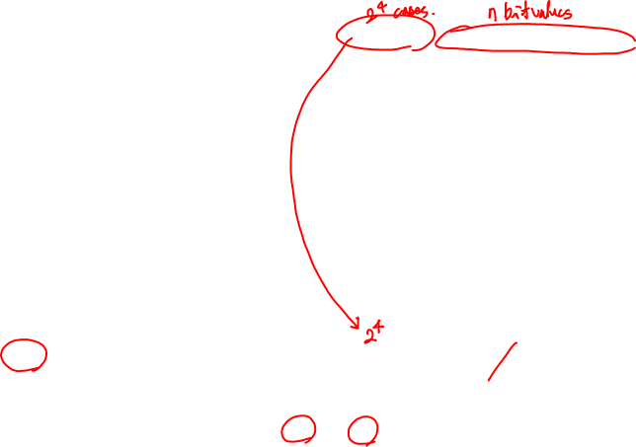

Formalize the problem
A B C D C0 C1 C2 C3 C4 C5 C6
0 0 0 0 1 1 1 1 1 1 0
0 0 0 1 0 1 1 0 0 0 0
0 0 1 0 1 1 0 1 1 0 1
0 0 1 1 1 1 1 1 0 0 1
0 1 0 0 0 1 1 0 0 1 1
0 1 0 1 1 0 1 1 0 1 1
0 1 1 0 1 0 1 1 1 1 1
0 1 1 1 1 1 1 0 0 0 0
1 0 0 0 1 1 1 1 1 1 1
1 0 0 1 1 1 1 0 0 1 1
1 0 1 – – – – – – – –
1 1 – – – – – – – – –
Truth table
  show don't cares
Choose implementation target
  if ROM, we are done
  don't cares imply PAL/PLA
  may be attractive
Follow implementation procedure
  minimization using K-maps or QM
How many input variables? And output variables?
If we use ROM for the implementation technology, then the game is over. What we need to do is just to store 7 bit values for each minterm, total 2**4 cases. Even though we need to use only 10 minterms, we have to use 2**4 AND gates, whose size is much bigger than other technologies. So we choose PAL or PLA, where minimum # of product terms are desirable. As there are DC terms, we may be able to reduce the size of the system by minimization in two-level logic design.

Slide 8
Implementation as minimized sum-of-products
15 unique product terms when minimized individually
C0
C1
C2
C3
C4
A
A
A
A
A
1 0 X 1
0 1 X 1
1 1 X X
1 1 X X
1 1 X 1
1 0 X 1
1 1 X X
1 0 X X
1 1 X 1
1 1 X 1
1 1 X X
0 1 X X
1 0 X 1
0 1 X 0
1 0 X X
1 1 X X
1 0 X 1
0 0 X 0
0 0 X X
1 1 X X
D
D
D
D
D
C
C
C
C
C
C5
B
B
B
B
B
A
C6
A
1 1 X 1
0 1 X 1
0 0 X X
0 1 X X
0 1 X 1
0 1 X 1
1 0 X X
1 1 X X
C0 = A + B D + C + B' D'
C1 = C' D' + C D + B'
C2 = B + C' + D
C3 = B' D' + C D' + B C' D + B' C
C4 = B' D' + C D'
C5 = A + C' D' + B D' + B C'
C6 = A + C D' + B C' + B' C
D
D
C
C
B
B
Here are the final two-level s-o-p forms for 7 output functions. After removing duplicate product terms, we have 15 different product terms to represent 7 outputs. We should note that the minimized form of each output may not lead to the globally minimum number of product terms. In this case, we have 15 product terms for 7 outputs
8

Slide 9
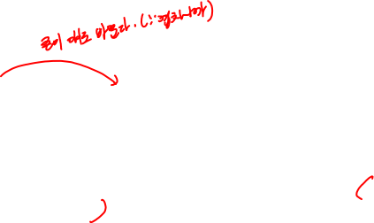
Implementation as minimized S-o-P (cont'd)
Can do better
  9 unique product terms (instead of 15)
  share terms among outputs
  each output not necessarily in minimized form
A
A
C2
1 1 X 1
1 1 X 1
1 1 X X
0 1 X X
C2
1 1 X 1
1 1 X 1
1 1 X X
0 1 X X
D
D
C
C
B
B
C0 = A + B D + C + B' D'
C1 = C' D' + C D + B'
C2 = B + C' + D
C3 = B' D' + C D' + B C' D + B' C
C4 = B' D' + C D'
C5 = A + C' D' + B D' + B C'
C6 = A + C D' + B C' + B' C
C0 = B C' D + C D + B' D' + B C D' + A
C1 = B' D + C' D' + C D + B' D'
C2 = B' D + B C' D + C' D' + C D + B C D'
C3 = B C' D + B' D + B' D' + B C D'
C4 = B' D' + B C D'
C5 = B C' D + C' D' + A + B C D'
C6 = B' C + B C' + B C D' + A
Let’s look at C2 output variable. If we relax the minimization process of C2, we have more terms for C2 output. However, this less efficient minimization achieves sharing more product terms in the overall system (7 outputs). Note that the number of product terms of each output increases. Can we figure out this globally optimal minimization?

Slide 10
PLA implementation
A B C D
BC'
B'C
B'D
BC'D
C'D'
CD
B'D'
A
BCD'
C0 C1 C2 C3 C4 C5 C6 C7
Since there are up to 5 product terms for outputs, PAL (with 4 product terms per output) may not be attractive. There are many common terms; so PLA is a good choice.

Slide 11
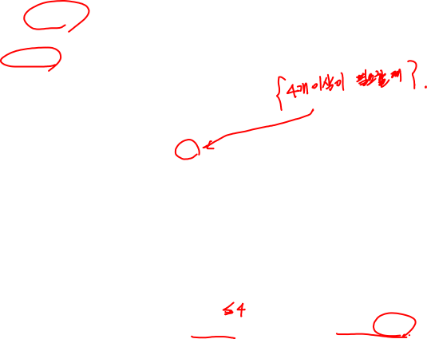
PAL implem. vs. Discrete gate implementation
Limit of 4 product terms per output
  decomposition of functions with larger number of terms
  do not share terms in PAL anyway
  (although there are some shared terms)
Decompose into multi-level logic (hopefully with CAD support)
  find common sub-expressions among functions
C2 = B + C' + D
C2 = B' D + B C' D + C' D' + C D + B C D'
C2 = B' D + B C' D + C' D' + W
W = C D + B C D'
need another input and another output
C0 = C3 + A' B X' + A D Y
C1 = Y + A' C5' + C' D' C6
C2 = C5 + A' B' D + A' C D
C3 = C4 + B D C5 + A' B' X'
C4 = D' Y + A' C D'
C5 = C' C4 + A Y + A' B X
C6 = A C4 + C C5 + C4' C5 + A' B' C
X = C' + D'
Y = B' C'
Let’s consider PAL implementation where up to 4 product terms can be ORed. Unfortunately, there are outputs that have 5 product terms. In that case, we have to resort to multi-level logic. You don’t need to do that; the CAD tool will do the job.

Slide 12
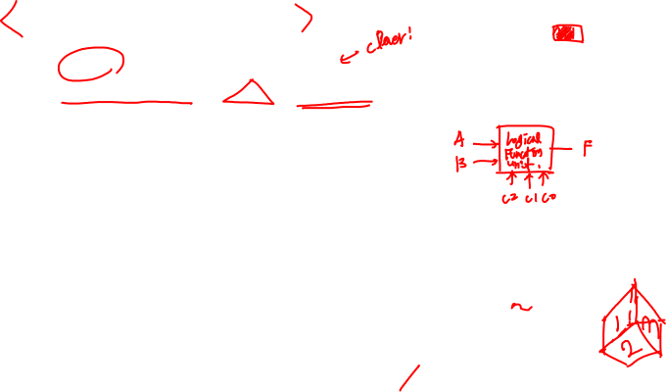
Logical function unit
Multi-purpose function block
  3 control inputs to specify operation to perform on operands
  2 data inputs for operands
  1 output of the same bit-width as operands
C0 C1 C2 Function Comments
0 0 0 1 always 1
0 0 1 A + B logical OR
0 1 0 (A • B)' logical NAND
0 1 1 A xor B logical xor
1 0 0 A xnor B logical xnor
1 0 1 A • B logical AND
1 1 0 (A + B)' logical NOR
1 1 1 0 always 0
3 control inputs: C0, C1, C2
2 data inputs: A, B
1 output: F
The next example is the very versatile functional block, which performs various functions. There are three control variables whose values determine the output of the function of two data input variables.

Slide 13

Formalize the problem
C0 C1 C2 A B F
0 0 0 0 0 1
0 0 0 0 1 1
0 0 0 1 0 1
0 0 0 1 1 1
0 0 1 0 0 0
0 0 1 0 1 1
0 0 1 1 0 1
0 0 1 1 1 1
0 1 0 0 0 1
0 1 0 0 1 1
0 1 0 1 0 1
0 1 0 1 1 0
0 1 1 0 0 0
0 1 1 0 1 1
0 1 1 1 0 1
0 1 1 1 1 0
1 0 0 0 0 1
1 0 0 0 1 0
1 0 0 1 0 0
1 0 0 1 1 1
1 0 1 0 0 0
1 0 1 0 1 0
1 0 1 1 0 0
1 0 1 1 1 1
1 1 0 0 0 1
1 1 0 0 1 0
1 1 0 1 0 0
1 1 0 1 1 0
1 1 1 0 0 0
1 1 1 0 1 0
1 1 1 1 0 0
1 1 1 1 1 0
choose implementation technology
5-variable K-map to discrete gates
multiplexer implementation
1
0
0
1
2
3
4
5
6
7
A
B
F
A
B
8:1 MUX
A
B
S2
S1
S0
C0
C1
C2
In order to realize the multi-purpose function, we combine discrete gates and an 8:1 MUX.

Slide 14
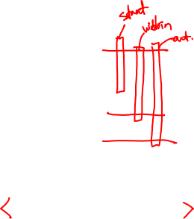
Production line control
Rods of varying length (+/-10%) travel on conveyor belt
  mechanical arm pushes rods within spec (+/-5%) to one side
  second arm pushes rods too long to other side
  rods that are too short stay on belt
  3 light barriers (light source + photocell) as sensors
  design combinational logic to activate the arms
Understanding the problem
  inputs are three sensors
  outputs are two arm control signals
  assume sensor reads "1" when tripped
    "0" otherwise (if nothing to detect)
  call sensors A, B, C
The next case study to look at is a product line control (PLC) system that manufactures a rod. What we need to do is to check whether each rod’s length is within a certain bound (± 5% of the spec). In order to examine the length of each rod, we use three sensors to measure the rod. If the rod is within spec, the rod will be pushed to one side. If the rod is too long, it will be pushed to the other side. Otherwise, it will stay on the belt.

Slide 15
Sketch of problem
Position of sensors
  A to B distance = specification – 5%
  A to C distance = specification + 5%
A
spec
- 5%
Too
Long
Within
Spec
Too
Short
spec
+ 5%
B
C
What if we don’t have sensor A? We cannot know the reference point or time at which we can measure the length of each rod. So when sensor A becomes 1, we should check sensors B and C as well to measure the length of the moving rod.

Slide 16

Formalize the problem
Truth table
  show don't cares
A B C Function
0 0 0 do nothing
0 0 1 do nothing
0 1 0 do nothing
0 1 1 do nothing
1 0 0 too short
1 0 1 don't care
1 1 0 in spec
1 1 1 too long
logic implementation now straightforward
just use three 3-input AND gates
"too short" = AB'C'
(only first sensor tripped)
"in spec" = A B C'
(first two sensors tripped)
"too long" = A B C
(all three sensors tripped)
If A is zero, that means there is no rod to inspect. So all the outputs are 0.
Otherwise, there is a rod. Then we have to check sensors B and C. Note that 101 is a DC term. 110 means that the rod is of standard length. The textbook says the top 4 minterms (000 – 011) are also DC terms, but that may cause energy waste.

Slide 17

Steps 3 and 4
Choose implementation technology
  The actual logic is so simple; use fixed logic gates
Follow implementation procedure
  One minterm for each output
So the truth table is done. As the overall logic is so simple. Maybe the random logic approach is the best. There are three outputs, each of which has only one minterm

Slide 18

Calendar subsystem
Determine number of days in a month (to control watch display)
  used in controlling the display of a wrist-watch LCD screen
  inputs: month, leap year flag
  outputs: number of days
Use software implementation
to help understand the problem
integer number_of_days ( month, leap_year_flag) {
  switch (month) {
    case 1: return (31);
    case 2: if (leap_year_flag == 1)
    then return (29)
    else return (28);
    case 3: return (31);
    case 4: return (30);
    case 5: return (31);
    case 6: return (30);
    case 7: return (31);
    case 8: return (31);
    case 9: return (30);
    case 10: return (31);
    case 11: return (30);
    case 12: return (31);
    default: return (0);
  }
}
For the next example, we revisit the number of days per month problem. But this time, we will follow the general procedure to design the system. Then we will look at the details of the leap year flag.

Slide 19
Formalize the problem
Encoding:
  binary number for month: 4 bits
  4 wires for 28, 29, 30, and 31
  one-hot – only one true at any time
Block diagram:
month leap 28 29 30 31
0000 – – – – –
0001 – 0 0 0 1
0010 0 1 0 0 0
0010 1 0 1 0 0
0011 – 0 0 0 1
0100 – 0 0 1 0
0101 – 0 0 0 1
0110 – 0 0 1 0
0111 – 0 0 0 1
1000 – 0 0 0 1
1001 – 0 0 1 0
1010 – 0 0 0 1
1011 – 0 0 1 0
1100 – 0 0 0 1
1101 – – – – –
111– – – – – –
month
leap
28
29
30
31
Again 4 wires for the input of month and one wire for leap year and 4 wires for the output (note that only two wires are needed for output at minimum)

Slide 20
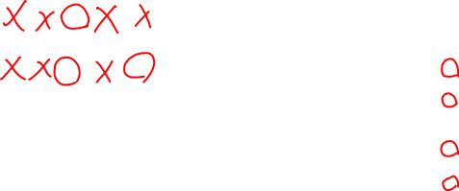
Choose implem. target and perform mapping
month leap 28 29 30 31
0000 – – – – –
0001 – 0 0 0 1
0010 0 1 0 0 0
0010 1 0 1 0 0
0011 – 0 0 0 1
0100 – 0 0 1 0
0101 – 0 0 0 1
0110 – 0 0 1 0
0111 – 0 0 0 1
1000 – 0 0 0 1
1001 – 0 0 1 0
1010 – 0 0 0 1
1011 – 0 0 1 0
1100 – 0 0 0 1
1101 – – – – –
111– – – – – –
Discrete gates
  28 =
  29 =
  30 =
  31 =
Can translate to S-o-P or P-o-S
m8’ m4’ m2 m1’ leap’
m8’ m4’ m2 m1’ leap
m8’ m4 m1’ + m8 m1
m8’ m1 + m8 m1’
If we are to use discrete logic gates such as AND or OR, SoP or PoS will be enough.
Just investigate all the elements of the On-set, and make product terms and then combine them by OR gates in SoP case. From now on we will look at the leap year flag. How can we know that a year is a leap year or not?

Slide 21

Leap year flag
Determine value of leap year flag given the year
  For years after 1582 (Gregorian calendar reformation),
  leap years are all the years divisible by 4,
  except that years divisible by 100 are not leap years,
  but years divisible by 400 are leap years.
Encoding the year:
  binary – easy for divisible by 4, 2006:1111101010
  but difficult for 100 and 400 (not powers of 2)
  BCD – easy for 100, 2006: 0010 0000 0000 0110
  but more difficult for 4, what about 400?
Parts:
  construct a circuit that determines if the year is divisible by 4
  construct a circuit that determines if the year is divisible by 100
  construct a circuit that determines if the year is divisible by 400
  combine the results of the previous three steps to yield the leap year flag
Pope Gregory I set up the current leap year system in 1582. There are only three simple rules that decide the number of days in Feb. Note that an encoding scheme can affect the system design fundamentally.

Slide 22
Activity: divisible-by-4 circuit
BCD coded year
  YM8 YM4 YM2 YM1 – YH8 YH4 YH2 YH1 – YT8 YT4 YT2 YT1 – YO8 YO4 YO2 YO1
Only need to look at low-order two digits of the year
all years ending in 00, 04, 08, 12, 16, 20, etc. are divisible by 4
  if tens digit is even, then divisible by 4 if ones digit is 0, 4, or 8
  if tens digit is odd, then divisible by 4 if the ones digit is 2 or 6.
Translates into the following Boolean expression
(where YT1 is the year's tens digit low-order bit,
YO8 is the high-order bit of year's ones digit, etc.):
YT1’ (YO8’ YO4’ YO2’ YO1’ + YO8’ YO4 YO2’ YO1’ + YO8 YO4’ YO2’ YO1’ )
+ YT1 (YO8’ YO4’ YO2 YO1’ + YO8’ YO4 YO2 YO1’ )
Digits with values of 10 to 15 will never occur, simplify further to yield:
D4 = YT1’ YO2’ YO1’ + YT1 YO2 YO1’
YM stands for year millennium and the each digit of the year will be represented as the binary value by BCD encoding. So we need 4 wires for each digit of the year, total 16 wires. D4 is the flag that indicates whether the year of input is divisible by 4

Slide 23
Divisible-by-100 and divisible-by-400 circuits
Divisible-by-100 just requires checking that all bits of two low-order digits are all 0:
D100 = YT8’ YT4’ YT2’ YT1’ • YO8’ YO4’ YO2’ YO1’
Divisible-by-400 combines the divisible-by-4 (applied to the thousands and hundreds digits) and divisible-by-100 circuits
D400 = (YM1’ YH2’ YH1’ + YM1 YH2 YH1’)
• (YT8’ YT4’ YT2’ YT1’ • YO8’ YO4’ YO2’ YO1’ )
With BCD encoding, it is easy to check whether the year of input is divisible by 100 and 400. A year is divided by 100 without remainder if the lowest two digits are 00
A year is divided by 400 without residue if the lowest two digits are 00 and the highest two digits are divided by 4.

Slide 24
Combining to determine leap year flag
Label results of previous three circuits: D4, D100, and D400
leap_year_flag = D4 • D100’ + D4 • D400
= D4 • D100’ + D400
Now we have three (internal) variables, each of which indicates whether the year is divisible by 4, 100, 400, respectively. The final leap year flag should be true when D4 is true. But if D100 is true than the flag is false. Note that the flag is also true when D4 and D400 is true

Slide 25
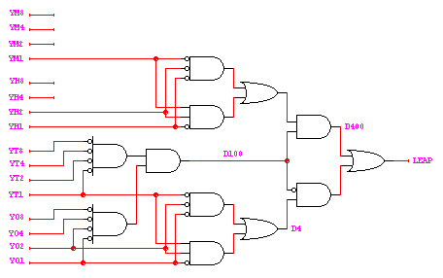
Implementation of leap year flag

Slide 26
Arithmetic circuits
Excellent examples of combinational logic design
Time vs. space trade-offs
  doing things fast may require more logic and thus more space
  example: carry lookahead logic
Arithmetic and logic units
  general-purpose building blocks
  critical components of processor datapaths
  used within most computer instructions
Now we are going to see a little bit different logic system, whose purpose is to perform a mathematical function. We will look at adders mostly.
In most of engineering systems, there is always a trade-off. We cannot have all the best features in a single system. As mentioned earlier, if we use a number of gates in parallel (say, two-level SoP canonical forms), we can minimize the delay of the system. If we want to reduce the number of gates, there will be multiple levels, which increases delay. We will revisit this issue by going over multiple variations of adder systems

Slide 27
Number systems
Representation of positive numbers is the same in most systems
Major differences are in how negative numbers are represented
Representation of negative numbers come in three major schemes
  sign and magnitude
  1s complement
  2s complement
Assumptions
  we'll assume a 4 bit machine word
  16 different values can be represented
  roughly half are positive, half are negative
To design arithmetic functions, we have to understand how a number is represented in computers. We talked about binary coding, BCD coding and so on. Here we choose the binary coding as the basic representation system but will focus on how negative numbers are expressed.
For the purpose of illustration, we consider the case of using 4 wires to represent a digit (positive and negative and zero).

Slide 28
Sign and magnitude
0 100 = + 4
1 100 = – 4
One bit dedicate to sign (positive or negative)
  sign: 0 = positive (or zero), 1 = negative
Rest represent the absolute value or magnitude
  three low order bits: 0 (000) thru 7 (111)
Range for n bits
  ±( 2^{n–1} –1) (two representations for 0)
Cumbersome addition/subtraction
  must compare magnitudes
  to determine sign of result
–7
+0
–6
1111
0000
+1
1110
0001
–5
+2
1101
0010
–4
1100
+3
0011
–3
1011
0100
+4
–2
1010
0101
+5
1001
0110
–1
1000
0111
+6
–0
+7
The first encoding scheme is sign and magnitude; one bit is dedicated to the sign of the number and the rest of the bits represents the absolute value of the number |x|. If we use 4 bits total, the MSB is the sign + or -, and the other three bits represent the magnitude from 0 to 7. The problem is that when adding or subtracting numbers, we have to check the sign of the results.

Slide 29
1s complement
If N is a positive number, then the negative of N (or its 1s complement) is N' = (2^{n} –1) – N
  example: 1s complement of 7
  shortcut: simply compute bit-wise complement ( 0111 -> 1000 )
4
2 = 10000
1 = 00001
2 –1 = 1111
7 = 0111
1000 = –7 in 1s complement form
4
To remedy the sign-magnitude encoding problem, 1s complement is introduced. Here, a negative of N (which is –N) is denoted by N’ and is expressed by (2^{n}-1)-N.
The 1st bit implicitly says the sign of the number. The merit of this encoding scheme is that subtraction becomes easier.

Slide 30
1s complement (cont'd)
Subtraction implemented by 1s complement and then addition
Two representations of 0
  causes some complexities in addition
High-order bit can act as sign bit
Carry should be added to the sum
–0
+0
–1
0000
+1
1111
–2
1110
0001
+2
1101
0010
–3
+3
0 100 = + 4
1 011 = – 4
1100
0011
–4
1011
0100
+4
–5
1010
0101
+5
1001
0110
–6
1000
0111
+6
–7
+7
Then, subtraction can be easily performed. To compute A-B, just calculate 1s complement of B and then add it to A. Actually this works only when B >= A. Look at the range from -7 to +7 and note that there are two kinds of 0s.

Slide 31
2s complement
1s complement with negative numbers shifted one position clockwise
  only one representation for 0
  one more negative number
  than positive numbers
  high-order bit can act as sign bit
–1
+0
–2
0000
+1
1111
–3
1110
0001
+2
1101
0010
–4
1100
0011
+3
–5
1011
0100
+4
0 100 = + 4
1 100 = – 4
–6
1010
0101
+5
1001
0110
–7
1000
0111
+6
–8
+7
2s compliment enhances the 1s complement encoding, it can represent up to -8 as shown in the above.

Slide 32
2s complement (cont’d)
If N is a positive number, then the negative of N (or its 2s complement) is N* = 2^{n} – N
  example: 2s complement of 7
  example: 2s complement of –7
  shortcut: 2s complement = bit-wise complement + 1
    0111 -> 1000 + 1 -> 1001 (representation of -7)
    1001 -> 0110 + 1 -> 0111 (representation of 7)
4
2 = 10000
7 = 0111
1001 = repr. of –7
subtract
4
2 = 10000
–7 = 1001
0111 = repr. of 7
subtract
Likewise, the 2s compliment of a positive number N is denoted by N*. If you want to make a 2s complement in case of 4 wires, just subtract the number from 2**4. Another simple way to calculate 2s complements is to invert all the bits and add 1.

Slide 33
2s complement addition and subtraction
Simple addition and subtraction
  simple scheme makes 2s complement the virtually unanimous choice for
  integer number systems in computers
4
+ 3
7
0100
0011
0111
– 4
+ (– 3)
– 7
1100
1101
11001
4
– 3
1
0100
1101
10001
– 4
+ 3
– 1
1100
0011
1111
Let’s see how we can add or subtract the numbers encoded by 2s complement. Now subtraction is not so different from addition. Just make 2s complement and add it.

Slide 34
Why can the carry-out be ignored?
Can't ignore it completely
  needed to check for overflow (see next two slides)
When there is no overflow, carry-out may be true but can be ignored
– M + N when N > M:
M* + N = (2^{n} – M) + N = 2^{n} + (N – M)
ignoring carry-out is just like subtracting 2^{n}
– M + – N where N + M ≤ 2^{n-1}
(– M) + (– N) = M* + N* = (2^{n}– M) + (2^{n}– N) = 2^{n} – (M + N) + 2^{n}
ignoring the carry, it is just the 2s complement representation for – (M + N)
So far, we didn’t pay attention to the carry. We will first look at the cases where carry-outs can be ignored. Let M be the positive number to be converted by 2s complement. M* denotes 2s complement of M, which is 2^{n}-M.

Slide 35
Overflow in 2s complement addition / subtraction
Overflow conditions
  add two positive numbers to get a negative number
  add two negative numbers to get a positive number
–1
+0
–1
+0
–2
0000
+1
–2
0000
+1
1111
1111
–3
1110
0001
+2
–3
1110
0001
+2
1101
0010
1101
0010
–4
1100
0011
+3
–4
1100
0011
+3
–5
1011
0100
+4
–5
1011
0100
+4
–6
1010
0101
–6
1010
0101
+5
+5
1001
0110
1001
0110
–7
1000
0111
+6
–7
1000
0111
+6
5 + 3 = –8
–8
+7
–8
+7
–7 – 2 = +7
There are two kinds of overflows in 2s complement arithmetic. In this case, the carry-out should not be ignored. The upper bound in 4 bits is +7; so when the sum exceeds this bound, there will be an overflow. Likewise, the lower bound is -8; so when the sum goes below -8, there is an overflow, which is also called underflow. Anyway, in these overflow cases, the adding system should report the error.

Slide 36
Overflow conditions
Overflow when carry into sign bit position is not equal to carry-out
0 1 1 1
0 1 0 1
0 0 1 1
1 0 0 0
1 0 0 0
1 0 0 1
1 1 1 0
1 0 1 1 1
5
3
– 8
– 7
– 2
7
overflow
overflow
0 0 0 0
0 1 0 1
0 0 1 0
0 1 1 1
1 1 1 1
1 1 0 1
1 0 1 1
1 1 0 0 0
5
2
7
– 3
– 5
– 8
no overflow
no overflow
The numbers in blue indicate carries into the next higher-order bits in calculation.
The condition to check overflow is to compare two highest carries in addition. If they are different, then it is an overflow.

Slide 37
Circuits for binary addition
Half adder (add 2 1-bit numbers)
  Sum = Ai' Bi + Ai Bi' = Ai xor Bi
  Cout = Ai Bi
Full adder (carry-in to cascade for multi-bit adders)
  Sum = Ci xor A xor B
  Cout = B Ci + A Ci + A B = Ci (A + B) + A B
Ai Bi Cin Sum Cout
0 0 0 0 0
0 0 1 1 0
0 1 0 1 0
0 1 1 0 1
1 0 0 1 0
1 0 1 0 1
1 1 0 0 1
1 1 1 1 1
Ai Bi Sum Cout
0 0 0 0
0 1 1 0
1 0 1 0
1 1 0 1
Now we get familiar with 2s complement. Let’s design a circuit that adds two binary numbers. First of all, let’s start with a 1 bit adder. Ai and Bi are i-th bits of two binary numbers, A and B, respectively. On the left, there is a truth table for a half adder; on the right, a truth table for a full adder which also considers the carry-in from the lower-order bits.

Slide 38
Full adder
Cout
Cin
Inputs: A, B, Carry-in
Outputs: Sum, Carry-out
A A A A A
B B B B B
S S S S S
A B Cin Cout S
0 0 0
0 0 1
0 1 0
0 1 1
1 0 0
1 0 1
1 1 0
1 1 1
0
0
0
1
0
1
1
1
0
1
1
0
1
0
0
1
A
S
B
Cout
Cin
S = A’ B’ Cin + A’ B Cin’ + A B’ Cin’ + A B Cin
Cout = A’ B Cin + A B’ Cin + A B Cin’ + A B Cin

Slide 39
(A or B)C vs. (A xor B)C
They are not equivalent but AB+(A+B)C = AB+(A⊕B)C
A B C A+B (A+B)C
0 0 0 0 0
0 0 1 0 0
0 1 0 1 0
0 1 1 1 1
1 0 0 1 0
1 0 1 1 1
1 1 0 1 0
1 1 1 1 1
A B C A⊕B (A⊕B)C
0 0 0 0 0
0 0 1 0 0
0 1 0 1 0
0 1 1 1 1
1 0 0 1 0
1 0 1 1 1
1 1 0 0 0
1 1 1 0 0
Before going to the next step, let’s see the relation between two boolean expressions.
(A or B)C is not equal to (A xor B)C. but when we add AB product term, they are equivalent.

Slide 40
Full adder implementations
A
B
Standard approach
  6 gates
  2 XORs, 2 ANDs, 2 ORs
Alternative implementation
  5 gates
  half adder is an XOR gate and AND gate
  2 XORs, 2 ANDs, 1 OR
Cin
S
A
B
Cin
Cout
A
B
Cout = A B + Cin (A xor B) = A B + Cin (A or B)
A
Sum
A xor B
A xor B xor Cin
Half
Adder
Half
Adder
Sum
B
A B
Cin (A xor B)
Cout
Cout
Cin
Cout
At the top, there is a fixed logic implementation of a full adder. If we use two half-adder modules to construct the full-adder system instead of using random logic, we can reduce the number of gates.

Slide 41
Adder/subtractor
Use an adder to do subtraction thanks to 2s complement representation
  A – B = A + (– B) = A + B' + 1
  control signal selects B or 2s complement of B
A3
B3
B3'
A2
B2
B2'
A1
B1
B1'
A0
B0
B0'
0
1
Sel
0
1
Sel
0
1
Sel
0
1
Sel
A
B
A
B
A
B
A
B
Cout
Add'
Subtract
Cin
Cout
Cin
Cout
Cout
Cin
Cin
Sum
Sum
Sum
Sum
S3
S2
S1
S0
Overflow
Now we have a full adder for one bit addition. Then what we want to do is addition/subtraction of two 4bit-numbers. Addition is easy. Recall that 2s complement of a number is its inverted form+1. So we can use the same adding function to perform subtraction too. For subtraction, we just enable the control input.

Slide 42
Ripple-carry adders
1111+0001
Critical delay
  the propagation of carry from
  low to high order stages
0
4 stage
adder
A0
S0 @2
A
B0
C1 @2
B
Cin
S
A1
S1 @3
@N
@N+1
B1
C2 @4
@0
@0
A
@1
@N+1
B
A2
S2 @5
@N
Cin
Cout
B2
C3 @6
@0
@0
A
@N+2
B
@1
A3
S3 @7
B3
Cout @8
late
arriving
signal
two gate delays
to compute Cout
The next advanced adder is a ripple-carry adder. What is the problem of the full adder in the previous slide? When we consider data bits, they are coming in parallel at the same time. However, carries should be cascaded with delays proportional to the bit positions. On the left, Cin comes at time N, then Cout will be valid at time N+2 (each one-bit adder incurs 2 gate delays)

Slide 43
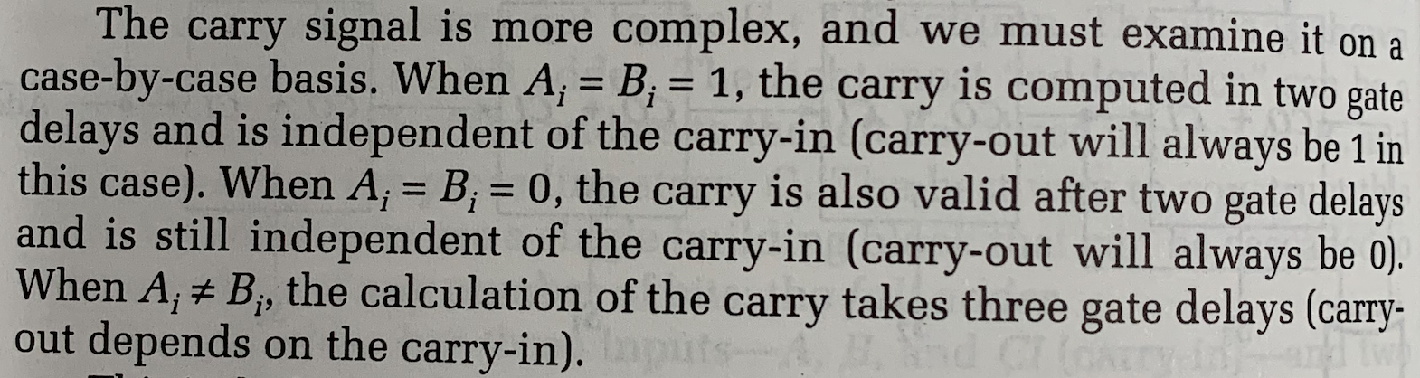
Why C1@2?
1111+0001
Worst-case delay of C_{out} = 3, but
  A=B=1 makes the delay 2 units
0
4 stage
adder
1
A0
S0 @2
A
1
1
B
B0
C1 @2
0
2
1
S
@N
Cin
@N+1
A1
S1 @3
1
@N+1
B1
C2 @4
@0
@0
A
@1
1
B
0
Cin
@N
2
1
Cout
A2
S2 @5
1
@N+2
B2
@0
@0
A
1
C3 @6
1
B
@1
A3
S3 @7
late
arriving
signal
two gate delays
to compute Cout
B3
Cout @8
Textbook 5.6.2

Slide 44
Ripple-carry adders (cont’d)
Critical delay
  the propagation of carry from low to high order stages
  1111 + 0001 is the worst case addition
  carry must propagate through all bits
1111+0001
0
4 stage
adder
A0
S0 @2
B0
C1 @2
A1
S1 @3
B1
C2 @4
A2
S2 @5
B2
C3 @6
A3
S3 @7
B3
Cout @8
This slide shows a waveform of a 4 bit adder. Suppose we add 1111 and 0001, the carry will propagate from the LSB all the way through to the final carry-out.

Slide 45
Carry-lookahead logic
Carry generate: Gi = Ai Bi
  must generate carry when A = B = 1
Carry propagate: Pi = Ai xor Bi
  carry-in will equal carry-out here
Sum and Cout can be re-expressed in terms of generate/propagate:
  Si = Ai xor Bi xor Ci
  = Pi xor Ci
  C_{i+1} = Ai Bi + Ai Ci + Bi Ci
  = Ai Bi + Ci (Ai + Bi)
  = Ai Bi + Ci (Ai xor Bi)
  = Gi + Ci Pi
Instead of awaiting the carry from the lower-order bits, we can process the carry in advance. How?
In order to do so, the carry should be derived from the lower-order data bits directly. First of all, let’s look at two new functions: Gi and Pi. Then Si and C_{i+1} can be rewritten as shown in the above. Actually, those imply two cases. When Gi is true, there is always a carry-out. If Pi is true, a carry-out depends on a carry-in.

Slide 46
Carry-lookahead logic (cont’d)
Re-express the carry logic as follows:
  C1 = G0 + P0 C0
  C2 = G1 + P1 C1 = G1 + P1 G0 + P1 P0 C0
  C3 = G2 + P2 C2 = G2 + P2 G1 + P2 P1 G0 + P2 P1 P0 C0
  C4 = G3 + P3 C3 = G3 + P3 G2 + P3 P2 G1 + P3 P2 P1 G0
  + P3 P2 P1 P0 C0
Each of the carry equations can be implemented with two-level logic
  all inputs are now directly derived from data inputs and not from
  intermediate carries
  this allows computation of all sum outputs to proceed in parallel
Then all the carries are calculated by the expanding Pi and Gi as shown in the above, which is called the carry-lookahead logic. Note that all carries are now just two-level logic functions. So here is the bottom line: there is a tradeoff between the number of gates and the delay.

Slide 47
Carry-lookahead (CLA) implementation
Adder with propagate and generate outputs
Ai
Pi @ 1 gate delay
Bi
increasingly complex
logic for carries
Ci
Si @ 2 gate delays
Gi @ 1 gate delay
C0
P0
P1
C0
C0
P2
P0
C1 @ 3
P0
P3
G0
P1
G0
P2
P1
G0
P2
C0
P1
P3
P0
P2
G1
P1
P2
G1
C3 @ 3
P3
G0
C2 @ 3
P2
G2
C4 @ 3
P1
P3
G2
G1
G3
This slide shows how 4 carries are implemented in two level fixed logic based on Pi and Gi. As Pi and Gi take only one gate delay, the final carries take maximum 3 gate delays.

Slide 48
Building Blocks of Carry Lookahead Adder
Ai
Pi @ 1 gate delay
Ai
1b Adder
Pi
Bi
Ci
Si @ 2 gate delays
Bi
Si
Gi @ 1 gate delay
Ci
Gi
C0
4b Carry Lookahead logic
C1
C0
C0
C0
P0
P0
C1
P0
P0
G0
G0
P1
P1
C2
P2
P2
P1
G0
P3
G1
C0
P1
G0
P0
P2
P1
C3
P1
G1
C3
P2
P2
G0
P2
P3
G2
P1
C2
G1
G2
P2
P3
G1
P3
C4
G3
C4
G2
P3
G3
Assume all the inputs, A, B and C0 arrive at time 0. Unit gate delay.
For all i, delay of Pi, Gi = 1. Thus, delay of C1 = 2 + 1 = 3
Delay of C2 = 3, Delay of C3 = 3, Delay of C4 = 3 ➔ Delay of Ci = 3

Slide 49
4-bit Carry Lookahead Adder
A0
1b Adder
P0
B0
S0
C0
C0
G0
C0
4b Carry Lookahead logic
C1
4b Carry Lookahead Adder
S0
P0
A1
1b Adder
P1
A0
G0
B0
C2
B1
S1
A1
P1
C1
G1
B1
S1
G1
P2
C3
A2
S2
G2
A2
1b Adder
P2
B2
P3
C4
B2
S2
A3
G3
C2
G2
B3
S3
A3
1b Adder
P3
C4
B3
S3
C3
G3
Ai
Pi @ 1 gate delay
Assuming A, B and C0 arrive at time 0
For all i >=1
Delay of Si = 1 + delay of Ci = 4
Bi
Ci
Si @ 2 gate delays
Gi @ 1 gate delay

Slide 50
CLA implementation (cont’d)
Carry-lookahead logic generates individual carries
  sums computed much more quickly in parallel
  however, cost of carry logic increases with more stages
0
0
A0
S0 @2
S0 @2
B0
A0
B0
C1 @2
C1 @3
A1
S1 @4
A1
S1 @3
B1
B1
C2 @4
C2 @3
A2
S2 @4
A2
S2 @5
B2
B2
C3 @6
C3 @3
A3
S3 @4
A3
S3 @7
B3
B3
Cout @8
C4 @3
C4 @3
on the left, there is the original full adder, which takes a long time to finish addition. On the right, there is the carry lookahead adder. The two level logic functions for carries are not shown. Each box is the one-bit adder module. Overall, by using a lot of gates for CLA in the previous slide, we can reduce the delay of the addition process.

Slide 51
16bit CLA adder with cascaded carry-lookahead logic
Carry-lookahead (CLA) adder
  4 four-bit adders with internal carry lookahead
  second level carry lookahead unit extends lookahead to 16 bits
G = G3 + P3 G2 + P3 P2 G1 + P3 P2 P1 G0
P = P3 P2 P1 P0
4
4
4
4
4
4
4
4
A[15-12]
B[15-12]
A[11-8]
B[11-8]
A[7-4]
B[7-4]
A[3-0]
B[3-0]
4-bit Adder
C12
4-bit Adder
C8
4-bit Adder
C4
4-bit Adder
C0
@0
P
G
P
G
P
G
P
G
4
4
4
4
S[15-12]
S[11-8]
S[7-4]
S[3-0]
@8
@2
@3
@8
@2
@3
@7
@2
@3
@4
@2
@3
@5
@5
@4
P3
G3
C3
P2
G2
C2
P1
G1
C1
P0
G0
C16
C4
Lookahead Carry Unit
C0
C0
@5
@0
P3-0
G3-0
@3
@5
C1 = G0 + P0 C0
C2 = G1 + P1 G0 + P1 P0 C0
If we add 16bit long numbers, we have to use 4 4bit CLA adder modules. Each module adds 4 bits. Here Ci at the bottom box is the carry from the i-th 4bit CLA adder module. Pi and Gi in blue color are the same functions in the previous example. While Pi and Gi at the bottom unit give info about the carries between the 4bit CLA modules, which is more complicated.

Slide 52
16-bit Carry-Lookahead Adder
Group propagate and generate
  P = P0P1P2P3 (2 unit delay)
  G = G3 + G2P3 + G1P3P2 + G0P3P2P1 (3 unit delay)
4
4
4
4
4
4
4
4
A[15-12]
B[15-12]
A[11-8]
B[11-8]
A[7-4]
B[7-4]
A[3-0]
B[3-0]
4-bit Adder
C12
4-bit Adder
C8
4-bit Adder
C4
4-bit Adder
C0
@0
P
G
P
G
P
G
P
G
4
4
4
4
S[15-12]
S[11-8]
S[7-4]
S[3-0]
@8
@2
@3
@8
@2
@3
@7
@2
@3
@4
@2
@3
@5
@5
@4
P3
G3
C3
P2
G2
C2
P1
G1
C1
P0
G0
C16
C4
Lookahead Carry Unit
C0
C0
@5
@0
P3-0
G3-0
@3
@5

Slide 53
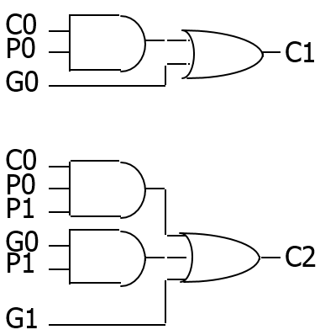
16-bit Carry-Lookahead Adder
2
3
4
2
2nd level lookahead carry logic
  Delay of C1 = 4
  Delay of C2, C3 and C4 = 5
2
3
2
5
3
4
4
4
4
4
4
4
4
A[15-12]
B[15-12]
A[11-8]
B[11-8]
A[7-4]
B[7-4]
A[3-0]
B[3-0]
4-bit Adder
C12
4-bit Adder
C8
4-bit Adder
C4
4-bit Adder
C0
@0
P
G
P
G
P
G
P
G
4
4
4
4
S[15-12]
S[11-8]
S[7-4]
S[3-0]
@8
@2
@3
@8
@2
@3
@7
@2
@3
@4
@2
@3
@5
@5
@4
P3
G3
C3
P2
G2
C2
P1
G1
C1
P0
G0
C16
C4
Lookahead Carry Unit
C0
C0
@5
@0
P3-0
G3-0
@3
@5

Slide 54
16-bit Carry-Lookahead Adder
Delay of sum
  Delay of S[3-0] = 4
4
4
4
4
4
4
4
4
A[15-12]
B[15-12]
A[11-8]
B[11-8]
A[7-4]
B[7-4]
A[3-0]
B[3-0]
4-bit Adder
C12
4-bit Adder
C8
4-bit Adder
C4
4-bit Adder
C0
@0
P
G
P
G
P
G
P
G
4
4
4
4
S[15-12]
S[11-8]
S[7-4]
S[3-0]
@8
@2
@3
@8
@2
@3
@7
@2
@3
@4
@2
@3
@5
@5
@4
P3
G3
C3
P2
G2
C2
P1
G1
C1
P0
G0
C16
C4
Lookahead Carry Unit
C0
C0
@5
@0
P3-0
G3-0
@3
@5

Slide 55
4-bit Carry Lookahead Adder
A0
1b Adder
P0
B0
S0
C0
C0
G0
C0
4b Carry Lookahead logic
C1
4b Carry Lookahead Adder
S0
P0
A1
1b Adder
P1
A0
G0
B0
C2
B1
S1
A1
P1
C1
G1
B1
S1
G1
P2
C3
A2
S2
G2
A2
1b Adder
P2
B2
P3
C4
B2
S2
A3
G3
C2
G2
B3
S3
A3
1b Adder
P3
C4
B3
S3
C3
G3
Ai
Pi @ 1 gate delay
Assuming A, B and C0 arrive at time 0
For all i >=1
Delay of Si = 1 + delay of Ci = 4
Bi
Ci
Si @ 2 gate delays
Gi @ 1 gate delay

Slide 56
16-bit Carry-Lookahead Adder
For the other sums, delay of sum = 3 + delay of Cin
  Delay of S[7-4] = 7
  Delay of S[11-8] and S[15-12] = 8
4
4
4
4
4
4
4
4
A[15-12]
B[15-12]
A[11-8]
B[11-8]
A[7-4]
B[7-4]
A[3-0]
B[3-0]
4-bit Adder
C12
4-bit Adder
C8
4-bit Adder
C4
4-bit Adder
C0
@0
P
G
P
G
P
G
P
G
4
4
4
4
S[15-12]
S[11-8]
S[7-4]
S[3-0]
@8
@2
@3
@8
@2
@3
@7
@2
@3
@4
@2
@3
@5
@5
@4
P3
G3
C3
P2
G2
C2
P1
G1
C1
P0
G0
C16
C4
Lookahead Carry Unit
C0
C0
@5
@0
P3-0
G3-0
@3
@5

Slide 57
Carry-Lookahead Implementation
C0 → Ci: 2 time units and Ci → Si: 1 time unit
Thus, C0 → Si: 3 time units (Note: Ai and Bi arrive at time 0)
C0
C0
C0
P0
C1
P0
P0
G0
P1
P1
P2
P2
G0
P3
C0
P1
G0
P0
P2
P1
P1
G1
C3
P2
G0
P2
P3
P1
C2
G1
G2
P2
G1
P3
G2
C4
P3
Ai
G3
Bi
Pi @ 1 gate delay
Ci
Si @ 2 gate delays
Gi @ 1 gate delay

Slide 58
16bit CLA adder with cascaded carry-lookahead logic
Carry-lookahead (CLA) adder
  4 four-bit adders with internal carry lookahead
  second level carry lookahead unit extends lookahead to 16 bits
G = G3 + P3 G2 + P3 P2 G1 + P3 P2 P1 G0
P = P3 P2 P1 P0
4
4
4
4
4
4
4
4
A[15-12]
B[15-12]
A[11-8]
B[11-8]
A[7-4]
B[7-4]
A[3-0]
B[3-0]
4-bit Adder
C12
4-bit Adder
C8
4-bit Adder
C4
4-bit Adder
C0
@0
P
G
P
G
P
G
P
G
4
4
4
4
S[15-12]
S[11-8]
S[7-4]
S[3-0]
@8
@2
@3
@8
@2
@3
@7
@2
@3
@4
@2
@3
@5
@5
@4
P3
G3
C3
P2
G2
C2
P1
G1
C1
P0
G0
C16
C4
Lookahead Carry Unit
C0
C0
@5
@0
P3-0
G3-0
@3
@5
C1 = G0 + P0 C0
C2 = G1 + P1 G0 + P1 P0 C0
If we add 16bit long numbers, we have to use 4 4bit CLA adder modules. Each module adds 4 bits. Here Ci at the bottom box is the carry from the i-th 4bit CLA adder module. Pi and Gi in blue color are the same functions in the previous example. While Pi and Gi at the bottom unit give info about the carries between the 4bit CLA modules, which is more complicated.

Slide 59
Carry-select adder
Redundant hardware to make carry calculation go faster
  compute two high-order sums in parallel while waiting for carry-in
  one assuming carry-in is 0 and another assuming carry-in is 1
  select correct result once carry-in is finally computed
C8
4-bit adder
[7:4]
1
adder
high
C8
4-bit adder
[7:4]
0
adder
low
@4
five
2:1 mux
1
0
1
0
1
0
1
0
1
0
C4
4-Bit Adder
[3:0]
C0
@3
@5
C8
S7
S6
S5
S4
S3
S2
S1
S0
The next version, a carry-select adder, achieves even lower delay by redundant h/w. Note that the carry between 4bit CLA adders is either 0 or 1. We use two adder modules for high 4 bit of the 8-bit adder system. So we perform addition for both cases and then the carry from the lower 4bit CLA module will perform selection (MUX).

Slide 60
Arithmetic logic unit (ALU) design specification
M = 0, logical bitwise operations
S1
0
0
1
1
S0
0
1
0
1
Function
Fi = Ai
Fi = not Ai
Fi = Ai xor Bi
Fi = Ai xnor Bi
Comment
input Ai transferred to output
complement of Ai transferred to output
compute XOR of Ai, Bi
compute XNOR of Ai, Bi
M = 1, C0 = 0, arithmetic operations
0
0
1
1
0
1
0
1
F = A
F = not A
F = A plus B
F = (not A) plus B
input A passed to output
complement of A passed to output
sum of A and B
sum of B and complement of A
M = 1, C0 = 1, arithmetic operations
0
0
1
1
0
1
0
1
F = A plus 1
F = (not A) plus 1
F = A plus B plus 1
F = (not A) plus B plus 1
increment A
twos complement of A
increment sum of A and B
B minus A
logical and arithmetic operations
not all operations appear useful, but "fall out" of internal logic
An ALU is a key subsystem of computers that performs logic and arithmetic functions. There are one high level control input M, and two lower level selection inputs S1 and S0. Here Ci is the carry value which is useful only for some arithmetic functions.

Slide 61
Arithmetic logic unit (ALU) design (cont’d)
M
0
1
1
S1
0
0
1
1
0
0
1
1
0
0
1
1
S0
0
1
0
1
0
1
0
1
0
1
0
1
Ci
X
X
X
X
X
X
X
X
X
X
X
X
0
0
0
0
0
0
0
0
0
0
0
0
1
1
1
1
1
1
1
1
1
1
1
1
Ai
0
1
0
1
0
0
1
1
0
0
1
1
0
1
0
1
0
0
1
1
0
0
1
1
0
1
0
1
0
0
1
1
0
0
1
1
Bi
X
X
X
X
0
1
0
1
0
1
0
1
X
X
X
X
0
1
0
1
0
1
0
1
X
X
X
X
0
1
0
1
0
1
0
1
Fi
0
1
1
0
0
1
1
0
1
0
0
1
0
1
1
0
0
1
1
0
1
0
0
1
1
0
0
1
1
0
0
1
0
1
1
0
Ci+1
X
X
X
X
X
X
X
X
X
X
X
X
X
X
X
X
0
0
0
1
0
1
0
0
0
1
1
0
0
1
1
1
1
1
0
1
Sample ALU – truth table
First of all, there are three control inputs, three data inputs, and two data outputs.
If M is 0, Ci is a DC term. Sometimes, Bi is also a DC term when only the 1st input, Ai, matters

Slide 62
ALU design (cont’d)
Sample ALU – multi-level discrete gate logic implementation
\S1
\Bi
[35]
Ci
M
[33]
Ci
\Co
[30]
Co
Ci
M
S1
Bi
[33]
[30]
[33]
[33]
Fi
M
\Co
Ci
[30]
[30]
[35]
S0
Ai
[30]
\Co
\[30]
\[35]
Total 12 gates + 5 inverters
If we implement the truth table in the previous slide by a random logic with some minimization techniques, we can get the above multi-level logic system. Don’t worry; there are six variables. Humans are not supposed to do that. This result comes from a CAD tool. Numbers in [] are internal wires.

Slide 63
Summary for examples of combinational logic
Combinational logic design process
  formalize problem: encodings, truth-table, equations
  choose implementation technology (ROM, PAL, PLA, discrete gates)
  implement by following the design procedure for that technology
Binary number representation
  positive numbers the same
  difference is in how negative numbers are represented
  2s complement easiest to handle: one representation for zero, slightly complicated complementation, simple addition
Circuits for binary addition
  basic half-adder and full-adder
  carry lookahead logic
  carry-select
ALU Design
  specification, implementation
We looked at the design process of several combinational logic circuits and then reviewed how binary numbers are represented. Arithmetic functions are also discussed.

