Slide 1
BDD

Slide 2
Some Key Concepts
TDD(1) TDD(2) BDD DDD. Obviously.

Slide 3
What is TDD?
Test Driven Development
You write what your code is intended to do with tests
Tests are written before code
You code until the tests pass

Slide 4
What is DDD?
Domain Driven Design
Aims for a common vernacular between “business” and code
Code structure and product elements should align

Slide 5
What is BDD?
Behavior Driven Development
A combination of TDD and DDD
Aimed at eliminating the gap between business expectations and development output
Attempts to use business language to increase the reliability and relevance of software

Slide 6
How BDD is Useful
Writing tests before code is an integral part of BDD (making more reliable code)
BDD aims to define a common vernacular between product and development through tests
Intended to present business value in a way that is useful to the development process through understandable tests

Slide 7
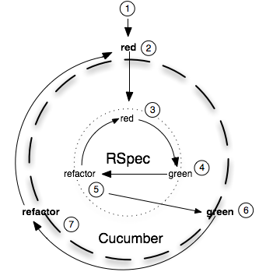
Development Process…

Slide 8
Acceptance Tests
BA, QA, dev write tests that define the behavior of a working feature
These tests are running (but at this stage) failing
They are readable and act as documentation for a system
Cucumber is a good tool for this
Here is an example with a car…
Notes:
Show the car cucumber example (not the plane yet). Show it failing.

Slide 9
Test, Code, Refactor
Development is cyclical
It takes the approach of outside-in
Tests drive the design of the code (Test Driven Design!)
The code is complete when all tests pass
… And no other tests are broken!
Here’s an example of some unit tests…
Notes:
Write car rspec tests until they all pass & so do the cucumber tests. Use audience members and ping-pong.

Slide 10
Refactoring
Refactoring is an integral part of the development process
Writing untidy code is ok… Temporarily!
Tests ensure confidence in refactoring
Only ever refactor working code (please!)
Here’s an example of refactoring patterns…
Notes:
Start the whole process with planes then encourage refactoring into parent class (e.g. Transport)

Slide 11
Remember….
Write tests
Code to those tests and no more
Refactor any common patterns
Rinse and repeat

