Slide 1

Electronic Circuit Design
The practical points — with Falstad examples
Prof. Dr. Markus Pfeil
Winter semester 2026/27
Notes:
Condensed deck: practical points per section, all Falstad examples. Derivations and exercises are in the script.

Slide 2
INTRODUCTION
How to use this deck
1
2
3
Slides
Script
Falstad
The practical points of each section: rules of thumb, design recipes, pitfalls
All derivations, worked numbers and the exercises: work the math there
Every example is one click away: the chips open the circuit in the browser
Falstad basics/led_resistor
Thread through all chapters: the capstone chain Pt100 bridge → amplifier → anti-aliasing filter → sample & hold → 3-bit flash ADC
Example chip: click it to open the circuit in the simulator
Electronic Circuit Design
2
Notes:
Explain the split: slides for the ideas, script for the math, Falstad for the proof.

Slide 3
INTRODUCTION
Contents
01
Basics
The tools every later chapter uses: Ohm, Kirchhoff, dividers, LED, RC
06
Operational Amplifiers
Basic op-amp circuits, real limits, and the capstone measurement amplifier
02
Op-Amp Basics
The minimum op-amp knowledge: golden rules, buffer, non-inverting amplifier
07
Active Filters
Remove interference before sampling: RC, active and Sallen-Key low-passes
03
Voltage and Current Sources
Real sources, Zener and transistor regulators, current sources for sensors
08
Sample and Hold
Freeze the filtered signal at a defined instant while the ADC converts
04
Voltage References
Zener and bandgap references, scaling to 4.00 V, ratiometric measurement
09
Analog-to-Digital Conversion
Sample, quantize, compare, encode: from voltage to code, the 3-bit flash way
05
Bridge Circuits
Turn small sensor resistance changes into a clean differential voltage
10
From Sensor to Digital Value
The whole course in one chain: Pt100 thermometer to 3-bit code on LEDs
Electronic Circuit Design
3

Slide 4
01
Basics
The tools every later chapter uses: Ohm, Kirchhoff, dividers, LED, RC
TAKE-HOME 1
TAKE-HOME 2
TAKE-HOME 3
Every connection is a divider: watch the load
Size LED resistors from V_{S} − V_{F}, round up
τ = RC: 63 % after τ, settled after 5τ
Electronic Circuit Design · Basics
4
Notes:
Chapter 1: Basics. Every connection is a divider: watch the load Size LED resistors from V_{S} − V_{F}, round up τ = RC: 63 % after τ, settled after 5τ

Slide 5
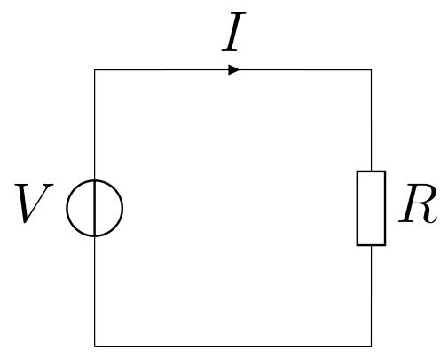
QUANTITIES, UNITS AND OHM'S LAW
Ohm's law, power and standard values
Calculate in V, kΩ and mA: no powers of ten needed
P = V·I = I²R = V²/R; stay below about 50 % of the power rating
SMD 0603: 0.1 W, 1206: 0.25 W, through-hole 0207: 0.25 … 0.6 W
E12: 1.0 1.2 1.5 1.8 2.2 2.7 3.3 3.9 4.7 5.6 6.8 8.2; E96 for 1 % parts
Capstone: sensor current limited to 1 mA because of self-heating
KEY RULE
V = R·I
Electronic Circuit Design · Basics
5
Notes:
Quick repetition from the intro course. Stress the kΩ/mA/V habit and the 50 % power rule; 100 Ω at 5 V already dissipates 250 mW. A design always ends with picking the next E-series value and recalculating.

Slide 6
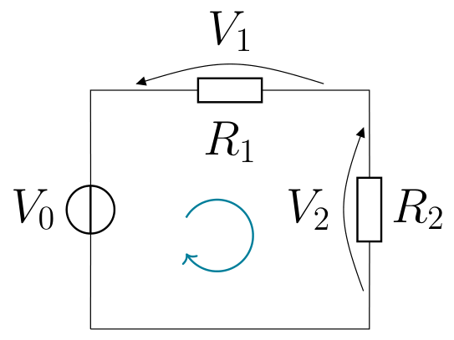
KIRCHHOFF'S LAWS AND NETWORKS
Series and parallel
Series
Same current, voltages add (KVL)
R = R₁ + R₂
Larger than the largest resistor
Parallel
Same voltage, currents add (KCL)
R₁‖R₂ = R₁R₂/(R₁+R₂)
Smaller than the smallest; R‖R = R/2
Electronic Circuit Design · Basics
6
Notes:
KCL: charge is not lost at a node; KVL: the voltages around a loop sum to zero. For our small networks we just combine series and parallel step by step.

Slide 7
KIRCHHOFF'S LAWS AND NETWORKS
Falstad: series-parallel network
TRY IT IN FALSTAD
Falstad basics/network
Hover over each resistor: current and power; check KCL at node A
OBSERVE
Recipe: combine parallel, add series, total current, then go back
KCL at node A as a cheap check: I₁ = I₂ + I₃
Compare each resistor's power with a 0.25 W rating
Electronic Circuit Design · Basics
7
Notes:
12 V, 100 Ω, 220 Ω ‖ 330 Ω; V_{A} = 6.83 V. Exercise 1.1 finds that R_{1} is overloaded and R_{2} runs too hot for the 50 % rule.

Slide 8
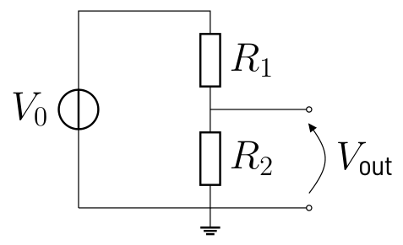
THE VOLTAGE DIVIDER
The voltage divider and its load
Unloaded: the voltages divide in the ratio of the resistances
Seen from the load: V_{th} = V₀·R₂/(R₁+R₂), R_{th} = R₁‖R₂
R_{L} ≥ 10·R_{th} for < 10 % error, ≥ 100·R_{th} for < 1 % (or buffer it)
Small R: stiff but high cross current; large R: sensitive to every load
Capstone ADC ladder: 8 × 1 kΩ at 4 V, loaded only by comparator inputs
KEY RULE
V_{out} = V₀·R₂/(R₁+R₂)
Falstad basics/divider_loaded
Compare Vout_open (5.00 V) and Vout_load (3.33 V)
Electronic Circuit Design · Basics
8
Notes:
The divider is the most used circuit in the lecture. In the example 10 kΩ/10 kΩ loaded with 10 kΩ loses one third of the output (Exercise 1.2). A trimmer between two fixed resistors gives a fine adjustment; in the capstone it sets the gain for exactly 0 … 4.00 V.

Slide 9
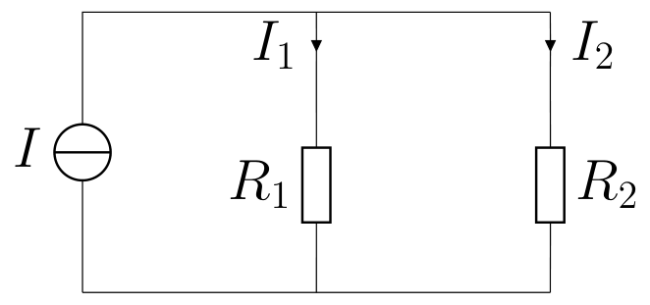
THE VOLTAGE DIVIDER
Current divider
The smaller resistor takes the larger current
I₁ = I·R₂/(R₁+R₂), I₂ = I·R₁/(R₁+R₂)
Potentiometer wiper: V_{out} = x·V₀; load the wiper only lightly
Falstad basics/current_divider
10 mA into 1 kΩ ‖ 4.7 kΩ: read 8.25 mA and 1.75 mA
Electronic Circuit Design · Basics
9
Notes:
The current divider is the dual of the voltage divider. Mention potentiometers and trimmers briefly here; the slide 'Potentiometer: adjustable divider' in the script has the details.

Slide 10
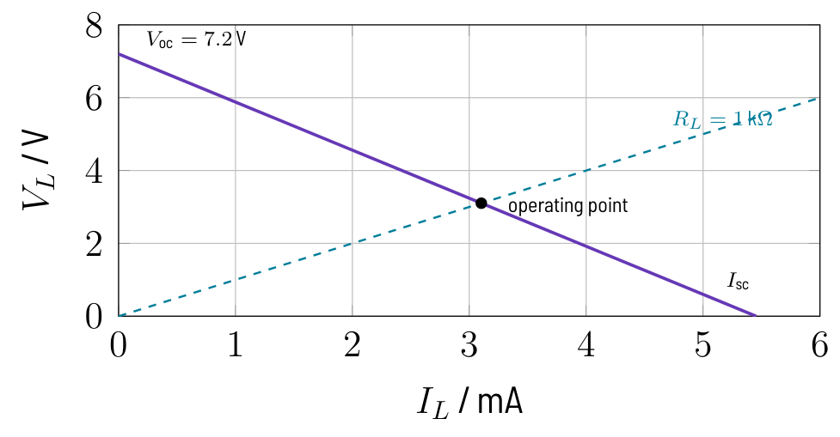
EQUIVALENT SOURCES AND SUPERPOSITION
Thevenin equivalent and load line
Any linear two-terminal network = V_{th} in series with R_{th}
V_{th} = V_{oc}, R_{th} = V_{oc}/I_{sc}, or set sources to zero
Zeroed sources: voltage source → wire, current source → open
Operating point: source line V_{th} − R_{th}·I_{L} meets the load line
KEY RULE
R_{th} = V_{oc}/I_{sc}
Falstad basics/thevenin
VL_orig = VL_equiv = 3.10 V; short R_{L} to read I_{sc}
Electronic Circuit Design · Basics
10
Notes:
The example is the 12 V divider 2.2 kΩ/3.3 kΩ with a 1 kΩ load: 7.2 V behind 1.32 kΩ. The load line also works for nonlinear loads like LEDs. Derivation in Exercise 1.3.

Slide 11
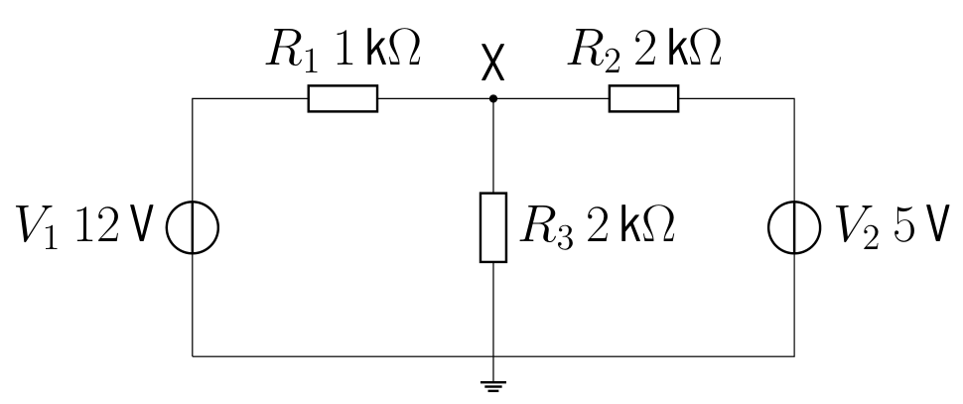
EQUIVALENT SOURCES AND SUPERPOSITION
Falstad: superposition
TRY IT IN FALSTAD
Falstad basics/superposition
Read VX1, VX2 and VX: 6.00 V + 1.25 V = 7.25 V
OBSERVE
Each source alone, the other set to zero, then add the results
Only for linear circuits: fails when a diode switches or an op-amp clips
Not valid for power (quadratic in current)
Electronic Circuit Design · Basics
11
Notes:
Superposition comes back for summing amplifiers and offset voltages. Exercise 1.4 checks the result with KCL and shows that the 5 V source is being charged.

Slide 12
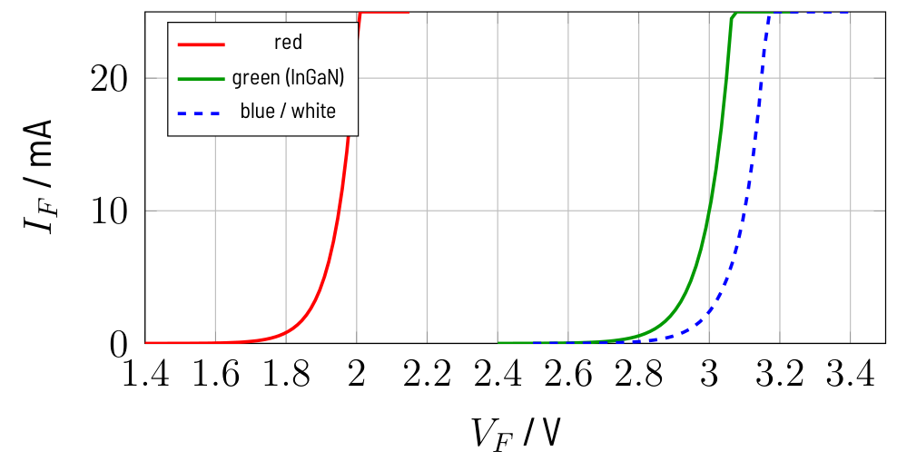
THE LED WITH SERIES RESISTOR
The LED: a nonlinear load
Current rises exponentially: never connect an LED directly to a source
Model: constant V_{F}; red ≈ 2.0 V, green/blue/white (InGaN) ≈ 3.0 V
Standard LEDs ≤ 20 mA; modern ones are visible at 2 … 5 mA
Reverse voltage only about 5 V: an LED is not a rectifier
Electronic Circuit Design · Basics
12
Notes:
V_{F} grows with photon energy. A blue LED on 3.3 V leaves only a few hundred mV for the resistor. V_{F} drops by about 2 mV/K, so an LED without resistor runs away thermally.

Slide 13
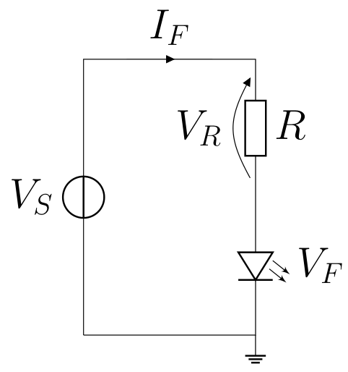
THE LED WITH SERIES RESISTOR
Design recipe: LED series resistor
1
Take V_{F} from the datasheet at the desired current (red 2.0 V, blue 3.0 V)
2
Choose I_{F}: 2 … 10 mA for an indicator; check the driver's maximum
3
R = (V_{S} − V_{F})/I_{F}, round up to the next E12/E24 value
4
Recalculate I_{F}, check P_{R} = I_{F}²·R against the rating
Electronic Circuit Design · Basics
13
Notes:
Rounding up protects LED and driver. The larger V_{S} − V_{F}, the less the current depends on the spread of V_{F}. Example: 5 V, red LED, 10 mA gives 330 Ω and 9.1 mA.

Slide 14
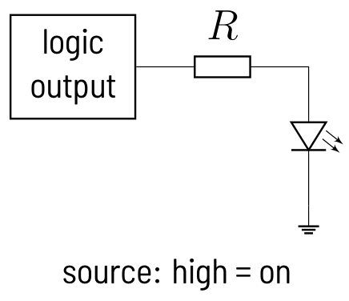
THE LED WITH SERIES RESISTOR
Falstad: LED on a logic output
TRY IT IN FALSTAD
Falstad basics/led_resistor
Read VLED (1.78 V), move the R slider, watch the blinking pair
OBSERVE
Source (LED to ground, on at high) or sink (LED to supply, on at low)
74HC at 5 V: ±4 mA with guaranteed levels, 25 mA absolute maximum
330 Ω at 5 V ≈ 9 mA, 1 kΩ ≈ 3 mA
Electronic Circuit Design · Basics
14
Notes:
A CMOS output acts as a switch with some 10 Ω, so the formula still applies. In the capstone the three encoder bits drive three LEDs to ground, exactly this circuit. Exercise 1.5.

Slide 15
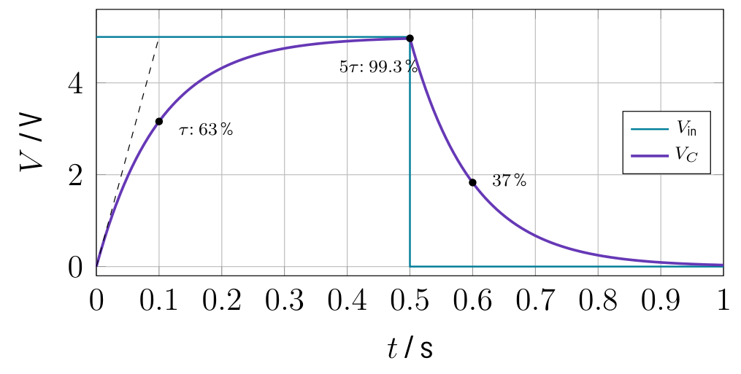
CAPACITOR AND RC CIRCUITS
Capacitor and RC time constant
I = C·dV/dt: the voltage cannot jump; at DC a charged C is an open circuit
After τ: 63 %, 3τ: 95 %, 5τ: 99.3 % (settled)
Settling to 1 %: 4.6τ; to ½ LSB of an n-bit ADC: τ·ln(2^{n+1})
Filters and hold capacitors: C0G or film, not X7R/Y5V
KEY RULE
V_{C}(t) = V₀·(1 − e^{−t/τ}), τ = RC
Falstad basics/rc_charging
10 kΩ, 10 µF, τ = 0.1 s: read 3.16 V at 0.1 s on the scope
Electronic Circuit Design · Basics
15
Notes:
The 3-bit capstone converter needs 2.8τ, a 12-bit converter 9τ; that is why acquisition time is always given with an accuracy. Exercise 1.6 reads the charging and discharging values from the scope.

Slide 16
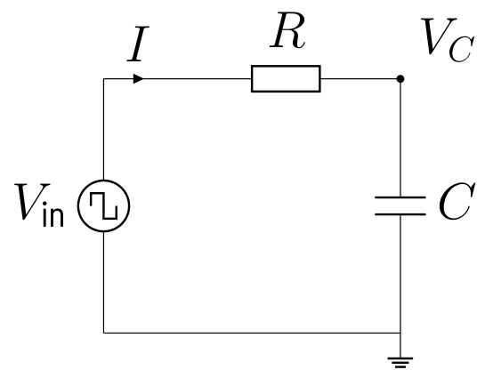
CAPACITOR AND RC CIRCUITS
Preview: the RC low-pass
Slow signals pass, fast ones are attenuated: −20 dB per decade above f_{c}
At f_{c}: amplitude 0.707 (−3 dB), phase −45°
Capstone anti-aliasing: f_{c} = 2.34 Hz with 6.8 kΩ and 10 µF
KEY RULE
f_{c} = 1/(2π·R·C)
Falstad basics/rc_lowpass
1 kHz sine at f_{c} = 995 Hz: output 0.705 V, lags ≈ ¼ period
Electronic Circuit Design · Basics
16
Notes:
The same RC circuit seen in the frequency domain. The chapter Active Filters treats filters in detail. Change the source frequency in Falstad and watch the amplitude.

Slide 17
WORKING WITH FALSTAD
Working with Falstad
Pitfalls
Measuring
Wires connect only at end points
Every circuit needs a ground
Singular matrix: floating node
Hover: V, I and P bottom right
Right click → View in New Scope
Sliders for the values worth changing
Electronic Circuit Design · Basics
17
Notes:
Open falstad.com/circuit/circuitjs.html, import an example via File → Import From Text. Show led_resistor live: hover over VLED and the resistor. Circuits with capacitors need a few time constants before the values settle.

Slide 18
EXERCISES
Now work it out in the script
Derivations, worked numbers and solutions: script, chapter 1 “Basics”. Check each result in the Falstad examples.
1.1
Power in a series-parallel network
1.4
Superposition
1.2
Loaded voltage divider
1.5
LED on a 5 V logic output
1.3
Thevenin equivalent from open-circuit voltage and short-circuit current
1.6
RC charging
Electronic Circuit Design · Basics
18
Notes:
Exercises with full solutions are in the script (docu.pdf); the student version has no solutions.

Slide 19
02
Op-Amp Basics
The minimum op-amp knowledge: golden rules, buffer, non-inverting amplifier
TAKE-HOME 1
TAKE-HOME 2
TAKE-HOME 3
Negative feedback: V₊ = V₋, no input current
A buffer stops one stage loading the next
Check input and output range before any formula
Electronic Circuit Design · Op-Amp Basics
19
Notes:
Chapter 2: Op-Amp Basics. Negative feedback: V_{+} = V_{-}, no input current A buffer stops one stage loading the next Check input and output range before any formula

Slide 20
THE OP-AMP IN A NUTSHELL
Op-amp and the golden rules
Amplifies the difference V₊ − V₋ with a huge gain A = 10⁵ … 10⁷
Without feedback it is a comparator (flash ADC)
Negative feedback: part of V_{out} goes back to the inverting input
Rule 1: the output makes V₊ = V₋; rule 2: inputs draw no current
KEY RULE
V₊ = V₋, I₊ = I₋ = 0 (with negative feedback)
Electronic Circuit Design · Op-Amp Basics
20
Notes:
With A = 10^{5} and 5 V out, the input difference is only 50 µV. Rule 1 holds only while the loop works: output not at a rail, feedback to the inverting input. Real inputs draw pA (CMOS) to some 10 nA (bipolar).

Slide 21
THE OP-AMP IN A NUTSHELL
Real op-amps on a single supply
CMOS rail-to-rail
Bipolar LM358
MCP6002, TLV9002 at 5 V
Output within ~10 mV of the rails
Inputs up to the supply
Up to 32 V supply
Output ~1.5 V below the + rail
Inputs only up to V_{S} − 1.5 V
Electronic Circuit Design · Op-Amp Basics
21
Notes:
Most lab circuits run from 5 V or 12 V and ground. The input common-mode range and the output swing are the first things to check in every op-amp circuit; the golden rules only hold inside them. Output current is typically 10 … 40 mA, short-circuit protected.

Slide 22
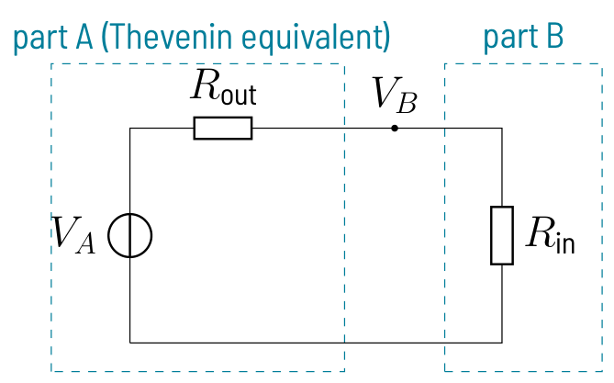
THE UNITY-GAIN BUFFER
Loading and the voltage follower
Every connection: R_{out} of stage A and R_{in} of stage B form a divider
Error ≈ R_{out}/R_{in}: need R_{in} ≥ 100·R_{out} for < 1 %
Follower: V_{out} = V_{in}, R_{in} → ∞ (GΩ … TΩ), R_{out} → 0
Stage A is not loaded, stage B sees an ideal source
KEY RULE
V_{B} = V_{A}·R_{in}/(R_{in}+R_{out})
Electronic Circuit Design · Op-Amp Basics
22
Notes:
Replace stage A by its Thevenin equivalent from chapter 1: a divider has R_{out} = R_{1}‖R_{2}. If R_{in} ≫ R_{out} cannot be met, put a buffer in between. Its load current comes from the supply, not from stage A.

Slide 23
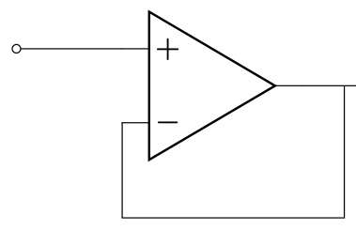
THE UNITY-GAIN BUFFER
Falstad: buffering a potentiometer
TRY IT IN FALSTAD
Falstad opampbasics/buffer_pot
Compare V_direct (0.714 V) with V_buffered (2.50 V)
OBSERVE
10 kΩ pot at mid position: 2.5 V behind R_{out} = 2.5 kΩ
1 kΩ directly at the wiper collapses it; behind the follower: 2.50 V
Use the slider: how large must R_{L} be without a buffer?
Electronic Circuit Design · Op-Amp Basics
23
Notes:
The op-amp delivers 2.5 mA from the 5 V supply, the wiper delivers nothing. Without buffer R_{L} would need 250 kΩ for 1 % error. Exercise 2.1, including why an LM358 fails near 5 V.

Slide 24
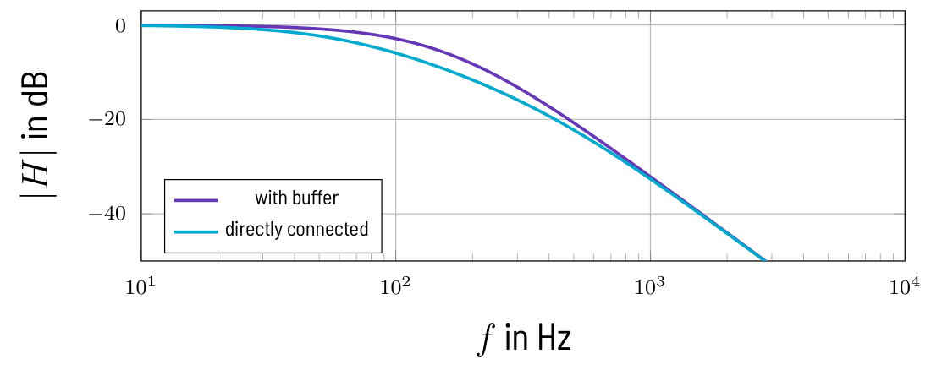
THE UNITY-GAIN BUFFER
Falstad: two RC low-passes in cascade
TRY IT IN FALSTAD
Falstad opampbasics/buffer_rc_cascade
Scope at f_{c} = 159 Hz: 0.500 V buffered vs 0.333 V direct
OBSERVE
With buffer: H = H₁·H₂, −6 dB at f_{c}
Directly connected: −9.5 dB, lower corner, softer knee
Buffered stages can be designed one by one (active filters)
Electronic Circuit Design · Op-Amp Basics
24
Notes:
Each stage is 10 kΩ and 100 nF. Without the buffer the second stage draws current from the first capacitor, so the product formula is no longer valid. This is the idea behind the chapter Active Filters.

Slide 25
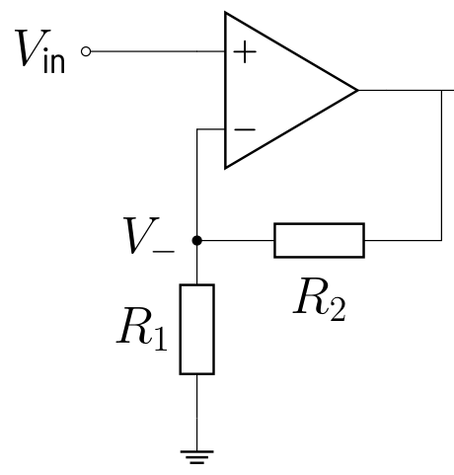
THE NON-INVERTING AMPLIFIER
Non-inverting amplifier and buffer limits
R₁, R₂ feed back part of V_{out}; R₂ = 0 gives the follower
Gain set only by the resistor ratio: 1 % resistors → about 2 % gain error
Limits: output current, swing and input common-mode range
Capacitive load may oscillate: add 50 … 100 Ω in series with the output
Offset: V_{out} = V_{in} + V_{OS} (µV … mV)
KEY RULE
G = 1 + R₂/R₁
Electronic Circuit Design · Op-Amp Basics
25
Notes:
Input resistance stays near infinite, so the source is still not loaded. Buffers appear behind references, at bridge taps, between filter stages and behind the hold capacitor. The chapter Operational Amplifiers derives the inverting amplifier and the effect of finite gain.

Slide 26
EXERCISES
Now work it out in the script
Derivations, worked numbers and solutions: script, chapter 2 “Op-Amp Basics”. Check each result in the Falstad examples.
2.1
Buffering a potentiometer
Electronic Circuit Design · Op-Amp Basics
26
Notes:
Exercises with full solutions are in the script (docu.pdf); the student version has no solutions.

Slide 27
03
Voltage and Current Sources
Real sources, Zener and transistor regulators, current sources for sensors
TAKE-HOME 1
TAKE-HOME 2
TAKE-HOME 3
Every real source has an internal resistance
Op-amp loops make voltages and currents exact
Excite the 1 kΩ sensor with 1 mA, not more
Electronic Circuit Design · Voltage and Current Sources
27
Notes:
Chapter 3: Voltage and Current Sources. Every real source has an internal resistance Op-amp loops make voltages and currents exact Excite the 1 kΩ sensor with 1 mA, not more

Slide 28
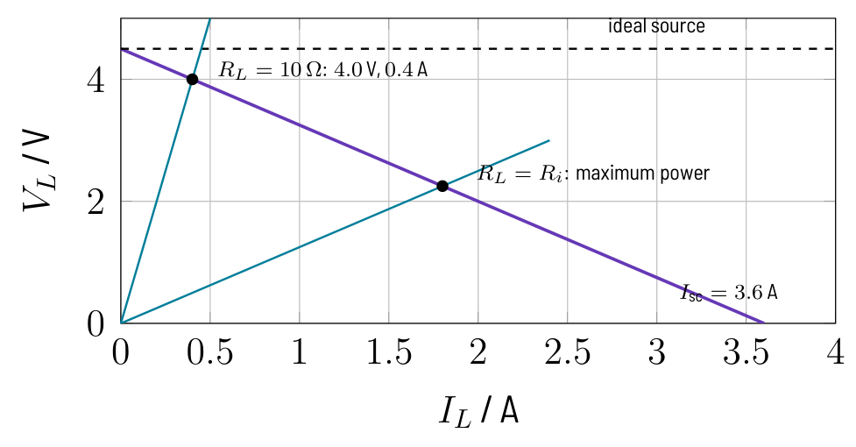
IDEAL AND REAL VOLTAGE SOURCES
Real voltage source
Terminal voltage drops with load current: V_{L} = V₀ − R_{i}·I_{L}
Typical R_{i}: AA cell 0.1–0.3 Ω, logic output 20–50 Ω, op-amp output ≪ 1 Ω
Power matching R_{L} = R_{i}: P_{max} = V₀²/(4R_{i}), but only 50 % efficiency
Supplies and measurement: voltage matching, R_{L} ≫ R_{i}
KEY RULE
V_{L} = V₀·R_{L}/(R_{i}+R_{L})
Falstad sources/real_source
Move the R_L slider to 1.25 Ω: load power peaks at 4.05 W
Electronic Circuit Design · Voltage and Current Sources
28
Notes:
Battery pack 4.5 V open, 4.0 V at 10 Ω gives R_i = 1.25 Ω. The operating point is the intersection of source line and load line. Calculation in Exercise 3.1.

Slide 29
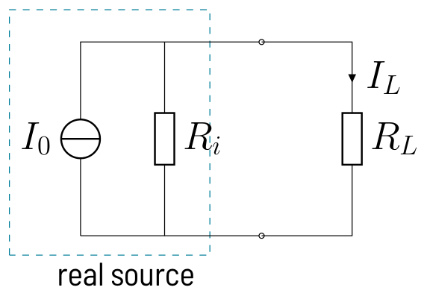
CURRENT SOURCES AND SOURCE TRANSFORMATION
Current source and source transformation
Good current source: large internal resistance, R_{i} ≫ R_{L}
Never leave an ideal current source open; real ones have a compliance range
Thevenin ↔ Norton: same V₀ and I₀ = V₀/R_{i}, same for every load
Equivalent only at the terminals: the power lost inside differs
KEY RULE
I_{L} = I₀·R_{i}/(R_{i}+R_{L})
Falstad sources/source_transform
10 V/10 kΩ and 1 mA ‖ 10 kΩ both give 3.20 V at 4.7 kΩ
Electronic Circuit Design · Voltage and Current Sources
29
Notes:
Show both models side by side in Falstad and change the load: the terminal voltages stay identical. Ask the students which internal resistor gets warmer. Exercise 3.2.

Slide 30
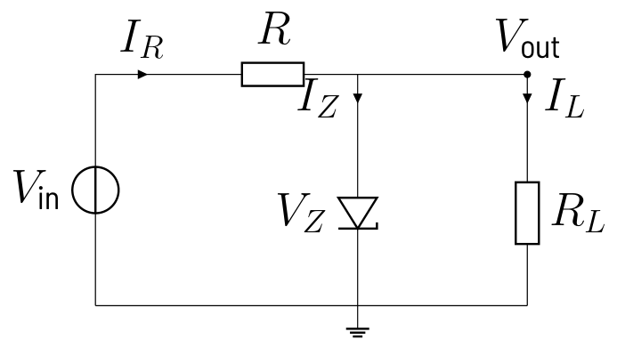
THE ZENER DIODE SHUNT REGULATOR
Zener shunt regulator
Resistor takes the difference: I_{R} = (V_{in} − V_{Z})/R
Zener takes what the load does not need: I_{Z} = I_{R} − I_{L}
Keep I_{Z} ≥ I_{Z,min} (about 5 mA) in every case
Line regulation ≈ r_{Z}/R, output resistance ≈ r_{Z}; poor efficiency
Falstad sources/zener_shunt
12 V, 220 Ω, 5.6 V: compare V_out open and with 270 Ω load
Electronic Circuit Design · Voltage and Current Sources
30
Notes:
The full current flows all the time, even without load. Small-signal model with r_Z is in the section on the shunt regulator (Regulation and ripple). With r_Z = 20 Ω and R = 220 Ω, 1 V input ripple gives about 83 mV output ripple.

Slide 31
THE ZENER DIODE SHUNT REGULATOR
Design recipe: Zener shunt regulator
1
Lowest V_{in}, full load: R ≤ (V_{in,min} − V_{Z})/(I_{L,max} + I_{Z,min})
2
Pick the next smaller E-value (12 V, 5.6 V, 20 mA → 220 Ω)
3
Highest V_{in}, no load: I_{Z,max} = (V_{in,max} − V_{Z})/R, P_{Z} = V_{Z}·I_{Z,max}
4
Resistor power: P_{R} = (V_{in,max} − V_{Z})²/R, choose the rating
Electronic Circuit Design · Voltage and Current Sources
31
Notes:
Two worst cases: one for regulation, one for the Zener's power. Full numbers in Exercise 3.3; at 11 V input the 220 Ω design is just at the edge.

Slide 32
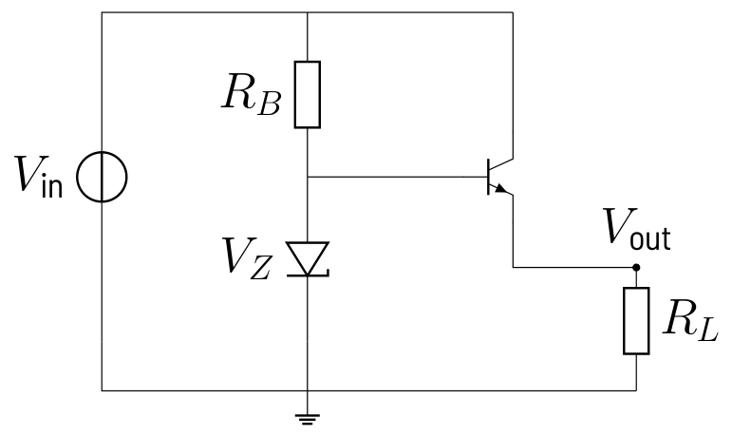
SERIES REGULATORS
Falstad: emitter follower regulator
TRY IT IN FALSTAD
Falstad sources/series_regulator
Switch R_L between 47 Ω and 470 Ω, watch V_Z hardly move
OBSERVE
V_{out} = V_{Z} − V_{BE} ≈ 4.9 V; the Zener only supplies I_{B} = I_{L}/(β+1)
Idle current 6.4 mA instead of 114 mA for an equivalent shunt regulator
Transistor power (V_{in} − V_{out})·I_{L} ≈ 0.74 W: heat sink, no short protection
Electronic Circuit Design · Voltage and Current Sources
32
Notes:
V_BE drifts with −2 mV/K, so V_out is only accurate to about 0.1 V. Comparison with the shunt regulator in Exercise 3.4.

Slide 33
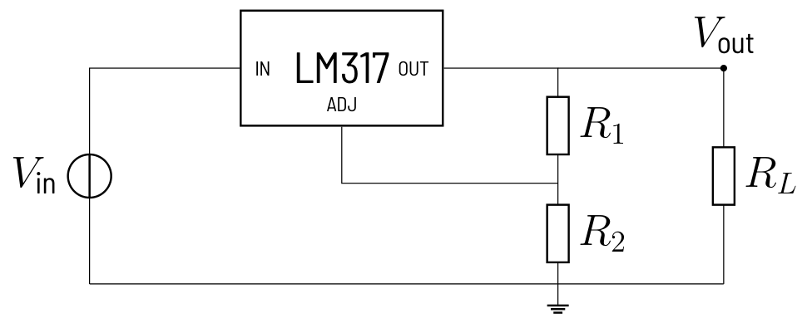
SERIES REGULATORS
Integrated regulators: 78xx vs LM317
78xx fixed
5, 12 V…; 1 A (TO-220), 0.1 A (78L05)
Dropout ≈ 2 V, LDO types 0.1–0.5 V
Current limit, thermal shutdown
LM317 adjustable
V_{out} = 1.25 V·(1 + R₂/R₁)
R₁ = 240 Ω sets the minimum load
1.25 V/R₁ alone: a current source
Electronic Circuit Design · Voltage and Current Sources
33
Notes:
Put the input and output capacitors close to the pins, or the regulator may oscillate. The LM317 has no ground pin; its quiescent current leaves through the output. Exercise 3.5 designs a 5 V supply and an LED current source.

Slide 34
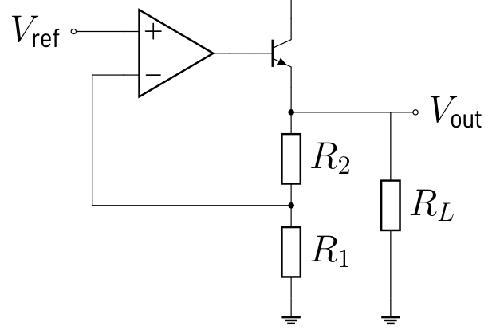
OP-AMP VOLTAGE SOURCES
Op-amp voltage source with booster
Reference + non-inverting amplifier: as accurate as V_{ref} and R₂/R₁
Loop gain makes R_{out} tiny: mΩ instead of the op-amp's 50 Ω
npn booster inside the loop: op-amp delivers only I_{L}/(β+1)
V_{BE} drops out; op-amp output must reach V_{out} + V_{BE}
KEY RULE
V_{out} = V_{ref}·(1 + R₂/R₁), R_{out} ≈ r_{o}/(1 + Aβ)
Falstad sources/opamp_voltage_source
Slide R_L from 1 kΩ to 20 Ω: V_out stays at 5.000 V
Electronic Circuit Design · Voltage and Current Sources
34
Notes:
Example: LM4040-2.5 with G = 2 gives 5.000 V from 12 V at up to 100 mA, compared with 4.89–4.95 V for the Zener follower. Point out that the simulation has no current limit; transistor power and SOA limit it in reality (Exercise 3.6).

Slide 35
TRANSISTOR CURRENT SOURCES
BJT current source
Emitter follows the base: fixed V_{E} → fixed emitter current
Load sits in the collector; keep V_{CE} ≥ 0.3 V (compliance)
Stiff base: divider current ≥ 10·I_{B}, or a Zener or 2 LEDs
Large V_{E} (≥ 1 V) reduces the −2 mV/K drift of V_{BE}
KEY RULE
I_{C} ≈ (V_{B} − 0.65 V)/R_{E}, R_{L,max} = (V_{CC} − V_{E} − 0.3 V)/I_{C}
Falstad sources/bjt_current_source
1 kΩ and 4.7 kΩ: same 1.02 mA; 15 kΩ saturates (0.71 mA)
Electronic Circuit Design · Voltage and Current Sources
35
Notes:
Capstone thread: 1 mA for the 1 kΩ sensor from 12 V with 10 kΩ/2.2 kΩ and R_E = 1.5 kΩ. The third load is outside the compliance range, so the current drops. Exercise 3.7.

Slide 36
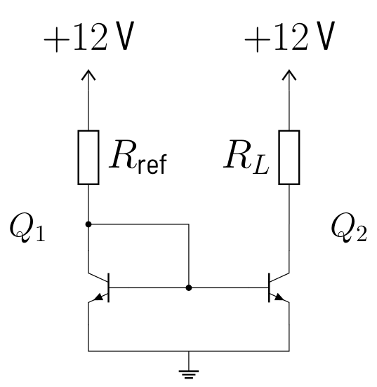
TRANSISTOR CURRENT SOURCES
Falstad: current mirror
TRY IT IN FALSTAD
Falstad sources/current_mirror
Change R_L: I_out stays near I_ref = 1.04 mA
OBSERVE
Q1 as a diode sets V_{BE}; Q2 with the same V_{BE} copies the current
I_{out} = I_{ref}·β/(β+2): 1.04 mA → 1.02 mA
Both transistors must match and share the same temperature
Electronic Circuit Design · Voltage and Current Sources
36
Notes:
Change R_ref to show that it alone sets the output current. Mirrors are everywhere inside ICs, including op-amps and references.

Slide 37
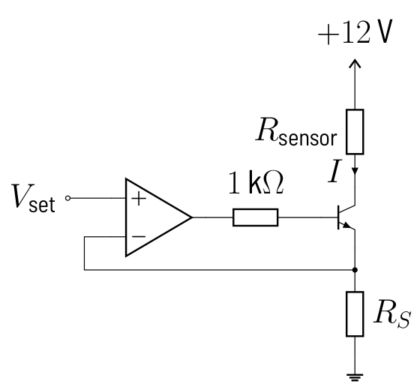
OP-AMP CURRENT SOURCES AND SENSOR EXCITATION
Op-amp current sources
Op-amp forces V_{RS} = V_{set}: I = V_{set}/R_{S}, V_{BE} drift drops out
With transistor: base current lost (1 % at β = 100), MOSFET avoids it
Floating sensor in the feedback path: exact current, no terminal at ground
Howland pump for grounded loads: needs well matched resistors
KEY RULE
I = V_{set}/R_{S}: as accurate as V_{set} and R_{S}
Falstad sources/opamp_current_source
Compare 0.990 mA (transistor) with 1.000 mA (floating)
Electronic Circuit Design · Voltage and Current Sources
37
Notes:
V_set = 1.00 V, R_S = 1.00 kΩ gives 1 mA; the floating sensor shows VOUT2 = 2.385 V at 1385 Ω. Compliance: V_out must stay inside the op-amp output range. Howland derivation in the script section on op-amp current sources.

Slide 38
OP-AMP CURRENT SOURCES AND SENSOR EXCITATION
Sensor excitation: why 1 mA?
Pt1000-like sensor: 1000 Ω at 0 °C, 1385 Ω at 100 °C
Constant current makes V_{sensor} linear in T: 3.85 mV/K at 1 mA
Self-heating: 1.39 mW → about 0.55 K error at 0.4 K/mW
The 1 V offset at 0 °C is removed by a bridge (next chapters)
KEY RULE
P = I²·R: half the current, a quarter of the self-heating
Electronic Circuit Design · Voltage and Current Sources
38
Notes:
This is the capstone thread: the sensor must not carry more than 1 mA. Self-heating depends strongly on mounting (still air vs flowing water). Ratiometric measurement in the chapter on voltage references is often better than a precise current.

Slide 39
EXERCISES
Now work it out in the script
Derivations, worked numbers and solutions: script, chapter 3 “Voltage and Current Sources”. Check each result in the Falstad examples.
3.1
Measuring a real voltage source
3.5
Adjustable regulator LM317
3.2
Source transformation
3.6
Op-amp voltage source for 3.3 V
3.3
Design of a Zener shunt regulator
3.7
BJT current source for a resistive sensor
3.4
Emitter follower regulator
Electronic Circuit Design · Voltage and Current Sources
39
Notes:
Exercises with full solutions are in the script (docu.pdf); the student version has no solutions.

Slide 40
04
Voltage References
Zener and bandgap references, scaling to 4.00 V, ratiometric measurement
TAKE-HOME 1
TAKE-HOME 2
TAKE-HOME 3
A reference error is a gain error of the chain
Never load a reference: buffer and scale it
Ratiometric measurement cancels the reference
Electronic Circuit Design · Voltage References
40
Notes:
Chapter 4: Voltage References. A reference error is a gain error of the chain Never load a reference: buffer and scale it Ratiometric measurement cancels the reference

Slide 41
WHY VOLTAGE REFERENCES?
Regulator or reference?
Voltage regulator
Voltage reference
Supplies power: mA … A
Accuracy 1–5 %, 100–300 ppm/K
Noise high, rarely specified
Defines a voltage: µA … 10 mA
Accuracy 0.02–1 %, 1–50 ppm/K
Low, specified noise
Electronic Circuit Design · Voltage References
41
Notes:
The ADC measures a ratio, code = 2^N·V_in/V_ref, and the bridge output is a fraction of its excitation: any error of V_ref is a gain error of the whole chain. A reference is a voltage standard on the board; if a load needs current, buffer it with an op-amp.

Slide 42
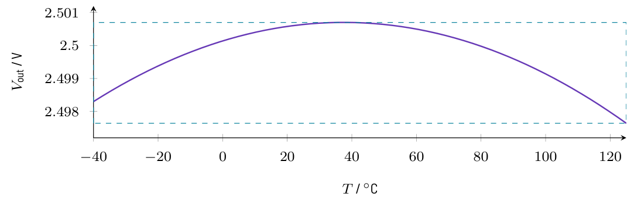
SPECIFICATIONS
Data sheet parameters
Initial accuracy at 25 °C (e.g. ±0.1 %) and TC (e.g. 20 ppm/K)
Line and load regulation (e.g. 50 µV/V, 100 ppm/mA)
Noise 0.1–10 Hz peak-to-peak, long-term drift, thermal hysteresis
KEY RULE
Box method: TC = (V_{max} − V_{min})/(V_{nom}·(T_{max} − T_{min}))·10⁶ ppm
Electronic Circuit Design · Voltage References
42
Notes:
The box method only uses the extremes, not the shape of the curve: a bandgap's bow looks better or worse depending on the temperature range. Calibration removes the initial accuracy, but not drift and hysteresis.

Slide 43
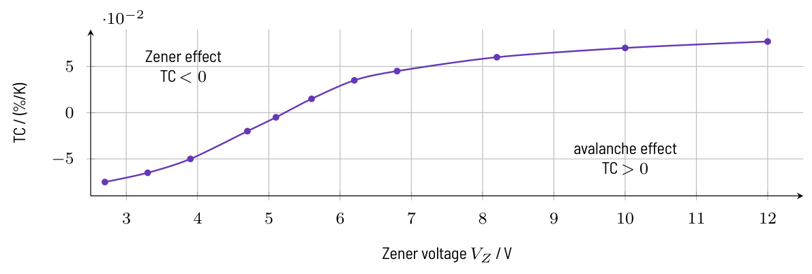
THE ZENER REFERENCE
The Zener reference
Smallest |TC| near 5–6 V: use 5.6 V or 6.2 V Zeners
6.2 V Zener + forward diode: compensated reference diode (1N821)
Fed by a resistor: line regulation ≈ r_{Z}/(R_{V} + r_{Z}), r_{Z} = 5–50 Ω
Fed by a current source: ≈ r_{Z}/r_{o}, far better
Electronic Circuit Design · Voltage References
43
Notes:
Below 5 V the Zener effect has a negative TC, above it the avalanche effect a positive one. The feed choice decides how much supply variation reaches the reference; both feeds are compared in Falstad on the next slide.

Slide 44
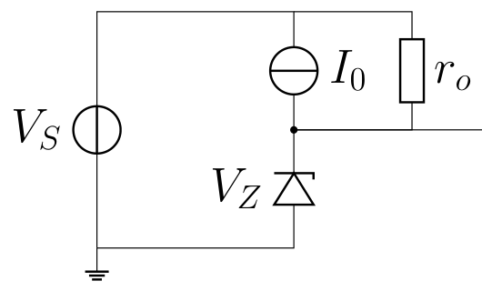
THE ZENER REFERENCE
Falstad: resistor vs current-source feed
TRY IT IN FALSTAD
Falstad references/zener_resistor
Supply 12 → 14 V: +7 mV; add 2.2 kΩ load: −17 mV
Falstad references/zener_current_source
Move the slider to 14 V: VzI changes by only 0.1 mV
OBSERVE
Series resistor 1.2 kΩ: 3.5 mV/V line regulation
Current source with r_{o} = 100 kΩ: 70 times better
The load current is taken from the Zener: keep I_{Z} ≥ I_{Z,min}
Electronic Circuit Design · Voltage References
44
Notes:
Read the labels Vz12, Vz14, Vz12L and VzR/VzI. Calculations with the exponential Zener model are in Exercise 4.1 and Exercise 4.2.

Slide 45
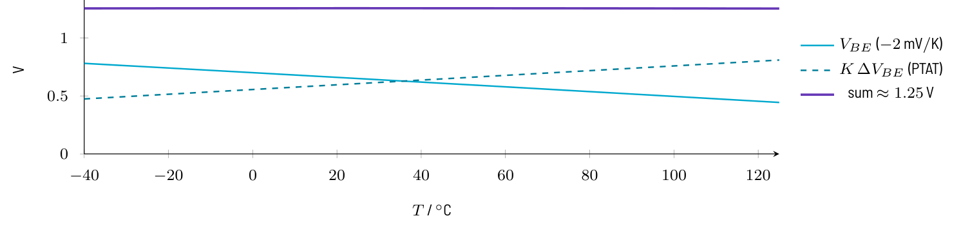
THE BANDGAP REFERENCE
The bandgap principle
V_{BE} falls by about 2 mV/K (CTAT)
ΔV_{BE} of two current densities rises with T (PTAT): V_{T}·ln N
Sum V_{BE} + K·ΔV_{BE} ≈ 1.25 V is flat at room temperature
Rule of thumb: about 60 mV per decade of current ratio
KEY RULE
V_{BG} = V_{BE} + K·V_{T}·ln N ≈ 1.25 V
Falstad references/delta_vbe
1× vs 8× area at the same current: ΔV_BE ≈ 53.8 mV
Electronic Circuit Design · Voltage References
45
Notes:
k/q = 86.2 µV/K; with N = 8, ΔV_BE = 53.5 mV at 25 °C and +0.179 mV/K. I_S cancels, so ΔV_BE depends only on T and N. Falstad has no temperature, but the room-temperature ΔV_BE can be measured.

Slide 46
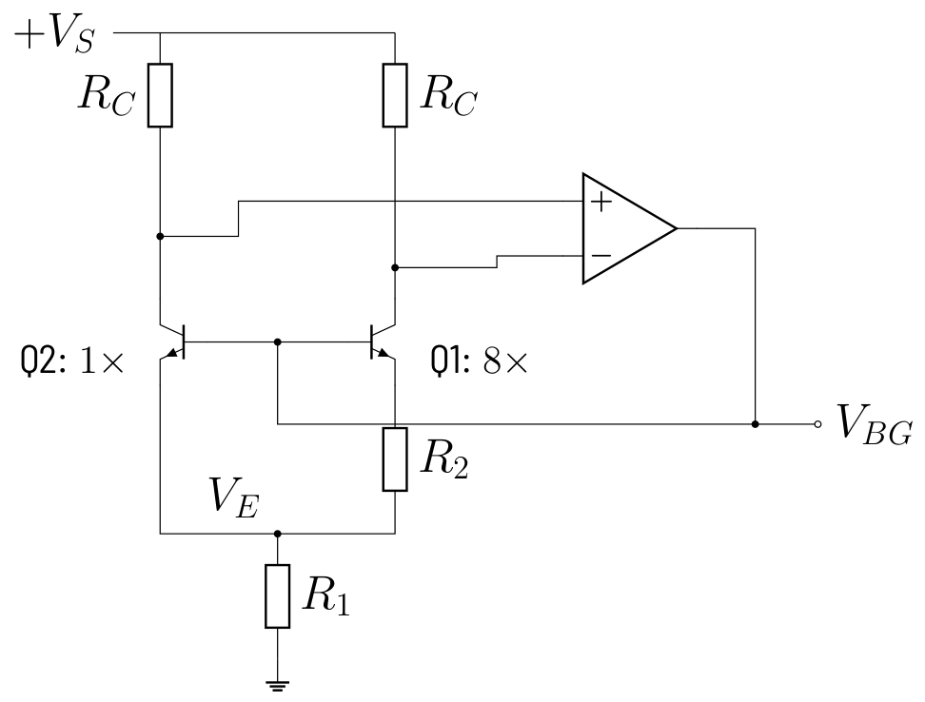
THE BANDGAP REFERENCE
Falstad: Brokaw bandgap cell
TRY IT IN FALSTAD
Falstad references/brokaw_cell
Check equal collectors (4.47 V) and 53.8 mV across R2
OBSERVE
Op-amp forces equal collector currents; ΔV_{BE} appears across R₂
R₁ carries both currents: V_{E} = 2·(R₁/R₂)·V_{T}·ln 8
V_{BG} = V_{BE2} + V_{E} = 0.520 V + 0.602 V = 1.122 V
Electronic Circuit Design · Voltage References
46
Notes:
K = 2R_1/R_2 = 11.2 makes the PTAT part rise by +2.0 mV/K, cancelling V_BE. Falstad gives 1.122 V instead of 1.25 V because of its transistor model. Exercise 4.3.

Slide 47
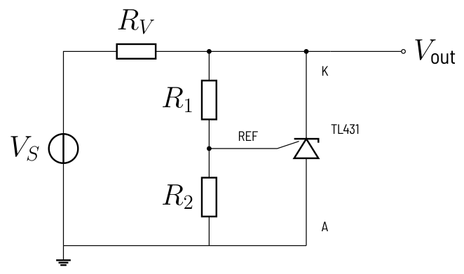
SHUNT AND SERIES REFERENCES
Adjustable shunt reference TL431
Error amplifier compares REF with an internal 2.5 V bandgap
Shunt conducts until V_{REF} = 2.495 V; cathode current 1–100 mA
Capstone: R₁ = 12 kΩ, R₂ = 20 kΩ → 2.5 V·1.6 = 4.00 V
I_{REF}·R₁ adds about 24 mV: use smaller resistors or trim
KEY RULE
V_{out} = V_{REF}·(1 + R₁/R₂) + I_{REF}·R₁
Falstad references/shunt_ref
Supply 6 V or 12 V: cathode stays at 4.00 V, REF at 2.50 V
Electronic Circuit Design · Voltage References
47
Notes:
Show the behavioural model inside the TL431 (op-amp, 2.5 V source, transistor). R_V must deliver I_K,min plus load and divider current at the lowest supply. Exercise 4.4.

Slide 48
SHUNT AND SERIES REFERENCES
Shunt or series reference?
Shunt (TL431, LM4040)
Series (REF50xx, ADR4xx)
Two terminals, any supply above V_{out}
Can serve as negative reference
R_{V} wastes I_{min} + I_{L,max} all the time
Three terminals, 0.1–1 mA quiescent
Better for varying loads and batteries
Needs V_{in} > V_{out} + V_{dropout}
Electronic Circuit Design · Voltage References
48
Notes:
Both types need decoupling exactly as in the data sheet: some are unstable with the wrong capacitor.

Slide 49
BUFFERING AND SCALING A REFERENCE
Falstad: a divider is no reference
TRY IT IN FALSTAD
Falstad references/ref_divider_loaded
10k/40k at 5 V: 4.00 V open, 2.00 V with the 8 kΩ ladder
Falstad references/ref_buffer_ladder
2.5 V × 1.6 = 4.00 V at the ladder top, taps every 0.5 V
OBSERVE
Divider source resistance 8 kΩ equals the ladder: voltage halves
A follower restores 4.00 V: input current ≈ 0, output resistance ≈ 0
Non-inverting amplifier scales and buffers in one step
Electronic Circuit Design · Voltage References
49
Notes:
This is the capstone reference for the 3-bit flash converter: 4.00 V on 8 × 1 kΩ, 0.5 mA ladder current. Exercise 4.5.

Slide 50
BUFFERING AND SCALING A REFERENCE
Design recipe: reference for an ADC ladder
1
Full scale and LSB: LSB = V_{FS}/2^{N} (4.00 V, 3 bit: 0.5 V)
2
Ladder current I = V_{FS}/(2^{N}·R) (8 × 1 kΩ: 0.5 mA)
3
Gain G = V_{FS}/V_{R} from a standard reference (2.5 V: G = 1.6)
4
R_{F}/R_{G} = G − 1, R_{F} + R_{G} ≫ ladder (12 kΩ + 20 kΩ)
5
Check op-amp current, resistor tolerance, G·V_{offset}; decouple the top
Electronic Circuit Design · Voltage References
50
Notes:
Resistor tolerance enters with (G−1)/G: 1 % resistors give ±0.75 %, about ±30 mV, irrelevant for 3 bit but 30 LSB at 12 bit. Decouple the ladder top with 100–1000 nF close to the comparators.

Slide 51
RATIOMETRIC MEASUREMENT
Ratiometric measurement
Feed sensor divider and ADC ladder from the same V_{ref}
The code then depends only on resistor ratios, not on V_{ref}
Sensor from a fixed 4.00 V, ladder from V_{ref}: 10 % error flips a code
Works only with the same voltage at the same time on both paths
KEY RULE
code = 2^{N}·R_{S}/(R₁ + R_{S}), independent of V_{ref}
Falstad references/ratiometric
VREF slider 4.0 → 3.6 V: left stays code 2, right jumps to 3
Electronic Circuit Design · Voltage References
51
Notes:
Two 2-bit flash converters with a 1 kΩ/2.7 kΩ sensor divider, V_in = 0.730·V_exc. A shared connection with voltage drops, or noise on one path only, breaks the cancellation. Exercise 4.6.

Slide 52
ERROR BUDGET
Error budget of the 4.00 V reference
Initial 0.20 %, TC 25 ppm/K over ±25 K 0.06 %, resistors 0.08 %
Op-amp offset 0.04 %, long-term drift 0.01 %
Worst case 0.39 %, RSS 0.23 %
3 bit (LSB 12.5 %): no problem; 12 bit: 16 LSB → calibrate
KEY RULE
Worst case = sum of all errors, RSS = √(sum of squares)
Electronic Circuit Design · Voltage References
52
Notes:
Compare the budget with the LSB of the converter. After calibration only drift remains: 25 ppm/K over 25 K is still 2.6 LSB at 12 bit (Exercise 4.6). Alternatively measure ratiometrically.

Slide 53
EXERCISES
Now work it out in the script
Derivations, worked numbers and solutions: script, chapter 4 “Voltage References”. Check each result in the Falstad examples.
4.1
Zener reference with series resistor
4.4
TL431 set to 4.00 V
4.2
Zener with current-source feed
4.5
Reference for the 3-bit flash converter
4.3
Bandgap design
4.6
Ratiometric measurement and error budget
Electronic Circuit Design · Voltage References
53
Notes:
Exercises with full solutions are in the script (docu.pdf); the student version has no solutions.

Slide 54
05
Bridge Circuits
Turn small sensor resistance changes into a clean differential voltage
TAKE-HOME 1
TAKE-HOME 2
TAKE-HOME 3
A bridge removes the constant part, leaves only the change
Unequal arms (m ≫ 1): less signal, much better linearity
Read the bridge differentially: buffers + difference amp
Electronic Circuit Design · Bridge Circuits
54
Notes:
Chapter 5: Bridge Circuits. A bridge removes the constant part, leaves only the change Unequal arms (m ≫ 1): less signal, much better linearity Read the bridge differentially: buffers + difference amp

Slide 55
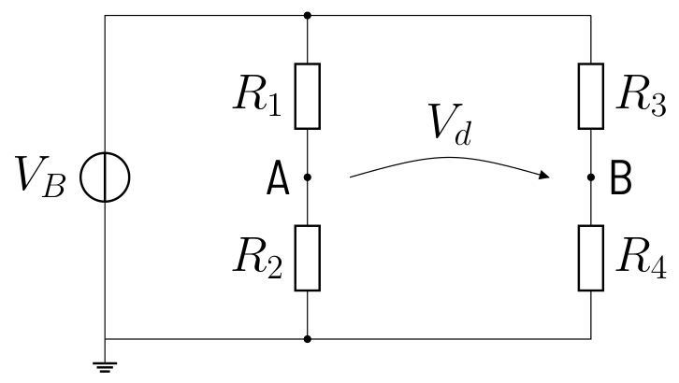
THE WHEATSTONE BRIDGE
Two dividers, one difference
V_{d} = V_{A} − V_{B}: difference of two divider taps, neither at ground
Balanced (V_{d} = 0) independent of V_{B}: supply drift cancels at balance
Null method: adjust a known R until V_{d} = 0 (classic Wheatstone)
Deflection method: fixed R, balanced at the reference point, measure V_{d}
KEY RULE
Balance: R₁·R₄ = R₂·R₃
Falstad bridges/wheatstone
Move the Rx slider: 1010 Ω gives 12.44 mV, 1500 Ω gives 0.500 V
Electronic Circuit Design · Bridge Circuits
55
Notes:
Start from the sensor in a plain divider: the tiny change sits on a large constant voltage. The second divider subtracts that constant part. Away from balance V_d is proportional to V_B, so the excitation must be stable or the measurement ratiometric. Exercise 5.1 does the numbers.

Slide 56
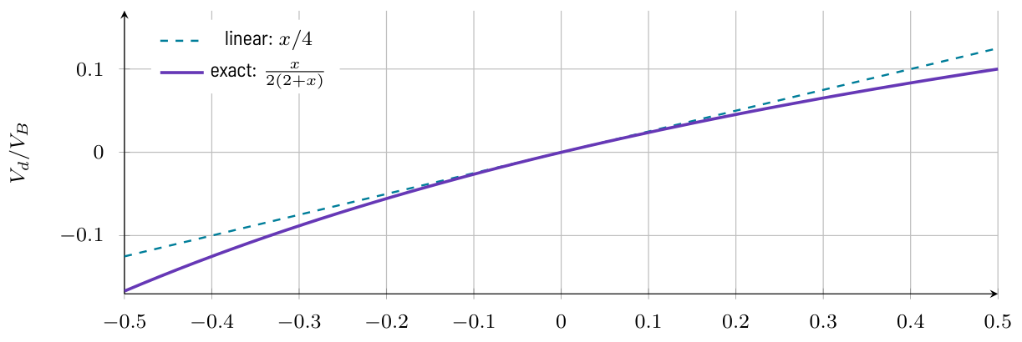
OUTPUT VOLTAGE AND LINEARITY
Quarter bridge: the output bends
One sensor R₀(1+x), other arms R₀: V_{d} = (V_{B}/4)·x/(1+x/2)
Relative error of the linear formula ≈ −x/2
Strain gauge (x < 0.5 %): negligible; Pt100 over 100 K (x = 38.5 %): 16 %
Cause: the current in the sensor leg changes with the sensor
KEY RULE
V_{d} ≈ (V_{B}/4)·ΔR/R₀
Electronic Circuit Design · Bridge Circuits
56
Notes:
Show the plot: positive x gives too small an output, negative x too large. The derivation is in section Output Voltage and Linearity of the script.

Slide 57
OUTPUT VOLTAGE AND LINEARITY
Sensitivity vs. linearity: choose m
Equal arms (m = 1)
Unequal arms (m = 39)
Max. sensitivity V_{B}/4 per unit x
Nonlinearity ≈ −x/2
High sensor current, self-heating
Sensitivity m/(m+1)² = 0.024
Nonlinearity ≈ −x/(m+1): 20× smaller
Sensor leg acts like a current source
Electronic Circuit Design · Bridge Circuits
57
Notes:
R1 = R3 = m·R0. A large m keeps the leg current nearly constant, so the sensor voltage is nearly proportional to its resistance. The amplifier needs gain anyway, while nonlinearity would need software correction.

Slide 58
HALF AND FULL BRIDGES: STRAIN GAUGES
Strain gauges: quarter, half, full bridge
Gauge factor k ≈ 2: x = k·ε; 1000 µm/m gives only 0.2 % ΔR
Quarter: V_{d} ≈ V_{B}·x/4, half: V_{B}·x/2, full: V_{B}·x
Half and full bridge are exactly linear: the leg current stays constant
Temperature changes all gauges equally: compensated
Falstad bridges/bridge_types
Compare the three voltmeters: 2.50 mV, 5.00 mV, 10.0 mV
Electronic Circuit Design · Bridge Circuits
58
Notes:
Gauges on top of a bending beam are stretched, on the bottom compressed; put them in adjacent arms. Load cells of scales are full bridges. In a quarter bridge a dummy gauge gives the temperature compensation. Exercise 5.2.

Slide 59
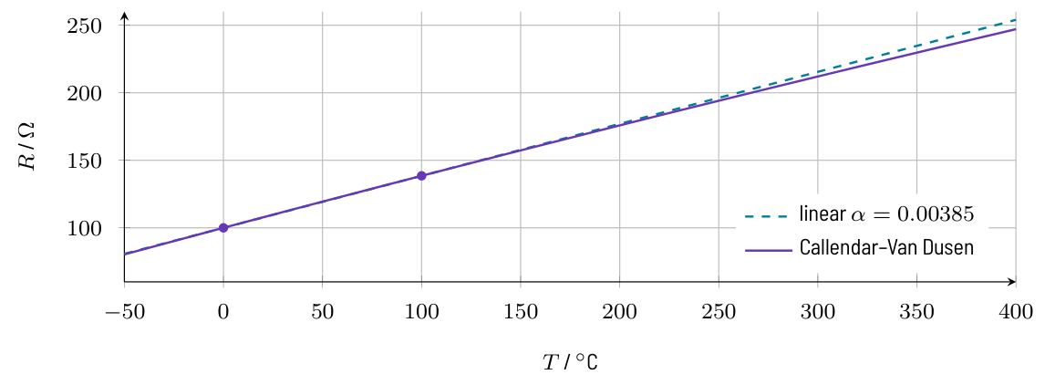
RESISTIVE TEMPERATURE SENSORS
Platinum sensors Pt100 and Pt1000
Pt100: 100 Ω at 0 °C, 138.5 Ω at 100 °C, 0.385 Ω/K
Linear model good to 0.4 K over 0 … 100 °C; Callendar–Van Dusen beyond
Class B: ±(0.3 K + 0.005·|T|), class A: ±(0.15 K + 0.002·|T|)
Self-heating ΔT = E·I²·R: Pt100 ≤ 1 mA, Pt1000 ≤ 0.3 mA
KEY RULE
R(T) = R₀·(1 + α·T), α = 3.85·10⁻³/K
Electronic Circuit Design · Bridge Circuits
59
Notes:
Platinum is stable and standardised (IEC 60751). Self-heating depends on coupling to the medium: 0.1 K/mW in flowing water, about 1 K/mW in still air. Exercise 5.3 has the numbers.

Slide 60
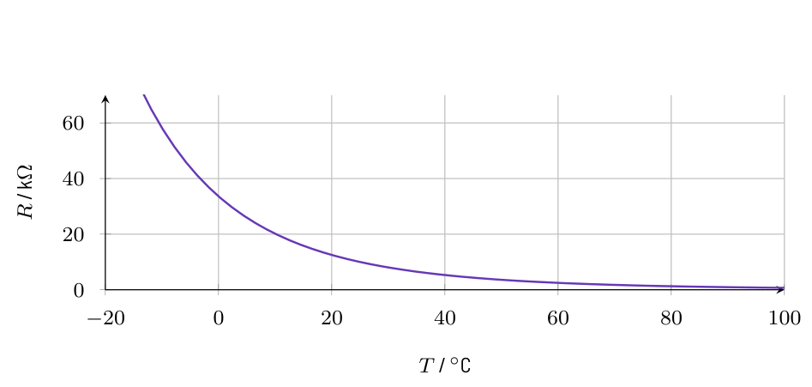
RESISTIVE TEMPERATURE SENSORS
Platinum RTD vs. NTC thermistor
Pt100 / Pt1000
+0.39 %/K, nearly linear
Standardised, accurate, stable
Needs a bridge and gain
NTC thermistor
About −4.4 %/K at 25 °C: 10× more
Strongly nonlinear (exponential)
Cheap; linearise with R or a table
Electronic Circuit Design · Bridge Circuits
60
Notes:
NTC model: R(T) = R25·exp(B·(1/T − 1/T25)), for example 10 kΩ and B = 3950 K. The capstone uses the Pt100 because its characteristic is reproducible.

Slide 61
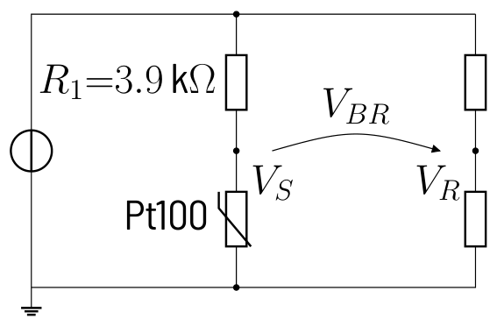
DESIGNING THE SENSOR BRIDGE
Design recipe: sensor bridge
1
Excite from the ADC reference (ratiometric): here V_{ref} = 4.00 V
2
R₄ = R_{sensor}(T_{min}): V_{d} = 0 at T_{min} (Pt100: R₄ = 100 Ω)
3
R₁ ≥ V_{B}/I_{max} − R_{sensor}, next E-value; R₃ = R₁ (here 3.9 kΩ)
4
Exact V_{d}(T_{max}) and gain G = V_{FS}/V_{d}(T_{max}): 37.18 mV, G = 107.6
5
Check nonlinearity x/(m+1), self-heating, common mode ≈ V_{B}/(m+1)
Electronic Circuit Design · Bridge Circuits
61
Notes:
This is the design card of the chapter applied to the capstone: Pt100, 0 to 100 °C, at most 1 mA. Sensitivity is about 0.37 mV/K and the self-heating 0.1 mW. Worked out in Exercise 5.4.

Slide 62
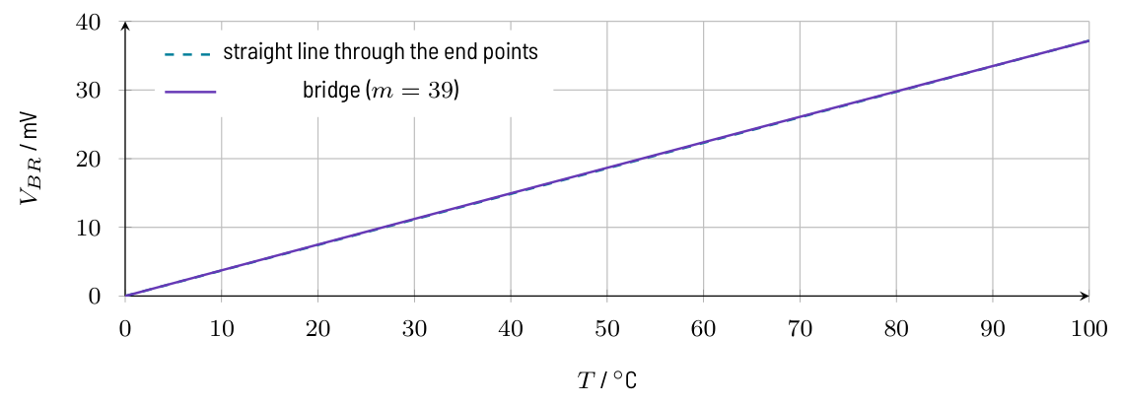
DESIGNING THE SENSOR BRIDGE
Falstad: capstone bridge, Pt100 and Pt1000
TRY IT IN FALSTAD
Falstad bridges/pt100_bridge
Slider 100 / 119.25 / 138.5 Ω: 0, 18.68, 37.18 mV
Falstad bridges/pt1000_bridge
Slider 1000 / 1192.5 / 1385 Ω: 0, 134.7, 260.9 mV
OBSERVE
Pt100, m = 39: almost a straight line, 0.09 mV ≈ 0.24 K off at 50 °C
V_{R} stays at 100 mV: the reference arm is the constant part
Pt1000 at 5 V (m = 4.7): 7× more signal, 1.6 % nonlinearity
Electronic Circuit Design · Bridge Circuits
62
Notes:
With m = 1 the same Pt100 bridge would deviate by 4.4 K. The Pt1000 version is Exercise 5.5: more signal and less gain needed, but almost ten times the self-heating power.

Slide 63
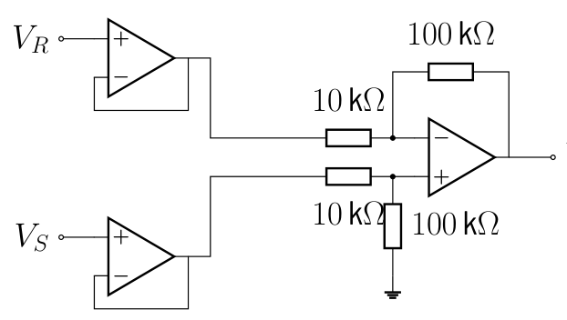
READING THE BRIDGE: COMMON-MODE VOLTAGE
Read the bridge differentially
Both taps sit at ≈ 100 mV (common mode); the signal is their difference
Single-ended gain 107.6 at V_{S}: 10.75 V at 0 °C instead of 0 V
Difference amplifier amplifies V_{S} − V_{R}, rejects V_{CM} if R match
Buffers keep the bridge unloaded; gain stage G₂ = 10.76 → 0 … 4.00 V
Falstad bridges/bridge_single_ended
Output far above 4 V: the constant part is amplified too
Falstad bridges/bridge_ina
Pt100 slider: 0 V, 2.01 V, 4.00 V at 0, 50, 100 °C
Electronic Circuit Design · Bridge Circuits
63
Notes:
Open the single-ended version first and show the huge output, then the buffered difference amplifier. Without buffers the 10 kΩ inputs would load the 97.5 Ω bridge and spoil the common-mode rejection. Details in chapter Operational Amplifiers.

Slide 64
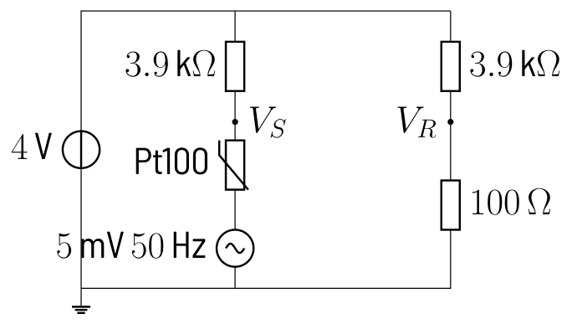
INTERFERENCE AND LEAD RESISTANCE
Falstad: 50 Hz in series with the sensor
TRY IT IN FALSTAD
Falstad bridges/bridge_50hz
Scope: 4.88 mV amplitude at V_S, 0.52 V at Vout
OBSERVE
Series interference changes only V_{S}: differential, not rejected
After G = 107.6: 0.52 V amplitude, about one LSB (0.5 V)
Remedies: twisted pair, shield, short leads, low-pass before the ADC
Electronic Circuit Design · Bridge Circuits
64
Notes:
The sensor loop acts as a transformer winding for the lamp fields. Only interference that reaches both nodes equally is common mode. The filter chapter designs the low-pass that removes it.

Slide 65
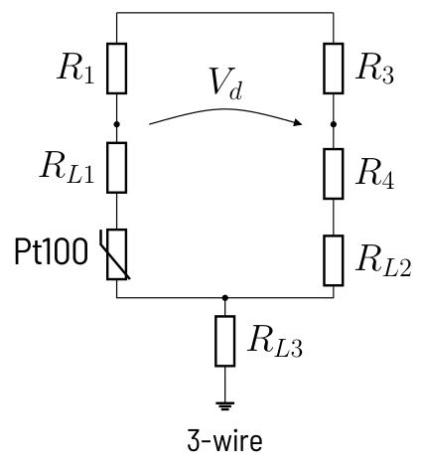
INTERFERENCE AND LEAD RESISTANCE
Falstad: 2-wire vs. 3-wire connection
TRY IT IN FALSTAD
Falstad bridges/bridge_3wire
At 100 Ω: 2-wire 0.975 mV, 3-wire 0 V; then both at 138.5 Ω
OBSERVE
2-wire: 2·R_{L} in series with the Pt100; 1 Ω → 2.6 K error
3-wire: R_{L1} and R_{L2} sit in adjacent arms and cancel at balance
4-wire: current through two leads, sense voltage on the other two
Electronic Circuit Design · Bridge Circuits
65
Notes:
Lead resistance 0.5 Ω per wire. At 100 °C the 3-wire error is only 0.05 K (37.16 instead of 37.18 mV), the 2-wire bridge reads 38.13 mV. Exercise 5.6.

Slide 66
EXERCISES
Now work it out in the script
Derivations, worked numbers and solutions: script, chapter 5 “Bridge Circuits”. Check each result in the Falstad examples.
5.1
Wheatstone bridge
5.4
Design of the capstone bridge
5.2
Strain gauge bridge
5.5
Alternative: Pt1000 at 5 V
5.3
Pt100 values
5.6
Interference and lead resistance
Electronic Circuit Design · Bridge Circuits
66
Notes:
Exercises with full solutions are in the script (docu.pdf); the student version has no solutions.

Slide 67
06
Operational Amplifiers
Basic op-amp circuits, real limits, and the capstone measurement amplifier
TAKE-HOME 1
TAKE-HOME 2
TAKE-HOME 3
Negative feedback: the resistors set the gain
Use an INA for bridges; resistor matching sets CMRR
Keep G < 100 per stage; watch offset and headroom
Electronic Circuit Design · Operational Amplifiers
67
Notes:
Chapter 6: Operational Amplifiers. Negative feedback: the resistors set the gain Use an INA for bridges; resistor matching sets CMRR Keep G < 100 per stage; watch offset and headroom

Slide 68
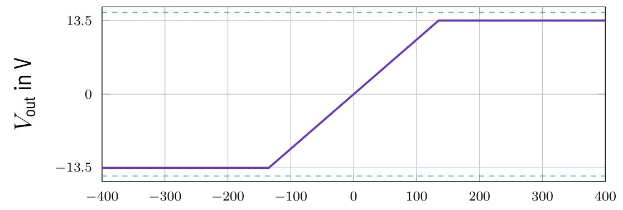
THE IDEAL OPERATIONAL AMPLIFIER
Op-amp and the golden rules
Amplifies V₊ − V₋ with A = 10⁵ … 10⁷; output stays inside supply
Open loop: ±135 µV linear range, else a rail → comparator
Negative feedback to the inverting input pulls V₊ − V₋ to ≈ 0
Rule 1 holds only while the output is not saturated
KEY RULE
With negative feedback: V₊ = V₋ and I₊ = I₋ = 0
Electronic Circuit Design · Operational Amplifiers
68
Notes:
The plot shows the open-loop transfer: a few hundred microvolts saturate the output. Golden rules from Horowitz/Hill; the property table ideal vs. real is in section The Ideal Operational Amplifier.

Slide 69
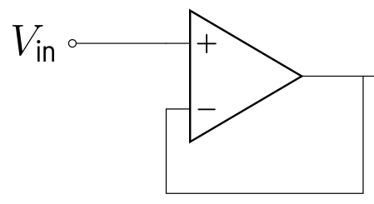
BASIC AMPLIFIER CIRCUITS
Voltage follower: buffer the source
V_{out} = V_{in}, gain 1; input current ≈ 0, output low impedance
100k/100k divider with 10 kΩ load: 0.833 V instead of 5 V
Behind a follower: 5.00 V, the divider does not notice the load
Used at bridge taps, ADC reference ladder, S&H hold capacitor
Falstad opamps/opamp_follower
Compare the loaded divider (0.833 V) with the buffered one (5.00 V)
Electronic Circuit Design · Operational Amplifiers
69
Notes:
The follower amplifies current, not voltage: it copies a high-impedance node to a low-impedance output.

Slide 70

BASIC AMPLIFIER CIRCUITS
Non-inverting vs. inverting amplifier
Non-inverting
G = 1 + R₂/R₁, in phase
Input resistance ≈ ∞
Gain ≥ 1 only
Inverting
G = −R₂/R₁, 180° phase
V₋ is a virtual ground
Input resistance = R₁ (loads source)
Electronic Circuit Design · Operational Amplifiers
70
Notes:
Both follow from the two golden rules in two lines. The figure shows the non-inverting amplifier: R1 and R2 divide the output back to the inverting input.

Slide 71
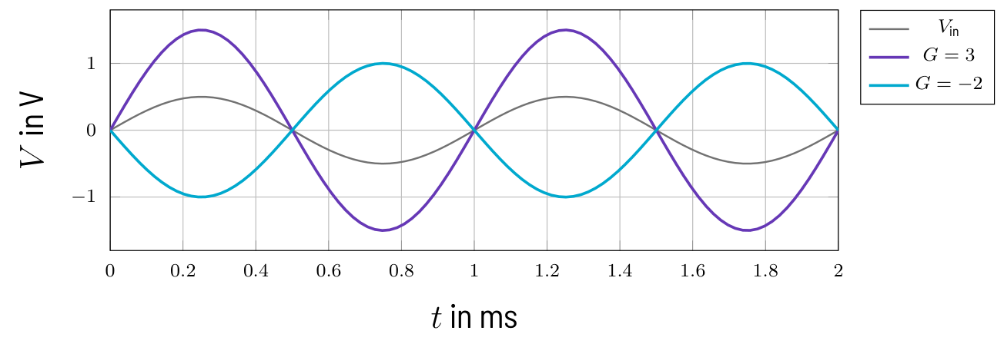
BASIC AMPLIFIER CIRCUITS
Falstad: G = 3 and G = −2
TRY IT IN FALSTAD
Falstad opamps/opamp_noninv_inv
Scope: ±1.50 V in phase and ±1.00 V inverted for 0.5 V in
OBSERVE
Same R₁ = 10 kΩ, R₂ = 20 kΩ in both circuits
Non-inverting: 1.5 V, in phase; inverting: 1.0 V, inverted
Try R₂ = 47 kΩ for an inverting gain of −4.7
Electronic Circuit Design · Operational Amplifiers
71
Notes:
Input 0.5 V amplitude at 1 kHz. Exercise 6.1 asks for gains, amplitudes and input resistances.

Slide 72
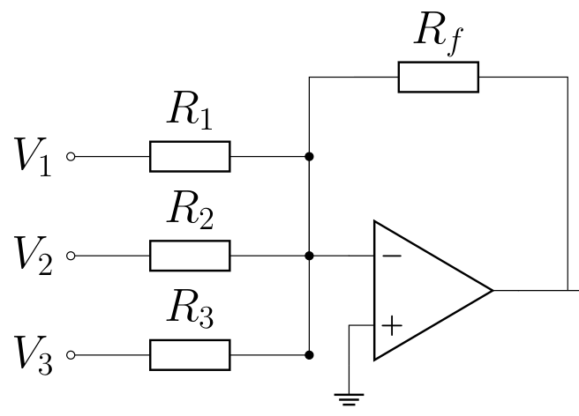
BASIC AMPLIFIER CIRCUITS
Summing amplifier
Virtual ground decouples the inputs; currents add up in R_{f}
Weight of input k: −R_{f}/R_{k}
Uses: audio mixer, weighted DAC, adding an offset (level shift)
KEY RULE
V_{out} = −R_{f}·(V₁/R₁ + V₂/R₂ + V₃/R₃)
Falstad opamps/opamp_summing
Vout = −1.50 V, summing node stays at 0.00 V
Electronic Circuit Design · Operational Amplifiers
72
Notes:
Inputs 1 V via 10 kΩ, 2 V via 20 kΩ and −0.5 V via 10 kΩ with Rf = 10 kΩ. Exercise 6.2.

Slide 73
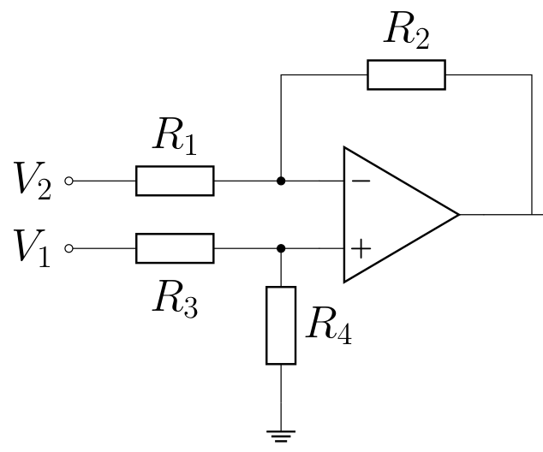
DIFFERENCE AND INSTRUMENTATION AMPLIFIERS
Difference amplifier and CMRR
With R₄/R₃ = R₂/R₁: V_{out} = (R₂/R₁)·(V₁ − V₂)
CMRR = A_{D}/A_{CM}; set by resistor matching, not the op-amp
G = 10, R₄ 1 % high: 72.6 mV instead of 50.0 mV (+45 %)
Remedy: 0.1 % or matched networks, trimmer, integrated diff. amp
KEY RULE
Worst case: CMRR ≈ (1 + G)/(4ε), 1 % parts, G = 10: ≈ 275 (49 dB)
Falstad opamps/opamp_diffamp
Matched 50.0 mV vs. 1 % mismatch 72.6 mV at 2.5 V common mode
Electronic Circuit Design · Operational Amplifiers
73
Notes:
A symmetric bridge has 2.5 V common mode and some 10 mV signal, so a tiny common-mode gain is a big error. The input resistances are unequal and low: the circuit loads a bridge. Exercise 6.3.

Slide 74
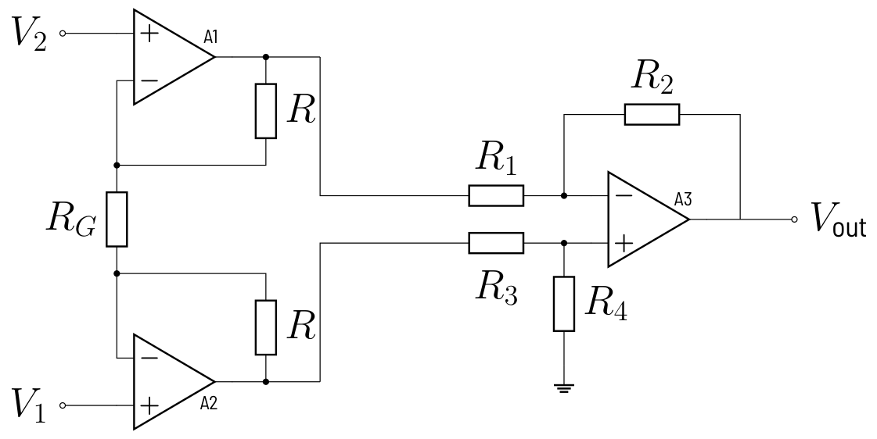
DIFFERENCE AND INSTRUMENTATION AMPLIFIERS
Instrumentation amplifier (INA)
A1, A2 non-inverting: inputs draw no current, bridge not loaded
Input stage: differential gain 1 + 2R/R_{G}, common mode gain 1
A3 difference stage removes the common mode
One R_{G} sets the gain: INA128, AD620, AD8221 (CMRR ≥ 100 dB)
Lab version: two followers + difference amp, all gain from R₂/R₁
KEY RULE
V_{out} = (1 + 2R/R_{G})·(R₂/R₁)·(V₁ − V₂)
Electronic Circuit Design · Operational Amplifiers
74
Notes:
The input stage improves the CMRR by the factor 1 + 2R/R_G. The lab circuit uses gain one in the buffers, so matching of R1 to R4 alone sets the CMRR.

Slide 75
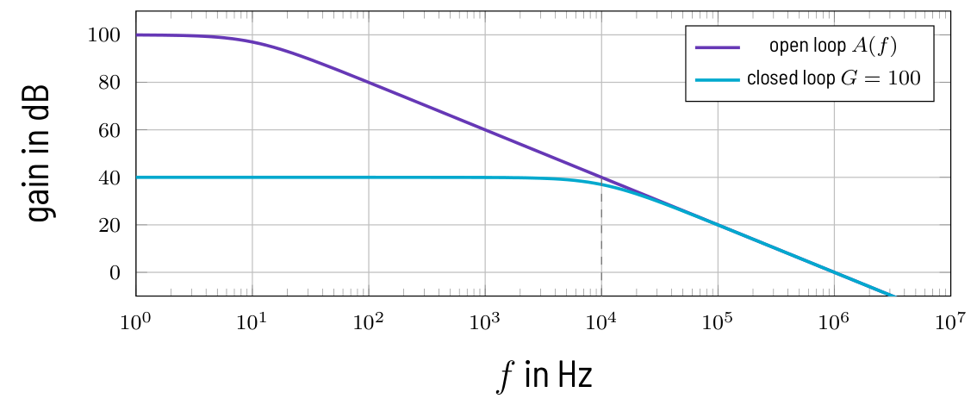
LIMITS OF REAL OP-AMPS
Finite gain and bandwidth
Gain error ≈ −G/A: A = 10⁵, G = 1000 → −1 %, G = 10000 → −9.1 %
Split the gain: 10·100 → −0.11 %; rule of the lab: G < 100 per stage
Bandwidth f_{c} ≈ GBW/G: 1 MHz/100 = 10 kHz
Falstad has constant A = 10⁵: no GBW, no slew rate
KEY RULE
G_{real} = G/(1 + G/A); GBW = A(f)·f = G·f_{c}
Falstad opamps/opamp_finite_gain
One stage 0.990 V / 9.09 V vs. two stages 0.999 V / 9.98 V
Electronic Circuit Design · Operational Amplifiers
75
Notes:
At 1 kHz a 1 MHz op-amp has only A = 1000, so a G = 100 stage is 10 % low; check fast circuits against the data sheet. The capstone signal is a few hertz, so GBW is no problem there. Exercise 6.4.

Slide 76
LIMITS OF REAL OP-AMPS
Output swing and single supply
Classic op-amp stays 1 … 2 V from the rails (LM358 at 5 V: 0 … 3.5 V)
Rail-to-rail output: within 10 mV … a few 100 mV of the rails
Check input common-mode range too: capstone bridge sits at 0.1 V
Single supply: bias bipolar signals to V_{S}/2, ±2 V → 0.5 … 4.5 V
Clipping cannot be repaired later: leave headroom for interference
Falstad opamps/opamp_level_shift
Shifted output 0.5 … 4.5 V vs. the follower clipping below 0 V
Electronic Circuit Design · Operational Amplifiers
76
Notes:
Exactly 0 V output is impossible on a single 5 V supply: use a negative rail or an offset range like 0.1 to 4.1 V. A clipped 50 Hz interference turns into a DC error after the low-pass filter.

Slide 77
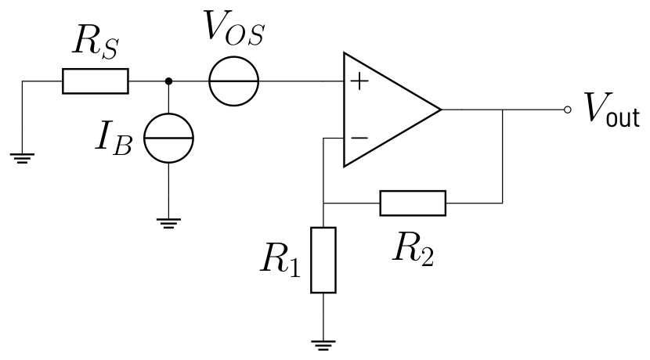
LIMITS OF REAL OP-AMPS
Offset voltage and bias current
LM358: V_{OS} ≈ 2 mV, I_{B} ≈ 20 nA; CMOS: ≈ 1 mV, ≈ 1 pA
Zero-drift (OPA2333, MCP6V02): V_{OS} < 10 µV
Capstone: 2 mV × 107.6 = 0.22 V, 5 % of full scale, almost ½ LSB
Remedies: zero-drift or CMOS op-amp, low R_{S}, offset trimming
KEY RULE
V_{out} = (1 + R₂/R₁)·(V_{OS} + R_{S}·I_{B})
Falstad opamps/opamp_offset
G = 101: 1 mV offset → 0.101 V; 100 nA via 100 kΩ → −1.01 V
Electronic Circuit Design · Operational Amplifiers
77
Notes:
Falstad's op-amp has no offset or bias current; the example models them with an extra voltage and current source. With the 100 Ω bridge source resistance I_B matters little, but behind a hold capacitor it does. Exercise 6.5.

Slide 78
DESIGNING THE MEASUREMENT AMPLIFIER
Capstone signal chain
Pt100 bridge at 4.00 V: V_{BR} = 0 … 37.18 mV
Total gain G = 4.00 V/37.18 mV = 107.6 = 10 × 10.76
Stage 1: buffers + difference amp 100k/10k; stage 2: G₂ = 10.76
Zero set by the bridge (R₄ = 100 Ω), span by R_{F} in stage 2
Common mode only 0.1 V: op-amp inputs must work near the low rail
Electronic Circuit Design · Operational Amplifiers
78
Notes:
The following low-pass, S&H and 3-bit flash ADC expect exactly 0 to 4 V, so one LSB is 0.5 V. In hardware R_F is 91 kΩ plus a 10 kΩ trimmer (G2 = 10.1 to 11.1); Falstad uses the E96 value 97.6 kΩ or the trimmer at 6.6 kΩ.

Slide 79
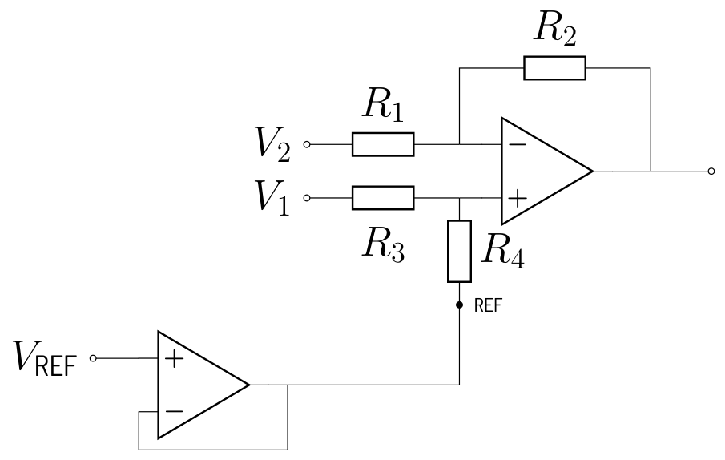
DESIGNING THE MEASUREMENT AMPLIFIER
Design recipe: zero and span
1
Bridge span V_{BR,max} and total gain G = V_{FS}/V_{BR,max} (107.6)
2
Split: G₁ = 10 (buffers + diff. amp), G₂ = G/G₁ = 10.76
3
R_{F} = fixed part + trimmer: 91 kΩ + 10 kΩ
4
Zero: sensor at 100 Ω, check 0.00 V; correct via R₄ or V_{REF}
5
Span: sensor at 138.5 Ω, trim to 4.00 V; then check the zero again
Electronic Circuit Design · Operational Amplifiers
79
Notes:
Zero first, then span: the span trimmer scales any remaining offset. The REF pin must be driven from a low impedance, as in the figure, or it spoils R4 and the CMRR.

Slide 80
DESIGNING THE MEASUREMENT AMPLIFIER
Falstad: the complete front end
TRY IT IN FALSTAD
Falstad opamps/opamp_ina
Pt100 at 100 Ω → 0.00 V; at 138.5 Ω → V_diff 372 mV, Vout 4.00 V
OBSERVE
V_{R} = 0.100 V, V_{BR} = 37.18 mV, V_{diff} = 372 mV at 138.5 Ω
50 Hz, 5 mV in series: 0.52 V at the output, no CMRR helps
Output needs headroom: 4 V + 0.52 V peak; low-pass must remove it
Electronic Circuit Design · Operational Amplifiers
80
Notes:
This is Exercise 6.6, the capstone amplifier. The 50 Hz interference is differential, so only the filter of the next chapter can remove it, below LSB/2 = 0.25 V.

Slide 81
EXERCISES
Now work it out in the script
Derivations, worked numbers and solutions: script, chapter 6 “Operational Amplifiers”. Check each result in the Falstad examples.
6.1
Non-inverting and inverting amplifier
6.4
Finite open-loop gain
6.2
Summing amplifier
6.5
Offset voltage and bias current
6.3
Difference amplifier and resistor matching
6.6
Capstone: instrumentation amplifier with 4.00 V full scale
Electronic Circuit Design · Operational Amplifiers
81
Notes:
Exercises with full solutions are in the script (docu.pdf); the student version has no solutions.

Slide 82
07
Active Filters
Remove interference before sampling: RC, active and Sallen-Key low-passes
TAKE-HOME 1
TAKE-HOME 2
TAKE-HOME 3
f_{c} = 1/(2πRC): −3 dB, −20 dB per decade per order
Op-amp buffers the filter: no loading, optional gain
Anti-aliasing low-pass with f_{c} ≤ f_{s}/2 before the S&H
Electronic Circuit Design · Active Filters
82
Notes:
Chapter 7: Active Filters. f_{c} = 1/(2πRC): −3 dB, −20 dB per decade per order Op-amp buffers the filter: no loading, optional gain Anti-aliasing low-pass with f_{c} ≤ f_{s}/2 before the S&H

Slide 83
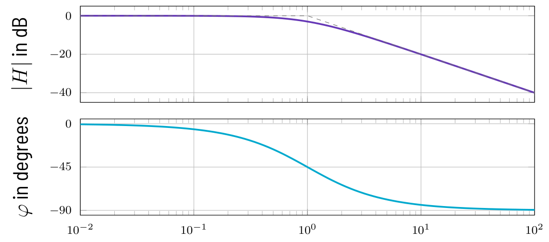
PASSIVE RC FILTERS
RC low-pass and high-pass
Low-pass: frequency-dependent divider, C shorts high frequencies
At f_{c}: |H| = 0.707 (−3 dB), phase −45° (high-pass: +45°)
Above f_{c}: −20 dB per decade (10× frequency → 1/10 amplitude)
High-pass blocks DC: coupling capacitor, +20 dB/decade below f_{c}
dB = 20·log₁₀|H|: cascaded gains add in dB
KEY RULE
f_{c} = 1/(2πRC), |H| = 1/√(1 + (f/f_{c})²)
Electronic Circuit Design · Active Filters
83
Notes:
Show the Bode plot: two straight asymptotes meeting at f_{c}. Derivation of H(jω), the dB table and the high-pass formula are in section Passive RC Filters. Remind them that τ = RC and f_{c} are two views of the same thing.

Slide 84
PASSIVE RC FILTERS
Falstad: RC low-pass and high-pass
TRY IT IN FALSTAD
Falstad filters/filter_rc_lowpass
Compare amplitudes at 100 Hz, 1 kHz, 10 kHz (f_{c} = 995 Hz)
Falstad filters/filter_rc_highpass
Same R, C swapped: watch the phase lead of +45° at 1 kHz
OBSERVE
Low-pass: 0.995 V, 0.705 V, 0.099 V at 100 Hz, 1 kHz, 10 kHz
High-pass mirrors it: 0.100 V, 0.709 V, 0.995 V
Add a load resistor at the output: f_{c} and amplitude shift
Electronic Circuit Design · Active Filters
84
Notes:
R = 1.6 kΩ, C = 100 nF. Point out the limits of passive filters: the load changes f_{c}, no gain. This motivates the op-amp in the next section. Exercise 7.1 works the numbers.

Slide 85
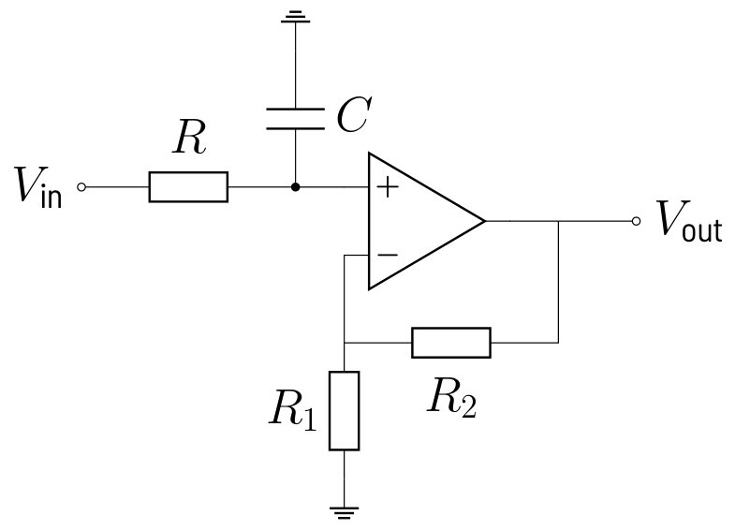
FIRST-ORDER ACTIVE FILTERS
First-order active filters
Non-inverting: RC low-pass, then follower or amplifier G = 1 + R₂/R₁
Op-amp input does not load C; output drives the next stage
Inverting low-pass: C parallel to R₂, f_{c} = 1/(2πR₂C), gain −R₂/R₁
Inverting high-pass: C₁ in series with R₁, f_{c} = 1/(2πR₁C₁)
KEY RULE
f_{c} is set by the R and C that form the filter
Falstad filters/filter_active_first_order
Three filters, 0.1 V at 1 kHz: compare Vout_a, Vout_b, Vout_c
Electronic Circuit Design · Active Filters
85
Notes:
Falstad values: non-inverting LP with G = 2 gives 0.141 V, inverting LP and HP with gain −10 give about 0.705 V. Circuits of the inverting variants are on the next script pages; Exercise 7.2.

Slide 86
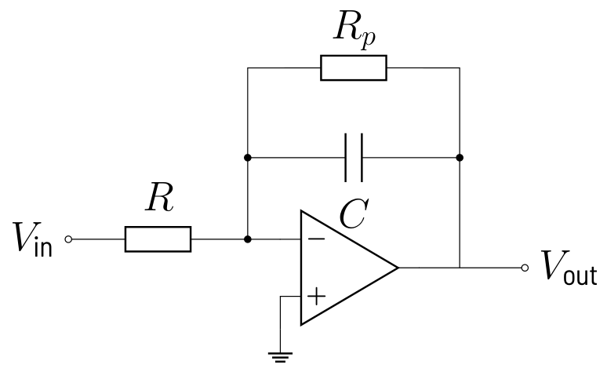
FIRST-ORDER ACTIVE FILTERS
The integrator
C in the feedback path: V_{out} = −(1/RC)·∫V_{in} dt
−20 dB per decade at all frequencies, DC gain infinite
Any offset drives a pure integrator into saturation
Practical: R_{p} parallel to C limits DC gain to −R_{p}/R
KEY RULE
Square wave in → triangle out, slope V_{in}/(RC)
Falstad filters/filter_integrator
±1 V square at 500 Hz: triangle of 1 V p-p; watch R_{p} centre it
Electronic Circuit Design · Active Filters
86
Notes:
R = 10 kΩ, C = 100 nF: slope 1000 V/s, 1 V per ms. The triangle starts between 0 and −1 V and is centred slowly by R_{p} (τ = 0.1 s). Exercise 7.3.

Slide 87

SECOND-ORDER FILTERS
Sallen-Key low-pass (unity gain)
Order n: −20·n dB per decade; 2nd order with one op-amp
C₁ to the output gives positive feedback near f₀
Q sets the corner: 0.707 Butterworth = maximally flat, −3 dB at f₀
Higher Q: peaking and ringing; |H(f₀)| = Q
KEY RULE
f₀ = 1/(2π√(R₁R₂C₁C₂)), Q = ½·√(C₁/C₂) for R₁ = R₂
Electronic Circuit Design · Active Filters
87
Notes:
At 20·f_{c} a first-order filter gives −26 dB, second order −52 dB. Transfer function and comparison of coefficients are in section Second-Order Filters. Higher orders: cascade of second-order stages with tabulated f_{0} and Q.

Slide 88

SECOND-ORDER FILTERS
Design recipe: Butterworth Sallen-Key
1
Choose R₁ = R₂ = R; Q = 0.707 needs C₁ = 2·C₂ (C₁ to the output)
2
Pick C₂ from E6, C₁ ≈ 2·C₂ (e.g. 10 nF and 22 nF: Q = 0.74)
3
Calculate R = 1/(2πf₀√(C₁C₂)), round to E24 or E96
4
Check f₀ and Q with rounded values; use film or C0G capacitors
Electronic Circuit Design · Active Filters
88
Notes:
Capacitors come in coarser steps, so choose them first. Q between 0.65 and 0.75 changes the response by less than 1 dB. Example 1 kHz: 10 nF, 22 nF, 10.7 kΩ gives f_{0} = 1003 Hz, Q = 0.742.

Slide 89
SECOND-ORDER FILTERS
Falstad: first vs. second order
TRY IT IN FALSTAD
Falstad filters/filter_sallen_key
At 10 kHz: RC passes 99 mV, Sallen-Key only 10 mV
OBSERVE
Near the corner (1 kHz) both are similar: 0.705 V vs. 0.744 V
One decade above: −20 dB vs. −40 dB
Change C₁ to raise Q and watch the peaking
Electronic Circuit Design · Active Filters
89
Notes:
Input 1 V amplitude; RC with f_{c} = 995 Hz, Sallen-Key with f_{0} = 1003 Hz, Q = 0.742. Exercise 7.4.

Slide 90
THE ANTI-ALIASING FILTER OF THE CAPSTONE
Why filter before sampling?
Only frequencies below f_{s}/2 are reproduced correctly
Capstone: f_{s} = 5 Hz → f_{c} ≤ 2.5 Hz (2.34 Hz chosen)
Above f_{s}/2 a component reappears at a wrong low frequency (aliasing)
50 Hz hum: 4.9 mV at the bridge × 107.6 = 0.52 V at the INA output
After sampling nothing separates alias from signal: filter first
KEY RULE
f_{c} ≤ f_{s}/2, filter before the S&H
Electronic Circuit Design · Active Filters
90
Notes:
Preview of the ADC chapter. 50 Hz = 10·f_{s}: the samples see the hum at a fixed phase; if mains drifts to 50.1 Hz the error becomes a slow 0.1 Hz wave in the data.

Slide 91


THE ANTI-ALIASING FILTER OF THE CAPSTONE
Capstone filter: 1st vs. 2nd order
1st order + follower
6.8 kΩ, 10 µF: f_{c} = 2.34 Hz
−26.6 dB at 50 Hz: 25 mV ≈ 0.05 LSB
Sufficient for the 3-bit ADC
Sallen-Key
91 kΩ, 91 kΩ, 1 µF, 470 nF: f₀ = 2.55 Hz
−52 dB at 50 Hz: 1.4 mV ≈ 0.003 LSB
Margin for a higher-resolution ADC
Electronic Circuit Design · Active Filters
91
Notes:
1 LSB = 0.5 V, so 25 mV is far below LSB/2. With 10 bits (LSB 3.9 mV) the first-order filter would leave about 6 LSB, the Sallen-Key less than half an LSB. Step response of the first-order filter: τ = 68 ms, 1 % after 0.31 s. Exercise 7.5.

Slide 92
THE ANTI-ALIASING FILTER OF THE CAPSTONE
Falstad: anti-aliasing filters
TRY IT IN FALSTAD
Falstad filters/filter_antialias
2 V DC + 0.52 V at 50 Hz: compare the 50 Hz residue of both
OBSERVE
Both outputs settle to 2.00 V in about 0.3 s
Residual 50 Hz: 25 mV (1st order), 1.4 mV (Sallen-Key)
Settling time stays short against the 200 ms sample period
Electronic Circuit Design · Active Filters
92
Notes:
Let the simulation run for about 0.6 s before reading the values. The input reproduces the capstone situation: 4.875 mV × 107.6 = 0.52 V of hum on the 2 V signal.

Slide 93
THE ANTI-ALIASING FILTER OF THE CAPSTONE
Twin-T notch at 50 Hz
Zero transmission at f₀ = 1/(2πRC): 31.8 kΩ, 100 nF → 50 Hz
Removes 50 Hz almost completely (1 V → 0.45 mV)
Also attenuates 5 Hz (0.927), needs precise parts
Removes one frequency only: no replacement for the low-pass
Falstad filters/filter_twin_t
Compare Vout_5Hz and Vout_50Hz; detune one C and watch 50 Hz return
Electronic Circuit Design · Active Filters
93
Notes:
The twin-T needs a follower at its output. Exercise 7.6.

Slide 94
THE ANTI-ALIASING FILTER OF THE CAPSTONE
Design recipe: anti-aliasing low-pass
1
Cutoff from the sample rate: f_{c} ≤ f_{s}/2 (capstone: 2.34 Hz at f_{s} = 5 Hz)
2
Attenuation: interference at the ADC must stay below LSB/2
3
1st order: choose C, R = 1/(2πf_{c}C), round so f_{c} ≤ f_{s}/2, buffer it
4
2nd order: unity-gain Sallen-Key with C₁ ≈ 2·C₂
5
Check settling (≈ 5τ) and headroom: signal + hum must not clip
Electronic Circuit Design · Active Filters
94
Notes:
This is the design card at the end of the section. Capstone: 0.52 V × 0.047 = 25 mV, well below 250 mV.

Slide 95
EXERCISES
Now work it out in the script
Derivations, worked numbers and solutions: script, chapter 7 “Active Filters”. Check each result in the Falstad examples.
7.1
RC low-pass
7.4
Sallen-Key low-pass
7.2
First-order active filters
7.5
Capstone: anti-aliasing low-pass
7.3
Integrator
7.6
Twin-T notch
Electronic Circuit Design · Active Filters
95
Notes:
Exercises with full solutions are in the script (docu.pdf); the student version has no solutions.

Slide 96
08
Sample and Hold
Freeze the filtered signal at a defined instant while the ADC converts
TAKE-HOME 1
TAKE-HOME 2
TAKE-HOME 3
C_{H} window: droop sets the minimum, acquisition the max
Settle to ½ LSB: t_{acq} ≈ 0.69·(N+1)·τ ≤ t_{track}
Buffer both sides: follower, switch, C_{H}, follower
Electronic Circuit Design · Sample and Hold
96
Notes:
Chapter 8: Sample and Hold. C_{H} window: droop sets the minimum, acquisition the max Settle to ½ LSB: t_{acq} ≈ 0.69·(N+1)·τ ≤ t_{track} Buffer both sides: follower, switch, C_{H}, follower

Slide 97
WHY SAMPLE AND HOLD?
Why sample and hold?
Defines the sampling instant t_{k} = k·T_{s}
Keeps the voltage constant while the ADC converts
Without S&H: |dV/dt|_{max}·t_{conv} < ½ LSB, e.g. 12 bit: f < 3.9 Hz
With S&H only the aperture time counts (nanoseconds)
Capstone: f_{s} = 5 Hz, 3-bit flash ADC, 0 to 4 V, LSB 0.5 V
Electronic Circuit Design · Sample and Hold
97
Notes:
Position in the chain: sensor, anti-aliasing low-pass, S&H, ADC. The 12-bit example (t_{conv} = 10 µs, 2 V amplitude) is worked in section Why Sample and Hold?. Even a flash converter needs a defined instant so the display does not flicker.

Slide 98

THE TRACK-AND-HOLD PRINCIPLE
Switch and hold capacitor
Clock high: switch closed, C_{H} follows V_{in} (track)
Clock low: switch open, C_{H} keeps its charge (hold)
Capstone clock: 5 Hz, duty cycle 10 %: track 20 ms, hold 180 ms
Errors: acquisition, aperture/jitter, pedestal, droop
KEY RULE
Held value = V_{in} at the end of the track phase
Electronic Circuit Design · Sample and Hold
98
Notes:
Strictly this is a track-and-hold; the names are used interchangeably. R_{S} contains source resistance, switch R_{on} and the 1 kΩ that limits the op-amp charging current. The terms diagram is in section The Track-and-Hold Principle.

Slide 99

THE TRACK-AND-HOLD PRINCIPLE
Falstad: basic sample and hold
TRY IT IN FALSTAD
Falstad samplehold/sh_basic
Watch Vhold step once per 200 ms at the falling clock edge
OBSERVE
Output is a staircase, one step per sampling period
Held values about 5 mV below V_{in}: C_{H} lags a rising input
Change the duty cycle of the clock rail and watch the track window
Electronic Circuit Design · Sample and Hold
99
Notes:
V_{in} = 2 V + 1.5 V·sin(2π·0.5 Hz·t), R_{S} = 1 kΩ, C_{H} = 1 µF. Held values 2.094, 2.956, 3.452 V and so on. The lag is slope × τ = 4.7 V/s × 1 ms.

Slide 100

ANALOG SWITCHES
Analog switches
nMOS switch: R_{on} grows as V_{in} approaches V_{G} − V_{th}
Transmission gate: nMOS + pMOS in parallel, almost constant R_{on}
Parts: CD4066, 74HC4066 (R_{on} ≈ 50 to 300 Ω), DG4xx; off leakage pA to nA
Falstad Analog Switch: closed above 2.5 V, R_{on} 20 Ω, R_{off} 10 GΩ
Electronic Circuit Design · Sample and Hold
100
Notes:
The Falstad switch has no charge injection and no leakage; we add them as discrete elements later. The 1 kΩ series resistor limits the charging current and keeps the op-amp stable with the large capacitive load.

Slide 101
DESIGNING THE HOLD CAPACITOR
Acquisition: settle to ½ LSB
Charging: τ = (R_{S} + R_{on})·C_{H}, worst case a full-scale step
N = 3: 2.77·τ; N = 8: 6.2·τ; N = 12: 9.0·τ; N = 16: 11.8·τ
Design rule: t_{acq} ≤ t_{track}, upper limit for C_{H}
Capstone: τ = 1.02 ms, t_{acq} = 2.83 ms ≪ 20 ms
KEY RULE
t_{acq} = τ·ln(2^{N+1}) ≈ 0.69·(N+1)·τ
Falstad samplehold/sh_acquisition
4 V step: 2.53 V after τ, 3.75 V (½ LSB below) after 2.83 ms
Electronic Circuit Design · Sample and Hold
101
Notes:
Use a time constant of a few percent of the track window; the rest is reserve for op-amp settling and tolerances. Derivation in section Designing the Hold Capacitor; Exercise 8.1.

Slide 102

DESIGNING THE HOLD CAPACITOR
Droop: losing charge in hold
Leakage: open switch, dielectric, buffer bias current, PCB surface
Droop rate dV_{H}/dt = I_{leak}/C_{H}
t_{hold}: worst case the whole period T_{s} − t_{track}
Design rule gives the lower limit for C_{H}
KEY RULE
C_{H} ≥ I_{leak}·t_{hold}/ΔV_{max}
Electronic Circuit Design · Sample and Hold
102
Notes:
Real leakage is pA to nA, so the lower limit is usually far away. The capstone allows ΔV_{max} = LSB/10 = 50 mV.

Slide 103
DESIGNING THE HOLD CAPACITOR
Falstad: too small, right, too large
TRY IT IN FALSTAD
Falstad samplehold/sh_capsize
3 V input, 50 nA leakage: compare 10 nF, 1 µF and 100 µF
OBSERVE
10 nF: charges fully, but droops 3.00 V → 2.10 V per hold
1 µF: 3.00 V → 2.99 V, the right choice
100 µF: only 18 % per sample, 1.88 V after five samples
Electronic Circuit Design · Sample and Hold
103
Notes:
The leakage is exaggerated to make droop visible. A too large capacitor turns the S&H into a low-pass filter. Exercise 8.2.

Slide 104
DESIGNING THE HOLD CAPACITOR
Design recipe: hold capacitor
1
Track window t_{track} = D·T_{s} (capstone: 5 Hz, 10 %: 20 ms)
2
Upper limit: C_{H} ≤ t_{track}/((R_{S} + R_{on})·ln 2^{N+1}) = 7.1 µF
3
Lower limit: C_{H} ≥ I_{leak}·t_{hold}/ΔV_{max} = 36 nF (10 nA, 50 mV)
4
Pick the geometric middle: C_{H} = 1 µF, safety factor ≈ 7 each side
5
Use PP, PS film or C0G; never electrolytic capacitors
Electronic Circuit Design · Sample and Hold
104
Notes:
Capstone result: R_{S} = 1 kΩ, C_{H} = 1 µF film, t_{acq} = 2.8 ms, droop 1.8 mV at 10 nA. Electrolytics leak in the µA range. Dielectric absorption makes the held voltage creep back; film capacitors show little of it.

Slide 105

ERRORS OF A REAL SAMPLE AND HOLD
Charge injection (pedestal)
Clock step couples through C_{gd} onto the hold node
C_{gd} = 10 pF, 5 V: −49.5 mV with 1 nF, −0.5 mV with 100 nF
Constant part can be calibrated, signal-dependent part cannot
Remedies: larger C_{H}, transmission gate, dummy switch
KEY RULE
ΔV_{ped} = −ΔV_{clk}·C_{gd}/(C_{gd} + C_{H}) ≈ −Q_{inj}/C_{H}
Falstad samplehold/sh_pedestal
2 V input: Vhold_1n drops to 1.9505 V, Vhold_100n to 1.9995 V
Electronic Circuit Design · Sample and Hold
105
Notes:
Falstad models only the coupling capacitance, not the channel charge. Exercise 8.4.

Slide 106
ERRORS OF A REAL SAMPLE AND HOLD
Feedthrough, aperture and jitter
Feedthrough: C_{ds} of the open switch couples V_{in} to C_{H}
Aperture delay: constant, only shifts the sampling instant
Aperture jitter: error ΔV = (dV/dt)·t_{j}; 12 bit, 1 MHz: t_{j} < 19 ps
Dielectric absorption: held voltage creeps back
KEY RULE
Full-scale sine: t_{j} < 1/(2π·f·2^{N})
Electronic Circuit Design · Sample and Hold
106
Notes:
Jitter is why fast converters need clean clocks. For the 5 Hz capstone a millisecond of jitter is harmless, see Exercise 8.6.

Slide 107
THE BUFFERED SAMPLE AND HOLD
Falstad: why both buffers?
TRY IT IN FALSTAD
Falstad samplehold/sh_buffered
Compare Vout_unbuf with the buffered output over one period
OBSERVE
Unbuffered (R_{i} 10 kΩ, R_{L} 100 kΩ): 2.425 V after track, 0.401 V at end
Buffered: 3.000 V during the whole period
Input buffer supplies the charge, output buffer draws none
Electronic Circuit Design · Sample and Hold
107
Notes:
The unbuffered circuit fails three ways: divider between source and load, slow charging, discharge through the load. Use a FET-input op-amp as output buffer; its bias current adds to I_{leak}. Exercise 8.3.

Slide 108

THE BUFFERED SAMPLE AND HOLD
Falstad: sampling a ramp
TRY IT IN FALSTAD
Falstad samplehold/sh_staircase
Triangle 0 to 4 V at 0.5 Hz: count the 0.8 V steps
OBSERVE
Steps 0.08, 0.88, 1.68, 2.48, 3.28 V: 4 V/s × 0.2 s = 0.8 V
0.8 V > 1 LSB (0.5 V): consecutive samples skip codes
Not an S&H error: the input is too fast for f_{s}
Electronic Circuit Design · Sample and Hold
108
Notes:
Clock rail: square, 5 Hz, 2.5 V amplitude, 2.5 V offset, duty cycle 0.1. Such fast signals must be removed by the anti-aliasing filter. Exercise 8.5.

Slide 109
THE BUFFERED SAMPLE AND HOLD
Practical hints
Rail-to-rail output for 0 to 4 V on 5 V; FET input for the output buffer
Guard ring around the hold node against surface leakage
Integrated S&H (LF398, AD783): only C_{H} external
SAR and sigma-delta ADCs sample internally: driver must settle in t_{acq}
Electronic Circuit Design · Sample and Hold
109
Notes:
The LF398 data sheet has acquisition time and droop curves versus C_{H}, a good illustration. Microcontroller SAR inputs sample with a few pF; the same t_{acq} = τ·ln 2^{N+1} calculation limits the source resistance.

Slide 110
EXERCISES
Now work it out in the script
Derivations, worked numbers and solutions: script, chapter 8 “Sample and Hold”. Check each result in the Falstad examples.
8.1
Choosing the hold capacitor for f_{s} = 5 Hz
8.4
Pedestal error
8.2
Droop and a too large capacitor
8.5
Ramp input and step size
8.3
Unbuffered sample and hold
8.6
Aperture jitter
Electronic Circuit Design · Sample and Hold
110
Notes:
Exercises with full solutions are in the script (docu.pdf); the student version has no solutions.

Slide 111
09
Analog-to-Digital Conversion
Sample, quantize, compare, encode: from voltage to code, the 3-bit flash way
TAKE-HOME 1
TAKE-HOME 2
TAKE-HOME 3
Filter everything above f_{s}/2 before the S&H
LSB = V_{FS}/2^{N}; each bit adds 6 dB of SNR
Flash = ladder + 2^{N}−1 comparators + encoder
Electronic Circuit Design · Analog-to-Digital Conversion
111
Notes:
Chapter 9: Analog-to-Digital Conversion. Filter everything above f_{s}/2 before the S&H LSB = V_{FS}/2^{N}; each bit adds 6 dB of SNR Flash = ladder + 2^{N}−1 comparators + encoder

Slide 112

SAMPLING AND ALIASING
Sampling theorem and aliasing
All input components must lie below the Nyquist frequency f_{s}/2
Applies to noise and interference too, not only to the wanted signal
Too-high frequencies fold back into 0 … f_{s}/2 and look like real signals
Capstone f_{s} = 5 Hz: 4 Hz → 1 Hz, 49 Hz → 1 Hz, 50 Hz → 0 Hz (DC!)
KEY RULE
f_{alias} = |f − k·f_{s}|, k chosen so that f_{alias} ≤ f_{s}/2
Electronic Circuit Design · Analog-to-Digital Conversion
112
Notes:
Show the folding plot: every input frequency lands somewhere in the pass band. After sampling no processing can tell an alias from a real component. The 4 Hz / 1 Hz sample picture is in section Sampling and Aliasing.

Slide 113

SAMPLING AND ALIASING
Falstad: sampling 50 Hz hum
TRY IT IN FALSTAD
Falstad adc/alias50
Compare the 5 Hz and 4.9 Hz S&H outputs; change the 50 Hz phase
OBSERVE
f_{s} = 5 Hz: every sample is 2.14 V instead of 2 V, a constant hidden offset
f_{s} = 4.9 Hz: the samples beat slowly at 1 Hz, the error becomes visible
Change the hum phase: the offset at 5 Hz moves between 1.5 V and 2.5 V
Electronic Circuit Design · Analog-to-Digital Conversion
113
Notes:
Input is 2 V DC plus 0.5 V of 50 Hz hum. Point out that nothing on the display looks wrong at 5 Hz: the error is invisible. Calculation of the 2.14 V is in Exercise 9.1.

Slide 114

SAMPLING AND ALIASING
Design recipe: anti-aliasing filter
1
Choose f_{s} from the signal bandwidth; Nyquist frequency is f_{s}/2
2
Place a low-pass before the S&H with f_{c} ≈ f_{s}/2 (capstone 2.34 Hz)
3
Require: interference amplitude × |H(f)| < ½ LSB (better ¼ LSB)
4
1st order gives f_{c}/f (−20 dB/dec), 2nd order (f_{c}/f)² (−40 dB/dec)
5
Not enough? Raise the order or oversample to widen the gap to f_{s}/2
Electronic Circuit Design · Analog-to-Digital Conversion
114
Notes:
At 50 Hz the 1st-order filter gives −26.6 dB (factor 21), 2nd-order Butterworth −53 dB. The filter must sit before the S&H: after sampling the damage is done.

Slide 115

QUANTIZATION
Resolution, LSB and quantization error
Code D = floor(V_{in}/LSB), limited to 0 … 2^{N}−1
Capstone: 3 bit, 4 V full scale → LSB = 0.5 V, codes 000 … 111
Error 0 … 1 LSB with thresholds at k·LSB; ±½ LSB if shifted by ½ LSB
Test at the bin centres 0.25 V, 0.75 V, … 3.75 V, never at a threshold
Ideal SNR = 6.02·N + 1.76 dB: every extra bit gives 6 dB
KEY RULE
LSB = V_{FS}/2^{N}
Electronic Circuit Design · Analog-to-Digital Conversion
115
Notes:
Typical values: 10 bit at 3.3 V gives 3.2 mV, 16 bit at 5 V gives 76 µV. The SNR derivation (LSB/√12 noise) is in section Quantization.

Slide 116

QUANTIZATION
Falstad: quantization made visible
TRY IT IN FALSTAD
Falstad adc/quant_error
Watch V_{in} and the DAC staircase V_{q} on the scope
OBSERVE
3-bit flash ADC followed by an R-2R DAC turns the code back into D·0.5 V
The gap V_{in} − V_{q} always stays between 0 V and 0.5 V (sawtooth)
Read examples: 1.8 V → 1.5 V, 3.98 V → 3.5 V
Electronic Circuit Design · Analog-to-Digital Conversion
116
Notes:
Input is a 0–4 V triangle at 0.25 Hz. The sawtooth figure is the error the scope shows. Exercise 9.2 uses this circuit.

Slide 117

THE COMPARATOR
Comparator and hysteresis
Comparator = 1-bit ADC: output high if V₊ > V₋
Op-amp open loop works but is slow; comparator ICs are fast (LM393, open collector)
Offset voltage must be ≪ LSB; never use a comparator IC as an op-amp
Slow noisy input → chatter; Schmitt trigger: hysteresis > noise (p-p)
Behind an S&H (flash ADC): no hysteresis, it would shift the thresholds
KEY RULE
V_{T+} = V_{ref}(1 + R₁/R₂), V_{T−} = V_{T+} − V_{OH}·R₁/R₂
Falstad adc/comparator_hyst
Count output edges: plain comparator vs Schmitt trigger
Electronic Circuit Design · Analog-to-Digital Conversion
117
Notes:
Falstad comparator: op-amp with max output 5 V and min output 0 V. With R1 = 10 kΩ, R2 = 100 kΩ, Vref = 2 V the thresholds are 2.2 V and 1.7 V. In the sim the plain comparator gives 10 edges per period, the Schmitt trigger exactly 2.

Slide 118

THE FLASH CONVERTER
The flash converter
Resistor ladder of 2^{N} equal resistors sets the thresholds k·LSB
One comparator per threshold: C_{k} = 1 if V_{in} > k·LSB
Output is a thermometer code: the number of ones is the code D
Fastest architecture, but 2^{N}−1 comparators: 7 for 3 bit, 255 for 8 bit
Capstone: 8 × 1 kΩ from 4 V, taps 0.5 … 3.5 V, ladder current 0.5 mA
Falstad adc/flash2
Sweep V_{in}: comparators switch at 1 V, 2 V, 3 V
Electronic Circuit Design · Analog-to-Digital Conversion
118
Notes:
Start with the 2-bit version: three comparators, LSB 1 V. The ladder current must be much larger than the comparator input currents; the reference must be stiff.

Slide 119

THE FLASH CONVERTER
Thermometer-to-binary encoder
B₂ = C₄
B₁ = C₂·¬C₄ + C₆
B₀ = C₁·¬C₂ + C₃·¬C₄ + C₅·¬C₆ + C₇
Gates: 3 NOT, 4 AND2, 1 OR2, 1 OR4
Bubbles (offset, noise) give wrong codes; priority encoder 74HC148 is robust
KEY RULE
Top of the column H_{k} = C_{k}·¬C_{k+1}; B_{i} = OR of H_{k} with bit i set
Electronic Circuit Design · Analog-to-Digital Conversion
119
Notes:
The derivation from the one-hot code is in section The Flash Converter, Deriving the encoder. In the capstone the input is held and the LSB is large, so bubbles do not occur. Exercise 9.4 shows a bubble causing a 2-LSB error.

Slide 120
THE FLASH CONVERTER
Falstad: 3-bit flash ADC with display
TRY IT IN FALSTAD
Falstad adc/flash3
Set V_{in} to bin centres 0.25 … 3.75 V, read codes 000 … 111
OBSERVE
Labeled nodes C1 … C7, B0 … B2: hover to read the voltages
7 LEDs form a bar graph, 3 LEDs show B₂B₁B₀
Default 2.6 V: five bar LEDs on, binary 101
Electronic Circuit Design · Analog-to-Digital Conversion
120
Notes:
Labeled nodes with the same name are connected, which keeps the drawing readable. This is the converter of the capstone. Design is Exercise 9.3.

Slide 121

DISPLAYING THE RESULT
LED display and current budget
One series resistor per LED, never one common resistor
Red LED: V_{F} ≈ 1.8 … 2 V, bright enough at 5 … 10 mA
Capstone: 330 Ω from 5 V logic → about 9 mA per LED
Code 7: 10 LEDs on ≈ 91 mA; check the driver's V_{OH} at load
Heavy loads: buffer gates, low-current LEDs or a driver IC
KEY RULE
R = (V_{OH} − V_{F})/I_{F}
Electronic Circuit Design · Analog-to-Digital Conversion
121
Notes:
In our circuit C4 drives its bar LED, the B2 LED and gate inputs: 18 mA. 74HC outputs are limited to 25 mA absolute maximum and V_OH drops under load. Falstad outputs are ideal and do not show this. Exercise 9.5.

Slide 122

OTHER CONVERTER ARCHITECTURES
R-2R DAC and successive approximation
R-2R ladder: only two resistor values for any number of bits
V_{out} = V_{ref}·D/2^{N}; output resistance is always R
SAR: binary search with one comparator and a DAC, MSB first
N clock cycles for N bits; 8 … 18 bit, typical in microcontrollers
KEY RULE
V_{out} = V_{ref}·(B₂/2 + B₁/4 + B₀/8)
Falstad adc/r2r_dac
Counter drives the bits: staircase in 0.625 V steps
Electronic Circuit Design · Analog-to-Digital Conversion
122
Notes:
The SAR worked example (4 bit, 2.6 V → 1010) is in section Other Converter Architectures. Most converters contain a DAC in a feedback loop, which is why we start with R-2R. Exercise 9.6.

Slide 123
OTHER CONVERTER ARCHITECTURES
Choosing a converter architecture
Fast
Precise
Flash: 4 … 8 bit, up to GS/s, oscilloscopes
SAR: 8 … 18 bit, kS/s … MS/s, microcontrollers
Need an anti-aliasing filter in front
Dual-slope: 12 … 22 bit, 1 … 100 S/s, multimeters
Sigma-delta: 16 … 24 bit, audio, scales
Built-in 50 Hz or digital filtering
Electronic Circuit Design · Analog-to-Digital Conversion
123
Notes:
Dual-slope integrates over 20 ms, so 50 Hz hum integrates to zero; the capstone instead removes it with the anti-aliasing filter. The capstone uses a flash converter because every part is visible: ladder, comparators, logic.

Slide 124
EXERCISES
Now work it out in the script
Derivations, worked numbers and solutions: script, chapter 9 “Analog-to-Digital Conversion”. Check each result in the Falstad examples.
9.1
Aliasing
9.4
Bubble error
9.2
Quantization
9.5
LED display
9.3
Designing the 3-bit flash converter
9.6
Schmitt trigger, R-2R DAC and SAR
Electronic Circuit Design · Analog-to-Digital Conversion
124
Notes:
Exercises with full solutions are in the script (docu.pdf); the student version has no solutions.

Slide 125
10
From Sensor to Digital Value
The whole course in one chain: Pt100 thermometer to 3-bit code on LEDs
TAKE-HOME 1
TAKE-HOME 2
TAKE-HOME 3
One 4 V reference for bridge and ladder: ratiometric
Anti-aliasing filter removes 50 Hz before sampling
Verify in Falstad at bin centres, not at thresholds
Electronic Circuit Design · From Sensor to Digital Value
125
Notes:
Chapter 10: From Sensor to Digital Value. One 4 V reference for bridge and ladder: ratiometric Anti-aliasing filter removes 50 Hz before sampling Verify in Falstad at bin centres, not at thresholds

Slide 126

THE MEASUREMENT CHAIN
Five stages from sensor to code
0 … 100 °C → 0 … 4.00 V → code 000 … 111
LSB = 4 V/2³ = 0.5 V → 12.5 °C
Interference: 5 mV at 50 Hz in series with the sensor
Every stage is a circuit from an earlier chapter
Electronic Circuit Design · From Sensor to Digital Value
126
Notes:
Bridge from chapter Bridge Circuits, INA from Operational Amplifiers, low-pass from Active Filters, S&H from Sample and Hold, flash ADC from the previous chapter, LED resistor from Basics. This chapter is the worked solution of Exercise 10.1.

Slide 127
THE MEASUREMENT CHAIN
Design values at a glance
Pt100, 100 … 138.5 Ω, sensor current ≈ 1 mA
Gain 107.6 = 10 × 10.76 (each stage < 100)
Anti-aliasing 6.8 kΩ, 10 µF: f_{c} = 2.34 Hz
S&H: f_{s} = 5 Hz, 20 ms window, C_{H} = 1 µF
Flash: 8 × 1 kΩ, 7 comparators; display 10 × (LED + 330 Ω)
Electronic Circuit Design · From Sensor to Digital Value
127
Notes:
These numbers run through the whole course; keep them on screen as the reference for the next slides. The full specification table is in section The Measurement Chain.

Slide 128

STAGE 1: SIGNAL CONDITIONING
Stage 1: bridge, INA and gain
Bridge fed from the 4.00 V reference, balanced at 0 °C (R₄ = 100 Ω)
Bridge output 0 … 37.18 mV; buffers keep the bridge unloaded
Difference amp G₁ = 10, gain stage G₂ = 1 + 97.6 k/10 k = 10.76
Keep G < 100 per stage: gain error ≈ G/A
Zero set by R₄, span by R_{F}: trims do not interact
KEY RULE
V_{COND} = G₁·G₂·V_{BR}, G₁·G₂ = 107.6
Electronic Circuit Design · From Sensor to Digital Value
128
Notes:
Ratiometric: if the reference is 1 % high, bridge output and ADC thresholds are both 1 % high, the code does not change (Exercise 10.2). Trim: set 100 Ω and check 0 V, then 138.5 Ω and adjust R_F for 4.00 V.

Slide 129

STAGE 2: ANTI-ALIASING
Stage 2: anti-aliasing low-pass
50 Hz sampled at 5 Hz → alias at 0 Hz: a constant, invisible offset
Hum after gain 107.6 ≈ 0.52 V, about one full LSB
RC 6.8 kΩ, 10 µF: f_{c} = 2.34 Hz ≤ f_{s}/2, −26.6 dB at 50 Hz
Residual 25 mV < ½ LSB = 250 mV; follower decouples the RC
KEY RULE
Residual = V_{peak}/√(1 + (f/f_{c})²) < ½ LSB
Electronic Circuit Design · From Sensor to Digital Value
129
Notes:
For 3 bits a first-order filter is enough. For 10 bit the residual would be twelve times too large: then use 2nd or 3rd order, oversampling, or a sampling rate that is not a sub-multiple of 50 Hz (Exercise 10.3).

Slide 130
STAGE 3: SAMPLE AND HOLD
Stage 3: choosing the hold capacitor
Upper limit: charging
Lower limit: droop
τ = R_{on}·C_{H} = 20 Ω · 1 µF = 20 µs
Settle to ½ LSB in 2.8·τ ≪ 20 ms window
Too large C_{H}: staircase lags the input
ΔV = I_{L}·t_{hold}/C_{H} = 0.18 mV
1 nA leakage over 180 ms hold time
Too small C_{H}: held value drifts
Electronic Circuit Design · From Sensor to Digital Value
130
Notes:
Clock 5 Hz with 10 % duty: 20 ms track, 180 ms hold. Both limits leave a wide range, 10 nF to 100 µF; choose a 1 µF film capacitor. Exercise 10.5 redoes this with R_on = 1 kΩ and 10 nA.

Slide 131
STAGES 4 AND 5: FLASH ADC, ENCODER AND DISPLAY
Stages 4 and 5: flash ADC and display
Ladder 8 × 1 kΩ from 4.00 V: thresholds 0.5 … 3.5 V, 0.5 mA
C_{k} = 1 if V_{HOLD} > k·0.5 V: thermometer code, level 0 … 7
B₂ = C₄, B₁ = C₂·¬C₄ + C₆, B₀: odd levels
7 red LEDs as bar graph, 3 green LEDs for the binary code
330 Ω per LED from 5 V logic: about 9.8 mA in Falstad
Electronic Circuit Design · From Sensor to Digital Value
131
Notes:
Same converter as in the ADC chapter, Falstad example flash3. The full encoder equation for B0 is in section Stages 4 and 5. Exercise 10.4 extends it to four bits.

Slide 132
THE COMPLETE CHAIN IN FALSTAD
Falstad: the complete chain
TRY IT IN FALSTAD
Falstad capstone/capstone
Move Sensor R 100 → 138.5 Ω: bar fills, binary LEDs count
OBSERVE
Hover over VCOND, VAA, VHOLD: the held value updates every 200 ms
After a slider step wait ≈ 0.5 s: the low-pass needs 5τ = 340 ms
Bin-centre test points: e.g. 116.75 Ω → 1.75 V → code 011
Electronic Circuit Design · From Sensor to Digital Value
132
Notes:
Verification table in section The Complete Chain in Falstad: 6.2, 18.6, 43.5, 56.0, 81.1, 93.7 °C give codes 000, 001, 011, 100, 110, 111, with V_HOLD within 1 mV of the target.

Slide 133
THE COMPLETE CHAIN IN FALSTAD
Falstad: the aliasing experiment
TRY IT IN FALSTAD
Falstad capstone/capstone_nofilter
Sensor R = 116.75 Ω (V_{COND} = 1.75 V): code 100, not 011
OBSERVE
S&H samples V_{COND} directly; 0.52 V of 50 Hz is always hit at the same phase
Held value is a clean staircase, just 0.52 V too high: one code too high
With the filter (capstone) the same input gives the correct code 011
Electronic Circuit Design · From Sensor to Digital Value
133
Notes:
This is the worst-case phase; the offset size depends on the phase between mains and sampling clock. The point: nothing on the scope looks wrong, only the code is.

Slide 134
EXERCISES
Design recipe: sensor to digital value
1
Fix range and resolution: full scale, N bits, LSB = V_{FS}/2^{N}
2
Share one reference between sensor excitation and ladder (ratiometric)
3
Set total gain = V_{FS}/bridge span; split into stages with G < 100
4
Choose f_{s}, then an anti-aliasing filter keeping hum < ½ LSB
5
Size C_{H} between droop and charging limits; verify at bin centres
Electronic Circuit Design · From Sensor to Digital Value
134
Notes:
This is the procedure behind the capstone task, Exercise 10.1. Students should do the paper design first and then check every stage against the Falstad model.

Slide 135
EXERCISES
Now work it out in the script
Derivations, worked numbers and solutions: script, chapter 10 “From Sensor to Digital Value”. Check each result in the Falstad examples.
10.1
From sensor to digital value (capstone task 2025/26)
10.4
Four bits
10.2
Ratiometric measurement
10.5
Hold capacitor at the limits
10.3
Another sampling rate
Electronic Circuit Design · From Sensor to Digital Value
135
Notes:
Exercises with full solutions are in the script (docu.pdf); the student version has no solutions.

