Slide 1
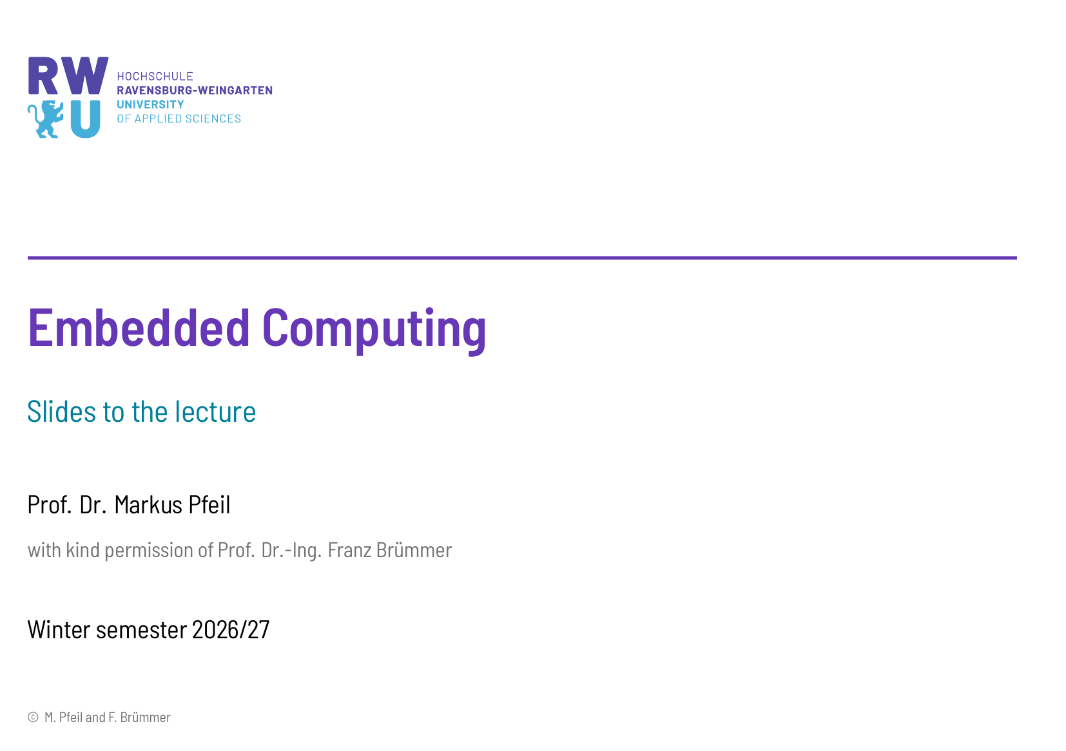

Slide 2
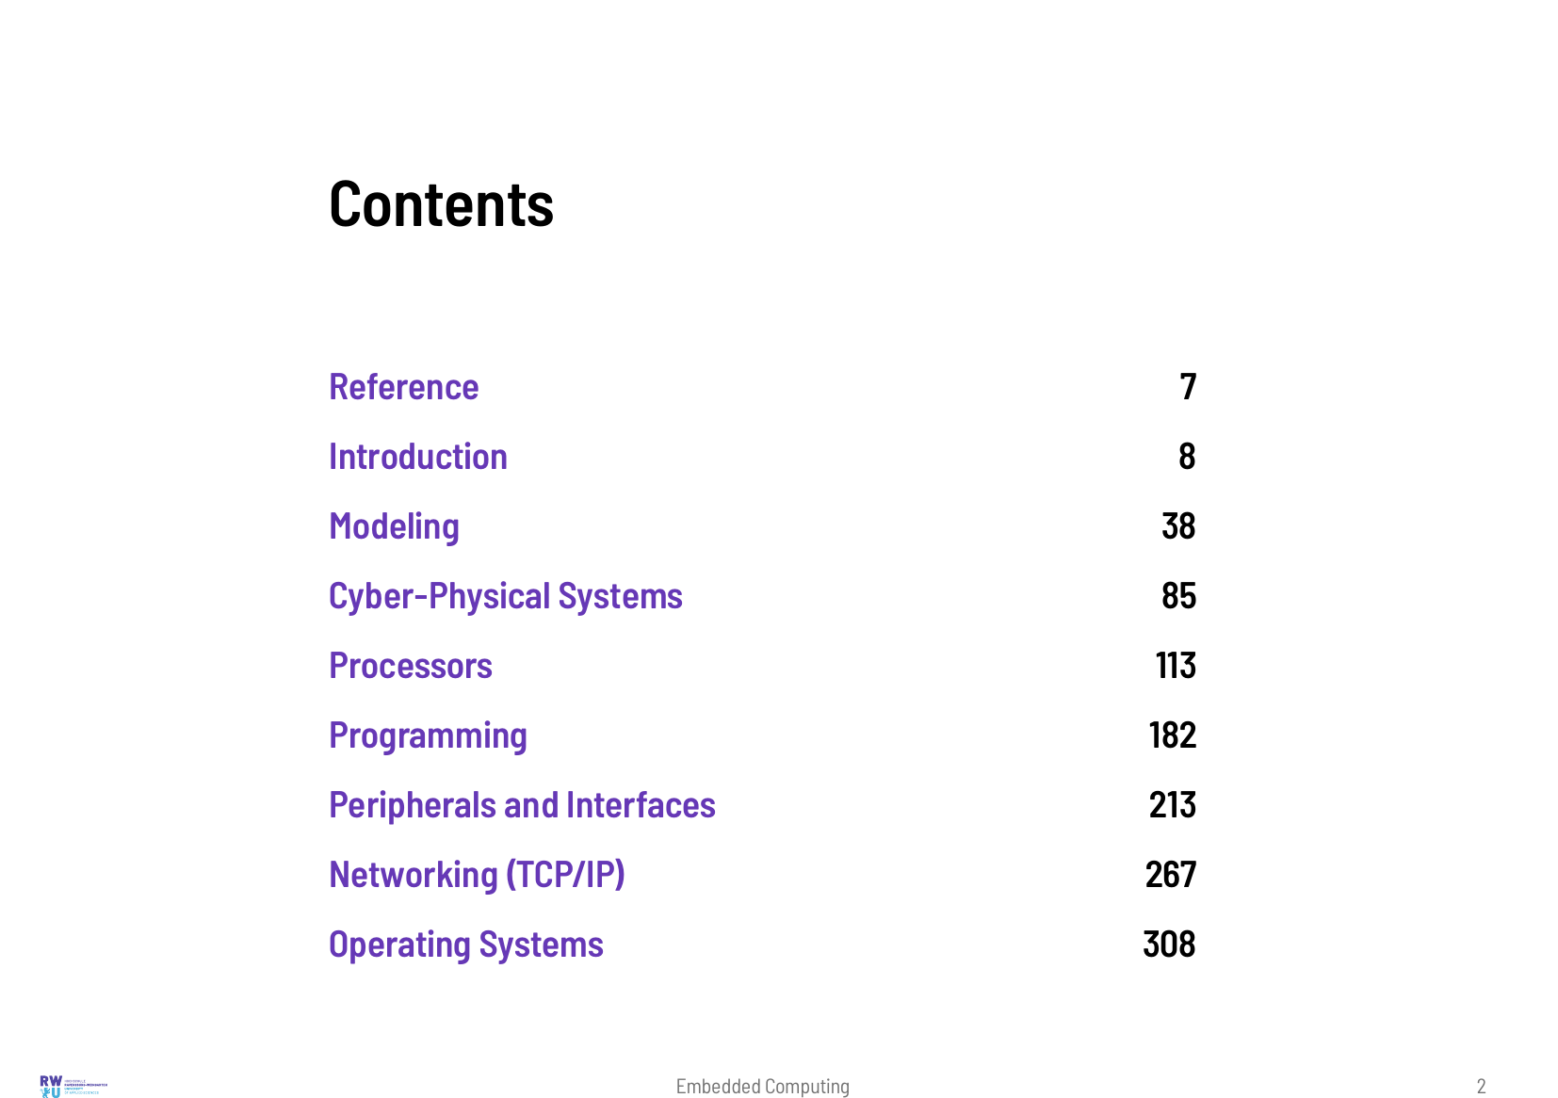

Slide 3
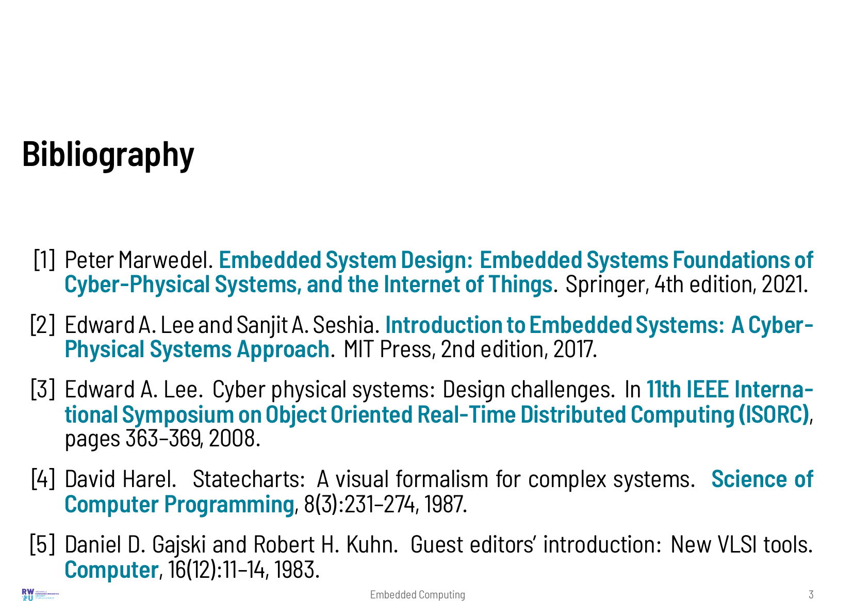

Slide 4
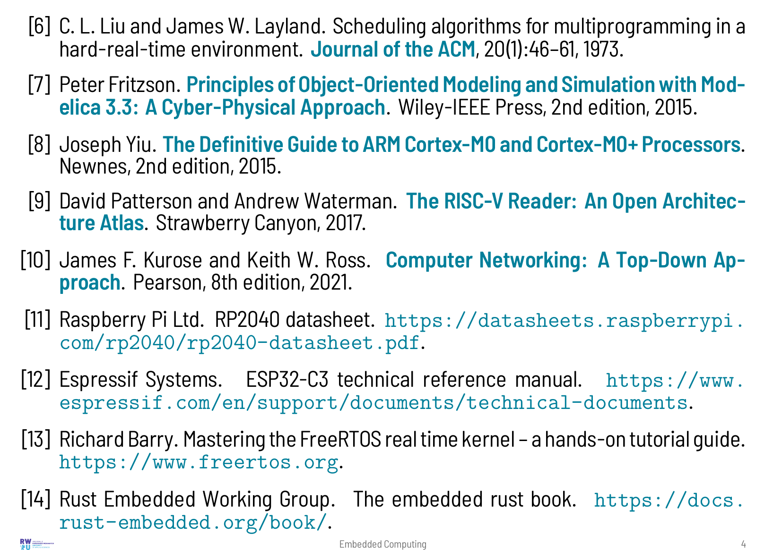

Slide 5
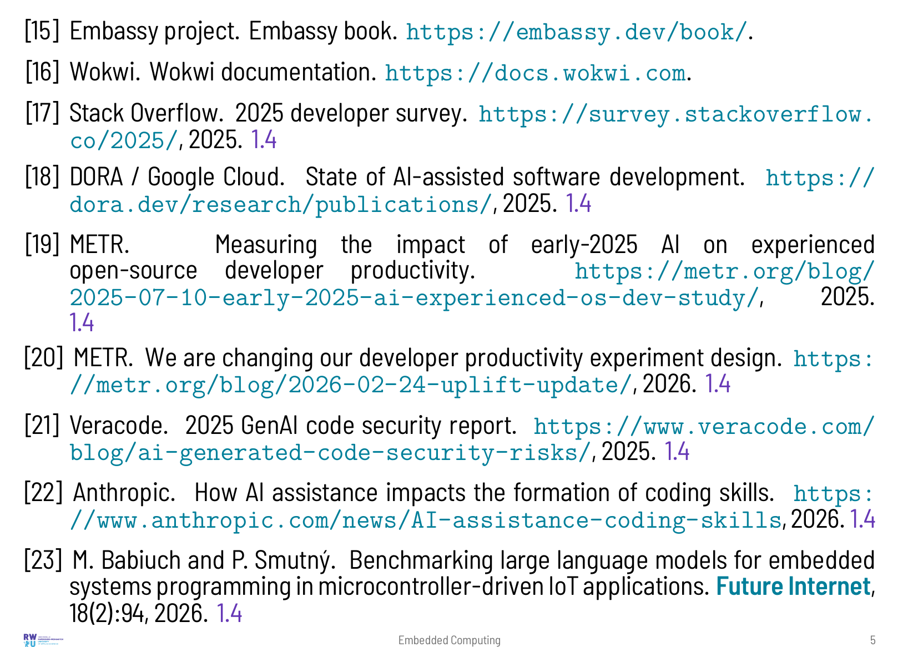

Slide 6


Slide 7


Slide 8
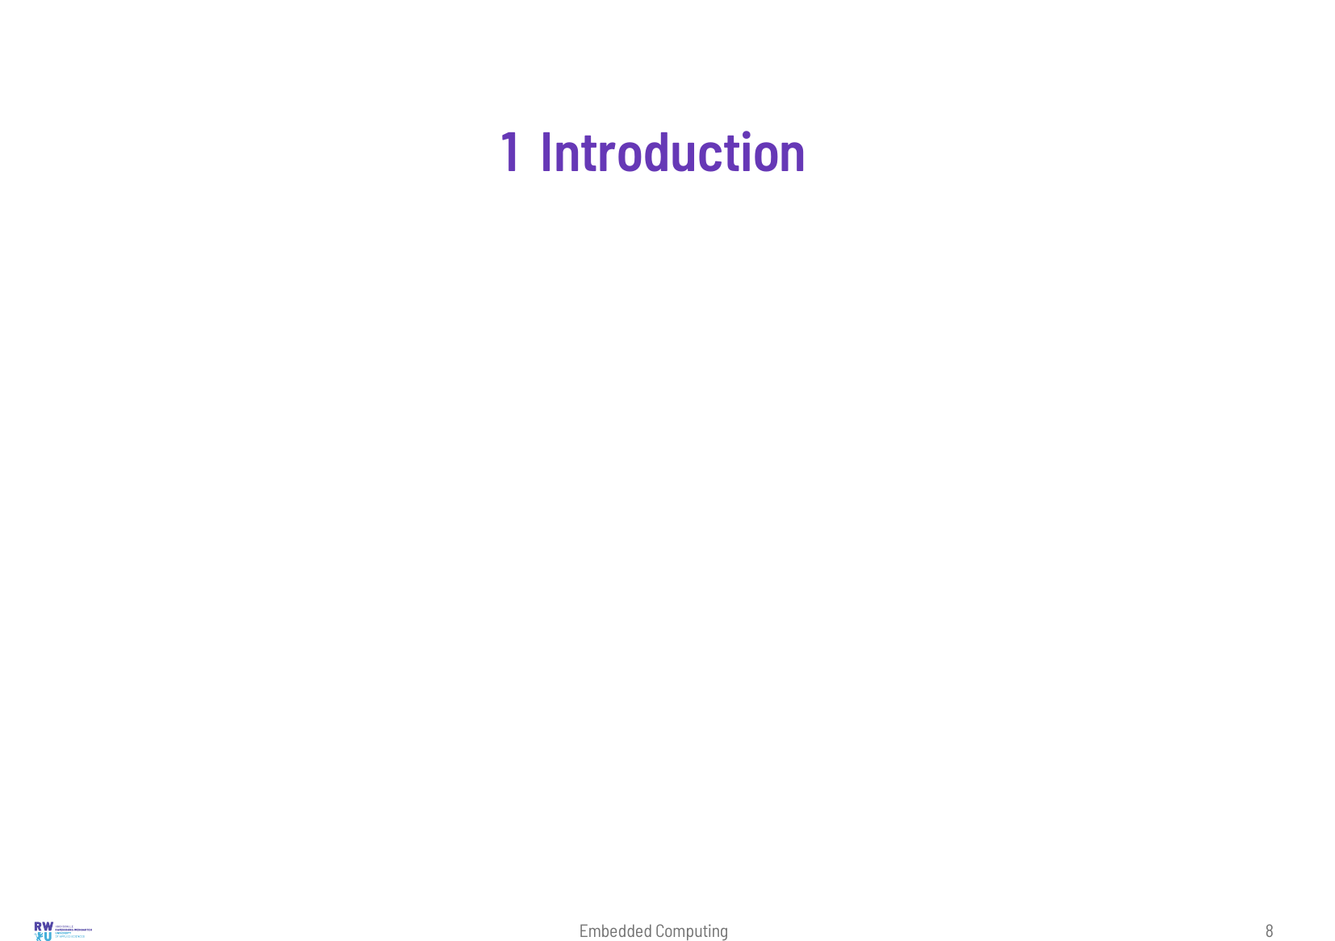
Notes:
Most computers are not on a desk. They are built into washing machines, cars, heating systems, medical devices and smartphones, and they control these devices without the user ever noticing that a computer is involved. Such embedded systems have their own requirements. They must react in time, work for years without a reset, run on a battery, cost a few euros at most, and they must never endanger anybody. This lecture covers the whole path from the requirements to a working device. It starts with models and cyber-physical systems, continues with processors and their programming in assembly, C, Rust and MicroPython, then treats the peripherals and interfaces of a microcontroller, networking and real-time operating systems. All examples run in the browser-based simulator Wokwi or on Replit, so they can be tried without any hardware.

Slide 9
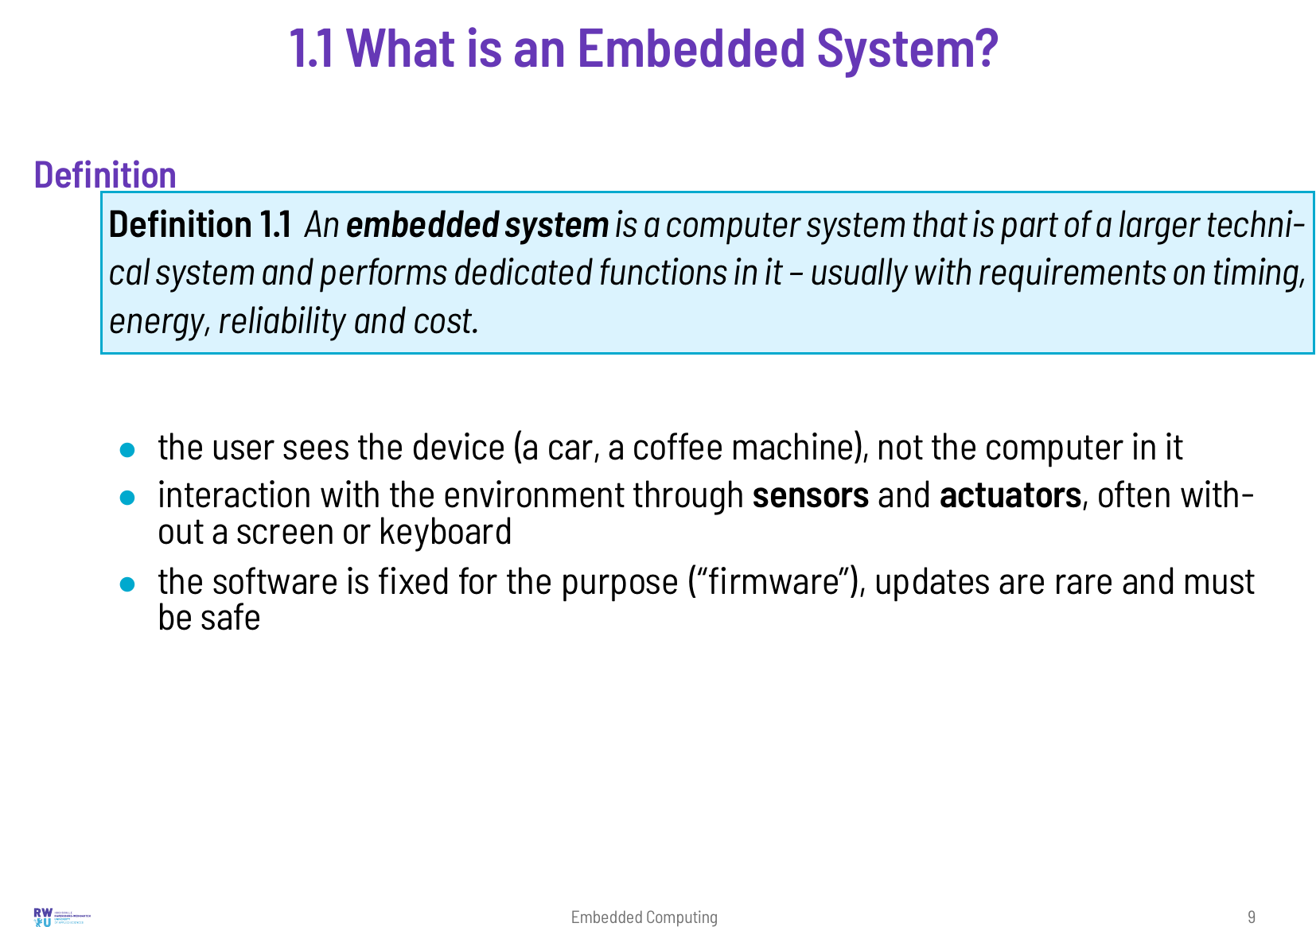

Slide 10
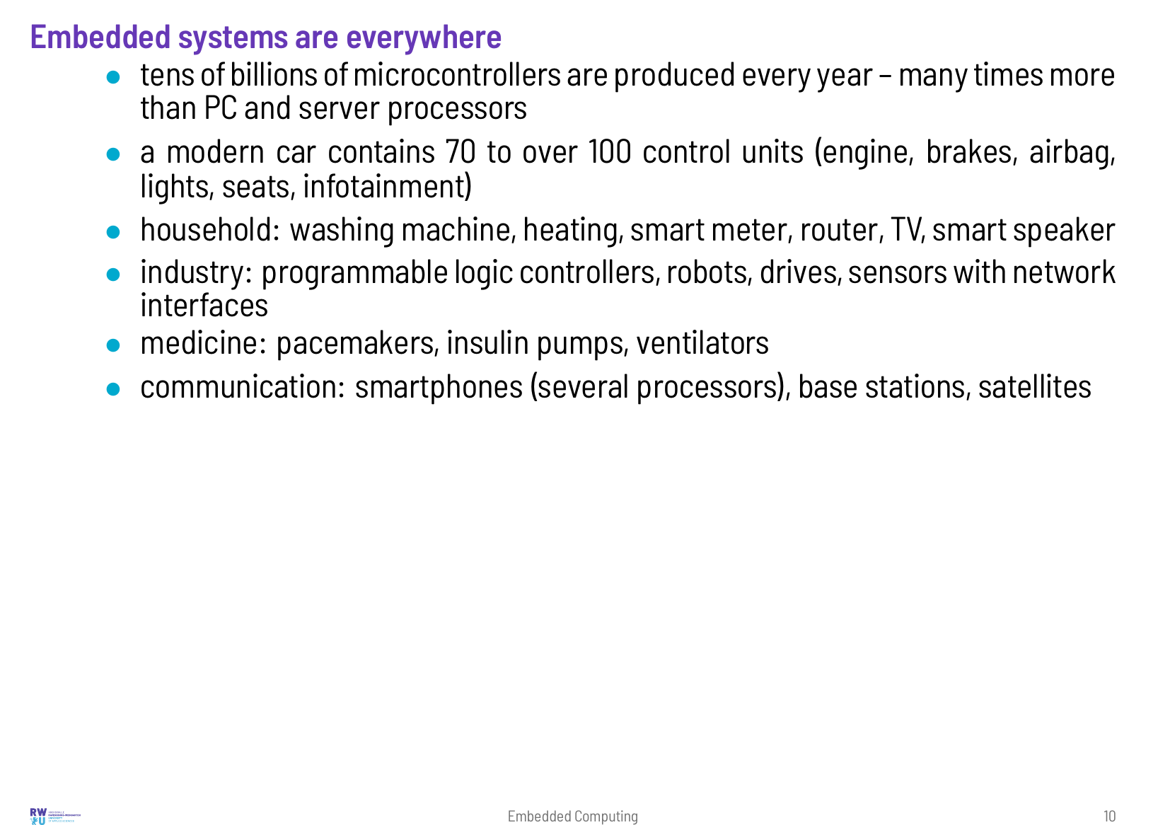

Slide 11
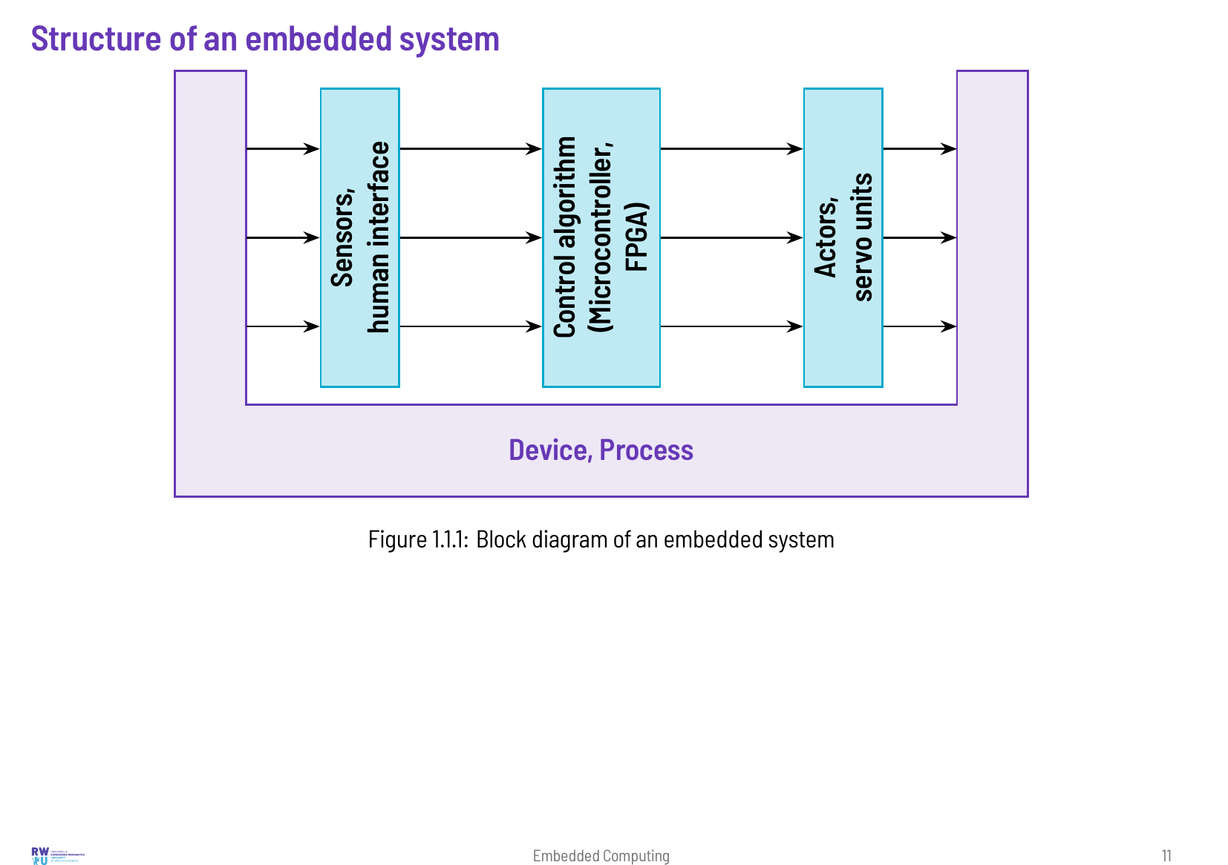

Slide 12
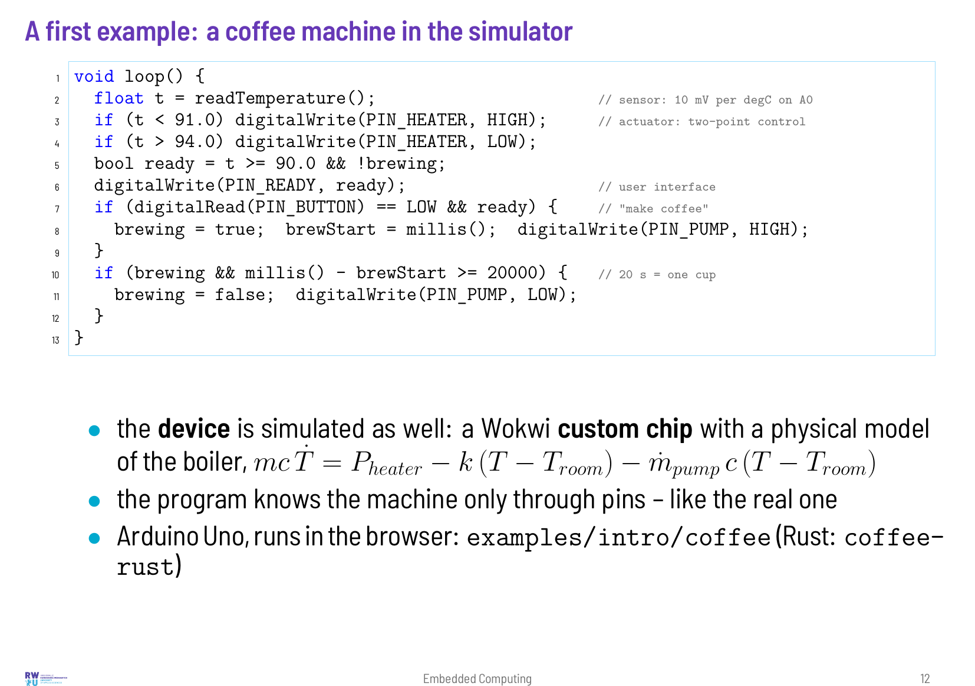

Slide 13
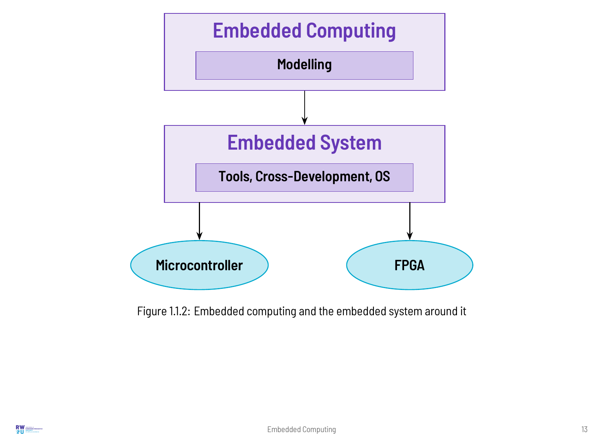

Slide 14
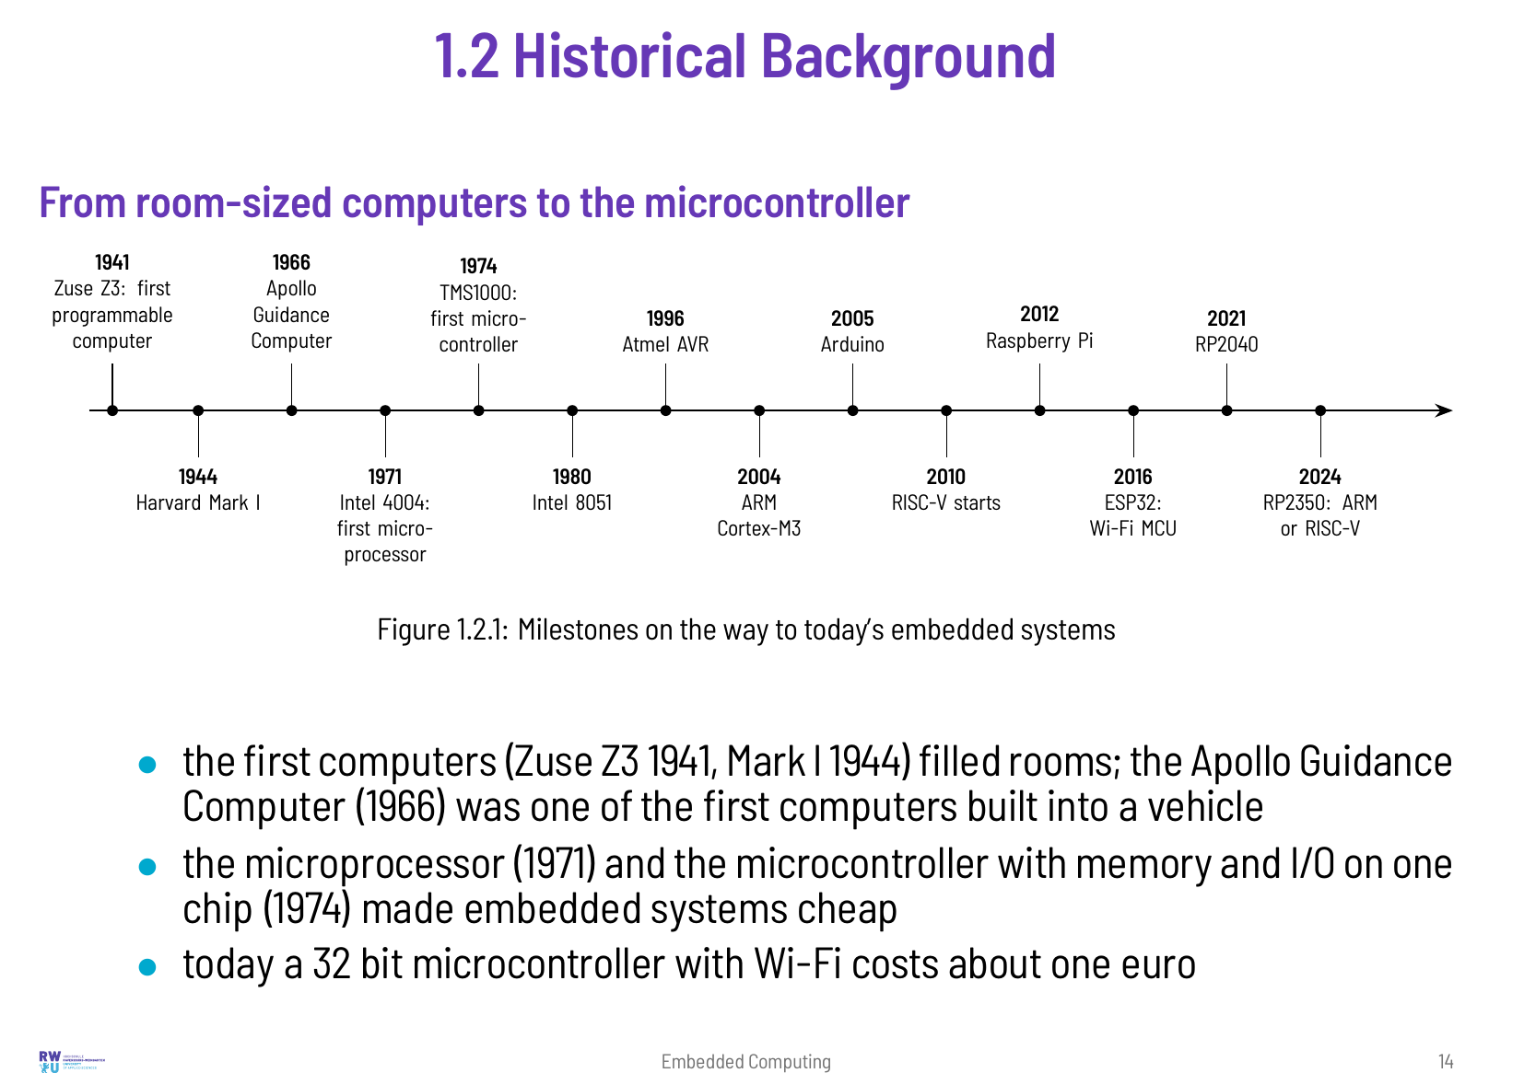

Slide 15
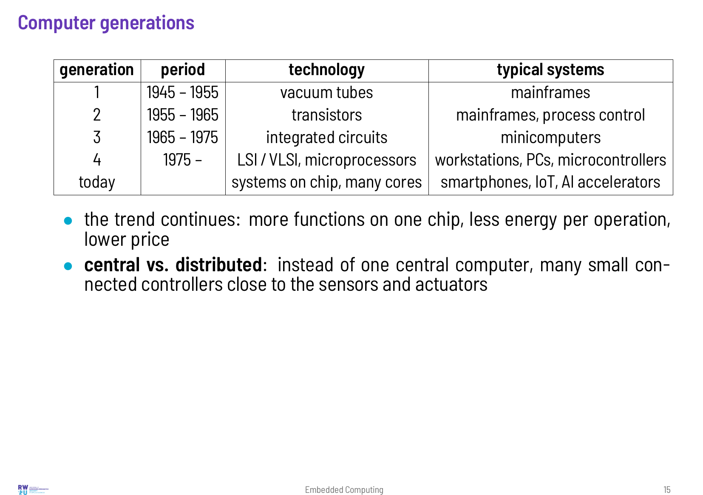

Slide 16
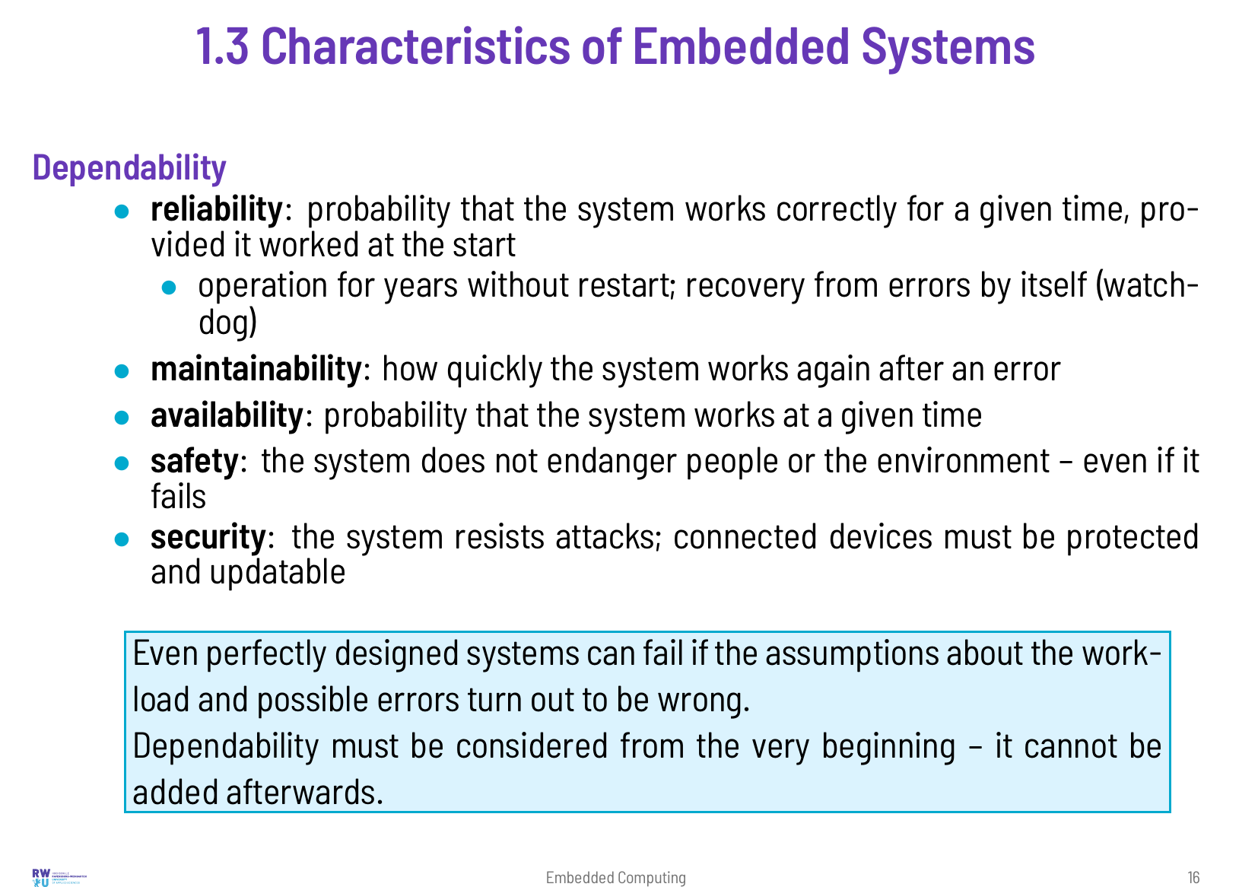

Slide 17
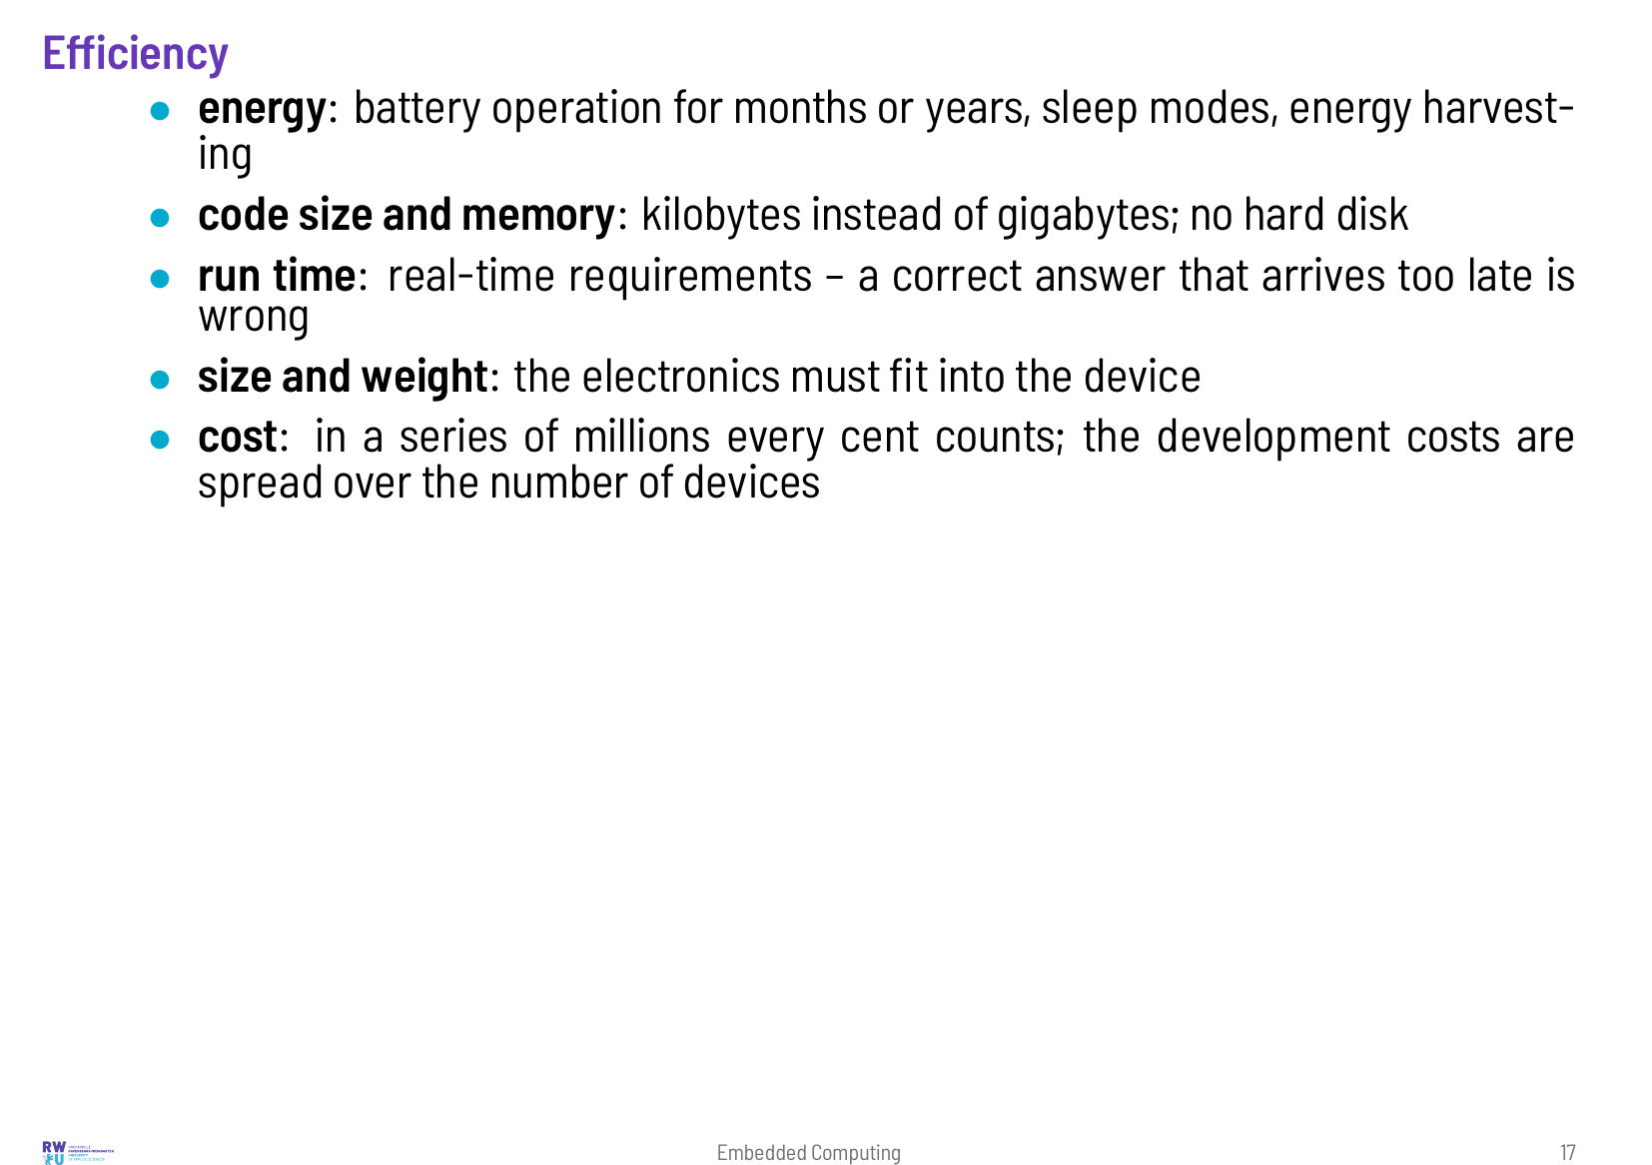

Slide 18
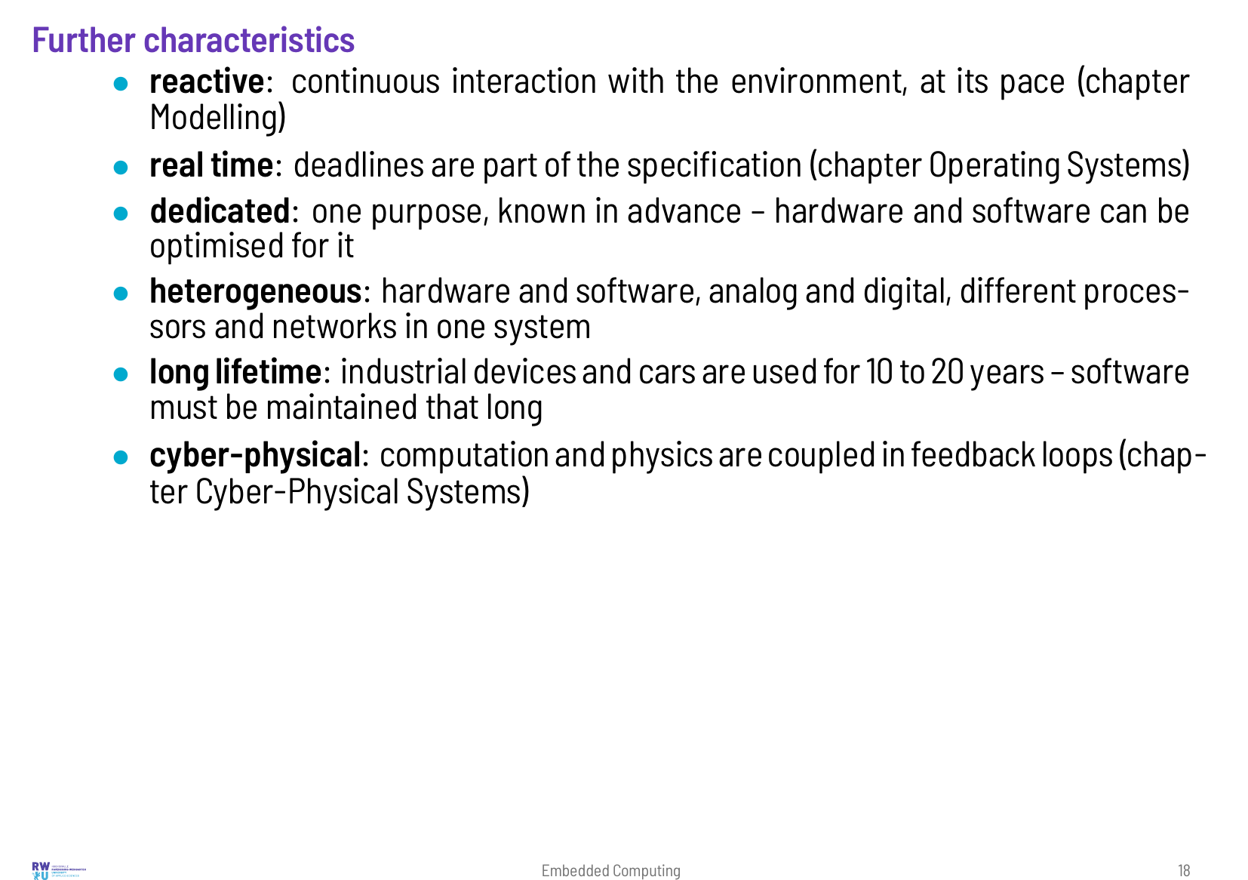

Slide 19
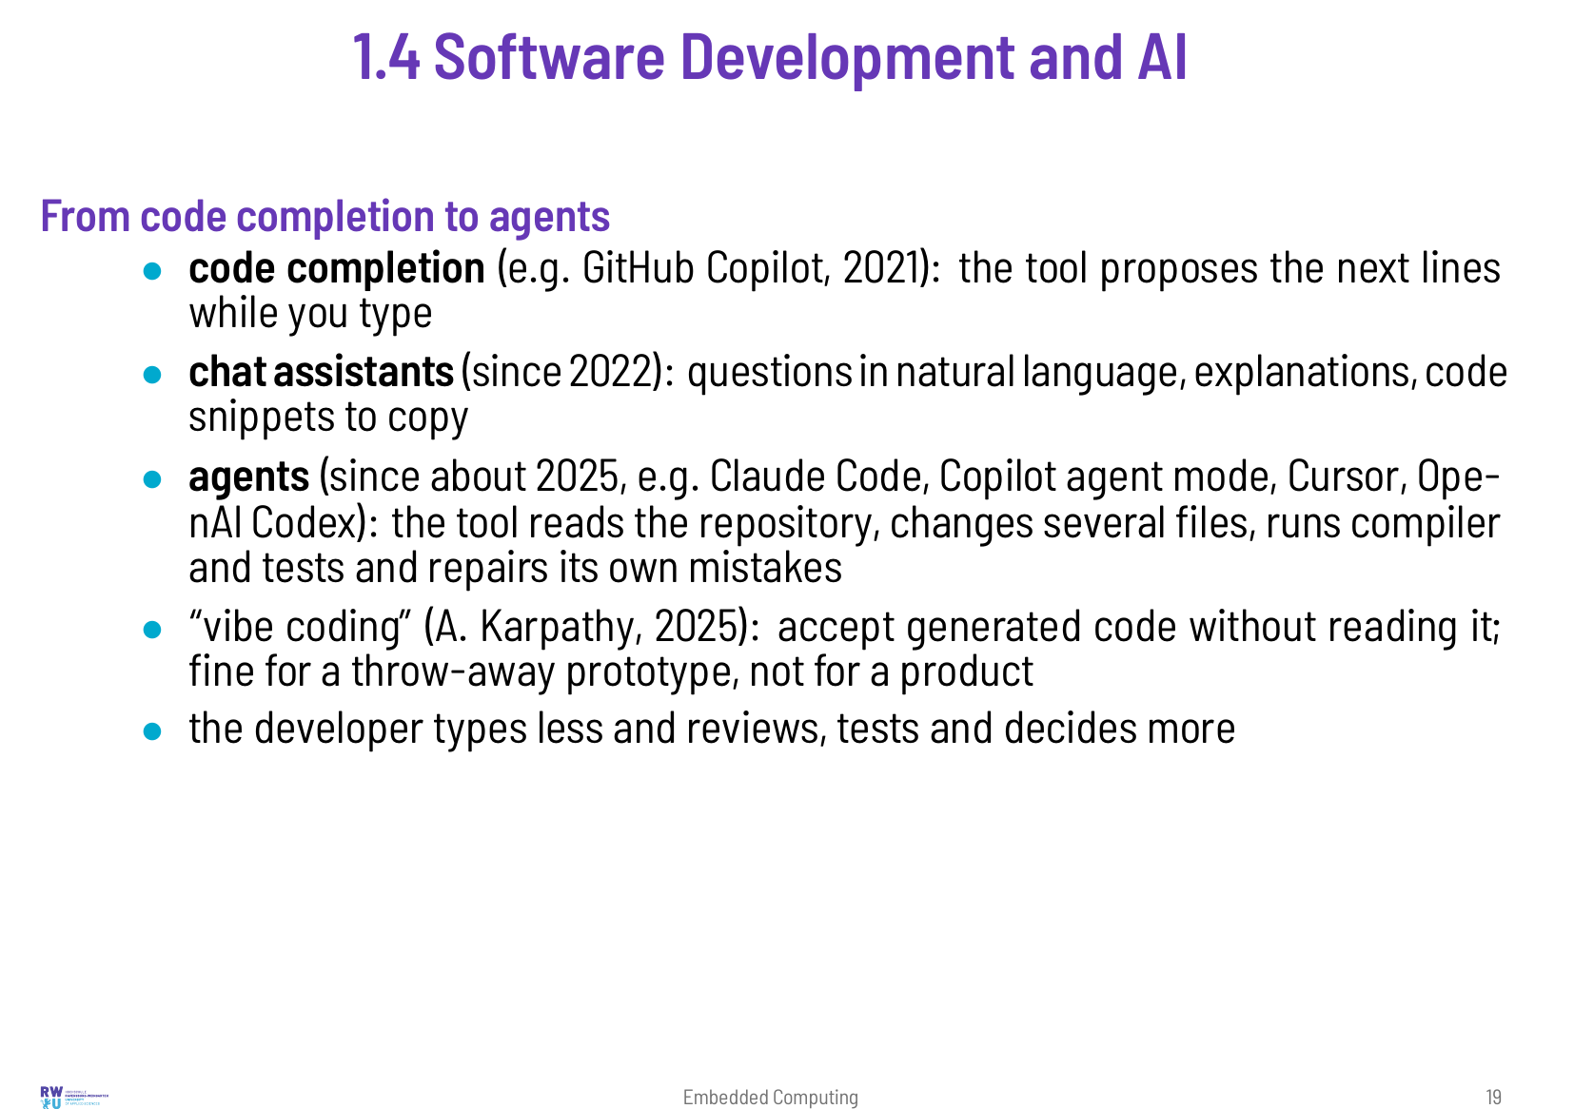
Notes:
AI tools write code. Since 2021 they have gone from completing the current line to working on whole projects: they edit several files, run the compiler and repair their own mistakes. Most developers use them today, and so did we when we revised this lecture. Two questions follow for an embedded systems course. What changes in the daily work? And what does an engineer still need to know when a machine writes much of the code? The studies disagree on how much time AI saves. Some measured faster delivery, one controlled experiment measured the opposite. On the second question they are clearer. The generated code is often almost right, and the last errors are found by people who understand the hardware, read the datasheet, write tests and know how to debug. We found the same while preparing this lecture. So it still teaches these things in detail, with or without AI. The section also maps where AI is used along the development of an embedded system today – from code and tests to PCB layout – and where it is not yet: on the lab bench, in timing guarantees, in certified safety software and in the final responsibility for a product. It ends with the skills that matter when working with AI, the skills that must stay active without it, and the rules for using AI in this lecture. The job market reacts as well. Employers now expect graduates to work with AI tools as a matter of course, and they pay more for these skills. At the same time there are fewer of the simple entry-level tasks that used to train beginners, so new engineers have to judge, test and debug earlier in their career. The second half of this section collects current figures and the skills that job advertisements ask for.

Slide 20
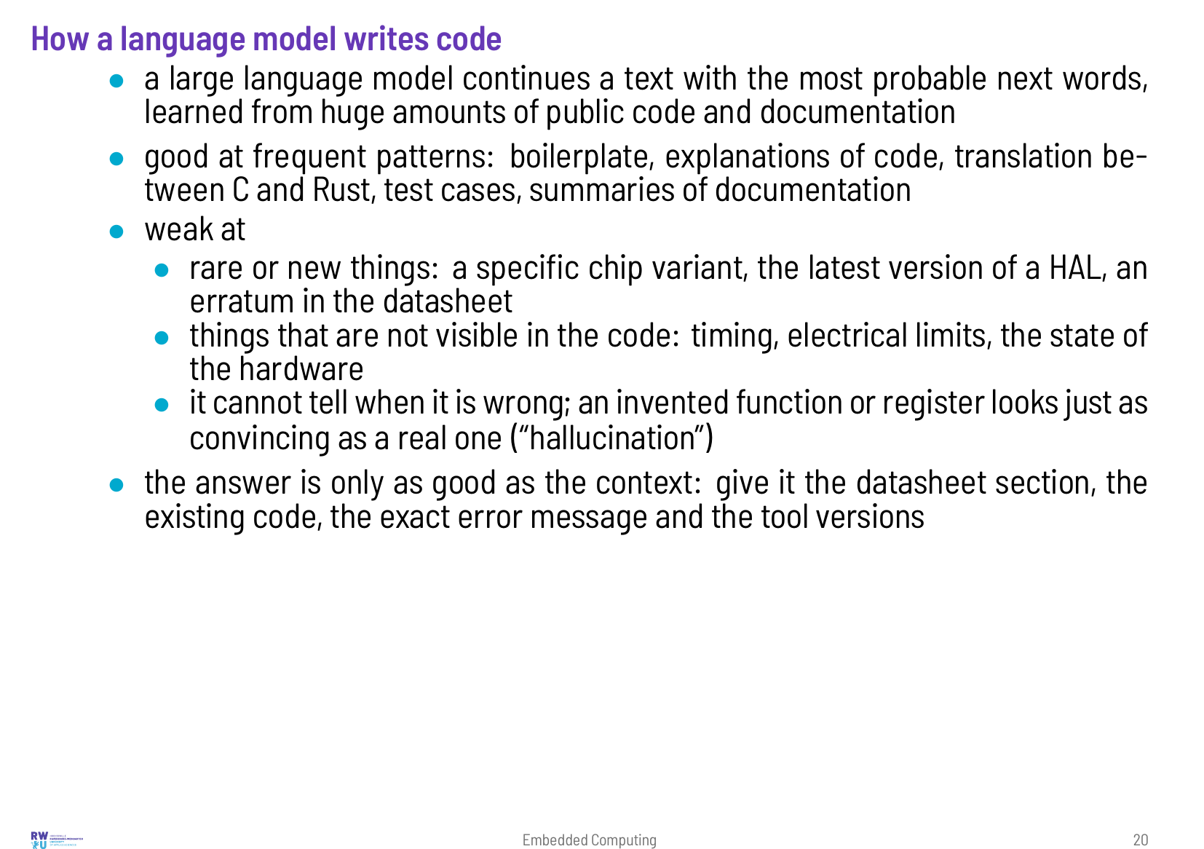

Slide 21
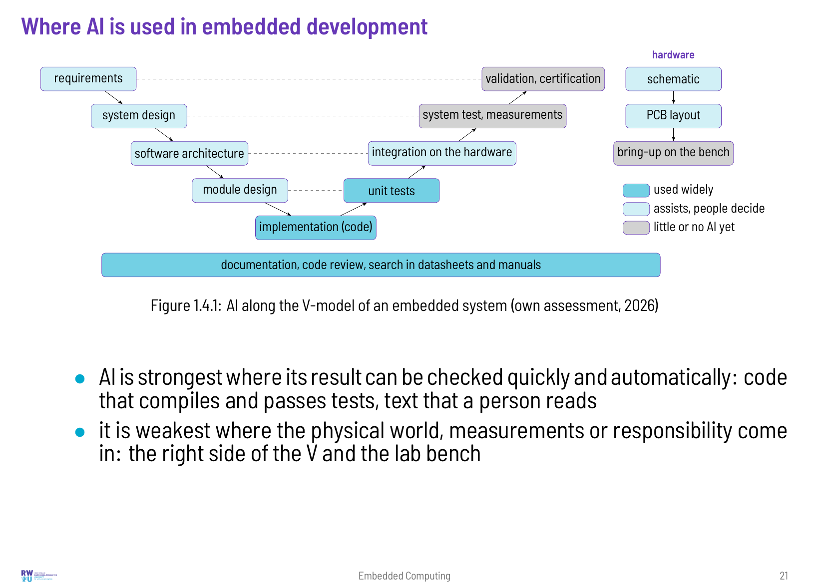

Slide 22
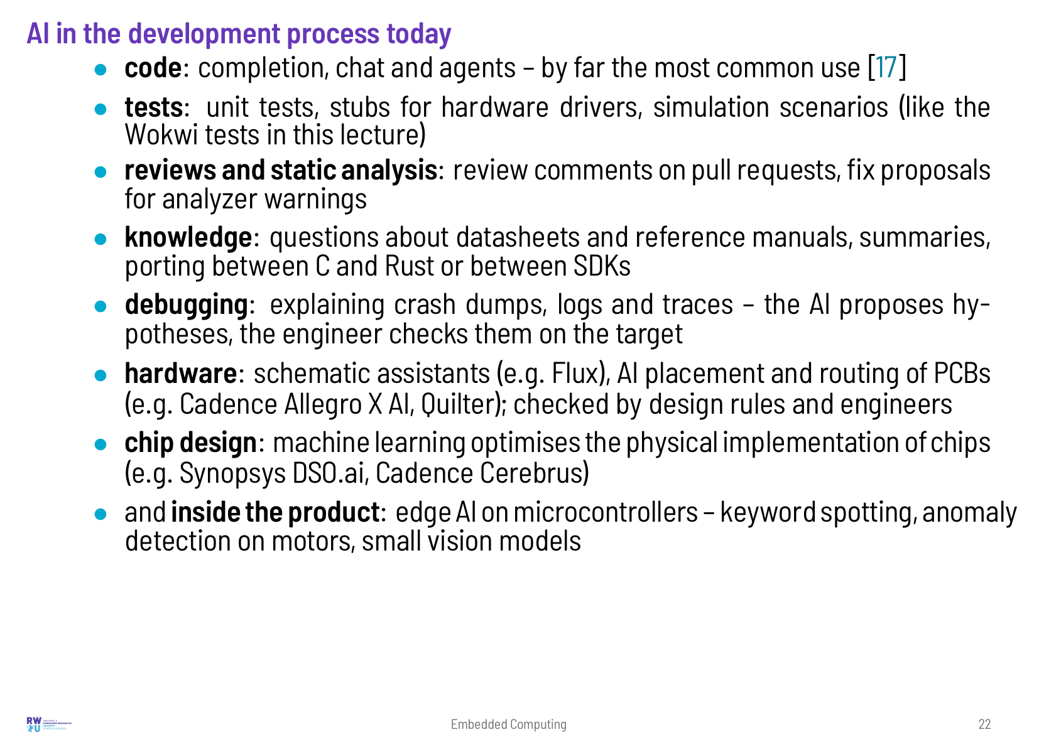

Slide 23
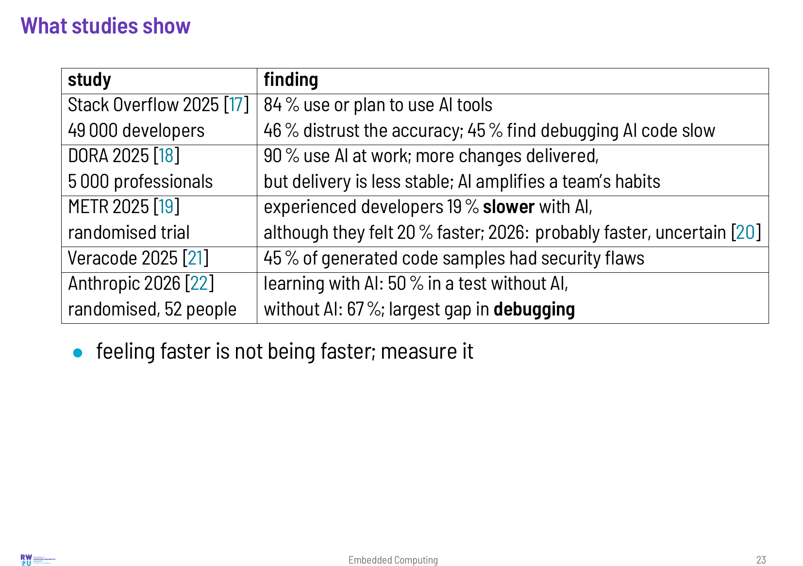

Slide 24
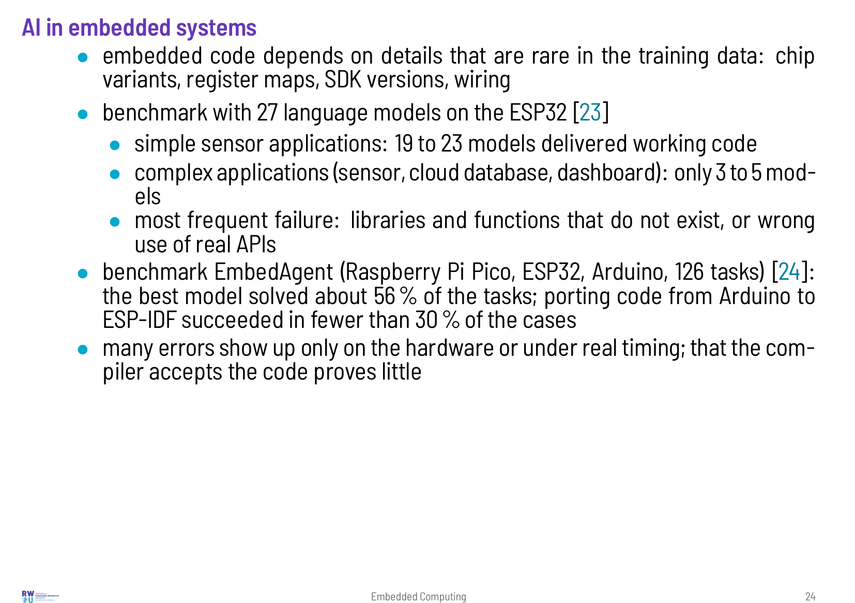

Slide 25
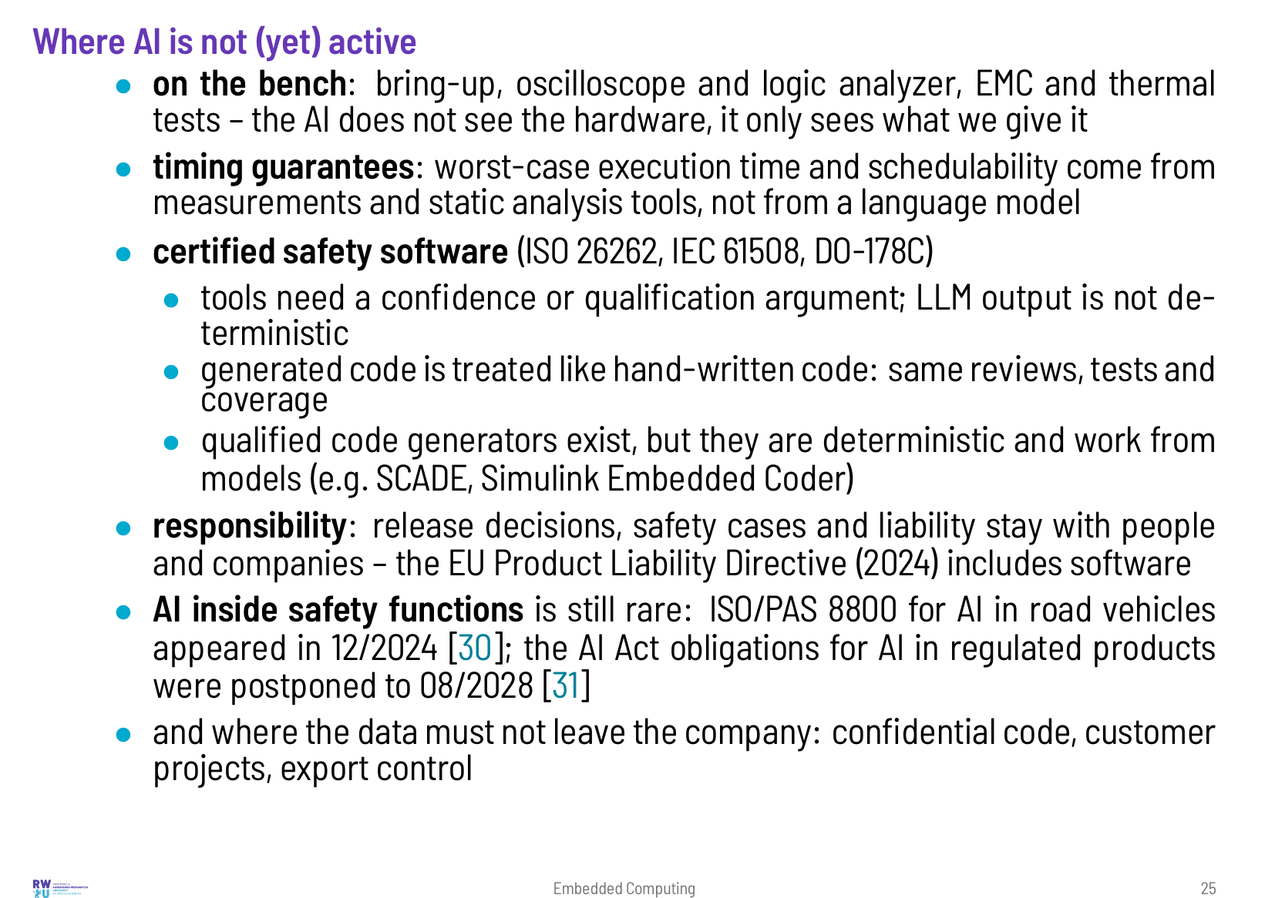

Slide 26
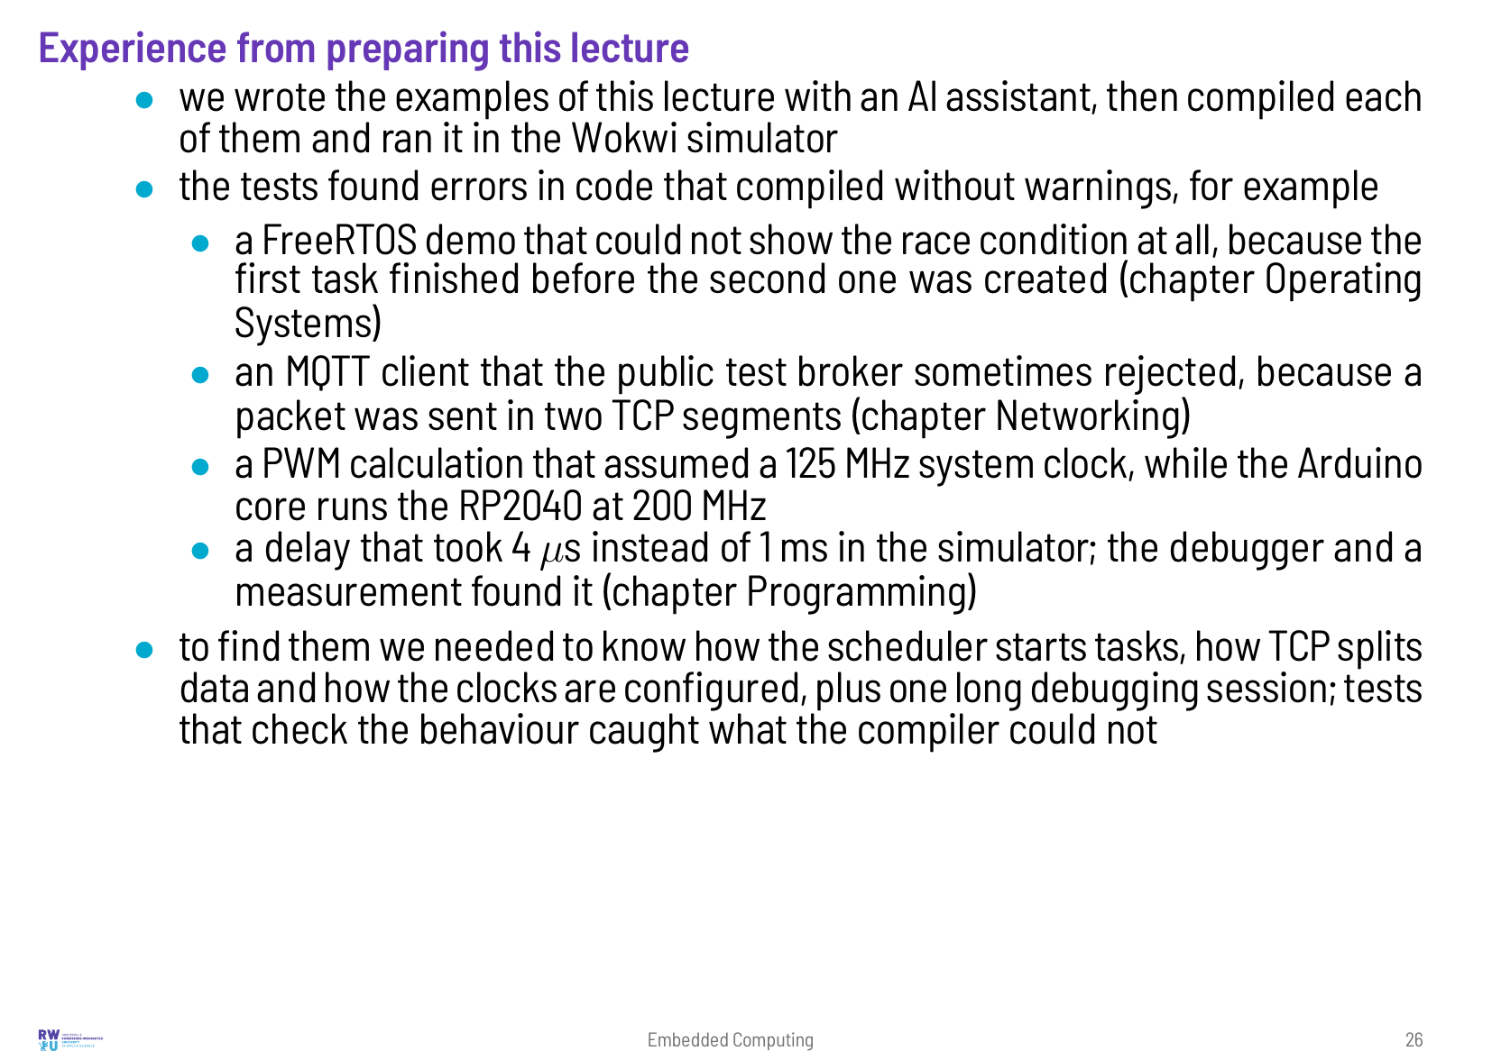

Slide 27
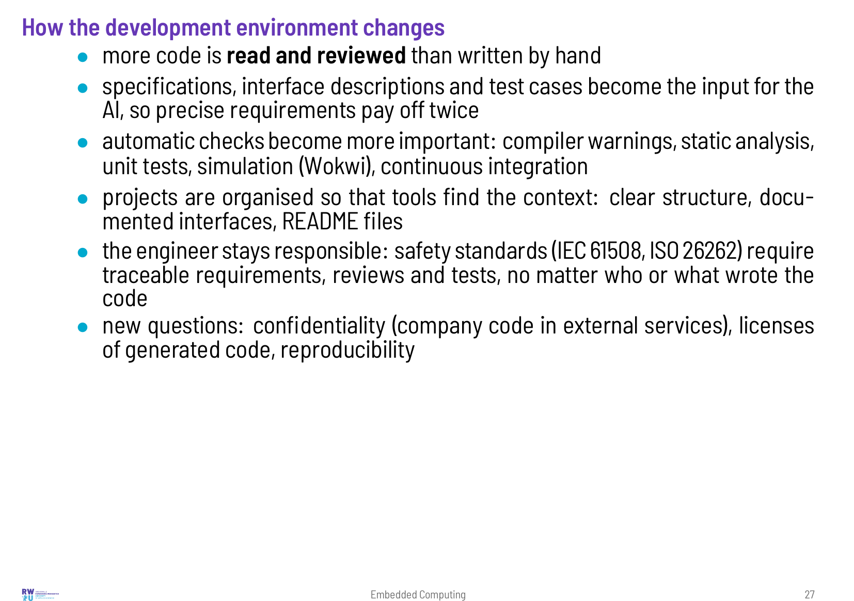

Slide 28
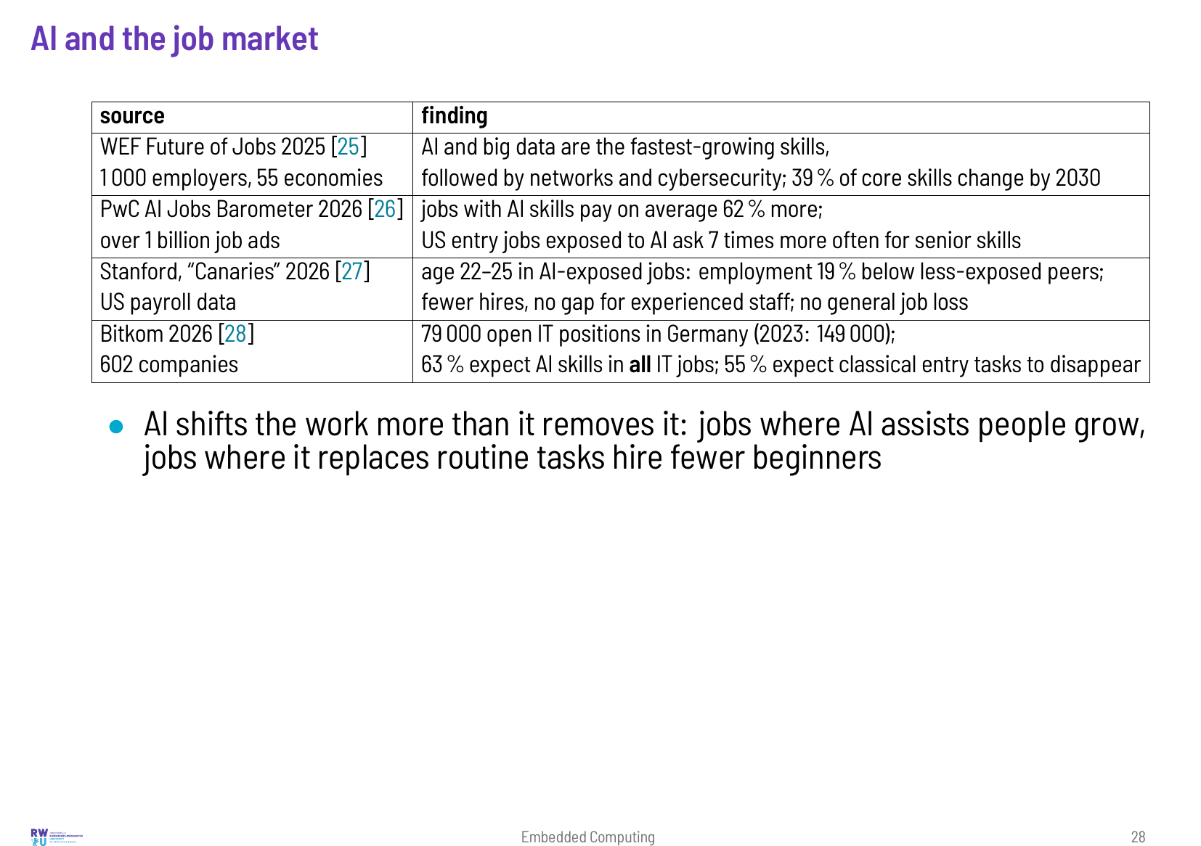

Slide 29
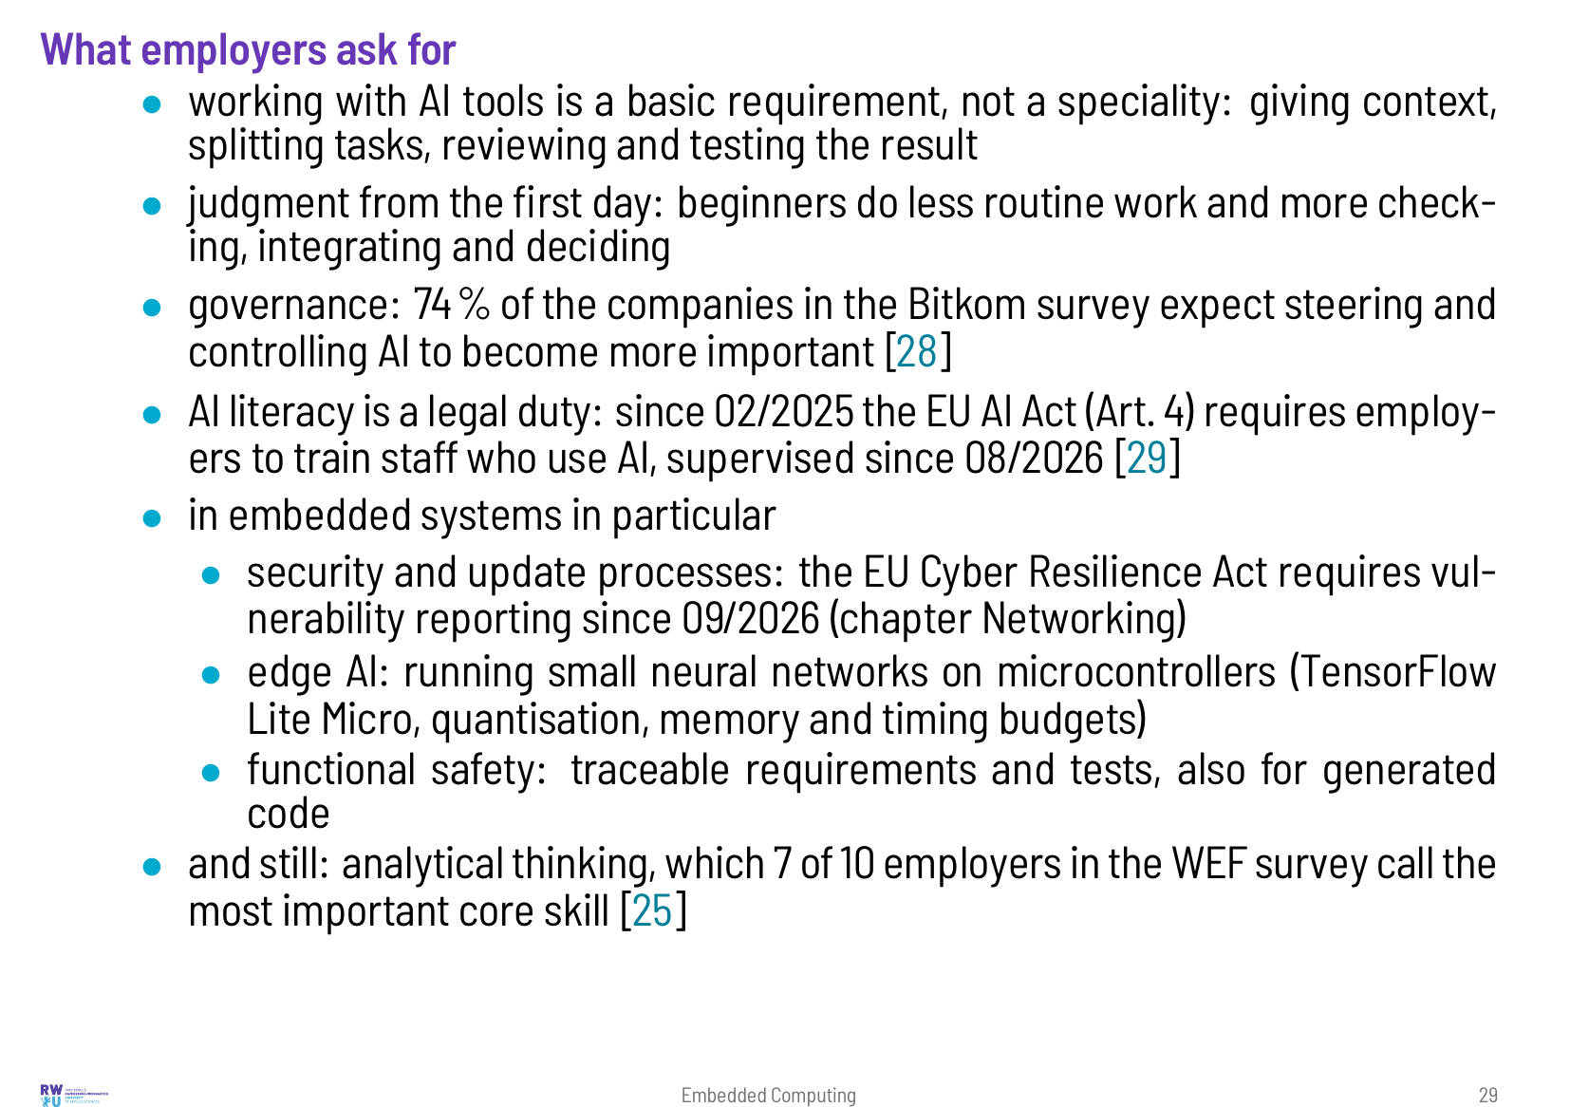

Slide 30
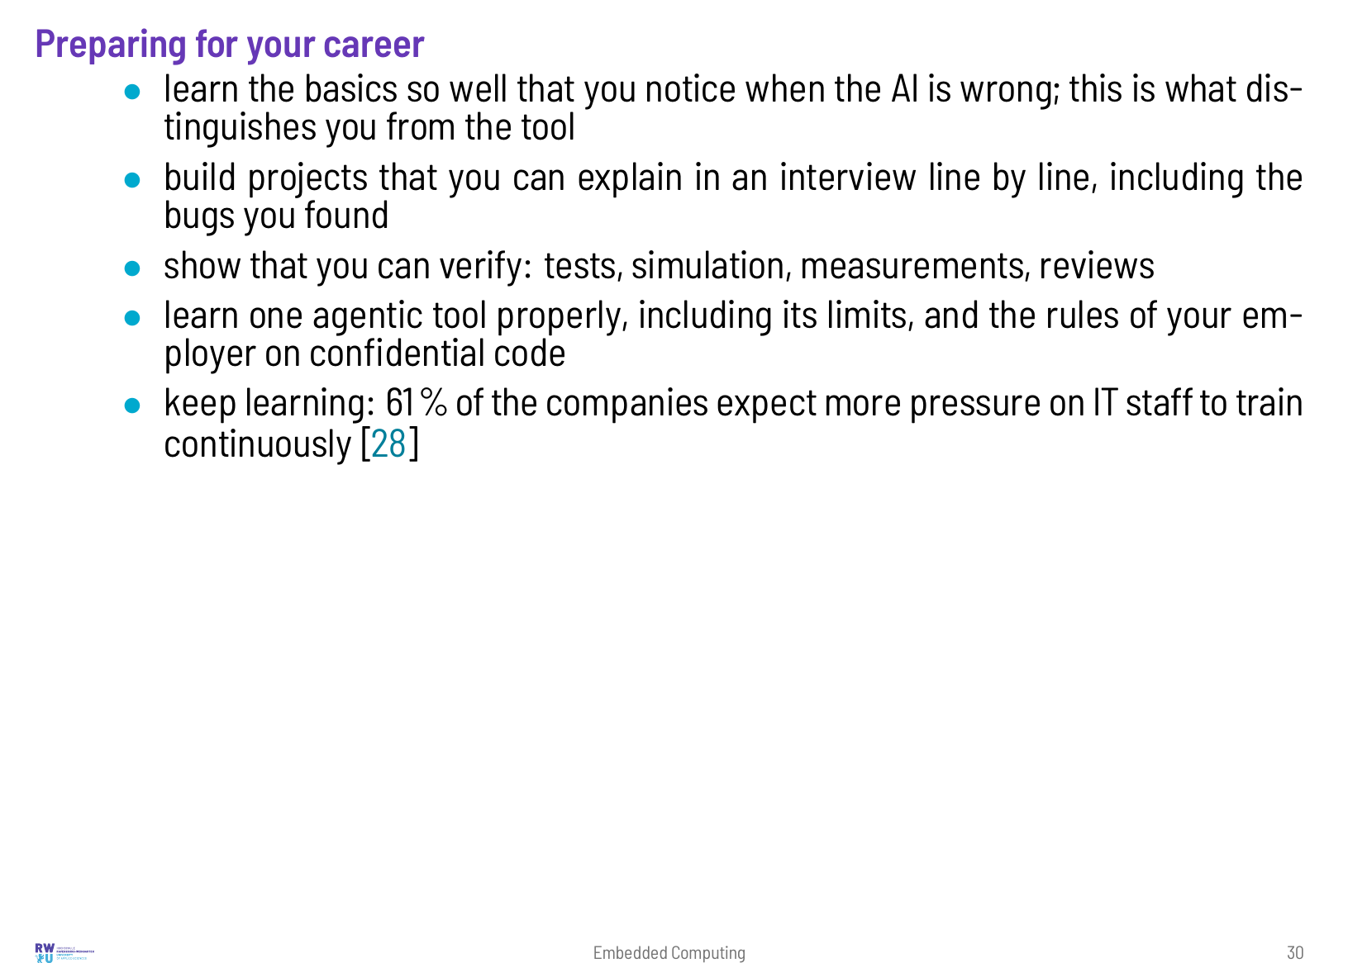

Slide 31
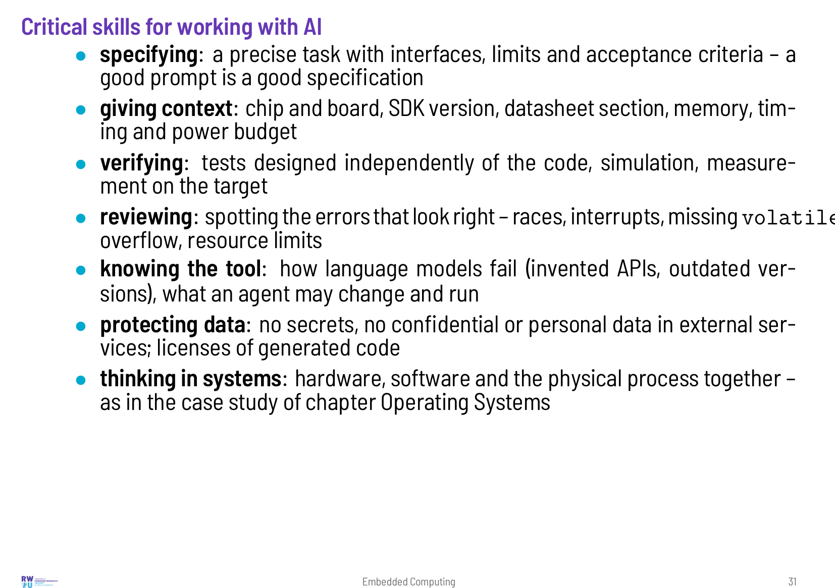

Slide 32
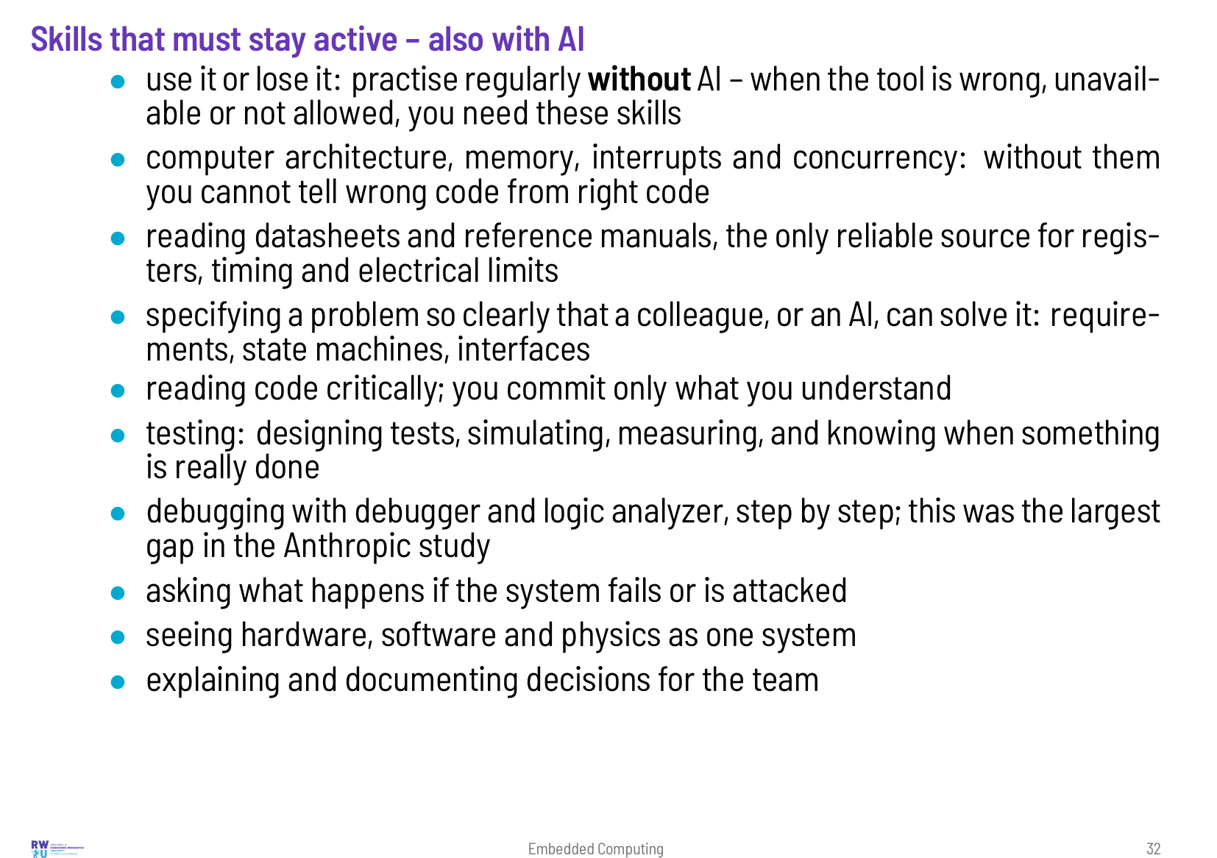

Slide 33
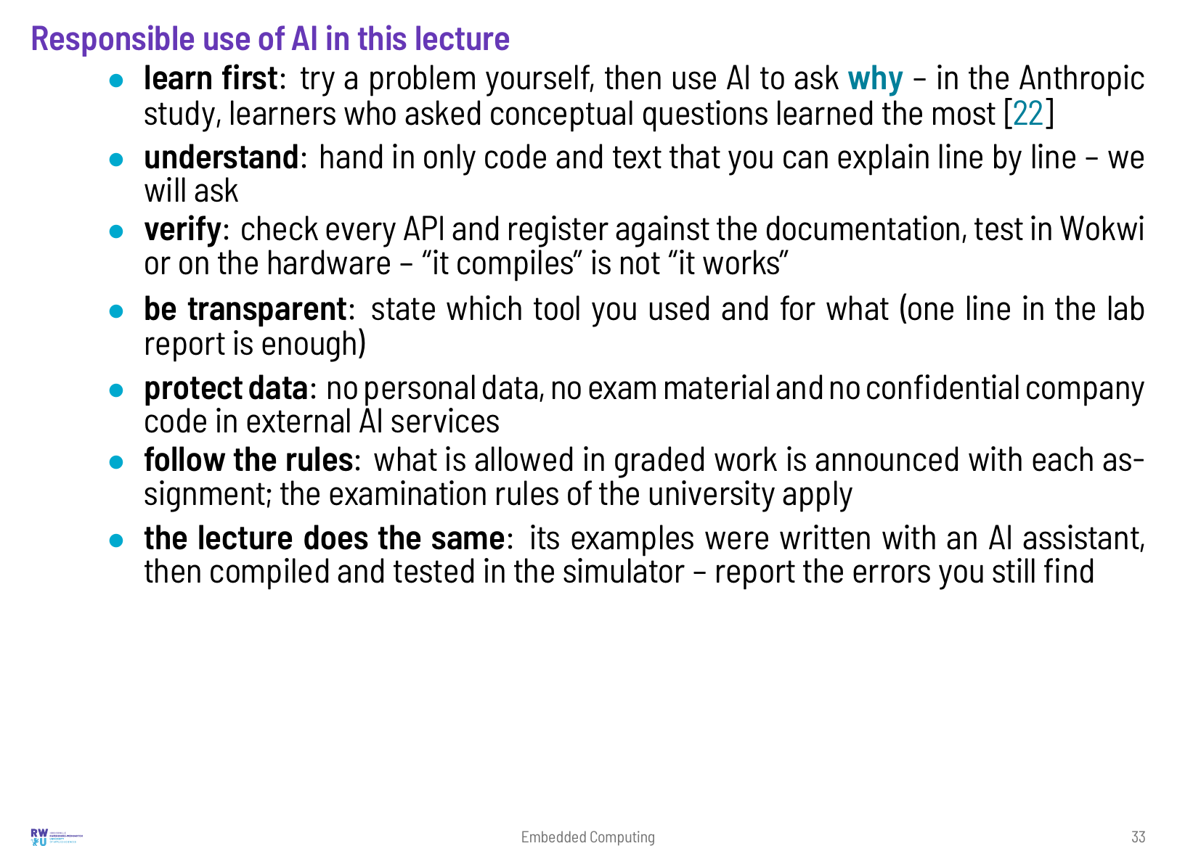

Slide 34
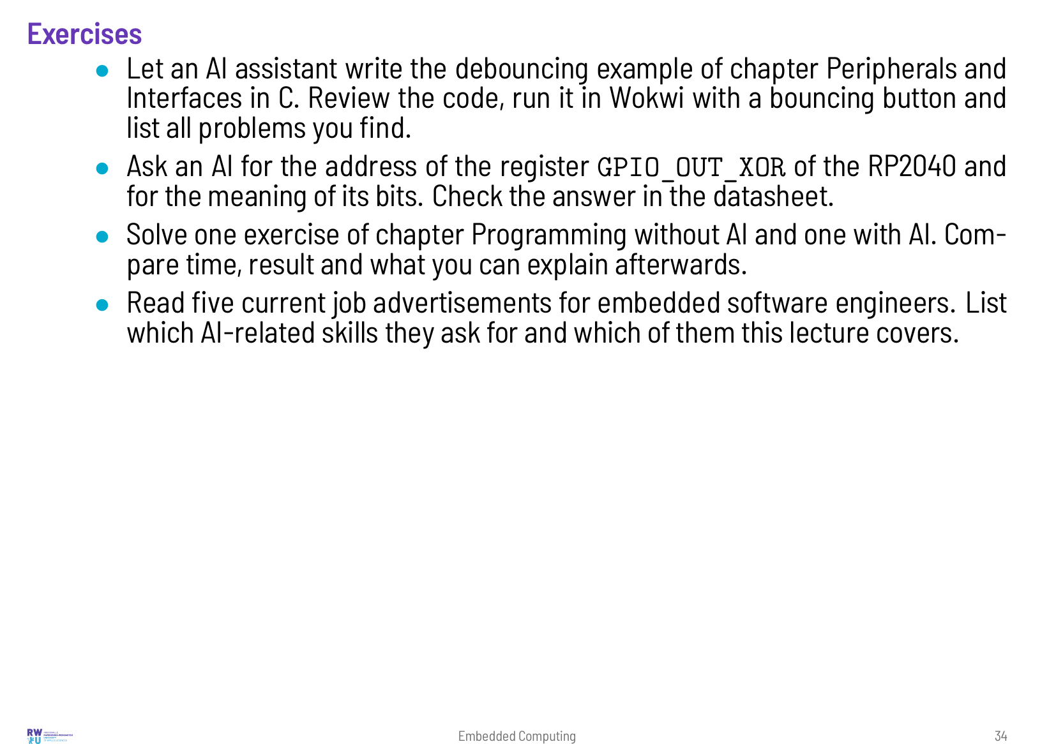

Slide 35
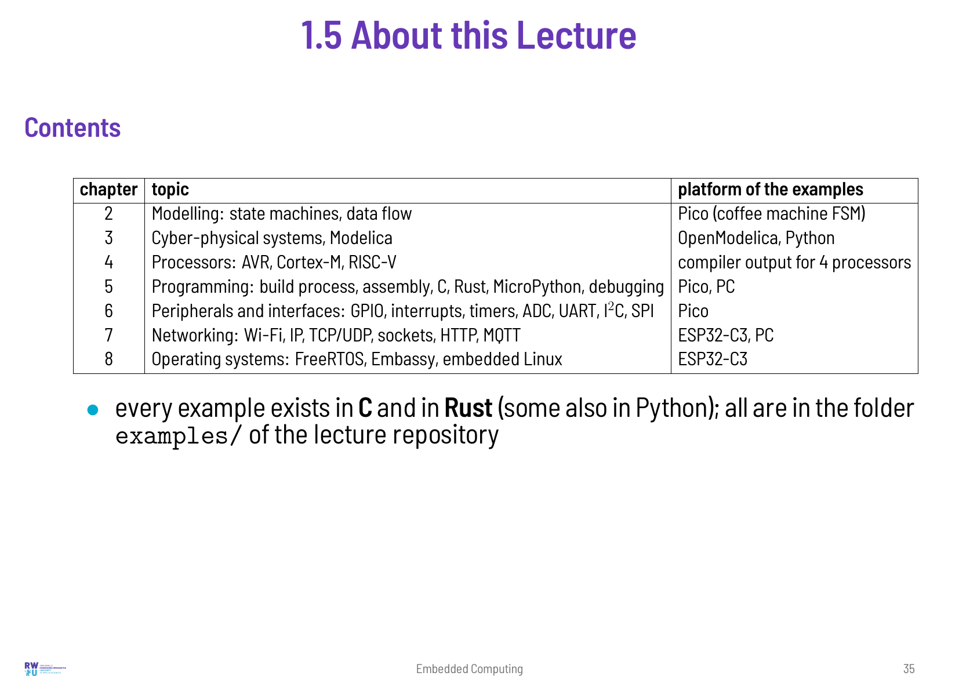

Slide 36
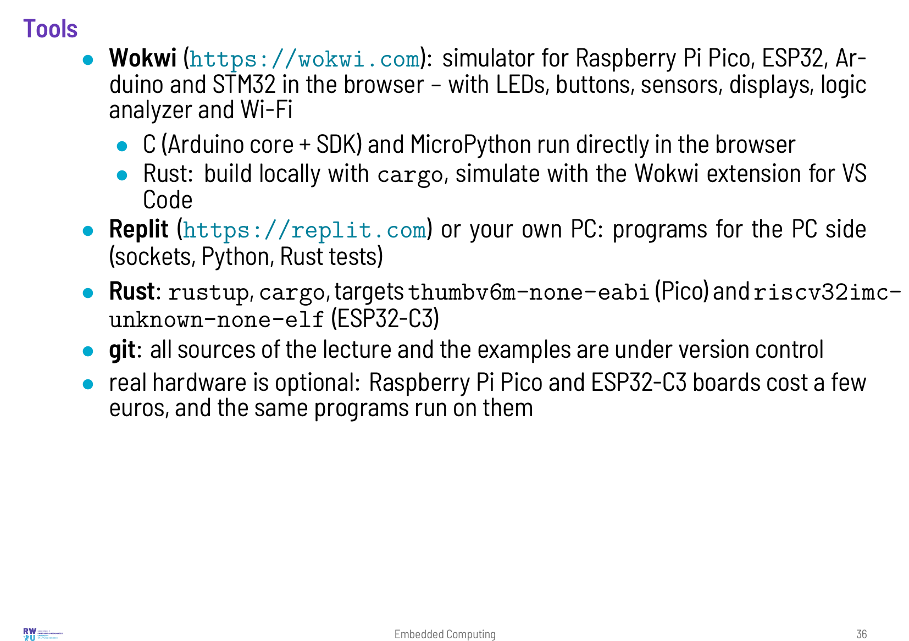

Slide 37
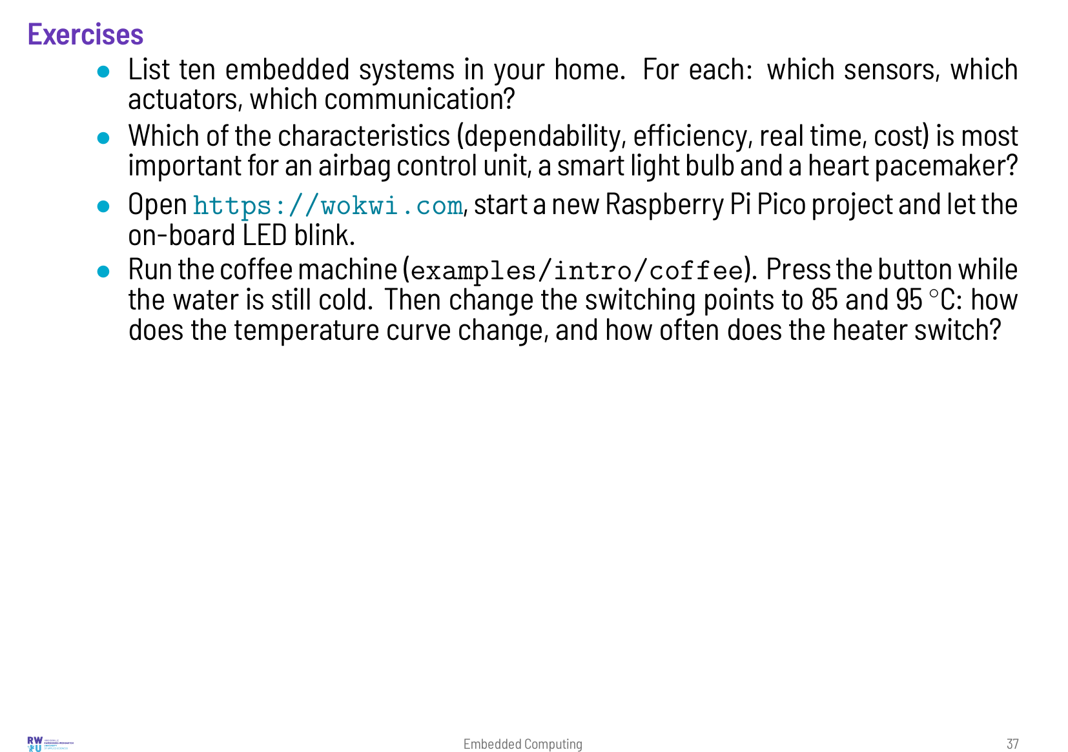

Slide 38
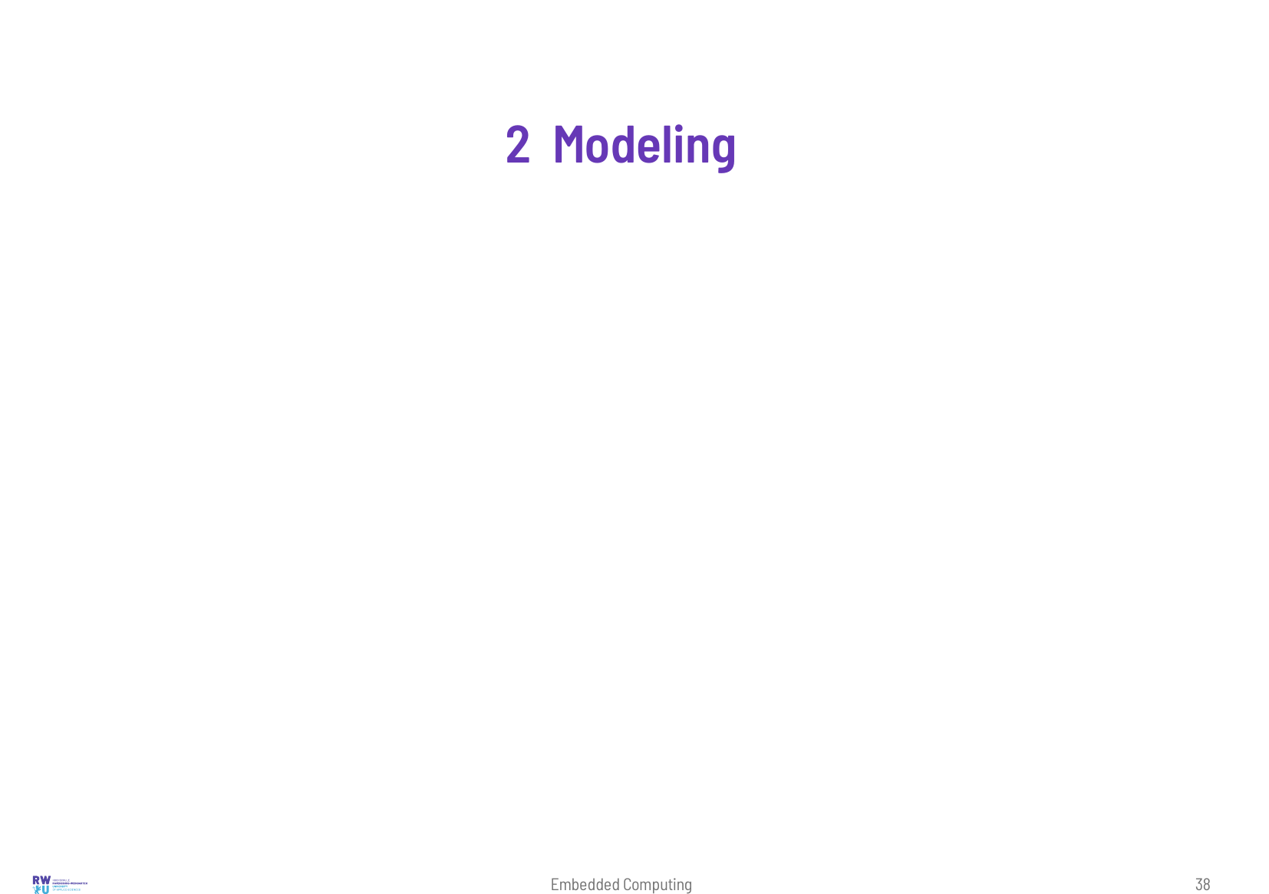

Slide 39
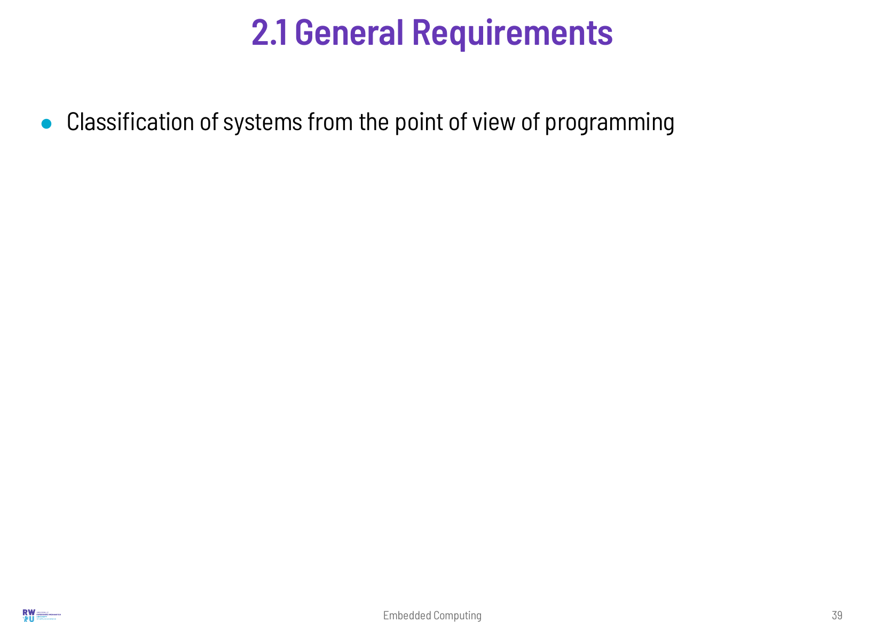
Notes:
A small embedded project can start directly with programming: one microcontroller, a few hundred lines of code, a test on the bench. Most products are larger. Several developers, hardware and software designed in parallel, safety requirements and a lifetime of many years make a more structured approach necessary. Models describe the system before it is built. They make it possible to discuss and check the behaviour, to simulate it, to generate code and documentation from it, and to test the implementation against it. No single kind of model covers all aspects of an embedded system. This chapter introduces the most important ones: state based models, which describe how a system reacts to events, and activity oriented models, which describe data flow and the order of operations. We implement a state machine in C and in Rust, then two StateCharts with hierarchy, timers and concurrency, and run all of them on the Pico in Wokwi.

Slide 40
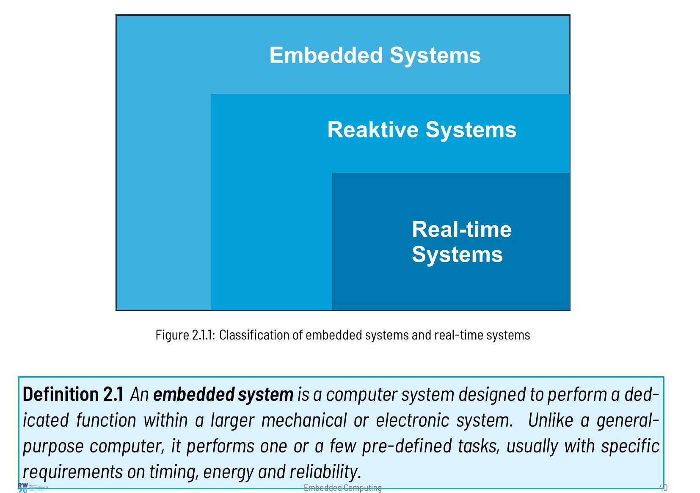

Slide 41
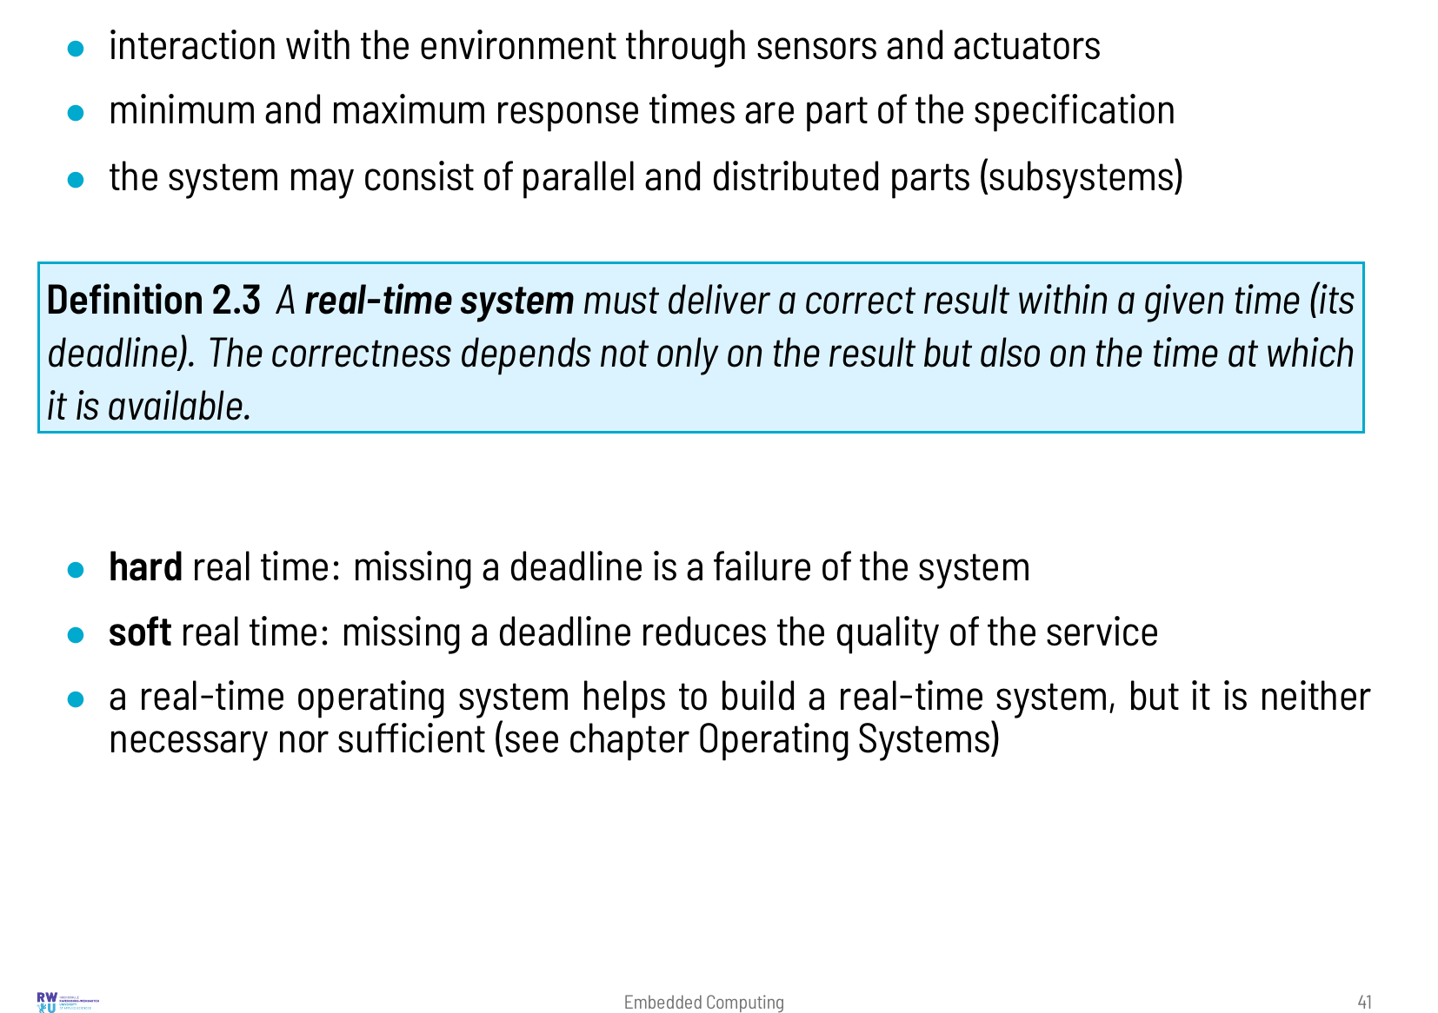

Slide 42
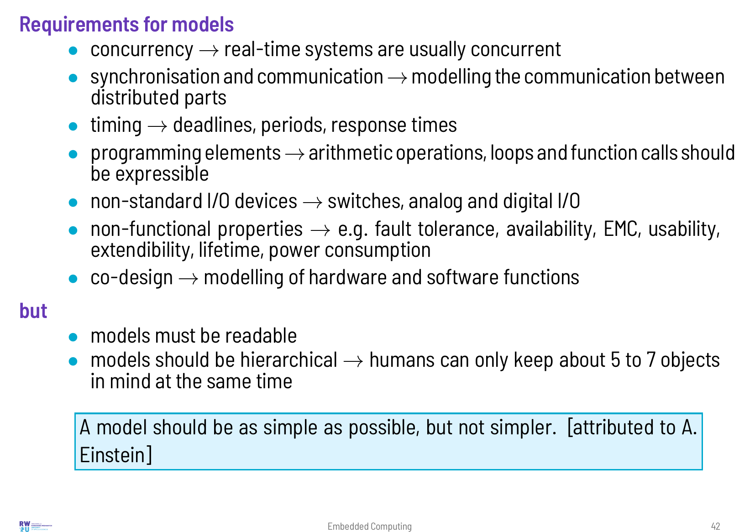

Slide 43
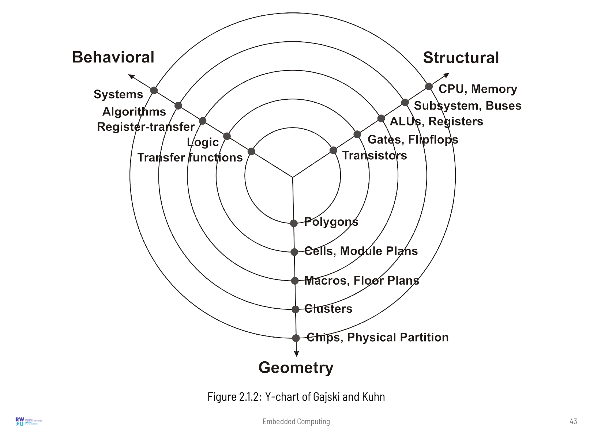

Slide 44
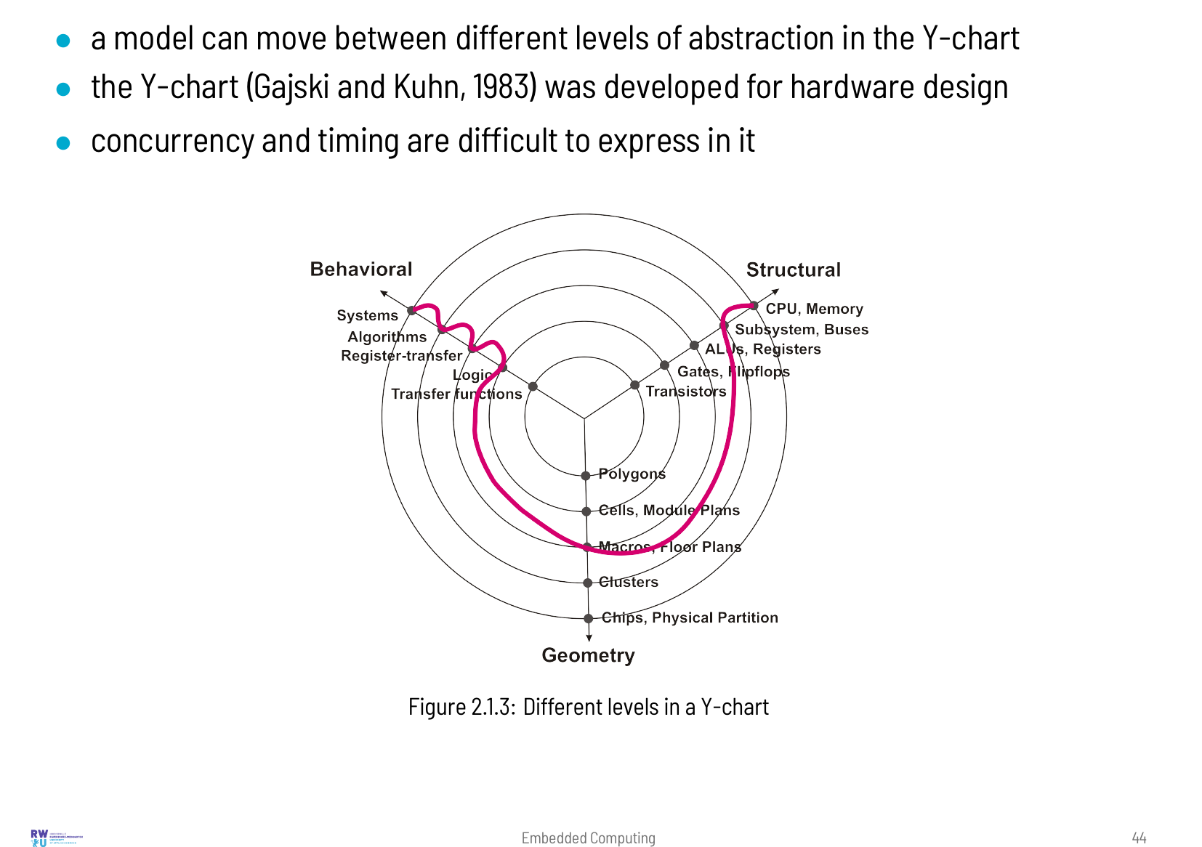

Slide 45
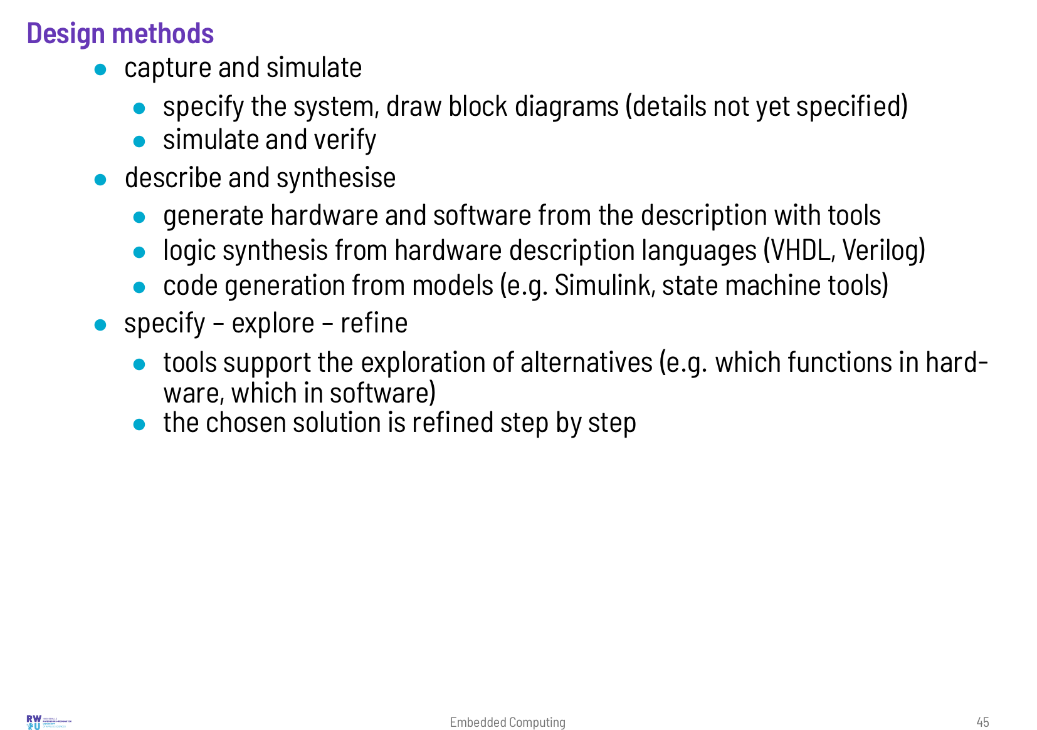

Slide 46
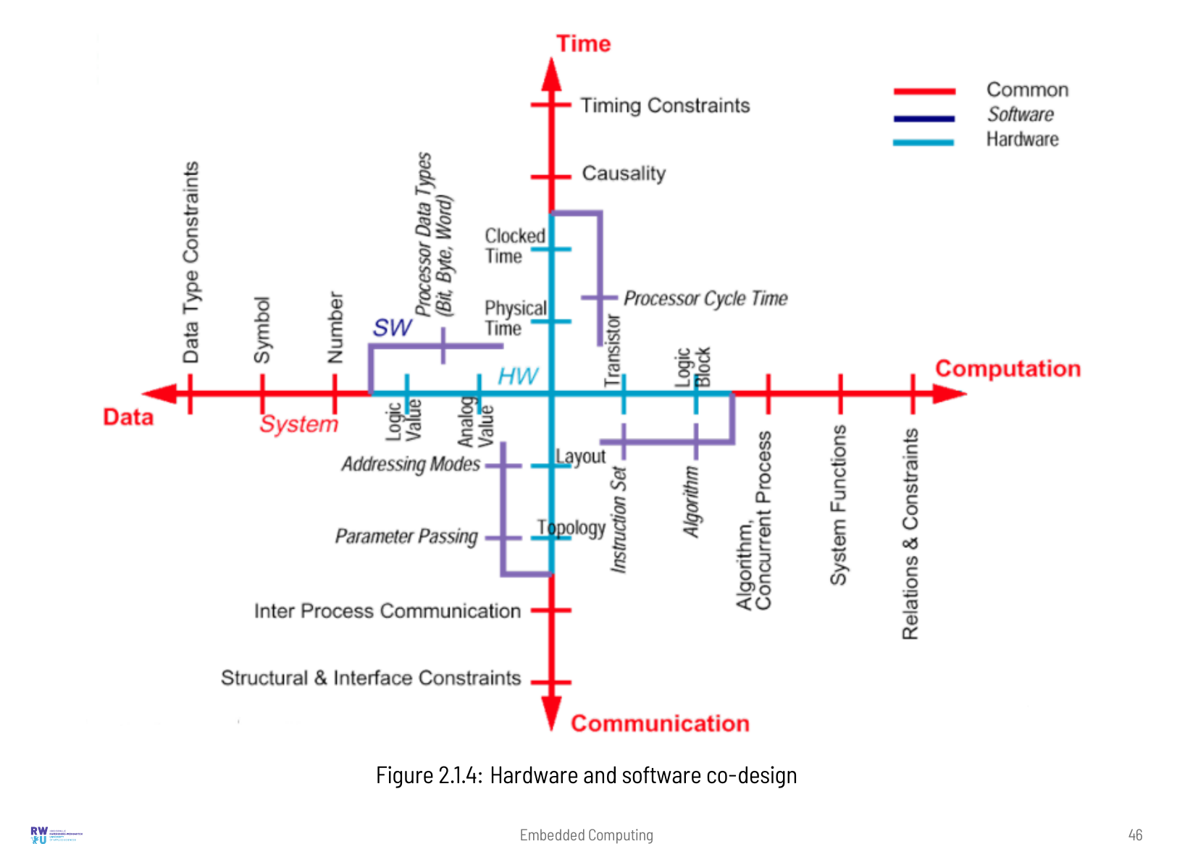

Slide 47
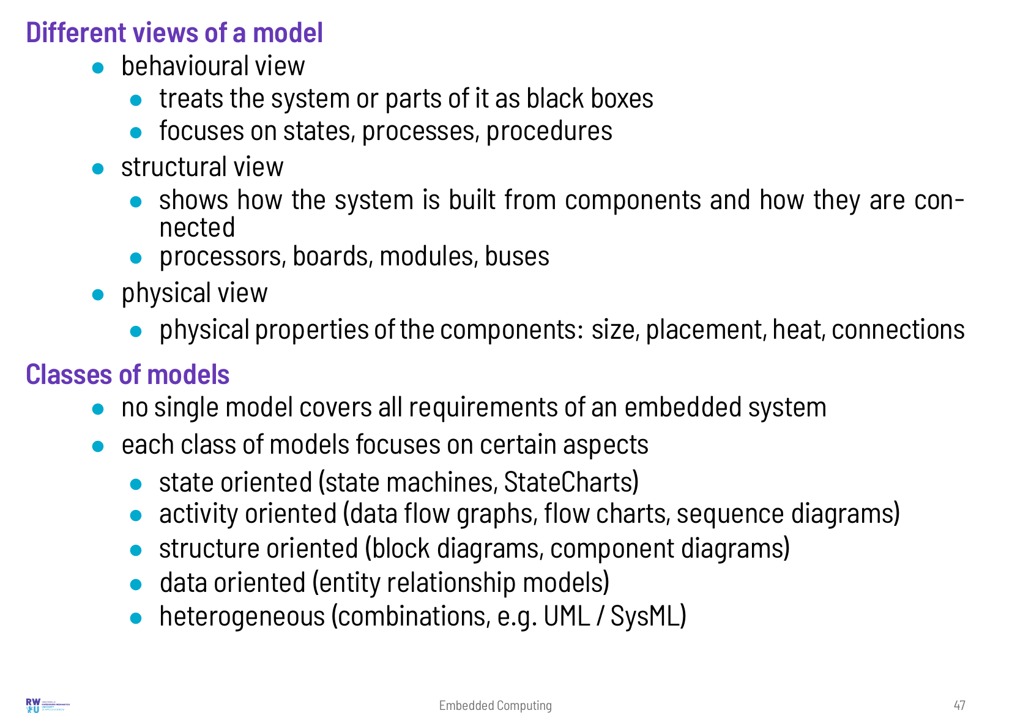

Slide 48
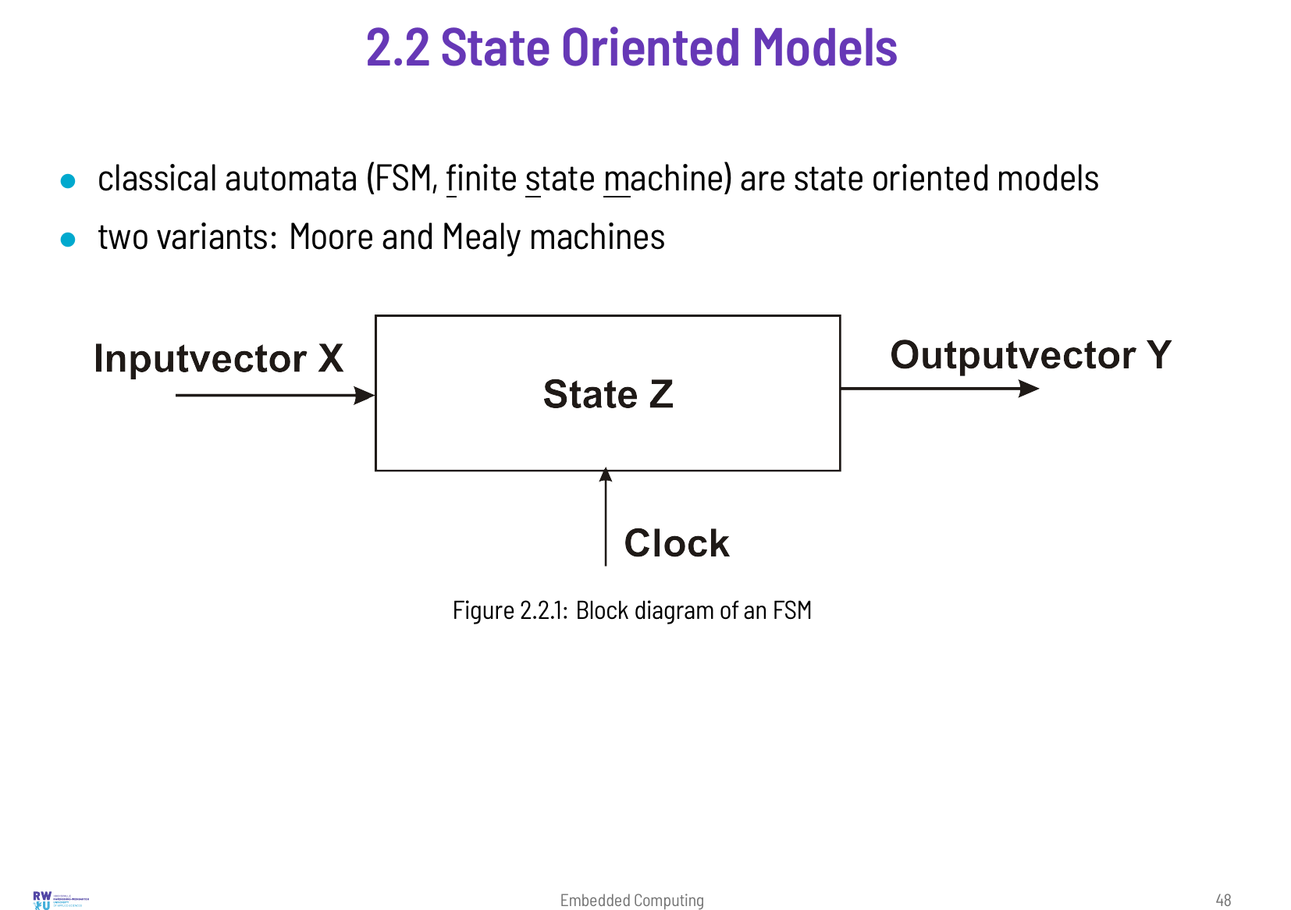
Notes:
Most embedded systems react to events: a button is pressed, a value exceeds a limit, a message arrives. What they do depends on the history, which a state machine summarises in its current state. State machines are easy to draw, easy to check (has every state a reaction to every input?) and easy to implement. For large systems they become unwieldy, and hierarchical state machines (StateCharts) were invented for this case.

Slide 49
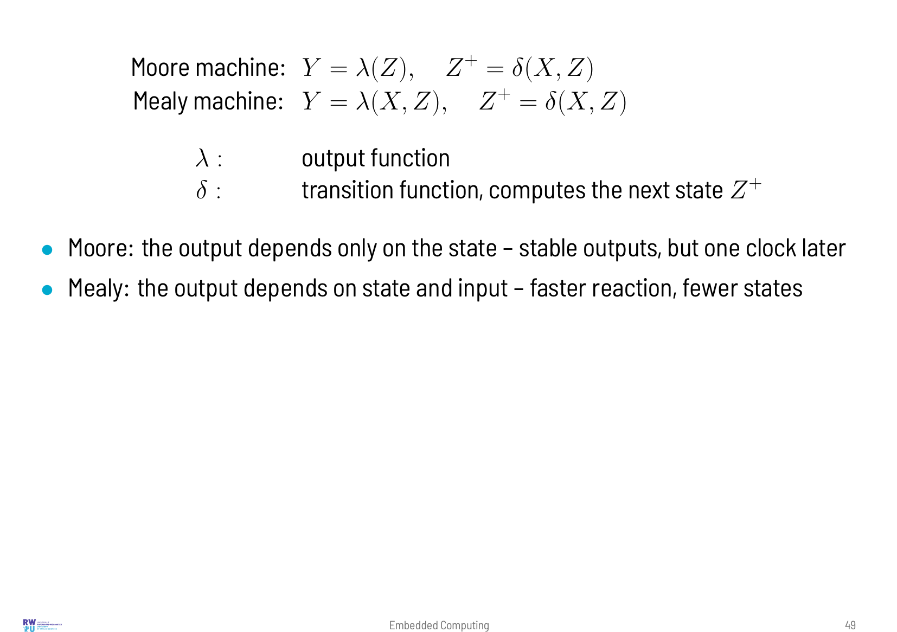

Slide 50
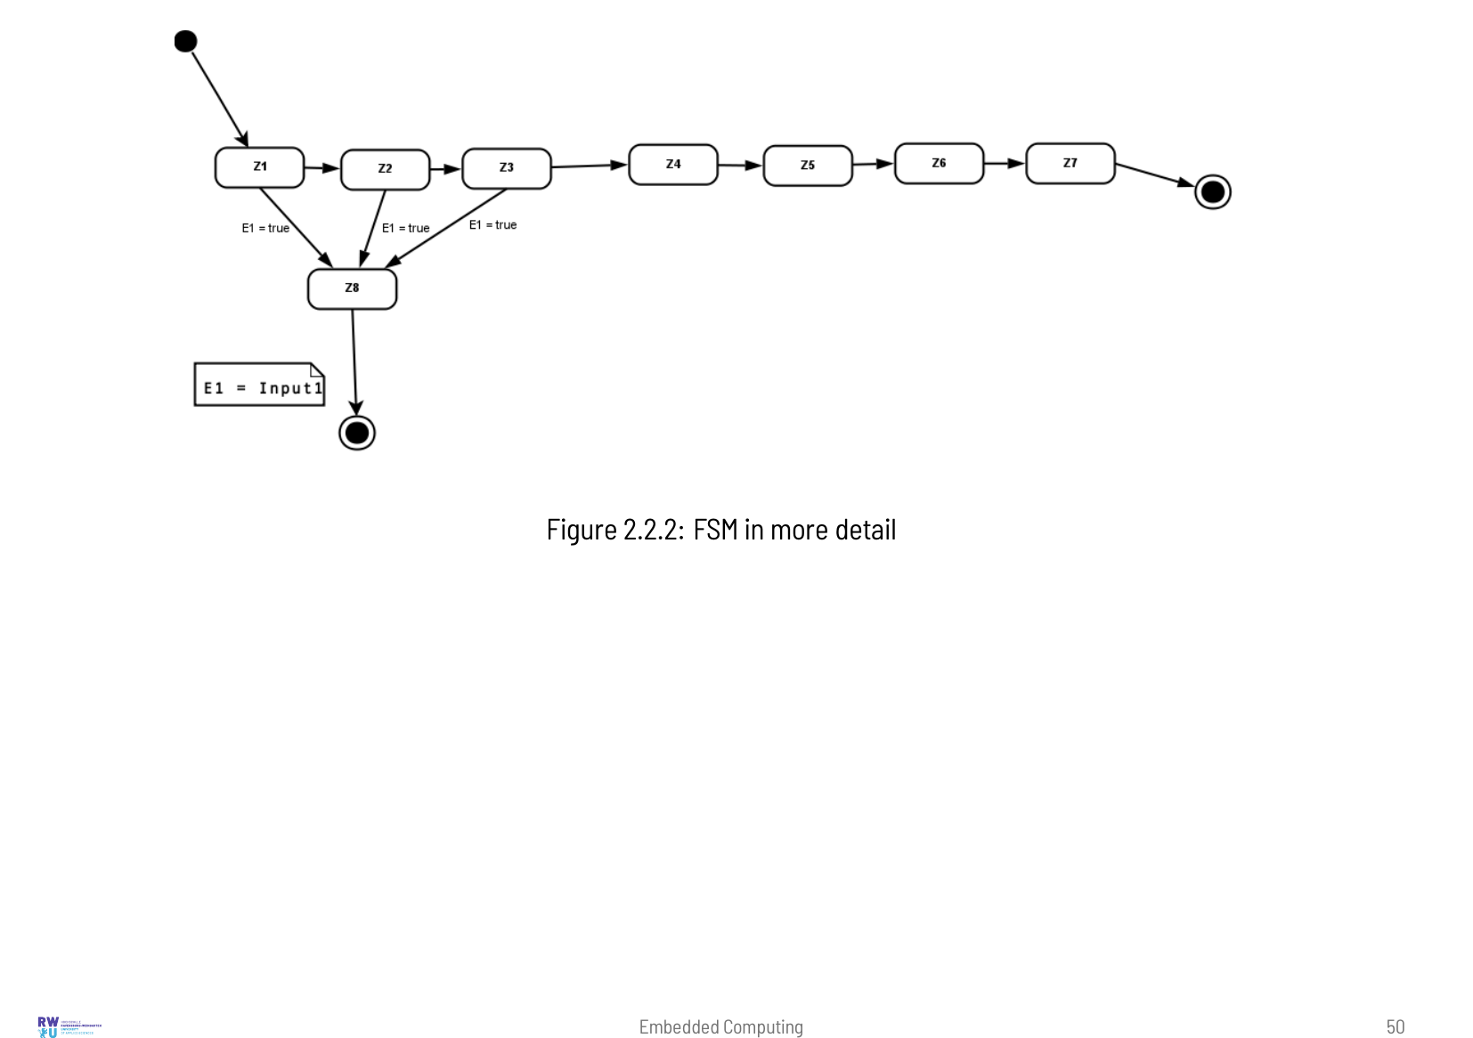

Slide 51
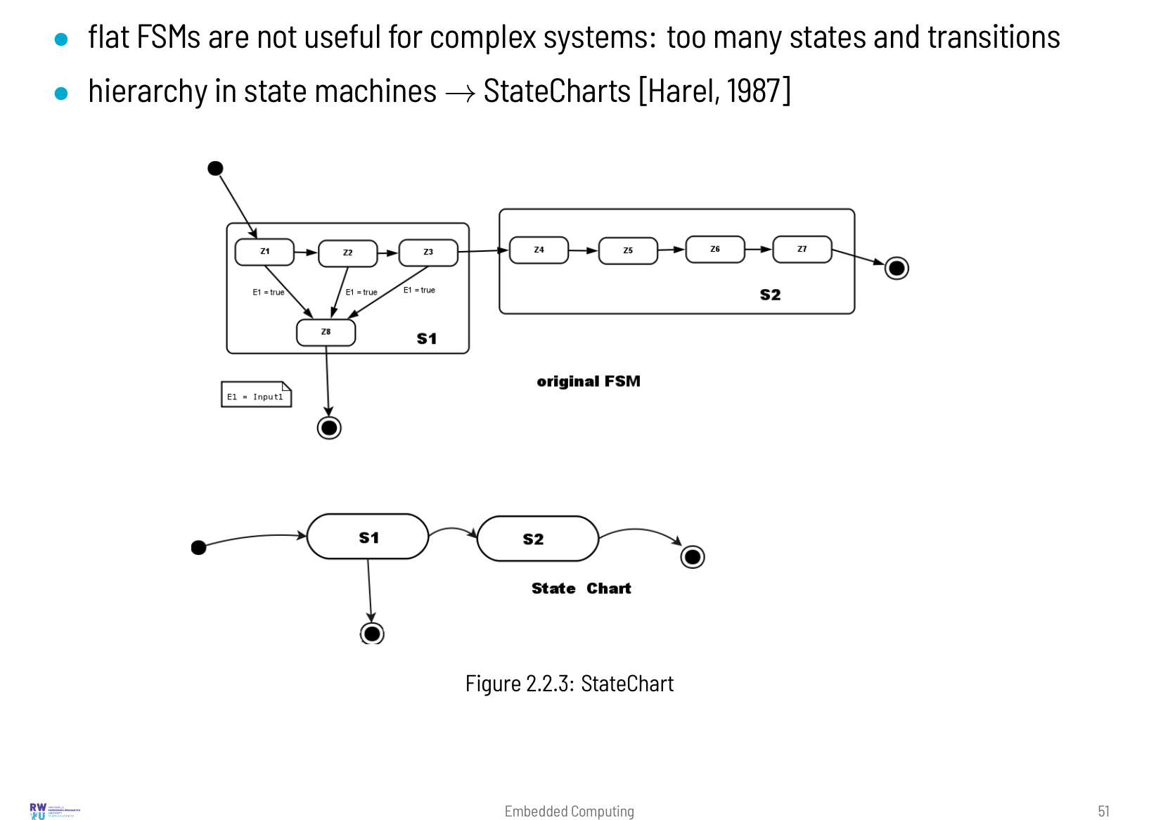

Slide 52
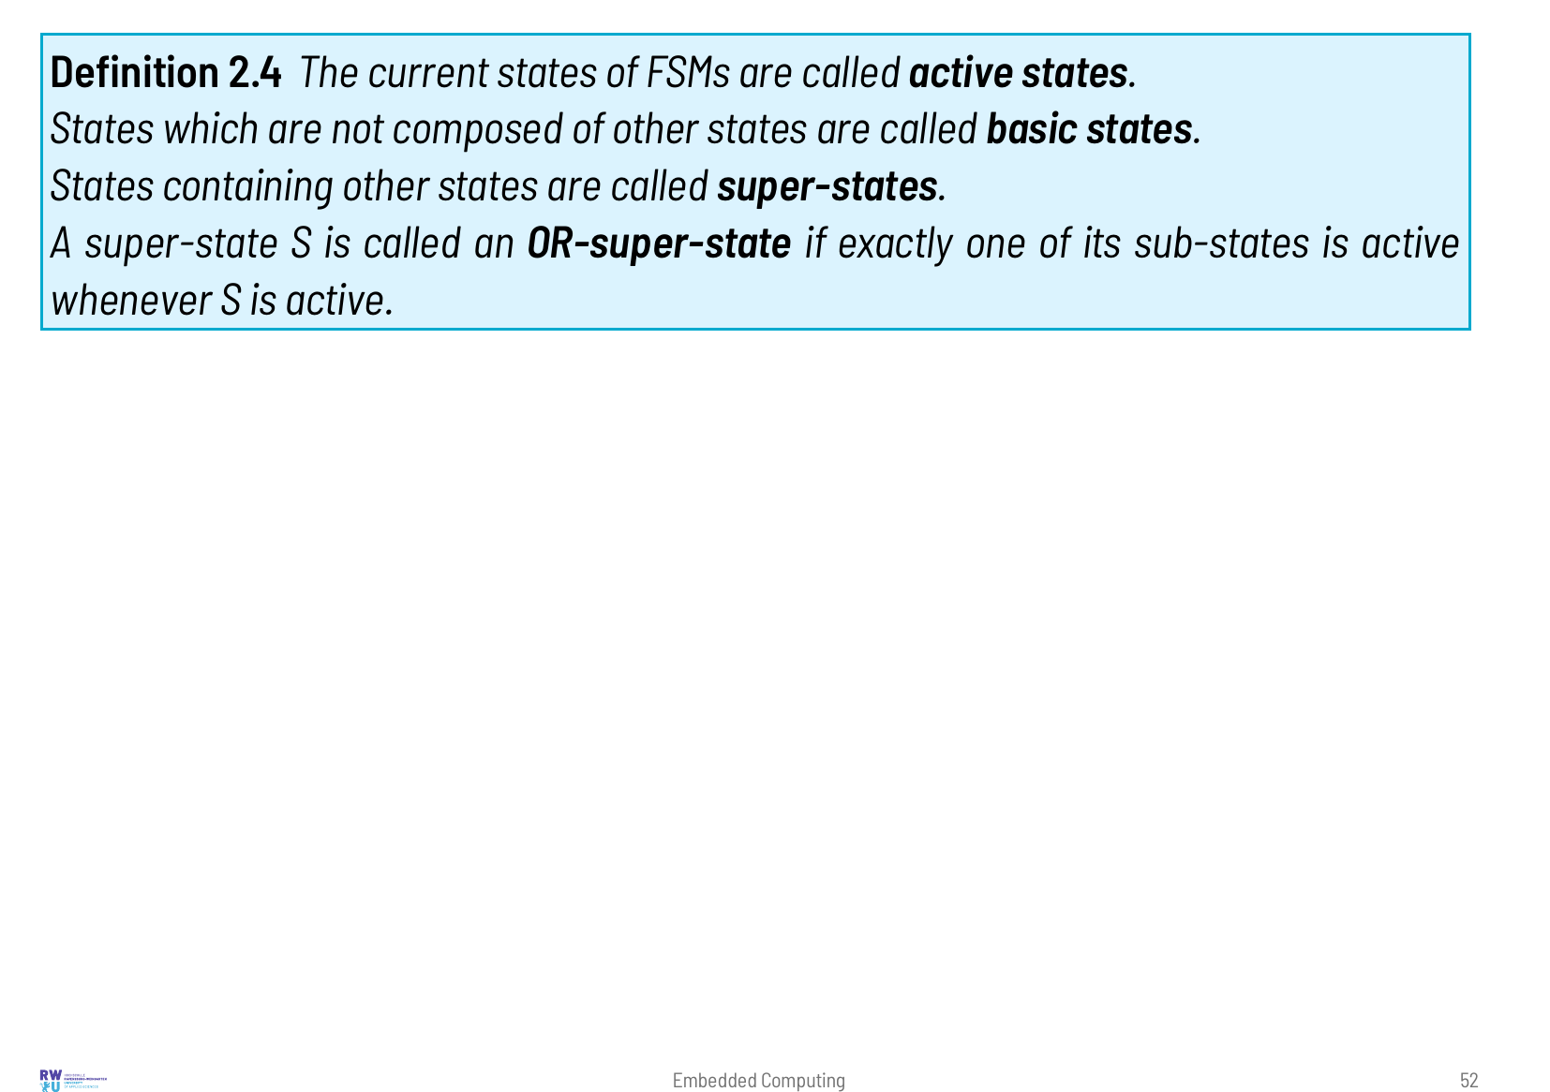

Slide 53


Slide 54


Slide 55


Slide 56


Slide 57


Slide 58

Notes:
A state machine translates directly into code: one variable holds the current state, and a function that is called periodically or for every event computes the next state and the outputs. As an example we use a coffee machine with two selection buttons and a timer that signals “ready”. The same machine is implemented in C with a switch statement and in Rust with enum and match. Both versions run on the Pico in Wokwi.

Slide 59


Slide 60


Slide 61


Slide 62


Slide 63


Slide 64


Slide 65


Slide 66


Slide 67

Notes:
The coffee machine is a flat state machine. Real controllers need the elements of StateCharts: super-states whose transitions apply to all their sub-states, timed transitions, actions on entering and leaving a state, and regions that run concurrently. None of this needs a tool or a framework; a few rules turn a StateChart into plain C. Two examples show how. A garage door controller uses hierarchy, timers and a concurrent warning lamp, and the door itself is a model as well: a Wokwi custom chip that simulates the motor, the end switches and a light barrier. A pedestrian crossing uses an AND-super-state with two communicating regions and an OR-super-state for the night mode. Both are in examples/modelling, with Wokwi scenarios that test them.

Slide 68


Slide 69


Slide 70


Slide 71


Slide 72


Slide 73


Slide 74


Slide 75


Slide 76

Notes:
Activity oriented models describe what happens to the data and in which order. Data flow graphs show the dependencies between operations and leave the order open, which is ideal for signal processing and for deciding which operations can run in parallel. Flow charts add control flow. Sequence charts show the communication between components over time.

Slide 77


Slide 78


Slide 79


Slide 80


Slide 81


Slide 82


Slide 83


Slide 84


Slide 85


Slide 86

Notes:
An embedded system never works alone. It measures and influences a physical process: the temperature of a room, the speed of a motor, the position of a robot arm. Cyber-physical systems (CPS) are systems in which this coupling of computation and physics is essential. They are often distributed and connected, as in a car, a factory, a power grid or an aircraft. Their behaviour can only be understood if both parts are described together: the physics with differential equations, the software with algorithms and state machines. Because building and testing the real system is expensive and sometimes dangerous, CPS are developed with models and simulation. This chapter introduces the idea of CPS and the steps from a model to the real system. It then shows how physical systems are modelled with the equation-based language Modelica, using the free tool OpenModelica, and with a few lines of Python.

Slide 87


Slide 88


Slide 89


Slide 90


Slide 91

Notes:
Modelica is a language for describing physical systems by equations. A model states which relations hold, for example Ohm's law u = R · i, without saying which variable is computed from which. The compiler sorts the equations, solves them symbolically where possible and generates simulation code. Components can be connected like real parts: connecting a resistor to a capacitor automatically produces Kirchhoff's laws. Modelica is standardised by the Modelica Association. OpenModelica is a free implementation with a graphical editor (OMEdit) and an extensive standard library for electrical, mechanical, thermal, fluid and control components.

Slide 92


Slide 93


Slide 94


Slide 95


Slide 96


Slide 97


Slide 98


Slide 99


Slide 100


Slide 101


Slide 102


Slide 103


Slide 104


Slide 105

Notes:
A model is most useful when it runs next to the real system and is fed with the same data. It then knows what the system should do and can compare this with what it does. This is the idea of the digital twin. This section builds a small but complete one. The physical part is a water tank with a pump, a consumer and a possible leak; it runs in Wokwi as a custom chip, controlled by an ESP32-C3. The cyber part is a Python program on a server in the internet. It receives the measurements over an encrypted connection, runs a model of the tank, estimates the leak flow that no sensor measures, and sends back setpoints and alarms. A web dashboard shows both sides. The example is in examples/cps/twin.

Slide 106


Slide 107


Slide 108


Slide 109


Slide 110


Slide 111


Slide 112


Slide 113


Slide 114

Notes:
Embedded systems use a wide range of processors, from 8 bit microcontrollers that cost a few cents to multi-core application processors that run Linux. The choice depends on the computing power needed, on the memory, on the peripherals, on the energy budget and, in large series, on the price. This chapter first describes the classes of processors, typical applications and the figures used to compare them. It then explains the architecture concepts that decide how fast and how predictably code runs: pipelines, caches and the instruction set. After that it looks at the important architectures (AVR, ARM Cortex-M/R/A, RISC-V, Xtensa and others) with assembly examples, at the inside of a microcontroller, at the peripherals and accelerators around the core (interfaces, signal and image processing, AI, security) and at the semiconductor manufacturers. Application processors, a short comparison of microcontrollers and FPGAs and a decision guide complete the chapter.

Slide 115


Slide 118
Notes:
CPI (cycles per instruction) is the average number of clock cycles per executed instruction. For cores that can finish more than one instruction per cycle the inverse, IPC (instructions per cycle), is more common. Both depend on the program: a loop full of loads from slow memory has a much higher CPI than one that only works on registers. Dhrystone is a small synthetic program from 1984. Its result is given in DMIPS, Dhrystone MIPS relative to a VAX 11/780, which reached 1757 Dhrystone loops per second. Because the program is tiny and spends much time in string functions that compilers can optimise away, the numbers are hard to compare. CoreMark (EEMBC, 2009) runs list processing, matrix operations, a state machine and a CRC. Its rules prevent the compiler from computing results in advance, and every published score must state the compiler and its options.

Slide 119
Notes:
A wait state is an extra clock cycle in which the core waits for a slow memory. A read from embedded flash takes about 30 ns, but at 168 MHz one clock cycle is only 6 ns, so the STM32F407 must insert five wait states. A prefetch unit that reads 128 bits at once and a small instruction cache (ST calls the combination ART accelerator) hide most of them for straight-line code. Every jump to an address that is not in the cache still costs the full access time.

Slide 120
Notes:
Jitter is the variation of a time, for example of the delay between an interrupt request and the first instruction of the handler. A control loop tolerates a long but constant delay better than a short delay that varies. AEC-Q100 is the qualification standard of the automotive industry for integrated circuits: stress tests for temperature, humidity and ageing, with temperature grades such as grade 1 for -40 to 125 °C. ASIL (Automotive Safety Integrity Level, ISO 26262, levels A to D) and SIL (IEC 61508, levels 1 to 4) classify how dangerous a failure of a function would be. The higher the level, the more hardware measures (lock-step cores, ECC, self-tests) and the more development process are required. A second source is a pin-compatible chip from another manufacturer that can replace the first one when it is not available.

Slide 122
Notes:
An instruction set architecture (ISA) is the contract between software and hardware: registers, instructions, data types, addressing modes and the exception model. A microarchitecture is one implementation of it. The Cortex-M3 and the Cortex-M4 implement almost the same ISA, but very different processors such as the Hazard3 in the RP2350 and the cores in the ESP32-C3 implement RISC-V. The ISA decides about N_instr and code size, the microarchitecture about CPI, clock rate and predictability. The most important microarchitecture concepts are the pipeline and the memory hierarchy with its caches.

Slide 124
Notes:
The original ARM instruction set uses 32 bit instructions only. Thumb (1994) added a second instruction set of 16 bit instructions for the most frequent operations. To fit into 16 bits, most of them can only use the registers r0–r7, have two operands instead of three and accept only small constants. Programs became about 30 % smaller but also slower, and the processor had to switch between the two instruction sets. Thumb-2 (2003) mixes 16 and 32 bit instructions in one instruction stream: the first halfword tells the decoder whether a second halfword follows. The compiler takes the short form where it is enough and the long form for everything else. The result is almost as compact as Thumb and almost as fast as the 32 bit instruction set. Cortex-M cores execute only Thumb-2; the Cortex-M0/M0+ support the 16 bit instructions and only a few 32 bit ones (for example bl). The “C” extension of RISC-V works the same way: frequently used 32 bit instructions have a 16 bit short form, and the two lowest bits of an instruction tell its length.

Slide 127
Notes:
Forwarding (also called bypassing) passes a result from the output of the ALU or of the memory access directly to the input of the next instruction, before it has been written into the register file. Without forwarding every dependent instruction would have to wait until the result is written back. A loaded value is only available at the end of the memory access, so an instruction that uses it immediately must still wait one cycle (load-use stall). Branch prediction guesses the outcome of a branch already in the fetch stage, either by a simple rule (“backward branches are taken”, which fits loops) or from a table of recent outcomes. A correct guess costs nothing, a wrong one the full branch penalty. A zero-overhead loop is a loop counter in hardware: the program tells the core once where the loop starts and ends and how often it runs, and the core jumps back by itself without executing compare and branch instructions. An IT block (if-then) makes up to four following instructions conditional, so that a short if/else needs no branch at all.

Slide 128
Notes:
A dual-issue core has two decoders and several execution units. In every cycle it checks whether the next two instructions are independent of each other and whether a free unit exists for each of them, for example one load and one addition. If so, both start in the same cycle; otherwise only the first one starts. A superscalar core is the general case with two or more instructions per cycle. These cores still execute in program order. An out-of-order core goes further: it fetches far ahead into a buffer of more than a hundred instructions and starts every instruction whose operands are ready, in any order. Register renaming maps the few registers the program sees onto many physical registers, so that two independent uses of the same register name do not have to wait for each other. Speculative execution runs instructions behind a predicted branch before the branch is decided and throws the results away if the prediction was wrong. Results become visible in program order, so the program behaves as if it ran sequentially, but its timing depends on the whole history of the core. This makes the worst-case execution time (WCET), the longest time a piece of code can take, very hard to bound. Hard real-time systems need such a bound, and for simple in-order pipelines tools can compute it. Spectre and Meltdown (2018) showed that discarded speculative instructions still leave traces in the cache, from which an attacker can read secret data by measuring access times.

Slide 129
Notes:
A tightly coupled memory (TCM) is a small SRAM that is connected to the core over its own port, not through the bus matrix and not through a cache. Every access takes exactly one cycle, and DMA or other bus masters cannot slow it down. Code and data in TCM therefore have a fixed, known timing, which is why interrupt handlers, control loops and their data are placed there on the Cortex-M7 and Cortex-R. Unlike a cache, the TCM does not fill itself: the linker script decides what is in it.

Slide 130
Notes:
A cache stores copies of memory in lines of typically 32 or 64 bytes. The index bits of the address select a set; in an n-way set-associative cache each set has n places (ways) for lines. A direct-mapped cache has one way per set, a fully associative one consists of a single set. The tag stored with each line holds the remaining upper address bits, so that the cache can tell which memory address a line belongs to; a valid bit marks lines that hold data. When all ways of a set are used, the replacement policy chooses the line to throw out, for example the least recently used one (LRU) or a random one. For stores there are two policies. Write-through writes every store into memory as well. Write-back only changes the line in the cache and marks it dirty; it is written to memory when it is thrown out. Write-back saves bus cycles, but for a while the memory holds old data – the reason for the DMA problem on the next slide.

Slide 133
Notes:
Most new designs today use one of two 32 bit architectures: ARM Cortex-M, licensed by Arm to almost every semiconductor company, or RISC-V, an open instruction set that anybody may implement without license fees. 8 bit microcontrollers are still produced in huge numbers for very simple and cost-sensitive devices, and some application areas have their own architectures: Xtensa in older Espressif chips, TriCore and RH850 in automotive control units, C2000 in motor control. The assembly examples at the end of this section show how the same C code becomes different machine code.

Slide 135
Notes:
In a lock-step system two identical cores execute the same program, the second one a few cycles later. A comparator checks their outputs in every cycle and signals an error at the first difference. This detects random hardware faults, for example a bit flipped by radiation, which a single core would silently pass on. ECC (error-correcting code) adds check bits to every memory word, for example 7 bits to 32 data bits: a single wrong bit is corrected, two wrong bits are detected. An MMU (memory management unit) translates the virtual addresses of a program into physical addresses with page tables, so that every process has its own protected address space; Linux needs it. big.LITTLE combines fast, large cores with small, efficient cores of the same instruction set on one chip; the operating system moves each thread to the type of core that fits its load. NEON and SVE are the vector (SIMD) extensions of the Cortex-A cores.

Slide 136
Notes:
ARMv6-M, ARMv7-M and ARMv8-M are versions of the architecture, i.e. of the instruction set and the programmer's model; Cortex-M0, M3 or M33 are cores that implement one of them. The NVIC (nested vectored interrupt controller) is part of every Cortex-M core. Each interrupt has its own entry in the vector table (vectored) and its own priority, and an interrupt with higher priority can interrupt a running handler (nested). SysTick is a simple 24 bit down counter in the core that every RTOS uses for its periodic tick, so the RTOS does not depend on a vendor-specific timer. SWD (serial wire debug) is the two-wire debug interface of all Cortex-M cores. Helium, the M-profile Vector Extension (MVE), adds eight 128 bit vector registers. Each holds, for example, sixteen 8 bit, eight 16 bit or four 32 bit values, and one instruction processes all of them. Small cores like the Cortex-M55 handle a vector instruction in several steps of 32 or 64 bits, but overlap consecutive instructions, so the throughput stays high.

Slide 137
Notes:
MAC (multiply-accumulate) computes s ← s + a · b in one instruction, the core operation of filters, FFTs and neural networks. SIMD (single instruction, multiple data) treats a 32 bit register as two 16 bit or four 8 bit values: smlad computes two products and adds both to the sum. Saturating arithmetic clamps the result at the largest or smallest value instead of wrapping around: 32767 + 1 stays 32767 instead of becoming -32768. In audio processing a wrap-around is a loud click, in a motor controller a sudden reversal of the torque. Low-overhead loops (dls/le) are the ARM version of the zero-overhead loop explained under pipeline hazards. PACBTI protects against attacks that overwrite return addresses on the stack (return-oriented programming): pointer authentication adds a cryptographic signature to the return address and checks it before the return, and branch target identification allows indirect jumps only to instructions marked as valid targets. The AAPCS (Arm Architecture Procedure Call Standard) defines how functions pass arguments and which registers they must preserve. Code from different compilers, libraries and assembly files can call each other because all of them follow it.

Slide 138
Notes:
With TrustZone the processor has two security states, secure and non-secure. Every address is marked as secure, non-secure or non-secure callable. The IDAU (implementation defined attribution unit) gives a fixed marking chosen by the chip vendor, the SAU (security attribution unit) is programmed by the secure firmware at boot. Non-secure code that accesses a secure address causes a SecureFault. It can enter the secure world only at an sg (secure gateway) instruction in a non-secure callable region. The compiler creates these entry points for functions with the attribute cmse_nonsecure_entry. Peripherals and interrupts are assigned to one of the two worlds as well. The switch takes only a few cycles, because no monitor software is involved as in TrustZone for Cortex-A.

Slide 139
Notes:
The name of a RISC-V core lists its extensions: RV32IMAC means 32 bit, base integer instructions (I), multiplication (M), atomic instructions (A) and compressed 16 bit instructions (C). G stands for IMAFD together with two small extensions. Names starting with Z (Zba, Zbb, Zicsr, …) are smaller extensions that can be chosen one by one. The privilege modes control what code may do: machine mode (M) has access to everything, supervisor mode (S) is for an operating system kernel with virtual memory, user mode (U) for applications. PMP (physical memory protection) is the RISC-V counterpart of the ARM MPU: machine mode sets up a few address ranges with read, write and execute rights, and code in user mode is restricted to them.

Slide 140
Notes:
The CLINT (core-local interruptor) only provides the timer interrupt, a software interrupt and a single line for all external interrupts, without priorities or vectors per source. The PLIC (platform-level interrupt controller) collects many external interrupts, gives them priorities and distributes them to the cores. Software must read (“claim”) the number of the interrupt and confirm (“complete”) it at the end; this is common in Linux SoCs. The CLIC (core-local interrupt controller) adds a vector, a level and preemption for each interrupt, much like the NVIC. In all three cases the registers are usually saved by software, unless the vendor adds its own hardware for it.

Slide 141
Notes:
With register windows a program sees 16 registers out of a larger set of 64. On a function call the instruction entry moves the window on, so the called function gets fresh registers without saving anything to the stack; retw moves it back. Only when all windows are used does an exception store the oldest ones to memory. The HSM (hardware security module) of the AURIX is a separate core with its own memory for keys and cryptography that the application cores cannot read. The CLA (control law accelerator) of the C2000 is an independent floating point core that runs control loops in parallel to the main CPU and is started directly by ADC or PWM events.

Slide 148
Notes:
The processor core is only a small part of a microcontroller. Around it are memories of different kinds, a bus system that connects the core with the peripherals, a clock system and a power management unit. How these parts work determines how fast a program really runs, how exactly its timing can be predicted and how long a battery lasts.

Slide 149
Notes:
XIP (execute in place) means that code runs directly from flash without being copied into RAM. With external QSPI flash the chip maps the flash into the address space; on a read the flash controller sends a command and the address over four data lines and receives the data. Because this takes far longer than an internal access, a cache keeps the most recently used lines (16 KB on the RP2040). An MPU (memory protection unit) divides the address space into a few regions (8 or 16 on Cortex-M) with access rights such as read-only, no-execute or privileged only. An access that violates them causes a fault. A typical use is a small forbidden region below each stack: a stack overflow then stops the program at once instead of silently destroying other data. Unlike an MMU, an MPU does not translate addresses.

Slide 151
Notes:
On an interrupt the Cortex-M core saves eight registers onto the stack: r0–r3, r12, lr, pc and xpsr. These are exactly the registers that a C function may change according to the calling convention AAPCS, so a handler can be compiled like any other function. The link register receives the special value EXC_RETURN; a normal return to it tells the core to restore the registers. If another interrupt is pending when a handler ends, the core skips the restore and the save and starts the next handler directly (tail chaining). If an interrupt with higher priority arrives while the registers are still being saved, the core starts that handler first (late arrival). With an FPU the floating point registers are only saved if the handler actually uses them (lazy stacking).

Slide 152
Notes:
Dynamic power is used when transistors switch: every switching charges a small capacitance. It grows with the clock frequency and with the square of the supply voltage, so lowering the voltage saves the most. Many application processors therefore change voltage and frequency together with the load (DVFS, dynamic voltage and frequency scaling). Clock gating switches off the clock of blocks that are not in use, which is why on most MCUs the clock of every peripheral must be enabled before it can be used. Race to sleep means: finish the work as fast as possible and go to deep sleep early. While the chip is awake, regulators, oscillators and leakage draw current independent of the clock, so a short active phase at a high clock often needs less energy than a long one at a low clock.

Slide 153
Notes:
In fixed point the programmer decides where the binary point is. In Q15 a 16 bit integer q stands for q / 2^15, so the range is -1 to just below +1 in steps of about 3 · 10^-5. A Q15 times Q15 product is a Q30 value in 32 bits and has to be shifted right by 15 to become Q15 again. Circular addressing lets an address register wrap around automatically at the end of a buffer. The delay line of a filter then needs neither copying nor index checks. Dedicated DSPs have it in hardware; on Cortex-M the library code does this in software.

Slide 154
Notes:
When a processor is chosen, the core is often less important than what is built around it: the interfaces to the outside world, analog circuits, accelerators for signal processing, camera and display units, neural network accelerators and security functions. These blocks work in parallel with the CPU and are connected to it through the bus matrix, DMA and interrupts. This section gives an overview from the point of view of processor selection; how GPIO, timers, ADC, UART, I^2C and SPI are programmed is shown in chapter Peripherals and Interfaces.

Slide 158
Notes:
Field-oriented control (FOC) is the standard method for brushless motors. The controller transforms the three measured phase currents into a coordinate system that rotates with the rotor (Clarke and Park transformation). There the current that produces torque and the current that produces magnetic flux become two slowly changing values, which two PI controllers regulate. The transformation needs the sine and cosine of the rotor angle in every cycle. A CORDIC unit computes them, and also arctangent and square roots, iteratively with shifts and additions only, faster than a software library and in parallel with the CPU. The FMAC (filter math accelerator) of the STM32G4 computes FIR and IIR filters on its own from a local buffer. With centre-aligned PWM the timer counts up and down, so all switching edges lie symmetrically around the middle of the period. That middle is the quietest moment for a current measurement. A SAR ADC (successive approximation register) finds the result by binary search: it compares the input with an internal DAC voltage and decides one bit per step. A sigma-delta ADC samples very often with a 1 bit converter and computes a slow, very precise result from this bit stream with a digital filter.

Slide 161
Notes:
An image sensor measures only brightness. A colour filter on each pixel lets only red, green or blue pass, arranged in the Bayer pattern: two green, one red and one blue pixel in each 2 × 2 square. Debayering computes the two missing colours of every pixel from its neighbours. The ISP (image signal processor) does this together with white balance, noise reduction, lens correction and the combination of several exposures (HDR) in hardware, at the speed at which the pixels arrive. In software these steps would load even a fast CPU completely.

Slide 163
Notes:
TOPS means tera (10^12) operations per second, where one multiply-accumulate counts as two operations. An NPU with 256 MAC units at 1 GHz therefore has a peak of 0.5 TOPS. Neural networks are trained with 32 bit floating point numbers. For the device they are quantised: weights and activations are stored as 8 bit integers q together with a scale factor S and a zero point Z per tensor or per channel, so that the real value is S · (q - Z). The model becomes four times smaller, integer MACs need much less chip area and energy than floating point MACs, and the accuracy usually drops only slightly. Whether this is acceptable is checked with test data after the quantisation.

Slide 164
Notes:
The tensor arena is a memory block in SRAM that the runtime reserves at start-up for all intermediate results (activations) of the network; its size is fixed, so no dynamic memory allocation is needed during inference. The weights are constant and stay in flash. The Vela compiler assigns each layer either to the NPU or, if the NPU does not support the operator, to the CPU. Layers that fall back to the CPU often decide the total inference time.

Slide 166
Notes:
OTP (one-time programmable) memory consists of fuses that can be set exactly once. It holds the hash of the public key and settings such as “secure boot on” or “debug port locked”. Because they can never be changed back, a mistake makes the chip useless. A PUF (physically unclonable function) derives a key unique to each chip from tiny manufacturing differences, for example from the random start-up values of an SRAM block. The key is computed again at every start and never stored, so it cannot be read out of the chip. A TRNG (true random number generator) uses physical noise as its source and is needed for keys and nonces. Glitch detectors watch the supply voltage and the clock, because a short disturbance at the right moment can make the processor skip the instruction that checks the signature.

Slide 167
Notes:
Processor cores and chips usually come from different companies. IP vendors such as Arm, SiFive, Andes or Cadence design cores and license them. Semiconductor manufacturers combine licensed or own cores with memories, peripherals and analog circuits and sell the chips. The market has been consolidated by acquisitions: Microchip bought Atmel (2016), NXP merged with Freescale (2015), Infineon bought Cypress (2020), Renesas bought Dialog (2021). Because the cores are similar, the manufacturers differ mainly in their peripherals, in their focus markets, in their software tools and in how long they deliver a chip.

Slide 172
Notes:
When an application needs a graphical user interface, a camera, a lot of memory or complex network software, a microcontroller is no longer enough. Application processors run an operating system with virtual memory such as Linux. Most of them are heterogeneous systems on chip: next to the application cores they contain microcontroller cores for real-time tasks, graphics and video units and, more and more, accelerators for neural networks.

Slide 173
Notes:
In asymmetric multiprocessing (AMP) each core runs its own software: Linux on the Cortex-A cores, an RTOS or bare-metal firmware on the Cortex-M core. In symmetric multiprocessing (SMP), in contrast, one operating system distributes its threads over several identical cores. remoteproc is the Linux framework that loads the ELF file of the firmware into the memory of the M core, releases the core from reset and stops it again. RPMsg is a message protocol on top of it. Both sides exchange messages through ring buffers in shared memory, and the mailbox unit triggers an interrupt on the other side when a new message is there. OpenAMP is the library that implements RPMsg for the RTOS side.

Slide 174
Notes:
A processor executes instructions one after the other; even a superscalar core does only a few things at the same time. A field programmable gate array (FPGA) contains no fixed processor, but thousands of small configurable logic blocks and a configurable network between them. The algorithm is turned into a circuit, and all parts of this circuit work in parallel in every clock cycle. This section compares the two approaches and shows where they meet.

Slide 176
Notes:
Synthesis turns the hardware description into a netlist of LUTs, flip-flops and RAM blocks. Place and route then chooses a position on the chip for each of them and connects them through the routing network. Timing closure is reached when every signal path between two flip-flops is shorter than one clock period; otherwise the design must be changed, for example by adding pipeline registers. HLS (high-level synthesis) generates the hardware description from C++ code, but the result depends strongly on how the code is written.

Slide 178
Notes:
The PIO (programmable I/O) of the RP2040 consists of two blocks, each with four small state machines that share a memory for 32 instructions. There are only nine instructions (jmp, wait, in, out, push, pull, mov, irq, set), and each takes exactly one cycle plus an optional delay. Shift registers and FIFOs connect a state machine to the CPU or to the DMA. Because the timing is exact to the clock cycle and independent of the CPU, the PIO can generate or read protocols that no built-in peripheral supports, such as WS2812 LEDs, VGA or DShot.

Slide 179
Notes:
The last part of this chapter summarises the selection as a decision tree and a checklist and gives exercises that use the examples of this chapter.

Slide 183
Notes:
Embedded software is developed on a PC and runs on a different processor: it is cross-compiled. The toolchain translates the source code into machine code for the target, the linker places code and data at the addresses of the target's memory, and a programming tool writes the result into the flash. This chapter starts with these steps. Then it looks at the languages used in this lecture, from assembly through C and Rust to MicroPython, and ends with systematic debugging. Several examples run on the Raspberry Pi Pico in Wokwi again.

Slide 186
Notes:
Today almost nobody writes complete programs in assembly. Compilers generate good code, and C and Rust are portable and much easier to maintain. Still, every embedded developer must be able to read assembly. You need it to understand what the compiler made of your code, to analyse a crash in the debugger, and to write the few parts that cannot be expressed in a high level language, such as start-up code, context switches and special instructions. We use the Cortex-M0+ of the RP2040 as our example. Its instruction set (Thumb, ARMv6-M) is small enough to be learned in a few hours.

Slide 191
Notes:
C is still the most widely used language for microcontrollers. It is close to the hardware, every chip vendor supports it, and almost all existing code is written in it. On the other hand C checks very little. Out of bounds accesses, integer overflows and use of freed memory compile without complaint and lead to errors that are hard to find. Embedded C is therefore usually written following coding rules, compiled with all warnings enabled and checked with static analysis tools.

Slide 195
Notes:
Rust is a systems programming language with the performance of C and without a garbage collector, but with memory safety checked by the compiler. A Rust program without unsafe blocks has no dangling pointers, no out of bounds accesses and no data races. For embedded systems it adds more: the type system can express hardware states, as we saw with the GPIO pins in chapter 6. Cargo makes libraries and builds easy, and a large ecosystem of hardware abstraction crates exists. Rust is now used in the Linux kernel, and a qualified compiler (Ferrocene) is available for safety-critical products. This section summarises the concepts we used in the previous chapters and shows how to test embedded code on the PC.

Slide 200
Notes:
Python plays two roles in embedded development. On the PC it is the standard language for tools: test scripts, data analysis, communication with devices, build automation. On the microcontroller itself, MicroPython (and its variant CircuitPython) implements Python 3 in about 256 KB of flash. The program is interpreted, so it is much slower than C or Rust and the garbage collector causes pauses. But changes can be tried out at once in the interactive prompt. This makes MicroPython excellent for prototypes, teaching and devices where the computing time does not matter.

Slide 202
Notes:
Debugging embedded systems is harder than debugging PC programs. The program runs on another device, often without a screen. Timing matters and changes when you observe it, and the error may lie in the hardware, in the software or between them. A systematic procedure and the right tools save a lot of time. This section describes both, with a real example from the preparation of this lecture.

Slide 209
Notes:
With -Og the variable sum lives in a register, so a watchpoint on it fails; display at a breakpoint works.

Slide 214
Notes:
A microcontroller is more than a processor core. Most of the chip area is used by peripherals: blocks of hardware that talk to the outside world on their own, such as GPIO ports, timers, PWM generators, analog-to-digital converters and serial interfaces. The processor only configures them and exchanges data with them. It does so by reading and writing registers that appear at fixed addresses in the memory map. In this chapter we use the Raspberry Pi Pico with the RP2040 microcontroller as our reference platform. It is cheap, very well documented and, most importantly for the lecture, it can be simulated completely in the browser with Wokwi. All examples exist in two versions: in C using the Pico SDK (running in the browser) and in Rust using the rp2040-hal crate (built locally and simulated in Wokwi for VS Code). The concepts carry over to any other microcontroller; only register names and addresses change.

Slide 220
Notes:
General purpose input/output (GPIO) is the simplest interface: the software decides whether a pin drives a level (output) or reads one (input). Even this simple case shows the typical structure of every peripheral. There is a multiplexer that connects the pin to one of several internal functions, a pad with electrical options such as pull resistors and drive strength, and registers to control everything.

Slide 232
Notes:
Polling a button every millisecond works, but it keeps the processor busy and the reaction time depends on the loop. With an interrupt the hardware itself watches the pin. When the selected edge occurs, the processor finishes the current instruction, saves its state and jumps to an interrupt service routine (ISR). Afterwards the interrupted program continues as if nothing had happened. This is efficient, but it brings a new class of errors. The ISR and the main program run “at the same time” from the program's point of view, so every variable they share must be protected.

Slide 237
Notes:
Almost every embedded application needs time: a periodic control loop, a timeout, the frequency of a signal, the brightness of an LED. A timer is basically a counter that is incremented by a known clock. Comparing the counter with a value produces events at defined times (output compare, PWM). Copying the counter at an external edge measures the time of that edge (input capture). A special timer, the watchdog, resets the system if the software stops working.

Slide 246
Notes:
Sensors often deliver a voltage: a potentiometer, a thermistor in a voltage divider, a microphone amplifier. An analog-to-digital converter (ADC) turns this voltage into a number. Two parameters describe it: the resolution (how many steps) and the sampling rate (how many conversions per second). The datasheet value for the resolution is an upper bound; noise and non-linearity reduce the effective number of bits.

Slide 249
Notes:
Sending data bit by bit over a few wires saves pins, cable and board space, so nearly all communication between chips and devices is serial. Three interfaces dominate on the board level. The UART is asynchronous and point-to-point and is used for consoles, GPS receivers and radio modules. I^2C is a two-wire bus with addresses, used for slow sensors and configuration. SPI is a fast synchronous interface with a separate select line per device, used for displays, memories and converters. They differ in how the receiver knows when to sample a bit: an agreed baud rate (UART) or a separate clock line (I^2C, SPI).

Slide 268
Notes:
More and more embedded systems are connected. A heating controller reports its state to a smartphone app, a machine sends its sensor data to a server for predictive maintenance, a car downloads software updates over the air. In almost all of these cases the protocols of the internet are used: IP, TCP and UDP, and on top of them HTTP, MQTT or similar application protocols. This chapter explains these protocols layer by layer. We use an ESP32-C3 microcontroller with integrated Wi-Fi, simulated in Wokwi. The simulator provides a Wi-Fi access point and forwards the traffic to the real internet, so our simulated device can talk to real servers. As in the previous chapter every example exists in C and in Rust. The socket examples run on a PC or on Replit.

Slide 273
Notes:
The link layer transports frames between devices that are directly connected: over a cable to the next switch, or over radio to the access point. It uses its own addresses, the MAC addresses, which are only meaningful within one local network. Ethernet and Wi-Fi use the same 48 bit address format and look the same to the layers above. This is why an IP stack does not care whether it runs over a cable or over radio.

Slide 277
Notes:
The Internet Protocol connects networks. Each device has an IP address that consists of a network part and a host part. Within the own network a packet is delivered directly. Everything else is handed to a router, the default gateway, which forwards it towards the destination network. IP itself gives no guarantees: packets can be lost, duplicated or arrive in a different order. Before a device can send its first packet it needs an address, the address of its gateway and of a name server. In most networks it gets all three automatically via DHCP.

Slide 286
Notes:
IP delivers packets to a device. The transport layer delivers data to a particular program on that device, identified by a port number. The internet offers two transport protocols. UDP adds little more than the port numbers: each datagram is sent on its own and may get lost. TCP builds a reliable, ordered byte stream on top of the unreliable IP. It numbers every byte, waits for acknowledgements and repeats what was lost. This costs time, memory and a connection set-up, but the application does not have to care about lost packets.

Slide 293
Notes:
Programs use the transport layer through sockets. The socket API comes from BSD Unix (1983) and is available almost unchanged on Linux, macOS, Windows and in lwIP on microcontrollers. Higher-level libraries such as the Rust standard library, Arduino's WiFiClient or embassy-net wrap the same concepts. The examples in this section run on a PC or on Replit. They show the server side, which our simulated ESP32 cannot offer to the outside world.

Slide 297
Notes:
On top of TCP the application protocols define what the bytes mean. HTTP is the protocol of the web. A client sends a request, the server answers, and every request stands on its own. Embedded devices use it to call web services (REST APIs) or to offer a small web interface. MQTT was designed for devices that send small messages over unreliable links. Instead of talking to each other directly, all devices connect to a broker that forwards messages by topic. A sensor does not need to know who reads its values.

Slide 305
Notes:
Our examples send everything in clear text to a public server. That is fine for learning, but not for a product. Anybody on the path can read the messages, change them or pretend to be the server. In the public test broker, anybody can even publish to our LED topic. This section summarises what a connected product needs, and shows how to look at the traffic with Wireshark.

Slide 309
Notes:
Small embedded programs often consist of one endless loop that polls inputs and calls functions in turn, plus some interrupt service routines. This works well as long as all jobs are short and have similar timing requirements. It becomes hard when one job takes long (a network transfer, a display update) while another must react within milliseconds. A real-time operating system (RTOS) solves this by splitting the program into tasks. Each task is written as if it had the processor to itself, and a scheduler decides which task runs. The scheduler always picks the most important ready task, so the reaction time of high priority tasks no longer depends on the others. In this chapter we look at the concepts behind an RTOS and at two ways to apply them on the ESP32-C3: FreeRTOS in C, which the Arduino core and ESP-IDF are built on, and the async framework Embassy in Rust. At the end we compare other systems, up to embedded Linux on larger processors.

Slide 312
Notes:
A task is a function that usually never returns. The kernel keeps a task control block (TCB) for every task, with its state, its priority and the saved stack pointer. When the scheduler switches from one task to another, it saves the registers of the running task on its stack and restores those of the next task. Each task therefore has its own stack, which is the main memory cost of an RTOS. A task that waits for something, such as a time, a message or a lock, is blocked and uses no processor time at all.

Slide 318
Notes:
Tasks rarely work alone. They pass data to each other, wait for events from interrupts and share resources such as a bus, a display or a global variable. The kernel offers objects for this: queues to pass data, semaphores to signal events, and mutexes to protect shared resources. Used carelessly they lead to the classic errors of concurrent programs: race conditions, deadlocks and priority inversion. All three can be shown in a few lines of code, and our examples do exactly that.

Slide 328
Notes:
An embedded program never runs on its own. It reads sensors, drives actuators, and the physical process it controls answers by changing what the sensors measure. Whether the program is correct can therefore only be decided together with its environment: a temperature controller is right if the temperature is right, and a fault handler is right if the device reaches a safe state when the fault really happens. This section puts the pieces of this and the previous chapters together in one Wokwi project. An ESP32-C3 with FreeRTOS controls a small climate chamber. The chamber and its fan do not exist as hardware: they are two custom chips, small C programs that the simulator runs next to the processor and that model the physics. A logic analyzer records the signals between program and environment, and a test scenario switches faults on and off. The example is in examples/os/chamber, in C with FreeRTOS and in Rust with Embassy.

Slide 340
Notes:
FreeRTOS is only one of many options. The choice depends on the hardware (microcontroller or application processor with a memory management unit), on the required functions (network stack, file system, drivers), on certification needs, on the language and on the license. This section gives an overview. At the upper end, embedded Linux is used whenever the hardware is large enough and complex functions such as graphical user interfaces, many network protocols or containers are needed.

