Slide 1


Slide 2
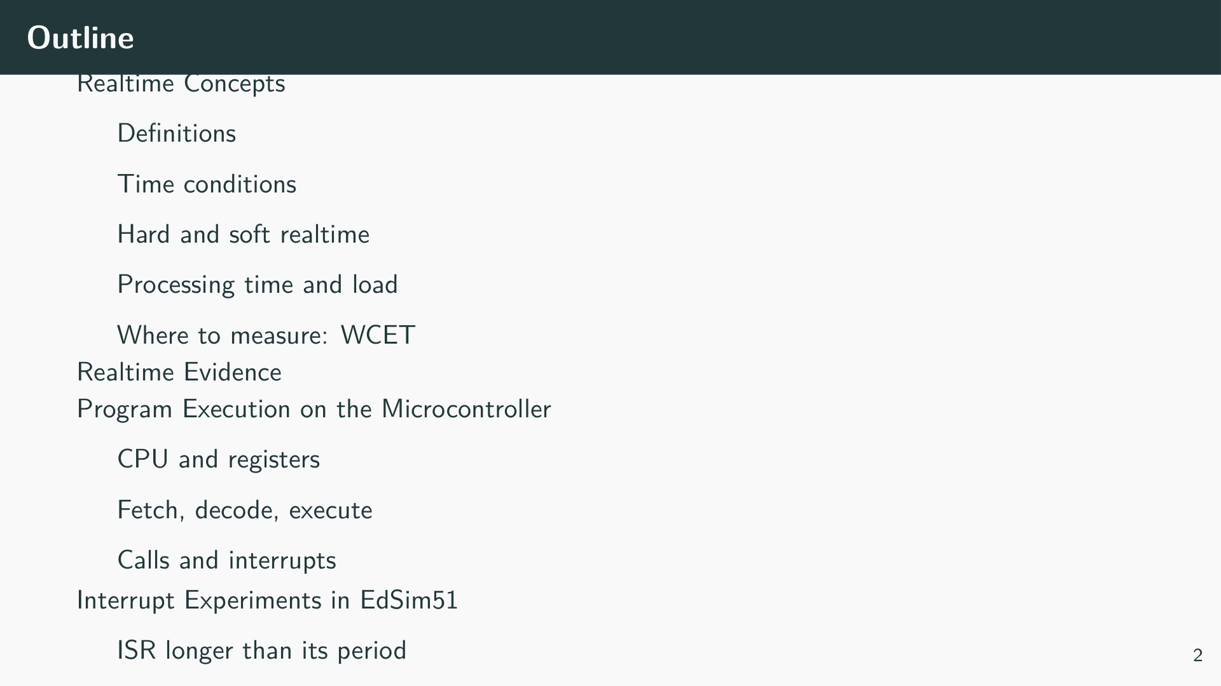

Slide 3


Slide 4
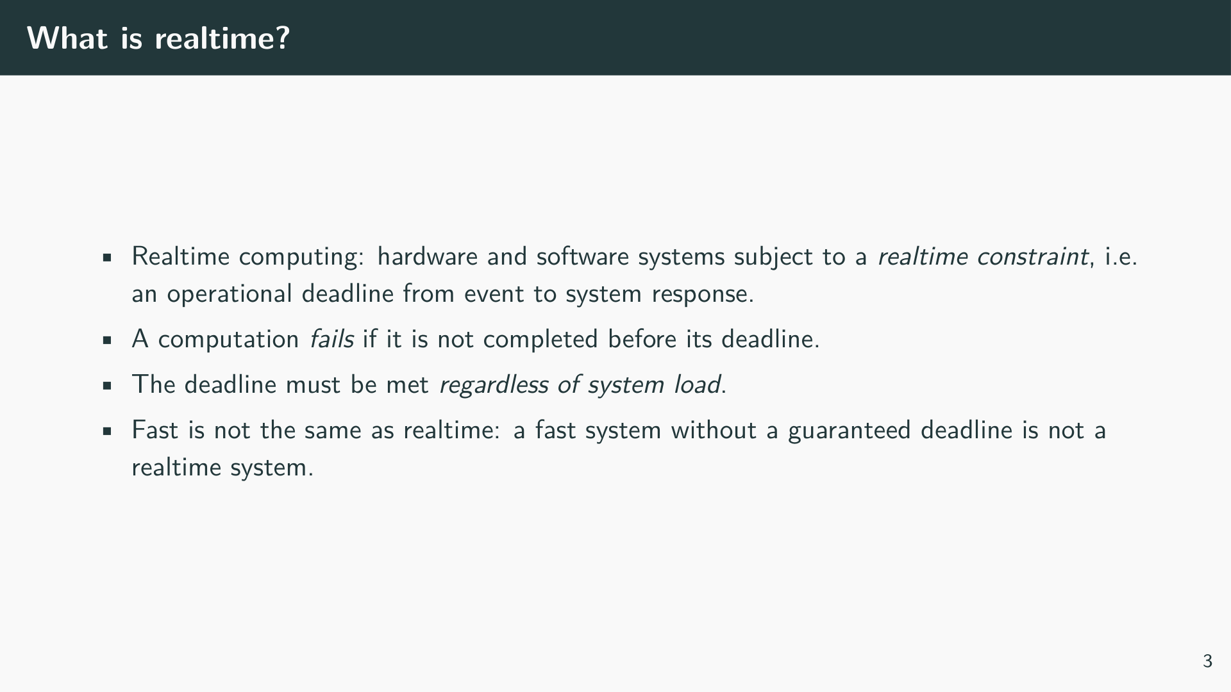
Notes:
Realtime does not mean “as fast as possible”. It means that the correctness of a result depends on when it is delivered, not only on its value. A braking controller that calculates the right brake force 200 ms too late is wrong.

Slide 5
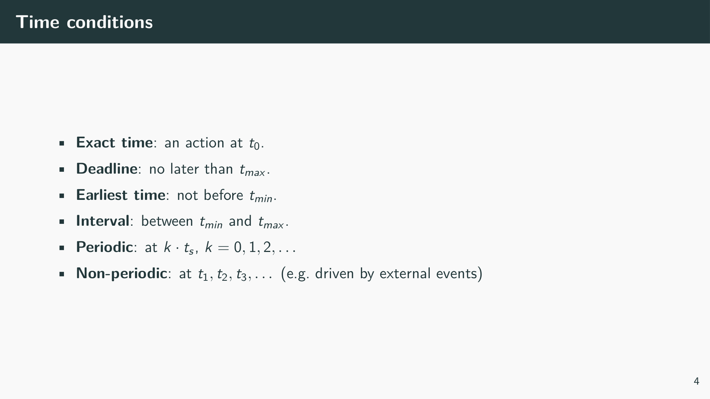

Slide 6
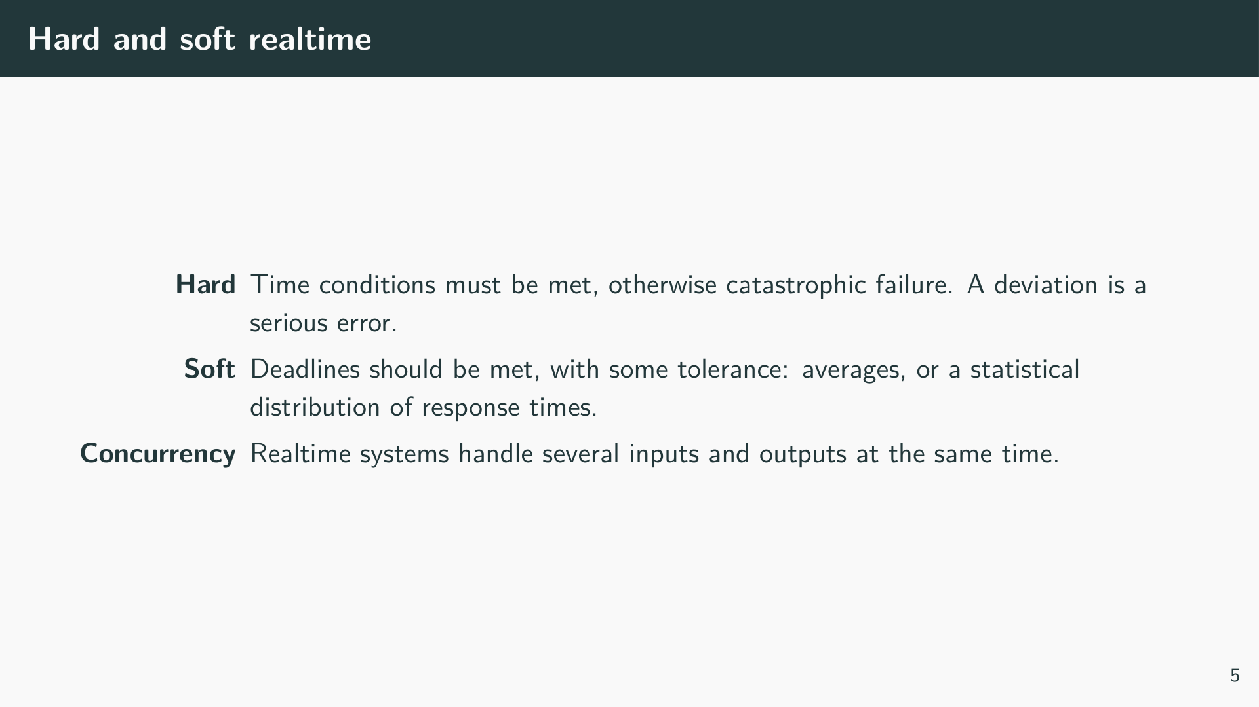

Slide 7
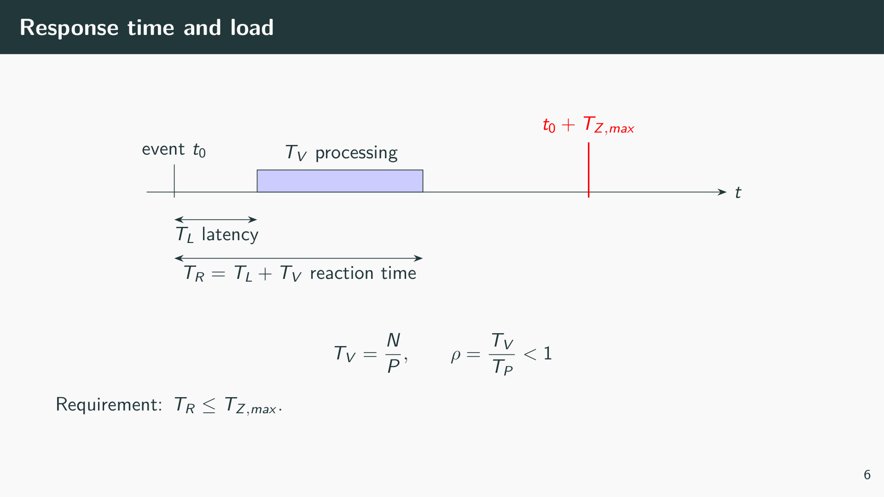
Notes:
N is the number of operations, P the computing power in operations per second, T_P the time between two requests of the same type. The utilisation ρ = T_V/T_P must always be smaller than 1. Latency T_L is the time the task waits before it starts, for example because another task or an interrupt is running. In a realtime system the maximum of T_R is what counts, not the average.

Slide 8
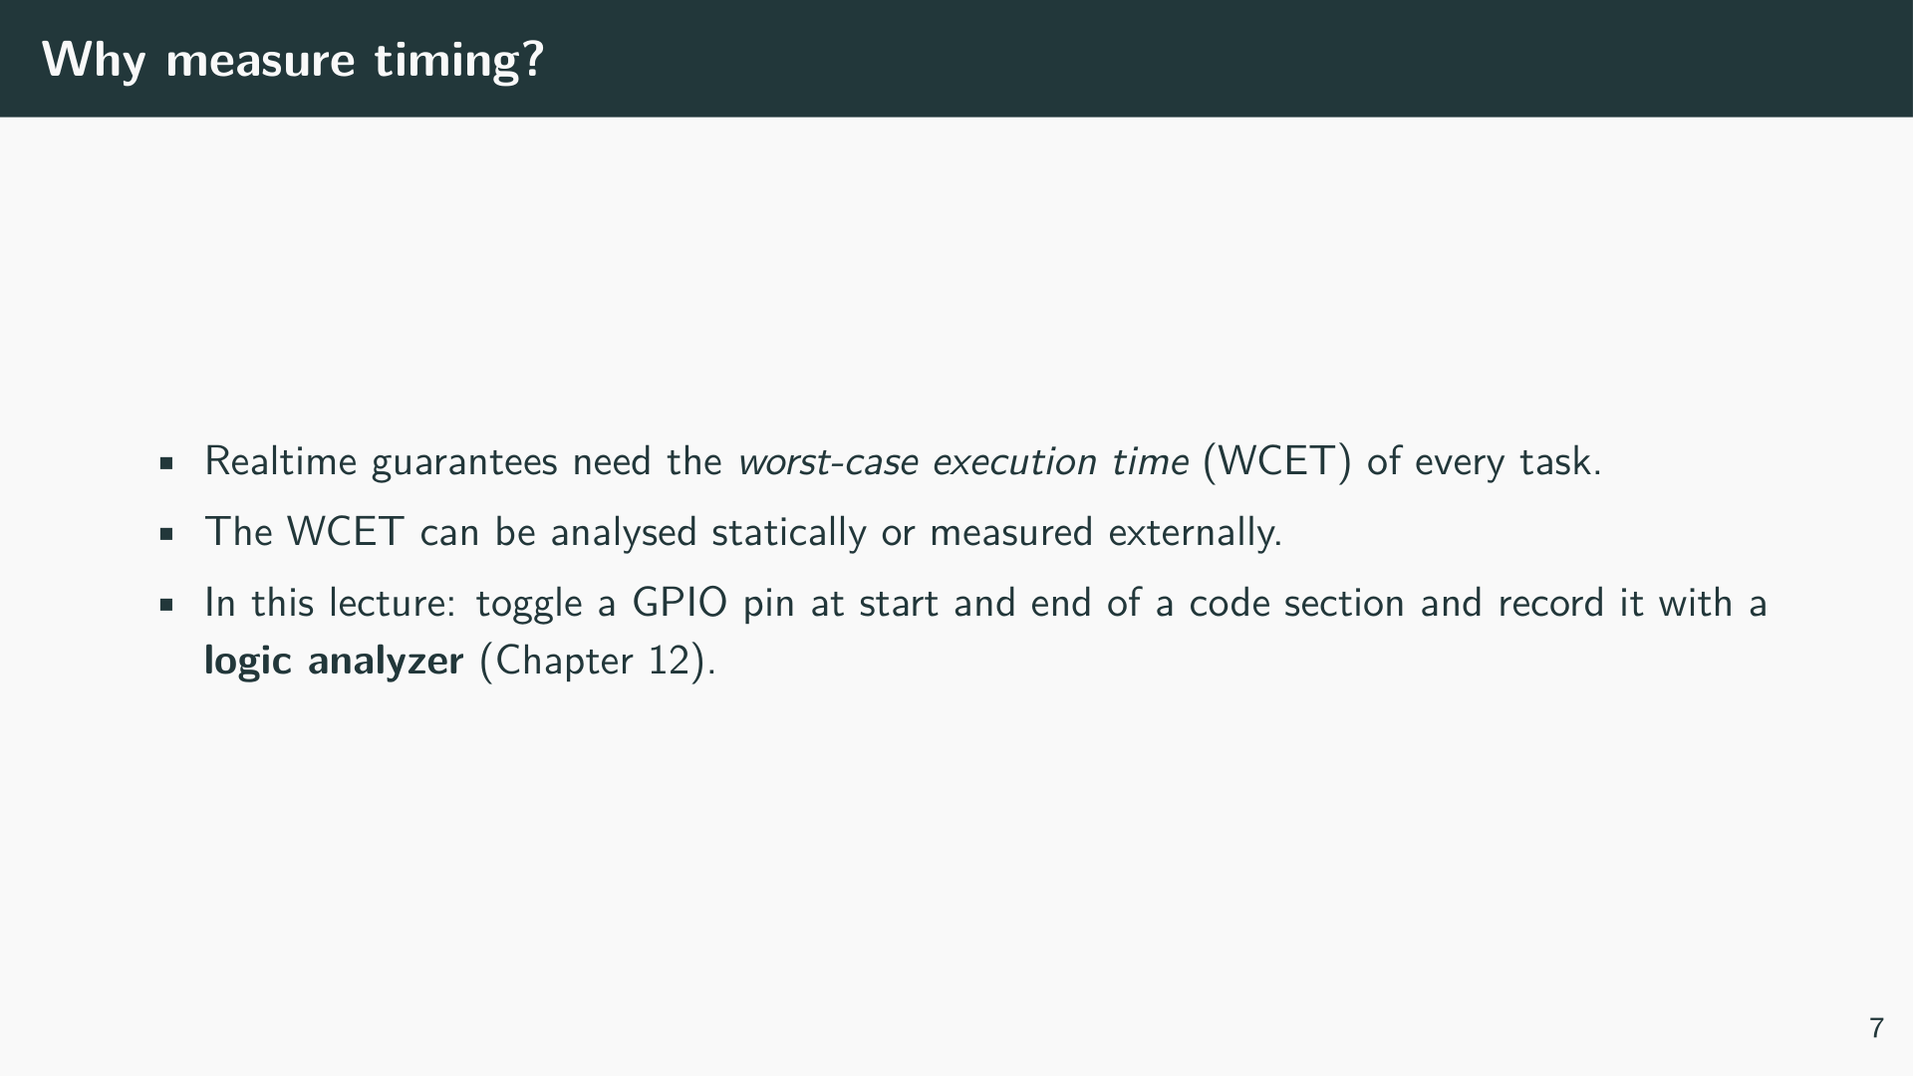

Slide 9


Slide 10
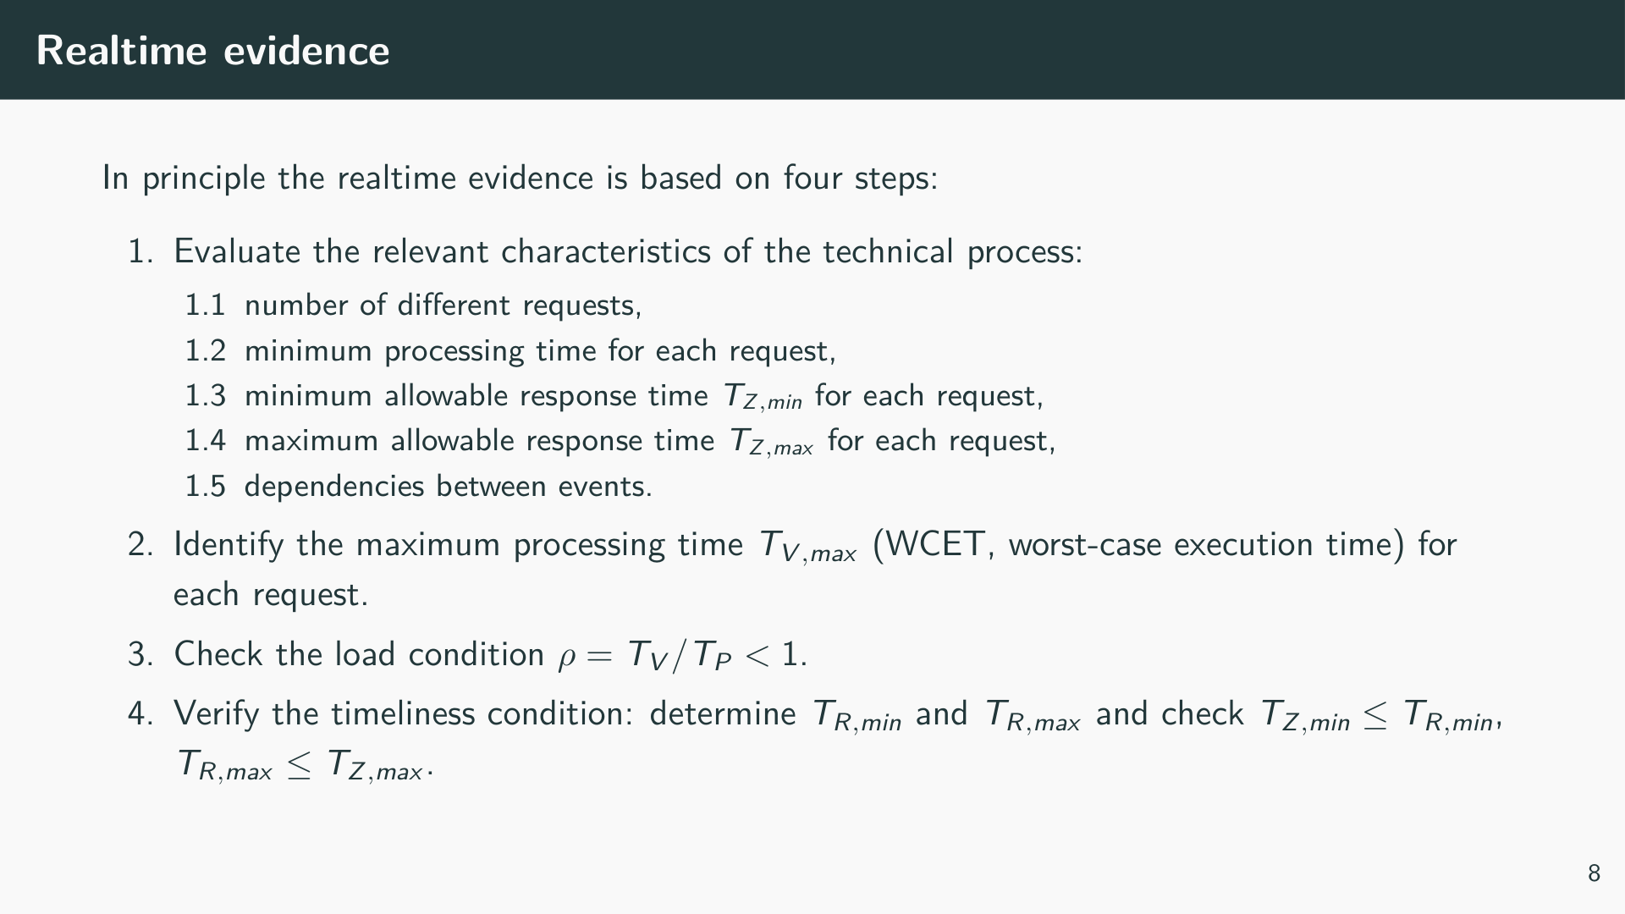
Notes:
Step 4 is the hard part. The maximum response time T_R,max contains the WCET of the request itself and the latency caused by everything that can delay it: other tasks, interrupts, and code that runs with interrupts disabled. All of these must be known as worst-case values, so the whole argument rests on the WCET of every code section.

Slide 11
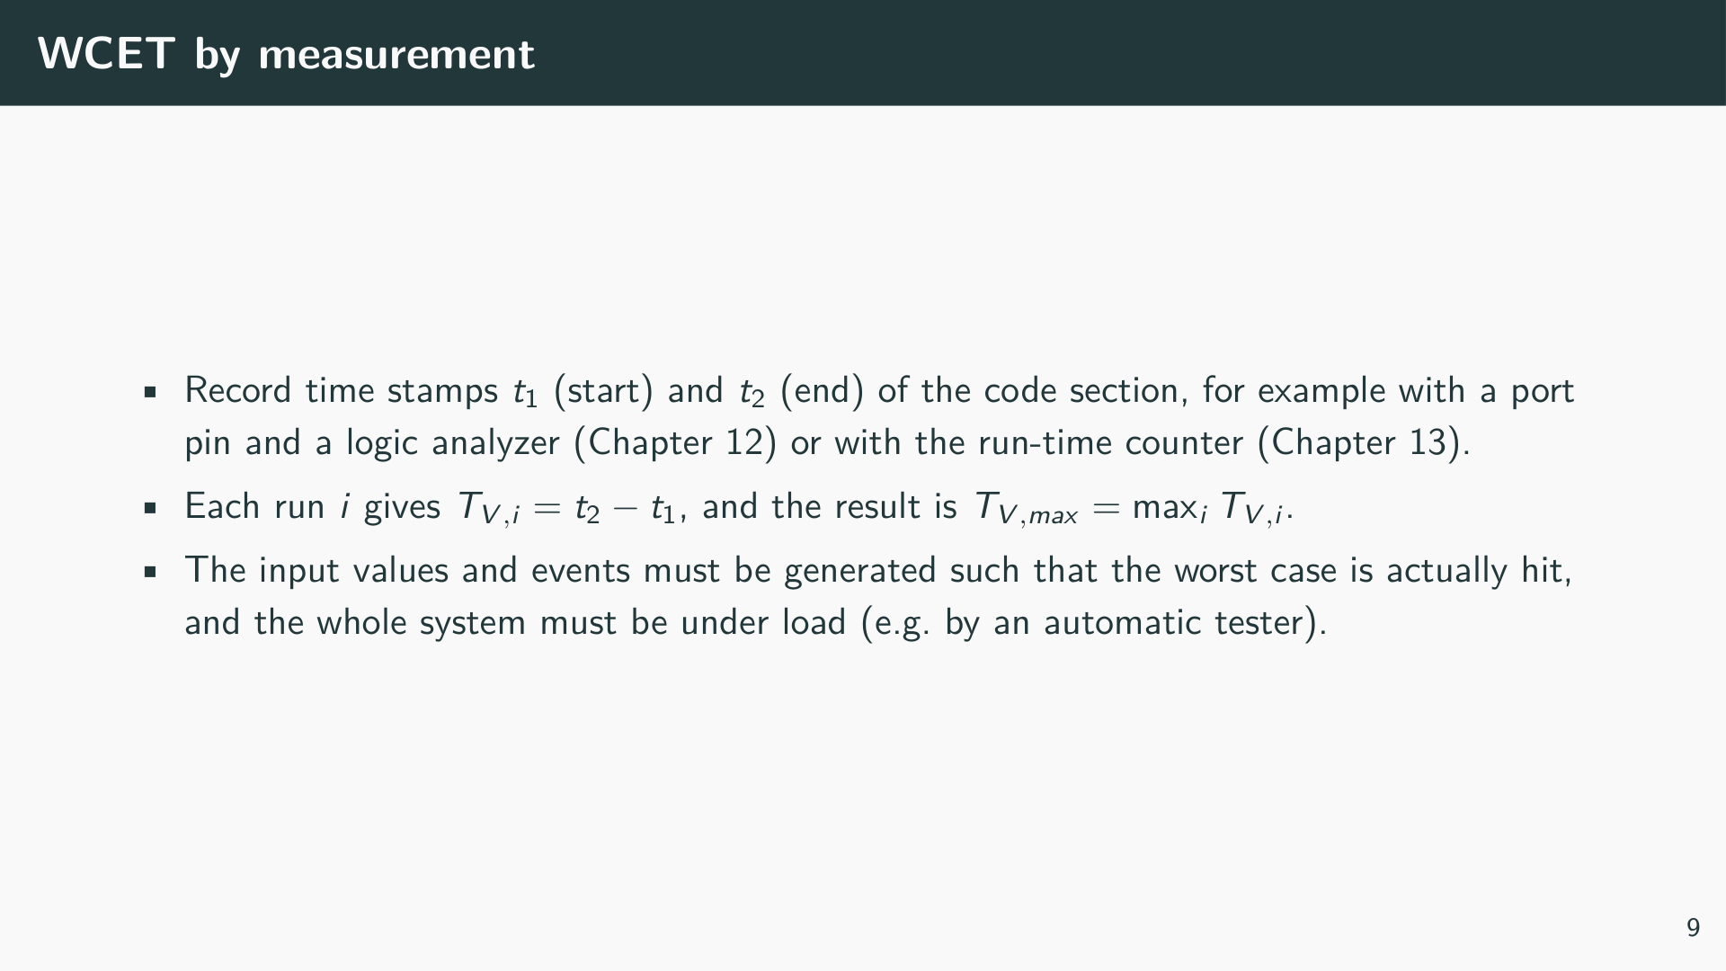

Slide 12
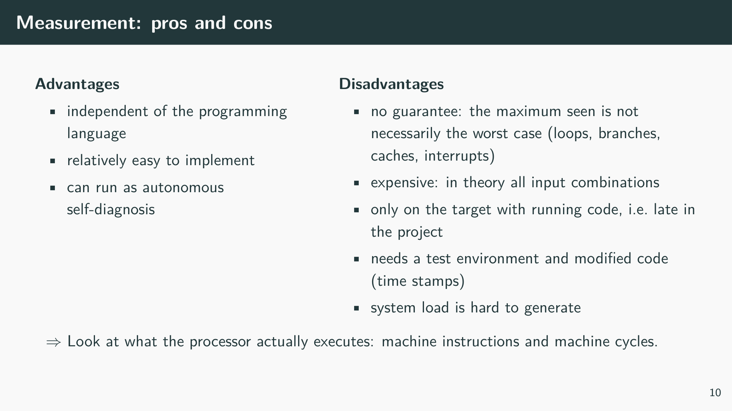

Slide 13
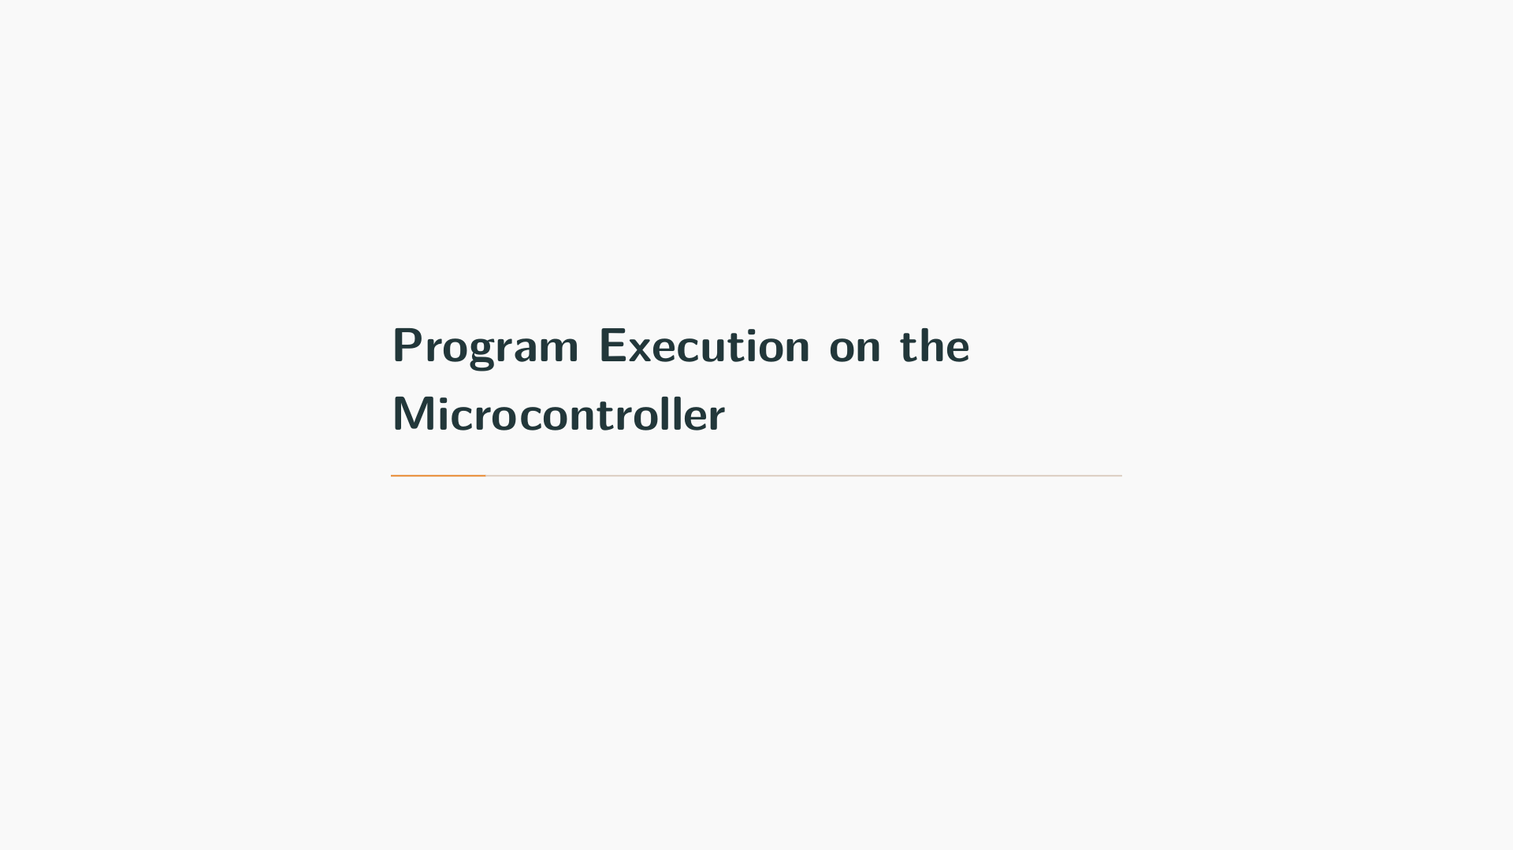

Slide 14
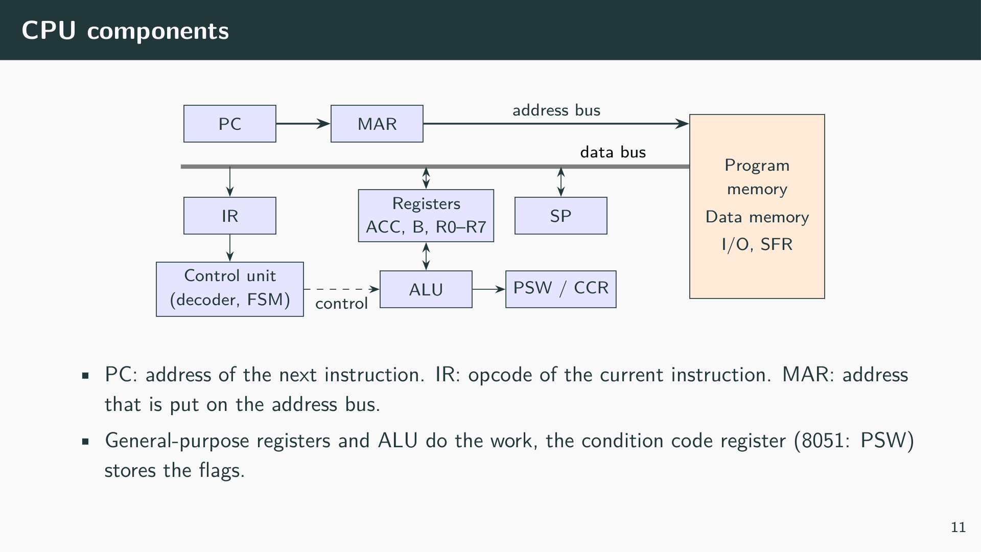
Notes:
Instruction register (IR) holds the binary code of the instruction being executed. It is read from program memory as the first part of instruction execution. The control unit uses it to decide which states of its finite state machine to traverse.
Memory address register (MAR) holds the address currently used to access memory. It is loaded with the PC to fetch instructions, or with an operand address to access data memory and I/O.
Program counter (PC) holds the address of the instruction to be executed next. It increments sequentially through program memory until an instruction (jump, call, return) or an interrupt loads a new value.
General-purpose registers are temporary storage for the program. Instructions move data between them and memory and perform arithmetic and logic operations on them.
Condition code register (CCR) holds the status flags of the last ALU operation: typically negative, zero, two's complement overflow, and carry. It can also contain flags for the state of the computer, such as interrupt enable.
IR and MAR are internal: no instruction can read them, and they do not appear in the register view of a simulator. PC, SP, and the flags are visible and are the registers to watch when debugging interrupts and stack problems.

Slide 15
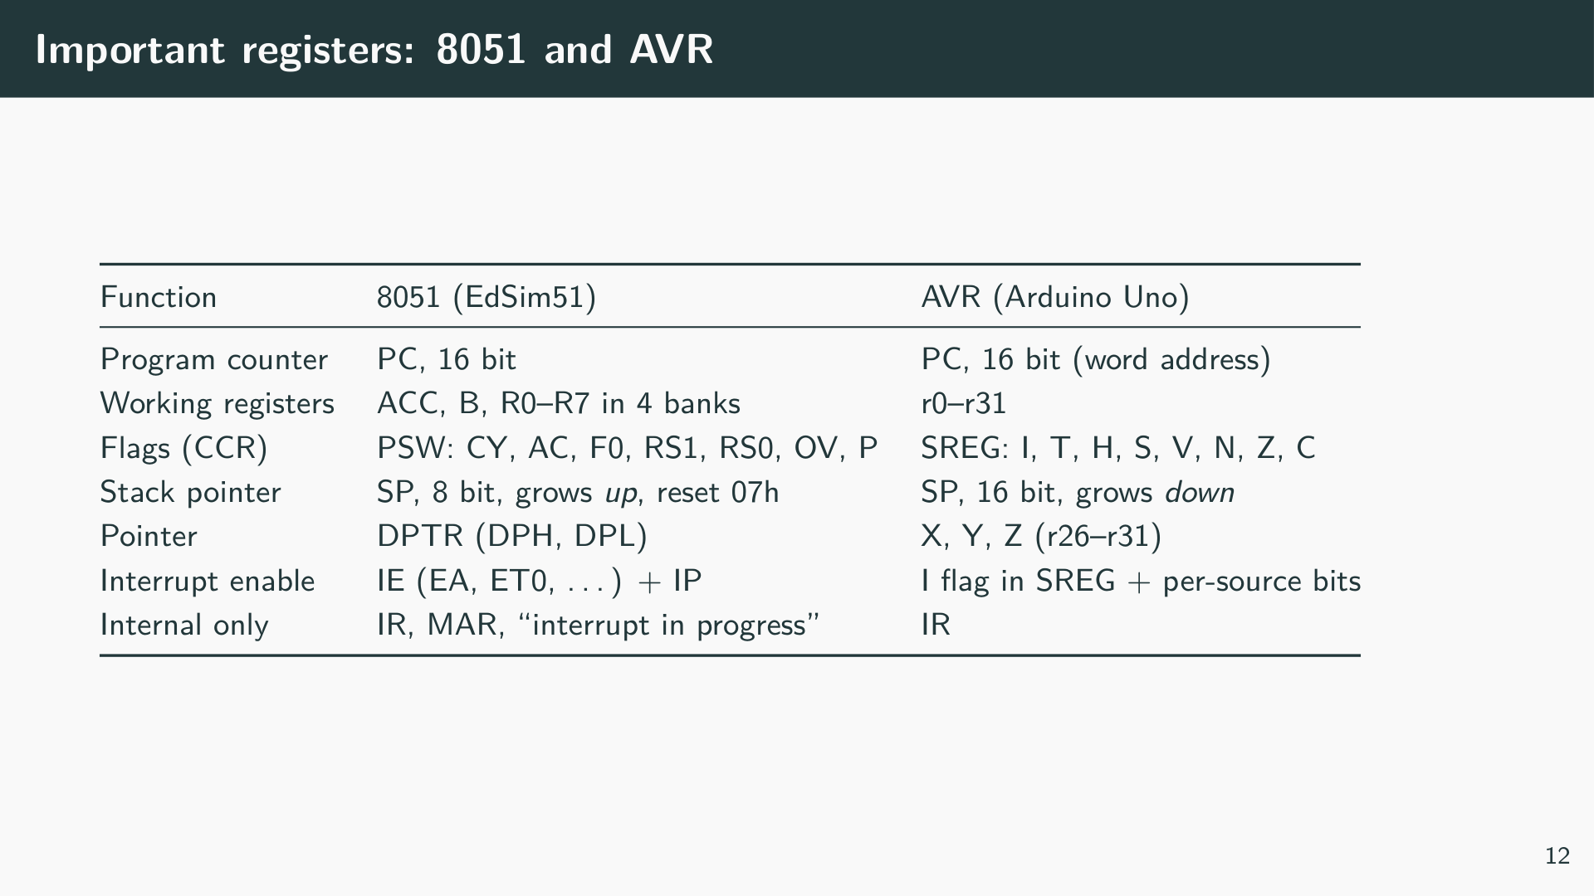

Slide 16
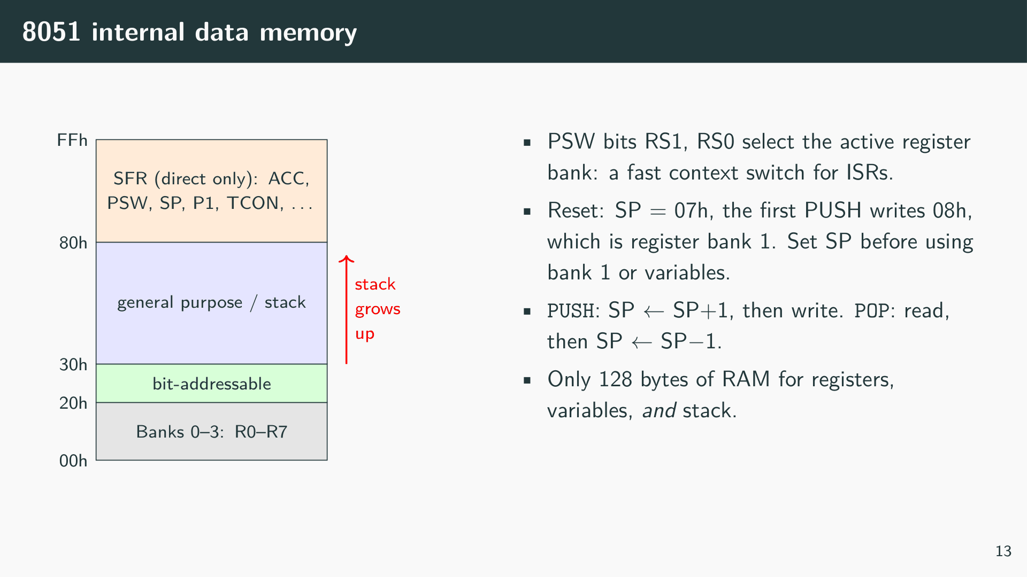

Slide 17
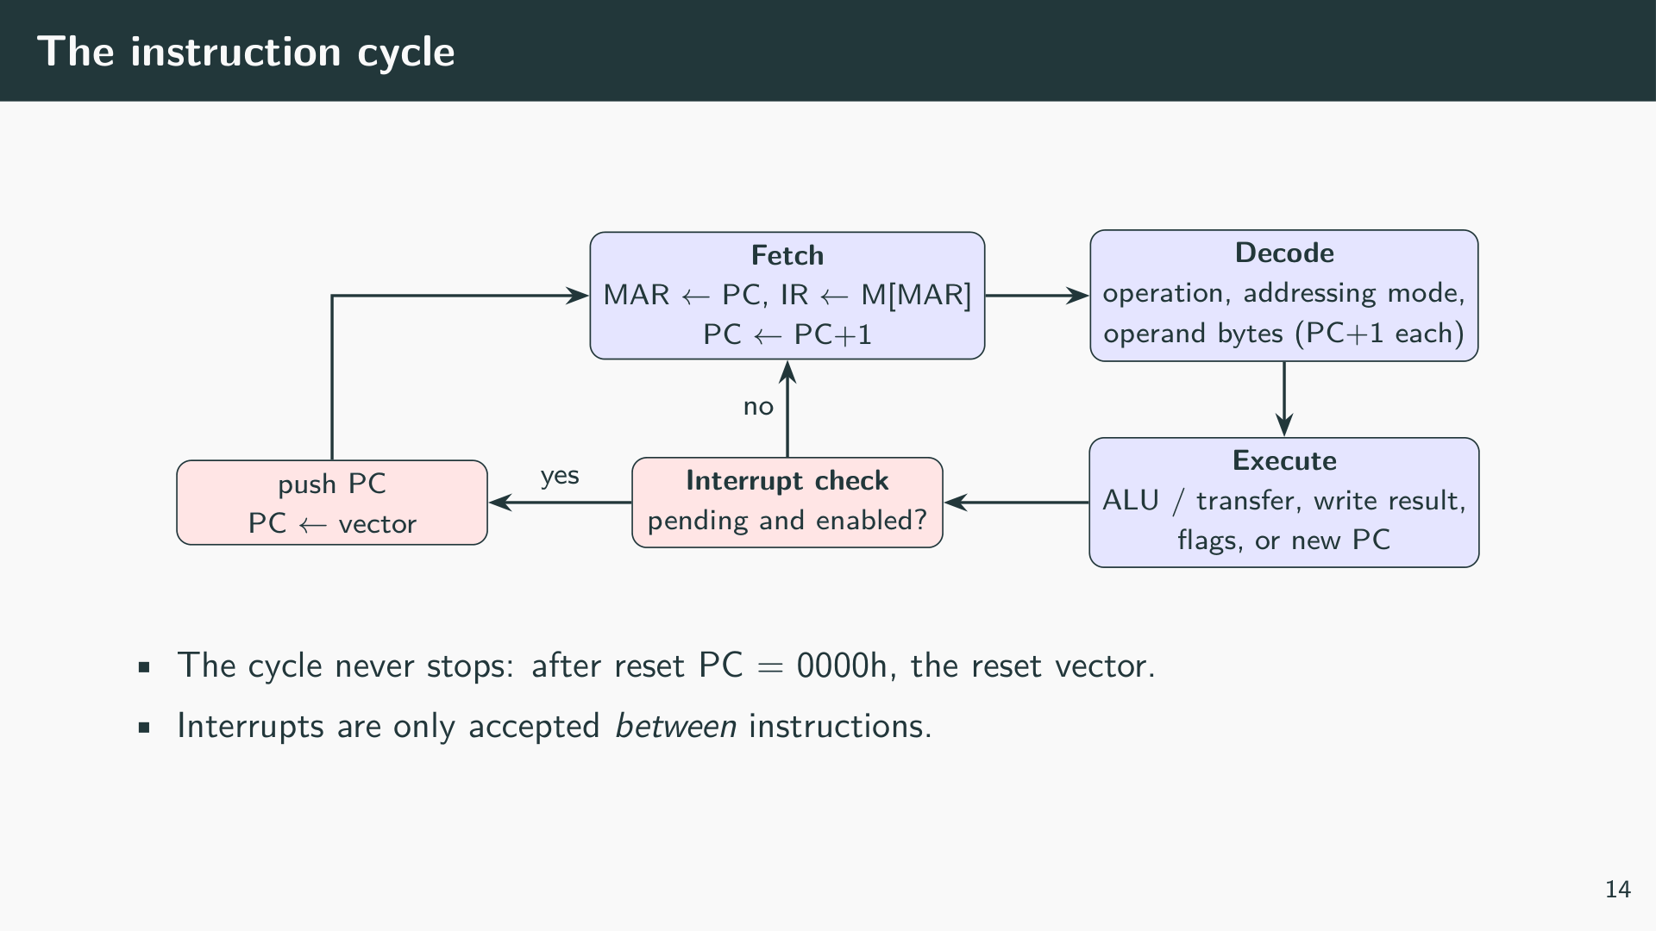
Notes:
Fetch. The PC is copied to the MAR and put on the address bus; the byte read from program memory is the opcode and goes into the IR. The PC is incremented and now points to the next byte.
Decode. The control unit decodes the opcode: which operation, which addressing mode (immediate, direct, register, indirect), and how many operand bytes follow. The operand bytes are fetched in the same way, each one incrementing the PC. When decoding is complete, the PC already points to the next instruction.
Execute. The control unit drives the ALU and the data paths: the result is written to a register or memory, the flags in the PSW are updated, or, for jumps and calls, a new value is loaded into the PC.
Interrupt check. At the end of each instruction the CPU checks for pending and enabled interrupts. If one is accepted, the hardware executes a call to the interrupt vector instead of fetching the next instruction. A long instruction therefore delays the reaction to an interrupt; this is part of the latency T_L.

Slide 18
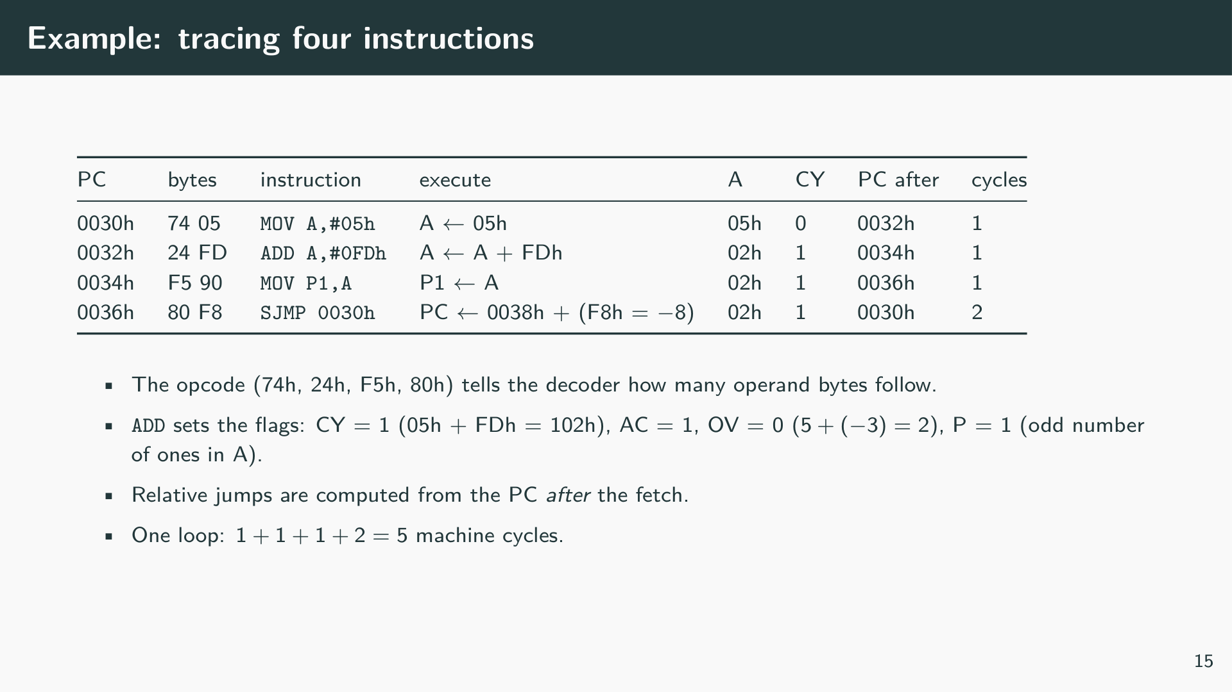
Notes:
Exercise: run these four instructions in EdSim51 with the Step button and watch PC, A, and PSW. Then encode MOV A,#3Fh and ADD A,#0C1h yourself (8051 instruction set table) and predict all four flags.

Slide 19
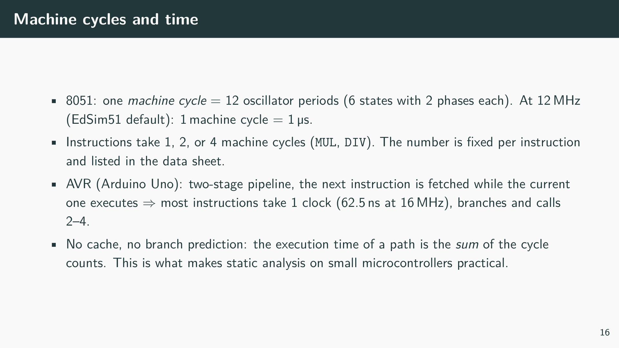

Slide 20
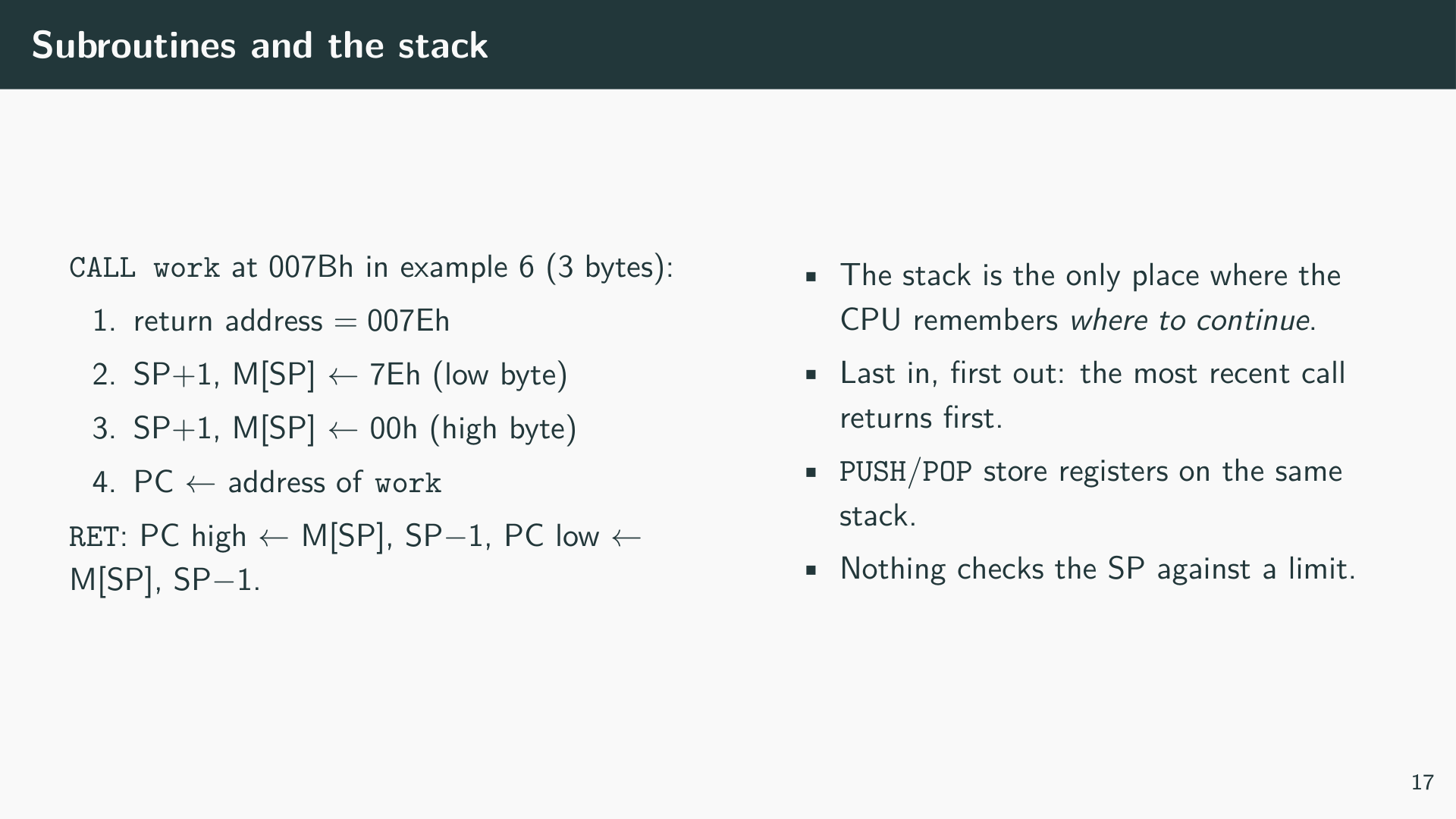

Slide 21
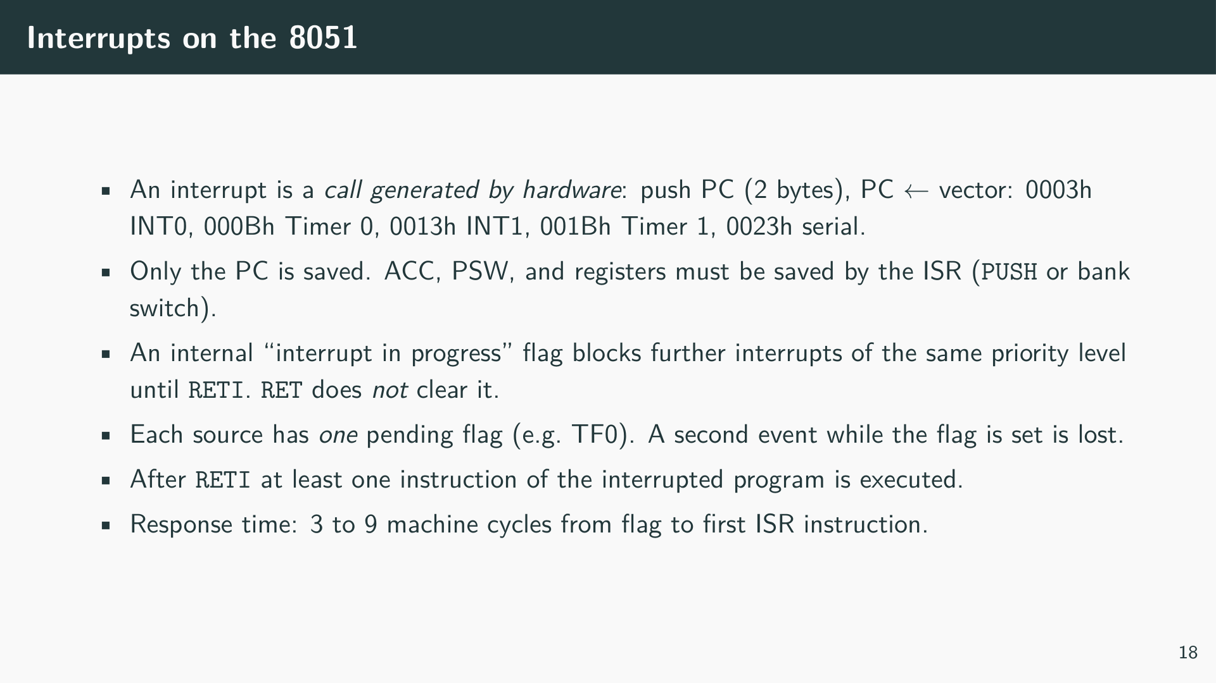
Notes:
The AVR behaves in the same way with different names: the hardware pushes the PC and clears the I flag in SREG, so no other interrupt is accepted; reti sets the I flag again. SREG and the registers are saved by code that the compiler generates. Each interrupt source has one flag, and a second event while it is set is lost.

Slide 22
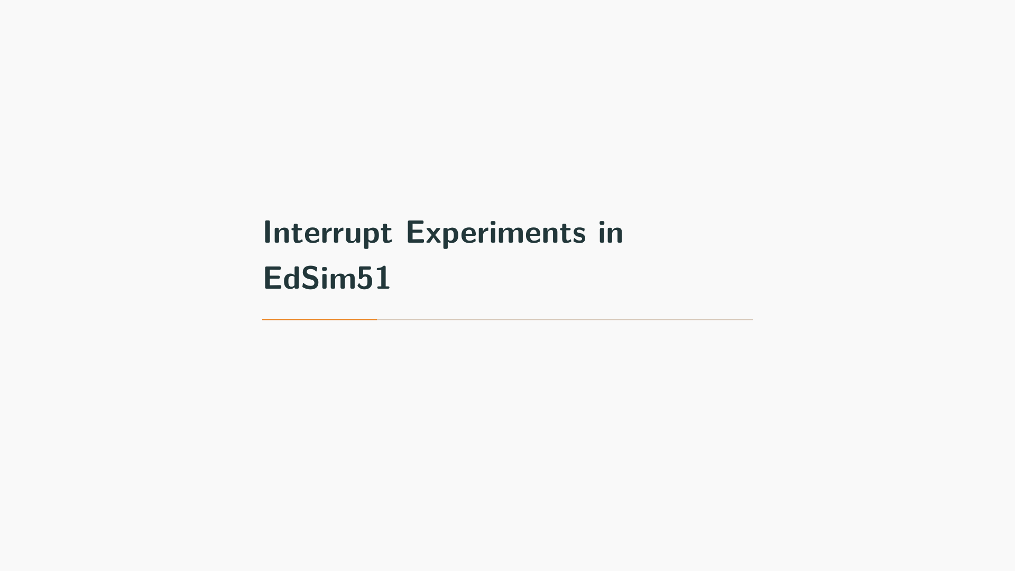

Slide 23
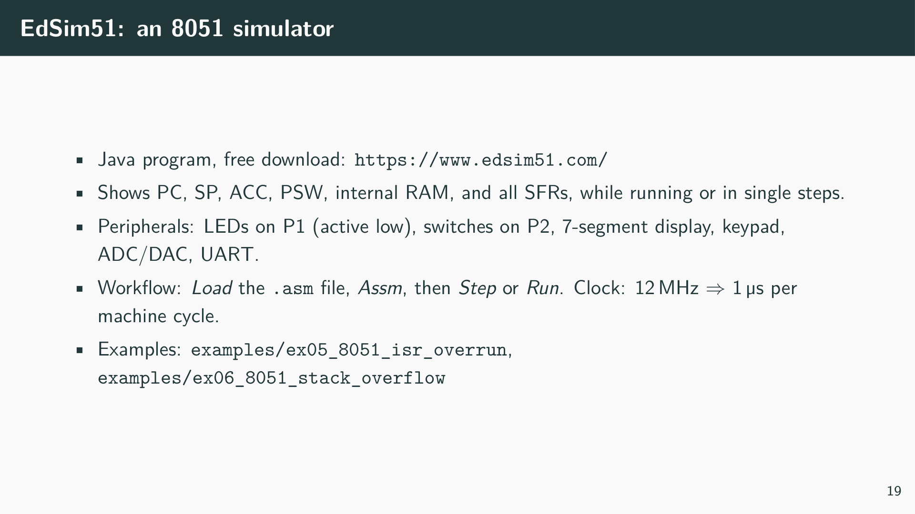
Notes:
The examples in this chapter are plain 8051 assembler and are not Wokwi projects: the effects are visible at the level of single instructions, stack bytes, and machine cycles, which EdSim51 shows directly. The Arduino Uno behaves the same way in principle (see the comparison table above). Both examples were checked with a cycle-accurate model of the instructions they use; the cycle numbers given below are computed from the 8051 instruction set and should be confirmed in EdSim51.

Slide 24
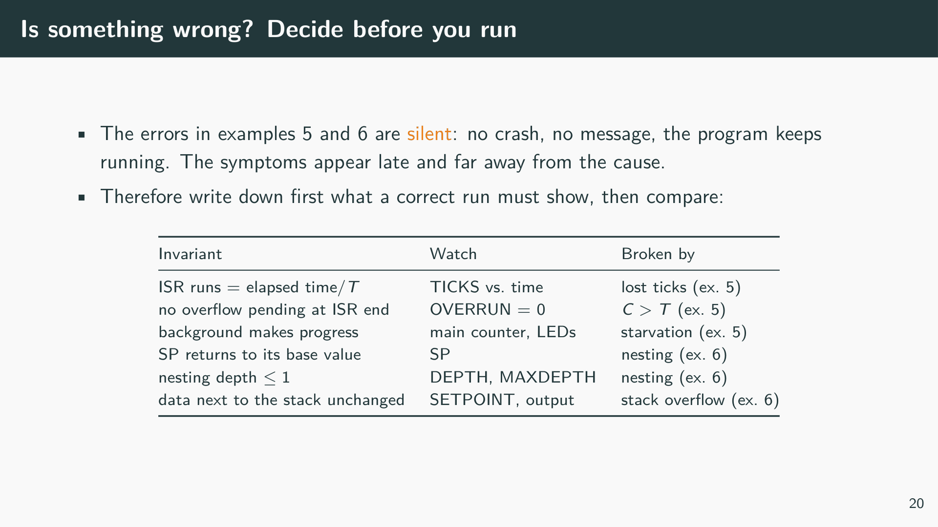
Notes:
Both examples contain a design error that the hardware does not report. The 8051 has no counter for lost interrupt requests and no stack limit; the program simply continues with wrong timing or corrupted data. Whoever runs the examples without a clear expectation will see blinking LEDs and changing numbers and conclude that everything works. The table lists the invariants of a correct interrupt-driven system and the variables in the examples that make them observable. Each example file starts with a block “How to spot the error” that lists, for both switch positions, what to look at and when the first symptom appears.

Slide 25
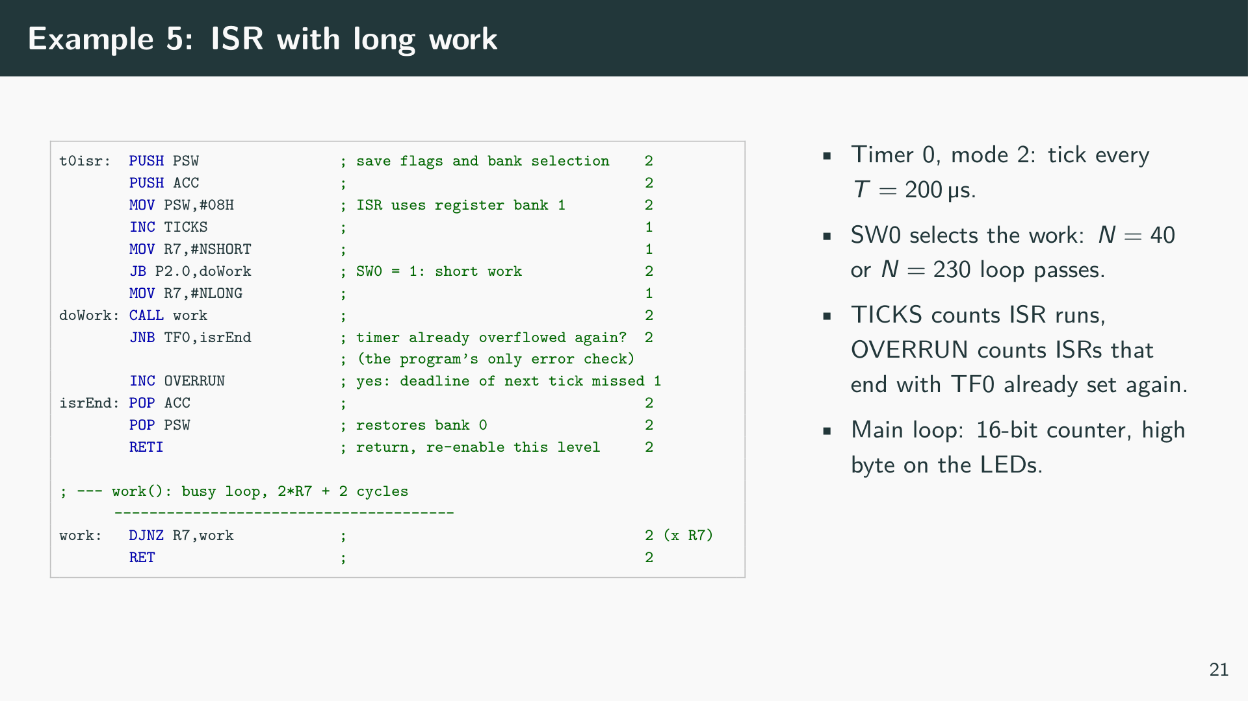
Notes:
[Listing: EdSim51 example 5: ISR work longer than the interrupt period, examples/ex05_8051_isr_overrun/isr_overrun.asm]
Example 1 sets the stack pointer to 2Fh first, because the ISR uses register bank 1 (08h–0Fh), exactly where the stack would start after reset. Timer 0 runs in mode 2: TL0 counts machine cycles and is reloaded from TH0 on overflow, so with a reload value of 256-200 = 56 the overflow flag TF0 is set every 200 machine cycles. The ISR saves PSW and ACC, switches to register bank 1 and calls work, a busy loop of 2N + 2 cycles. The right-hand comment column of the file lists the machine cycles of each instruction.

Slide 26
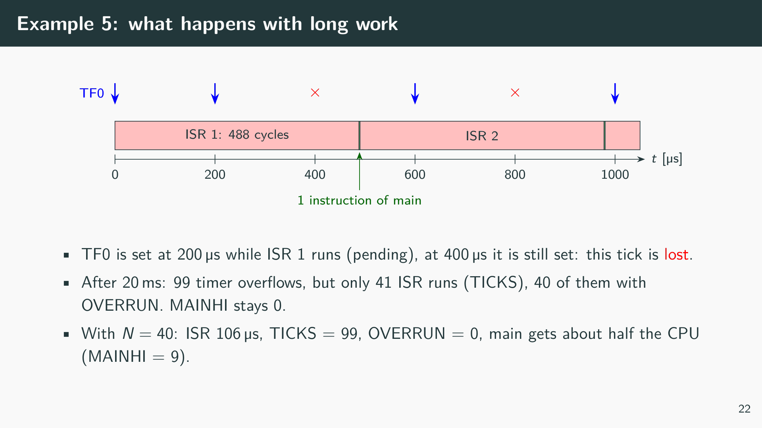
Notes:
The ISR needs 488 machine cycles, almost 2.5 periods. Hardware remembers only one pending overflow per source, so of the 2.44 overflows per ISR run, 1.44 are lost: the system silently runs at a lower rate than the one programmed. Between two ISR runs the CPU returns to the main program for exactly one instruction, because the 8051 always executes one instruction after RETI before it accepts the next interrupt. The main loop therefore advances by one instruction every 489 µs and appears frozen. Nothing in the hardware reports the problem; only the software check of TF0 at the end of the ISR makes it visible.

Slide 27
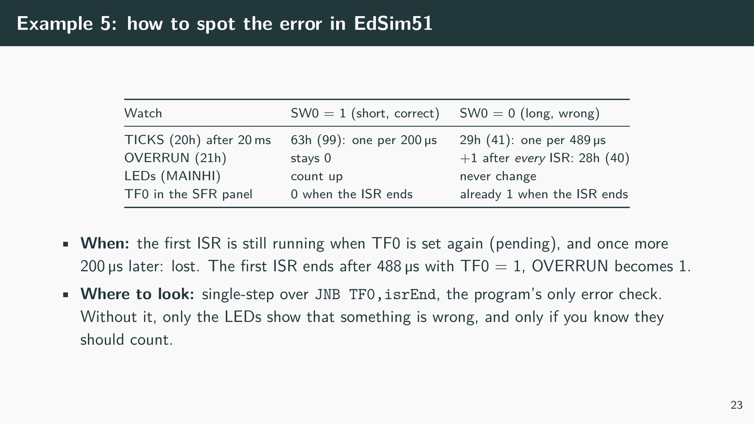

Slide 28
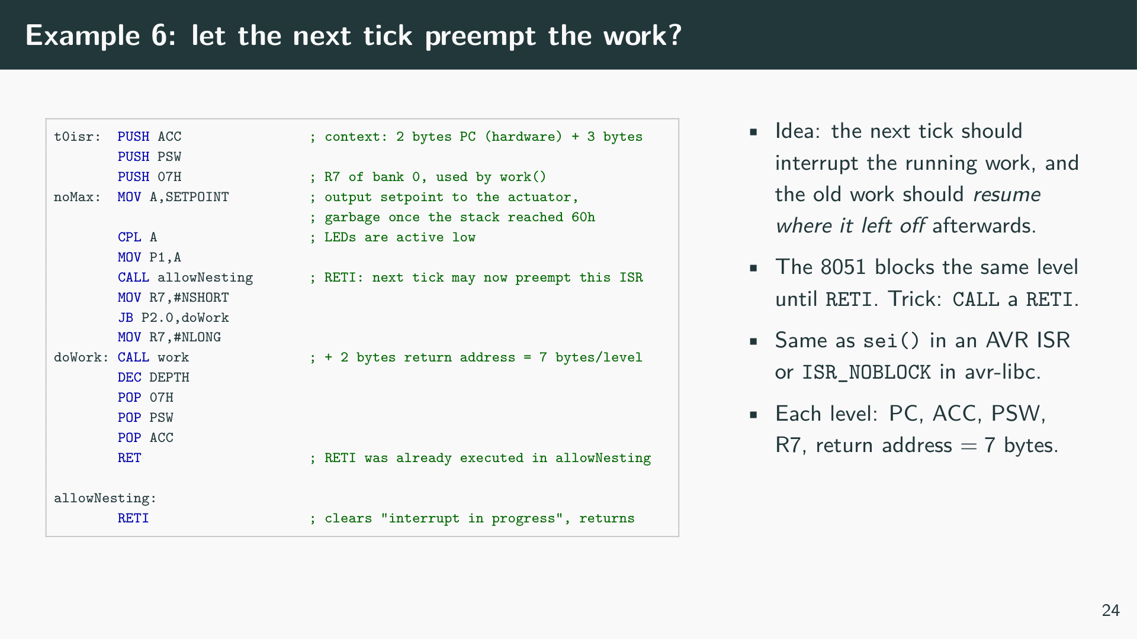
Notes:
[Listing: EdSim51 example 6: nested interrupts lead to a stack overflow, examples/ex06_8051_stack_overflow/stack_overflow.asm]
In Example 2 the ISR calls allowNesting, which consists of a single RETI. This pops the return address, as RET would, and additionally clears the “interrupt in progress” flag. From then on the ISR runs like normal code, and the next Timer 0 overflow interrupts it. The ISR therefore ends with RET. Each ISR instance outputs the variable SETPOINT (60h) to the LEDs, as a controller would output its setpoint to an actuator, and the ISR checks at its entry whether SP has reached the limit 78h.

Slide 29
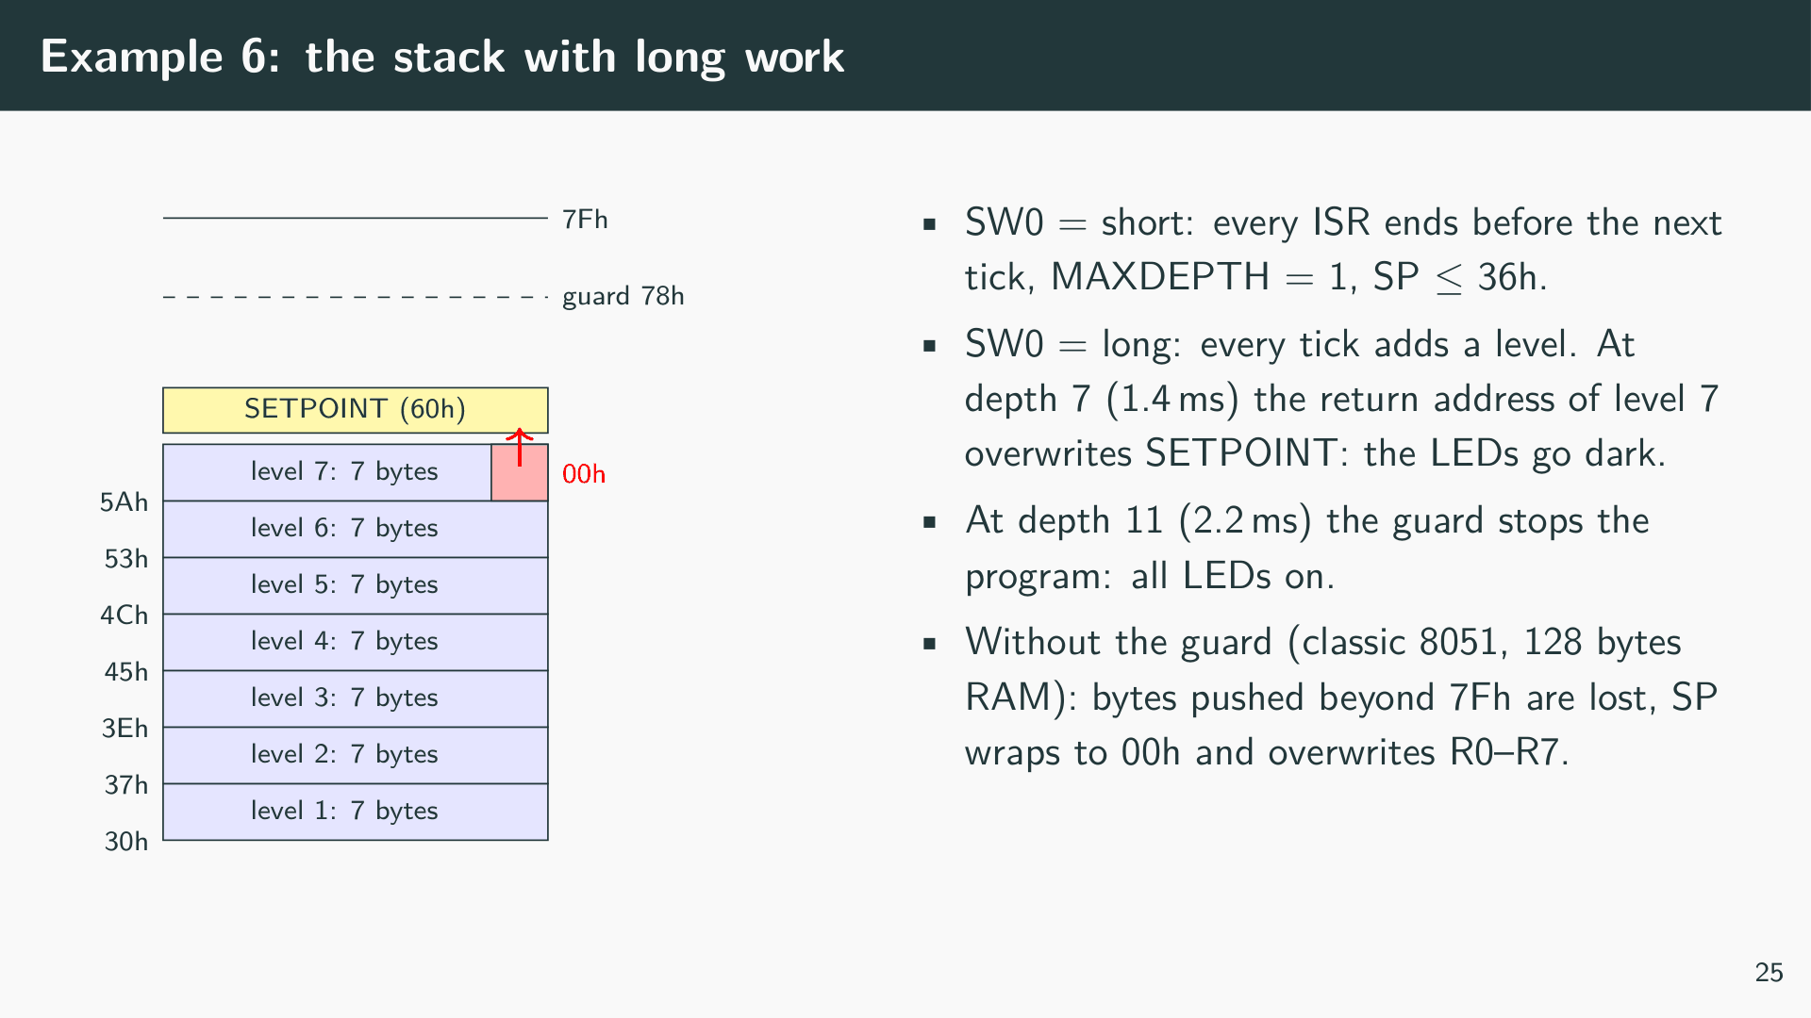

Slide 30
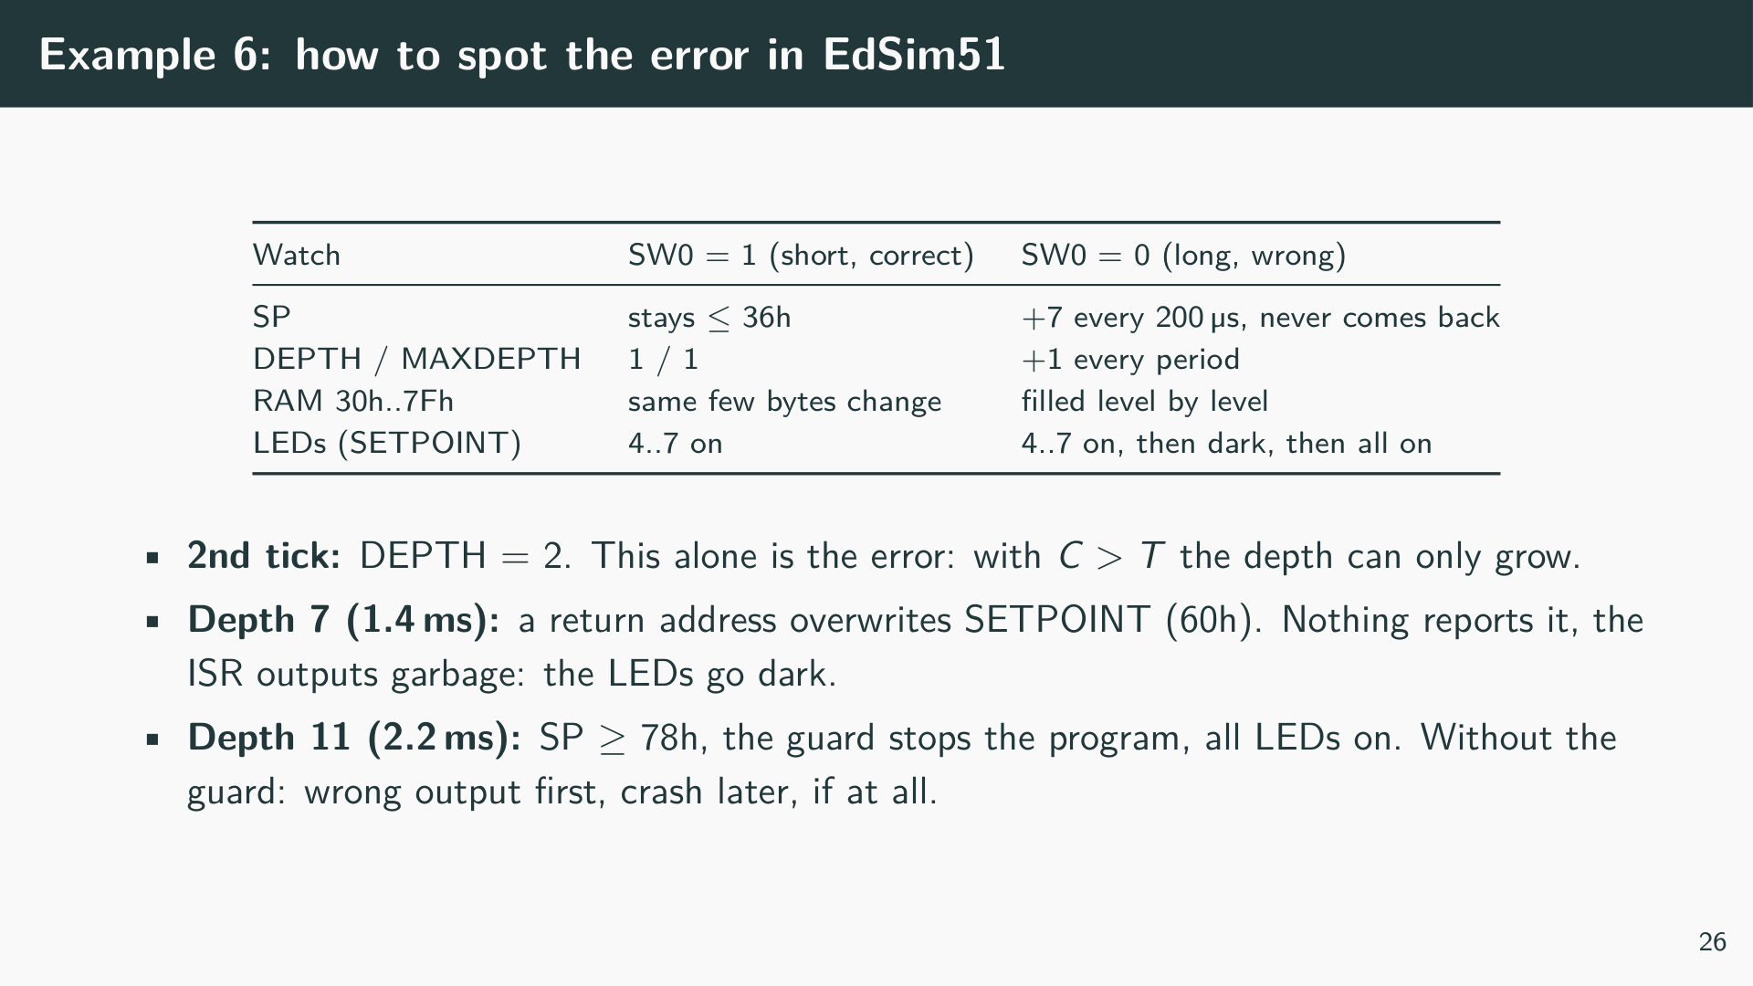

Slide 31
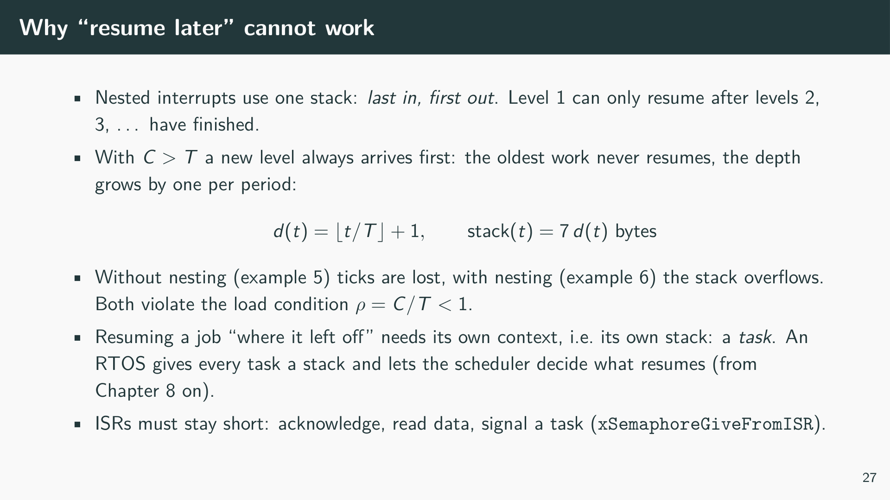
Notes:
A task does not remove the load problem: if a periodic job needs more processor time than its period, no scheduler can meet all deadlines. But a task-based design makes the problem visible and controllable. A missed deadline can be counted (Example 4 in Chapter 13 will show how), lower-priority work is delayed in a defined way, and the stack of each task has a fixed, known size, independent of how often the event occurs.

Slide 32
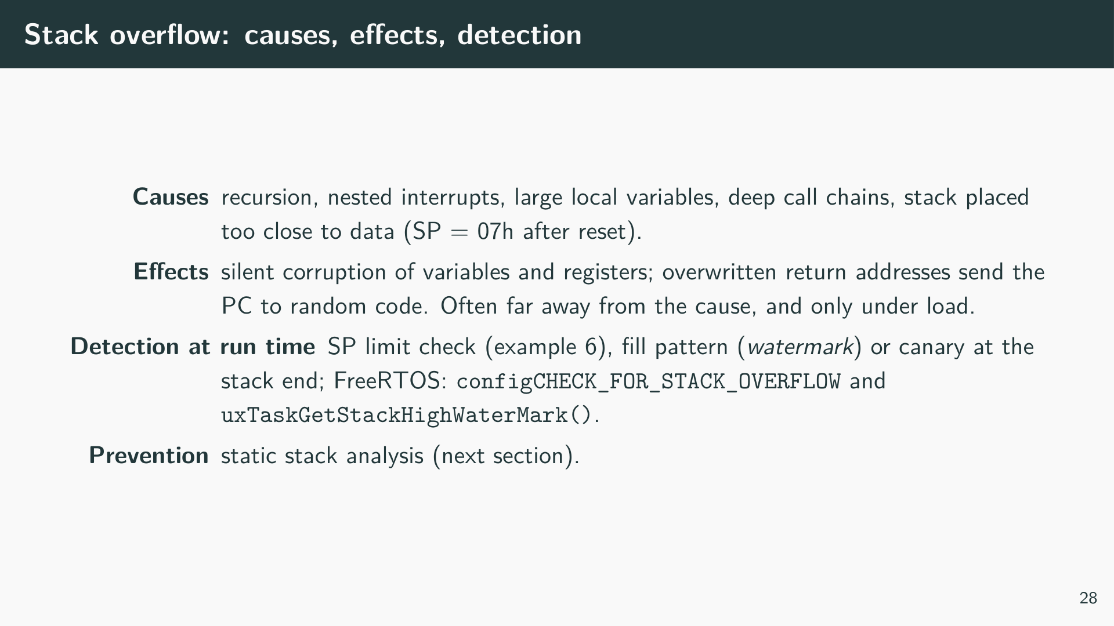

Slide 33
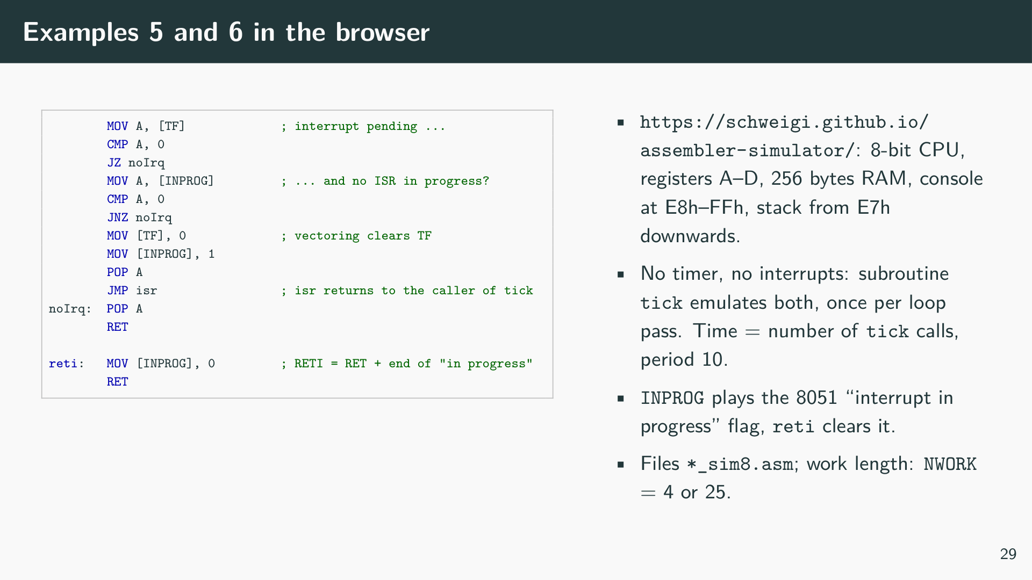
Notes:
EdSim51 must be installed (Java). The browser-based simulator by Schweigi needs no installation, but it simulates a much simpler CPU: four general-purpose registers, a stack pointer, the flags Z and C, 256 bytes of memory shared by code, data and stack, and a 24-character console mapped to E8h–FFh. It has neither a timer nor interrupts nor input pins. The files isr_overrun_sim8.asm and stack_overflow_sim8.asm in the folders of examples 5 and 6 therefore emulate the hardware in software: the subroutine tick is one clock of a timer with period 10. On overflow it sets TF, and if TF is set and no ISR is in progress (INPROG = 0), it clears TF, sets INPROG and jumps to the ISR, which returns to the caller of tick. The routine reti clears INPROG and returns, exactly the part of RETI the experiments depend on. Because every loop calls tick once per pass, interrupts are only accepted at these points, and time is counted in tick calls rather than machine cycles. The switch SW0 is replaced by the variable NWORK at address 08h, which is edited in the source before assembling.
[Listing: examples/ex05_8051_isr_overrun/isr_overrun_sim8.asm]
In Example 3 the console shows a timeline with one character per tick: . for the main loop, # for the ISR, | for a timer overflow and X for an overflow while TF was still set, i.e. a lost tick. With 𝙽𝚆𝙾𝚁𝙺 = 4 the pattern |####..... repeats and TICKS (02h) equals PERIODS (03h). With 𝙽𝚆𝙾𝚁𝙺 = 25 the ISR runs for 2.5 periods: after 13 periods only 5 ISRs have run, OVERRUN (04h) counts every ISR, and only one main loop pass (.) fits between two ISRs, the counterpart of the one instruction on the 8051.
[Listing: examples/ex06_8051_stack_overflow/stack_overflow_sim8.asm]
Example 4 calls reti early, as allowNesting does on the 8051. Each nesting level puts 4 bytes on the stack: the return address of the interrupted tick call, A, B and the return address of work. The memory view marks the stack area, which grows downwards from E7h by 4 bytes per period. The console shows SETPOINT as a character and one > per nesting level. With long work, the stack overwrites SETPOINT at depth 18 with a byte of a return address. Nothing happens at that moment; only the ISR at depth 19 outputs the corrupted value, and the S on the console turns into a C. When level 21 starts, the guard CMP SP, LIMIT stops the CPU with !. Without the guard the stack would run into the code, as there is no separation between code, data, and stack in this memory.

Slide 34
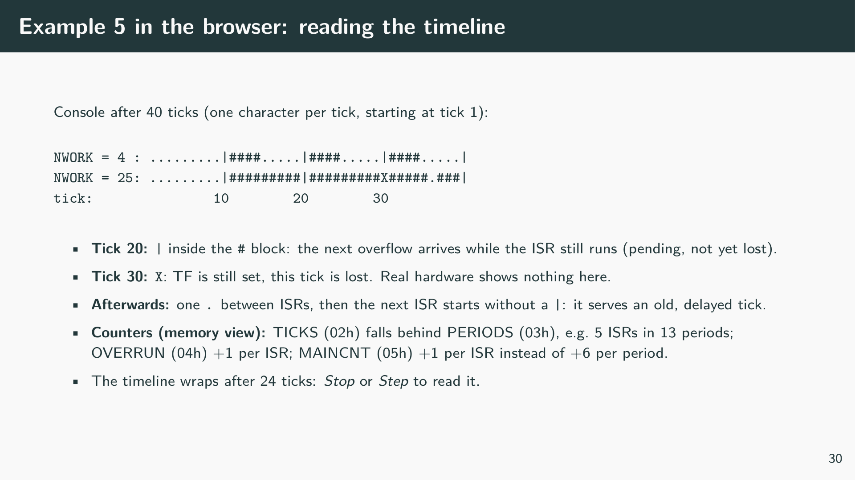

Slide 35
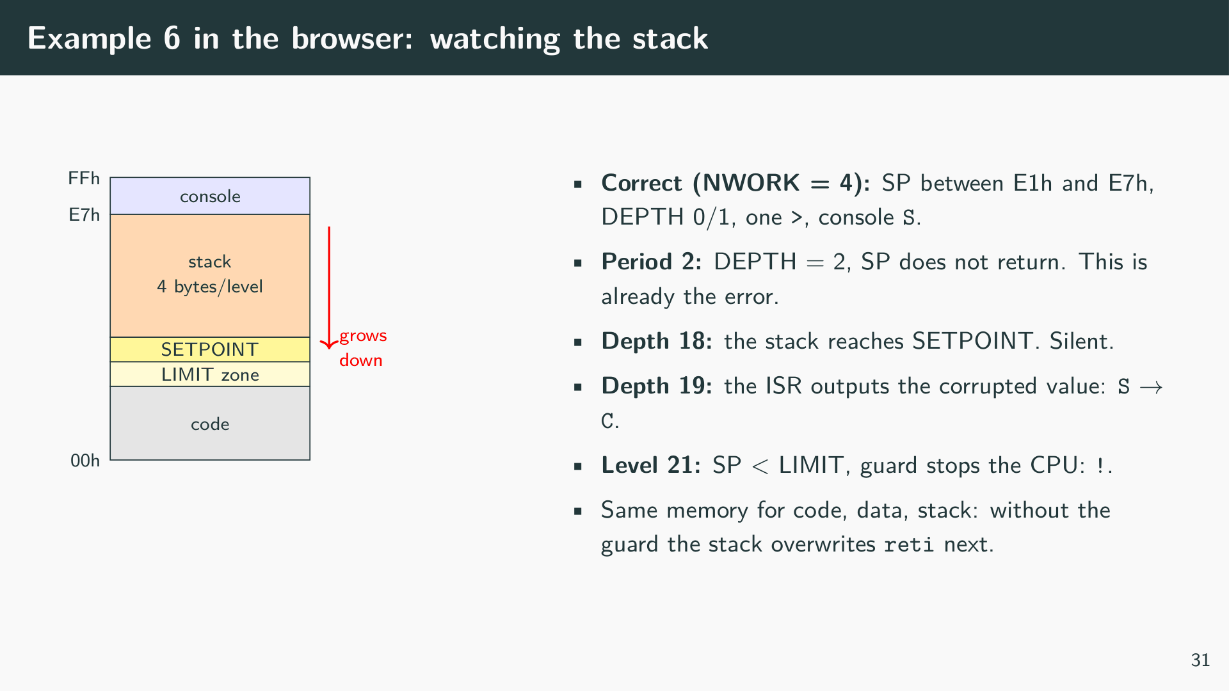
Notes:
In the browser versions the first symptom is always visible long before the visible failure. In example 5 the first X appears at tick 30, during the first ISR; from then on the counters TICKS and PERIODS drift apart. In example 6 the depth of 2 in the second period already proves the error, because with work longer than the period the depth can only grow. The corrupted output appears 17 periods later, the stop only after 20 periods. A test that only looks for a crash or a wrong output would need to run that long, and on a real controller with more RAM much longer; checking the invariants finds the error in the first periods.

Slide 36
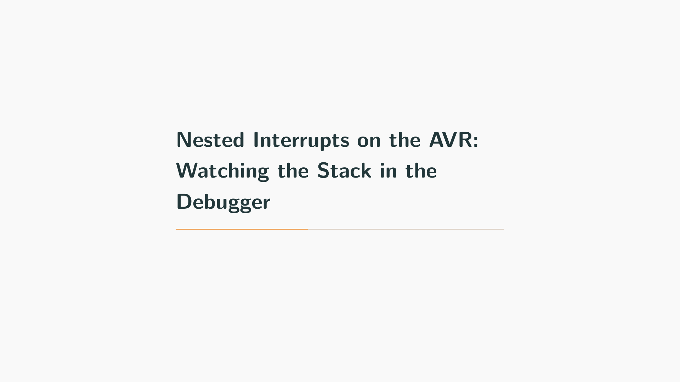

Slide 37
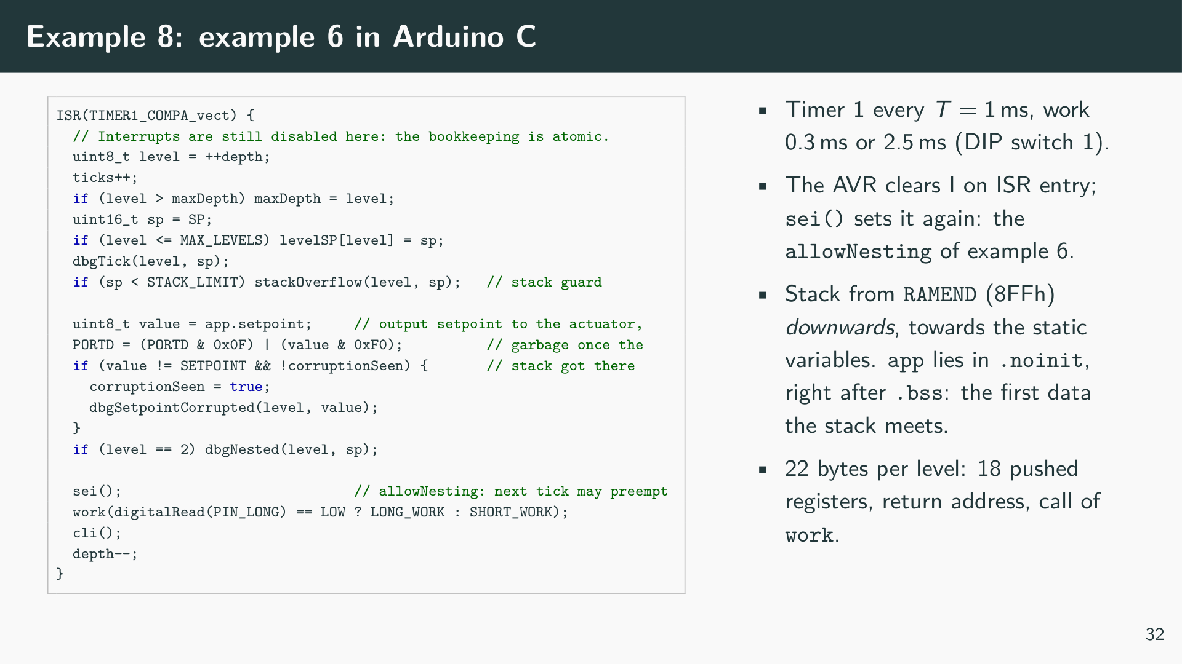
Notes:
[Listing: Nested timer interrupts on the AVR without an RTOS, examples/ex08_avr_isr_nesting/sketch.ino]
Example 5 transfers example 6 to the ATmega328P of the Arduino Uno. The AVR has no “interrupt in progress” flag per level; instead it clears the global interrupt flag I in SREG when it enters an ISR, and RETI sets it again. An ISR that executes sei() can therefore be interrupted by any interrupt, including its own. avr-libc offers the same as ISR_NOBLOCK, which places the sei before the prologue. The example executes sei() only after its bookkeeping, so that depth, maxDepth and levelSP[] are updated atomically.
The stack of the AVR grows from RAMEND (8FFh) downwards. Below it lie the free RAM, the heap (unused here), and the static variables in the order .data, .bss, .noinit. Placing app in .noinit makes it the variable with the highest address, so the stack meets app.setpoint first, just as it met SETPOINT on the 8051. The guard STACK_LIMIT leaves room for one more ISR frame below app; a guard that only trips once SP lies below the protected data would let the frame that trips it overwrite the variables below.
The empty functions dbgNested, dbgSetpointCorrupted and dbgStackOverflow do nothing at run time. They mark the moments worth looking at, and the debugger sets its breakpoints on them.

Slide 38
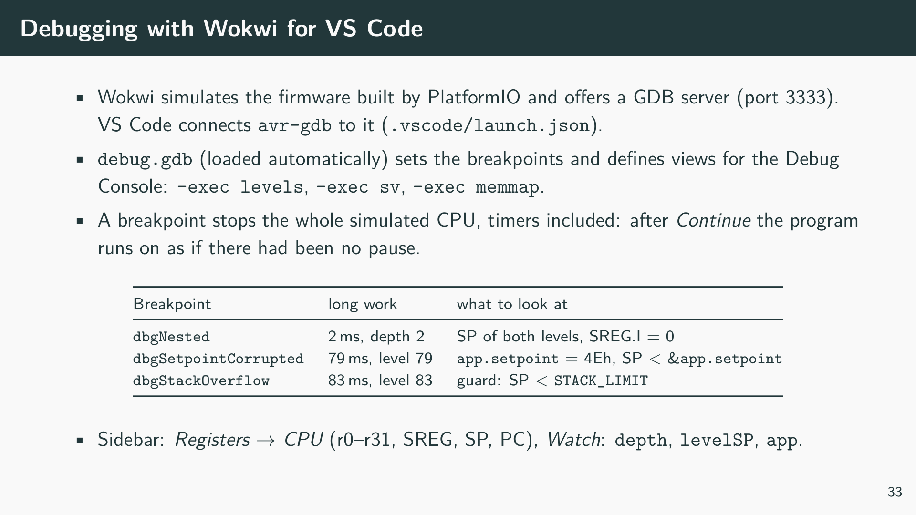

Slide 39
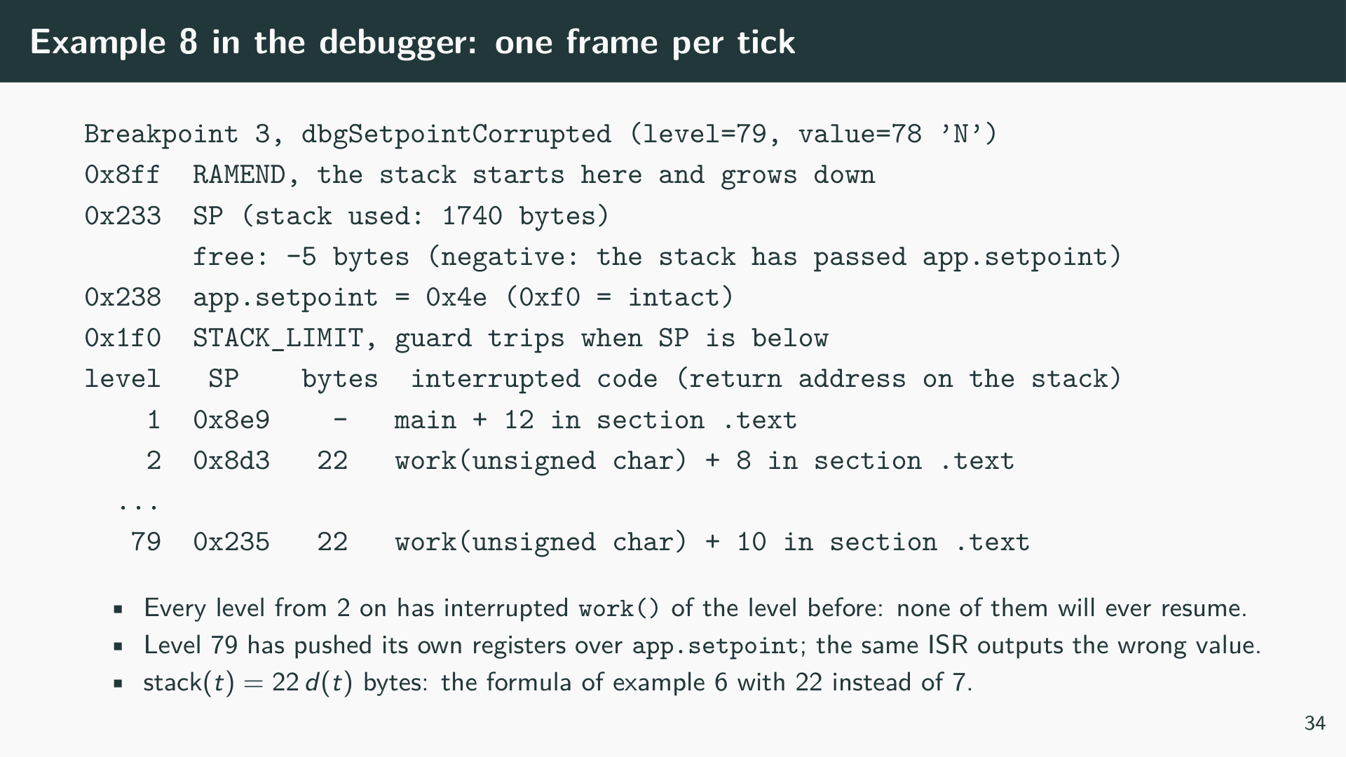
Notes:
The command levels reads levelSP[], the stack pointer each level stored right after its prologue, and finds the return address above the 18 pushed registers. The hardware pushes the program counter as a word address, high byte at the lower address; multiplied by two it is a byte address that GDB translates into a function and an offset. The output shows the mechanism of example 6 directly: level 1 interrupted the empty main loop, every further level interrupted the busy loop in work() of the level before, and the distance between two levels is always 22 bytes. GDB writes RAM addresses with an offset of 800000h (e.g. 0x8008d2), because on the AVR flash and RAM both start at address 0.
With the short work the depth stays 1 and none of the three breakpoints is hit. To look at a single ISR in that case, enable the breakpoint on dbgTick, which is called at every ISR entry: -exec info breakpoints lists the numbers, -exec enable n enables it.

Slide 40
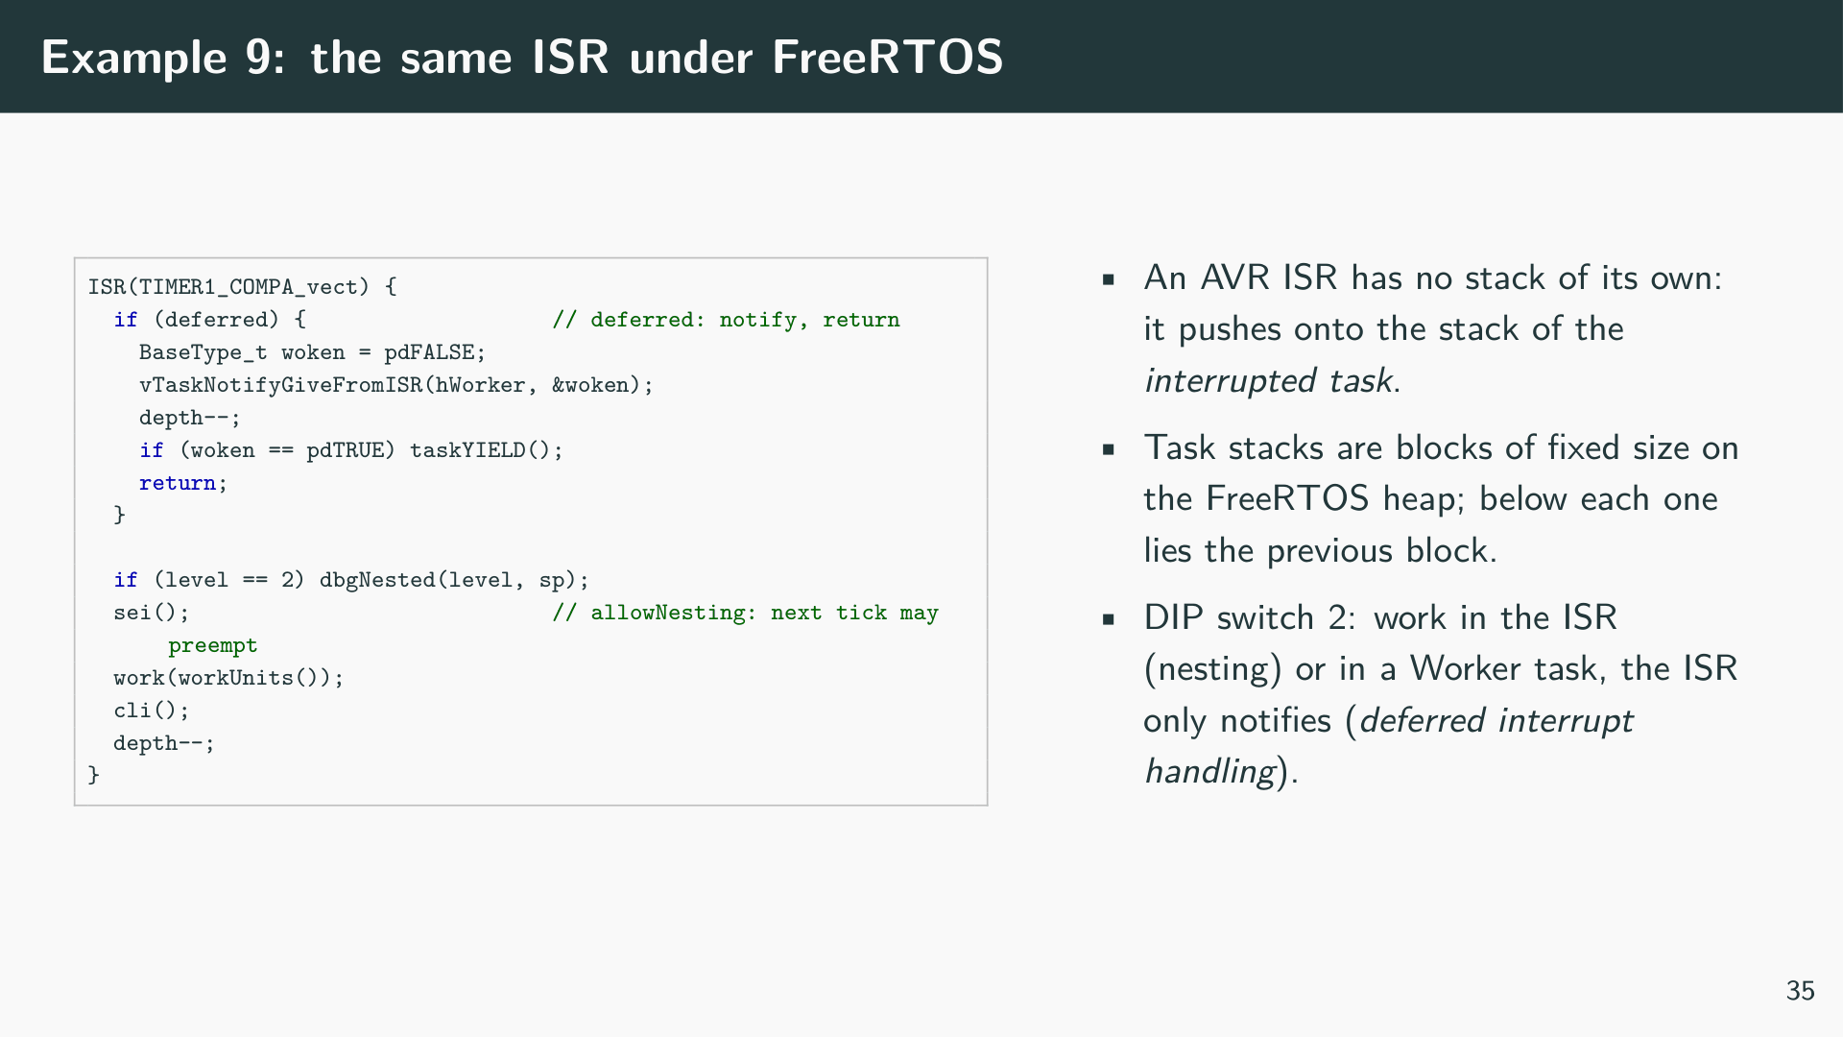
Notes:
[Listing: The nested ISR of example 8 under FreeRTOS, examples/ex09_rtos_isr_nesting/sketch.ino]
Example 6 uses the ISR of example 8 in a FreeRTOS application (tasks are introduced in Chapter 8). The Ctrl task outputs the setpoint every tick and otherwise waits, so the Idle task runs most of the time and is the task the timer interrupt usually interrupts. The Ctrl task also reads the DIP switches right after each tick, so that a phase of long work always starts at the same point of the scheduler period. The heap holds, in this order, the stack and TCB of the Worker, the stack and TCB of Ctrl, the block app, and the stack and TCB of Idle, which the scheduler creates after setup().

Slide 41
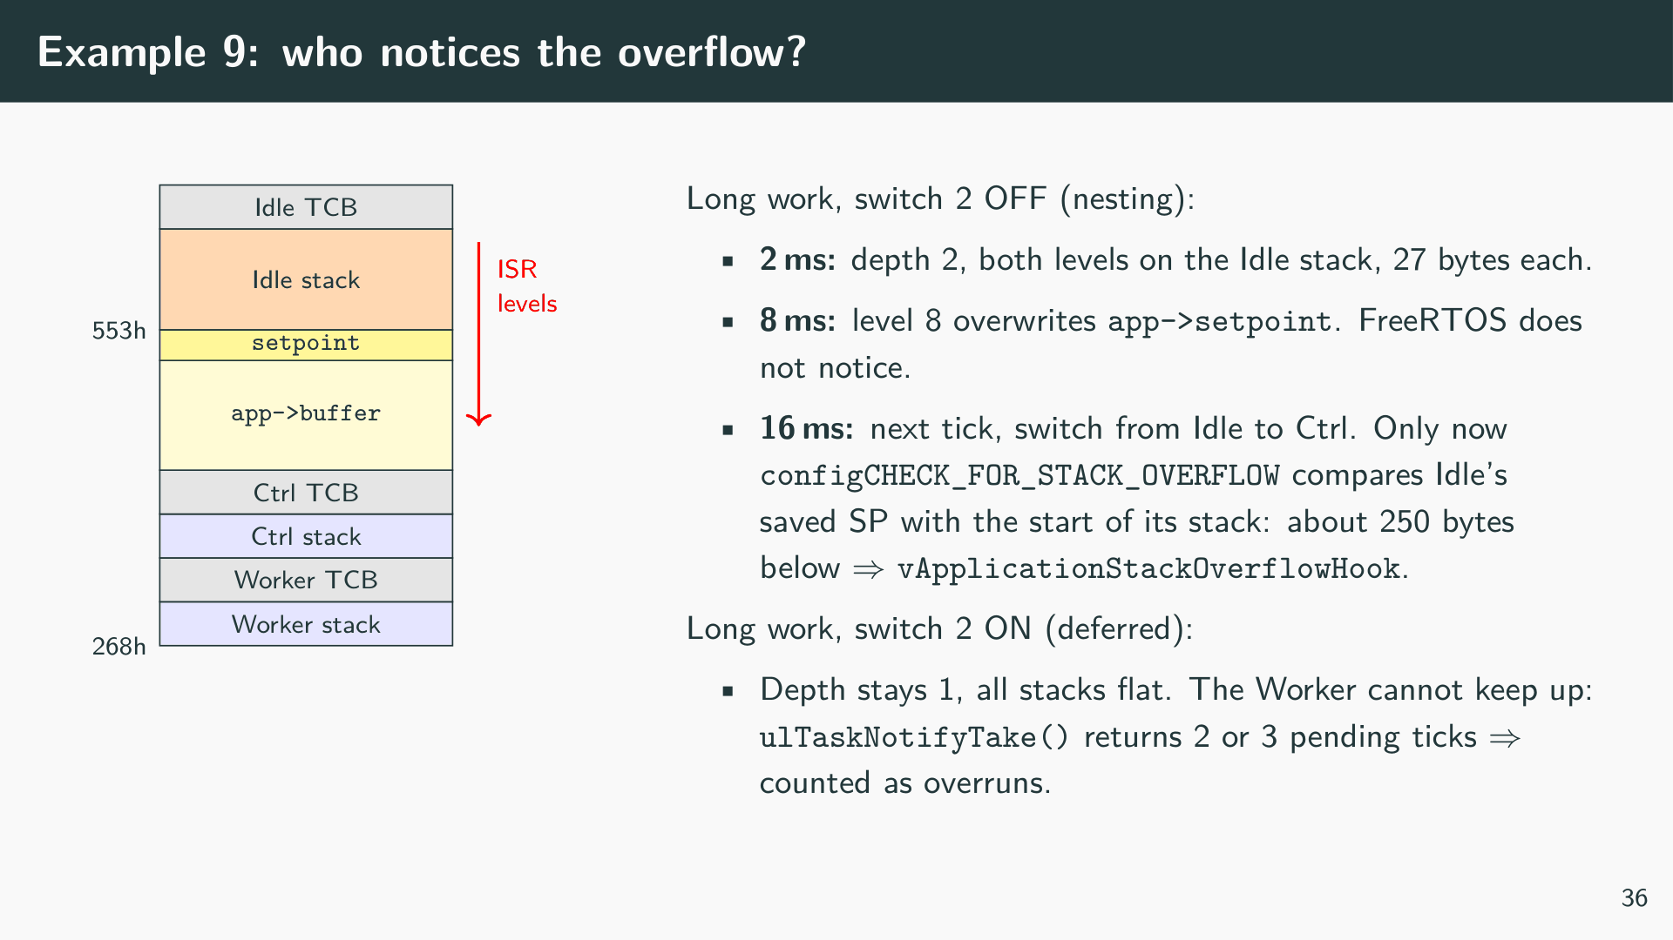
Notes:
The debug setup of example 9 adds two views to the Debug Console. -exec tasks lists every task with its priority, the start of its stack (pxStack in the TCB) and its current stack pointer: for the running task the CPU register SP, for all others the value saved in the TCB at the last switch. The difference is the number of bytes the task has left; a negative value is an overflow. -exec heap lists the heap blocks in address order. At the breakpoint dbgRtosStackOverflow the Idle task has -256 bytes left, while the stacks of all other tasks are untouched.
The check of FreeRTOS runs only when a task is switched out, and method 1 only compares the saved stack pointer with the start of the stack. Between two checks the overflow is invisible, and the overflow can destroy the data the check needs: with a smaller app block the stack reaches the TCB of Ctrl before the next tick. Ctrl is then no longer woken, there is no task switch, and in the simulation the hook was called only after 258 ms, after the stack had passed through the TCBs and stacks of two more tasks. The check is a useful alarm, not a protection. The design rule is the one of example 6: every task stack must have room for its own worst case plus the deepest ISR frame, and that depth has a bound only if ISRs do not nest themselves. Moving the work into a task (switch 2) gives this bound. The load problem remains, but it shows up as counted overruns and a starved Ctrl task instead of as corrupted memory.

Slide 42


Slide 43
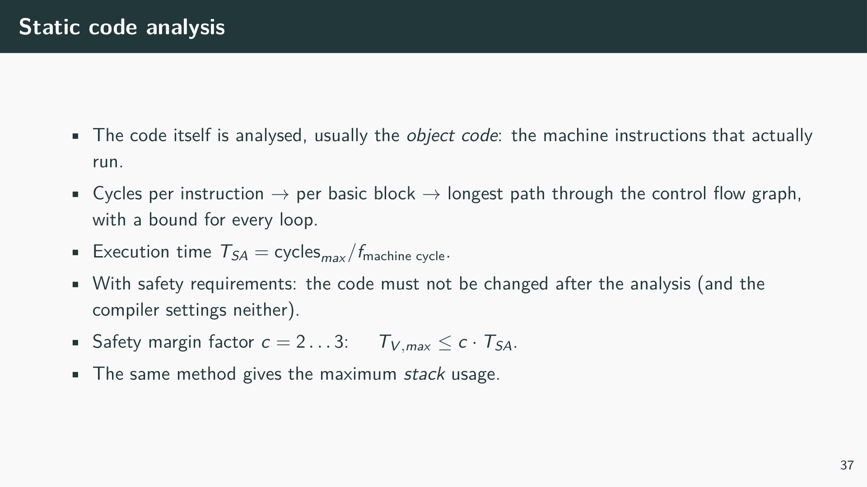

Slide 44
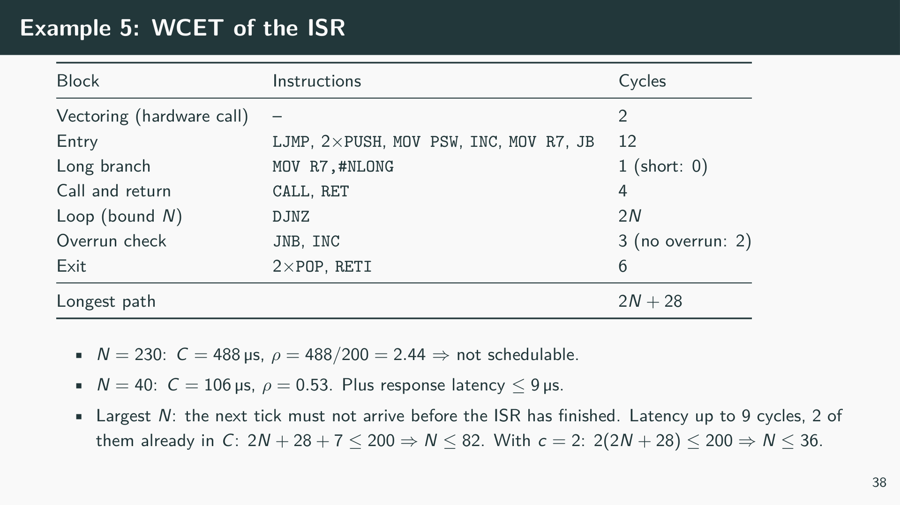
Notes:
The analysis needs exactly the information that is in the right-hand column of Example 1: the cycles of each instruction, the structure of the branches, and a bound for each loop. The loop bound is the critical input; here it is the constant loaded into R7. Whoever reads the analysis must be sure that no other path can load a larger value, which is why the code may not change afterwards. The response latency of up to 9 machine cycles is not part of C but adds to the reaction time T_R, as do the interrupt-disabled sections of the main program.

Slide 45
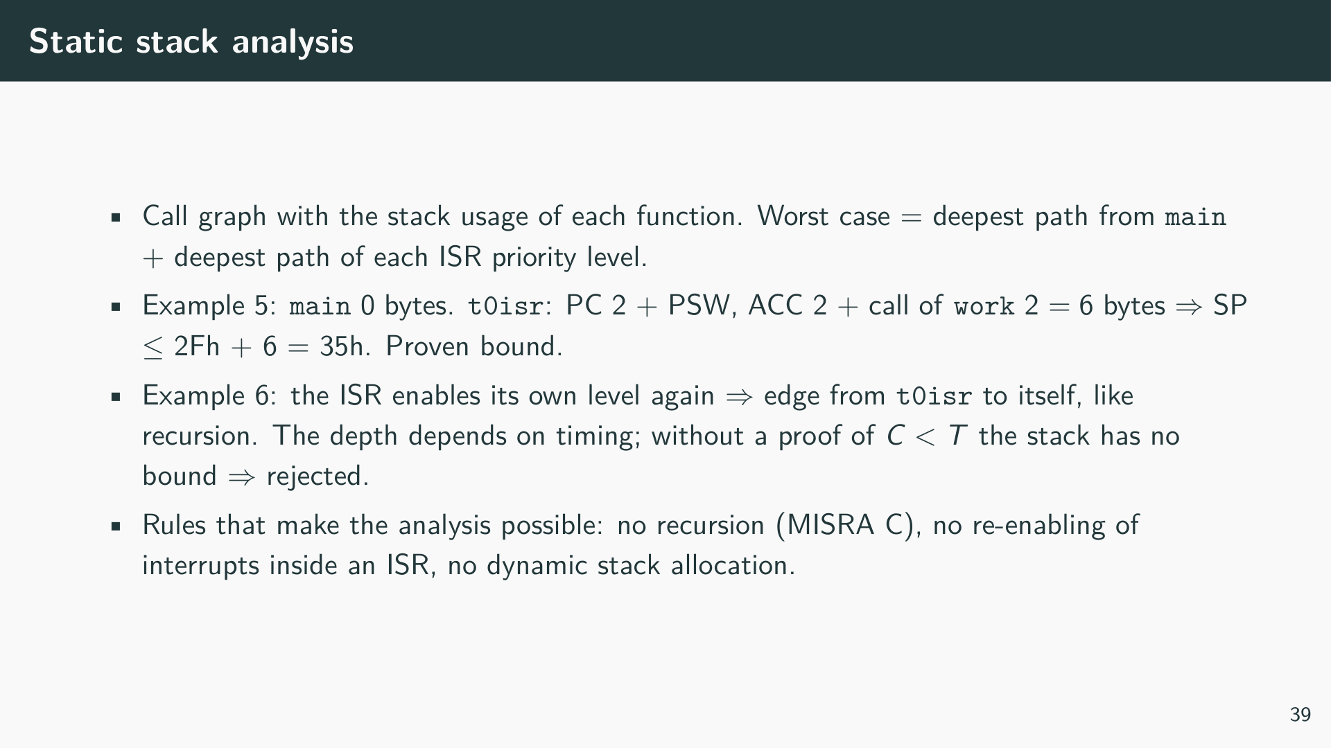

Slide 46
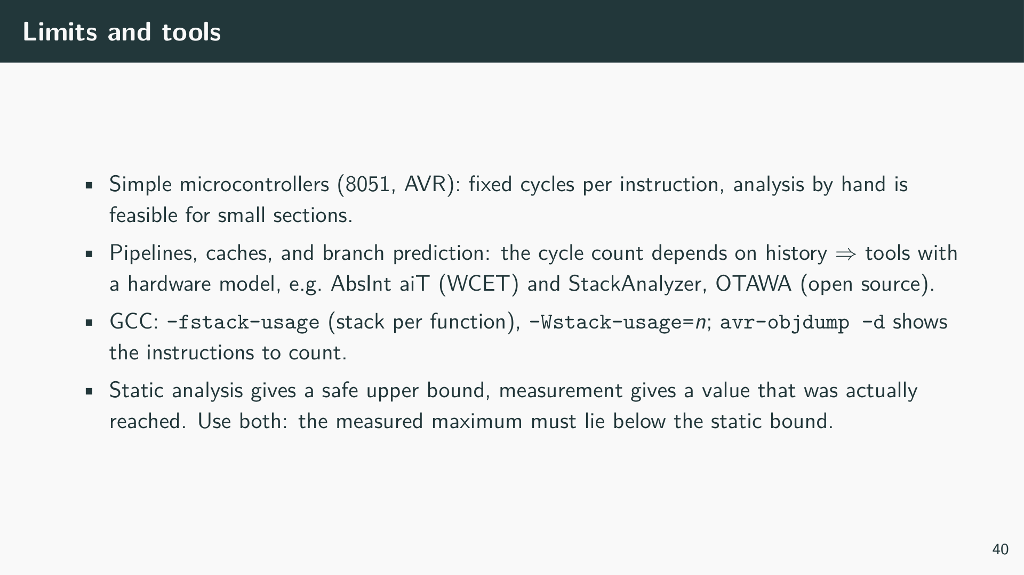

Slide 47
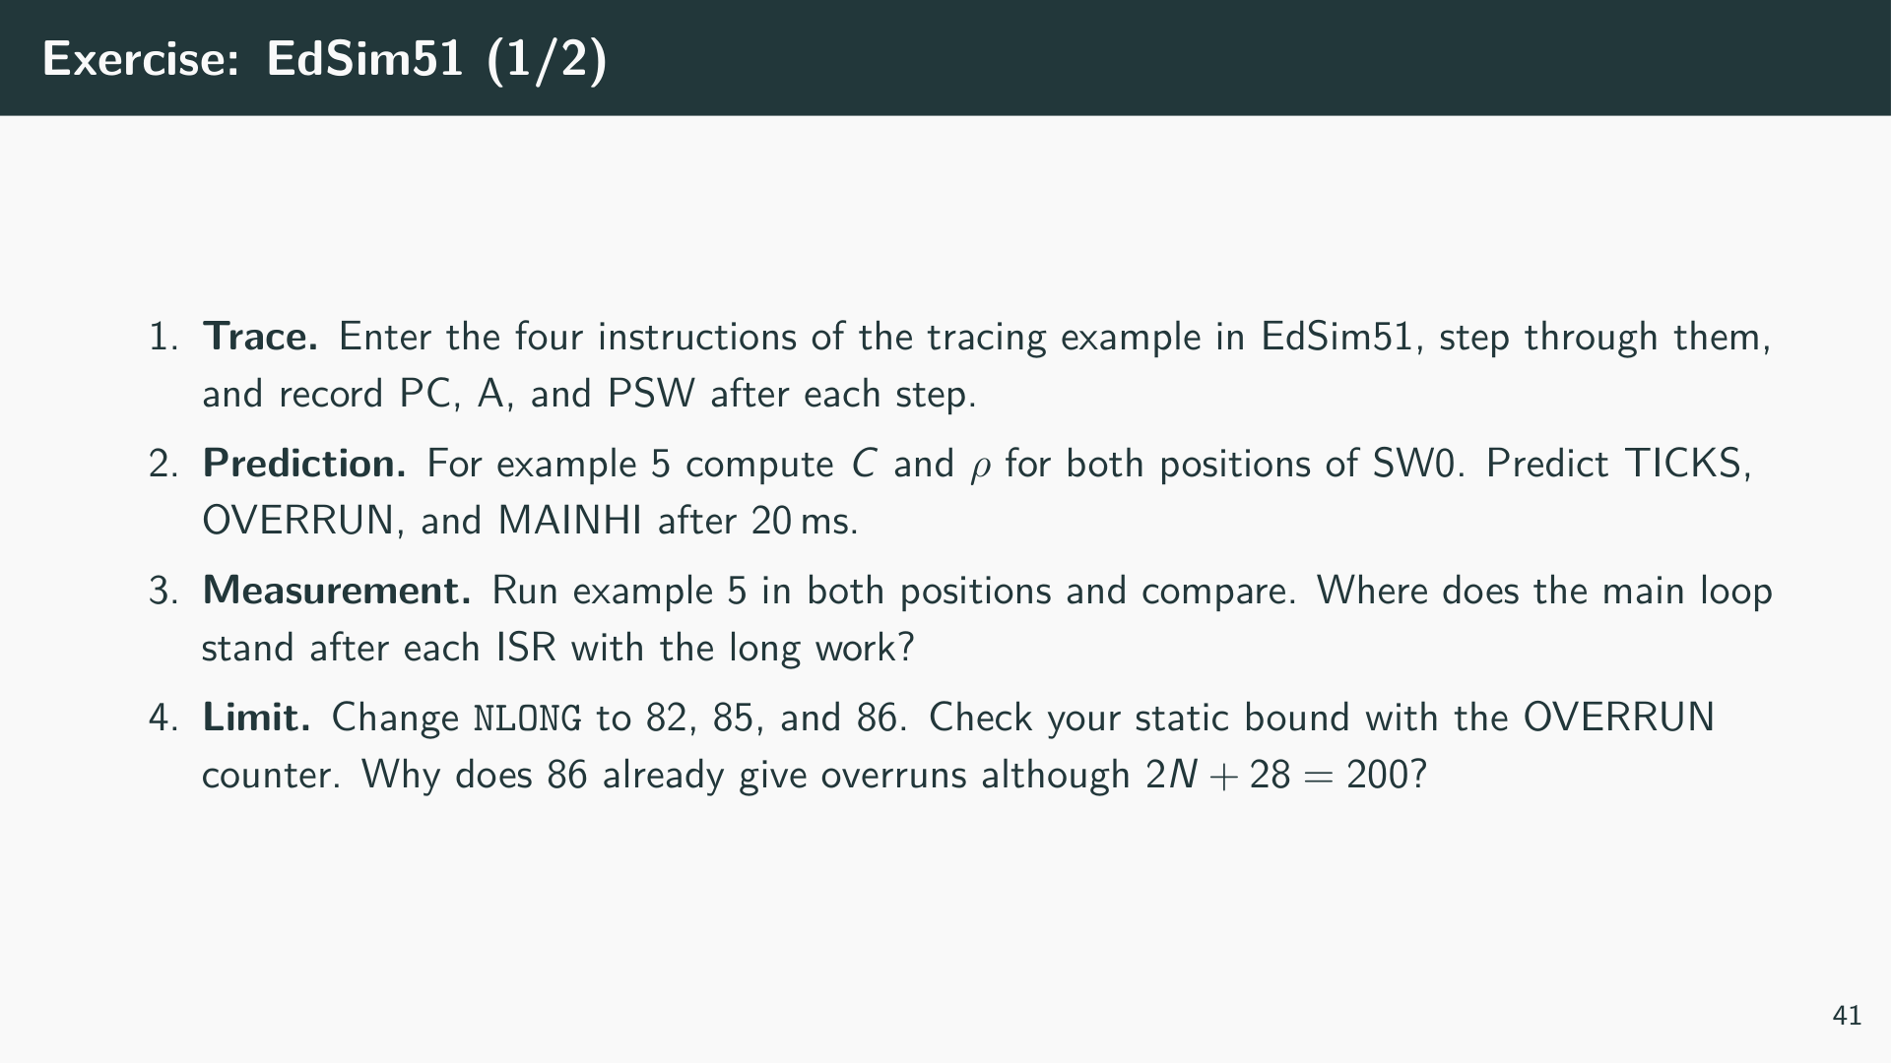

Slide 48
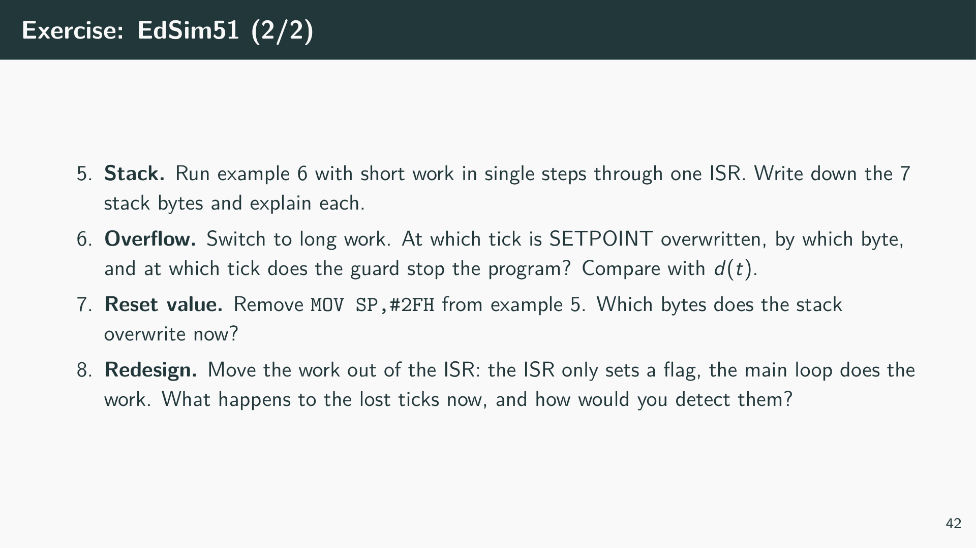
Notes:
Hints. In exercise 4 the ISR does not start at the overflow: the current instruction of the main loop finishes first, then the hardware call follows. With C = 199 cycles (no overrun increment) the ISR and one main instruction no longer fit into 200 cycles, the start drifts later with every tick until TF0 is set before the check. The static bound N ≤ 82 covers the worst-case latency, N = 85 only works because the main loop contains no long instructions. In exercise 7 the stack starts at 08h, in register bank 1, which the ISR uses as R0–R7. Check whether R7 of bank 1 (0Fh) is hit. In exercise 8 the work is still longer than the period; the difference is where the problem appears and whether it can be counted.

Slide 49


Slide 50
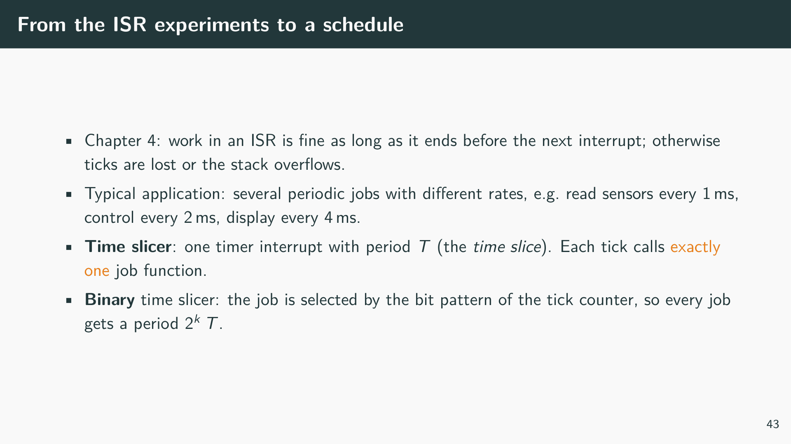
Notes:
The experiments of Chapter 4 showed what goes wrong when an interrupt service routine does more work than fits into its period. A time slicer turns the timer interrupt into a small, fixed schedule: the period of the timer is divided into slices of equal length T, and in every slice exactly one function, a job, is executed. Because the jobs of one slice never meet the jobs of another, many problems of concurrent programs do not occur. The binary variant chooses the job from the binary representation of the tick counter, which needs neither tables of start times nor a scheduler, and still gives each job a fixed period.

Slide 51
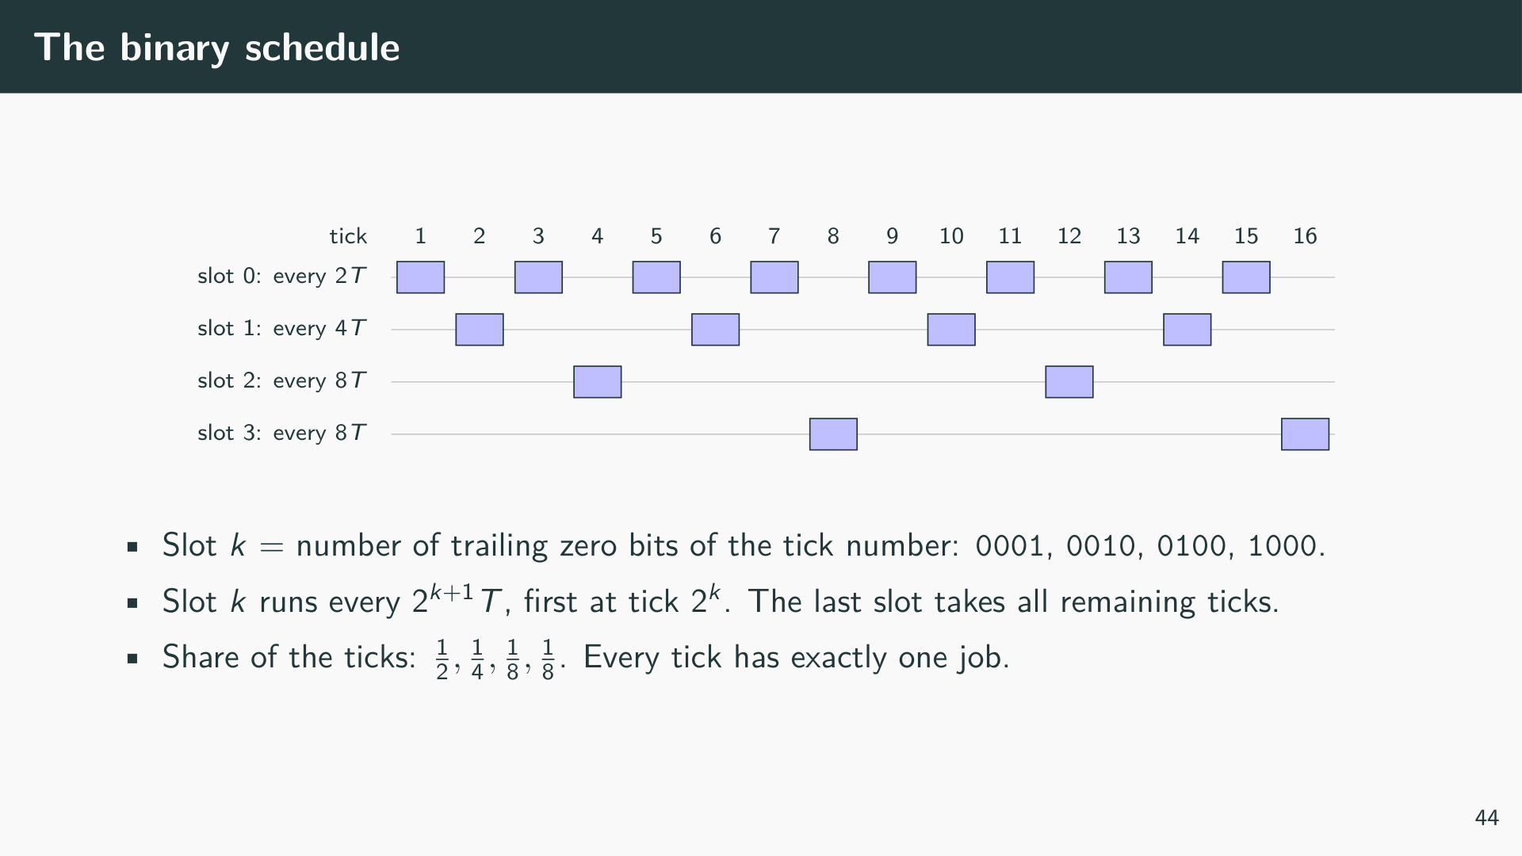
Notes:
Odd tick numbers end with the bit 1, so slot 0 runs in every second tick. Of the even numbers, those with exactly one trailing zero (2, 6, 10, …) belong to slot 1, those with two trailing zeros (4, 12, 20, …) to slot 2, and so on. With n slots the last one collects all numbers with n-1 or more trailing zeros, so it has the same period as the slot before it. The schedule repeats after 2^n-1 ticks. Each slot has its own offset, which is why two slots never fall into the same tick: the binary representation of a number has exactly one count of trailing zeros.

Slide 52
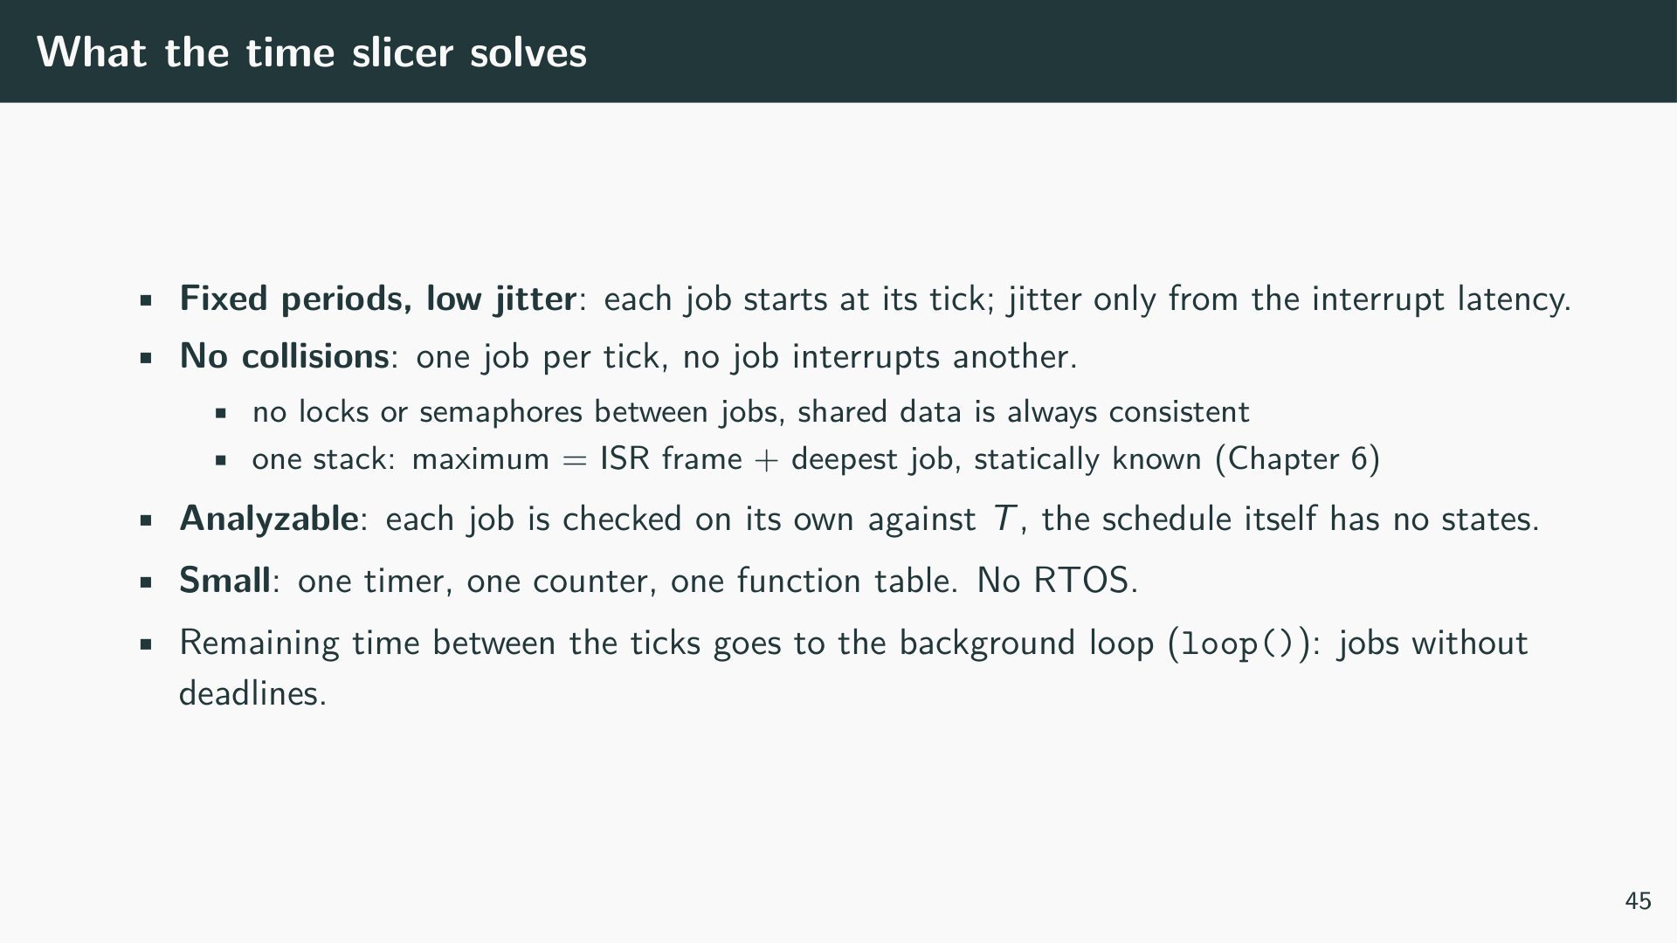

Slide 53
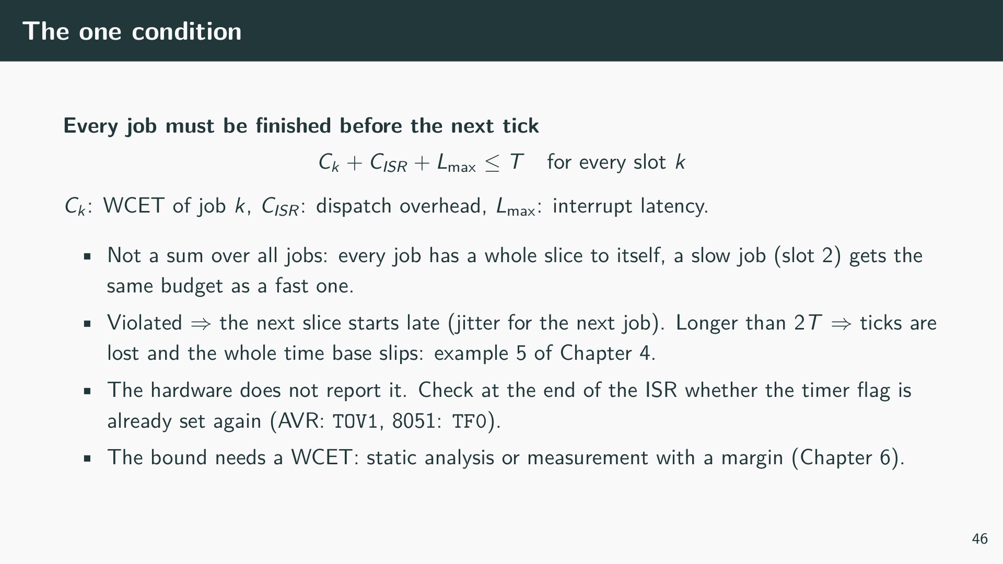
Notes:
The time slicer solves most problems of small periodic systems with very little code, but it depends on one condition that the program cannot enforce: each job must certainly be finished before the next tick. Since every slice contains exactly one job, the condition applies to each job individually and not to the sum of all jobs, unlike the utilization bound of a preemptive scheduler. The price is that the slice length T must accommodate the longest job, even if that job runs only every eighth tick. If one job takes longer than T, the next tick is not lost as long as the job ends within 2T; the timer flag stays pending and the ISR starts again immediately after it returns. The next job then starts late. If the job takes longer than 2T, the timer overflows twice while the flag can only store one request, and from then on the tick counter no longer matches the elapsed time. This is exactly the overrun of example 5, and it is detected the same way, by checking the timer flag at the end of the ISR.

Slide 54
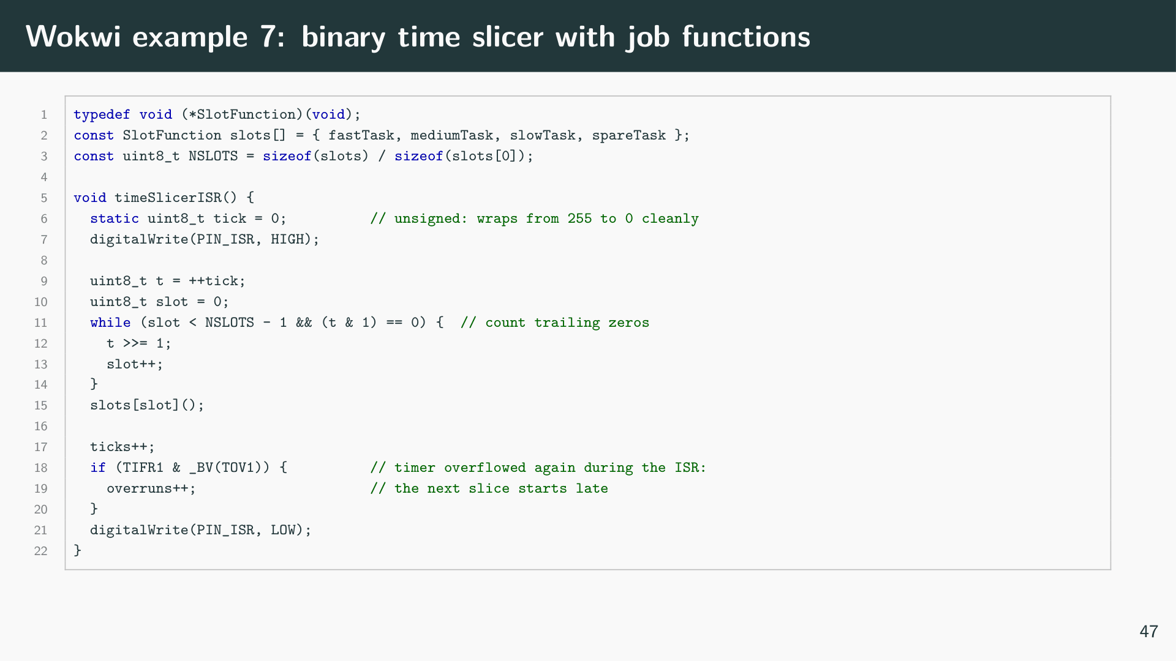
Notes:
[Listing: Binary time slicer: a timer ISR dispatches one job function per tick, examples/ex07_time_slicer/sketch.ino]
Example 7 uses the TimerOne library for a timer interrupt every T = 500 µs. The ISR increments an 8-bit tick counter, counts its trailing zeros to find the slot, and calls the job function of that slot through a table of function pointers. The jobs fastTask, mediumTask and slowTask toggle pins 13, 12 and 11, so the logic analyzer shows square waves with periods of 2, 4 and 8 ms, i.e. two slices per edge of the fastest job. Pin 10 is high while the ISR runs and shows how much of each slice is used. A new job is added by writing a function and entering it into the table; the ISR itself does not change.
The example is based on an earlier version (https://wokwi.com/projects/414976138190111745) in which the ISR toggled the pins directly with tick % 2 == 1, tick % 4 == 2 and tick % 8 == 4. Two things are changed. First, the jobs are separate functions, so the dispatch logic and the application code are separated and each job can be analyzed on its own. Second, the counter is an unsigned 8-bit value. The original static int tick overflows after 32767 ticks (3.3 s at 100 µs) to -32768; for negative numbers the remainders are negative or zero (tick % 2 is -1 or 0), none of the three conditions holds, and all pins stop toggling for the next 3.3 s until the counter is positive again. An unsigned counter wraps from 255 to 0, and 256 is a multiple of every slot period, so the schedule continues without a gap.
DIP switch 1 makes slowTask busy-wait for 700 µs, longer than one slice. Every 4 ms the ISR now ends after the next timer overflow, the overrun counter grows by 250 per second, and the analyzer shows the following slice starting late. No tick is lost yet, because the job ends within 2T: the serial monitor still reports 2000 ticks per second. The busy wait uses delayMicroseconds(), because millis() and micros() depend on the Timer 0 interrupt, which cannot run while the time slicer ISR is active.

Slide 55
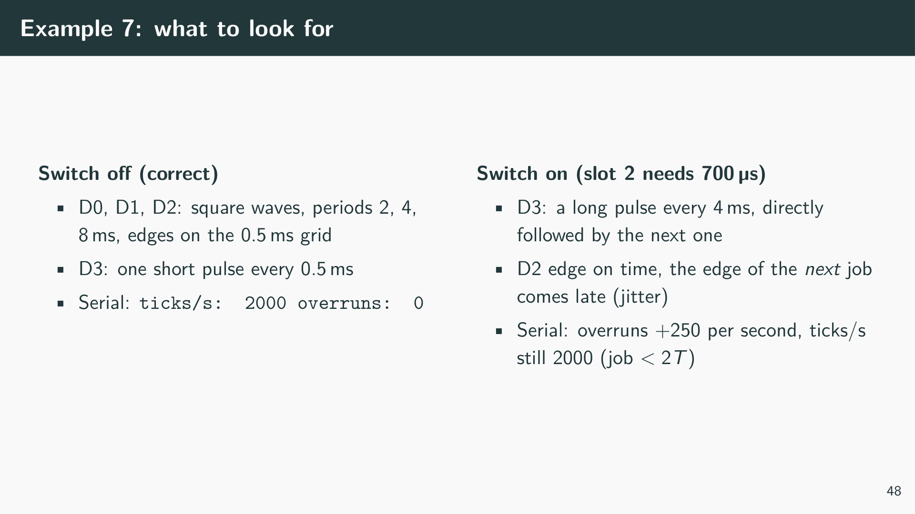

Slide 56

Notes:
The time slicer is a good choice as long as all periodic jobs are short and their WCET is known. It fails for jobs whose duration cannot be bounded below T, and splitting such a job into steps moves the problem into the application: the job must store its progress between calls, which is the manual form of the context a task keeps on its own stack. The next chapter introduces tasks under FreeRTOS, where the scheduler preempts long work and resumes it later, which is exactly the “resume later” that failed with nested interrupts in example 6.

Slide 57


Slide 58


Slide 59


Slide 60


Slide 61


Slide 62

Notes:
Internally, FreeRTOS keeps one ready list per priority level (pxReadyTasksLists[]). On a context switch, vTaskSwitchContext() walks down from the highest priority with a non-empty list and takes the next entry of that list. Because the list is circular, tasks of the same priority get equal shares. These few lines are the core of the scheduler; the rest of the kernel exists to keep them correct.

Slide 63


Slide 64

Notes:
Example 8 creates two periodic tasks. The patched scheduler sets the trace pin of a task high while it is Running and low otherwise. Attach a logic analyzer to pins 10 and 11 (see Chapter 12) to see when each task runs and how the higher-priority task preempts the other.

Slide 65


Slide 66


Slide 67

Notes:
Keep the ISR short: it gives the semaphore and requests a context switch if a higher-priority task was woken. The latency from the button edge to the first instruction of the task is exactly the kind of timing we measure in Chapter 12.

Slide 68


Slide 69


Slide 70


Slide 71


Slide 72


Slide 73


Slide 74

Notes:
The consumer blocks on the queue until an item arrives. If the consumer has the higher priority it runs immediately after each send. If the producer has the higher priority, the queue fills up and the producer blocks on a full queue. Use the logic analyzer to observe both cases.

Slide 75


Slide 76


Slide 77


Slide 78

Notes:
Exercise: implement the two-task example above on the Arduino, assign priorities according to RM, and verify the response times with the logic analyzer.

Slide 79


Slide 80

Notes:
The reference project (interrupt-triggered semaphore) uses pin 2 as button input (INT0), pin 13 and pin 12 for the two LEDs, and pins 10 and 11 as debug outputs. The logic analyzer is connected to D0–D7.

Slide 81

Notes:
The pin therefore shows exactly the time a task is Running, as decided by the scheduler, and not merely the time between two statements in the task code. Preemption is visible as a gap in the pulse of the lower-priority task while the pulse of the higher-priority task is high. The application tag must be set before the scheduler starts or at least before the task is first switched in. Two things to keep in mind: tasks without a tag have the tag NULL, so the macros drive pin 0 for them (this includes the idle task, and pin 0 is the serial RX pin on the Uno); and the pin has to be configured with pinMode() as output.

Slide 82

Notes:
Surfer is a web-based waveform viewer that runs entirely in the browser. Zoom to the region of interest, place one cursor on the event edge and another on the edge of the task pin, and read off the time difference. This gives T_L, T_V and T_R from the previous definitions directly.

Slide 83


Slide 84


Slide 85

Notes:
The counter must run much faster than the tick (FreeRTOS recommends 10 to 100 times the tick frequency). Otherwise a task that runs for less than one counter period is never charged, and the statistics are biased towards tasks that happen to be running when the counter increments. With a 16 ms watchdog tick on the Uno this rules out the tick counter itself.

Slide 86

Notes:
The configuration is compiled into the library, not into the sketch: a #define in the .ino file does not reach tasks.c. Therefore the switch lives in FreeRTOSConfig.h of the patched library and is active for all examples. The kernel does not protect against counter overflow; after about 71 minutes the counters are no longer meaningful.

Slide 87

Notes:
vTaskGetRunTimeStats() is convenient but has drawbacks on a small controller: it allocates a temporary TaskStatus_t array on the heap, uses sprintf(), and rounds percentages down to whole numbers (tasks below 1 % are shown as <1%). Because it divides by the total time since boot, a change in load shows up only slowly. Production code usually calls uxTaskGetSystemState() and evaluates the raw counters itself.

Slide 88

Notes:
Example 11 creates two periodic tasks with rate-monotonic priorities: A (T_A = 5 ticks, C_A = 16 ms, priority 2) and B (T_B = 10 ticks, C_B = 40 ms, priority 1). Both run the same task function; the parameters are passed in a PeriodicTask structure. The execution time is generated with delayMicroseconds(), which counts CPU cycles; time during which the task is preempted is therefore not counted, in contrast to the millis()-based loop in Example 8. At the end of each job the task checks whether it finished after its implicit deadline and counts a miss.
The monitor task (priority 3) wakes every 2 s, takes a snapshot with uxTaskGetSystemState(), and prints for each task the CPU time in the last window, the share in per cent, and the remaining stack. It then prints the built-in table of vTaskGetRunTimeStats() for comparison. The output appears in the Wokwi serial monitor; the trace pins of A and B are recorded by the logic analyzer as before.

Slide 89


Slide 90

Notes:
Hints. The watchdog tick is nominally 2048 / 128 kHz = 16 ms, so T_A = 80 ms and T_B = 160 ms. Because the periods are harmonic, rate monotonic can reach 100 % utilisation, beyond the Liu & Layland bound of 82.8 %; the response-time analysis of Chapter 5 gives the exact answer. The monitor is not part of the task set used in the analysis, but at priority 3 it preempts both tasks while it formats and sends its output (with a 64-byte transmit buffer, Serial.print() busy-waits until the UART has sent the characters). Note that every measurement disturbs the system it measures, including the run-time counter itself, which costs one micros() call per context switch.

