Slide 1

BAGGING a case for Random Forest
Presented by
Arjun Singh
Murali Krishna Mopidevi

Slide 2
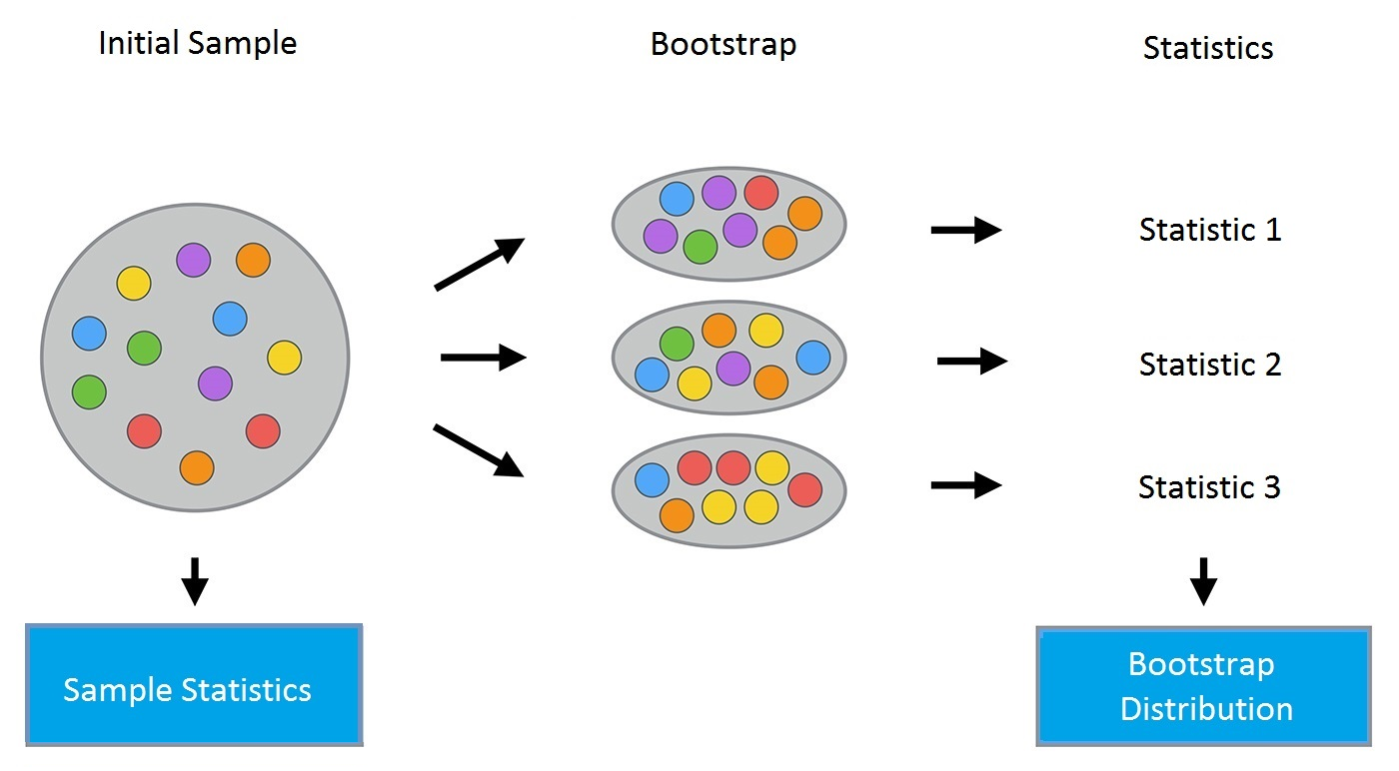
Bootstrap Method
let’s take a quick look at an important foundation technique called the bootstrap
Definition
Bootstrap is a powerful statistical method for estimating a quantity from a data sample. This is easiest to understand if the quantity is a descriptive statistic such as a mean or a standard deviation.
Let’s assume we havea sample of 100 values (x) and we’d like to get an estimate of the mean of the sample.
We can calculate the mean directly from the sample as
mean(x) = 1/100 * sum(x)
We know that our sample is small and that our mean has error in it. We can improve the estimate of our mean using the bootstrap procedure:
Create many (e.g. 1000) random sub-samples of our dataset with replacement (meaning we can select the same value multiple times).
Calculate the mean of each sub-sample.
Calculate the average of all of our collected means and use that as our estimated mean for the data.

Slide 3
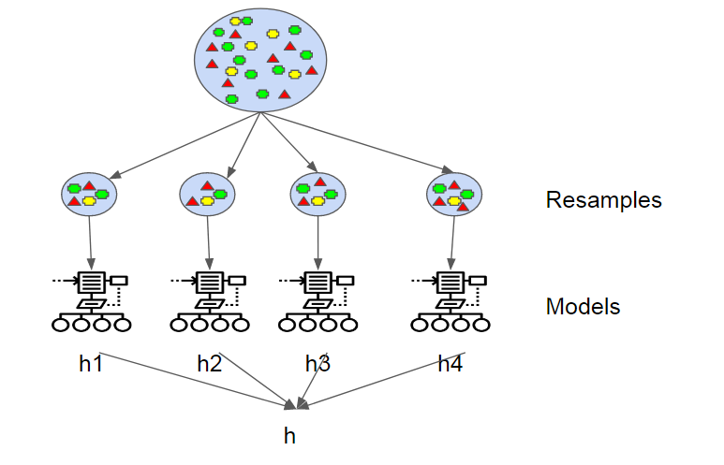
Bootstrap Aggregation (Bagging)
Bootstrap Aggregation (Bagging for short), is a simple and very powerful Ensemble Method.
Ensemble Method
Ensemble methods, which combines several decision trees to produce better predictive performance than utilizing a single decision tree. The main principle behind the ensemble model is that a group of weak learners come together to form a strong learner.
Bagging
(Bootstrap Aggregation) is used when our goal is to reduce the variance of a decision tree. Here idea is to create several subsets of data from training sample chosen randomly with replacement. Now, each collection of subset data is used to train their decision trees. As a result, we end up with an ensemble of different models. Average of all the predictions from different trees are used which is more robust than a single decision tree.

Slide 4
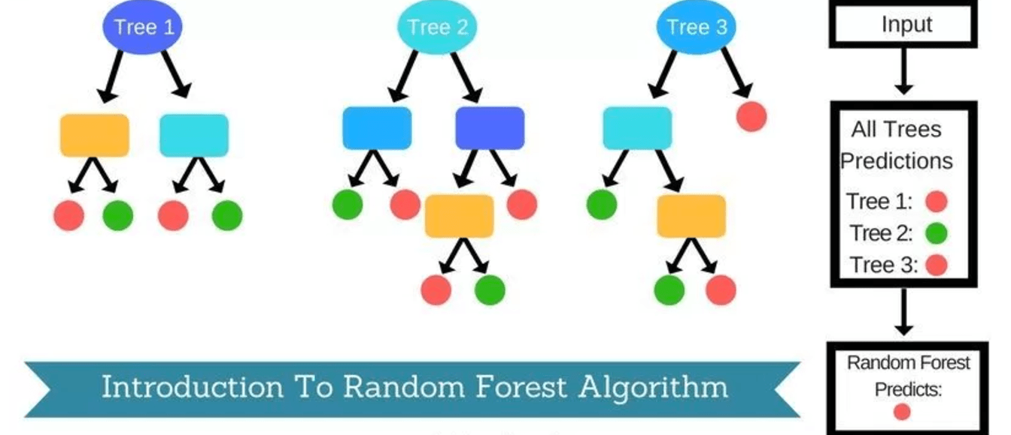
Random Forest Method
Bootstrap Aggregation (Bagging for short), is a simple and very powerful Ensemble Method.
Definition
Random Forest is one of the most popular and most powerful machine learning algorithms. It is a type of ensemble machine learning algorithm called Bootstrap Aggregation or bagging.
Random Forest is an extension over bagging. It takes one extra step where in addition to taking the random subset of data, it also takes the random selection of features rather than using all features to grow trees. When you have many random trees. It’s called Random Forest
A problem with decision trees like CART is that they are greedy. They choose which variable to split on using a greedy algorithm that minimizes error. As such, even with Bagging, the decision trees can have a lot of structural similarities and in turn have high corealtion in their predictions.

Slide 5
Random forest ~ Bagging
Random creates randomized samples of the data set (just like random forest) and grows trees on a different sample of the original data. The remaining 1/3 of the sample is used to estimate unbiased OOB error. It considers all the features at a node (for splitting).Once the trees are fully grown, it uses averaging or voting to combine the resultant predictions.
The need for random forest surfaced after discovering that the bagging algorithm results in correlated trees when faced with a data set having strong predictors. Unfortunately, averaging several highly correlated trees doesn't lead to a large reduction in variance.
But how do correlated trees emerge? Good question! Let's say a data set has a very strong predictor, along with other moderately strong predictors. In bagging, a tree grown every time would consider the very strong predictor at its root node, thereby resulting in trees similar to each other.
The main difference between random forest and bagging is that random forest considers only a subset of predictors at a split. This results in trees with different predictors at top split, thereby resulting in decorrelated trees and more reliable average output. That's why we say random forest is robust to correlated predictors.

Slide 6
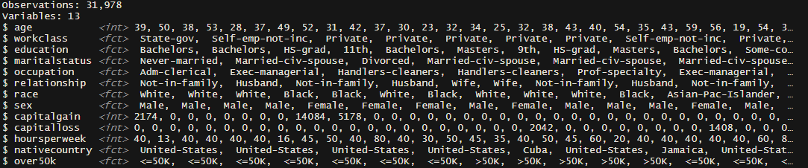
Project
USA Census dataset
Description
Dataset which contains numerical, categorical and missing values.

Slide 7
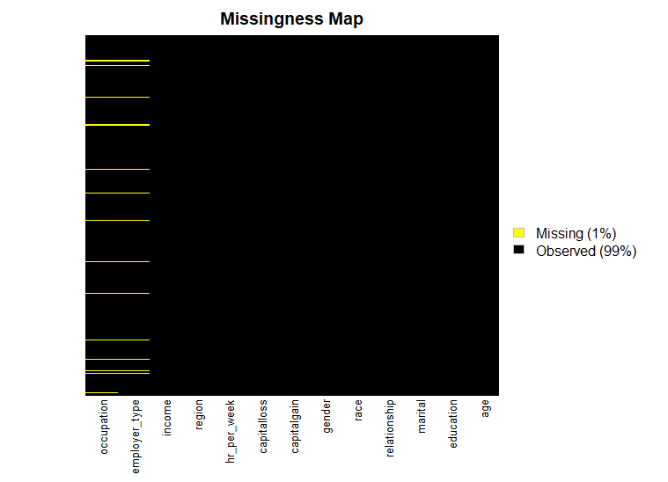
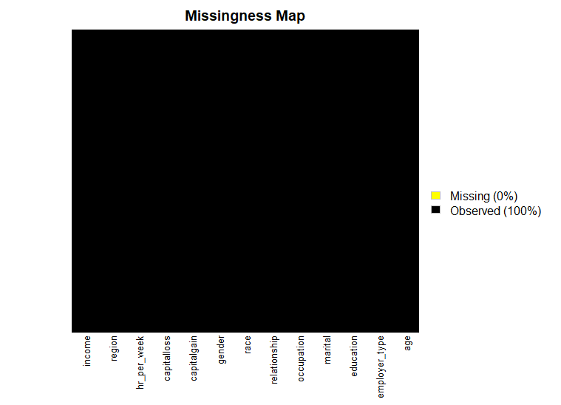
Data Cleaning
Cleaning the missing, NA values and changing the variable names for readability .
Before Cleaning
After Cleaning

Slide 8
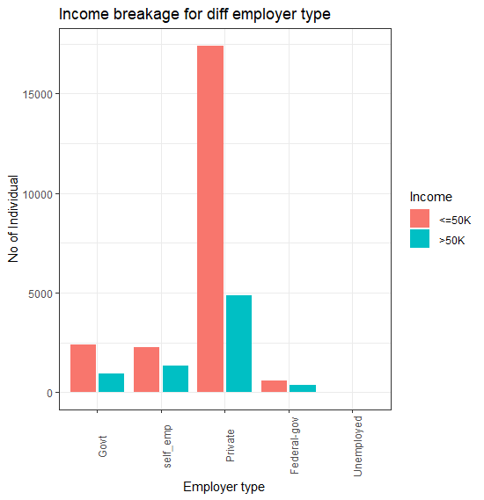
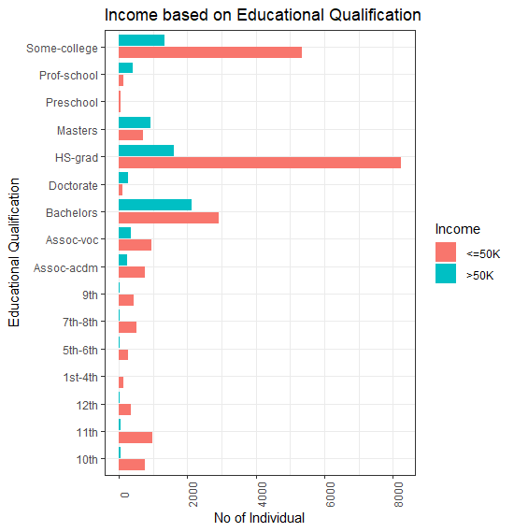
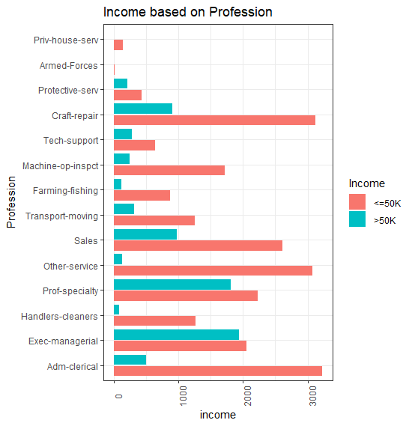
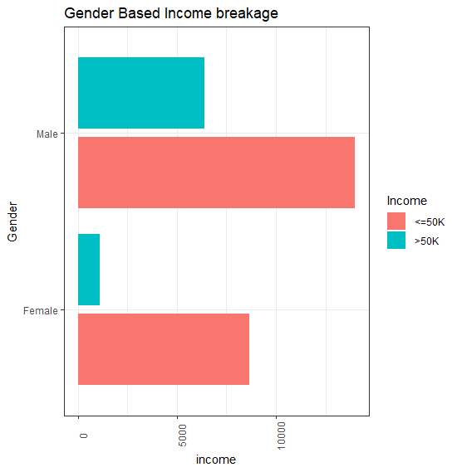
Data Visualization
Visualization the basic information of dataset using gglot2

Slide 9
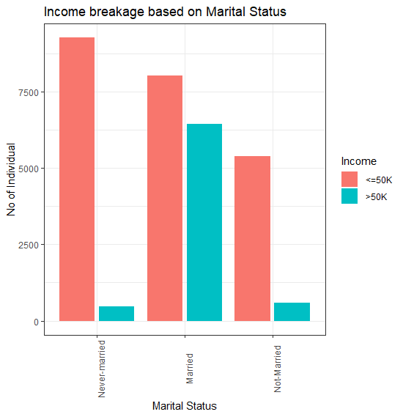
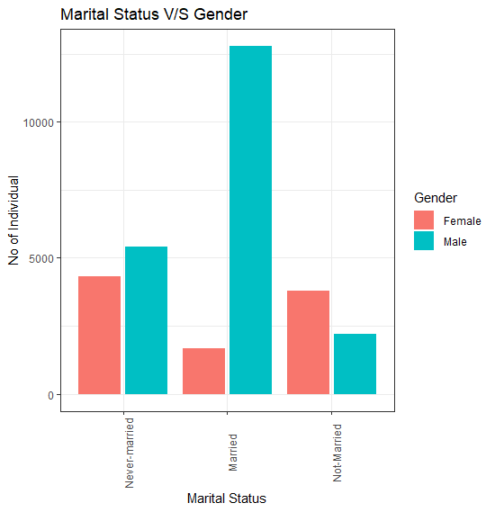
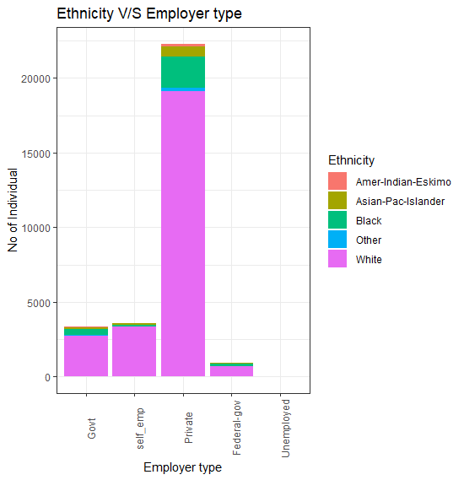
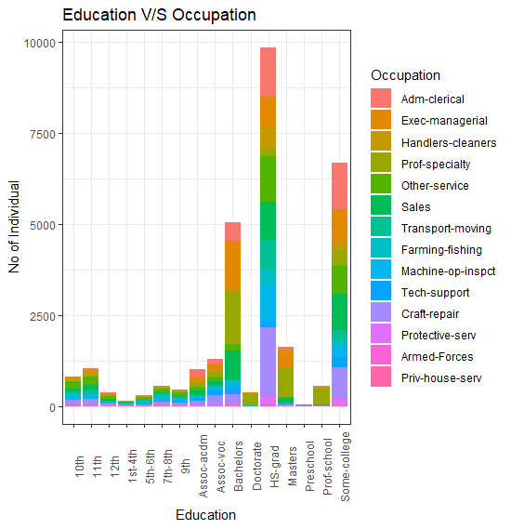
Data Visualization
Visualization the basic information of dataset using gglot2

Slide 10
Extracting Rule
Extracting rules from RandomForset
1 : education %in% c(' 10th',' 11th',' 12th',' 1st-4th',' 5th-6th',' 7th-8th',' 9th',' Assoc-acdm',' Assoc-voc',' Bachelors',' HS-grad',' Masters',' Preschool',' Some-college') & martialstatus %in% c('Never-married','Not-Married') & Occupation %in% c(' Adm-clerical',' Handlers-cleaners',' Other-service',' Sales',' Transport-moving',' Farming-fishing',' Machine-op-inspct',' Tech-support',' Craft-repair',' Armed-Forces',' Priv-house-serv') &
relationship %in% c(' Not-in-family',' Other-relative',' Own-child',' Unmarried') & gender %in% c(' Female') & WorkHour %in% c('Full-time','Part-time') --> <=50K
3, 4, 5, …,and so on

Slide 11
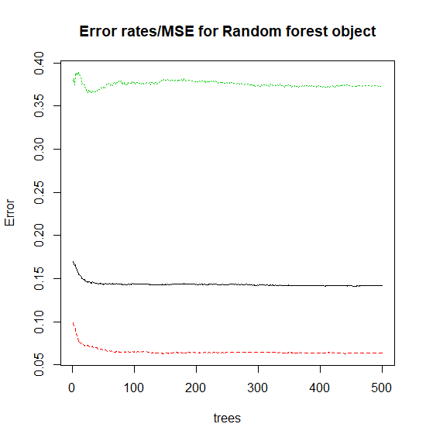
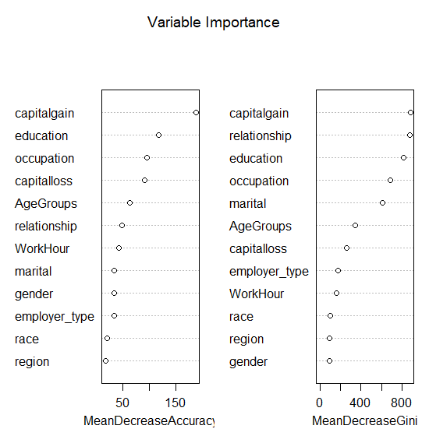
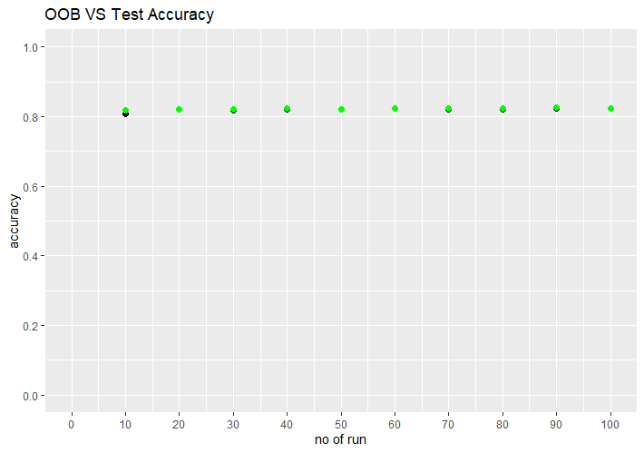
Random Forest
Multiple runs of Algorithm with variations of ntrees and mtry
Fixing the problem of randomness by using setseed

Slide 12
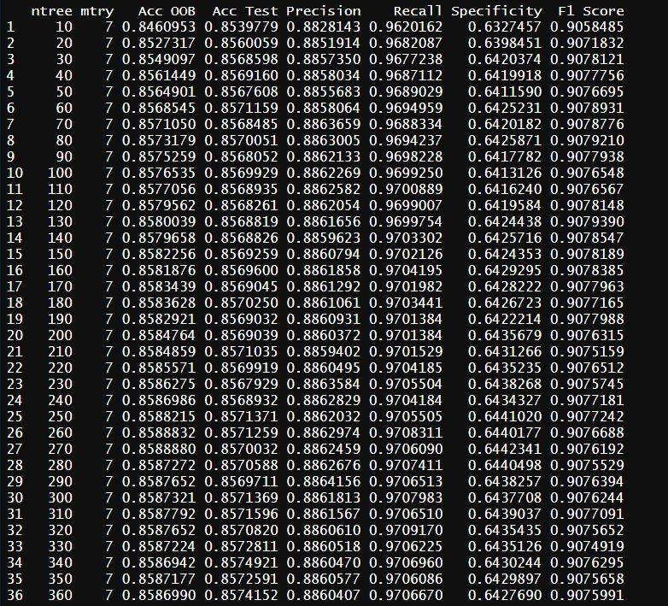
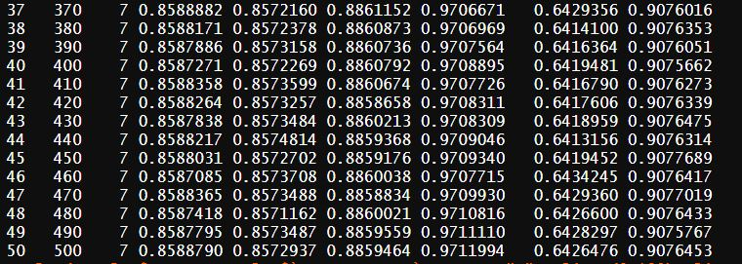
Results
BAGGING (ADEO-2, EISTI)

Slide 13
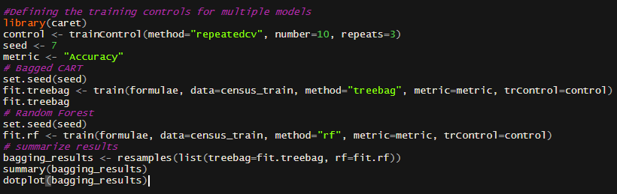
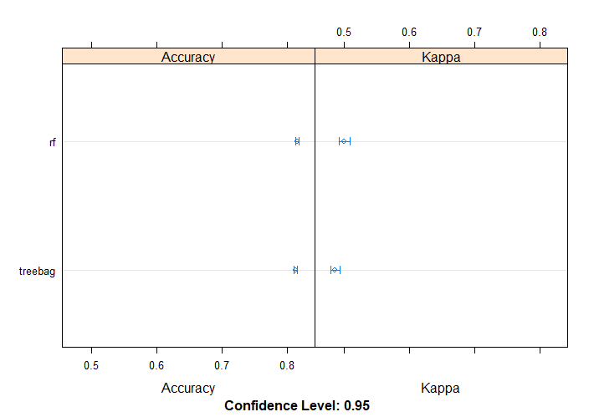
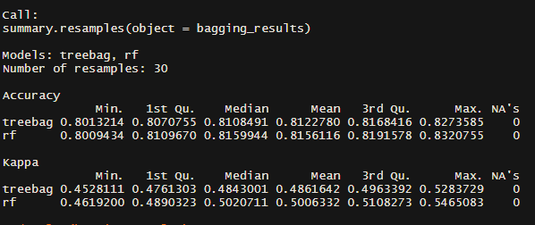
Bagged CART and Random Forest

Slide 14


THANK YOU!

