Slide 1
A Self-Hostable Open-Source Geospatial Platform for Small Teams, with Natural Language Querying via MCP
Host · See · Ask
Noboru Otsuka, Geolonia
FOSS4G 2026 Hiroshima
2026-09-02 17:30 · Dahlia1

Slide 2
A small team may need its spatial data to do three jobs
Hypothetical small-team context — not a measured deployment
Keep the team's spatial data
See it on a map
Ask focused questions about it
2

Slide 3
Three ways to meet the same need
External service
Provider-managed capabilities
Self-assembled stack
Team selects and operates the components
Assembled OSS platform
One self-hostable system
geo-base takes the assembled OSS position.
Design position — not a market, cost, or ownership result
3

Slide 4
geo-base assembles the core geospatial pieces
Manage · Admin UI
Shared platform · FastAPI + PostGIS
Team data
Map · Vector tiles
Ask · Natural-language client through MCP
Self-hostable · open source
4

Slide 5
Three user actions frame the discussion
Host
See
Ask
Make the team's data available.
Share the same map.
Start a focused question.
A simple way to describe a team's GIS work
5

Slide 6
One deployment gives these actions a shared data path
Host
Shared geo-base data layer
Team data
See
Ask
One shared data layer · three practical entry points
6

Slide 7
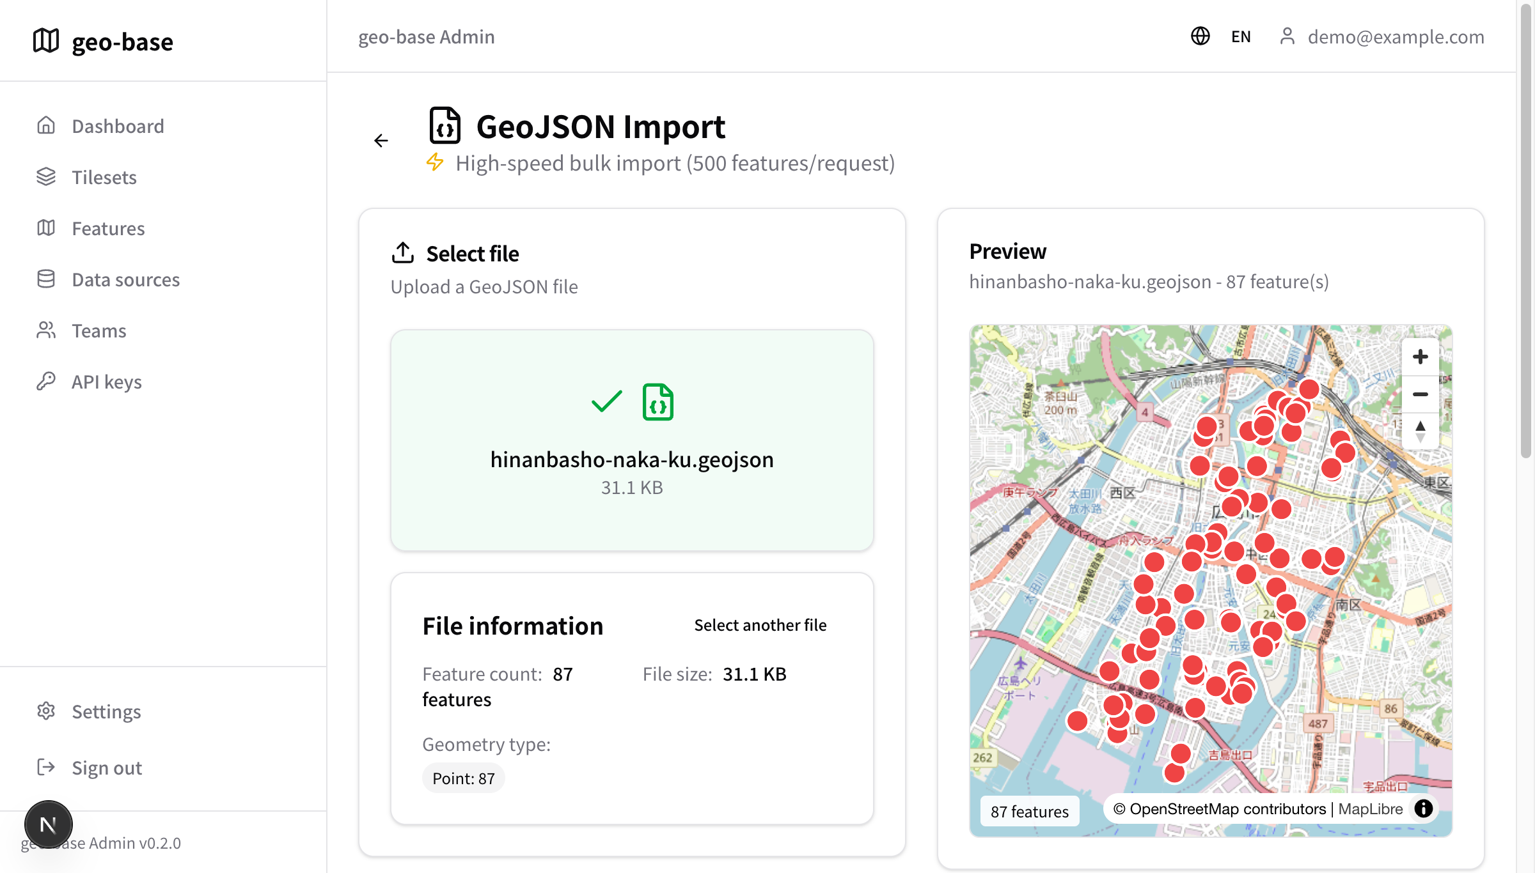
Host: Put the team's spatial data into the platform
Host
87 features
One GeoJSON dataset
Admin UI capture — File information after local GeoJSON import
7

Slide 8
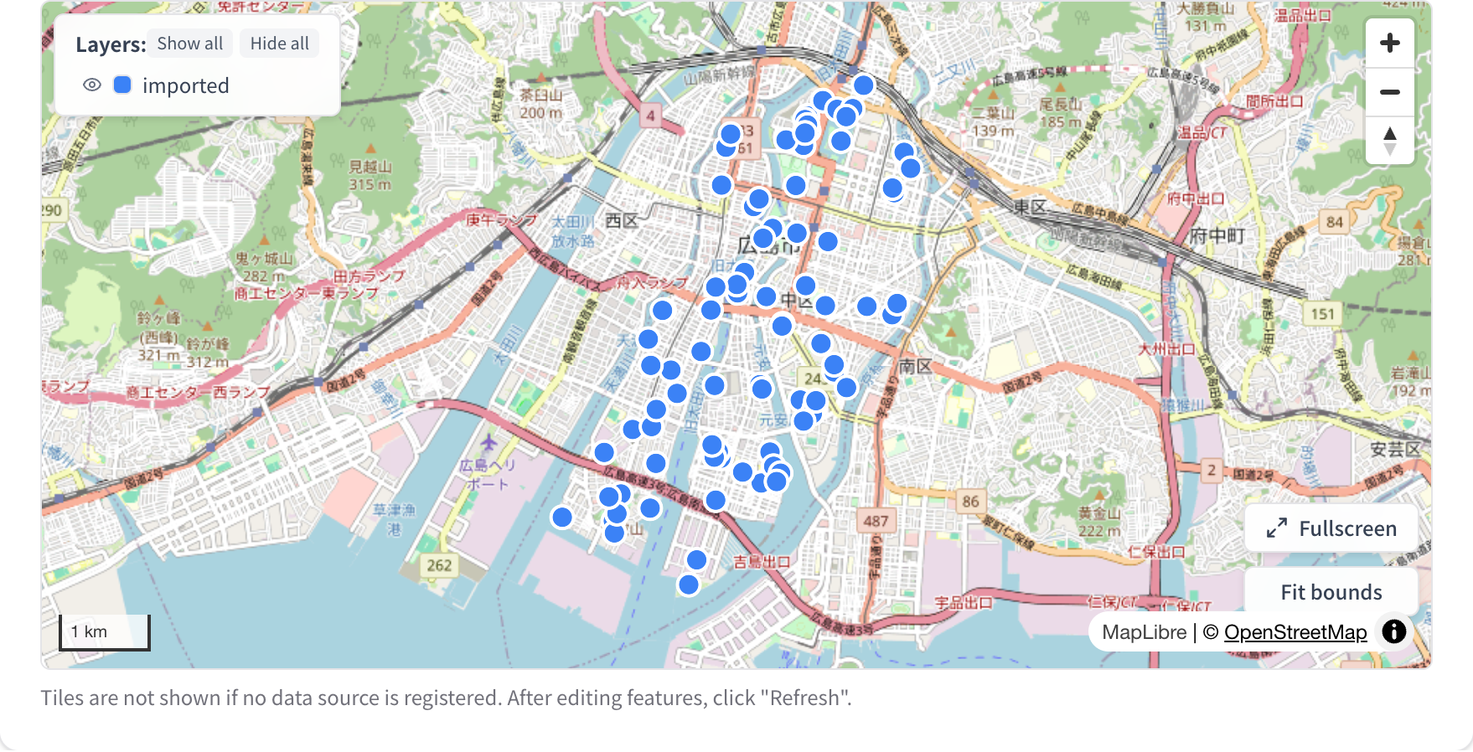
See: View the same data on a map
See
Same imported GeoJSON
Same source extent
Map preview capture — the same 87 points in the Naka-ku extent
8

Slide 9
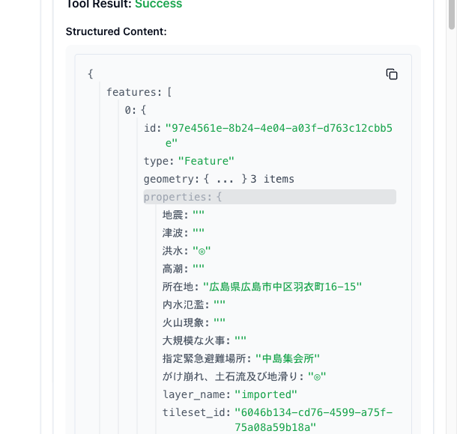
Ask: Query the same data through a natural-language interface
Ask
Original natural-language run — AI client selected MCP calls
Returned data — tested properties from the same dataset
Focused question → existing operation
Direct MCP Inspector capture — later verification, not the chat run
9

Slide 10
The demonstration connects a team's data to its next question
Own data
Shared view
Next question
Start from the team's file.
Look at the same spatial context.
Ask about the data through the client.
A possible small-team pattern — not a measured productivity result
10

Slide 11
One hosted dataset can support three small-team tasks
Keep the team's data
Host it as the starting point for the team's work.
See the same map
Give the team one shared spatial context.
Ask the next question
Use the shared data to begin a focused inquiry.
Interpretation from the demonstrated workflow — not a measured productivity result
11

Slide 12
What to confirm before using geo-base
Does this fit your team's work?
1 Data fit Format · size · structure
2 Workflow fit Host · See · Ask
3 Question fit Focused requests first
Start with the tested scope, then verify your own use case
12

Slide 13
Possible patterns for small teams
Inferred possibilities — not measured deployments
Municipal facility management
Possible use: keep facility data visible.
Field survey
Possible use: review collected points together.
Nonprofit or public-data work
Possible use: share a focused data view.
Each pattern may use Host · See · Ask.
13

Slide 14

One shared data layer. Three practical ways to use it.
Host · See · Ask
A focused, self-hostable open-source platform for small teams
One shared data layer → three practical entry points
Repository
github.com/mopinfish/geo-base
Thank you · Q&A
Contact
noboru.otsuka@geolonia.com
出典：国土地理院ウェブサイト（http://www.gsi.go.jp/bousaichiri/hinanbasho.html）
加工：「指定緊急避難場所データ」（国土地理院）（http://www.gsi.go.jp/bousaichiri/hinanbasho.html）を AIGID が加工して作成
上記データから広島市中区のフィーチャのみを抽出して使用。

