Slide 1
LinkedIn Connections
MAPPED WITH R David Russo

Slide 2


Scaping the Data LinkedIn Connections
LinkedIn Developer Network
API key and token
Needed Python
My data
Vivian’s data
David vs. Vivian

Slide 3
Raw Data
$values[[836]]$lastName
[1] "Zheng“
$values[[836]]$industry
[1] "Research“
$values[[836]]$siteStandardProfileRequest
url http://www.linkedin.com/profile/view?id=150644882&authType=name&authToken=P2V-&trk=api*a3206733*s3280453*
$values[[836]]$pictureUrl
[1] http://m.c.lnkd.licdn.com/mpr/mprx/0_54wi7e_HBgYcD3_dbMsy7ohXBVe9fFGdF0xy7IlZe0yFr_zWdOUf3wLnMNHHuhiLkRWj8u_ufzGz
$values[[836]]$location
$values[[836]]$location$country
code "us“
$values[[836]]$location$name
[1] "Providence, Rhode Island Area“
$values[[836]]$apiStandardProfileRequest
$values[[836]]$apiStandardProfileRequest$url
[1] http://api.linkedin.com/v1/people/OtrEe_mMbt
$values[[836]]$apiStandardProfileRequest$headers
$values[[836]]$apiStandardProfileRequest$headers$`_total`
[1] 1
$values[[836]]$apiStandardProfileRequest$headers$values
$values[[836]]$apiStandardProfileRequest$headers$values[[1]]
name value "x-li-auth-token" "name:P2V-“
$values[[836]]$id
[1] "OtrEe_mMbt"

Slide 4
Predefine the length of each data vector
Saves time of expanding vector
n <- 836
Name <- rep(“ ”, n)
Industry <- rep(“ ”, n)
Location <- rep(“ ”, n)
Coordinates <- rep(“ ”, n)

Slide 5
Errors filling the vectors with Data
# fix for the issue of people on private setting
if (V_raw$values[[i]][[1]] != "private"){
# fix for the issue of people who didn't enter an industry
if (is.null(V_raw$values[[i]]$industry) == FALSE){
# fix for the word "Greater" from the beginning of Location
if(substr(V_Location[i], start=1, stop=7) == "Greater")
V_Location[i] <- unlist(strsplit(sub(" ", ";", V_Location[i]), ";"))[2]

Slide 6
Convert the city into lon and lat coordinates
Coordinates <- geocode(Location)
Finally, the data frame
data <- data.frame(Name, Industry, Location, Coordinates)

Slide 7
Data frame format
D_Name D_Industry D_Location lon lat D_Quantity
1 Addona Financial Services New York City Area -74.11990 40.60455 1
2 Aditya Information Technology Boston Area -71.06064 42.35548 1
3 Alexander L.M.S.W. Higher Education New York City Area -74.11990 40.60455 1
4 Alomar Architecture & Planning New York City Area -74.11990 40.60455 1
5 Amon FSA Financial Services Hartford, Connecticut Area -72.70736 41.77221 1
6 Amos Apparel & Fashion New York City Area -74.11990 40.60455 1

Slide 8

Mapping

Slide 9
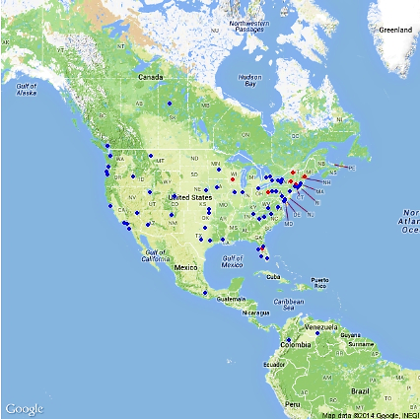
Google Maps
map <- ggmap(get_googlemap(center = 'usa', zoom=3, maptype='terrain'),
extent = 'device') +
geom_point(data = D_data,aes(x = lon,
y = lat), colour = 'red', alpha = 1.0) +
geom_point(data = V_data,aes(x = lon,
y = lat), colour = 'blue', alpha = 1.0) +
print(map)

Slide 10
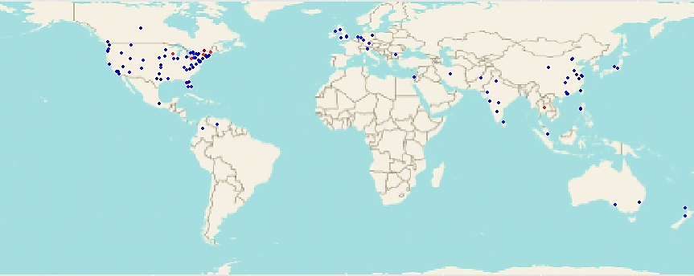
StreetMap
library(OpenStreetMap)
map <- openmap(c(70,-179),c(-70,179), zoom=1)
map <- openproj(map)
autoplot(map) + geom_point(data = D_data,aes(x = lon, y = lat), colour = 'red', alpha = 0.7) +
geom_point(data = V_data, aes(x = lon, y = lat), colour = 'blue',alpha = 0.7)

Slide 11
StreetMap
library(OpenStreetMap)
map <- openmap(c(70,-179), c(-70,179), zoom = 1, type = "mapquest-aerial")
map <- openproj(map)
autoplot(map) +
geom_point (data = D_data,aes (x = lon, y = lat), colour = 'white', alpha = 1.0) +
geom_point (data = V_data,aes (x = lon, y = lat), colour = 'yellow', alpha=1.0)

Slide 12
Quantity dataframe
D_data$D_Quantity <- rep(1, 195)
D_dataNew <- ddply(D_data, .(D_Location), summarise, D_Quantity = sum(D_Quantity))
D_dataNew$Coords <- geocode(as.character(D_dataNew$D_Location))
D_dataNew
D_Location D_Quantity Coords.lon Coords.lat
2 Albany, New York Area 1 -73.75808 42.64430
3 Austin, Texas Area 1 -97.82533 30.17477
4 Berlin Area, Germany 1 13.33875 52.50381
5 Boston Area 5 -71.06064 42.35548
6 Burlington, Vermont Area 6 -73.20997 44.47677
D_

Slide 13
StreetMap
autoplot (map) +
geom_point (data = D_dataNew,
aes (x = as.numeric (D_dataNew$Coords$lon),
y = as.numeric (D_dataNew$Coords$lat),
size = D_Quantity),
colour = 'white') +
scale_size_continuous(range = c(2, 10))

Slide 14
StreetMap
geom_point (data = V_dataNew,
aes (x = as.numeric (V_dataNew$Coords$lon), y = as.numeric (V_dataNew$Coords$lat),
size = V_Quantity), colour = 'yellow', alpha = 1.0) +
scale_size_continuous (range = c(2, 10))

