Slide 1

Medicare Fraud
Detection
with David Russo
NYC Data Science Academy
Machine Learning with R

Slide 2
2,000 people have been convicted of fraudulently billing Medicare for over $6 billion.
Cancer doctor convicted for billing medically unnecessary treatments. 1,200 patients from Medicare alone, payed $62M .
A storefront wheelchair retailer in Los Angeles has many customers in San Francisco, more than 350 miles away.
Scam artists dig up doctor and patient id #s to charge Medicare for... anything.
Personal: Primary care checkup, billed for additional codes: discussed something, tests, etc.

Slide 3
Provider Utilization and Payment Data
This Physician and Other Supplier PUF was prepared by the Centers for Medicare & Medicaid Services (CMS) in in an effort toward more transparent, affordable, and accountable healthcare.
http://www.cms.gov/Research-Statistics-Data-and-Systems/Statistics-Trends-and-Reports/Medicare-Provider-Charge-Data/Physician-and-Other-Supplier.html

Slide 4
Dataset
Downloaded: 9.2 million x 27
Each Observation: data regarding each service that each doctor has provided in 2012.
Cleaned, Preprocessed and Transformed: 880 K x 11
Each Observation: summary data for each doctor across all services provided in 2012.

Slide 5
Data Cleaning
Variable Reduction:
Remove provider address variables except for state (not relevant)
Remove provider name variables (provider id is easier identifier)
Remove ‘credentials’ variable (‘provider type’ is more relevant)
Remove ‘place of service’ variable (redundant with ‘entity code’)
Remove statistical variables for amounts allowed and amounts submitted (statistics on amounts paid are most relevant)
Missing or Unusual Entries
Delete the first observation (unusual npi and other data missing)
Delete 7 observations with (dot) as the ‘entity’ rather than I or O

Slide 6
Data Transformation
Current Dataset:
Each observation represents a unique combination of healthcare provider (npi) and a particular service (hcpcs) performed by that provider. All variables represent relevant information pertaining to that combination.
Therefore, the current data set gives us a summary of each service that each provider has performed in the year 2012.

Slide 7
Data Transformation
More useful to this study would be a data set that sums quantities for each provider across all services they provided in that year, rather than breaking it out by service.
Copy the data.frame to a data.table because only data.table can handle the sums and subsetting of such a large data.frame:
install.packages( "data.table" )
MPD_T <- data.table( MPD )
DOC_TOTALS <- MPD_T[ , list( num_services = sum( line_srvc_cnt ),
num_patients = sum( bene_unique_cnt ),
total_payment = sum( average_Medicare_payment_amt * line_srvc_cnt ),
serv_per_patient = sum( line_srvc_cnt ) / sum( bene_unique_cnt )
), by = "npi" ]

Slide 8
Data Transformation
Using dplyr package, join the non-numeric variables from the original dataset into the transformed data set by common npi:
DOC_TOTALS <- as.data.frame( DOC_TOTALS )
add <- cbind( MPD$nppes_provider_gender, MPD$nppes_entity_code,
MPD$nppes_provider_state, MPD$provider_type, MPD$npi )
add <- as.data.table( add )
names( add ) <- c( "gender", "entity", "state", "specialty", "npi" )
# reduce the add dataset to unique npi's by subsetting non-duplicates
add_reduce <- subset(add, !duplicated(add$npi))
DOC_TOTALS$npi <- as.character( DOC_TOTALS$npi )
library( dplyr )
DOC_INFO <- left_join( DOC_TOTALS, add_reduce, by="npi", copy=T )

Slide 9
Data Transformation
Create a binary dummy variable, 1 = possible fraud and 0 = no fraud, based on being over or under the .90 quantile of serv_per_patient in each specialty(serv_tail_per_spec)
DOC_INFO$fraud <- ifelse(DOC_INFO$serv_per_patient > DOC_INFO$serv_tail_per_spec, 1, 0)
DOC_INFO$fraud <- factor(DOC_INFO$fraud)
(tb1 <- table(DOC_INFO$fraud))
prop.table(tb1)
88K (10%) of the npi's are tagged as potentially fraudulant on the basis of being in the .90 quantile for services per patient within their specialty in the year 2012.

Slide 10
Variables on Transformed Dataset
Provider Identifier
Entity ( I or O – Individual, Organization )
Gender ( only when entity = I )
State
Specialty ( of provider’s largest # of services )
Total Number of Services Provided
Total Number of Distinct Patients
Average Number of Services per Patient
Total Amount Paid from Medicare
90th Quantile of 'Services per Patient' for each Specialty
Fraud Flag (1 or 0)

Slide 11
Descriptive Statistics
Looking for doctors who tack on extra codes per visit
Study each provider’s average services per patient statistic
Summary(DOC_TOTALS$serv_per_patient)
Min. 1st Qu. Median Mean 3rd Qu. Max.
0.769 1.082 1.472 2.981 2.277 3669.000

Slide 12
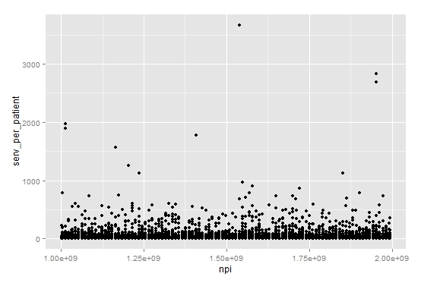
Plot each doctor's average number of services per patient
qplot( npi, serv_per_patient, data = DOC_TOTALS )
10 doctors > 1,000!

Slide 13
nrow(DOC_TOTALS[DOC_TOTALS$serv_per_patient > 5,]) / nrow(DOC_TOTALS)
* Only 12.5% of doctors are providing an avg of over 5 services/patient
nrow(DOC_TOTALS[DOC_TOTALS$serv_per_patient > 10,]) / nrow(DOC_TOTALS)
* Only 5% of doctors are providing an avg of over 10 services/patient
nrow(DOC_TOTALS[DOC_TOTALS$serv_per_patient > 20,]) / nrow(DOC_TOTALS)
* Only 1% of doctors are providing an avg of over 20 services/patient

Slide 14
Look closely at the highest one
DOC_TOTALS[ DOC_TOTALS$serv_per_patient > 3500, ]
npi=1538497235
MPD[ MPD$npi == "1538497235", ]
Supplier, Org, billed 51,372 times for only 14 patients for only 1 service (hemophilia drug/ treatment) - an average of 3,670 codes/patient/year.

Slide 15
Descriptive Statistics
Plot the 10 docs with over 1,000 services/patient
club_1000 <- DOC_INFO[ DOC_INFO$serv_per_patient > 1000, ]
qplot( npi, serv_per_patient, data = club_1000, color = specialty, shape = entity, size = 2,
main = "The 1,000 Services Per Patient Club" )

Slide 16
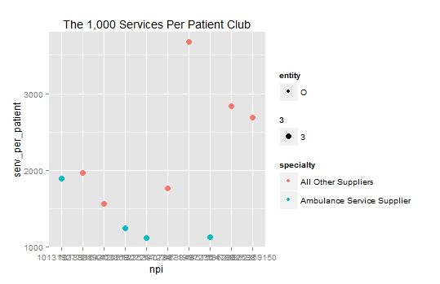
All are organizations (vs individual) and suppliers (vs doctor)

Slide 17
Descriptive Statistics
Plot the docs with over 200 services/patient
club_200 <- DOC_INFO[ DOC_INFO$serv_per_patient > 200, ]
qplot( npi, serv_per_patient, data = club_200, color = specialty, shape = entity, size = 2,
main = "The 200 Services Per Patient Club" )

Slide 18
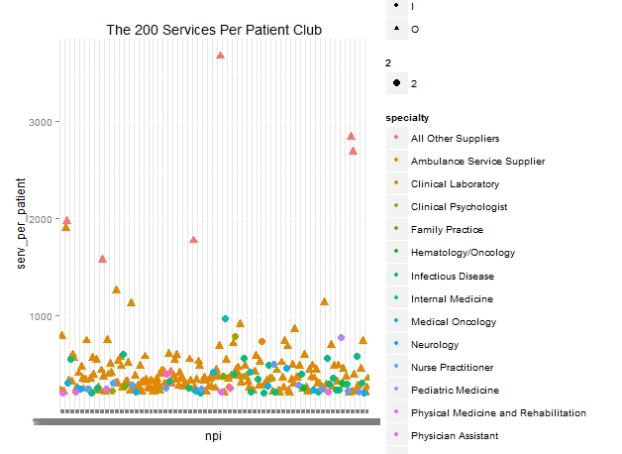
Organizations / Individuals, and 17% of all specialties

Slide 19
Descriptive Statistics
Plot the docs with over 100 services/patient
club_100 <- DOC_INFO[ DOC_INFO$serv_per_patient > 100, ]
qplot( npi, serv_per_patient, data = club_100, color = specialty, shape = entity, size = 2,
main = "The 100 Services Per Patient Club" )

Slide 20
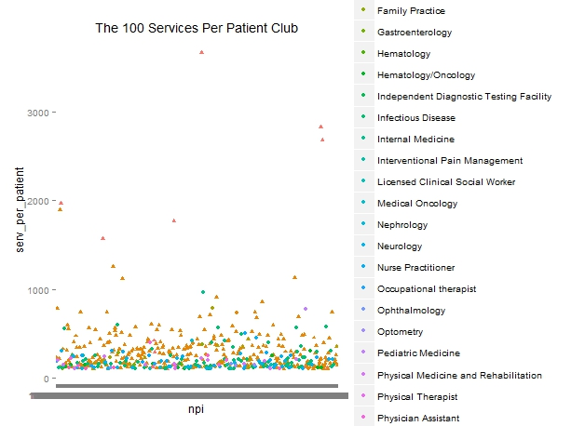
More specialties, but still only 35% represented

Slide 21
Descriptive Statistics
Create data frame showing the .90 quantile of serv_per_patient for each specialty
docMelt <- melt( DOC_INFO, id = "specialty", measure.vars = "serv_per_patient" )
upper.10 <- dcast( docMelt, specialty ~ variable, quantile, .90 )
Merge the quantile values into the DOC_INFO dataframe
DOC_INFO <- merge(DOC_INFO, upper.10, by="specialty")

Slide 22
Descriptive Statistics
Create a binary dummy variable “fraud”
Serv/patient/specialy > .90 quantile → investigate
Serv/patient/specialy < .90 quantile → do not
DOC_INFO$fraud <- ifelse( DOC_INFO$serv_per_patient > DOC_INFO$serv_tail_per_spec, 1, 0 )
prop.table( table( DOC_INFO$fraud ) )
88K (10%) of the npi's are tagged as fraudulent

Slide 23
Modeling
Decision Tree
Logistic Regression

Slide 24
Modeling
Separate into training and test sets
trainIndex <- createDataPartition(DOC_INFO$fraud, p = 0.6, list = FALSE, times = 1)
Train <- DOC_INFO[trainIndex, ]
Test <- DOC_INFO[-trainIndex, ]
Verify: 60% tagged as fraudulent are in the Train set
sum( as.numeric( Train$fraud ) ) / sum( as.numeric( DOC_INFO$fraud ) )

Slide 25
Decision Tree
Model 1
Use all variables except:
npi ( identifier )
serv_per_patient ( used to develop ‘fraud’ )
serv_tail_per_spec ( not doc specific )
treemodel_1 <- rpart( fraud ~ total_payment + specialty + num_services + num_patients +
gender + entity + state,
data = Train,
control = rpart.control( minbucket = 1 ) )

Slide 26
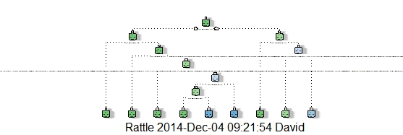
fancyRpartPlot( treemodel_1 )

Slide 27
treemodel_1
Significant
Variables
Same results
when using
only these 3
variables
#services and
#patients =
serv/patient =
fraud
root 528385 52841 0 (0.90, 0.10)
2) num_services< 6181.5 498178 42204 0 (0.92, 0.08)
4) num_services< 1745.05 399669 28171 0 (0.93, 0.07) *
5) num_services>=1745.05 98509 14033 0 (0.86, 0.14)
10) num_patients>=1061.5 70477 5451 0 (0.92, 0.08) *
11) num_patients< 1061.5 28032 8582 0 (0.69, 0.31)
22) specialty=Addiction Medicine,Allergy/Immunology,Ambulance Service Supplier, … (0.86, 0.14) *
23) specialty=All Other Suppliers,Ambulatory Surgical Center,Anesthesiology, … (0.41, 0.59)
46) num_patients>=790.5 6236 2424 0 (0.61, 0.39)
92) num_services< 2415.5 4181 654 0 (0.84, 0.16) *
93) num_services>=2415.5 2055 285 1 (0.14, 0.86) *
47) num_patients< 790.5 4087 449 1 (0.11, 0.89) *
3) num_services>=6181.5 30207 10637 0 (0.65, 0.35)
6) num_patients>=3302.5 16552 3167 0 (0.81, 0.19) *
7) num_patients< 3302.5 13655 6185 1 (0.45, 0.55)
14) specialty=Allergy/Immunology,Ambulance Service Supplier,Clinical Laboratory,… (0.72, 0.28)*
15) specialty=All Other Suppliers,Ambulatory Surgical Center,Anesthesiology,… (0.22 0.78) *

Slide 28
Prediction
newdoc1 <- data.frame( total_payment = 100000, specialty = 'Anesthesiology',
num_services = 150, num_patients = 50, gender = 'M',
entity = 'O', state = 'CA'
)
predict( treemodel_1, newdata = newdoc1 )
0 1
0.9295142 0.07048583
93% confidence in no-fraud

Slide 29
Decision Tree
Model 2
Only variables that do not go into developing "fraud“
Remove:
num_services
num_patients
treemodel_2 <- rpart( fraud ~ total_payment + gender + entity + state + specialty,
data = Train,
control = rpart.control( minbucket = 1 ) )

Slide 30
treemodel_2
n= 528385
root 528385 52841 0 (0.8999953 0.1000047) *
Only one node, branches end, no other variables significant

Slide 31
Prediction
newdoc2 <- data.frame( total_payment = 100000, gender = 'M', entity = 'O', state = 'CA',
specialty = 'Anesthesiology')
predict( treemodel_2, newdata = newdoc2 )
0 1
0.8999953 0.1000047
90% confidence

Slide 32
Decision Tree
Model 3
Same Model 2 variables
Decrease Complexity Parameter from .01 to .005
Admits less worthwhile splitting
treemodel_3 <- rpart( fraud ~ total_payment + gender + entity + state + specialty
data = Train,
control = rpart.control( cp = .005 ) )

Slide 33
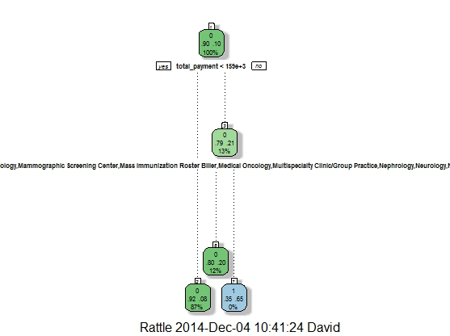
fancyRpartPlot( treemodel_3 )

Slide 34
treemodel_1
1) root 528385 52841 0 (0.89999527 0.10000473)
2) total_payment< 158519.1 462316 38800 0 (0.91607472 0.08392528) *
3) total_payment>=158519.1 66069 14041 0 (0.78747976 0.21252024)
6) specialty=Addiction Medicine,Allergy/Immunology,Ambulance Service, … 64220 12837 0 (0.80010900 0.19989100) *
7) specialty=All Other Suppliers,Anesthesiology,Audiologist, … 1849 645 1 (0.34883721 0.65116279) *

Slide 35
Prediction
predict( treemodel_3, newdata = newdoc2 )
0 1
0.9160747 0.08392528
92% confidence

Slide 36
Logistic Regression
Model 1
Use all variables except:
npi ( identifier )
serv_per_patient ( used to develop ‘fraud’ )
serv_tail_per_spec ( used to develop ‘fraud’ )
logmodel_1 <- glm( fraud ~ total_payment + gender + entity + state + specialty,
data = Train, family = 'binomial' )

Slide 37
Logistic Regression
summary( logmodel_1 )
many specialties showed significance, many did not
states did not show significance
Coefficients: (1 not defined because of singularities)
Estimate Std. Error z value Pr(>|z|)
(Intercept) -9.164e+00 8.444e+01 -0.109 0.913573
total_payment 8.122e-07 1.913e-08 42.460 < 2e-16 ***
genderF -1.367e+00 2.561e-01 -5.339 9.34e-08 ***
genderM -1.034e+00 2.560e-01 -4.041 5.33e-05 ***
… … … … …
… … … … …

Slide 38
Prediction
logmodel_1.pre <- predict( logmodel_1,type = 'response' )
pre_1 <- ifelse( logmodel.pre_1 > 0.5, 1, 0 )
table( pre_1, Train$fraud )
pre2 0 1
0 475,203 52,612
1 341 229
sum(diag(table1))/sum(table1)
90% overall success

Slide 39
Prediction
Run the Test dataset on logmodel_1
log_pred_test1 <- predict( logmodel_1, newdata = Test )
pre_1 <- ifelse( log_pred_test1 > 0.5, 1, 0 )
(table1 <- table( pre_1, Test$fraud ))
pre2 0 1
0 316,875 35,131
1 153 96
sum(diag(table1))/sum(table1)
90% overall success on Test too

Slide 40
Logistic Regression
Model 2
Variable Reduction
Use only:
total_payment
gender
logmodel_2 <- glm( fraud ~ total_payment + gender, data = Train, family = 'binomial' )

Slide 41
Logistic Regression
summary( logmodel_2 )
All significant
Estimate Std. Error z value Pr(>|z|)
(Intercept) -2.375e+00 1.931e-02 -122.974 <2e-16 ***
total_payment 6.322e-07 1.581e-08 39.997 <2e-16 ***
genderF -4.050e-02 2.094e-02 -1.934 0.0531 .
genderM 2.066e-01 1.981e-02 10.429 <2e-16 ***

Slide 42
Prediction
logmodel_2.pre <- predict( logmodel_2, type = 'response' )
pre_2 <- ifelse( logmodel_2.pre > 0.5, 1, 0 )
(table2 <- table( pre_2, Train$fraud ))
pre2 0 1
0 475,254 52,686
1 290 155
sum(diag(table1))/sum(table1)
90% overall success

Slide 43
Prediction
Run the Test dataset on logmodel_2
log_pred_test2 <- predict( logmodel_2, newdata = Test )
pre_2 <- ifelse( log_pred_test2 > 0.5, 1, 0 )
(table2 <- table( pre_2, Test$fraud ))
pre2 0 1
0 475,254 52,686
1 290 155
sum(diag(table2))/sum(table2)
90% overall success on Test too

Slide 44
Medicare Fraud
Detection
with David Russo
NYC Data Science Academy
Machine Learning with R

