Slide 1
Supervised Learning: Regression
IBM Machine Learning - Project Mohammed Qasim K.
October 2022

Slide 2
Main Objective
The main objective of this analysis was to predict the Temperature of the permanent magnet synchronous motor (PMSM) using the Linear Regression Method and different Regularization Regression techniques.
Both Train-Test-Split and Cross-Validation were used to used to understand how these methods can lead to different decisions in selecting the model.
The data set was split into Training set (60%), Validation set (20%), and Test set (20%) for Cross-Validation purpose.

Slide 3
About the Data
Variable name | Type | Description
u_q | float | Voltage q-component measurement in dq-coordinates (in V)
coolant | float | Coolant temperature (in °C)
stator_winding | float | Stator winding temperature (in °C) measured with thermocouples
u_d | float | Voltage d-component measurement in dq-coordinates
stator_tooth | float | Stator tooth temperature (in °C) measured with thermocouples
motor_speed | float | Motor speed (in rpm)
i_d | float | Current d-component measurement in dq-coordinates
stator_yoke | float | Stator yoke temperature (in °C) measured with thermocouples
i_q | float | Current q-component measurement in dq-coordinates
ambient | float | Ambient temperature (in °C)
torque | float | Motor torque (in Nm)
profile_id | int | Measurement session id. Each distinct measurement session can be identified through this integer id.
pm | float | Permanent magnet temperature (in °C) measured with thermocouples and transmitted wirelessly
The data set comprises of several sensor data collected from a permanent magnet synchronous motor (PMSM) deployed on a test bench. Test bench measurements were collected by the LEA department at Paderborn University.
This data set has 1330816 records and 13 variables. During the analysis, no duplicates were detected.
https://www.kaggle.com/datasets/wkirgsn/electric-motor-temperature

Slide 4
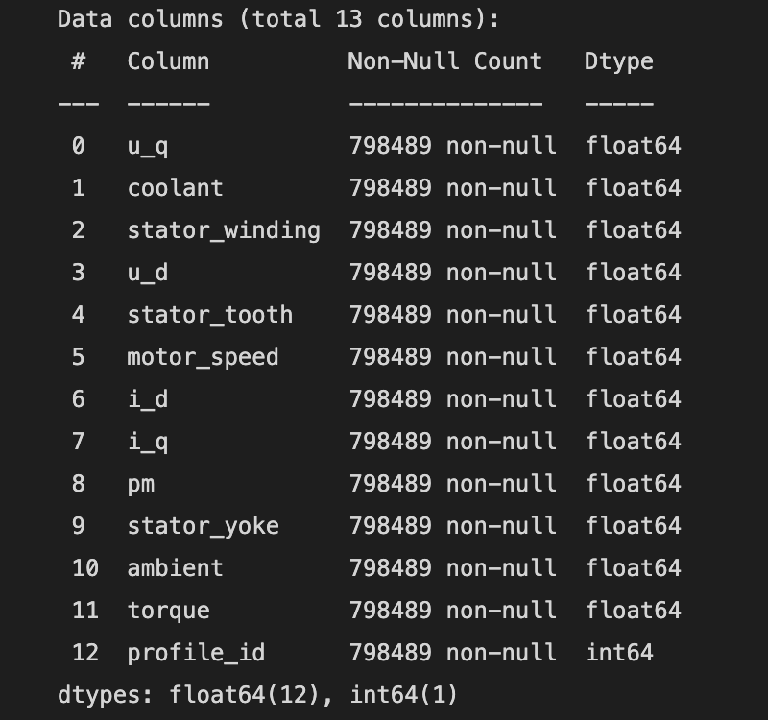
Data Exploration
After checking for duplicates, the EDA was conducted on the training set.
The data description is as follows:

Slide 5
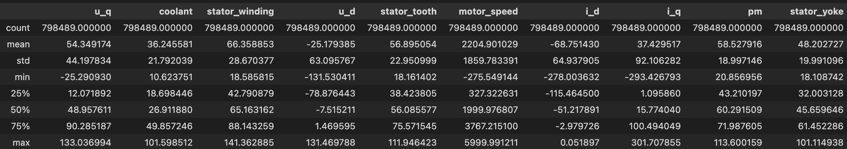
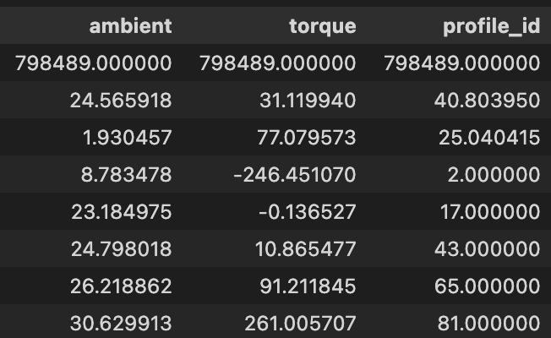
Data Exploration
Dropped profile_id column.

Slide 6
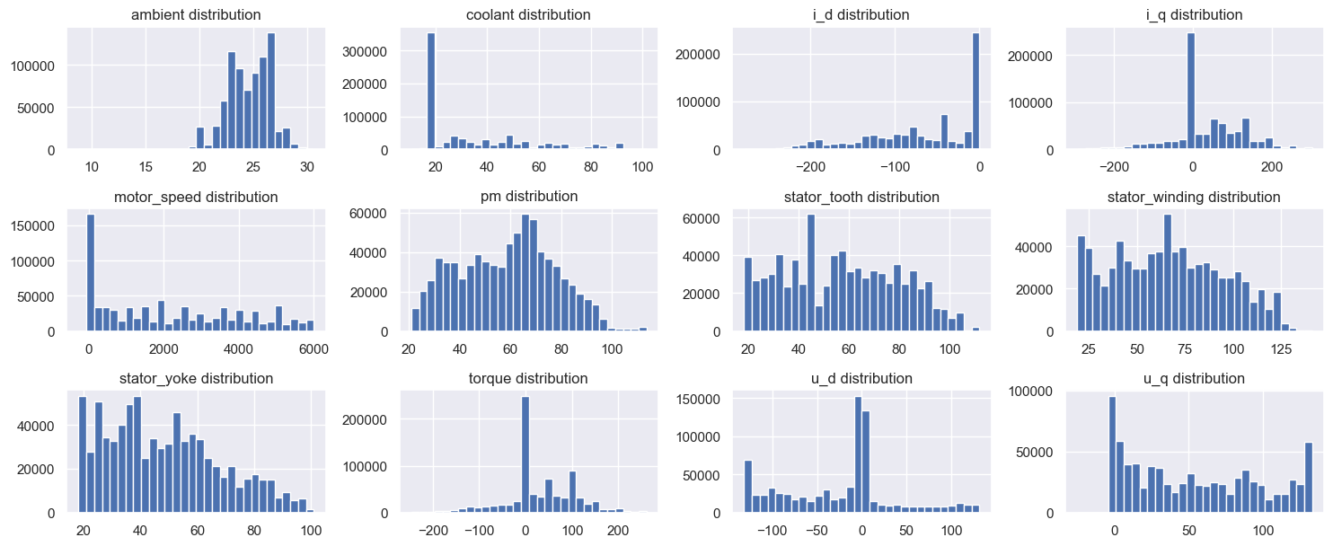

Slide 7
Data Exploration
Distributions of coolant and motor_speed were found to be right-skewed and the i_d distribution was found to be left-skewed.
Square Soot Transformation was used to eliminate the skewness in these cases.
The target variable (pm) was kept the unchanged.

Slide 8
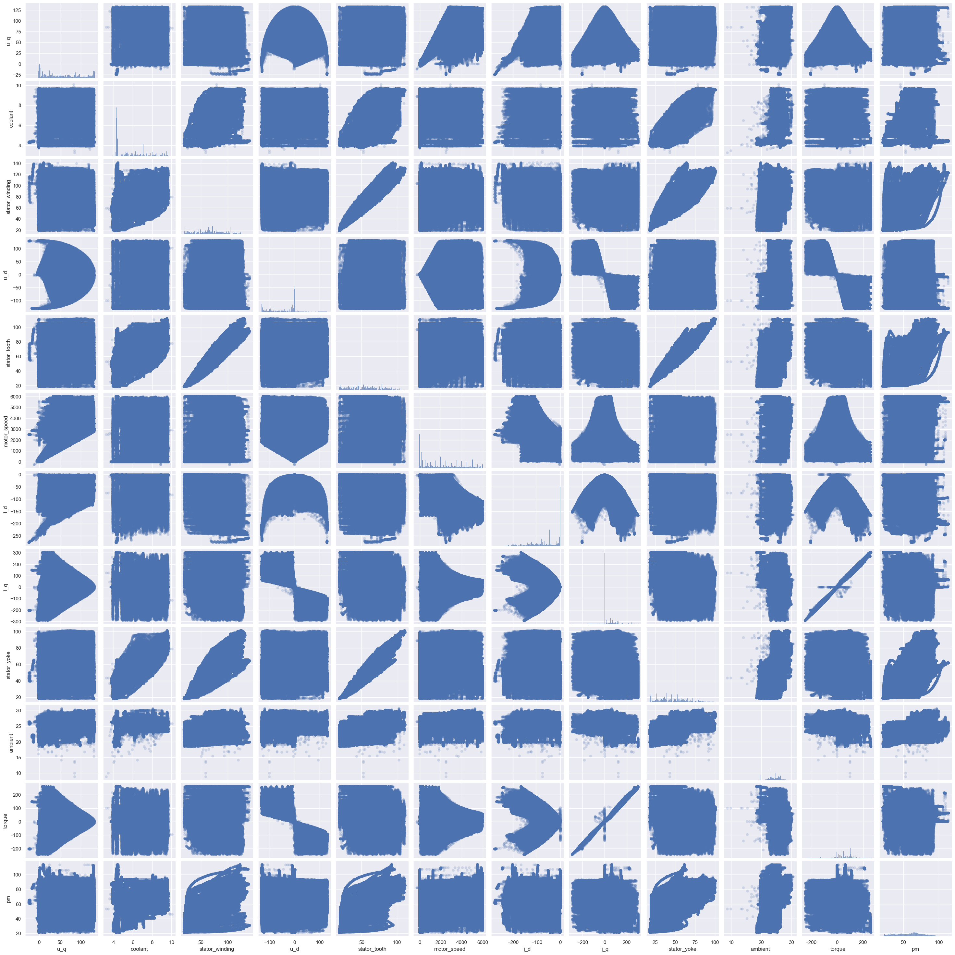
Data Exploration
After applying Square Root Rransformations of skewed features (only coolant skewness was above threshold value of 0.75)
The pair plot shows that:
torque has a linear relationship with i_q.

Slide 9
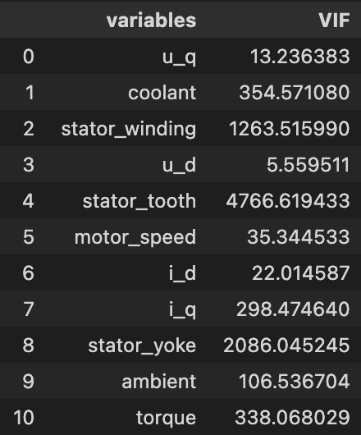
Data Exploration
Severe Multicollinearity was found to exist in the data set based on the Variation Inflation Factor(VIF) values.

Slide 10
Feature Engineering and Model Variations
Feature engineering was applied in order to create model variations. Each model was evaluated based on its Root Mean Square Error (RMSE).
Applied Square Root Transformation to features that have a skew value greater than 0.75 (coolant)
Scaled numerical features
Added polynomial features
All these feature engineering steps were performed on training and validation sets, using a K-fold cross-validation with k=5.

Slide 11
Feature Engineering and Model Variations
RMSEs of validation sets were slightly higher than training sets, which is expected but there were no signs of overﬁtting.
The transformations improves all models.
Scaling features is for regularization later. RMSEs of both training set and validation set will stay the same.

Slide 12
Feature Engineering and Model Variations
Polynomial Features were added to the latest model (Square Root Transformed and Scaled) and the model was fit again.
Only up to seconf polynomial degree transformation was possible due to system restrictions using such a large data set and is assumed to be provide the best result as a greater degree transformation would lead to a higher number of features and complexity risking overfitting.

Slide 13
Cross-Validation and Regularization
Using the same data pipeline: Square Root Transformation, Standard Scaling, and Polynomial Features Addition.
Cross-validation is used to ﬁt the linear regression model again, and then the hyperparameters are tuned to ﬁnd a proper combination of alpha and polynomial degree for regularization. Regularized models include Lasso, Ridge, and Elastic Net.
Each model was evaluated based on its average Root Mean Squared Error (from 5 folds).

Slide 14
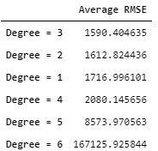
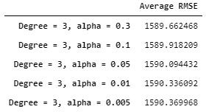
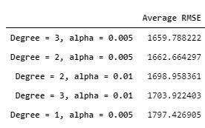
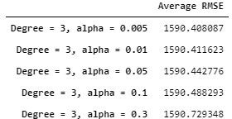
Linear
Lasso
Cross-Validation and Regularization
Iterations over different polynomial degrees (1, 2,) and alphas.
Results are sorted by RMSE in ascending order.
Ridge
Elastic Net

Slide 15
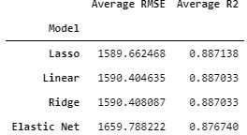
Cross-Validation and Regularization
The error metrics among Lasso, Ridge, and Linear regression were not signiﬁcantly different.
The best model found was Ridge Regression with polynomial degree of 3 and alpha equal to 0.005.
Elastic Net had the highest RMSE value.

Slide 16
Predictions on the Test Set
The four models were then fit on the unseen Test Set and the R2 score was calculated for each model.
Linear Regression with third degree polynomial features
Lasso Regression with third degree polynomial features and alpha = 0.3
Ridge Regression with third degree polynomial features and alpha = 0.005
Elastic Net Regression with third degree polynomial features and alpha = 0.005
Next page shows the scatter plots (true vs predicted pm) and the R2 scores.

Slide 17
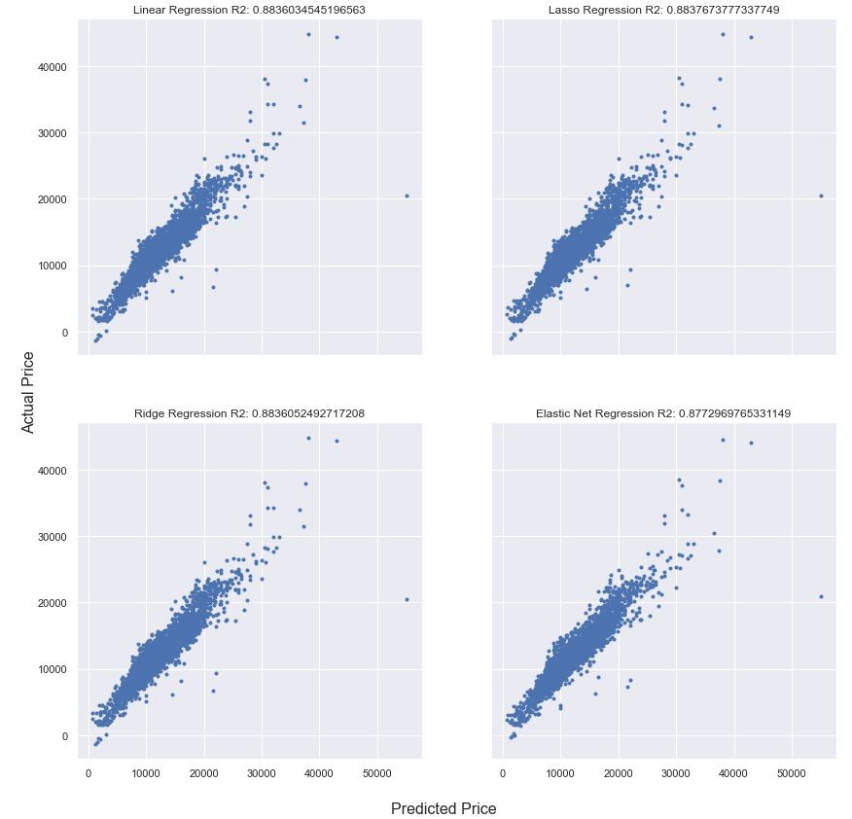
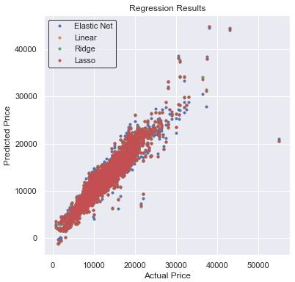

Slide 18
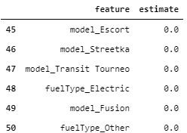
Predictions on the Test Set
The plots show that all the four models performed pretty well with no signs of overﬁtting. R2 scores among Lasso, Ridge, and Linear Regression were not signiﬁcantly different.
Lasso Regression was the best model (R2=0.8837), and it also shrunk some of the coefﬁcients.

Slide 19
Predictions on the Test Set
The next page shows a plot of feature importance of the Lasso Regression. Among the different features, xxx and xxx have the strongest predictive power. Most interaction terms and polynomial features have low estimates in comparison to others.

Slide 20
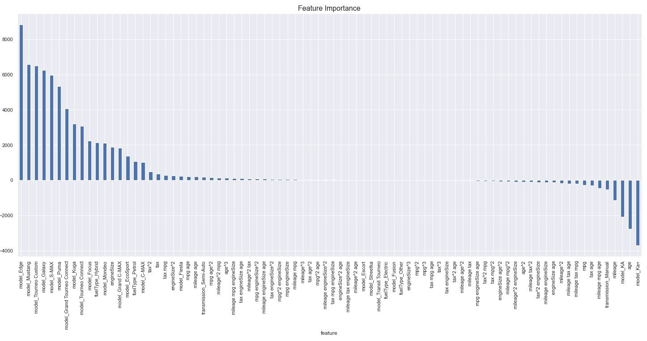

Slide 21
Conclusion
The analysis shows that Feature Engineering has a large effect on the model performance, and if the data is sufﬁciently large, Cross-Validation should be preferred over Train-Test-Split to perform the model evaluation. In this case, even though the predictors have high Multicollinearity, their coefﬁcients were not shrunk by the Lasso Model, and it was shown that Regularization does not drastically improve a given model. The Lasso Regression had the highest R2 value when predicting on the test set, and xxx appear to be the most important features to predict the motor temperature. Also, the Lasso model shrunk some of the features that do not contribute significantly to the prediction.
Jupyter Notebook can be found here:
https://github.com/thuynh323/IBM-Machine-Learning/blob/master/2-Supervised-Learning-Regression/Projec t-2.ipynb

