Slide 1
Supervised Learning: Classification
IBM Machine Learning - Project Mohammed Qasim K.
October 2022

Slide 2
Main Objective
The main objective of this analysis was to classify the fictional users in the data set as likely to spend money or not using Classification Methods
The data set was split into Training set (60%), Validation set (20%), and Test set (20%) using Train-Test-Split.

Slide 3
About the Data
Variable name | Type | Description
user_id | int | Unique identifier for a given user
ts | object | Time Stamp of the given behavior
behaviour_type | object | A particular behavior of the app (like, disklike, etc.)
consume | int | Amount of money that occurred for those records
target_user | int | Unique identifier of the receptor user_id
The data set comprises of fictional user behaviors on the Stranger social app platform.
This data set has 3000000 records and 5 variables. During the analysis, 7 duplicates were detected and removed.
https://www.kaggle.com/datasets/sexiaoze/stranger-social-app-user-behaviour-data?select=user_id.csv

Slide 4
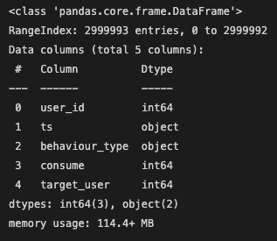
Data Exploration
After checking for duplicates, the EDA was conducted on the data set.
The data description is as follows:

Slide 5
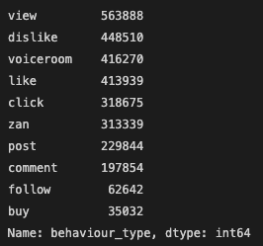
Data Exploration
behaviour_type | Description
dislike | the user doesn't want to match with the target user
like | the user feels ok to match the target user
zan | a like given by the user to any post
view | browse for recommended items, ads, posts, and any things you could imagine here with staying for at least a few seconds
post | put up a post
voiceroom | the user enters a voice chatting room
click | click a banner or an ad
buy | spend money on something
comment | comment a post
follow | follow a topic, a user, a group or something else
EDA was conducted on the behaviour_type column.
The data description is as follows:

Slide 6
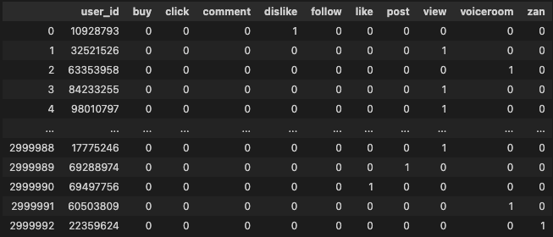
Data Exploration
One Hot Encoded the behaviour_type column and summed the column based on the user_id.
Dropped ts, target_user and consume columns.
Encoded the buy column into a Binary decision.
0 : Not Likely to perform In app purchases
1: Likely to perform In app purchases

Slide 7
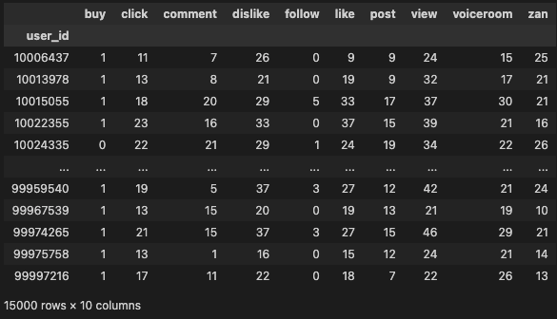
Data Exploration
The new data set upon which analysis will be conducted has 15000 unique records and 11 variables.
The target label is the buy column where:
0 : Not Likely to perform In app purchases
1: Likely to perform In app purchases

Slide 8
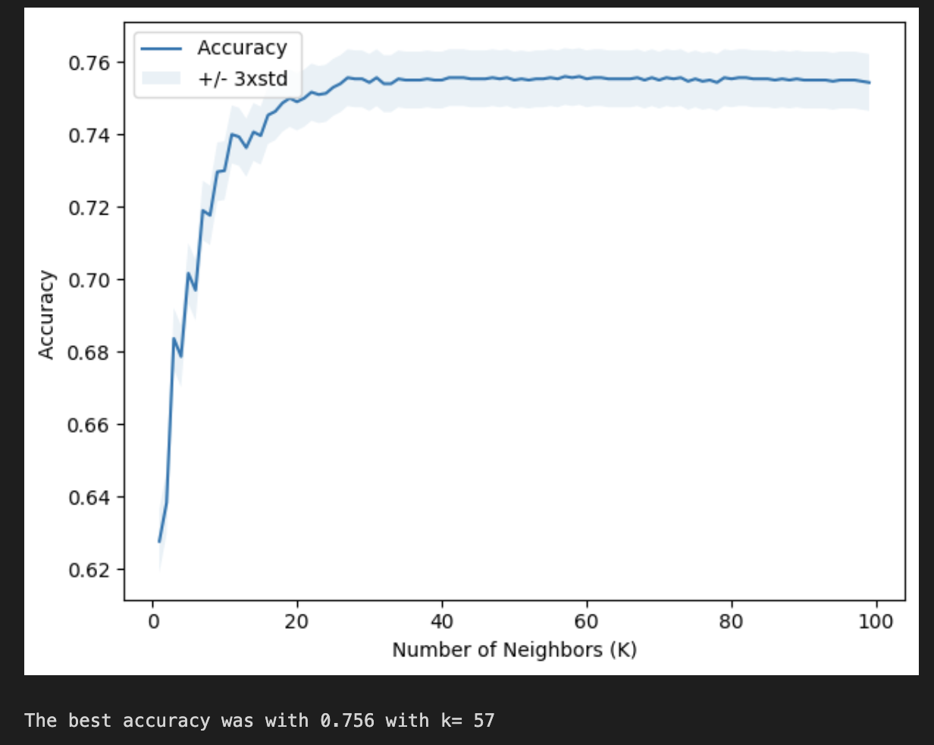
Model Variations
Implemented a K Nearest Neighbor algorithm, with a range of different K values (0 – 100) for finding the appropriate number of neighbors for clustering the dataset.

Slide 9
Predictions on the Validation Set
The four models were then fit on the unseen Validation Set and the appropriate evaluation metrics were calculated for each model.
K Nearest Neighbor with n_neighbors = 57
Decision Tree with an Entropy criterion
Support Vector Machine with a Sigmoid kernel
Logistic Regression with C = 0.01

Slide 10
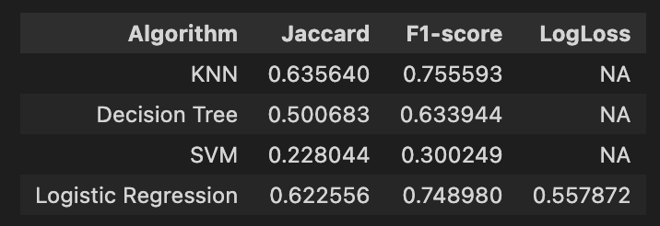
Comparing the Metrics
The metrics show that KNN and Logistic Regression performed decently with no signs of overﬁtting.
SVM performed the worst on the validation set and is probably not fit for the data set.
The best classification model is KNN (Jaccard score = 0.635640 & F1-score = 0.755593)

Slide 11
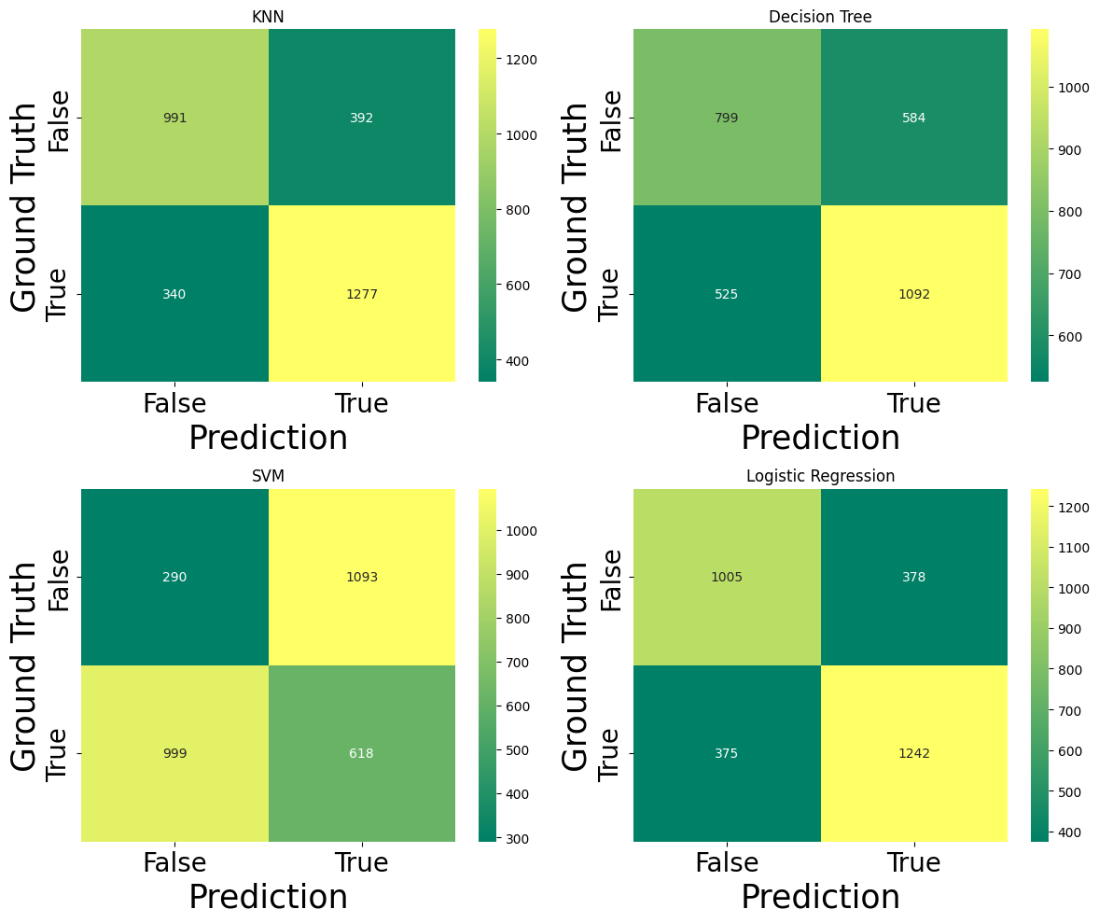
Comparing the Metrics
The confusion matrix shows that KNN and Logistic Regression performed decently with less False Positives & Negatives.
SVM performed the worst on the validation set.
The best classification model is KNN (True Positives= 0.79 & True Negatives = 0.72)

Slide 12
Predictions on the Test Set
The four models were then fit on the unseen test Set and the appropriate evaluation metrics were calculated for each model.
K Nearest Neighbor with n_neighbors = 57
Decision Tree with an Entropy criterion
Support Vector Machine with a Sigmoid kernel
Logistic Regression with C = 0.01

Slide 13
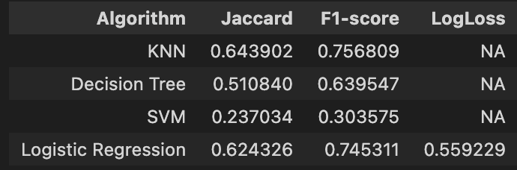
Comparing the Metrics
The metrics show that KNN and Logistic Regression performed decently with no signs of overﬁtting.
SVM performed the worst of the test set and is probably not fit for the data set.
The best classification model is KNN (Jaccard score = 0.643902 & F1-score = 0.756809)

Slide 14
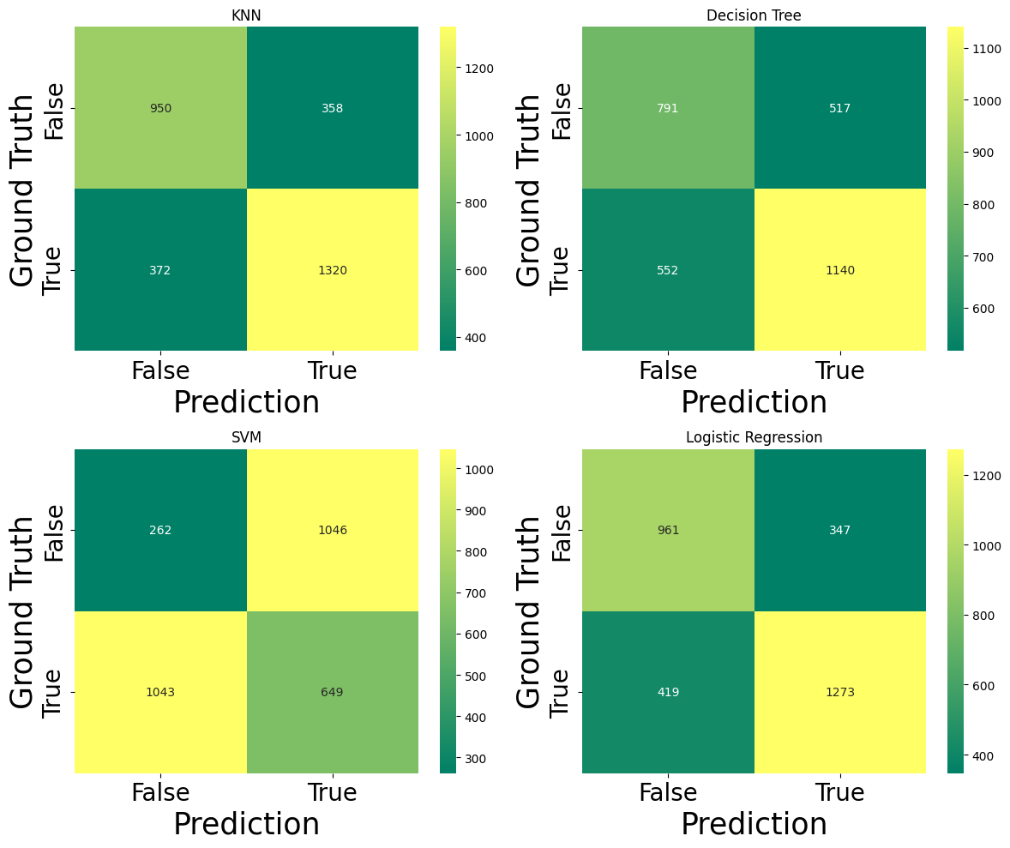
Comparing the Metrics
The confusion matrix shows that KNN and Logistic Regression performed decently with less False Positives & Negatives.
SVM performed the worst on the test set.
The best classification model is KNN (True Positives= 0.78 & True Negatives = 0.73)

Slide 15
Conclusion
The analysis shows that Feature Engineering has a large effect on the model performance, and if the data is sufﬁciently large, Cross-Validation should be preferred over Train-Test-Split to perform the model evaluation. In this case, even though the predictors have high Multicollinearity, their coefﬁcients were not shrunk by the Lasso Model, and it was shown that Regularization does not drastically improve a given model. The Ridge Regression had the highest R2 value when predicting on the test set.
Jupyter Notebook can be found here: https://github.com/moqa19/IBM-Machine-Learning/blob/main/ML%203.ipynb

