Slide 1

Seaweed:
Scalable Delay Aware Querying
Austin Donnelly, Richard Mortier,
Dushyanth Narayanan, Ant Rowstron
Microsoft Research, Cambridge

Slide 2

Motivation
Large, highly distributed data sets
  Data stored on endsystems
  Endsystems often unavailable
  Centralization, replication do not scale
  Must query data in-situ
  How can we deal with unavailability?
Notes:
Focussing in *this* talk on one-shot rather than continuous or streaming-type queries.

Slide 3
Delay aware querying
In-situ
  Push queries to endsystems
Incremental results
  As endsystems become available
Progress estimation
  Current and future completeness
Scalability
Fault-tolerance
Notes:
I’ll explain later in the talk how we measure completeness.

Slide 4
Applications
Admin, diagnostics, resource mgmt
  Select-Project-Aggregate queries
  Small results
  Low to moderate query rates
Different network scales
  Data center (10,000+)
  Enterprise (100,000+)
  Internet (1,000,000+)

Slide 5
Enterprise network management
Endsystem-based monitoring
  Endsystems log their own traffic
  Flow and PacketHeader tables
Queries by admins/operators
  SELECT SUM(Bytes) FROM Flow WHERE SrcPort=80
  Flow is horizontally partitioned
300,000 hosts, 1 month
  765 TB total size
  2.4 Gbps update rate
Notes:
Specific driving application is Anemone. Anemone collects network data for admins to query. Fits Seaweed model very well.
The admin addresses Flow as a single logical table, even though it is actually spread over all the endsystems.
Based on our estimates, if you had 300,000 hosts (which is about the size of Microsoft’s corporate network), and wanted to keep all data for 1 month, then your total data would be 765 TB, and you would need 2.4 Gbps on average to keep it updated at a central location), and even more if you did P2P replication.

Slide 6
Roadmap
Motivation
Design
  Overview
  Delay awareness
  Distributed query protocols
Evaluation
Conclusion

Slide 7
Seaweed overview
In-situ querying
  One-shot queries
Incremental results
Progress estimation
  Meta-data replication
Exactly-once semantics
Scalable, failure-resilient protocols
  Built on P2P overlay
Notes:
Replicating small amount of meta-data so that this meta-data is highly available even if the data is not. I’ll be talking a lot more about meta-data replication shortly.
When an endsystem becomes available, it will respond to any live queries. And it will contribute its result exactly once, no double-counting. We ensure this by persisting a small amount of query state in the network, and I’ll tell you how we do this efficiently and fault-tolerantly.
Part of this is because we build on top of an efficient, failure-resilient substrate: Pastry which is a structured P2P overlay.

Slide 8
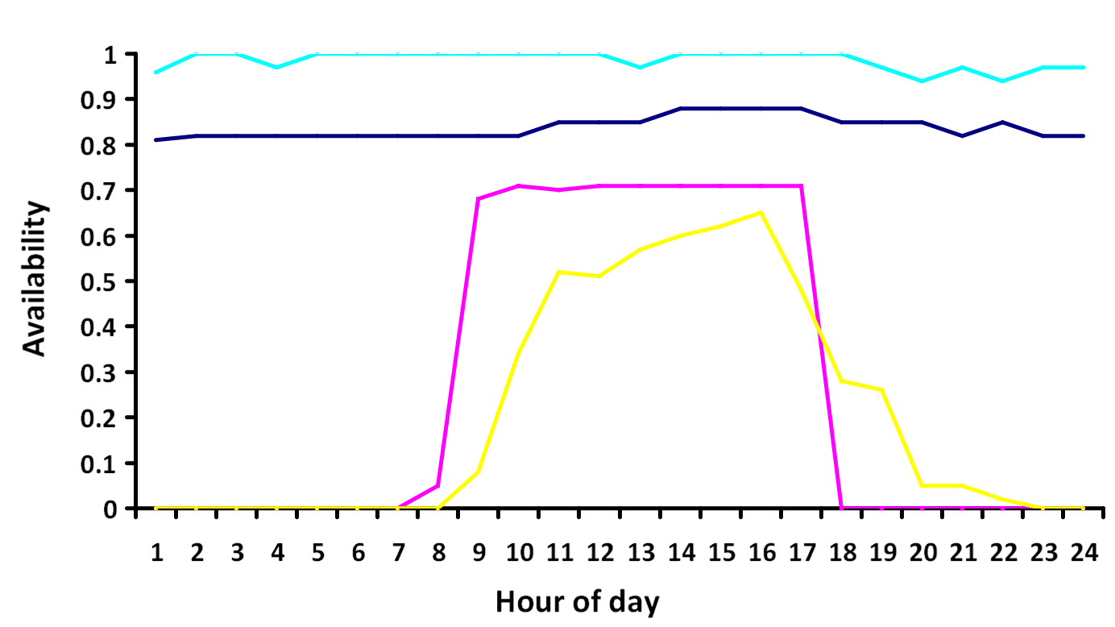
Why delay awareness?
Endsystem unavailability
Notes:
Hopefully the numbers I showed you previously convinced you that data has to be queried in-situ. But is this really a problem for data availability? Here’s an illustration that shows the problem. Four sample machines.
Even in an enterprise network, mean availability is about 80% of machines, and at certain times of day it could be a lot lower.
With time zones, could have multiple periods for different machines.

Slide 9
What is delay awareness?
User receives partial results
Needs progress indicator
  How much data is out there?
  How much have I seen?
  How long before I get to 99%?
Delay/completeness tradeoff
  Predicted by Seaweed
Notes:
Quick recap.

Slide 10
Completeness
% of relevant data rows seen so far
  Relevant → matches query predicates
  Query-specific
Completeness predictor:
  Currently available rows
  Total rows
  Expected rows/time
Notes:
Key to this is the notion of completeness.
The way we measure completeness is as the % of relevant data rows seen so far, to the total number of relevant rows that are out there. Relevant -> matches query predicates. (result could be aggregate).
So it is query-specific, we compute it when the query is issued

Slide 11
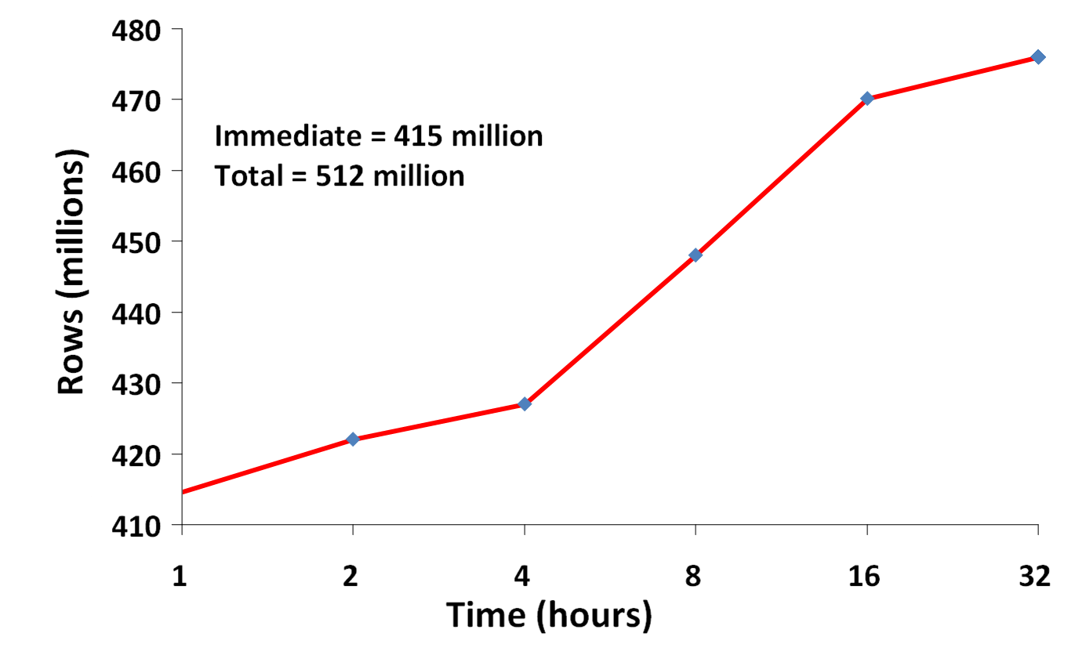
Completeness predictor
Notes:
Note that the time is on a log scale. This is intentional. We use log-buckets to deal with a wide range of times, in theory it could be seconds to days.

Slide 12
Completeness prediction
Relevant rows
  Column histograms
    Standard row-count estimation
    Replication → remote estimation
Uptime
  Availability models
Replicated meta-data
  Highly available
  Orders of magnitude smaller than data
Notes:
Availability models → someone else can figure out when I will next come up, if I am down.
Data summaries → are a set of histograms, from which we can compute the relevant rows for a query using standard row count estimation.
Once someone can compute when I will be up and how many rows I have, they can generate a completeness predictor for me.

Slide 13
Predictor generation
Meta-data replicated periodically
Query sent to all endsystems
  Application-level multicast tree
  Retransmit on failure
  Aggregate predictors in-tree
Exactly-once semantics
  Available → local histogram, time=0
  Unavailable → replica histogram, avail.

Slide 14
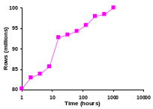

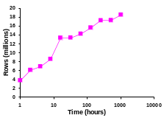
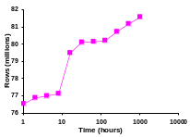

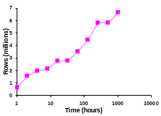
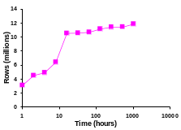



Predictor generation
A+B+C+D
A+B
C+D
A+B
C
D
A
B
C
D
A
B
C
D
B:
Notes:
Four machines A, B, C, D.
B periodically replicates histograms and availability models, in this case to A.
At some later point, say B becomes unavailable, and the user issues a query. The query goes down a multicast tree from the root, and reaches all available endsystems. Each available endsystem will respond with its own completeness predictor, in addition for unavailable endsystems like B, exactly one of its buddies (in this case A) will also generate a completeness predictor for it.
These predictors go back up the tree, and they are aggregated at each step, giving the overall completeness predictor at the root.

Slide 15
Query execution
Persistent query state
  New endsystems get active query list
Incremental convergecast of results
  Deterministic child → parent mapping
  Each vertex is replicated set
  Parent remembers child result versions
Exactly-once semantics
In-network aggregation

Slide 16
Roadmap
Motivation
Design
Evaluation
Conclusion

Slide 17
Evaluation
Packet-level simulation
Farsite availability traces
  51663 hosts, ~4 weeks
Flow tables from packet traces
  456 hosts, ~4 weeks
  Assigned randomly to simulation hosts
Two queries
  SELECT SUM(Bytes) FROM Flow WHERE SrcPort=80
  SELECT COUNT(*) FROM Flow WHERE Bytes > 20000
Notes:
Availability 50000 hosts in the MS Corpnet for 4 weeks
We also have the flow data (we’re just using the flow data in our experiments here) from 456 hosts at the Cambridge lab, also for about 4 weeks, for a different period.
Since the availability and flow are not correlated, we randomly pair up flow tables with availability profiles.
We evaluated two queries, only one of which I will talk about (other one is in the paper).
And we inserted the query at different times of day, since these availability effects are very strongly dependent on time of day.

Slide 18
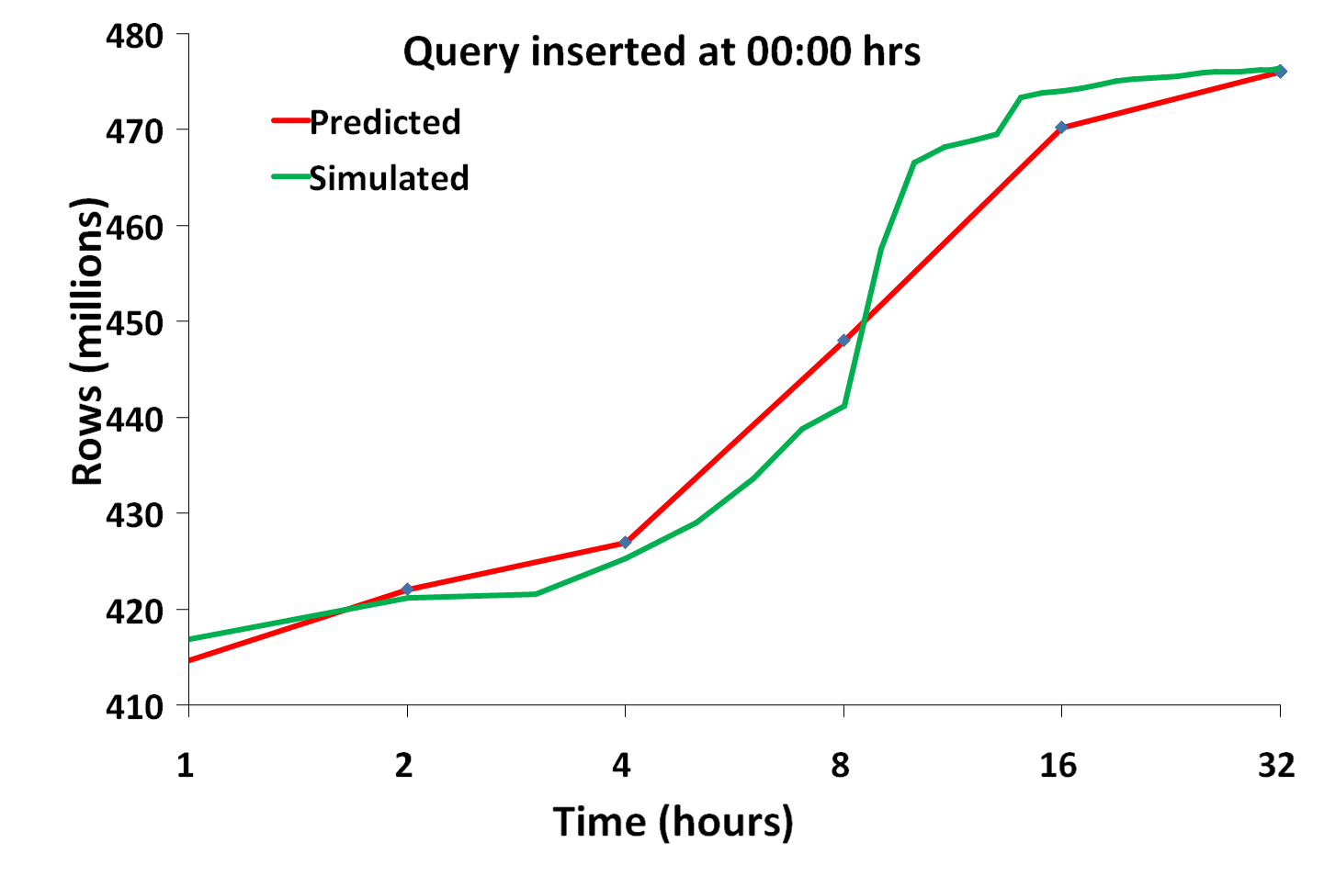
Predictor accuracy

Slide 19
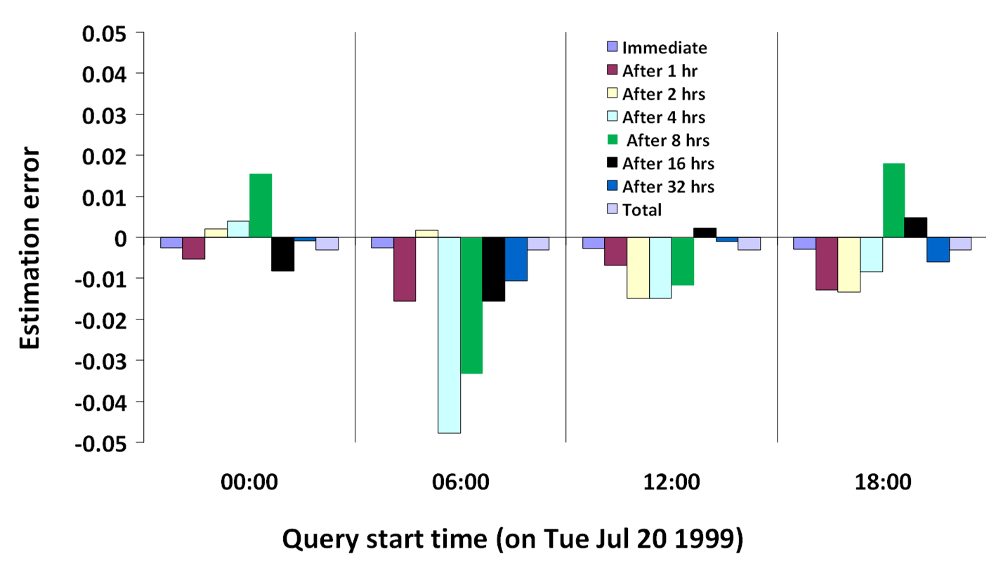
Prediction accuracy (2)
Notes:
For the query injected at diff points of day, and also for different periods into the future, i.e. what was the error of our projection 1 hour out, 2 hours out, etc.
The takeaway here is that in all cases the error was under 5%, except this one bar here which was just over 6%. So still pretty good.

Slide 20
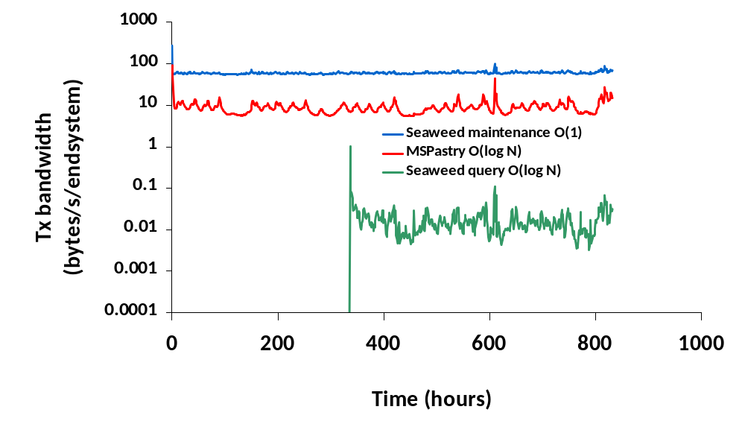
Overheads

Slide 21
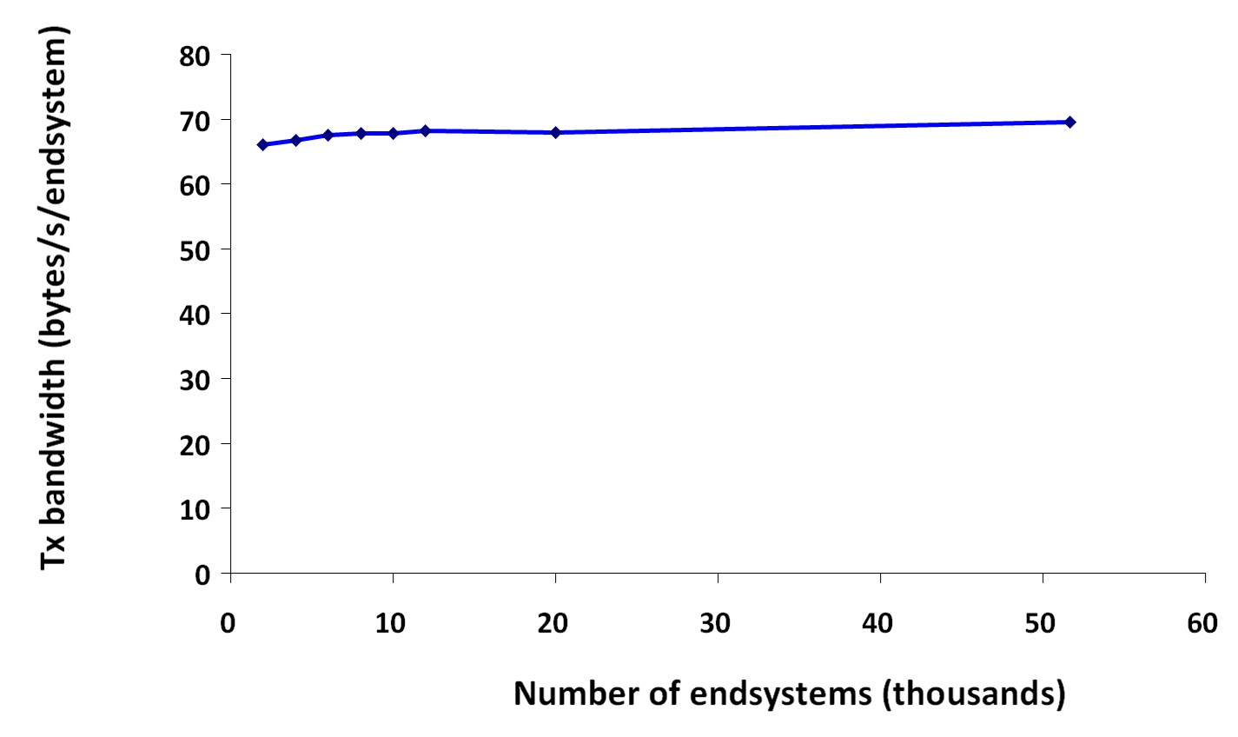
Scalability
Notes:
Y axis is the total bandwidth per endsystem in bytes/s, same as previous but on a linear scale. The x axis is the number of endsystems in our simulation.
Theoretically we expect a logarithmic increase, but even that is in the smaller overheads, so we don’t see that.

Slide 22
Roadmap
Motivation
Design
Evaluation
Conclusion

Slide 23
Related work
P2P querying
  PIER, Mercury, …
  Move data across network
Continuous/streaming queries
  Astrolabe, SDIMS, Borealis, …
  Ignore availability

Slide 24
Future work
Selective centralization
  “Distributed materialized views”
  Need bandwidth/availability estimation
    Large views can melt network
Beyond histograms
  Wavelets → approximate results?
Real-life experience, measurements
  Deployment within Microsoft

Slide 25
Conclusion
Querying highly distributed data
  Challenges are unavailability, scale
Delay awareness
  Predict delay/availability tradeoff
  Exactly-once semantics
Seaweed:
scalable delay aware querying
    Meta-data replication
    Fault-tolerant protocols

Slide 26
Questions?

Slide 27
Consistency (membership)
“Exactly-once” semantics
  No double-counting
  Every endsystem’s results counted
    If available at any point in query lifetime
  “Precise single-site validity”
Estimate always generated
  For all endsystems, available or not
  Endsystem computes own estimate
    If available through estimation phase

Slide 28
Consistency (time)
Avoid tight synchronization
Clock-skewed snapshots
  Loosely synchronized clocks
  With good NTP, milliseconds
Currently left to application layer
  Timestamped, append-only tuples
  Explicit predicates on timestamp

Slide 29
Result aggregation
R₁+R₂+R₃’
R₁+R₂+R₃
R₁+R₂,R₃’
R₁+R₂,R₃
R₁+R₂,R₃’
R₁+R₂,R₃
R₁+R₂
R₃’
R₃
R₁,R₂
R₁,R₂
Deterministic mapping to parent
Each parent is replicated set
Parents remember child results
R₁
R₂
Notes:
Two endsystems send results up to parent. First thing parent does is to replicate the results to two buddies. So we’ve replaced the single parent node by a replicated set, which means the probability of losing the state due to failure is very small. All three would have to fail within a short interval of time.
Sends it further up the tree after doing any aggregation.
Now, suppose the query is still live and at some later point in time we get some new endsystems appearing under that right-hand side and submitting their result. So now we have an update result R3, and we do exactly the same thing again, but now just for that one path up the tree.
Combination of these three gives us exactly-once semantics.

Slide 30
Query dissemination in Pastry
FFF
000
hash(query)
E9A
DA0
???
E??
0FA
836
8??
3??
37B

Slide 31
Replication in Pastry
Topology-independent
node identifiers
FFF
000
910
90E
8F6
8F0
8E2
Each node maintains
a virtual neighbor set (vset)

Slide 32
Result routing in Pastry
036
0F6
0FA = hash(query)
836

