Slide 1
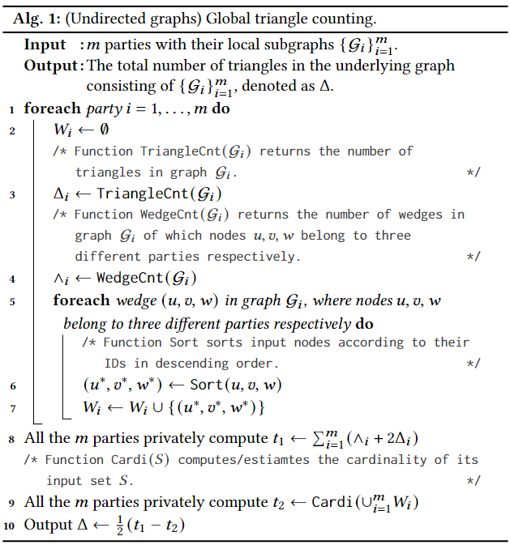

移动
7
8
联通
电信
4
5
6
1
2
3
假设我们的图$G$长这样

Slide 2

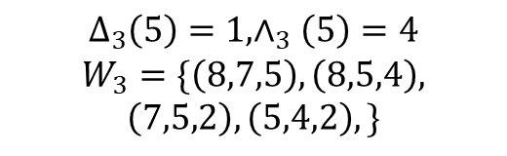

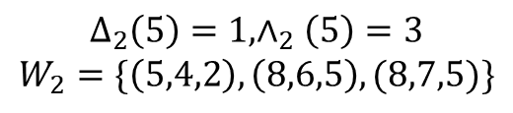
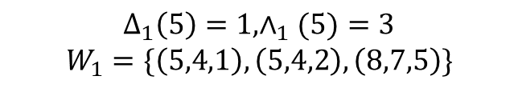

7
8
$$Δ_{1}\left(5\right)=1,∧_{1}(5)=3$$
$$W_{1}=\{\left(5,4,1\right),\left(5,4,2\right),\left(8,7,5\right)\}$$
7
8
4
5
4
4
5
6
1
2
3
移动$G_{1}$
1
2
3
7
8
4
5
6
$$Δ_{2}\left(5\right)=1,∧_{2}\left(5\right)=3$$
$$W_{2}=\{\left(5,4,2\right), \left(8,6,5\right),(8,7,5)\}$$
1
2
3
联通$G_{2}$
7
8
4
5
6
$$Δ_{3}\left(5\right)=1,∧_{3}\left(5\right)=4$$
$$W_{3}=\{\left(8,7,5\right),\left(8,5,4\right),$$
$$\left(7,5,2\right),\left(5,4,2\right),\}$$
2
3
电信$G_{3}$

Slide 3
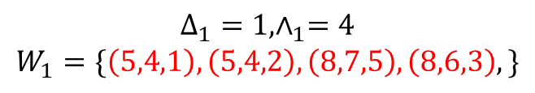
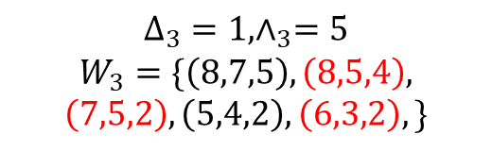
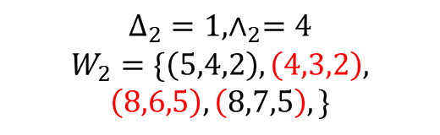
7
8
$$Δ_{1}=1,∧_{1}=4$$
$$W_{1}=\{\left(5,4,1\right),\left(5,4,2\right),\left(8,7,5\right),\left(8,6,3\right),\}$$
4
5
6
1
2
3
移动$G_{1}$
7
8
4
5
6
$$Δ_{2}=1,∧_{2}=4$$
$$W_{2}=\{\left(5,4,2\right), \left(4,3,2\right),$$
$$\left(8,6,5\right),\left(8,7,5\right),\}$$
1
2
3
联通$G_{2}$
7
8
7
8
4
5
6
$$Δ_{3}=1,∧_{3}=5$$
$$W_{3}=\{\left(8,7,5\right),\left(8,5,4\right),$$
$$\left(7,5,2\right),\left(5,4,2\right),\left(6,3,2\right),\}$$
4
5
6
2
3
1
2
3
电信$G_{3}$

Slide 4
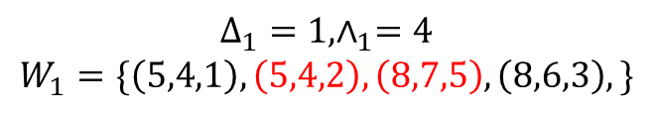
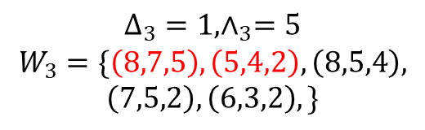
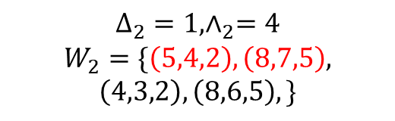
7
8
$$Δ_{1}=1,∧_{1}=4$$
$$W_{1}=\{\left(5,4,1\right),\left(5,4,2\right),\left(8,7,5\right),\left(8,6,3\right),\}$$
4
5
6
1
2
3
移动$G_{1}$
7
8
4
5
6
$$Δ_{2}=1,∧_{2}=4$$
$$W_{2}=\{\left(5,4,2\right),\left(8,7,5\right),$$
$$\left(4,3,2\right),\left(8,6,5\right),\}$$
1
2
3
联通$G_{2}$
7
8
7
8
4
5
6
$$Δ_{3}=1,∧_{3}=5$$
$$W_{3}=\{\left(8,7,5\right),\left(5,4,2\right),\left(8,5,4\right),$$
$$\left(7,5,2\right),\left(6,3,2\right),\}$$
4
5
6
2
3
1
2
3
电信$G_{3}$

Slide 5
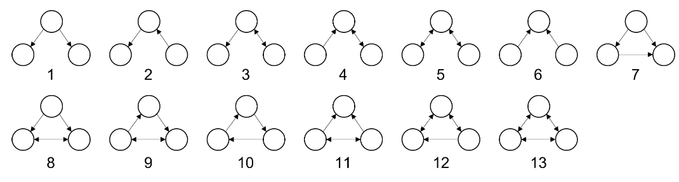


7
8
4
5
6
1
2
3
7
8
7
8
7
8
4
5
6
4
5
6
4
5
6
1
2
3
1
2
3
2
3
$$W_{1}=\{\left(5,4,1\right),\left(5,4,2\right),\left(8,7,5\right),\left(8,6,3\right),\}$$
$$W_{2}=\{\left(5,4,2\right),\left(8,7,5\right),\left(4,3,2\right),\left(8,6,5\right),\}$$
$$W_{3}=\{\left(8,7,5\right),\left(5,4,2\right),\left(8,5,4\right),\left(7,5,2\right),\left(6,3,2\right),\}$$
0 | 1 | 2 | 0 | 1 | 0
0 | 1 | 0 | 2 | 0 | 1
0 | 1 | 2 | 1 | 1 | 0
1 | 2 | 3 | 4 | 5 | 6 | 7 | 8 | 9 | 10 | 11 | 12 | 13
1 | 2 | 3 | 4 | 5 | 6 | 7 | 8 | 9 | 10 | 11 | 12 | 13
1 | 2 | 3 | 4 | 5 | 6 | 7 | 8 | 9 | 10 | 11 | 12 | 13
0 | 1 | 2 | 0 | 1 | 0 | 1 | 0 | 3 | 1 | 2 | 3 | 1
0 | 1 | 0 | 2 | 0 | 1 | 2 | 2 | 3 | 1 | 1 | 2 | 0
0 | 1 | 2 | 1 | 1 | 0 | 1 | 1 | 4 | 1 | 2 | 4 | 1
1 | 2 | 3 | 4 | 5 | 6 | 7 | 8 | 9 | 10 | 11 | 12 | 13
1 | 2 | 3 | 4 | 5 | 6 | 7 | 8 | 9 | 10 | 11 | 12 | 13
0 | 3 | 4 | 3 | 2 | 1 | 4 | 3 | 9 | 3 | 5 | 9 | 2
0 | 3 | 4 | 3 | 2 | 1 | 1 | 0 | 2 | 1 | 1 | 2 | 0

Slide 6




7
8
$$S_{7}=\{\left(5,4,1\right),\left(5,4,2\right),\left(8,7,5\right),\left(8,6,3\right),\}$$
$$S_{8}=\{\left(5,4,1\right),\left(5,4,2\right),\left(8,7,5\right),\left(8,6,3\right),\}$$
4
5
6
$$S_{10}=\{\left(5,4,1\right),\left(5,4,2\right),\left(8,7,5\right),\left(8,6,3\right),\}$$
1
2
3
7
8
$$W_{2}=\{\left(5,4,2\right),\left(8,7,5\right),\left(4,3,2\right),\left(8,6,5\right),\}$$
7
8
4
5
6
4
5
6
1
2
3
1
2
3
7
8
4
5
6
$$W_{3}=\{\left(8,7,5\right),\left(5,4,2\right),\left(8,5,4\right),\left(7,5,2\right),\left(6,3,2\right),\}$$
2
3

Slide 7


































$$v_{7}$$
$$v_{8}$$
User from party $A$
$$v_{4}$$
$$v_{5}$$
6
$$v_{6}$$
User from party $B$
$$v_{1}$$
$$v_{2}$$
$$v_{3}$$
User from party $C$
(a) The Coupled graph
$$v_{7}$$
$$v_{8}$$
$$v_{7}$$
$$v_{8}$$
$$v_{7}$$
$$v_{8}$$
$$v_{4}$$
$$v_{5}$$
6
$$v_{6}$$
$$v_{4}$$
$$v_{5}$$
6
$$v_{6}$$
$$v_{4}$$
$$v_{5}$$
6
$$v_{6}$$
$$v_{1}$$
$$v_{2}$$
$$v_{2}$$
$$v_{1}$$
$$v_{2}$$
$$v_{3}$$
$$v_{3}$$
$$v_{3}$$
(b) View of party A
(c) View of party B
(d) View of party C

Slide 8


























$$v_{7}$$
$$v_{8}$$
User from party $A$
$$v_{4}$$
$$v_{5}$$
6
$$v_{6}$$
User from party $B$
$$v_{1}$$
$$v_{2}$$
User from party $C$
$$v_{3}$$
(a) The Coupled graph
$$v_{7}$$
$$v_{8}$$
$$v_{7}$$
$$v_{8}$$
$$v_{7}$$
$$v_{8}$$
$$v_{4}$$
$$v_{5}$$
6
$$v_{6}$$
$$v_{4}$$
$$v_{5}$$
6
$$v_{6}$$
$$v_{4}$$
$$v_{5}$$
6
$$v_{6}$$
$$v_{1}$$
$$v_{2}$$
$$v_{2}$$
$$v_{1}$$
$$v_{2}$$
$$v_{3}$$
$$v_{3}$$
$$v_{3}$$
(b) View of party A
(c) View of party B
(d) View of party C

Slide 9
$$v_{7}$$
$$v_{8}$$
User from party $A$
$$v_{4}$$
$$v_{5}$$
6
$$v_{6}$$
User from party $B$
$$v_{1}$$
$$v_{2}$$
User from party $C$
$$v_{3}$$
(a) The Coupled graph
$$v_{7}$$
$$v_{8}$$
$$v_{7}$$
$$v_{8}$$
$$v_{7}$$
$$v_{8}$$
$$v_{4}$$
$$v_{5}$$
6
$$v_{6}$$
$$v_{4}$$
$$v_{5}$$
6
$$v_{6}$$
$$v_{4}$$
$$v_{5}$$
6
$$v_{6}$$
$$v_{1}$$
$$v_{2}$$
$$v_{2}$$
$$v_{1}$$
$$v_{2}$$
$$v_{3}$$
$$v_{3}$$
$$v_{3}$$
(b) View of party A
(c) View of party B
(d) View of party C

Slide 10













$$∧_{1}$$
$$∧_{2}$$
$$∧_{3}$$
$$∧_{4}$$
$$∧_{5}$$
$$∧_{6}$$
$$Δ_{1}$$
$$Δ_{2}$$
$$Δ_{3}$$
$$Δ_{4}$$
$$Δ_{5}$$
$$Δ_{6}$$
$$Δ_{7}$$

Slide 11













$$∧_{1}$$
$$∧_{2}$$
$$∧_{3}$$
$$∧_{4}$$
$$∧_{5}$$
$$∧_{6}$$
$$Δ_{1}$$
$$Δ_{2}$$
$$Δ_{3}$$
$$Δ_{4}$$
$$Δ_{5}$$
$$Δ_{6}$$
$$Δ_{7}$$

Slide 12













$$∧_{1}$$
$$∧_{2}$$
$$∧_{3}$$
$$∧_{4}$$
$$∧_{5}$$
$$∧_{6}$$
1 | 1 |  |  |  | 1
1 |  |  | 2
 | 1 | 1 | 1
 | 3
 |  | 2 |  |  | 1
 |  | 1 | 1 | 1
 |  |  |  | 3
$$Δ_{1}$$
$$Δ_{2}$$
$$Δ_{3}$$
$$Δ_{4}$$
$$Δ_{5}$$
$$Δ_{6}$$
$$Δ_{7}$$

