Slide 1
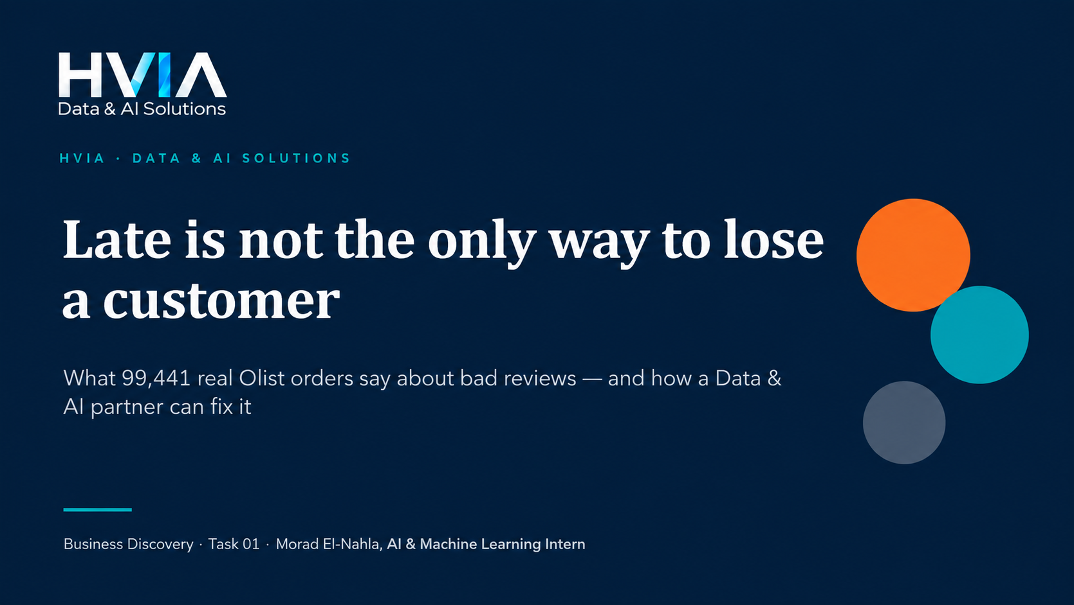

Slide 2
COMPANY RESEARCH
Olist started as a marketplace hub — today it is a full retail-tech ecosystem
Marketplace Hub
Ecommerce
ERP
170+ integrations, one listing
The seller's own online store
Manage stock, orders, invoices
Logistics & Shipping
Payments & Account
Business Credit + AI
From order to delivery
Collect and settle money
Working capital and AI agents
Who is the customer? Olist's paying clients are small and medium sellers. Shoppers are their customers, and every review lands on the seller's public profile.
So what? When a delivery fails, it is not only Olist's problem — it damages the sellers Olist exists to help.
HVIA · Olist Business Discovery
3

Slide 3
THE STORY IN ONE PAGE
About 1 in 9 orders goes wrong, and they cause 44% of all bad reviews
8.1%
2.9%
44%
4.3 → 1.7
of delivered orders arrive late
of orders never arrive at all
of 1-2 star reviews come from late or missing orders
review score: on time vs. 2+ weeks late
The problem
Olist promises 24 days and delivers in 13, yet delivery still breaks at peak months, and 2,965 orders never arrive (canceled, out of stock, stuck).
The fix
Delivery Intelligence: an early-warning score per order, a seller health scorecard, and honest delivery promises.
So what? Fixing delivery is the single most measurable way to lift reviews, and reviews are what sellers live on.
HVIA · Olist Business Discovery
2

Slide 4
STEP 1 · DATA INSPECTION
We inspected all 8 data files before choosing a single analysis
Table | Rows | Cols | One row = one
geolocation | 1,000,163 | 5 | none
order_items | 112,650 | 6 | order_id + order_item_id
order_payments | 103,886 | 5 | order_id + payment_sequential
order_reviews | 100,000 | 7 | review_id + order_id
orders | 99,441 | 8 | order_id
products | 32,951 | 9 | product_id
sellers | 3,095 | 4 | seller_id
product_category_name_translation | 71 | 2 | product_category_name
What the data can answer
No: Customer location (state / zip)
No: Repeat buyers (customer_unique_id)
No: Seller shipping deadline
No: Costs or margins
Yes: Order review score
Yes: Delivery dates (5 timestamps)
So what? The data decided the questions: with no customer location or repeat-buyer data, the story had to come from orders, sellers and reviews.
HVIA · Olist Business Discovery
4

Slide 5
STEP 2 · DATA MODEL
Everything connects through the order, and three joins would inflate totals
payments
103,886 rows
products
+ English names
What we cleaned
Items, payments and reviews share order_id with each other: many-to-many. We reduce each to one row per order first.
555 orders have 2+ reviews: we keep the latest.
189 impossible dates: only that duration is blanked.
75 reviews dated before the purchase: removed.
orders
99,441 rows
order_items
112,650 rows
reviews
100,000 rows
sellers
3,095 rows
geolocation
not joined
linked by order_id, product_id, seller_id
So what? Joining blindly would repeat rows and inflate every total, so each table is reduced to the right grain first.
HVIA · Olist Business Discovery
5

Slide 6
FINDING 1 · GROWTH
Orders grew 135% in a year, then stopped at ~6,749 a month
+135%
Jan–Aug 2018 vs Jan–Aug 2017
7,544
orders in Nov 2017, the peak month
So what? With growth flat, every existing order and seller becomes more valuable to protect.
HVIA · Olist Business Discovery
6

Slide 7
FINDING 2 · THE DELIVERY PROMISE
Olist promises 24 days, delivers in 13 — and still breaks at peak
21%
late in Mar 2018, the worst month
3 of 20
months above 12% late: Nov 17, Feb 18, Mar 18
So what? The average promise is safe, so the issue is peak volume, which is predictable weeks ahead.
HVIA · Olist Business Discovery
7

Slide 8
FINDING 3 · THE COST OF BEING LATE
A few days late is forgiven. Over a week late is not
9.5% vs 54.6%
orders rated 1-2 stars: on time vs late
78.3%
of orders that never arrived got 1-2 stars
So what? The damage starts after 3 days late, so the goal is to catch the risky orders early.
HVIA · Olist Business Discovery
8

Slide 9
THE KEY FINDING
Late and missing orders are 11% of orders but 44% of bad reviews
2,965 orders never arrived
1,107 stuck in "shipped"
619 canceled
609 out of stock ("unavailable")
615 stuck before shipping
Average score: 1.74 stars
Association, not proof of cause: late or missing orders may also differ by product or seller.
HVIA · Olist Business Discovery
9

Slide 10
FINDING 4 · WHERE THE TIME GOES
Late orders spend 3.3x longer in transit, and slow hand-overs make it worse
16.6% vs 6.3%
late rate when the hand-over to the carrier takes 5+ days vs. less
17.6%
of delivered orders wait 5+ days from purchase until the carrier picks them up
So what? Two levers: the seller's hand-over time (2.6x more late risk) and carrier transit on risky routes.
HVIA · Olist Business Discovery
10

Slide 11
FINDING 5 · SELLERS
A small group of sellers keeps missing — and we can name them today
67%
101 of 634
60%
of sales come from the top 10% of sellers
sellers with 30+ orders have 15%+ late or missing orders
of all sellers are based in São Paulo state
How the scorecard works
Only sellers with 30+ orders are scored (634 sellers, 77% of sales).
Problem rate = late orders + orders that never arrived, divided by all their orders.
The average scored seller has 9.5%. Anyone at 15% or more goes on a watch-list.
Small sellers (median: 6 orders) are too thin to judge, so they need onboarding help instead.
So what? The 101 watch-list sellers hold 8.2% of sales, so coaching them is cheap and protects sales.
HVIA · Olist Business Discovery
11

Slide 12
FINDING 6 · HIDDEN PROBLEMS
Even on-time orders fail when they arrive in pieces
Score of on-time orders
What 1-2 star comments say
So what? 1,257 on-time orders had 2+ sellers and score 2.86 vs 4.3. Customers say "only part arrived" in 14% of bad comments.
HVIA · Olist Business Discovery
12

Slide 13
FINDING 7 · SMALL THINGS THAT ADD FRICTION
Shipping costs 77% of the price on items under R$25
16.6%
average shipping cost compared to item price
1.38 days
to approve a boleto payment vs 0.19 days for a card
So what? Boleto adds a day before the seller even starts, and cheap items make the shipping cost feel unfair.
HVIA · Olist Business Discovery
13

Slide 14
BUSINESS INTERPRETATION
Every problem we found has a matching fix
Problem | What we do | Module
Peak-month delays (Nov, Feb, Mar) | Early-warning score + capacity plan | Delivery Intelligence
Orders that never arrive (3%) | Stuck-order alerts, stock sync with sellers | Delivery Intelligence
Slow seller handling | Seller scorecard + watch-list coaching | Seller Health
Orders split across sellers | Warn the buyer early, bundle where possible | Seller Health
Promise is too long or too short | Realistic delivery date per route and season | Promise Calibration
So what? One connected solution, not a menu of tools.
HVIA · Olist Business Discovery
14

Slide 15
HVIA SOLUTION
Delivery Intelligence & Seller Health
1
2
3
Early-warning score
Seller scorecard
Promise calibration
Rates every order at checkout for its chance of arriving late, using seller history, route, product size and season. Data Olist already has.
Tracks late rate, missing orders, handling time and review trend for each seller, with a minimum-volume rule and a weekly watch-list.
Learns realistic delivery windows per route and month: tighter when safe, wider when risky. Tested with an A/B test before rollout.
Why this one? The problem is real, it repeats (so it can be predicted), the data exists, and it fits Olist's move to proactive, AI-first tools.
HVIA · Olist Business Discovery
15

Slide 16
THE PLAN
From first call to a working pilot in 12 weeks
Weeks 1–2
Weeks 3–6
Weeks 7–12
Quarter 2
Discover
Build the base
Pilot
Scale
Workshop with Olist ops and data teams. Confirm data access. Re-run this analysis on current data.
Seller scorecard, route and peak-season diagnostics, first watch-list.
Train and test the early-warning model on selected routes, with a control group.
Connect scores to the ERP and AI agents. Add promise calibration with an A/B test.
So what? Illustrative upside: if a quarter of late orders behaved like on-time ones, about 7.1% of all bad reviews would not happen. The pilot measures the real number.
HVIA · Olist Business Discovery
16

Slide 17
OUTREACH & NEXT STEPS
How we would approach Olist
Next steps
Find the right person (Operations, Data or Growth lead) on LinkedIn and confirm their current title.
Send the message on LinkedIn, attach a one-page scorecard.
Discovery call, then scope the 12-week pilot.
“Hi [Name], I analysed Olist's public order data at HVIA Data & AI Solutions and one pattern stood out: orders that arrive late or never arrive are about 11% of orders, but they carry 44% of all 1-2 star reviews. Since Olist is building proactive AI tools for merchants, I wonder if a delivery-risk early warning is on your roadmap. Would you be open to a 20-minute call in the next two weeks?”
Limits: 2016–2018 data only; shows association, not cause; no costs, customer location or repeat-buyer data. Today's Olist is much larger.
HVIA · Olist Business Discovery
17

