Slide 1
Wireless Communication
Project
By: Abhinav Adduri, Morad Shefa

Slide 2
Modulation
To increase transmission speed we changed AFSK
Increased BAUD to 1400
1600 worked but unreliably
Changed mark to BAUD, i.e. 1400
Changed space to 2*BAUD, i.e. 2800

Slide 3
Transformation
Discrete Cosine Transform on 8x8 tiles of the image
Quantized according to JPEG quantization standards and converted to integers.
Increased quantization if needed based on image size
The DCT transform was very sparse so we kept track of running zeros.
Tried Huffman encoding, noticed gained compression was not worth sending the decoding tree
Switched to zipping

Slide 4
Transformation
Tried transforming to YCbCr before taking the DCT
Quantize the chroma components more than luminance
Pictures turned greenish, preferred the blurry pictures when quantizing RGB

Slide 5
Issues
Hardware!
VOX: GPIO were very fragile causing issues with PTT
USB hub would fail
Buffer: Not copying overwrote the buffer
Changing BAUD (and number of flags) was extremely time consuming.
Huffman Encoding: Heapq had very weird behavior got resolved when changing to Priorityqueue

Slide 6
Beautiful Results
PSNR and images for all practice images
Original PSNR calculation was wrong, so we subtracted 48 from each of our PSNR’s
Pasted new number image over the old slides

Slide 7
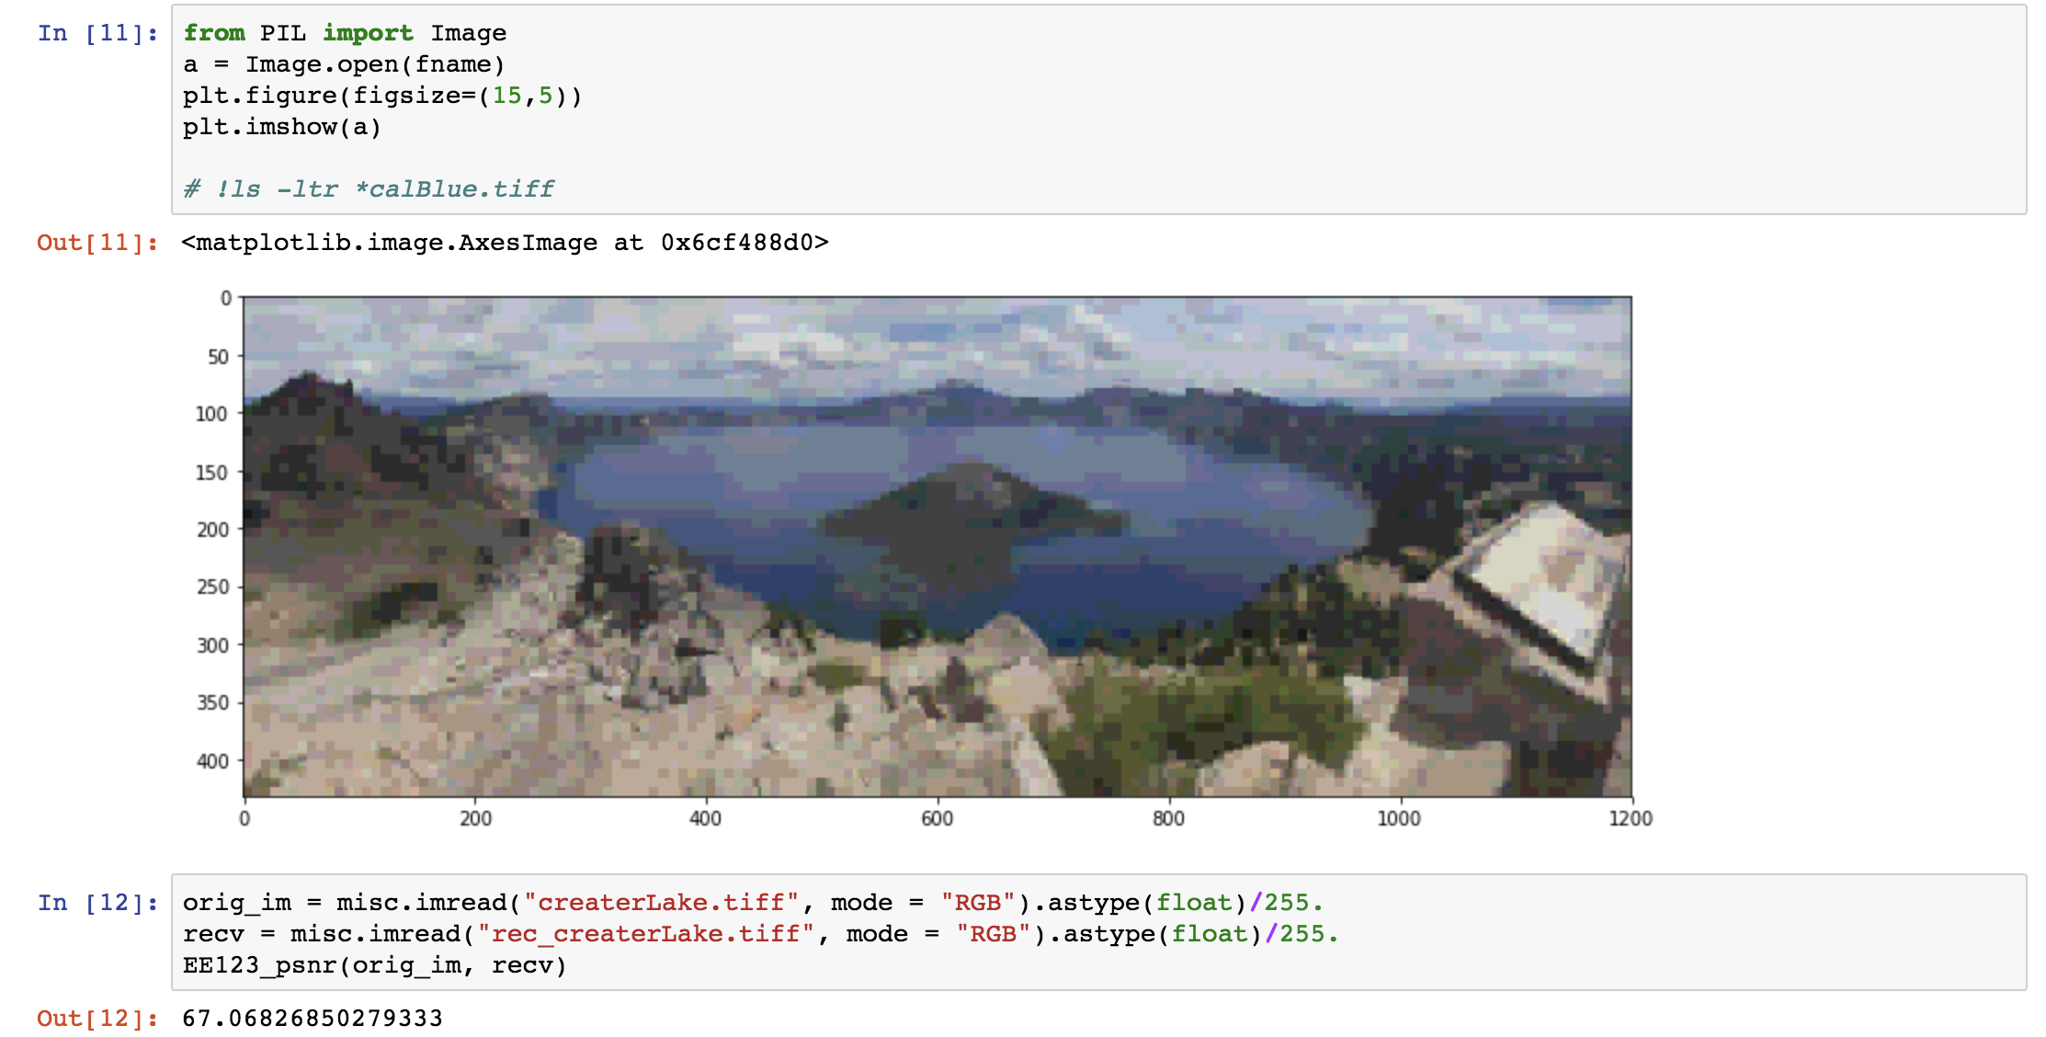


Slide 8
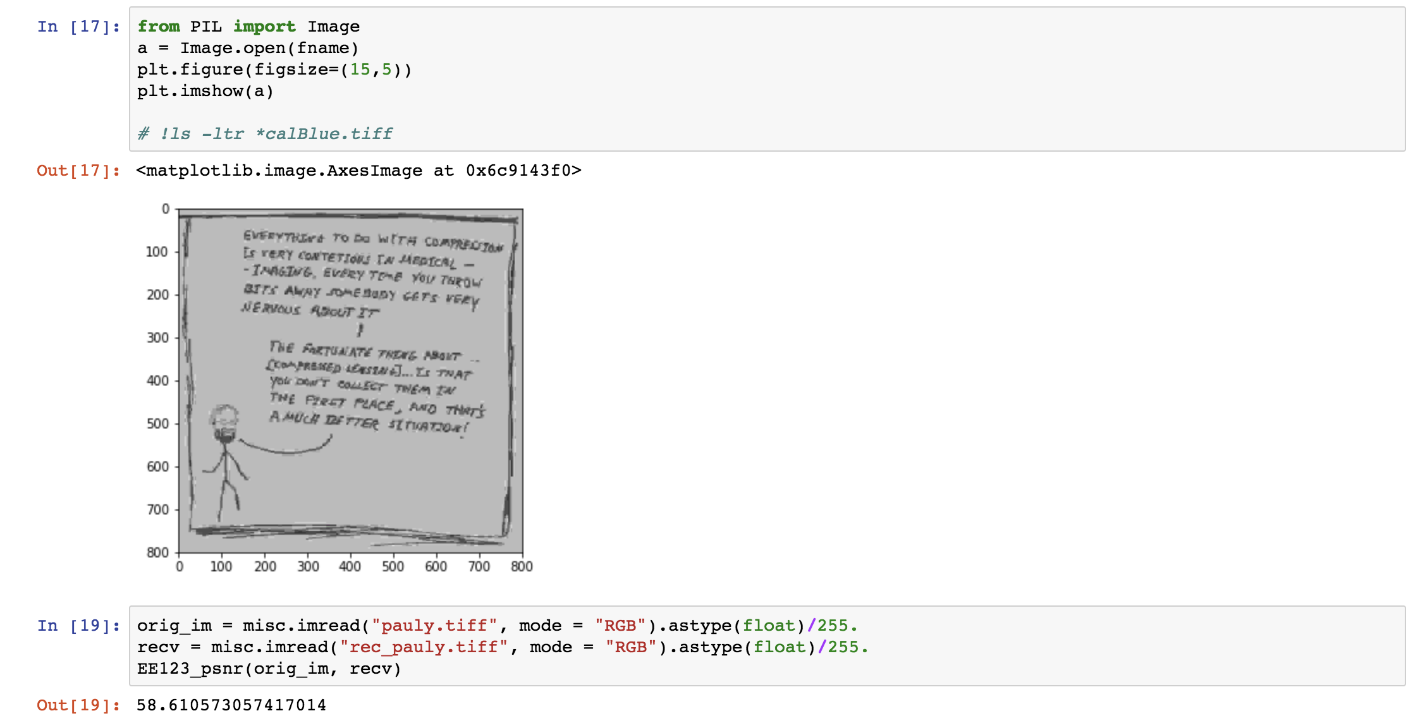

Slide 9
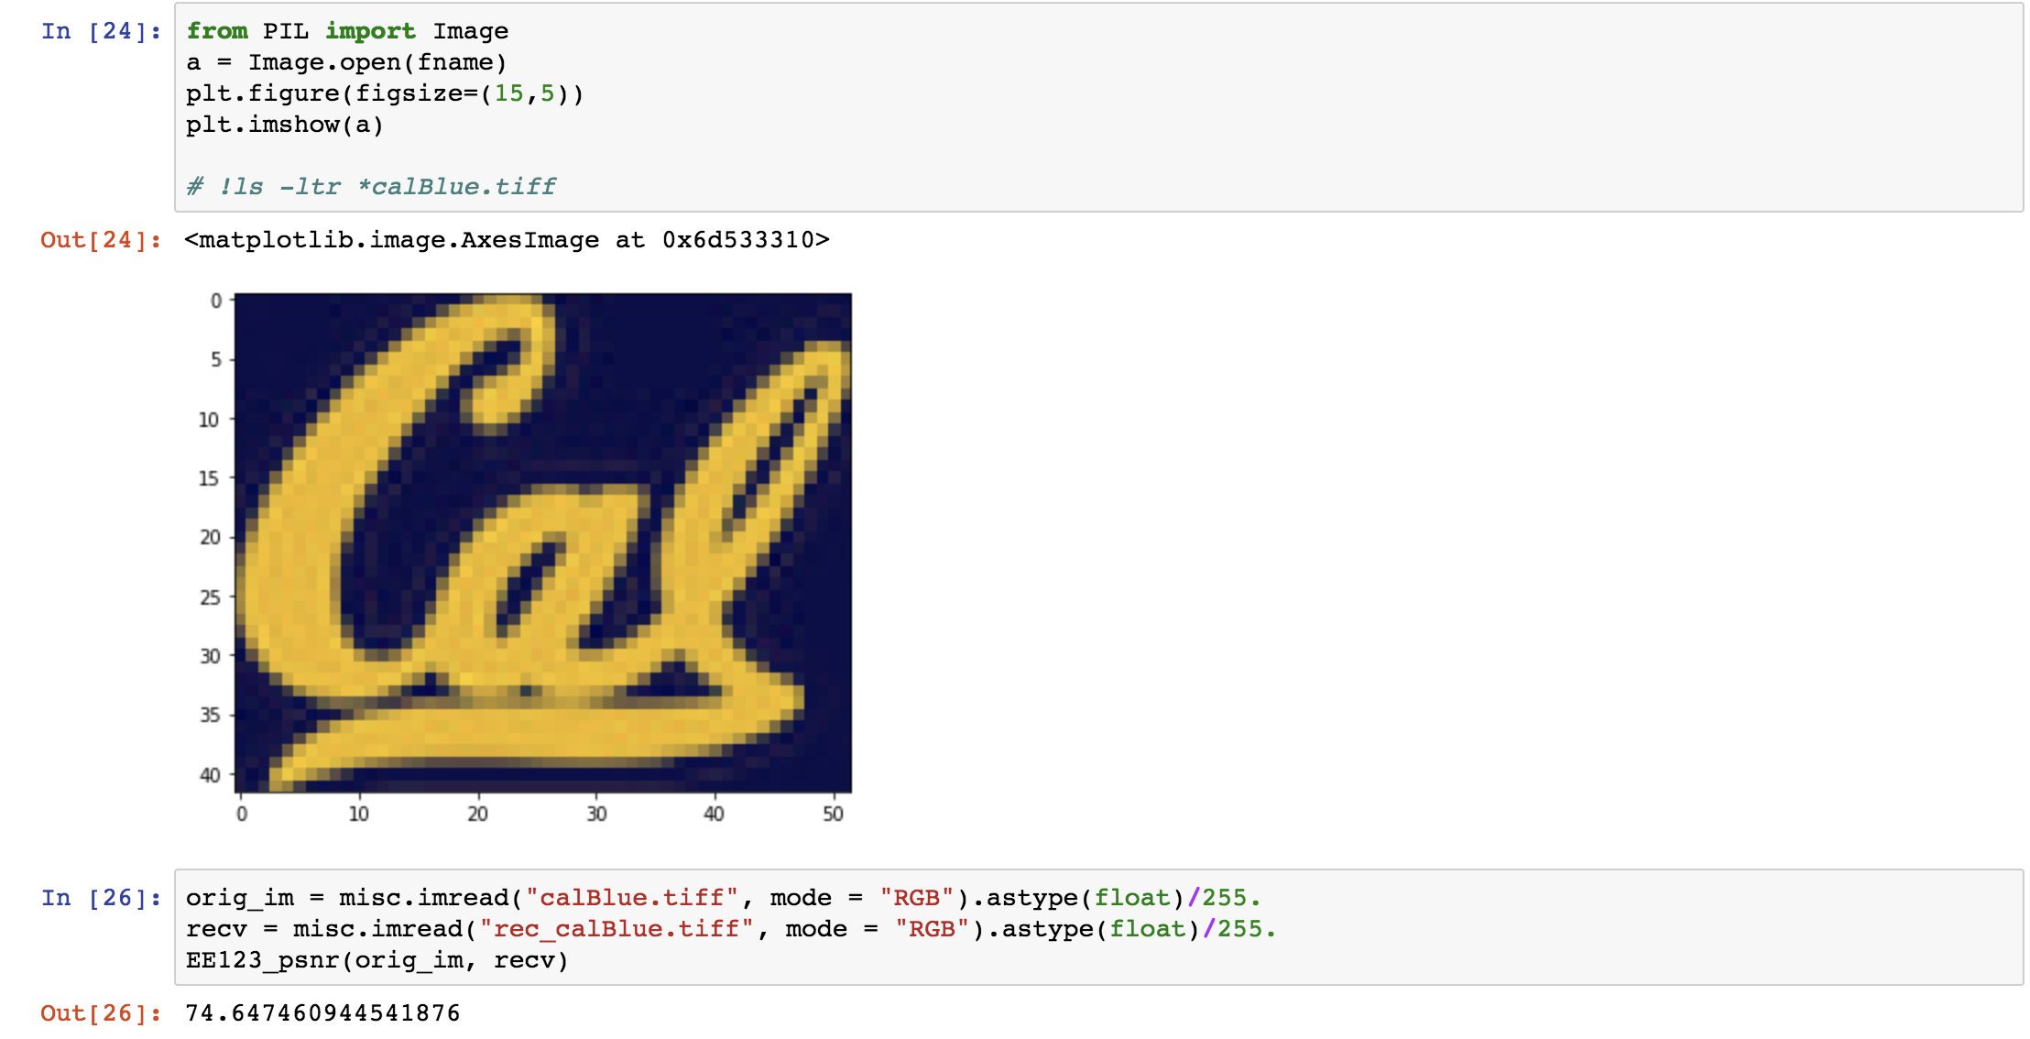
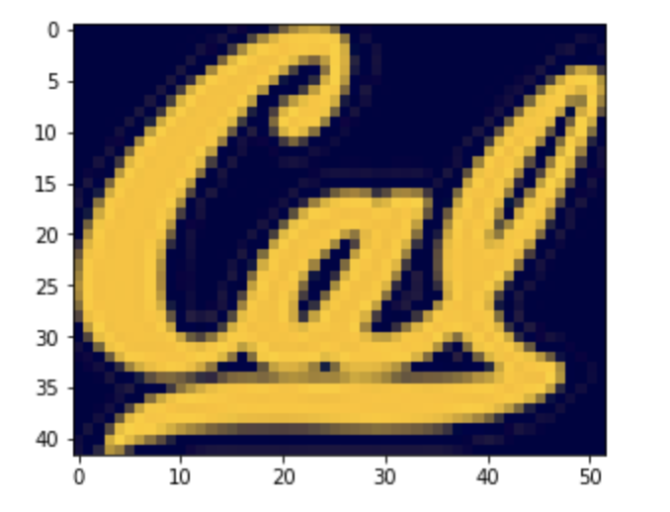

Slide 10
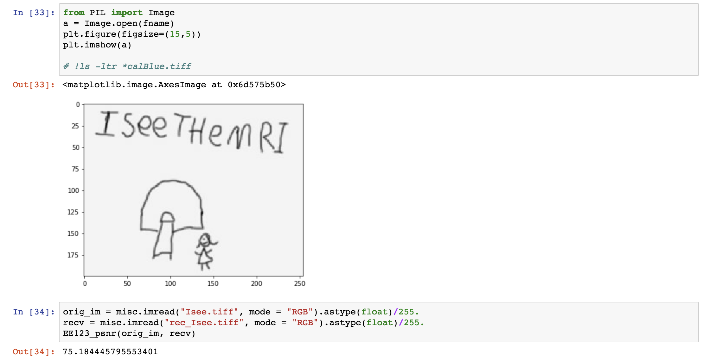

Slide 11
