Slide 1
Bidirectional Generative Adversarial Networks
Author: Alireza Moradzadeh
ECE 598
Instructor: Prof. Pramod Viswanath

Slide 2
Outline
Introduction to GAN and BiGAN
GAN results on MNIST and Fashion-MNIST
Future Work
Conclusion

Slide 3
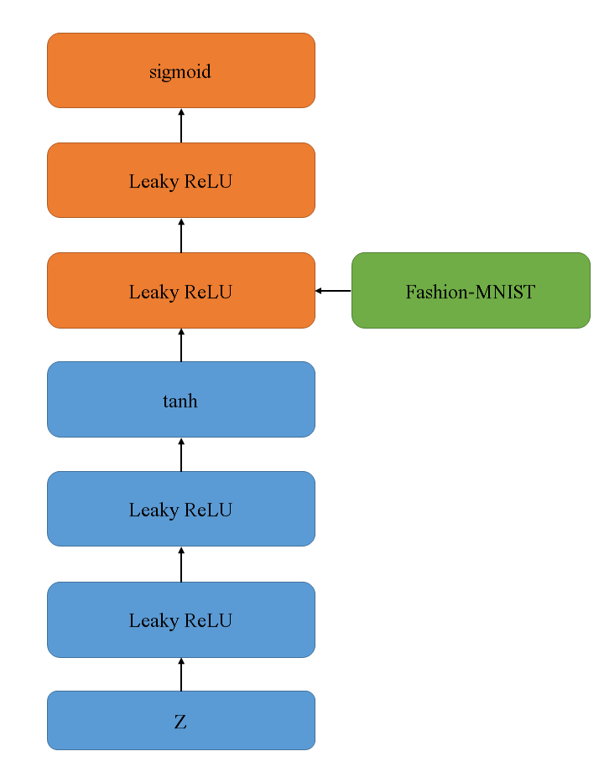

Generative Adversarial Neural Network (GAN)
Theory
$$\min{\max{V\left(D,G\right)}=}$$
$$E_{x\sim p_{data\left(x\right)}}\left[\log{D\left(x\right)}\right]+E_{z\sim p_{z}\left(z\right)}[\log{(1−D\left(G\left(z\right)\right)]}$$

Slide 4
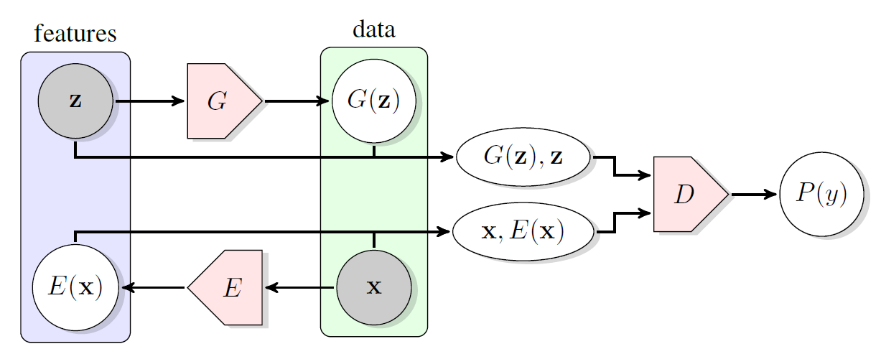
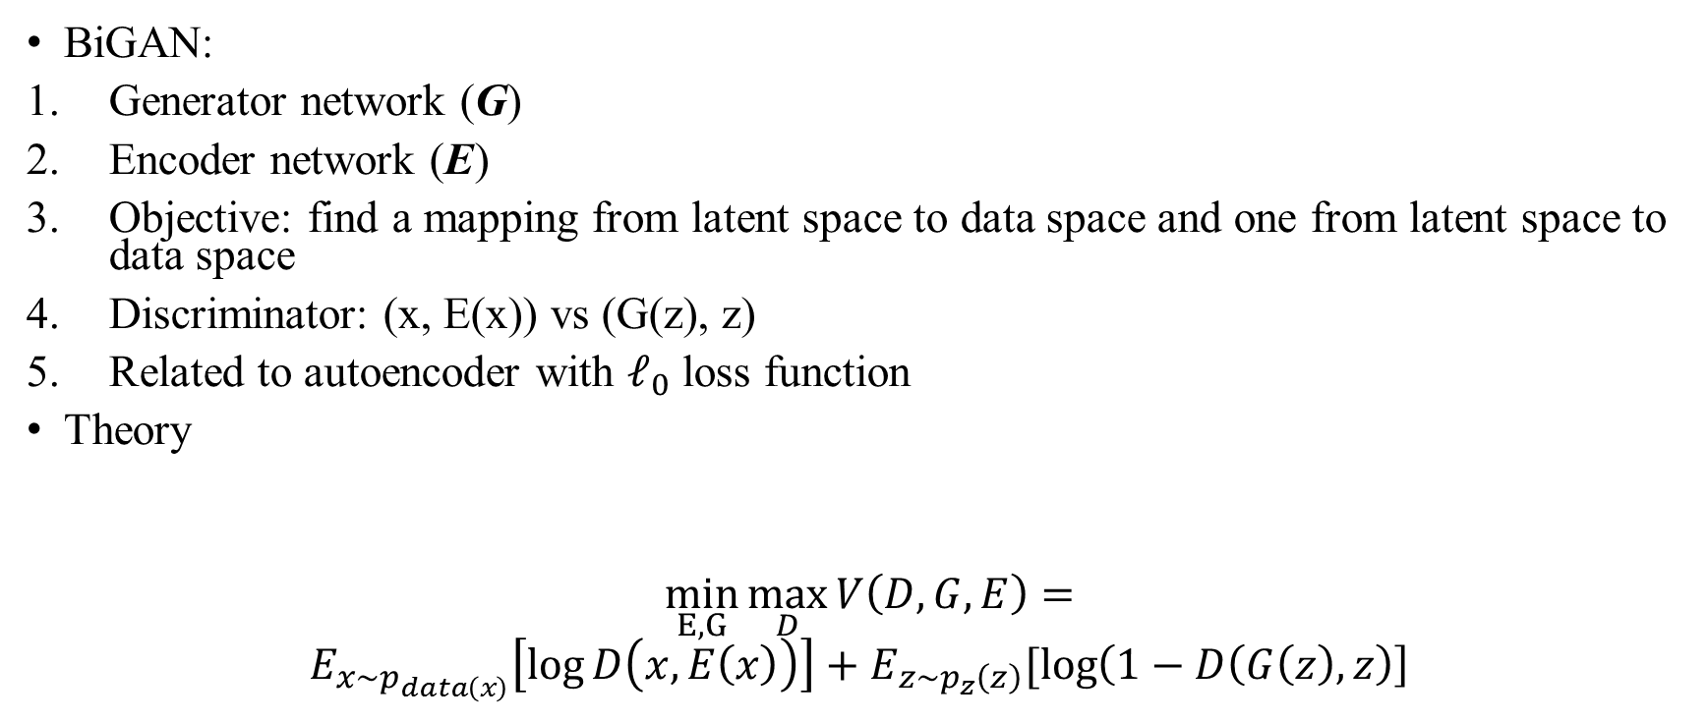
Bidirectional Generative Adversarial Networks
BiGAN:
Generator network (G)
Encoder network (E)
Objective: find a mapping from latent space to data space and one from latent space to data space
Discriminator: (x, E(x)) vs (G(z), z)
Related to autoencoder with $ℓ_{0}$ loss function
Theory
$$\min_{E, G}{\max_{D}{V\left(D,G, E\right)}=}$$
$$E_{x\sim p_{data\left(x\right)}}\left[\log{D\left(x, E\left(x\right)\right)}\right]+E_{z\sim p_{z}\left(z\right)}[\log\left(1−D\left(G\left(z\right), z\right)\right]$$
Donahue, J., Krähenbühl, P. and Darrell, T., 2016. Adversarial feature learning. arXiv preprint arXiv:1605.09782.

Slide 5
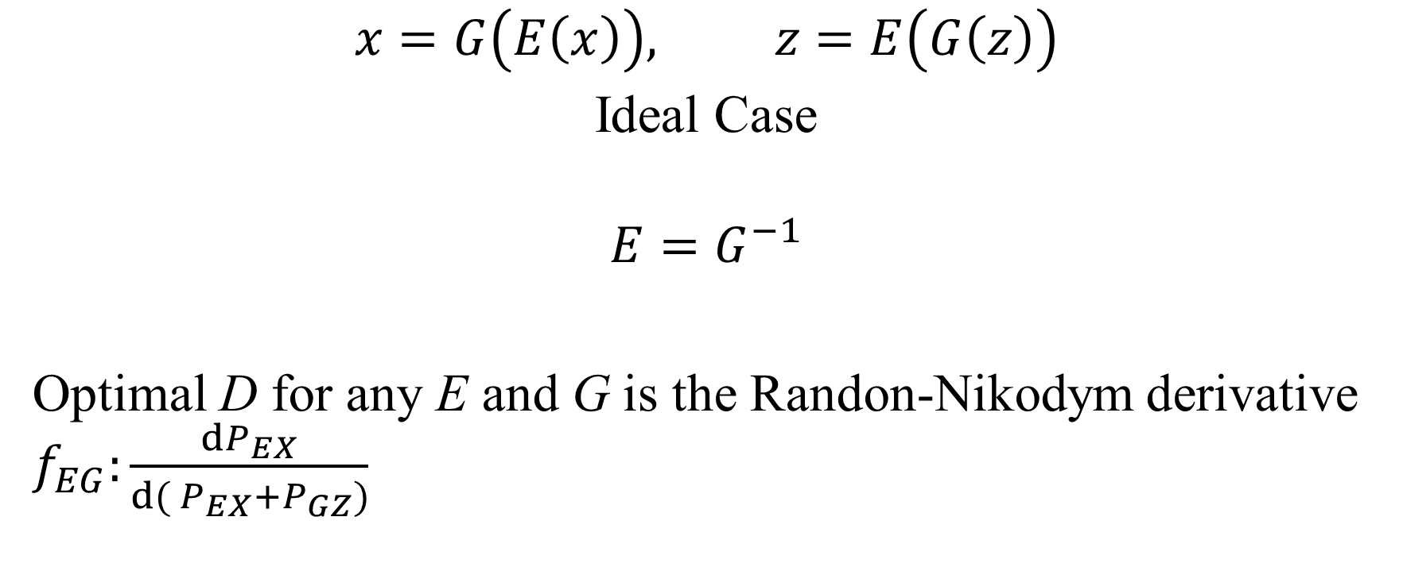
Optimal Encoder and Generator
$$x=G\left(E\left(x\right)\right), z=E\left(G\left(z\right)\right)$$
Ideal Case
$$E=G^{−1}$$
Optimal D for any E and G is the Randon-Nikodym derivative $f_{EG}:\frac{{dP}_{EX}}{d( P_{EX}+P_{GZ})}$

Slide 6

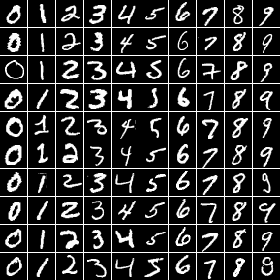
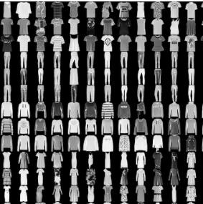
Implementation
Tensorflow by Google
Two different datasets:
MNIST
2. Fashion-MNIST

Slide 7
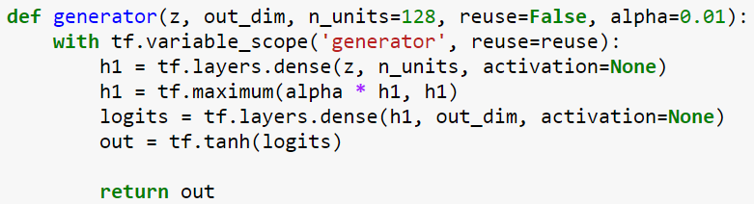
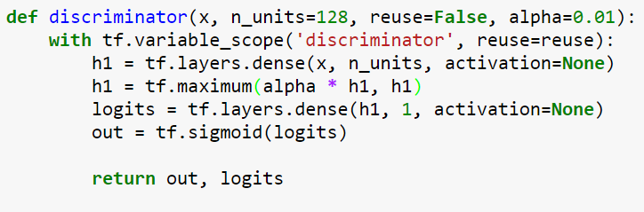
GAN Architecture
Generator
Discriminator

Slide 8
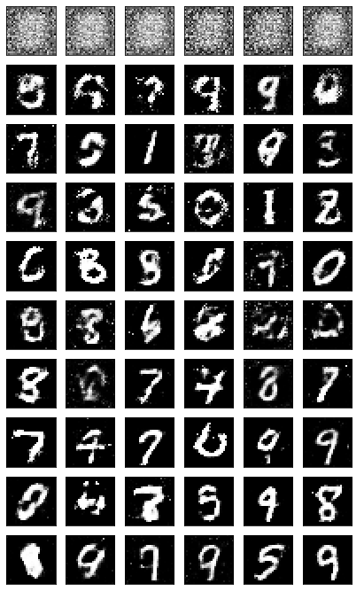
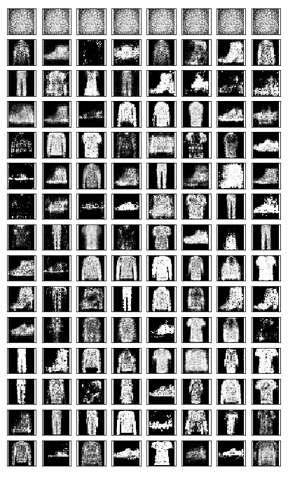
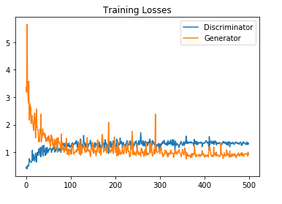
GAN Results on MNIST and Fashion-MNIST
During Training

Slide 9
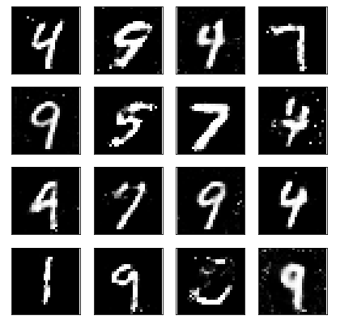
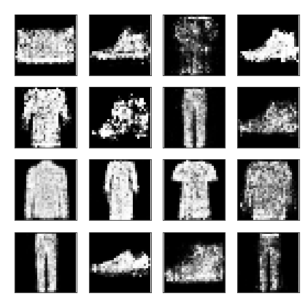
GAN Results on MNIST and Fashion-MNIST
After Training

Slide 10
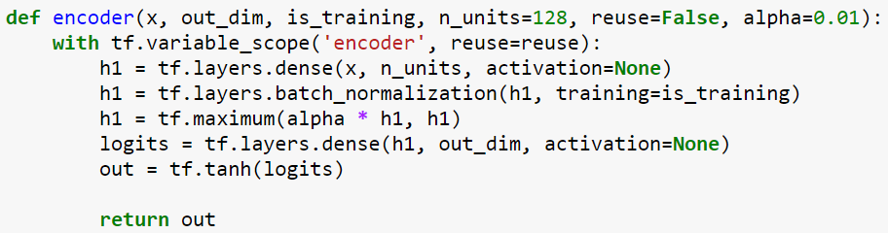
BiGAN Architecture
Encoder
Generator and Discriminator same as GAN

Slide 11

Future Work
Solve Issue with BiGAN
BiGAN for Fashion-MNIST and MNIST
Comparison between GAN and BiGAN
Calculating accuracy of BiGAN i.e. $x ?G\left(E\left(x\right)\right) and z?E(G\left(z\right))$

Slide 12
Conclusion
GAN network implemented in TF
GAN is trained on Fashion-MNIST and MNIST
BiGAN Network is theoretically explained
BiGAN implemented but still problem with training

Slide 13
Thank You
Any Question?

