Slide 1
THE JULY RELEASE BRIEFING
The Efficiency Frontier
Choose the configuration that clears the bar with the least total cost, time, and access risk.
A model is on the frontier when no available alternative matches its outcomes while improving at least one of quality, cost, speed, reliability, or access.
Grok 4.5 | Muse Spark 1.1 | Fable 5 redeployed | GPT-5.6 Sol, Terra, Luna
LONGMONT AI | JULY 22, 2026
01

Slide 2
RELEASE MAP
Four releases, one routing problem
The practical unit is model plus effort setting plus harness, not the model name alone.
Grok 4.5
Coding and agentic-work flagship; speed and token efficiency are the claim.
Muse Spark 1.1
Multimodal agent reasoning, new Meta Model API preview, parallel subagents.
Claude Fable 5
Redeployed after access disruption; availability is part of operational value.
GPT-5.6
Sol for maximum capability, Terra for balance, Luna for efficient scale.
LONGMONT AI | JULY 22, 2026
02

Slide 3
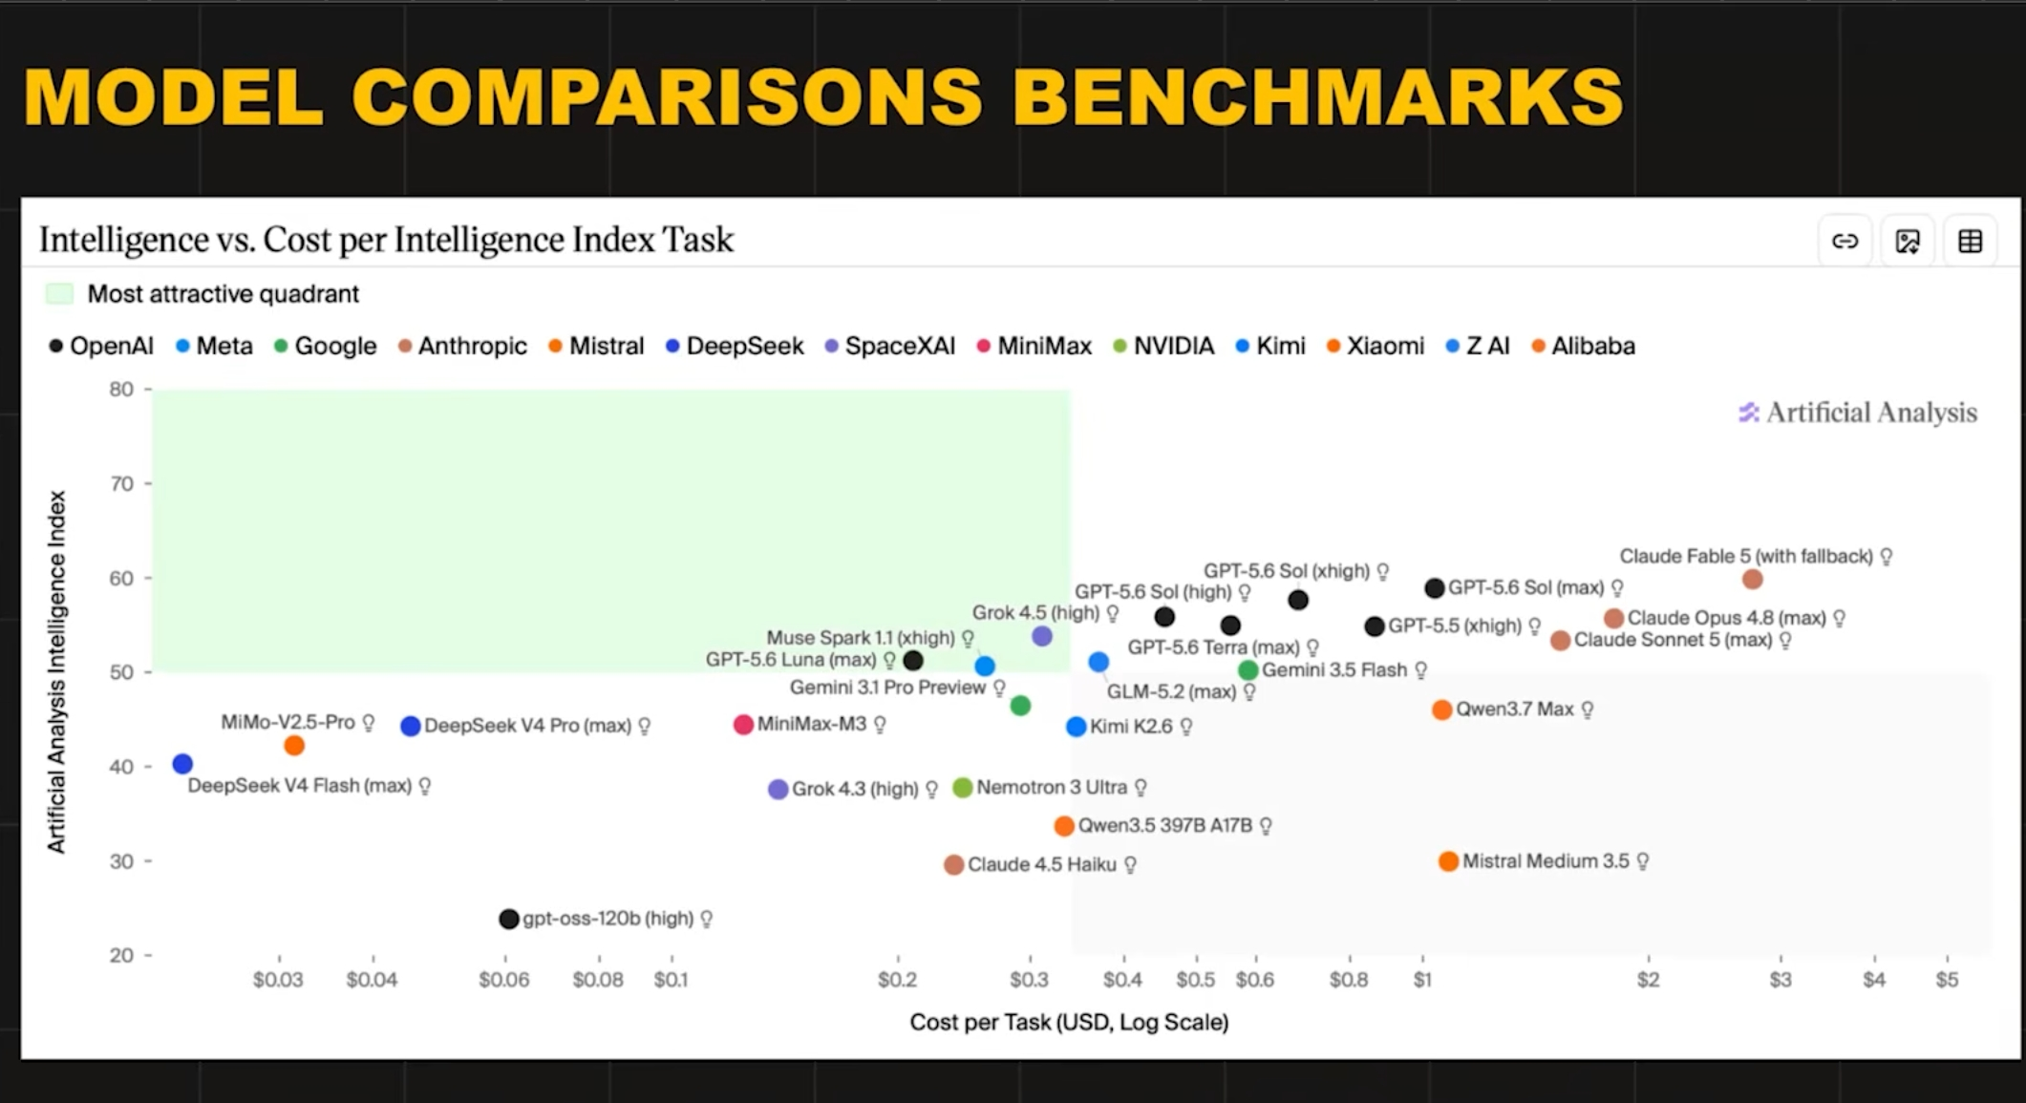
EVIDENCE: INDEPENDENT TASK-COST VIEW
The useful dots are high and left
A snapshot can create a shortlist. Your own evaluation decides whether a dot belongs in production.
LONGMONT AI | JULY 22, 2026
03

Slide 4
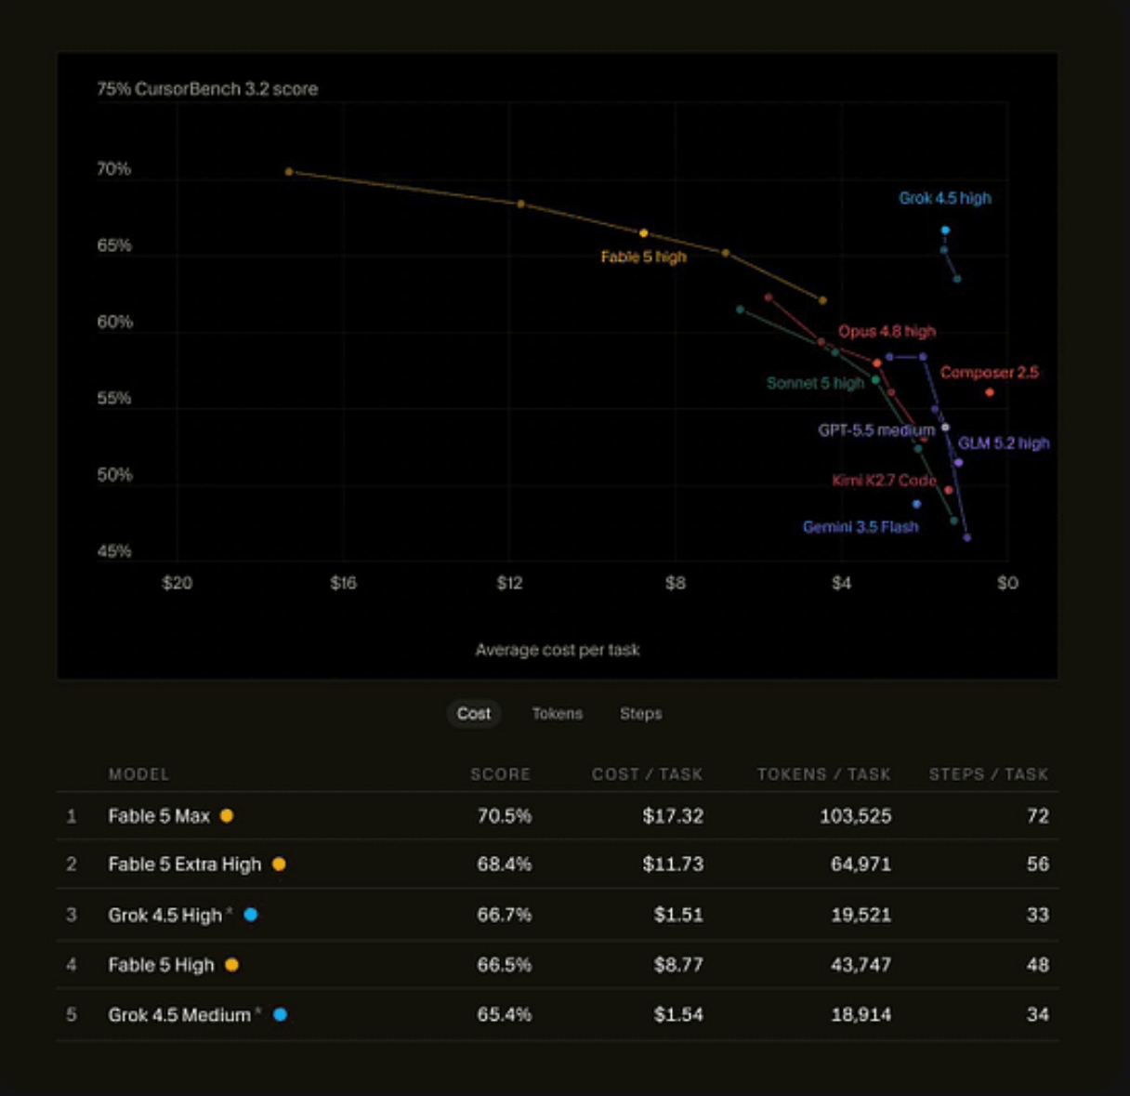
EVIDENCE: COST IS NOT A FOOTNOTE
Score only answers half the question
A benchmark result changes when model effort, output tokens, agent steps, or the task harness changes.
Decision rule
Pick the least-expensive available configuration that passes a shared acceptance test. Compare models with a fixed harness, then compare harnesses separately.
LONGMONT AI | JULY 22, 2026
04

Slide 5
DEEPSWE V1.1
The coding frontier is a tradeoff cloud
A common long-horizon harness makes the comparison more useful, but it does not replace a local acceptance set.
GPT-5.6 Sol
Claude Fable 5
GPT-5.6 Terra
GPT-5.6 Luna
73% +/- 3%
70% +/- 4%
70% +/- 3%
67% +/- 4%
$8.39 average cost
$21.63 average cost
$4.95 average cost
$3.03 average cost
Source: DeepSWE v1.1 leaderboard, July 13, 2026. Scores are not cross-task guarantees.
LONGMONT AI | JULY 22, 2026
05

Slide 6
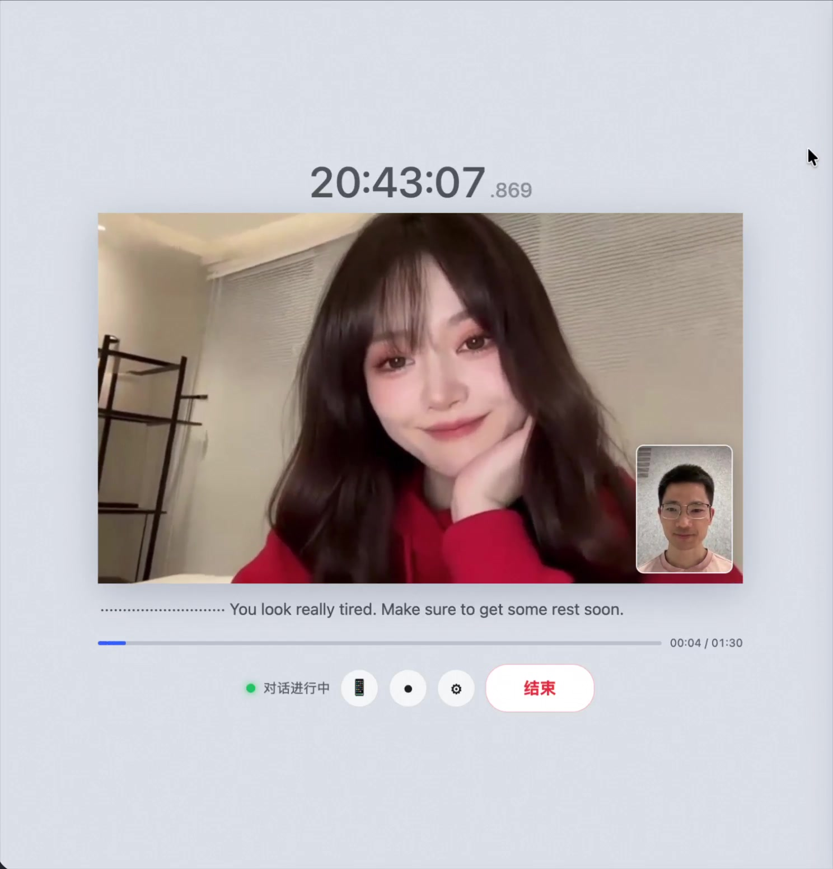
BEYOND TEXT: REAL-TIME AGENTS
Video agents have a latency budget too
Wan-Streamer v0.2 reports a 640 x 368 interactive stream at 25 FPS with roughly 200 ms model-side latency.
The next frontier is not just stronger reasoning. It is the whole experience: motion, speech, scene grounding, responsiveness, and usable latency.
Read the paper: arxiv.org/pdf/2607.04443
LONGMONT AI | JULY 22, 2026
06

