Slide 1
JUNE 24 BRIEFING
Routing the Fallout
The frontier is no longer just model quality. It is access, cost, workflow design, and proof.
Use the best model you can justify. Route everything else. Verify before it leaves the building.
Fable 5 • token maxxing • GLM routing • deep verification
Visual briefing
01

Slide 2
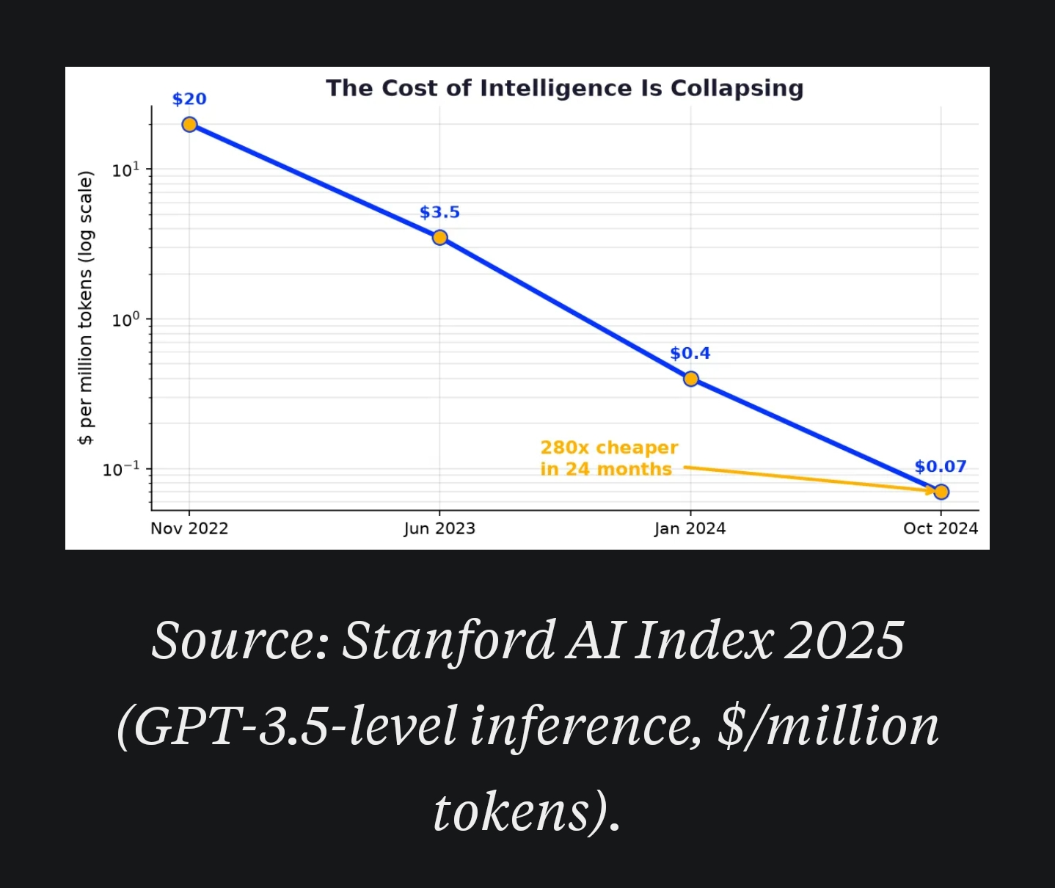
THE BIG PICTURE
Inference got cheaper.
The baseline cost collapse is the starting point for the story.
Stanford AI Index screenshot
02

Slide 3
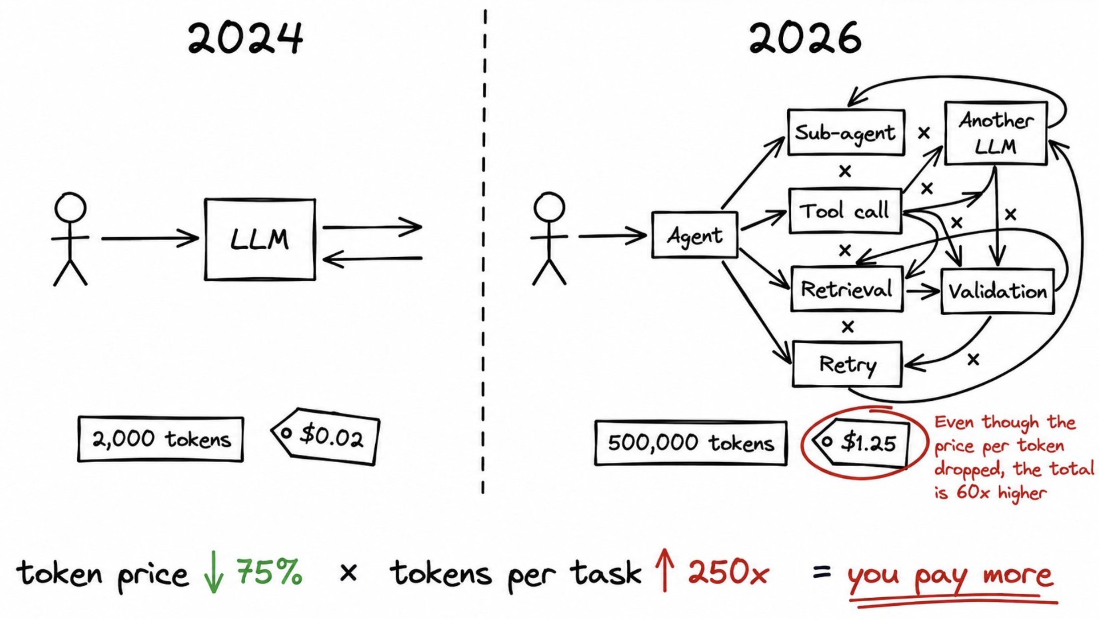
TOKEN MAXXING
Work got hungrier.
Agents can turn cheaper tokens into a larger total task bill.
Token-maxxing diagram
03

Slide 4
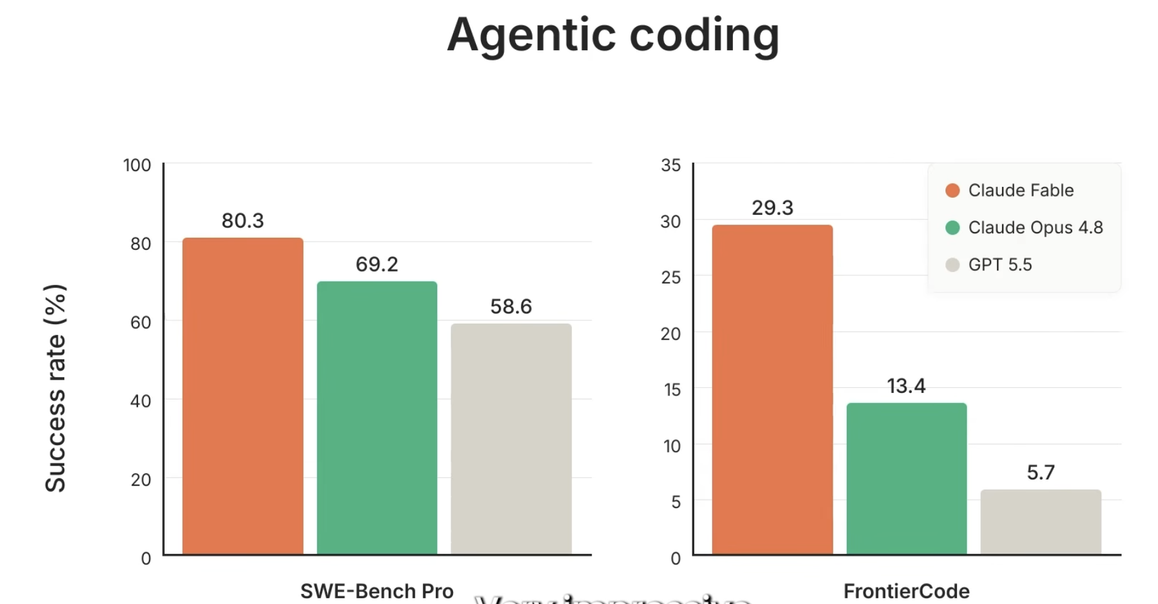
ACCESS
A top model can become a fragile dependency.
Access changes should be a routing event, not a system failure.
Keep it portable.
Fable 5 screenshot
04

Slide 5
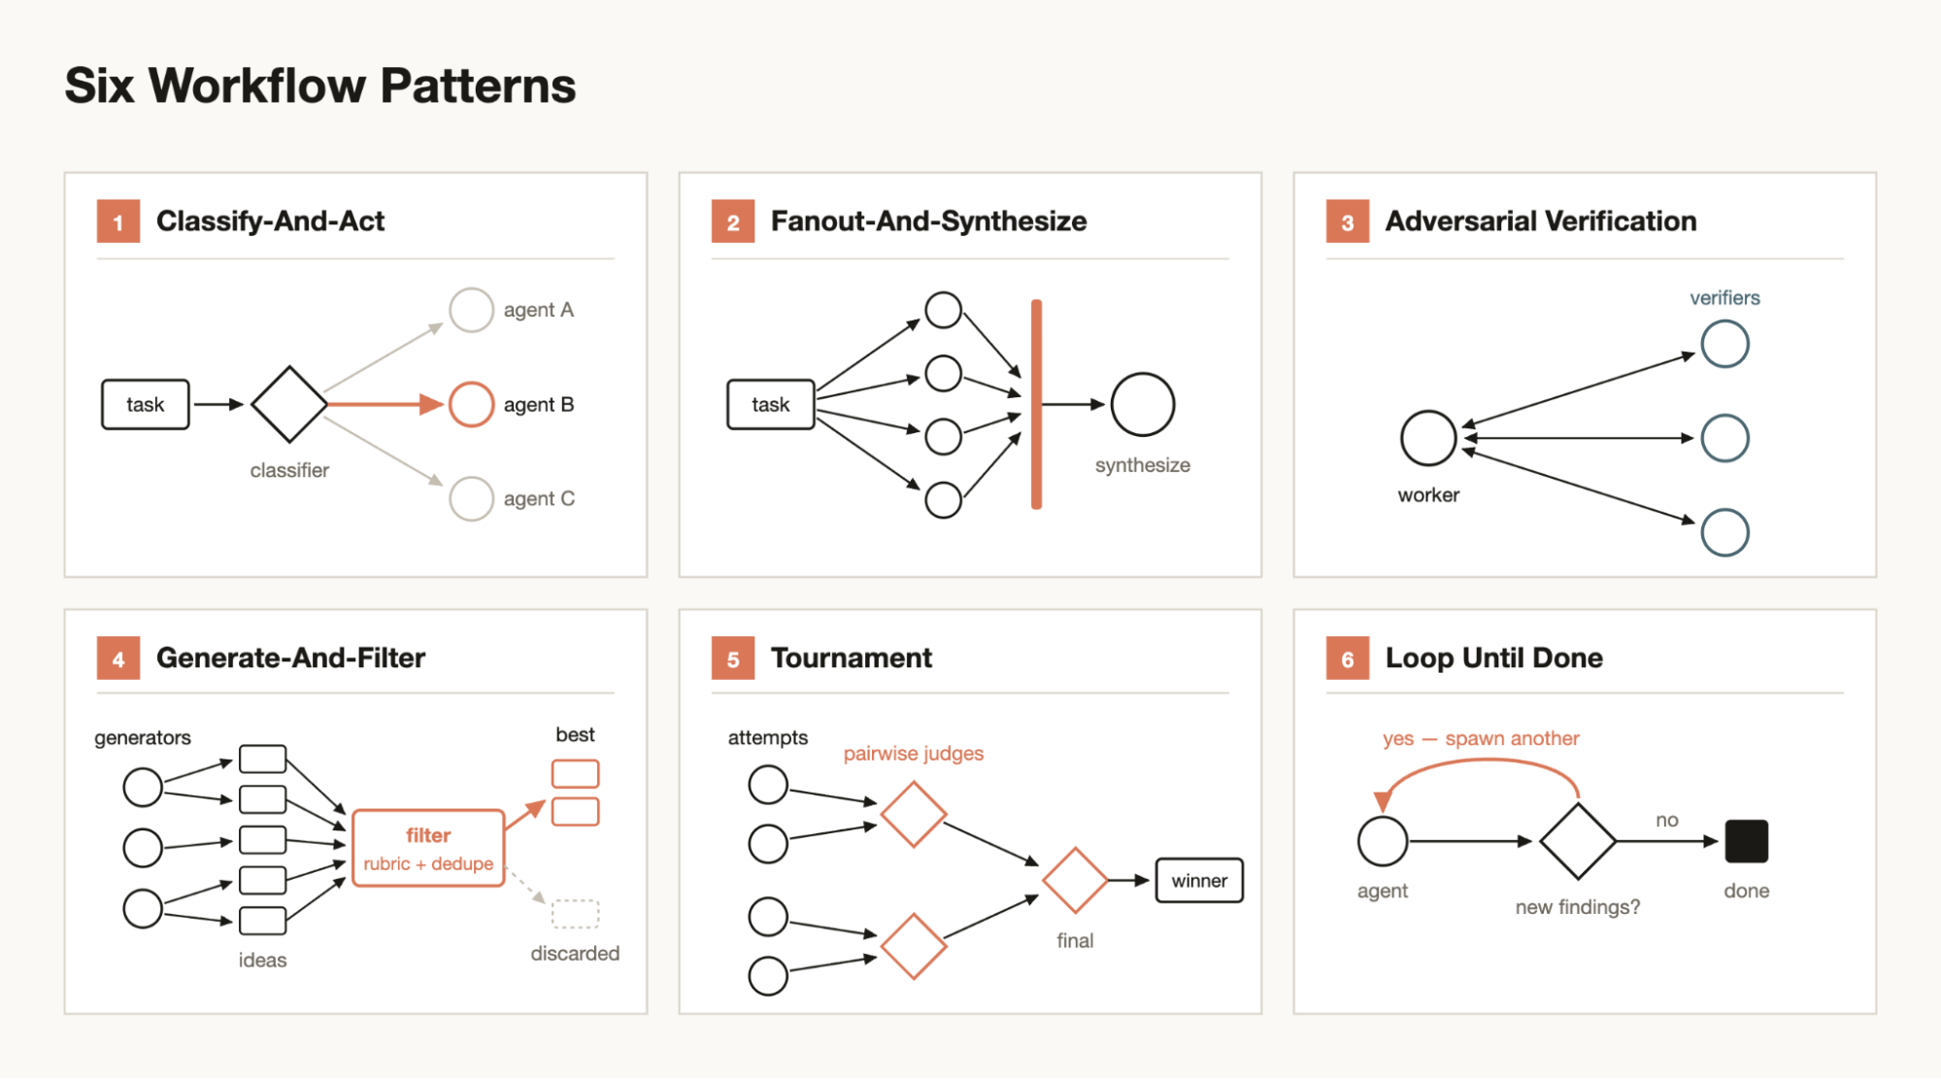
HARNESSES
The workflow is the product surface.
Classify, fan out, verify, filter, compete, and loop only until the stop condition is real.
Six workflow patterns diagram
05

Slide 6
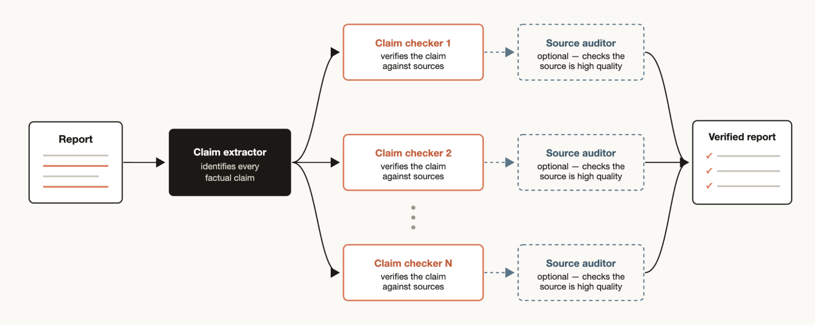
DEEP VERIFICATION
Verification becomes a workflow.
The harness checks claims, sources, and decisions separately.
Deep verification diagram
06

Slide 7
GLM LOCAL / CLOUD INFERENCE
Route the model, not the belief.
GLM is a lane to evaluate. Frontier APIs are another. The harness chooses the job.
Classify
Research
Synthesize
Verify
cheap and fast
GLM lane
frontier when worth it
adversarial checks
Cloud first for comparison. Local when the workload repeats or the data matters.
GLM routing action step
07

Slide 8
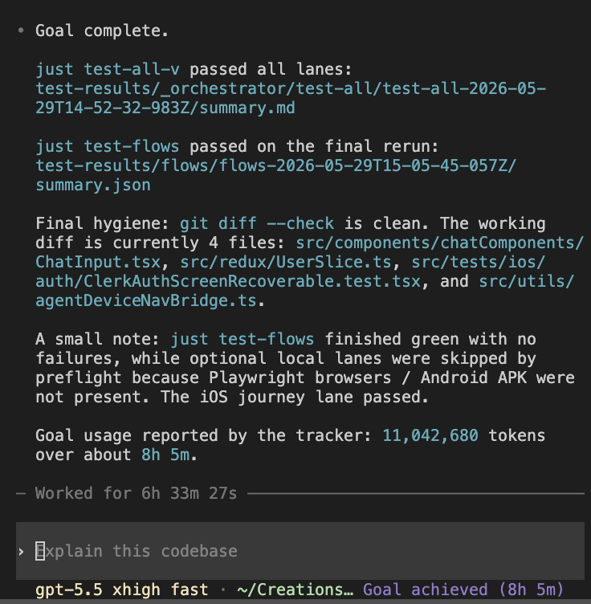
PROOF
Proof before publish.
A finished AI task should show what ran, what passed, what changed, and what it cost.
Goal Achieved screenshot
08

Slide 9
CURSOR + SPACEX
Coding tools are becoming infrastructure bets.
Reporting framed SpaceX's Cursor move as a $60B all-stock acquisition agreement, with compute as the strategic prize.
The product is not just the editor.
It is the model lane, the GPU lane, and the workflow lane behind it.
Times of India June 17 + MarketWatch June 19
09

