Slide 1
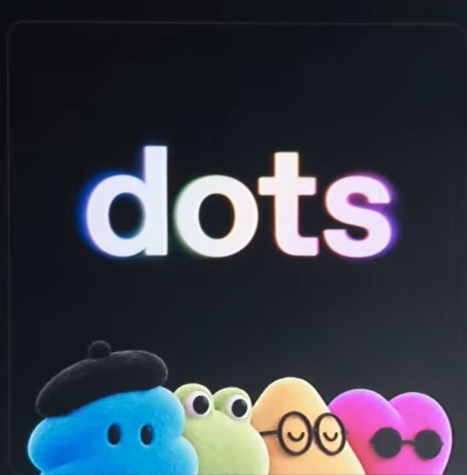
AI DEVELOPMENTS
Agents, bots,
dots, oh my!
September 17–30, 2026
LongmontAI
01
Notes:
The fortnight brought new mid-price models, an agent stack, and measurable progress in physical AI. Scope excludes earlier launches unless labeled context. Source: https://app.notion.com/p/3eb57c81addd8170a56bed2415d972f4 and https://openai.com/index/devday-2026-recap/ .
Image provenance: user-supplied screenshot from Photos-1-001, asset 54. Cropped to Dots panel.

Slide 2
Token demand sets the backdrop
Annual tokens processed, quadrillions
Altimeter estimate, August 2026. 2026E is an annualized estimate.
LongmontAI
02
Notes:
Faithful redraw of supplied Library JPEG libfile_2c7562cf69548191a0dfa717d37c4e2a, also Downloads asset 7. Source chart says company disclosures and Altimeter analysis, annualized estimate as of 8/2026. Keep TOTALS only: the screenshot does not provide exact company segment values. Do not claim independent verification. Caption image is retained in the asset bundle for source review. Do not use a trend line or extrapolate beyond 2026E.

Slide 3
Three models share the $2 input lane
USD per million tokens, standard short context
List prices. Tools, caching and retries change the cost of a job.
LongmontAI
03
Notes:
Primary prices checked September 30. OpenAI https://developers.openai.com/api/docs/pricing ; Anthropic https://www.anthropic.com/claude-sonnet-5-5 ; xAI https://docs.x.ai/developers/pricing . OpenAI standard long context applies above 272K input tokens; Grok long rates apply at 200K and bill the full request. Cached input, cache writes, tools, reasoning tokens, retries and regional rates affect total job cost. Compare one real task before changing a default. Sol is available in Work/Codex, not yet Chat. Grok 4.7 Fast is only Cursor/Grok Build, not the public xAI API; premium 2x short context and 1.5x long. Benchmarks remain vendor-reported; this chart ranks price only.

Slide 4
Speed has a separate bill
GPT-6 Astra output, USD per million tokens
6×
token rate
OpenAI reports
up to 6× faster
in the API
LongmontAI
04
Notes:
Astra Ultrafast is live; GPT-6.1 Sol Ultrafast remains coming in the next days. OpenAI reports up to 8x faster in Codex, about 300 tok/s, vs up to 6x API. Short-context Astra Ultrafast input/output is $60/$300; long-context is $120/$450. Standard input/output $10/$50. Vendor speed claims are workload-dependent. Source: https://developers.openai.com/api/docs/pricing?latest-pricing=ultrafast and https://openai.com/index/devday-2026-recap/ . Practical distinction: pay for speed when a person is waiting; measure the time saved.

Slide 5
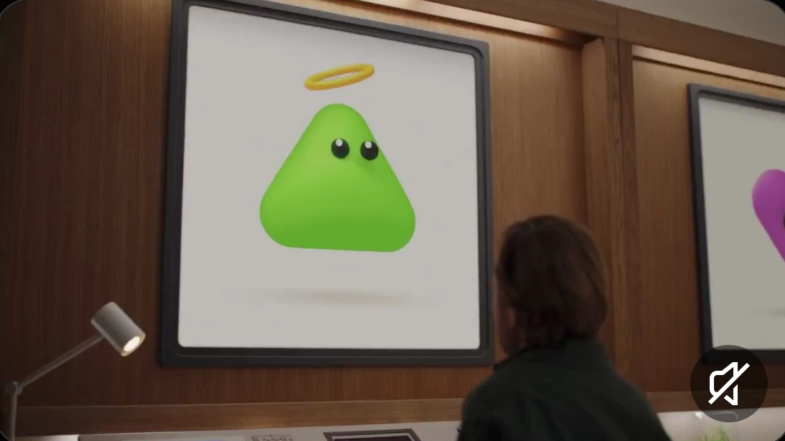
Dots keep working after you log off
GPT-6 Astra
Own cloud computer
and browser
4,000+
connected apps
LongmontAI
05
Notes:
September 29 rollout starts with eligible Pro and Business Premium users. Enterprise and eligible organizations have an admin beta. First Dot included; Dot conversations do not count toward ChatGPT limits, but Work/Codex tasks it launches do. App count is OpenAI-reported. Source: https://openai.com/index/introducing-dots/ and https://help.openai.com/en/articles/20001530-getting-started-with-your-dot . Keep approval gates for sending, spending, merging and publishing. Do not call it GPT-6.1 Astra.
Image: user-supplied asset 24, cropped to promotional video. This is not a stage photograph.

Slide 6
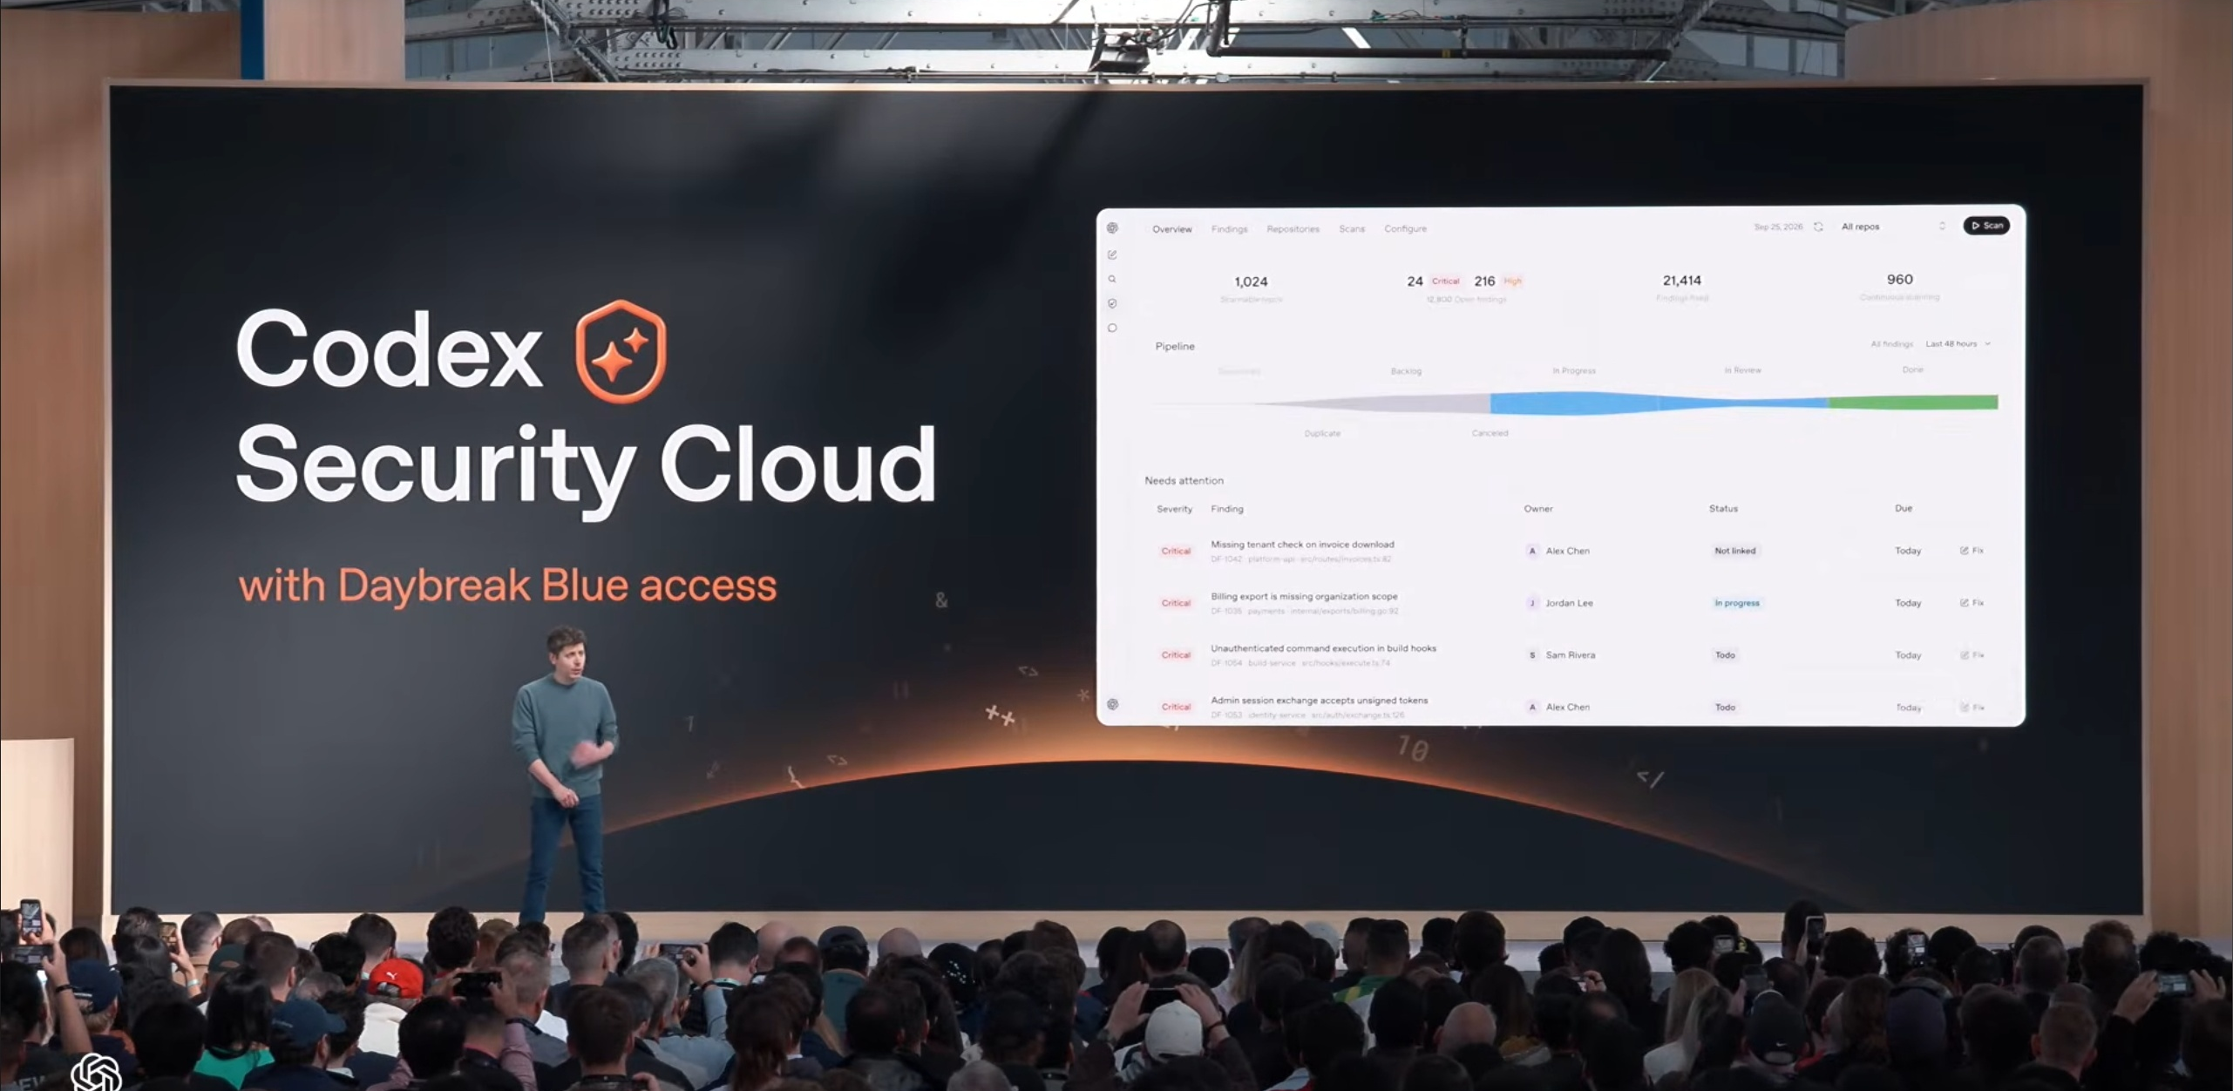
Codex work continues in the cloud
Reusable
environments
Automatic
code review
Security
Cloud scans
LongmontAI
06
Notes:
September 29. Codex cloud tasks continue after the laptop closes and are accessible remotely. Security Cloud scans GitHub repos, investigates findings and prepares fixes, with Daybreak Blue access. Cloud Codex and Security Cloud have different plan eligibility. Review prepared fixes. Source: https://openai.com/index/devday-2026-recap/ . Image: user-supplied screenshot of OpenAI DevDay, Downloads Photos-1-001.

Slide 7
DevDay availability matters
Available / rolling out
Preview / coming
Astra Ultrafast
Codex cloud
Dots
Decisions API
Private Inference
Collaborative slides
Availability varies by plan and region
LongmontAI
07
Notes:
Decisions API is limited preview, broad release coming days. Private Inference preview due this fall. Collaborative slides coming weeks. Dots rollout staged. Private Safety Processing / ZDR available now, distinct from future Private Inference. Source: https://openai.com/index/devday-2026-recap/ . Asset 38 clearly says Decisions API in preview but need not be included if it makes the slide dense.

Slide 8
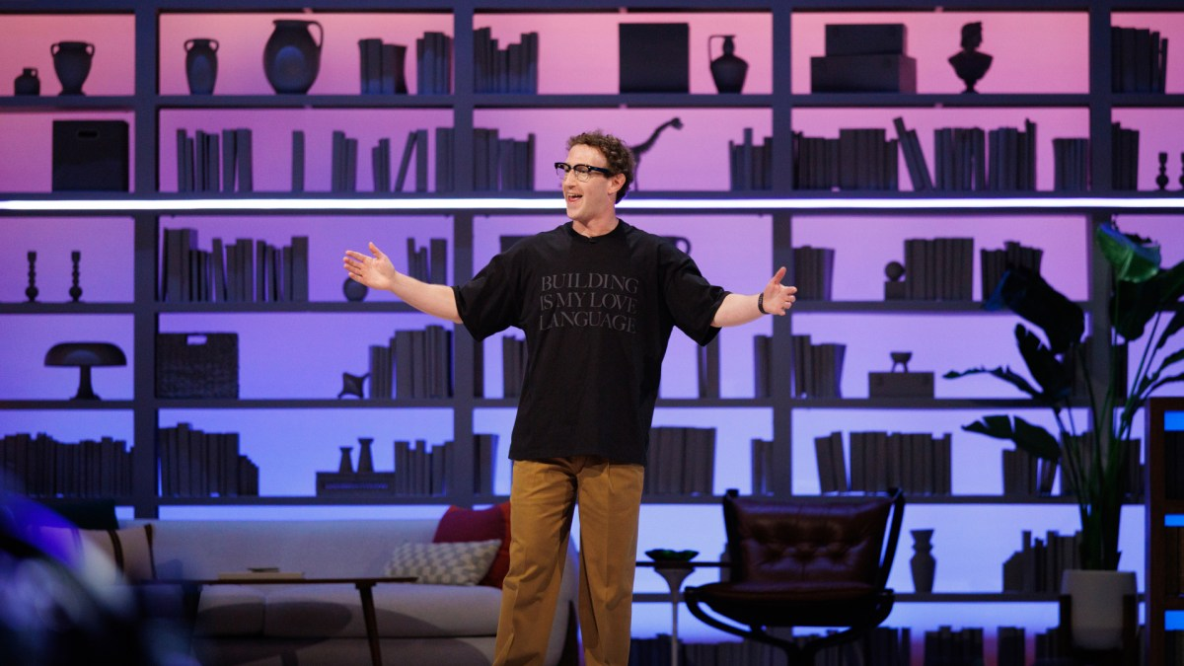
Assistants gain new voices and surfaces
Meta Connect
Glasses and
wearable previews
Gemini 3.8 TTS
Eleven v4
and Turbo
LongmontAI
08
Notes:
Meta expanded Muse to glasses and app connectors. Gen 3 is available; Audio preorder ships Oct 13; Charm is preview. Google Gemini Flash/Flash-Lite TTS reached API GA Sep 22–23, enterprise still coming. Eleven v4/Turbo launched Sep 28. Sources: https://about.fb.com/news/2026/09/the-biggest-news-from-connect-2026/ ; https://blog.google/innovation-and-ai/models-and-research/gemini-models/gemini-3-8-text-to-speech/ ; https://elevenlabs.io/blog/eleven-v4 . Live Avatar Sep 24 is Gemini Enterprise; custom avatars allowlisted, not a free consumer feature. Compare latency and pronunciation on a real script. No vendor preference scores required.
Image: official Meta Connect event photograph from https://about.fb.com/news/2026/09/the-biggest-news-from-connect-2026/

Slide 9
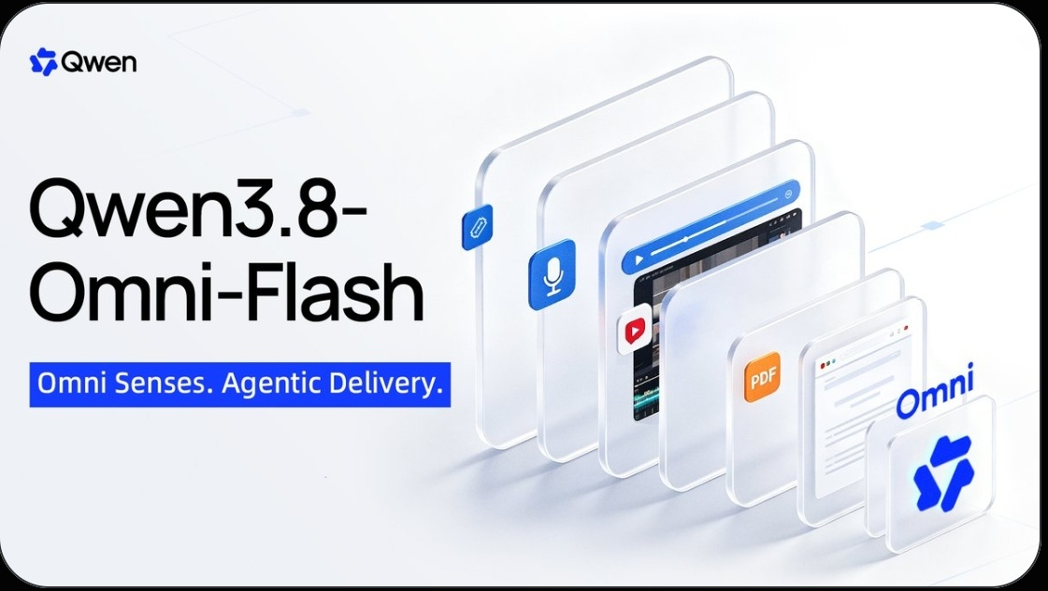
Multimodal choices broaden
MiMo-V2.6
Open weights
MIT Pro-RL checkpoint
Qwen3.8-Omni-Flash
Text, images, audio and video
LongmontAI
09
Notes:
MiMo Sep 22 Pro-RL checkpoint has native multimodal inputs. Qwen Sep 18 announcement, some-region deployment Sep 17. API availability does not establish open model weights for Qwen3.8-Omni-Flash. Separate Qwen-Image-2.1 Sep 20 is open-sourced image generation/editing. FLUX 3 Action Sep 23 is a 7B open-weight world-action research model that predicts video and robot actions, not ordinary image generation. Sources: https://mimo.mi.com/docs/en-US/updates/model ; https://huggingface.co/XiaomiMiMo/MiMo-V2.6-Pro-RL ; https://qwen.ai/research/qwen3.8-livetranslate ; https://bfl.ai/models/flux-3-action . Omit parameter-count clutter and comparative benchmarks.
Image: asset 14 from user-supplied Photos-1-001 screenshots. Official illustration only, social text excluded.

Slide 10
Suno Studio improves MIDI workflows
MIDI
MIDI generation
in chat
to audio
Studio update
September 17
LongmontAI
10
Notes:
In-window Studio update improves MIDI conversion/generation and clip controls. Suno v6 launched Sep 9, outside the reporting window; only background if discussed. Source: https://suno.com/release-notes/studio-improved-midi . v6, v6-wild and custom model claims remain Suno-reported. Practical audience example: import a familiar MIDI part and compare instrument/arrangement output.

Slide 11
AMD agrees to buy World Labs
$8.2B
All-stock acquisition agreement
Expected close by end of 2026
Approvals pending
LongmontAI
11
Notes:
AMD announced approximate $8.2B agreement, subject to approvals and customary conditions. Acquisition has not closed. World Labs develops spatial intelligence, interactive 3D environments and robot-learning technology. Source: https://ir.amd.com/news-events/press-releases/detail/1299/amd-to-acquire-world-labs-to-advance-the-future-of-ai-compute . Agreement does not itself launch a product. No speculative Anthropic IPO chart on this slide.

Slide 12
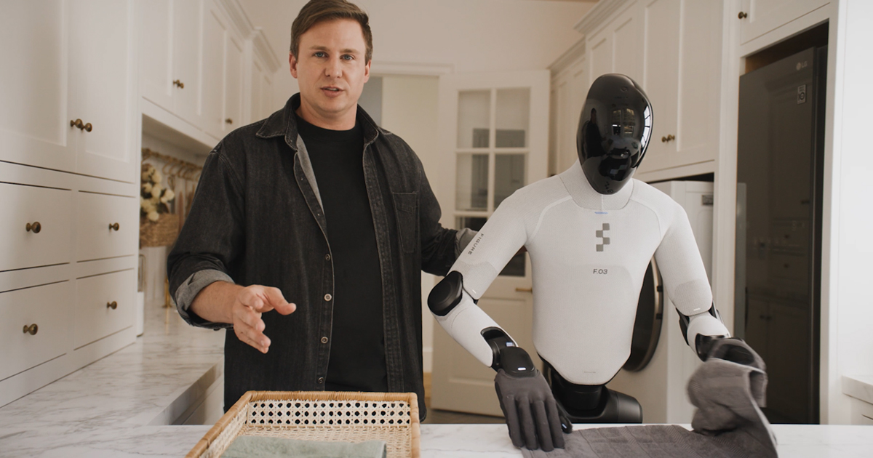
Helix 2.5 transfers to unseen homes
Full-task success, Figure-reported
30 unseen homes
Three household behaviors
LongmontAI
12
Notes:
Sep 17. Holding task data, architecture and evaluation fixed, Figure reports Index pretraining improved success from 9% to 56%. Trials require complete tidying, towel folding or bed-making, no partial credit. No evaluation-home adaptation. Three behaviors in Bay Area homes do not establish general household reliability. Source: https://www.figure.ai/news/helix-2-5-zero-shot-30-home-generalization . Do not compare directly to Tesla production volume.
Image: Figure official Helix 2.5 article open graph photograph, https://www.figure.ai/news/helix-2-5-zero-shot-30-home-generalization

Slide 13
NVIDIA puts controls around agents
Open Agent
Safety Platform
Sandboxing
Independent
monitoring
Policy enforcement
LongmontAI
13
Notes:
Open software plus reference system design. OpenShell software/skills available, Sentry BlueField-4 is a reference design, not a claim of full hardware GA. NVIDIA partner best-practice initiative is separate from White House accord. Source: https://nvidianews.nvidia.com/news/open-agent-safety-platform . Product claims do not prove agent risk solved.

Slide 14
Who grades the safety homework?
“Grading each
other’s homework”
Elon Musk
Six companies
Voluntary accord
External evaluation promised
LongmontAI
14
Notes:
White House Joint Commitment on Frontier Responsibilities includes monitoring, internal checks, external auditors/evaluators and independent board oversight. Participants: NVIDIA, xAI, Anthropic, Google, Meta, OpenAI. Voluntary; no mandatory government enforcement or public release of findings. Source: https://www.sbs.com.au/news/article/ai-industry-ceos-bow-to-trump-led-push-for-self-regulation/j9rdp2hr4 ; https://www.nextgov.com/artificial-intelligence/2026/09/white-house-unveils-super-intelligence-executive-order-and-industry-accord/416325/ ; https://www.theguardian.com/us-news/2026/sep/29/trump-ai-deal-tech-ceos-superintelligence . Reporting attributed rather than primary documentation. Buyers can ask for testing scope, evaluator independence and remediation evidence.

Slide 15
One real job is the next test
Quality and total cost
Time saved
The agent’s actual work
Which workflow would you try first?
LongmontAI
15
Notes:
These are editorial practical prompts, not measured findings. Choose a job you currently run on a flagship model. Keep acceptance criteria, tools and harness stable. Preserve human confirmation for consequential actions. For creative tools, compare the same script or musical brief. For robots, ask about new-environment success rather than only demo clips.

Slide 16
Sources and release detail
Models and pricing
DevDay and agents
OpenAI, Anthropic, xAI
OpenAI DevDay 2026 recap
Physical AI
Voice, music and safety
AMD, Figure, NVIDIA
Google, Suno, industry reporting
Benchmarks and product claims are vendor-reported
LongmontAI
16
Notes:
Complete source URLs appear on the relevant slides. Prices are standard short-context list prices as of September 30, 2026. Benchmarks, product performance and speed comparisons are vendor-reported. Altimeter token-demand data is historical context, with an annualized August 2026 estimate for 2026E.
Complete source URLs are preserved in the notes on every topic slide. Original article: https://app.notion.com/p/3eb57c81addd8170a56bed2415d972f4

