Slide 1
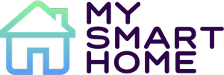
SmartHome
G11

Slide 2
Objectives of the project
Control your appliances in a remote way making your life easier
Monitorize the status of your home in the app
Send notifications to the user if anything goes wrong

Slide 3
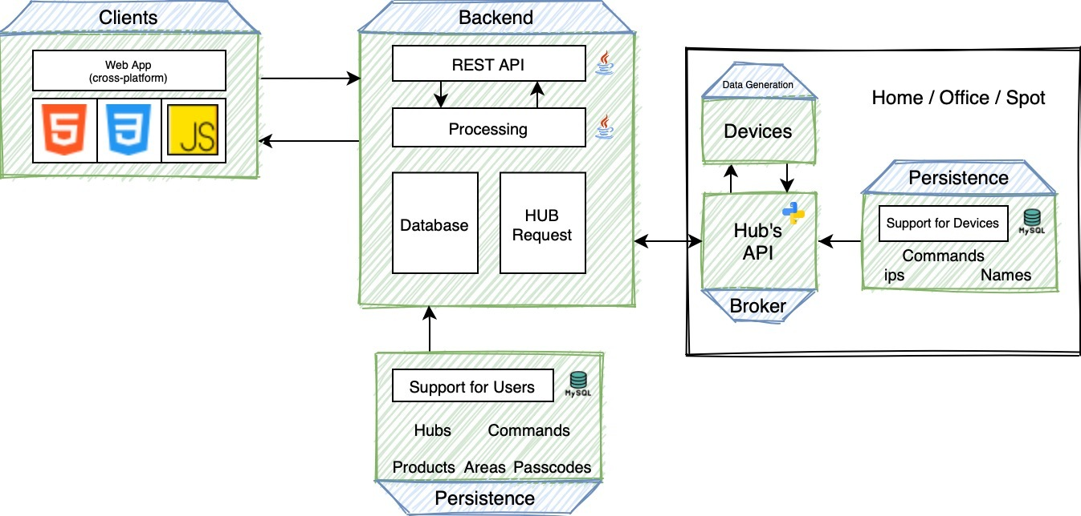
Architecture

Slide 4



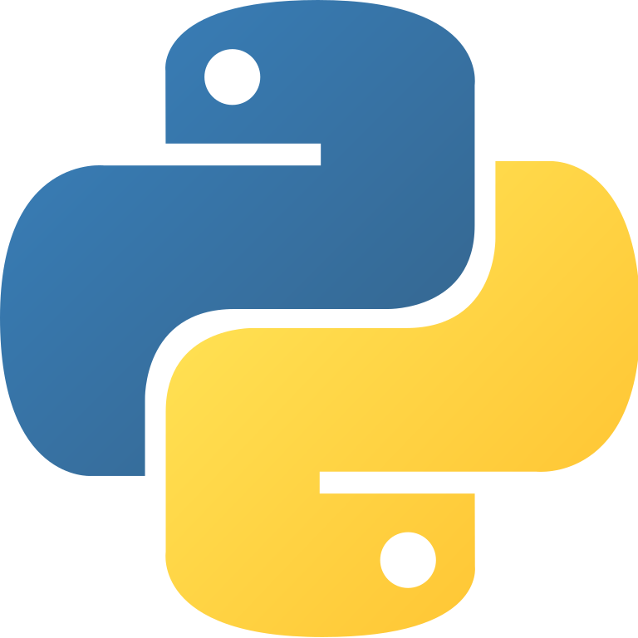
Backend
Data and Messages Generation
Database Model

Slide 5
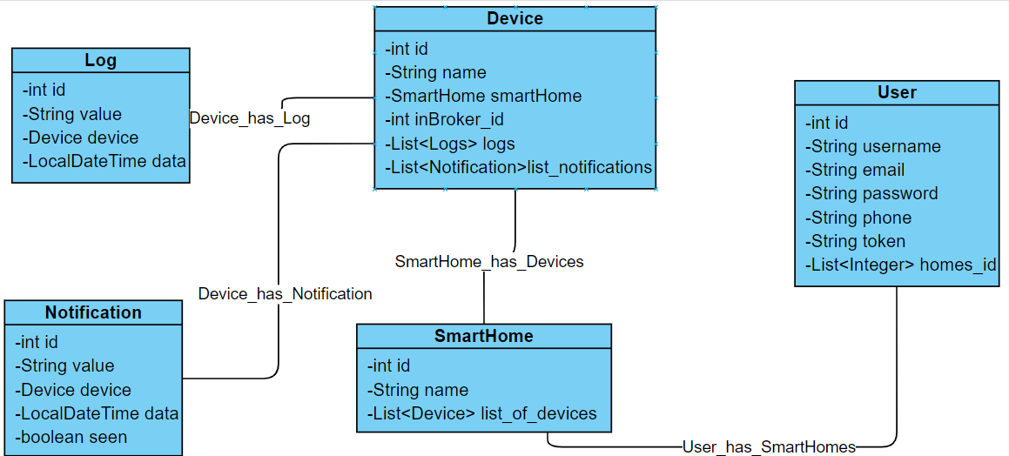
Database Model

Slide 6
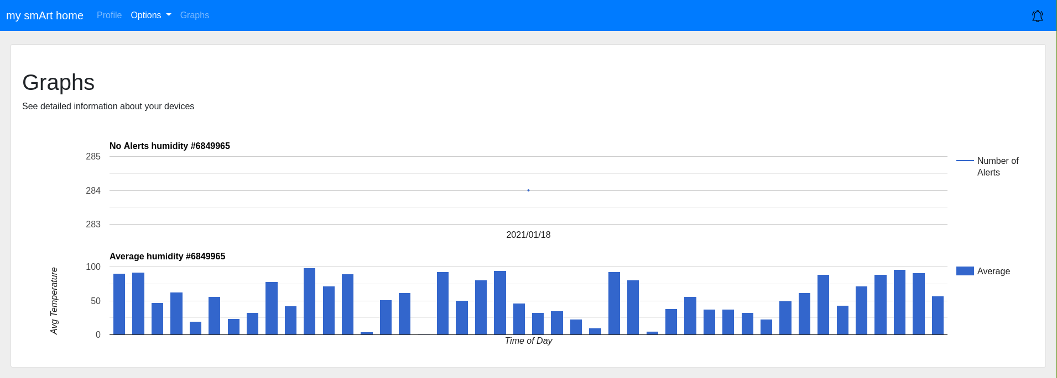
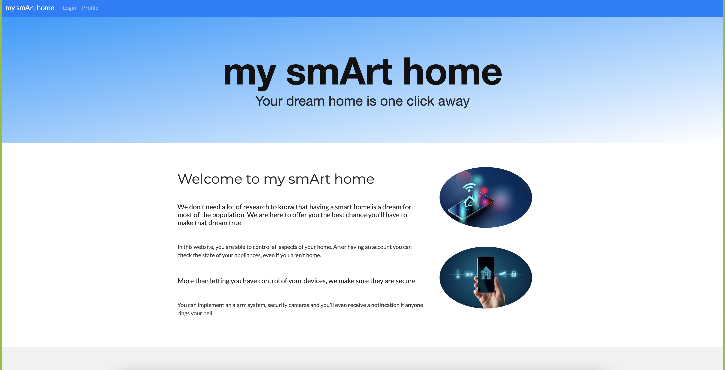
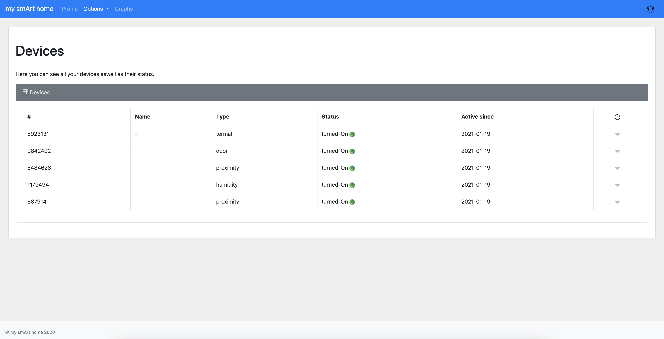
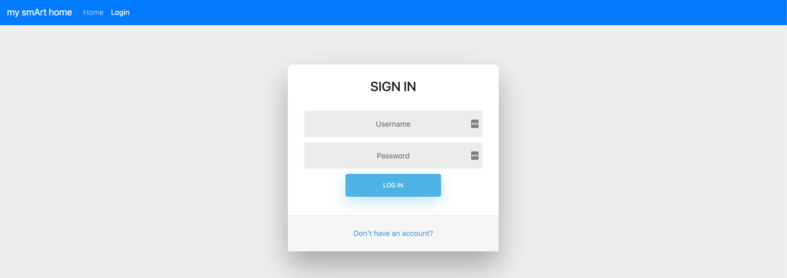
Main View

Slide 7
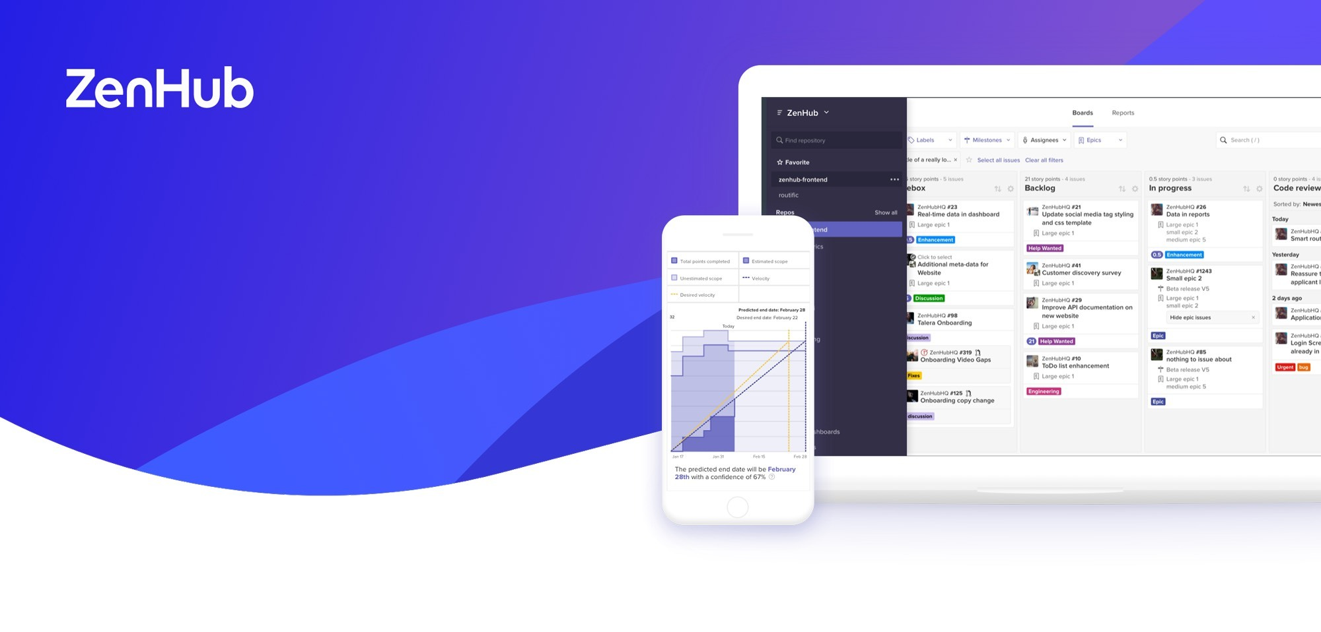
Agile Concept

Slide 8
Team
Eduardo Santos
Diogo Moreira
Andre Filipe Morais
Gonçalo Pereira
Óscar Sánchez

