Slide 1
Model Predictive Control A Model Predictive Control Strategy of PV-Battery Microgrid Under Variable Power Generations and Load Conditions
Berkay Nerse | Kerim Moral
Instructor: Assoc. Prof. Yaprak Yalçın
20.01.2021

Slide 2
Content
1. Introduction
2. Microgrid configuration and modeling
3. SOC-oriented control of BES
4. Proposed MPC strategy of interlinking converter
5. Energy management system
6. Case studies
7. Application
8. Conclusion

Slide 3
Introduction
Nowadays, the need for renewable energy has increased due to environmental problems and problematic resources used. Although simplified AC grid systems by taking DC equivalence are good for the literature, they are not scalable due to the problems arising in applications. To avoid this situation, variable generation and consumption should be considered together in the grid.
In such systems, the interlinking converter plays an important role in ensuring power balance. In autonomous mode, the ac/dc interlinking converter is controlled to provide a stable ac voltage and frequency for the ac grid. The dc-bus voltage is maintained by the bidirectional dc-dc converter. Besides these systems, battery energy storage (BES) is used to support the grid.

Slide 4
Introduction
In the literatures conventional multiple feedback loops with proportional-integral-differential (PID) controllers are commonly used to control the interlinking converters. Conventional cascade linear controllers suffer from PID parameters tuning work and low dynamic response, due to their cascaded structures. Besides, complicated coordination transformation and PWM modulation are needed. Also, different control structures are required for grid-tied and autonomous operations.
Even grid-connected operation has also been achieved, another concern is raised from the operation of BES. The BES is kept discharging or being charged with constant rate in grid-connected mode. By using SOC feedback and real-time power allocation, a control strategy was developed for smoothing the fluctuating output of the renewable energy. The details about BES operation in grid-connected mode is however not investigated.

Slide 5
Introduction
However, battery technologies related to SOC estimation are being investigated. Even so, some techniques are used due to their proper computational load and sufficient accuracy. For examples Luenberger observers and Kalman filters. Another topic in the existing microgrid control is the reactive capacity for the grid support. It has been demonstrated that when reactive power support is done with localized control, 80% savings are made.
To address the issues mentioned above, a model predictive control (MPC) strategy is developed in this paper. MPC is applied to control the interlinking converter to achieve multiple objectives including stable voltage supply, flexible power regulation and grid support in ac/dc microgrids.

Slide 6
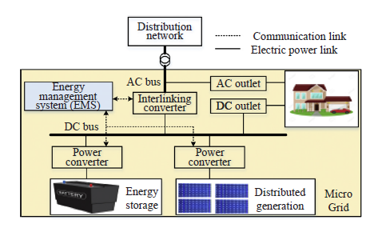
Microgrid configuration and modeling
A solar PV array is connected to the dc bus through a dc/dc boost converter.
A battery as energy storage is connected to the same dc bus via a bidirectional dc/dc converter.
The ac and dc buses are interconnected through a bidirectional ac/dc interlinking converter.

Slide 7
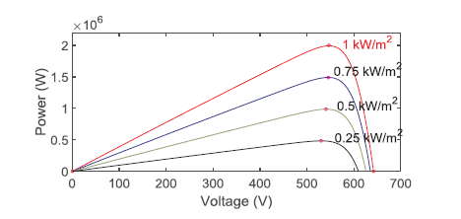
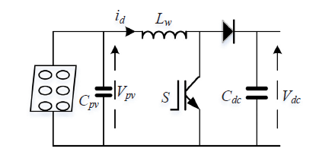
Modeling of PV system
The PV array is connected to the common power points of the power-voltage curves are associated dc-bus through a boost dc-dc converter.
Under different solar irradiance, the maximum with different output voltages.

Slide 8
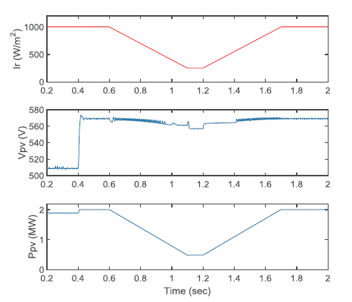
Modeling of PV system
To maximize the utilization of solar energy from the PV farm, solar PV system should be operated in maximum power point tracking (MPPT).
The MPPT techniques of solar PVs have been widely developed. Here, an incremental conductance method is used. The PV system performance is shown in the figure. The MPPT algorithm starts to operate at 0.4 sec.
It can be seen that the PV system is continuously adjusting the optimal voltage under solar irradiance variation.

Slide 9
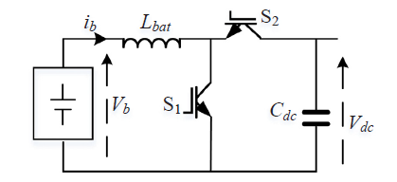
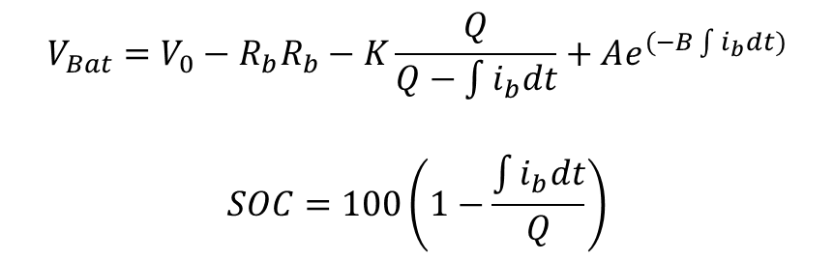
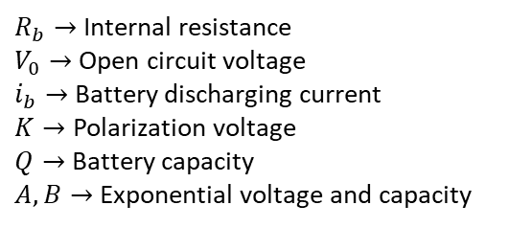
Modeling of battery energy storage (BES)
$$V_{Bat}=V_{0}−R_{b}R_{b}−K\frac{Q}{Q−\int{i_{b}dt}}+Ae^{(−B\int{i_{b}dt})}$$
$$SOC=100\left(1−\frac{\int{i_{b}dt}}{Q}\right)$$
$R_{b}→$ Internal resistance
$V_{0}→$ Open circuit voltage
$i_{b}→$ Battery discharging current
$K→$ Polarization voltage
$Q→$ Battery capacity
$A, B→$ Exponential voltage and capacity
The battery is connected to the dc-bus through a bidirectional buck-boost converter for charging or discharging.

Slide 10
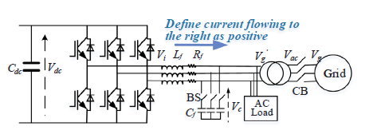

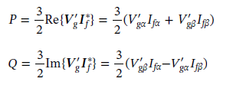


Modeling of the interlinking converter
The ac/dc interlinking converter is the main power converter of the system.
For smooth power transfer
For flexible active and reactive powers regulation
Switches
In autonomous mode bypass switch is turned ON
In grid-tied mode circuit breaker CB is turned ON

Slide 11
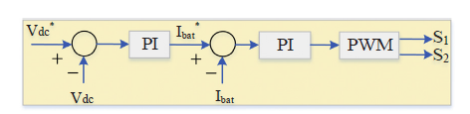
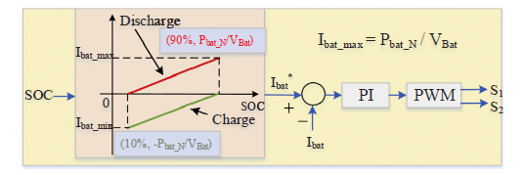
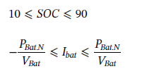
SOC-oriented control of BES
The bidirectional dc-dc converter is used to inject power to, or absorb power from the dc-bus.
For instance, when the dc-bus voltage is greater than the reference, the outer voltage controller generates a negative current reference.
The inner current loop then adjusts duty cycle to force the current flow from the dc-bus to the battery, which results in charging the battery.
On the contrary, if the dc-bus voltage is lower than the nominal value, a positive current reference is produced.

Slide 12
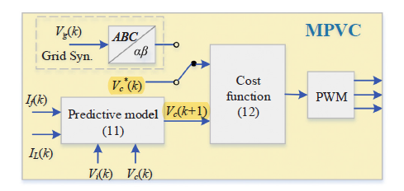


Proposed MPC strategy of interlinking converter
Model Predictive Voltage Control (MPVC)
In autonomous operation, dc/ac interlinking converter aims to provide a stable ac voltage for the ac load.
Capacitor isthe control objective of the MPC controller.

Slide 13
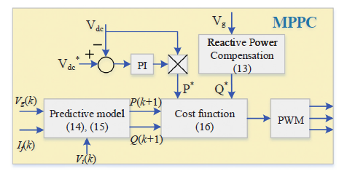
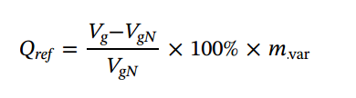
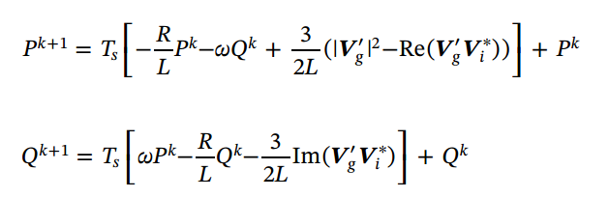

Proposed MPC strategy of interlinking converter
Grid-tied mode
After the power references are obtained, an MPC algorithm is developed to control the active and reactive powers.
In MPC, the system model is used to predict the behavior of variables at next sampling instant, and a cost function is then employed as the criterion to select the optimum voltage vector of the converter.
Finally, the voltage vector that can minimize the cost function is applied in the next sampling period.

Slide 14
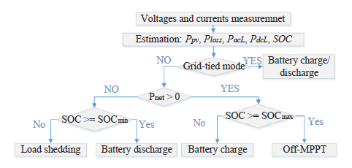
Energy management system
If the power generated by the PV is insufficient for the power demand at the load side, the battery discharges to provide addition power if its SOC is greater than the minimum value, otherwise load shedding is needed.
In case of power generation exceeding the load consumption, the battery is charged to store the surplus power. If the battery SOC exceeds its maximum, Off-MPPT operation is required.

Slide 15
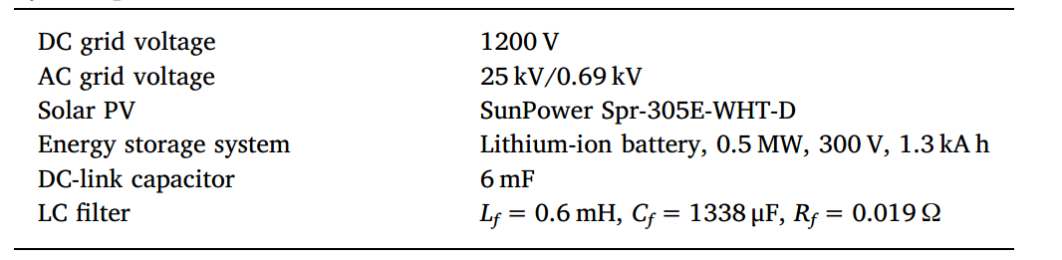
Case Studies
Simulation parameters are as given above.
The microgrid is connected to the 25 kV line through a 260 V/25 kV 2.5MVA transformer, and then further connected to the 120 kV line through a 19-km feeder and a 25 kV/ 120 kV 47MVA transformer.
The switching frequencies of PV converter and battery converter are 5 kHz.
The sampling frequency of the ac/dc interlinking converter is 20 kHz, resulting in about 3.3 kHz average switching frequency

Slide 16
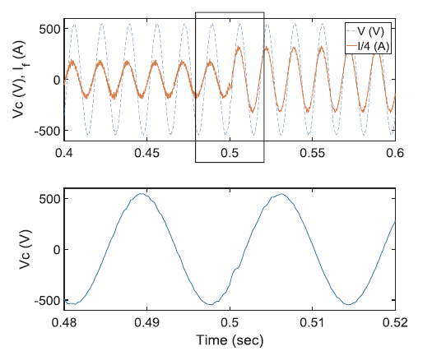
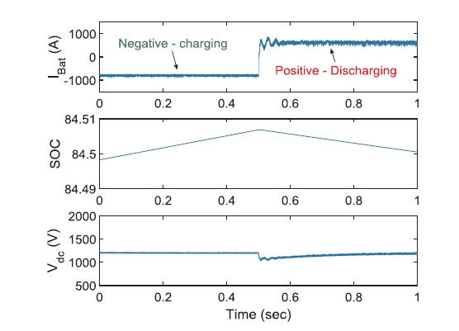
Autonomous Mode
The ac load steps up from 0.5 MW to 1 MW at 0.5 s.
It can be seen that the interlinking converter automatically increases the output current to meet the load demand, while the ac voltage maintained stable.
A 0.3 MW dc load is switched in at 0.5 s.
It can be seen that the bidirectional dc-dc converter is able to maintain the dc-bus voltage and regulate the charging current properly to keep the power balance.

Slide 17
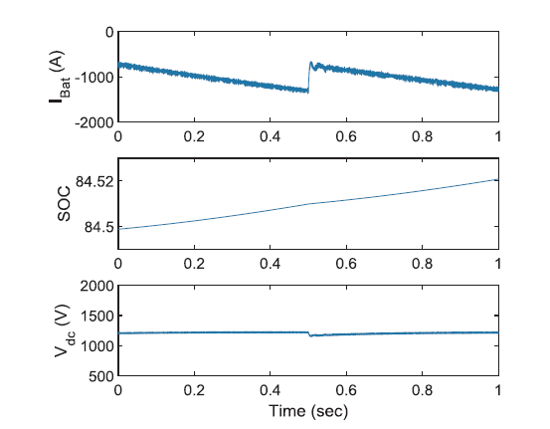
Autonomous Mode
When grid synchronization starts, the voltage reference is set as the actual grid voltage.
Once the ac voltage can match the grid voltage, the micro-grid can be connected to the utility grid.

Slide 18
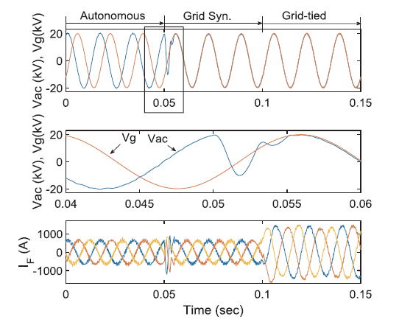
Grid synchronization mode
At autonomous operation, the ac/dc interlinking converter is controlled using model predictive voltage control scheme to establish stable ac voltage.
When grid synchronization starts, the voltage reference in cost function is set as the actual grid voltage.
It can be observed that the microgrid voltage can track the grid voltage tightly within 5ms, prompting smooth grid connection without major overshoot current.
After successful grid connection, the power can be transferred between the microgrid and utility.

Slide 19
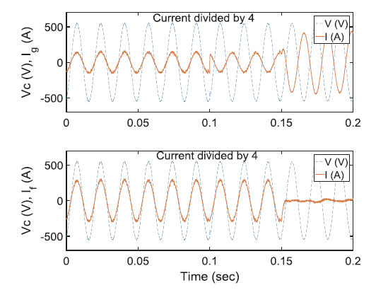
Grid-tied mode
The battery charging/discharging current is regulated by the bidirectional dc-dc converter according to the SOC.
The solar irradiation is fixed at 600 W/m2 (around 1.2MW output). A 0.5MW ac load is kept connected. Another 1MW ac load is connected at 0.1 s and 1MW dc load is connected at 0.15 s.
The figure presents responses at the ac side of the microgrid.

Slide 20
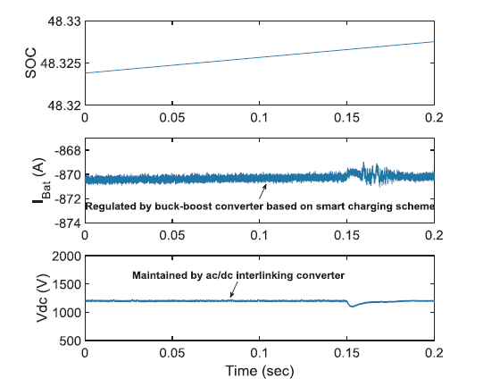
Grid-tied Mode
The figure shows the responses of the battery and the dc-bus voltage.
It is seen from grid current direction that the power is injected from the utility to the microgrid after 0.1 s because the PV generation is less than the total load demand.
It can be also seen that the direction of the interlinking converter output current is reversed after 150ms.
This means that the power is passed to dc sub-grid for the dc load and the battery charging.

Slide 21
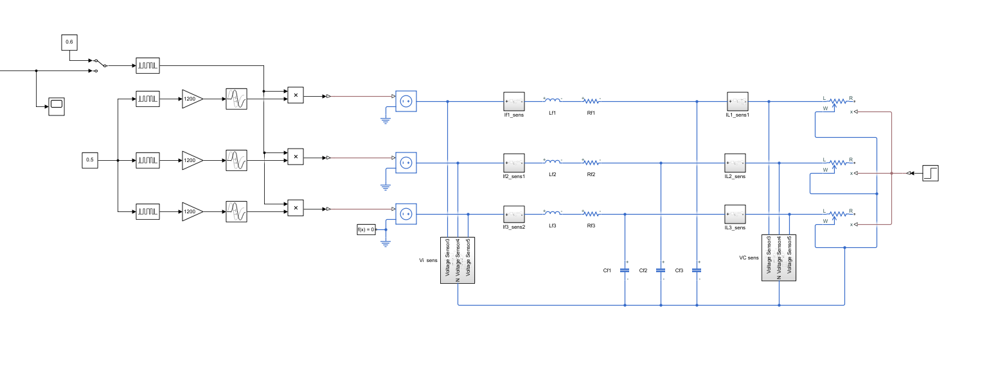
Plant model built in simscape

Slide 22
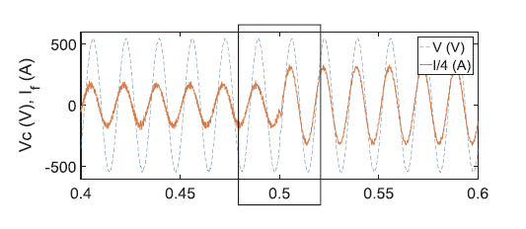
Open-loop plant response
Simulation result
Expected simulation result
I_L differences with varying loads (0.5 MW to 1 MW).

Slide 23
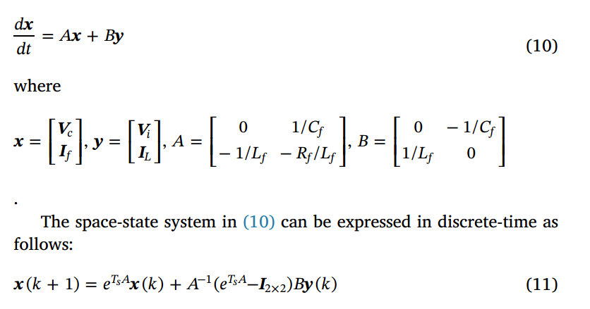
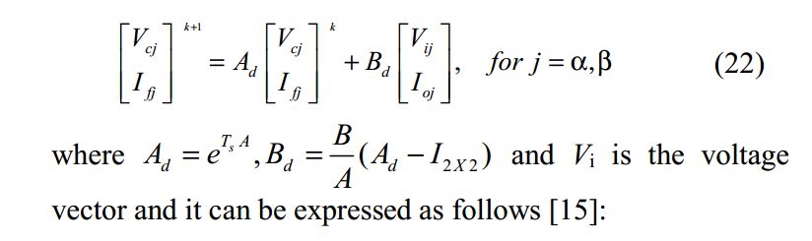
Predictive Model

Slide 24

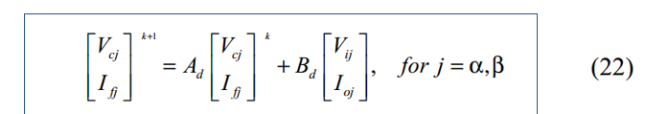


Cost-function formulation
Prediction function is:
For
$$Y=\tilde{F}\tilde{x}+\tilde{H}\tilde{u}$$
Type of systems cost function can be computed as:
$${J=u}^{T}μu+2f^{T}u+b$$
where
$\tilde{F}=Ad,\tilde{H}=Bd, w=V_{c}^{ref},μ$ = $\tilde{H^{T}}H, f=\tilde{H^{T}}\tilde{F}\tilde{x−}H^{T}$w for one step ahead prediction.

Slide 25
MPC modeling and simulation
3 Different Models have been built to test and Simulate MPC Structure:
MPC as .m-file + Simscape Plant Model
MPC as .m-file + State Space Plant Model
MPC toolbox + State Space Plant Model

Slide 26
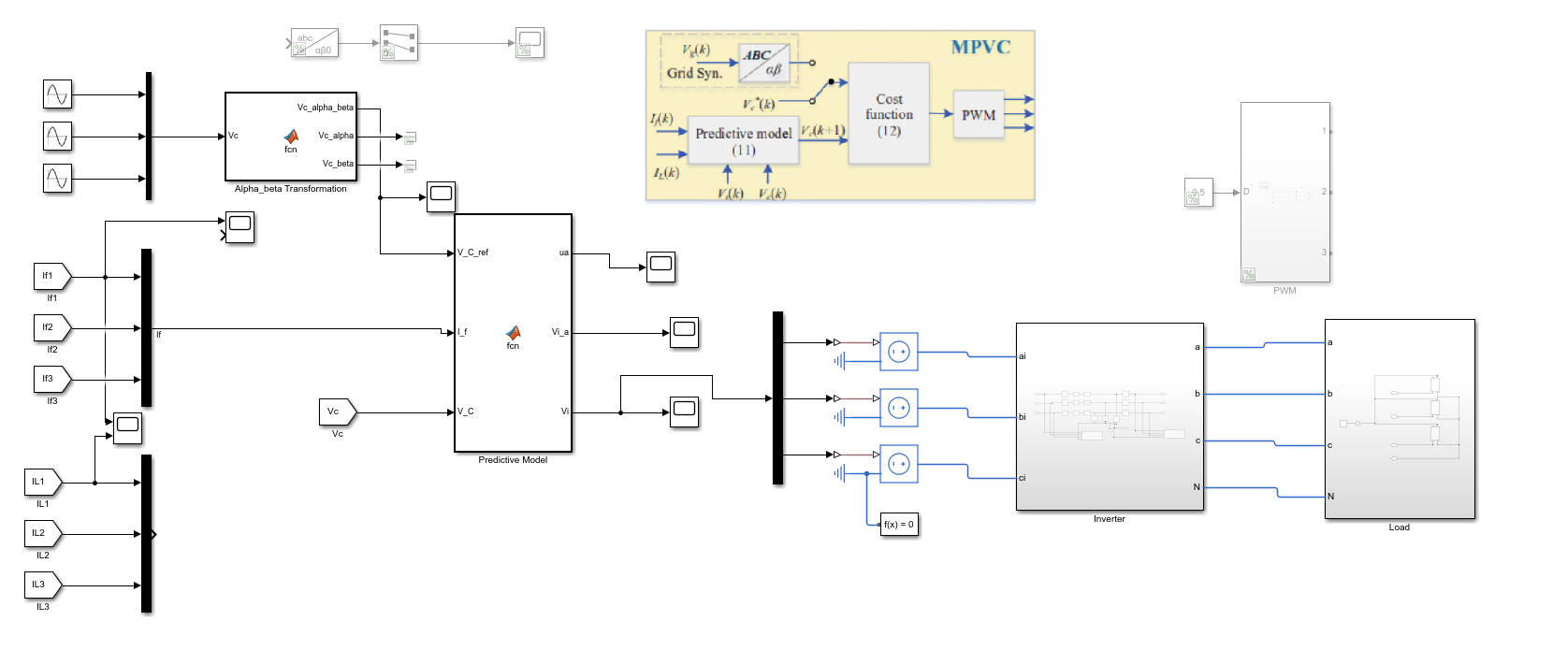
MPC as .m-file + Simscape Plant Model

Slide 27
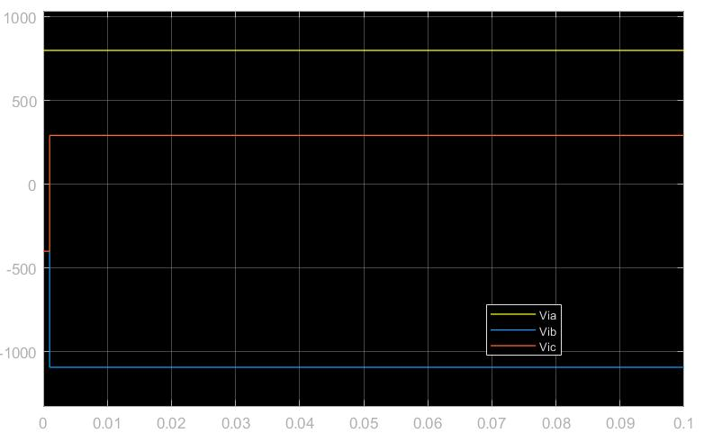
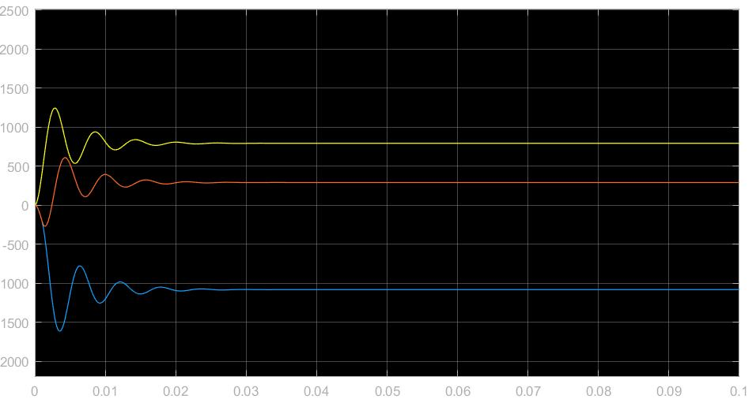
MPC as .m-file + Simscape Plant Model
Plant Input
Plant Output

Slide 28
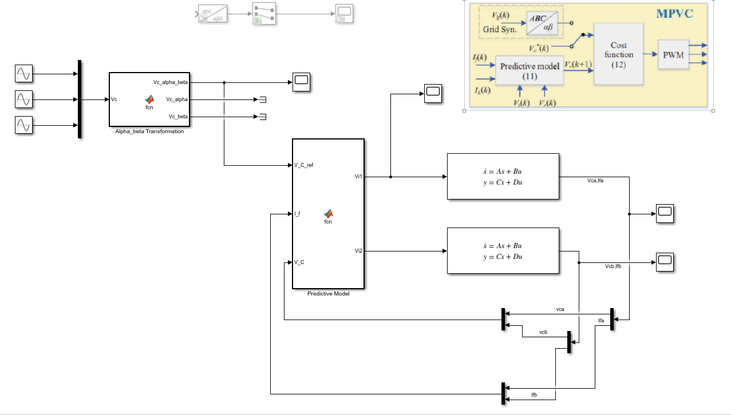
MPC as .m-file + State Space Plant Model

Slide 29
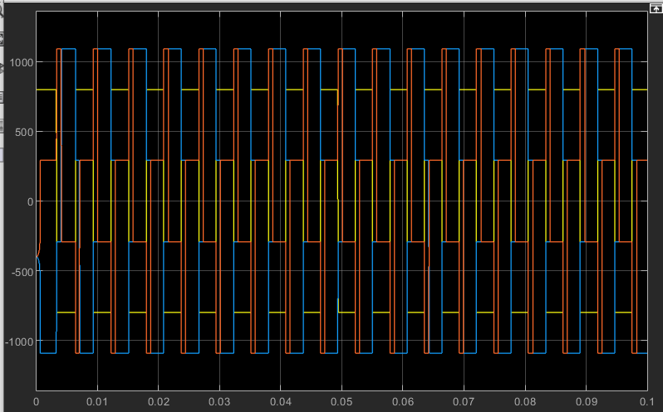
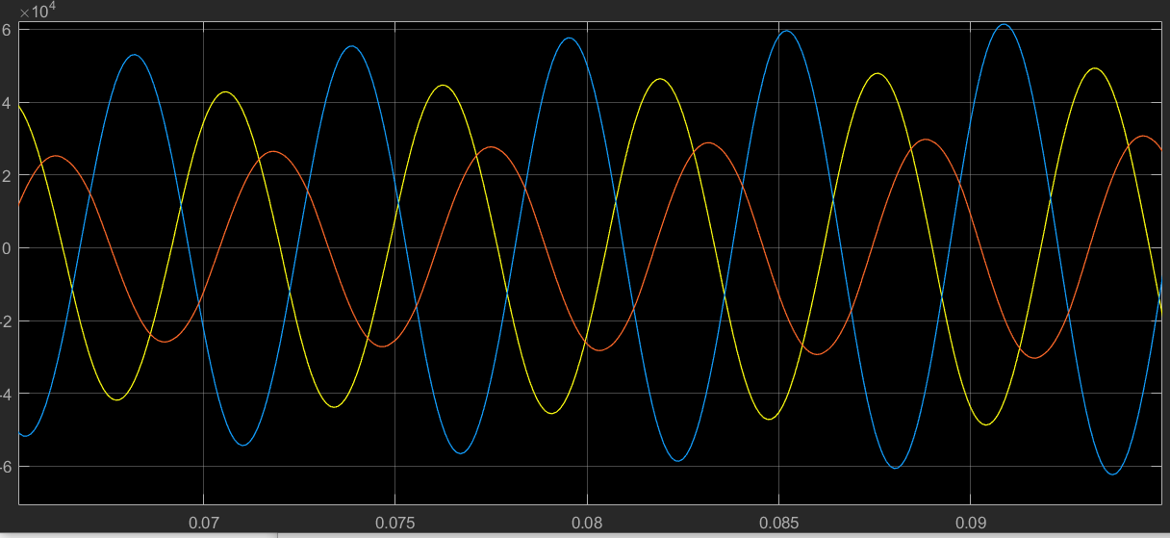
MPC as .m-file + State Space Plant Model
Plant Input
Plant Output

Slide 30
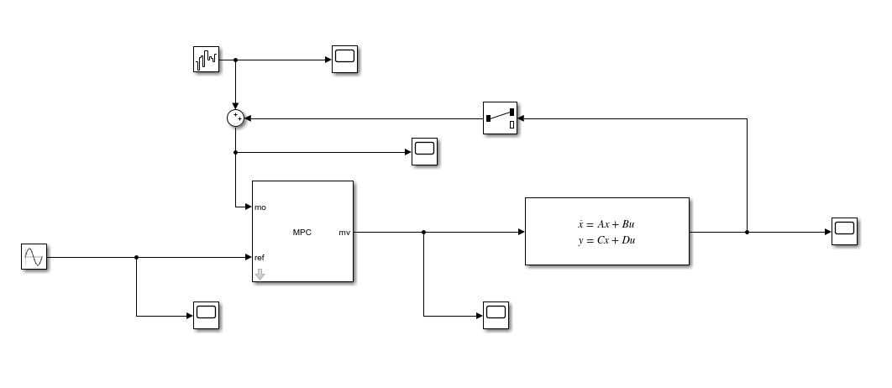
MPC toolbox with state-space plant model

Slide 31
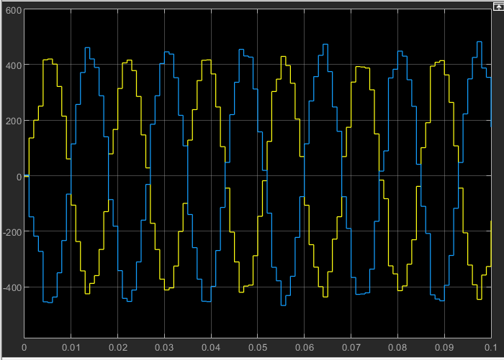
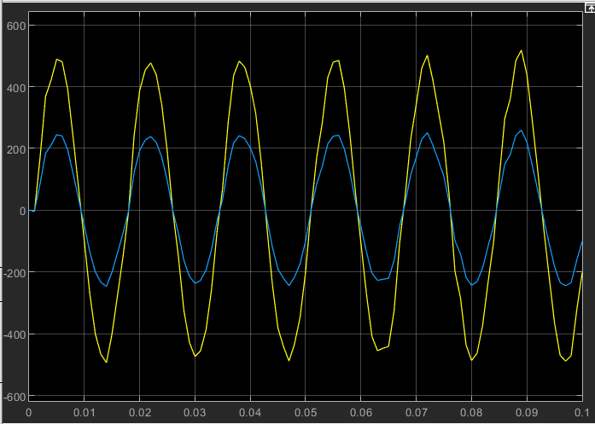
MPC toolbox with state-space plant model
Plant Input
Plant Output

Slide 32
Conclusion
First, the working principle of the systems on the article was examined. Then, open loop simulations were made over the main components. Different MPC approaches have been tried. In some approaches, results (sinusoidal signals and phase angles) similar to the outputs in the article were obtained.

Slide 33
THANK YOU FOR LISTENING

