Slide 1
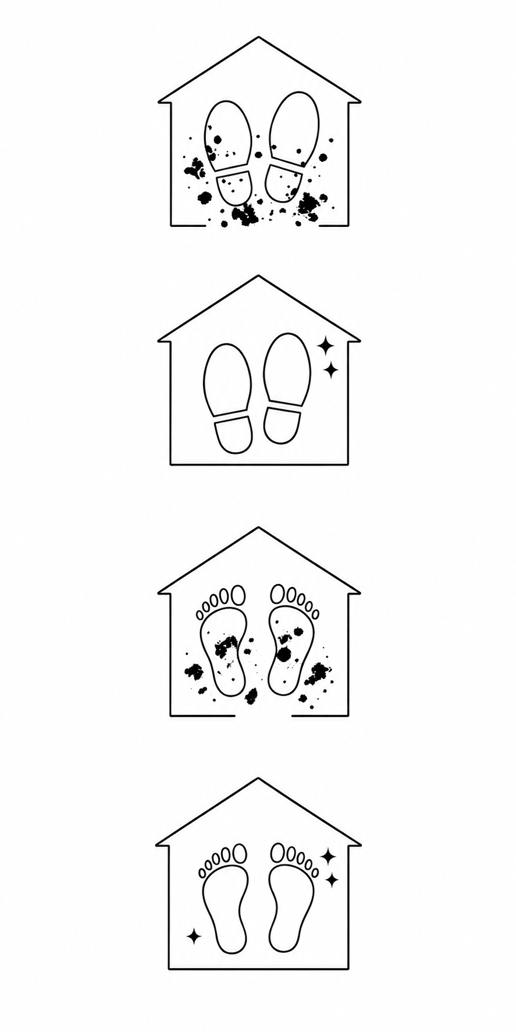
Violation
Literal
Violation
Literal
Compliance
Compliance

Slide 2
