Slide 2
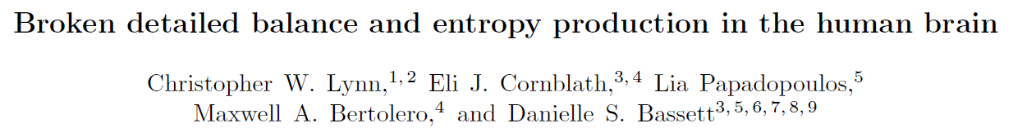
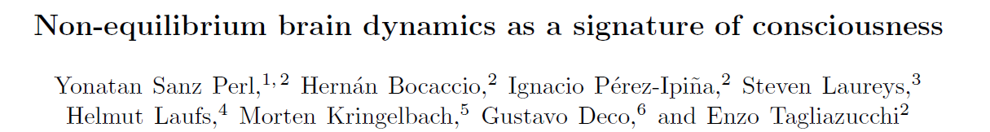
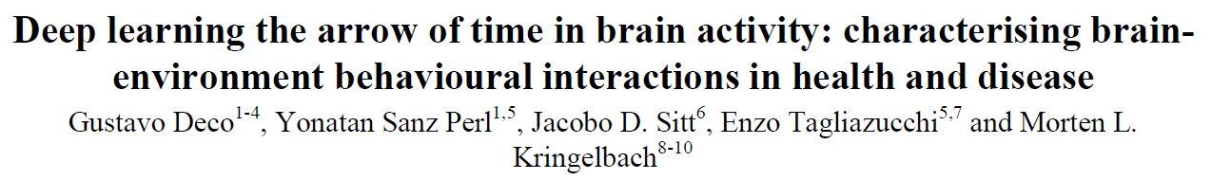
Roadmap:

Slide 3
General considerations
Living matter
=
Non-equilibrium

Slide 4
General considerations
Living matter
=
Non-equilibrium

Slide 5
General considerations
Living matter
=
Non-equilibrium
Scale-dependant violation
Externally or intrinsically driven

Slide 6
General considerations
Living matter
=
Non-equilibrium
Scale-dependant violation
Externally or intrinsically driven
Broken detailled balance

Slide 7
General considerations
Living matter
=
Non-equilibrium
Scale-dependant violation
Externally or intrinsically driven
Broken detailled balance
Probability flux
Entropy production

Slide 8
General considerations
Living matter
=
Non-equilibrium
Scale-dependant violation
Externally or intrinsically driven
Rotational if steady state
Broken detailled balance
Probability flux
Entropy production

Slide 9
General considerations
Living matter
=
Non-equilibrium
Scale-dependant violation
Externally or intrinsically driven
Rotational if steady state
Broken detailled balance
Probability flux
Curl
Entropy production

Slide 10
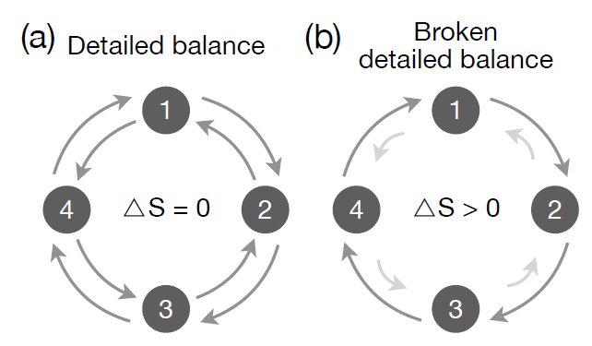
General considerations
Living matter
=
Non-equilibrium
Scale-dependant violation
Externally or intrinsically driven
Rotational if steady state
Broken detailled balance
Probability flux
Curl
Entropy production

Slide 11
General considerations
Case study: The Brain

Slide 12
Roadmap:

Slide 13
Broken detailed balance and entropy production in the human brain
Motivation: Microscopic processes (enzimatic, metabolic) involve non-equilibrium dynamics. Coarse graining results in “effective” macroscopic dynamics reaproaching equilibrium.
Aim: Quantify macro broken detailled balance via entropy production
Methodolody: PCA, 2D projection, flux analysis
Theoretical framework: Asymmetric Sherrington-Kirkpatrick Model
Experimental data: whole brain activity via fMRI. 590 adults, 100 cortical parcels

Slide 14
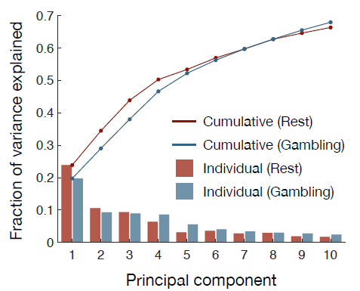
Broken detailed balance and entropy production in the human brain
Principal Component Analysis
Natural choice for low-dim embedding
About 30% of variance is explained by 2 first PCs

Slide 15
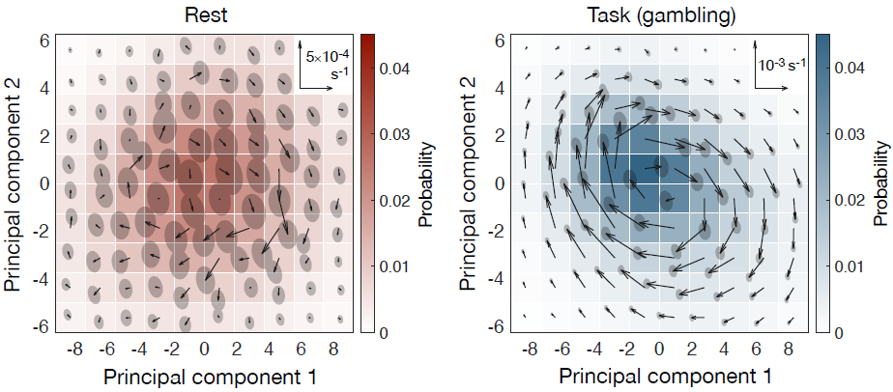
Broken detailed balance and entropy production in the human brain
Principal Component Analysis
Natural choice for low-dim embedding
About 30% of variance is explained by 2 first PCs
2D Projection in state space
Obs: Net flux at rest Neural dynamics break det. bal. at large scales
Q: Purely structural origin? Examine task dependency (eg. gambling)
Combined PCs of rest and gambling as axes for consistent visualization

Slide 16
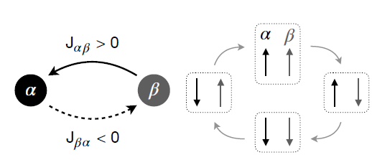
Broken detailed balance and entropy production in the human brain
Emergence of macroscopic broken detailed balance
Asymmetric interactions for Ising results in microscopic divergence from detailled balance
Loops of flux involving pairs of spins appear

Slide 17
Broken detailed balance and entropy production in the human brain
Emergence of macroscopic broken detailed balance
Asymmetric interactions for Ising results in microscopic divergence from detailled balance
Loops of flux involving pairs of spins appear
Q: Can this originate macroscopic violations of DB?
Sherrington-Kirkpatric with N = 100 (100 parcelations) Interactions Jab drawn from Gaussian with var 1/N

Slide 18
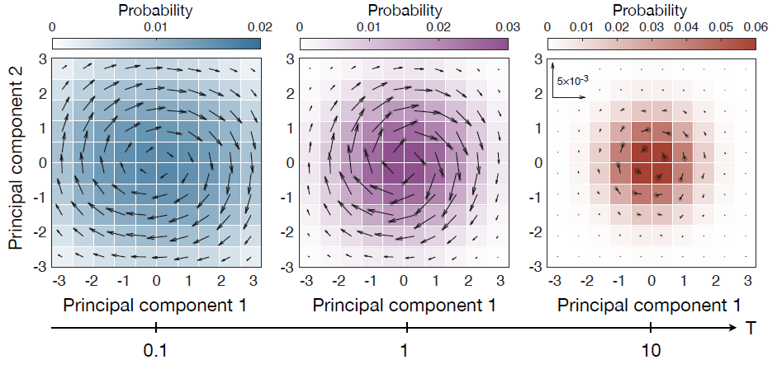
Broken detailed balance and entropy production in the human brain
Emergence of macroscopic broken detailed balance
Asymmetric interactions for Ising results in microscopic divergence from detailled balance
Loops of flux involving pairs of spins appear
Q: Can this originate macroscopic violations of DB?
Sherrington-Kirkpatric with N = 100 (100 parcelations) Interactions Jab drawn from Gaussian with var 1/N
Simulation and 2D projection via PCA

Slide 19
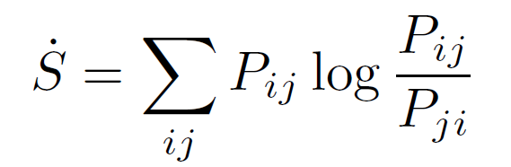
Broken detailed balance and entropy production in the human brain
Entropy production
Microscopically well defined and accesible-
Lower bounded by information-theoretic entropy production in macroscopic systems
For Markovian dynamics:
KL Divergence between Pij and Pji
If transtition probs are equal, no net flux → detailled balance
Problem: requires stimating all Pij; number of states grows exp with size N
Instead: Hierarchical clustering → Reduced number of coarse-grained states

Slide 20
Broken detailed balance and entropy production in the human brain
Findings
Net fluxes at rest → Brain activity belong to non-equilibrium
Increased flux when active. Task dependency
Higher entropy production when physical or cognitive effort involved

Slide 21
Roadmap:

Slide 22
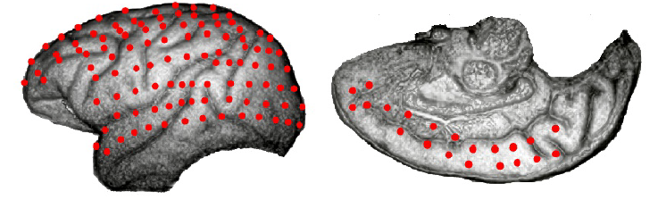
Non-equilibrium brain dynamics as a signature of consciousness
Motivation: Macroscopic brain dynamics shown to be non-eq. Still the. Brain states associated with unconsciousness could obey macro detailled balance, while being supported by microscopic non-equilibrium.
Aim: Investigate relationship between conciousness and non-eq dynamics
Methodolody: PCA, 2D projection, flux analysis
Theoretical framework: Former paper, semi-empirical models
Experimental data: Electrocorticography (128 channels) fMRI fitted on semi-empirical models (data enhancement) 2 non-humane primates, 4 different unconsciousness states

Slide 23
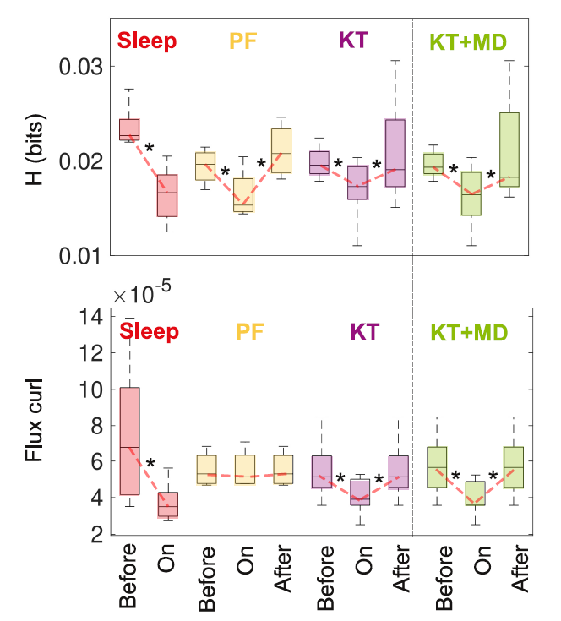
Non-equilibrium brain dynamics as a signature of consciousness
Sleep, Propofol, Ketamine, Medetomidine
Stimated violations of detailed balance
Entropy production is reduced when entering unconscious states
Significantly lower fluxes for unconscious states (except propofol)
Independent of spectral frequency

Slide 24
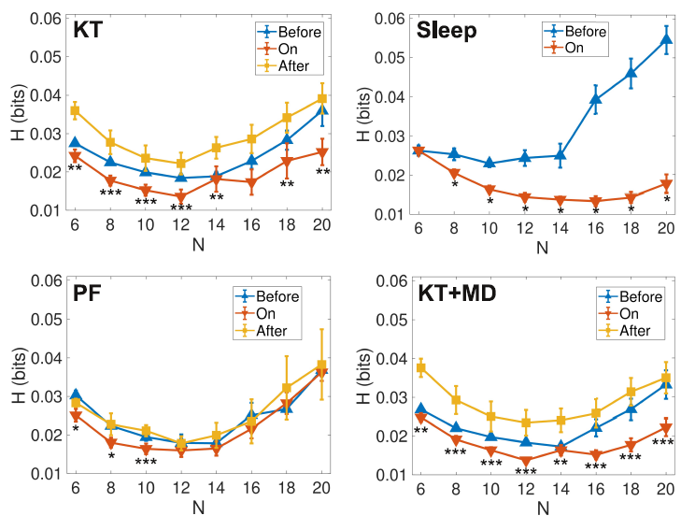
Non-equilibrium brain dynamics as a signature of consciousness
Sleep, Propofol, Ketamine, Medetomidine
Stimated violations of detailed balance
Entropy production is reduced when entering unconscious states
Significantly lower fluxes for unconscious states (except propofol)
Independent of spectral frequency
Entropy production depends on grid size (partition) Minimum about N=10-12

Slide 25
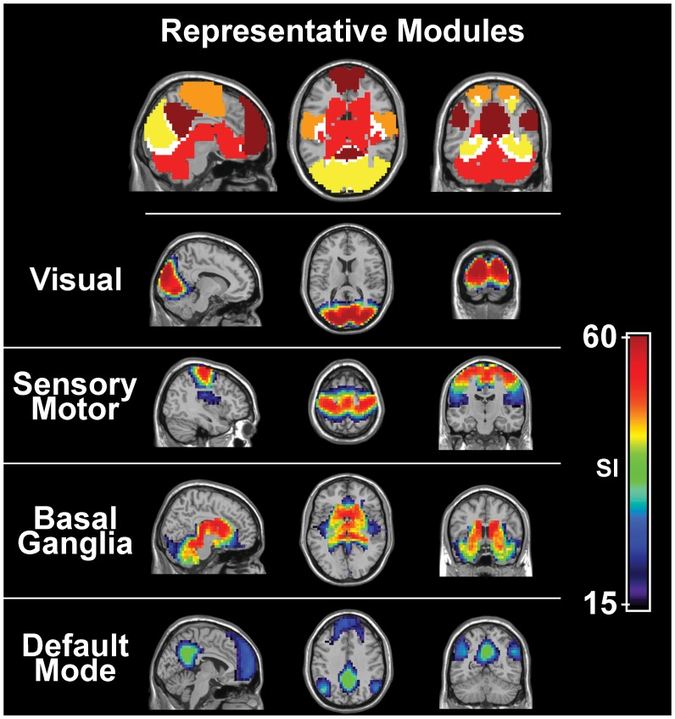
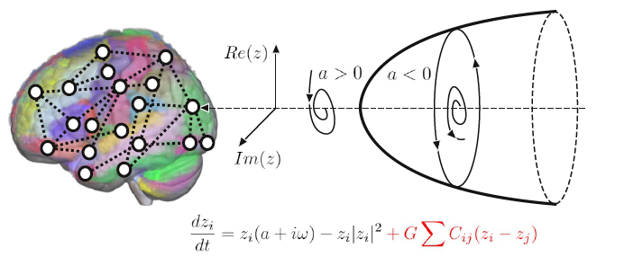
Non-equilibrium brain dynamics as a signature of consciousness
Semiempirical model for data enhancement
- Human fMRI recordings - Diffusion Tensor Imaging to infer structural connectivity - 90 brain regions → Investigate brain’s large-scale functional connectivity
- Empirical priors (coupling strength) from Resting State Networks

Slide 26
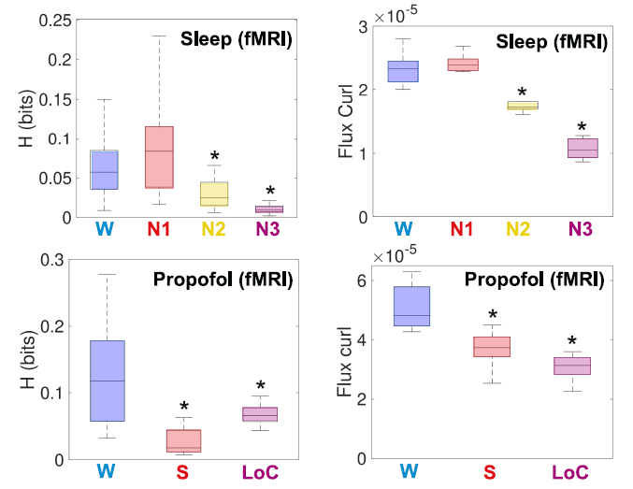
Non-equilibrium brain dynamics as a signature of consciousness
Results from 2nd model
Wake, NREM N1, N2, N3
Wake, Sleep, Loss of Consciousness
(2 doses)
Deep sleep (N2, N3) lowers entropy production and probability current curl
Propofol sedation and loss of consciousness as well

Slide 27
Non-equilibrium brain dynamics as a signature of consciousness
Results from 2nd model
Wake, NREM N1, N2, N3
Wake, Sleep, Loss of Consciousness
(2 doses)
Deep sleep (N2, N3) lowers entropy production and probability current curl
Propofol sedation and loss of consciousness as well
Macroscopic non-equilibrium dynamics are an indicator of consciousness
Overall conclusion:

Slide 28
Roadmap:

Slide 29
Deep learning the arrow of time in brain activity
Motivation: Non-equilibrium is linked to irreversibility and entropy production. Instead of estimating entropy production, one may characterize non-eq in the brain by directly attending to the arrow of time in brain signals.
Aim: Assess the level of nonequilibrium and non-stationarity of brain dynamics. Quantify intrinsic and externally driven non-equilibrium. Construct biomarker to distinguish among tasks and pathologies.
Methodolody: Temporal Evolution NETwork (TENET)
Theoretical framework: Time-reversibility in thermodynamics, ML, DL, Supervised Learning, Physics-based
Experimental data HCP fMRI dataset of 1003 human pacients 265 neuropsychiatric patients

Slide 30
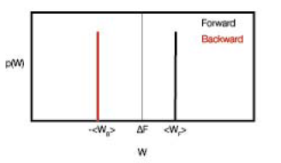
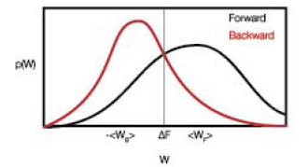
Deep learning the arrow of time in brain activity
Time-reversibility

Slide 31
Deep learning the arrow of time in brain activity
Time-reversibility
Idea: Decode temporal inversion from brain signals.
Output: 2 labels for classification: F or B

Slide 32
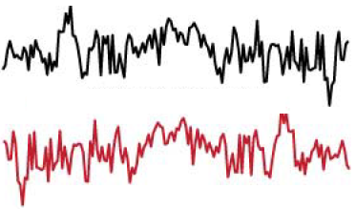
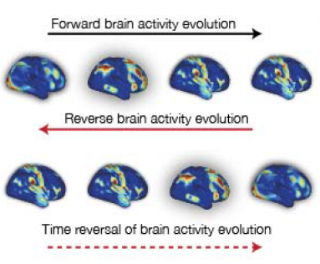
Deep learning the arrow of time in brain activity
Time-reversibility
Time-reversibility
Idea: Decode temporal inversion from brain signals.
Output: 2 labels for classification: F or B
Higher accuracy → Further from equilibrium Lower accuracy → Closer to equilibrium

Slide 33
Deep learning the arrow of time in brain activity
Whole brain level
DK80 parcellation
Rest + 7 tasks
Sliding windows of 20 TRs (20*0.72s)

