Slide 1
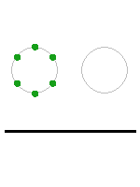
Between 5 and 7 dots are arranged in a circle.
Between 5 and 7 dots form a circle.

Slide 2
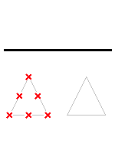
(1)
Between 5 and 7 dots are arranged in a triangle.
Between 5 and 7 dots form a triangle.

Slide 3
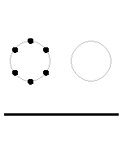
(2)
Between 5 and 7 dots are above the line.

Slide 4
(3)
Between 5 and 7 crosses are below the line.

Slide 5
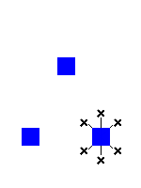
(4)
Between 5 and 7 crosses surround their closest square. Between 5 and 7 crosses surround the square next to them.

Slide 6
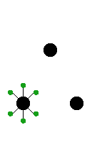
Between 5 and 7 dots are connected to their closest circle.
Between 5 and 7 dots are connected to the circle next to them.

