Slide 1
AI Agent for Smart Farming Advice
CAPSTONE PROJECT
Presented By:
Student name : Kshetrimayum Moramba Singh
College Name & Department : Manipur Institute of Technology, Department of Computer Science & Engineering

Slide 2
OUTLINE
Problem Statement
Technology used
Wow factor
End users
Result
Conclusion
Git-hub Link
Future scope
IBM Certifications

Slide 3
Problem Statement
Small-scale farmers often lack timely access to critical agricultural information such as local weather forecasts, crop suitability, pest threats, soil conditions, and market prices. Traditional sources are fragmented, language-restricted, and difficult to navigate, making informed decision-making a major hurdle. This knowledge gap can lead to poor yields, financial losses, and missed market opportunities.
Proposed Solution: An AI Agent for Smart Farming Advice, powered by Retrieval-Augmented Generation (RAG), that delivers real-time, localized, and trusted agricultural guidance to farmers in an intuitive and language-accessible format.

Slide 4
Technology used
IBM cloud lite services
Natural Language Processing (NLP)
Retrieval Augmented Generation (RAG)
IBM Granite model

Slide 5
IBM cloud services used
IBM Cloud Watsonx AI Studio
IBM Cloud Watsonx AI runtime
IBM Cloud Agent Lab
IBM Granite foundation model

Slide 6
Wow factors
This AI agent helps small farmers make smarter decisions by giving quick, easy-to-understand farming advice. It uses trusted data on weather, soil, pests, and crops to guide what to grow and how to care for it. Farmers can talk to it in their local language and ask questions like “Which crop should I grow now?” or “How to control pests in my tomato plants?” It saves time, boosts harvests, and makes farming easier and more profitable.
Unique Features
Real-time weather updates for farm planning
Soil tips based on local data
Best crop suggestions for each season
Pest control advice specific to region and crop
Talk in local languages—easy for everyone to use

Slide 7
End users
Agricultural Extension Workers
Agri-Tech Startups
Local Farming Cooperatives & NGOs
Rural Youth with Mobile Access

Slide 8
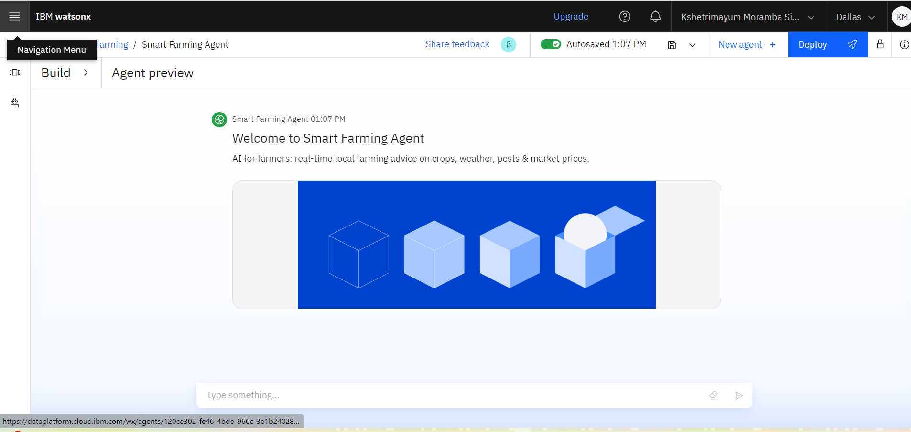
Results

Slide 9
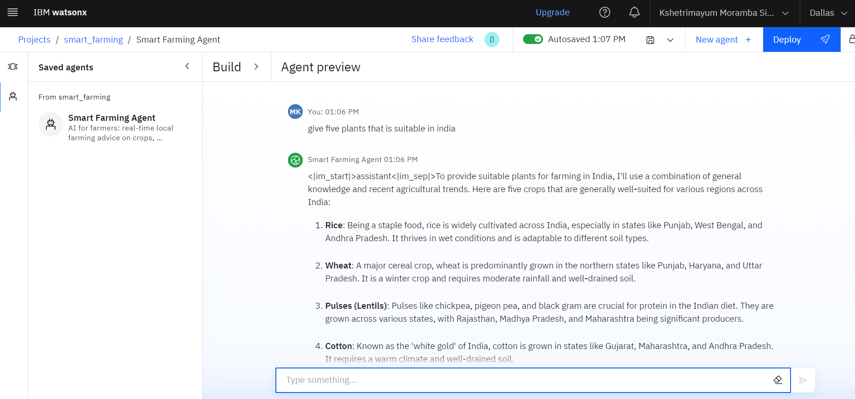
Results

Slide 10
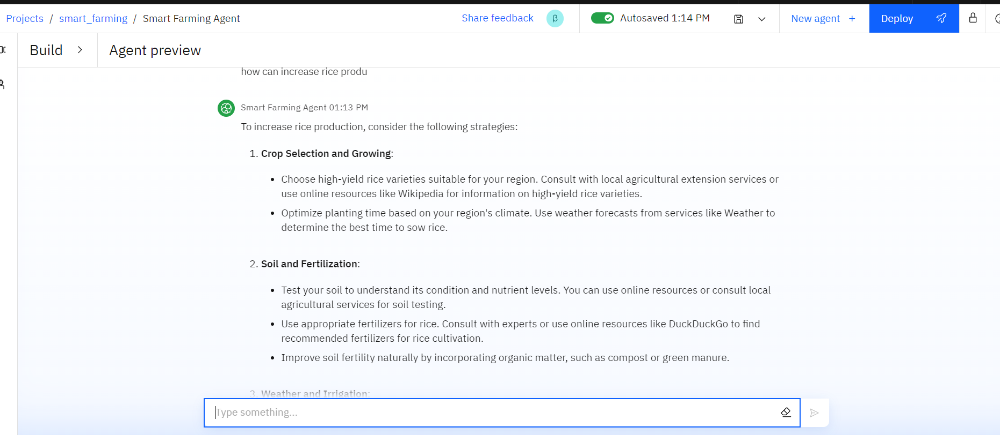
Results

Slide 11
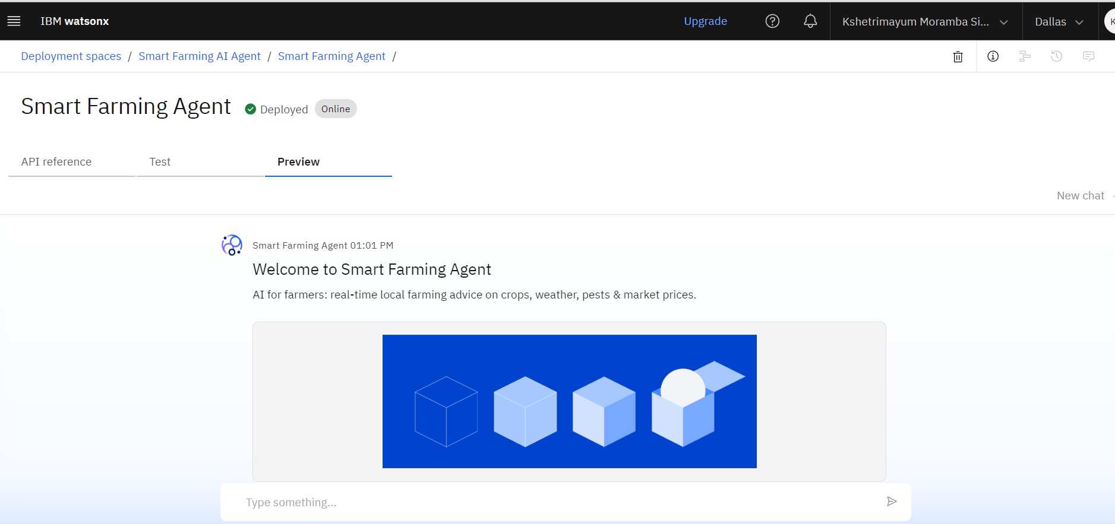
Results
Deployed AI Agent

Slide 12
Conclusion
The agent can generate reports, suggest hypotheses, and even draft sections of research papers.
It saves time by automating repetitive tasks like citation management and data extraction.
Research Agents enhance efficiency, accuracy, and innovation in both academic and industrial R&D.

Slide 13
Future scope
Integration with Satellite Imaging
Voice-to-Action Commands
Supply Chain Optimization
Learning-Based Customization
Community Support Hub
Sustainability Scoring
Predictive Analytics for Yield Forecasting

Slide 14
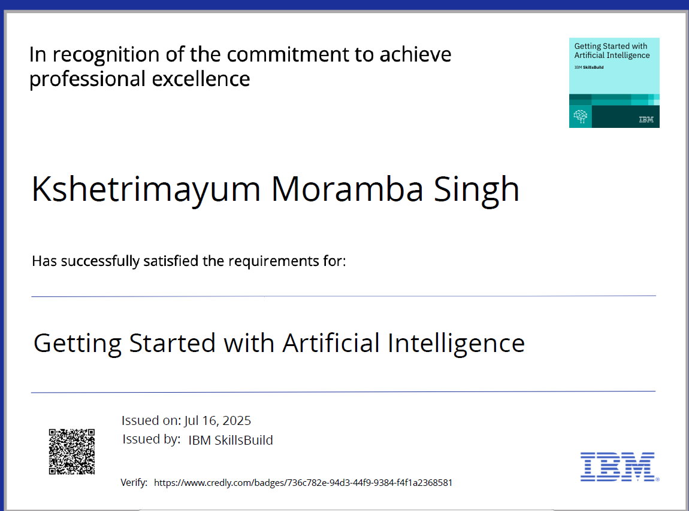
IBM Certifications

Slide 15
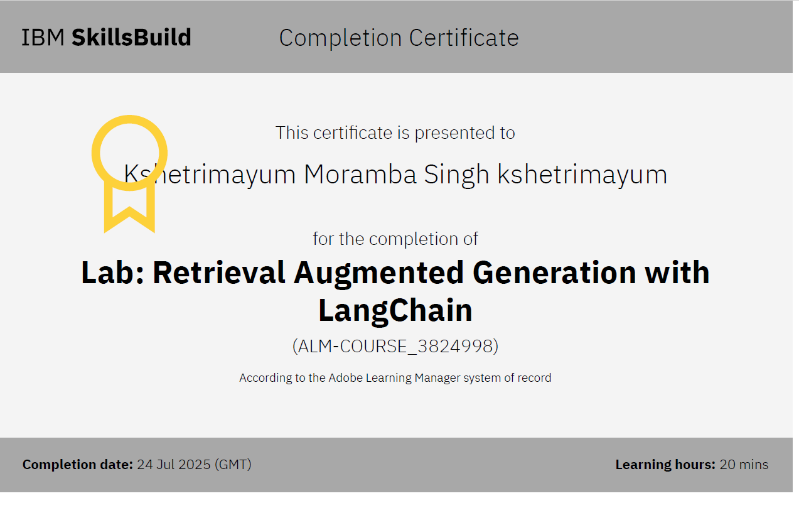

Slide 16
Git hub link : https://github.com/moramba2005/farming.git

Slide 17
GitHub Link
Make sure that there should be readme file

Slide 18
THANK YOU

