Slide 1
JavaScript ES7, ES8, ES9, ES10
by Roman Romaniv

Slide 2

Array.prototype.includes()
Index operator

Slide 3
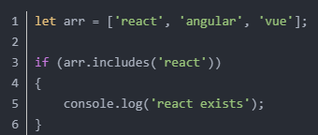
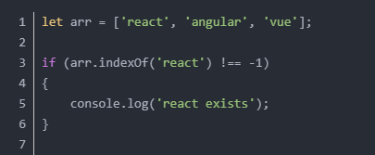
Array.prototype.includes()
Use indexOf() to verify if an element exists in the array, you need to judge whether the return value is -1 or not
Using includes() to verify that an element exists in the array is more intuitive and simple:

Slide 4


Index operator
Introduced the exponent operator in ES7 ** and Math.pow(..) have equivalent calculation result.

Slide 5

async/await
Object.values()
Object.entries()
String padding: padStart()withpadEnd(), fill the string to the current length
Allow commas at the end of the function argument list
Object.getOwnPropertyDescriptors()
ShareArrayBufferwithAtomicsObject for reading and writing from shared memory locations

Slide 6
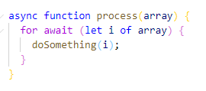

The ES2018 introduces asynchronous iterators, just like regular iterators, exceptnext(). The method returns a Promise. Therefore await can be inside for...of loops and thay are used together to run asynchronous operations.
Object.values() returns all values ​​of the Object's own properties, excluding the inherited values.

Slide 7


Object.entries() method returns an array of key-value pairs for a given object's enumerable property.
Added two instance functions to String in ES8 String.prototype.padStart with String.prototype.padEndAllows an empty string or other string to be added to the beginning or end of the original string.
String.padStart(targetLength,[padString])
targetLength: The target length to which the current string needs to be filled. If this value is less than the length of the current string, the current string itself is returned.
padString: (Optional) Populates the string. If the string is too long, so that the length of the filled string exceeds the target length, only the leftmost part is retained, and the rest is truncated. The default value of this parameter is " ".

Slide 8

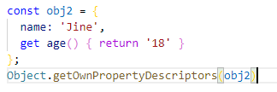
String.padEnd(targetLength,padString])
targetLength: The target length to which the current string needs to be filled. If this value is less than the length of the current string, the current string itself is returned.
padString: (optional) Fills the string. If the string is too long, so that the length of the filled string exceeds the target length, only the leftmost part is retained, and the other parts are truncated. The default value of this parameter is " ";
Object.getOwnPropertyDescriptors()The function is used to get the descriptor of all the properties of an object. If there is no self property, it returns an empty object.
returnobjA descriptor for all of its own properties, or an empty object if there are no properties of its own.

Slide 9
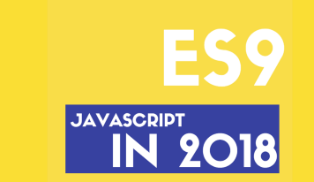
Asynchronous iteration
Promise.finally()
Rest/Spread property
Regular expression named capture group（Regular Expression Named Capture Groups）
Regular expression reverse assertion（lookbehind）
Regular expression dotAll mode
Regular expression Unicode escape
Template string for non-escaped sequences

Slide 10
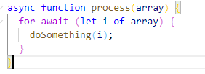
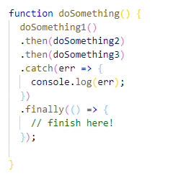
Asynchronous iteration
inasync/awaitAt some point in time, you might try to call an asynchronous function in a synchronous loop. E.g:
Promise.finally()
A Promise call chain either successfully reaches the last one.then(), or failure to trigger.catch(). In some cases, you want to run the same code, such as clearing, deleting conversations, closing database connections, etc., regardless of whether Promise runs successfully or fails. .finally()Allows you to specify the final logic:

Slide 11
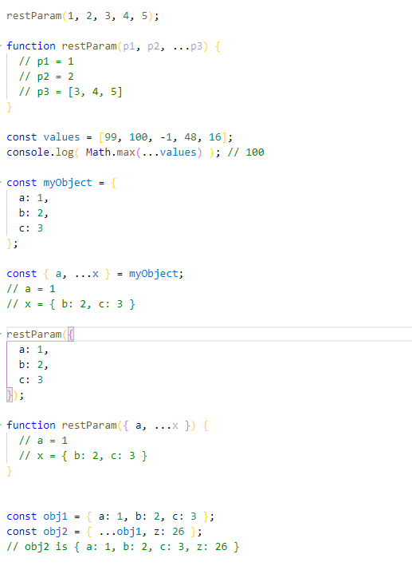
Rest/Spread property
ES2015 introducedRest parameterwithExtended operator. Three points (...) are only used for arrays. The Rest parameter syntax allows us to represent an indefinite number of parameters as an array.

Slide 12
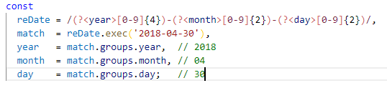
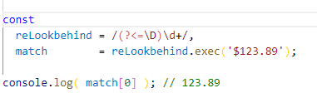
Regular expression named capture group
A JavaScript regular expression can return a matching object - an array of classes containing matching strings, for example:YYYY-MM-DDFormat resolution date. ES2018 allows named capture groups to use symbols?<name>, opening the capture brackets(Named immediately after, the example is as follows:
Regular expression reverse assertion
JavaScript currently supports lookahead in regular expressions. This means that a match will occur, but there will be no captures, and the assertion is not included in the entire match field. The ES2018 introduces the same way to work but matches the previous reverse assertion (lookbehind) so that I can ignore the currency symbol and simply capture the price of the number:

Slide 13


Regular expression dotAll mode
Regular expression midpoint.Match any single character except the carriage return, marksChange this behavior to allow the occurrence of a line terminator, for example:
Regular Expressions Unicode Escape
So far, local access to Unicode character attributes in regular expressions is not allowed. ES2018 adds Unicode attribute escaping - in the form\p{...}with\P{...}, using tags in regular expressionsu (unicode) settings, in\pWithin the block, the attributes that need to be matched can be set in a key-value pair rather than the specific content. E.g:

Slide 14

Line separator (U + 2028) and segment separator (U + 2029) symbols are now allowed in string literals to match JSON
More friendly JSON.stringify
Added Arrayflat()Methods andflatMap()method
Added StringtrimStart()Methods andtrimEnd()method
Object.fromEntries()
Symbol.prototype.description
String.prototype.matchAll
Function.prototype.toString()Now return exact characters, including spaces and comments
simplifytry {} catch {}, modifiedcatch Binding
New basic data typeBigInt
globalThis
import()
Legacy RegEx
Private instance methods and accessors

Slide 15
1. Line separator (U + 2028) and segment separator (U + 2029) symbols are now allowed in string literals to match JSON
Previously, these symbols were treated as line terminators in string literals, so using them would cause a SyntaxError exception.
2. More friendly JSON.stringify
If you enter a Unicode format but are out of range characters, the original JSON.stringify returns a malformed Unicode string. Now implements a change to JSON.stringify, so it outputs an escape sequence for it to be valid Unicode (and expressed in UTF-8)

Slide 16
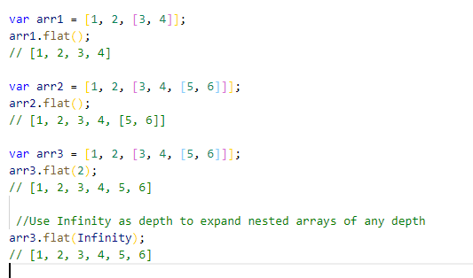
Added Array's flat() method and flatMap() method
flat()withflatMap()Essentially it is the operation of reduction and concat.
Array.prototype.flat()
flat() The method recursively traverses the array at a specified depth and combines all the elements with the elements in the traversed subarray into a new array.
flat()The most basic role of the method is the dimensionality reduction of the array.

Slide 17
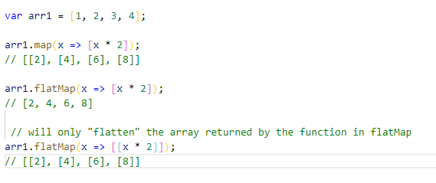
Array.prototype.flatMap()
flatMap() The method first maps each element using a mapping function and then compresses the result into a new array. It is almost identical to map and flat with a depth value of 1, but flatMap is usually slightly more efficient when combined into a single method. Here we take a map method and a flatMap method to make a comparison.
Added String's trimStart() method and trimEnd() method.
These two new methods are well understood, and the whitespace characters at the beginning and the end of the string are removed separately.

Slide 18

5.Object.fromEntries()
Object.entries()The purpose of the method is to return an array of key-value pairs of the enumerable properties of the given object itself, in the same order as when the for...in loop traversed the object (the difference is that the for-in loop also enumerates the prototype chain In the attribute).
andObject.fromEntries() ThenObject.entries() Reverse.
Object.fromEntries() The function passes in a list of key-value pairs and returns a new object with these key-value pairs. This iterator parameter should be an object that implements the @iterator method, returning an iterator object. It generates an array-like object with two elements, the first element is the value that will be used as the property key, and the second element is the value associated with the property key.

Slide 19

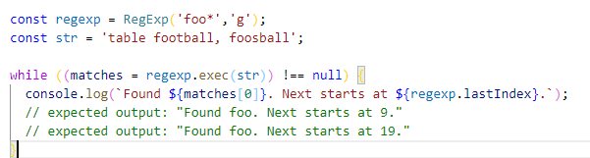
Symbol.prototype.description
When creating a symbol via the factory function Symbol(), you can choose to provide a string as a description via the parameter:
String.prototype.matchAll
matchAll() The method returns an iterator containing all the matching regular expressions and the result of the group capture. Before matchAll appears, all the matching information is obtained by calling regexp.exec in the loop (regexp needs to use the /g flag:

Slide 20
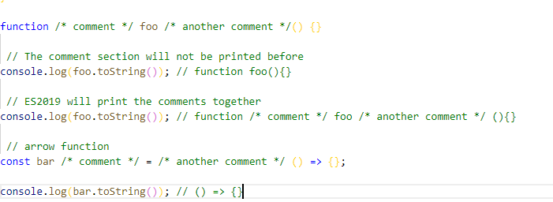
Function.prototype.toString() now returns exact characters, including spaces and comments

Slide 21

Modify the catch binding
Prior to ES10, we had to bind exception variables to the catch clause by syntax, whether or not it was necessary. Many times catch blocks are redundant. The ES10 proposal allows us to simply omit variables.
Not a big change.
New basic data type BigInt
There are now more than 5 basic data types (value types) (six types after ES6)! Plus BigInt has a total of seven basic data types, namely: String, Number, Boolean, Null, Undefined, Symbol, BigInt

Slide 22


