Slide 1
Bootstrap
By Roman Romaniv

Slide 2
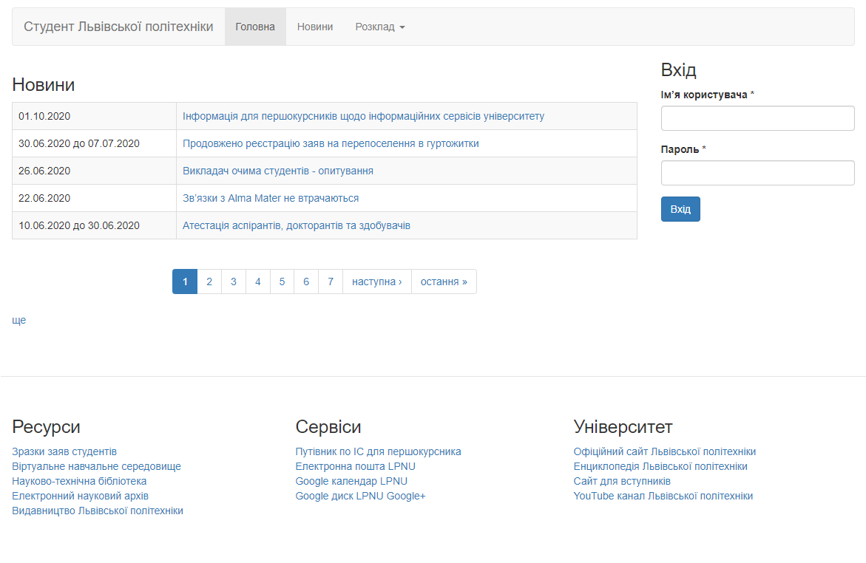
Bootstrap is a free front-end framework for faster and easier web development
Bootstrap includes HTML and CSS based design templates for typography, forms, buttons, tables, navigation, modals, image carousels and many other, as well as optional JavaScript plugins
Bootstrap also gives you the ability to easily create responsive designs

Slide 3
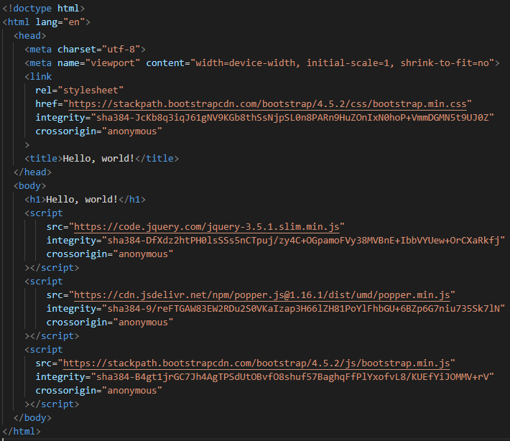

To connect this framework to your project you can use CDN, or download it in folders and add it to your html file.

Slide 4
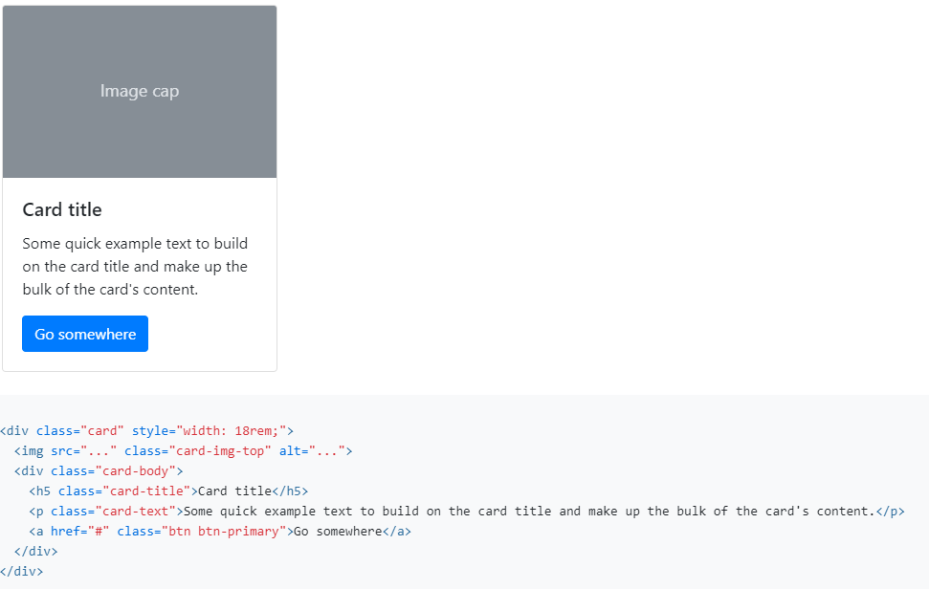
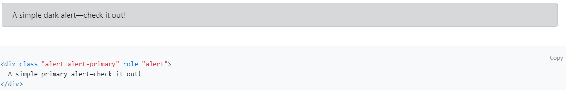
Usage
Bootstrap requires the use of the HTML5 doctype. Without it, you’ll see some funky incomplete styling, but including it shouldn’t cause any considerable hiccups.
Bootstrap is developed mobile first, a strategy in which we optimize code for mobile devices first and then scale up components as necessary using CSS media queries. To ensure proper rendering and touch zooming for all devices, add the responsive viewport meta tag to your <head>.
You need to add class names to your html tags to add styles.

Slide 5
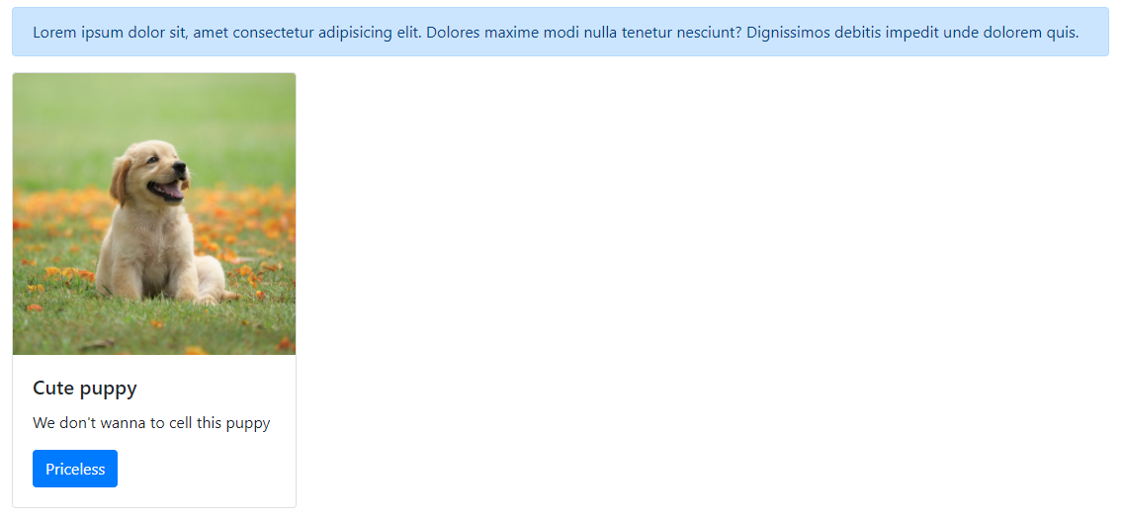
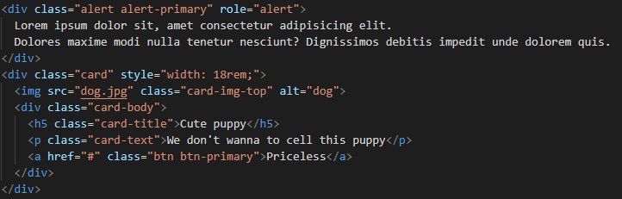

Slide 6
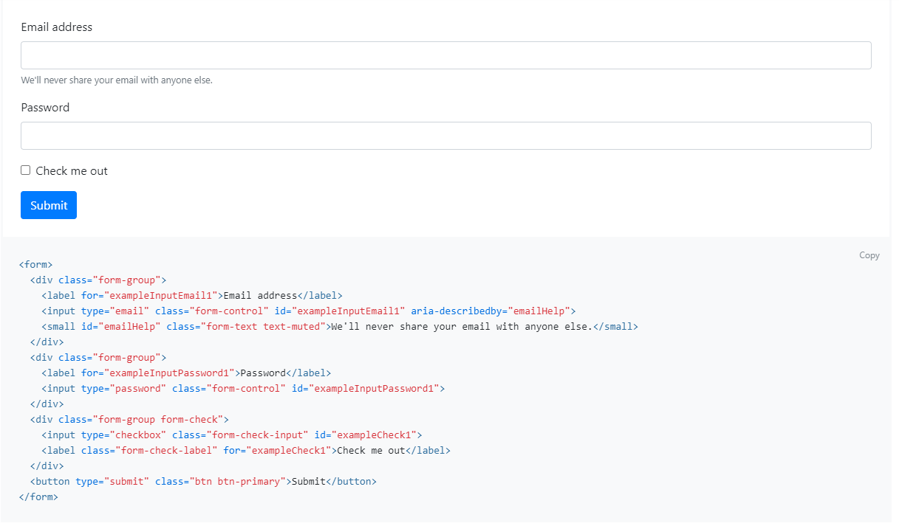

Slide 7
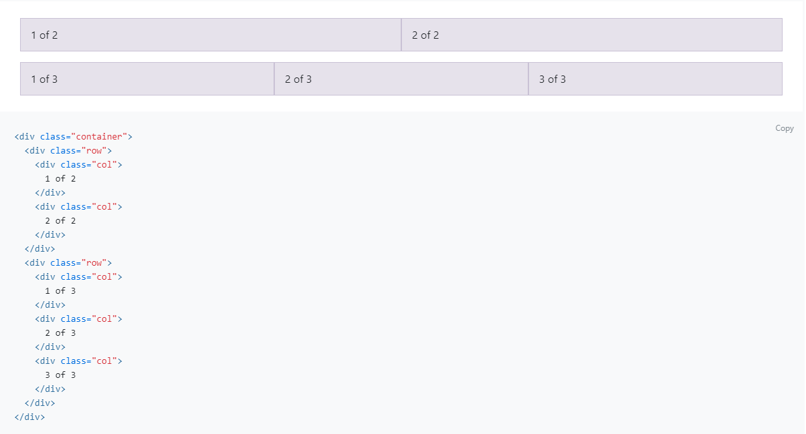

Slide 8




Another popular frameworks

Slide 9

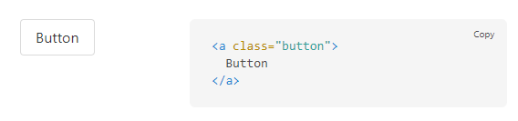
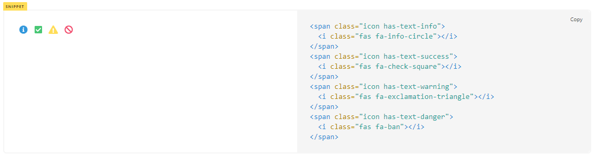
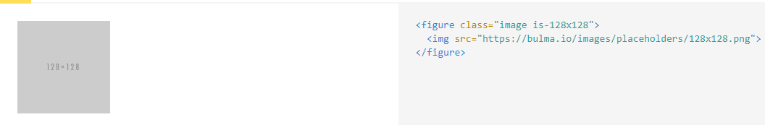
Responsivity: The framework is mobile-first and works similarly to the popular Bootstrap CSS.
Well-documented: Often a very important component for developers, Bulma is very well documented, and comes with an active community of people ready to help with projects.
Solid foundation: Bulma comes packed with all of the goods you would expect from a CSS framework, including diverse typography, buttons, forms, tables, and more.
Various components: Bulma is packed with a vertical alignment solution, layouts, and various media objects.
Modular: The Bulma setup is built with Sass, which means that you can design your framework step by step with only the features you need.

Slide 10

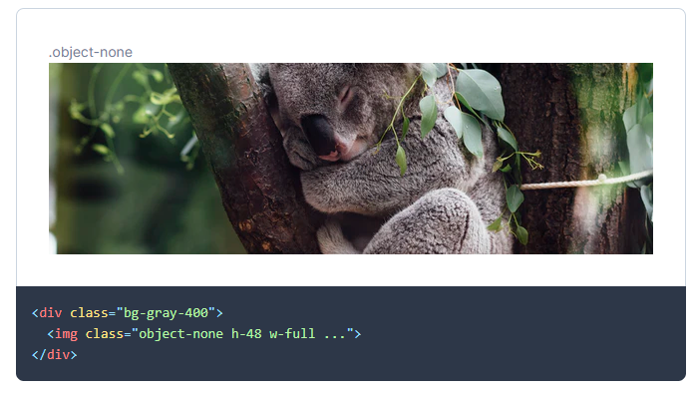
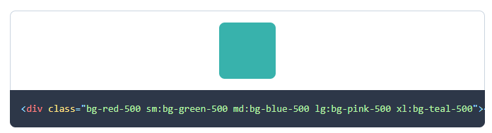
Tailwind is different from frameworks like Bootstrap, Foundation, or Bulma in that it's not a UI kit.
It doesn't have a default theme, and there are no built-in UI components.
On the flip side, it also has no opinion about how your site should look and doesn't impose design decisions that you have to fight to undo.
If you're looking for a framework that comes with a menu of predesigned widgets to build your site with, Tailwind might not be the right framework for you.
But if you want a huge head start implementing a custom design with its own identity, Tailwind might be just what you're looking for.

Slide 11

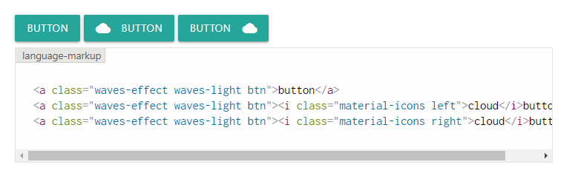
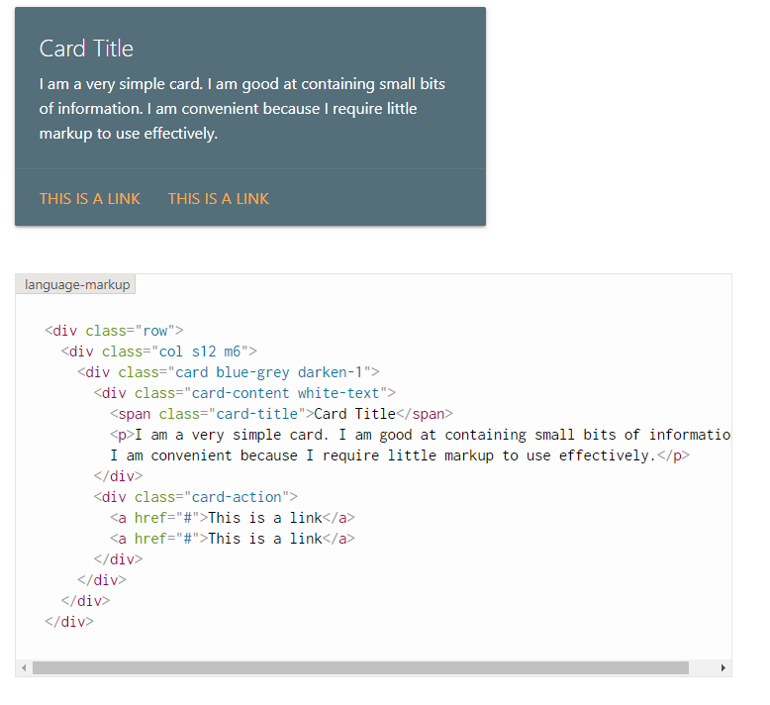
Materialize is a library created with CSS, JavaScript, and HTML and its components combine classic principles of good design and essential design principles such as browser portability and responsiveness. The framework is extremely light at 29kb and provides built-in features that cover modern support, easy to use features, parallax elements, flow texts, cards, hoverable items & objects. These features help reduce coding time and is that is a key parameter you are looking for, then Materialize will work. Implementing the Materialize framework is also simple – it can be installed by downloading the materialize.min.css and materialize.min.js files on a local machine and integrating it with the HTML code. For the CDN (Content Delivery Network) based version, the materialize.min.css and materialize.min.js files can be integrated into the HTML code directly from the CDN.

Slide 12
My projects with Bootstrap
https://moran711.github.io/MyProject
https://github.com/moran711/UsersInfo

Slide 13
Advantages and disadvantages
Advantages:
Fewer Cross browser bugs
A consistent framework that supports major of all browsers and CSS compatibility fixes
Lightweight and customizable
Responsive structures and styles
Several JavaScript plugins using the jQuery
Good documentation and community support
Loads of free and professional templates, WordPress themes and plugins
Great grid system
Disadvantages:
There will be requirement of lots of style overrides or rewriting files that can thus lead to a lot of time spent on designing and coding the website if the design tends to deviate from the customary design used in Bootstrap.
You would have to go the extra mile while creating a design otherwise all the websites will look the same if you don’t do heavy customization.
Styles are verbose and can lead to lots of output in HTML which is not needed.
JavaScript is tied to jQuery and is one of the commonest library which thus leaves most of the plugins unused.
Non-compliant HTML.

Slide 14
