Slide 1
Webpack
By Roman Romaniv

Slide 2
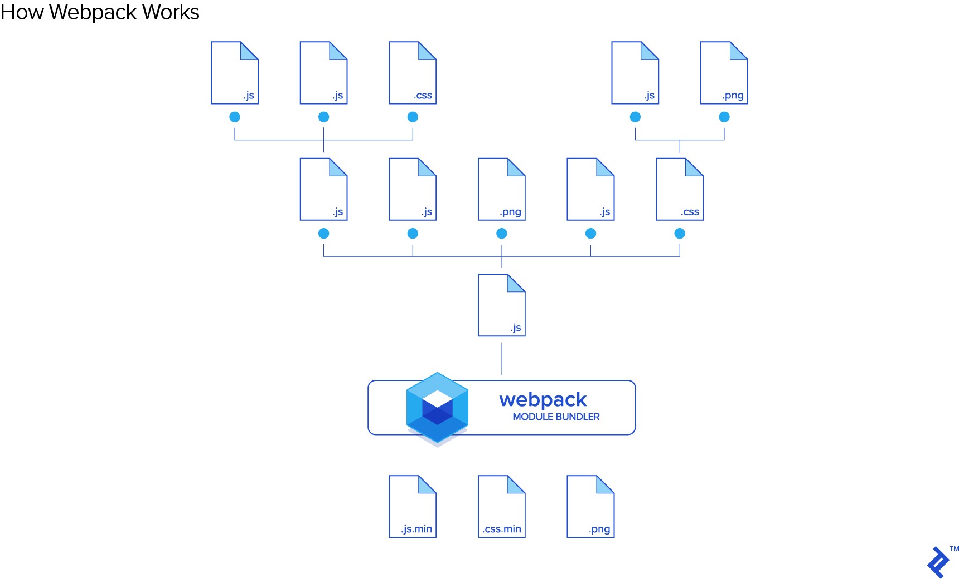
Webpack is a static module bundler for JavaScript applications — it takes all the code from your application and makes it usable in a web browser. Modules are reusable chunks of code built from your app’s JavaScript, node_modules, images, and the CSS styles which are packaged to be easily used in your website. Webpack separates the code based on how it is used in your app, and with this modular breakdown of responsibilities, it becomes much easier to manage, debug, verify, and test your code.

Slide 3

An entry point indicates which module webpack should use to begin building out its internal dependency graph. webpack will figure out which other modules and libraries that entry point depends on (directly and indirectly).
By default its value is ./src/index.js, but you can specify a different (or multiple entry points) by setting an entry property in the webpack configuration. For example:

Slide 4
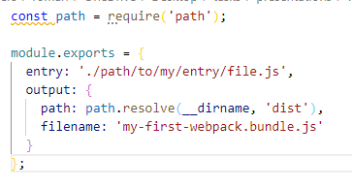
The output property tells webpack where to emit the bundles it creates and how to name these files. It defaults to ./dist/main.js for the main output file and to the ./dist folder for any other generated file.
You can configure this part of the process by specifying an output field in your configuration:
webpack.config.js

Slide 5
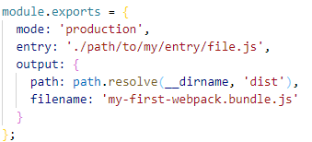
By setting the mode parameter to either development, production or none, you can enable webpack's built-in optimizations that correspond to each environment. The default value is production.

Slide 6
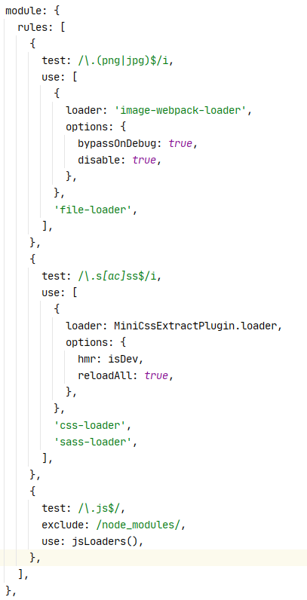
Loaders
Out of the box, webpack only understands JavaScript and JSON files. Loaders allow webpack to process other types of files and convert them into valid modules that can be consumed by your application and added to the dependency graph.
Note that the ability to import any type of module, e.g. .css files, is a feature specific to webpack and may not be supported by other bundlers or task runners. We feel this extension of the language is warranted as it allows developers to build a more accurate dependency graph.
At a high level, loaders have two properties in your webpack configuration:
The test property identifies which file or files should be transformed.
The use property indicates which loader should be used to do the transforming.
"Hey webpack compiler, when you come across a path that resolves to a '.txt' file inside of a require()/import statement, use the raw-loader to transform it before you add it to the bundle."

Slide 7
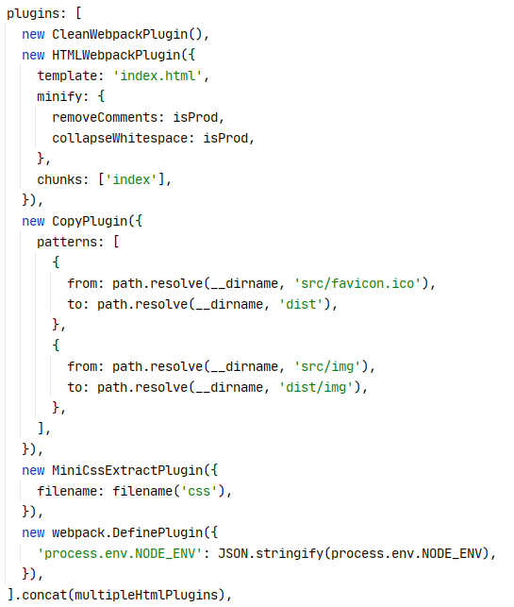
Plugins
While loaders are used to transform certain types of modules, plugins can be leveraged to perform a wider range of tasks like bundle optimization, asset management and injection of environment variables.
Check out the plugin interface and how to use it to extend webpack's capabilities.
In order to use a plugin, you need to require() it and add it to the plugins array. Most plugins are customizable through options. Since you can use a plugin multiple times in a configuration for different purposes, you need to create an instance of it by calling it with the new operator.

Slide 8
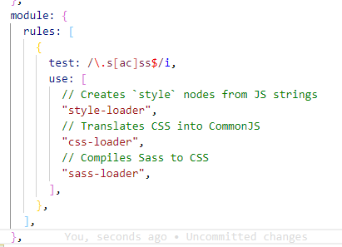
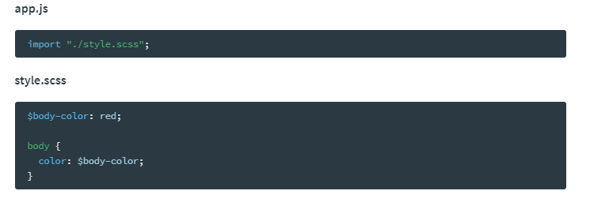
SASS
To begin, you'll need to install sass-loader:
npm install sass-loader sass webpack --save-dev
sass-loader requires you to install either Dart Sass or Node Sass on your own (more documentation can be found below).
This allows you to control the versions of all your dependencies, and to choose which Sass implementation to use.
Chain the sass-loader with the css-loader and the style-loader to immediately apply all styles to the DOM or the mini-css-extract-plugin to extract it into a separate file.
Then add the loader to your Webpack configuration. For example:

Slide 9
Useful links:
https://webpack.js.org/

Slide 10
My projects:
https://github.com/moran711/EXCEL
https://github.com/moran711/SoftServe-homework

Slide 11


