Slide 1
Linters: JSLint, JSHint, ESLint
By Roman Romaniv

Slide 2
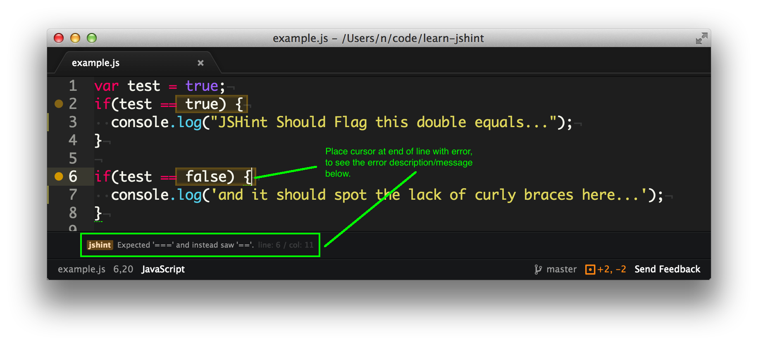
For what?
JavaScript linters are tools that you can use to help you debug your code.
They scan your scripts for common issues and errors, and give you back a report with line numbers that you can use to fix things.
In addition to actual bugs and errors, they also check for subjective, stylistic preferences as well. Did you include a space between the function name and parentheses? Did you use single or double quotes around strings? Things like that.

Slide 3

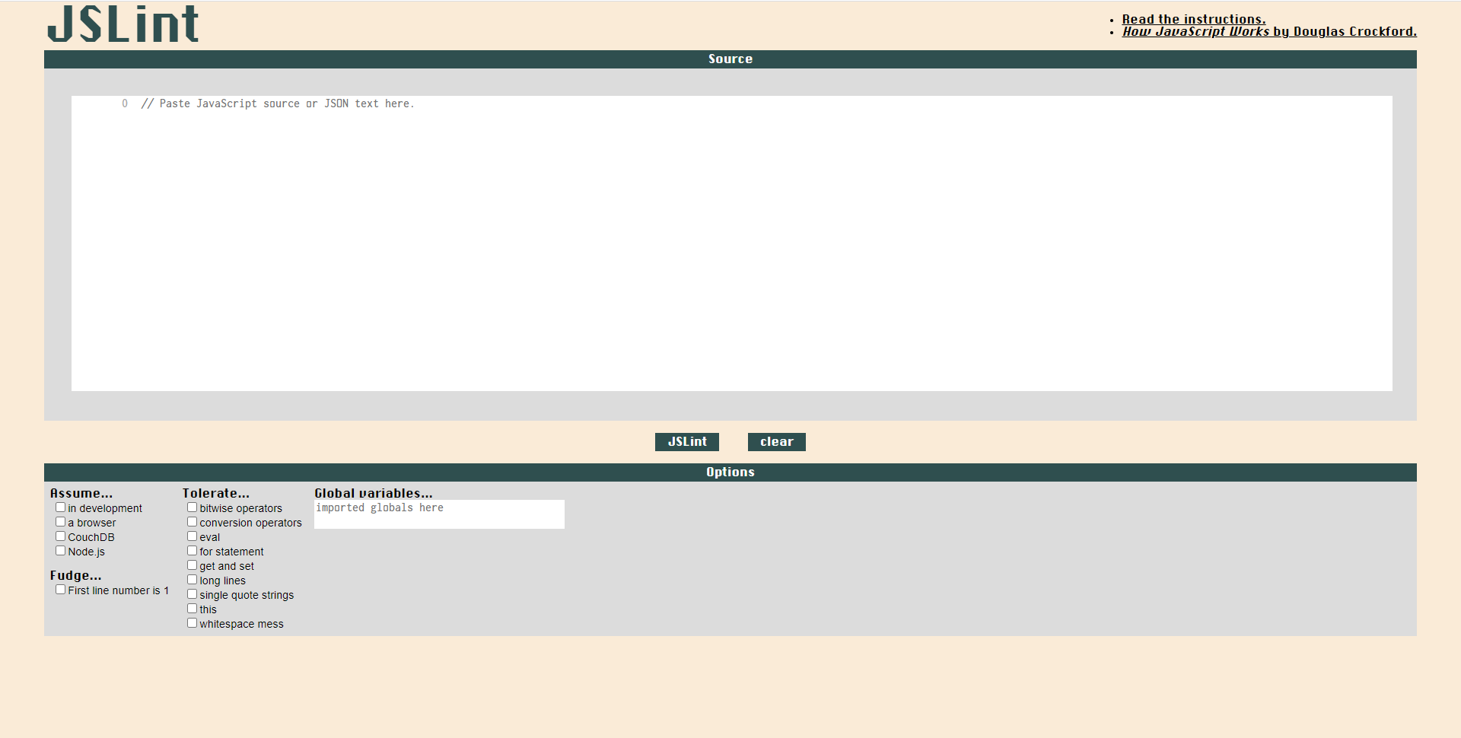

Slide 4

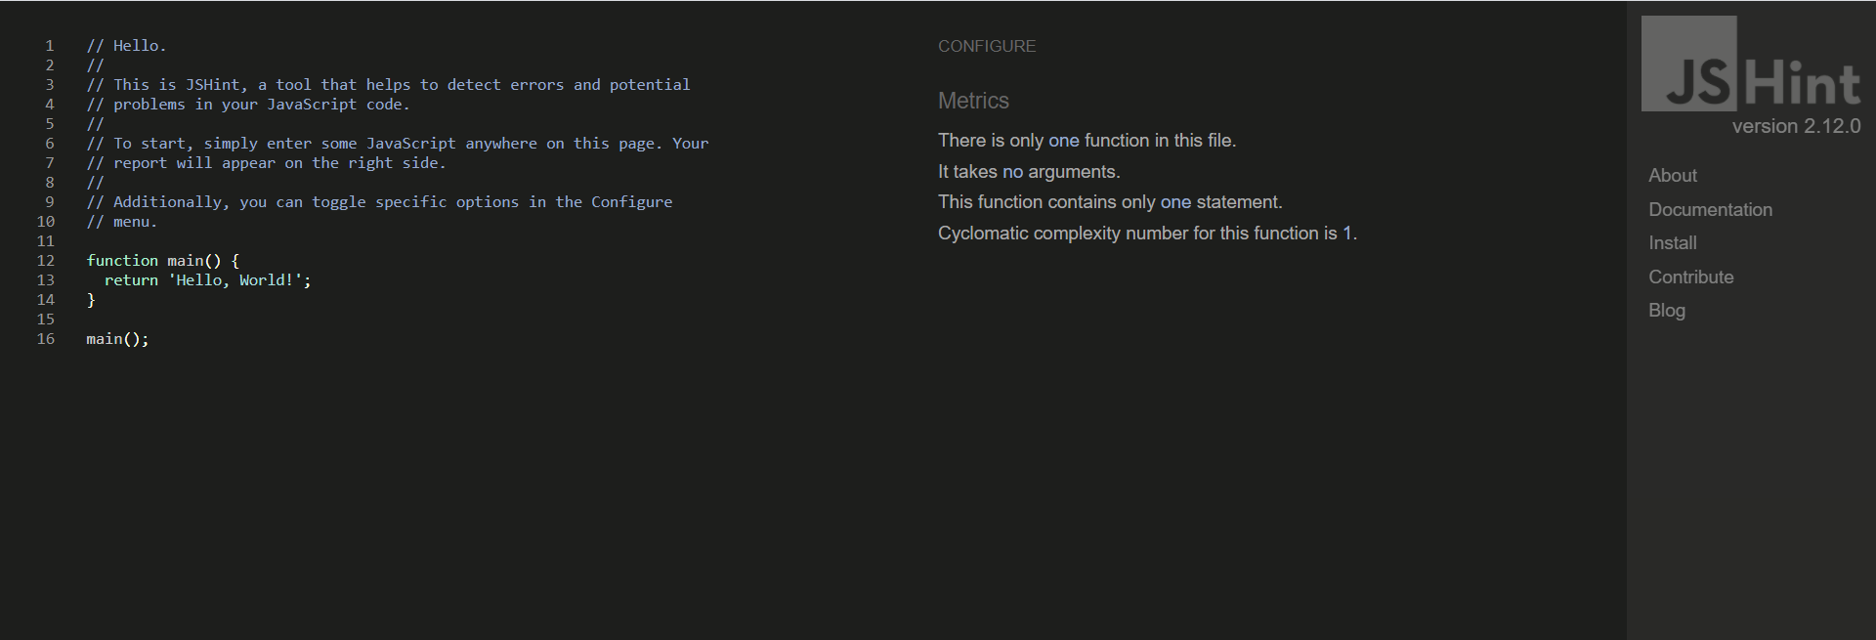

Slide 5
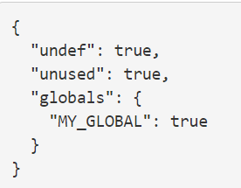
.jshintrc
Configuration file is a simple JSON file that specifies which JSHint options to turn on or off. For example, the following file will enable warnings about undefined and unused variables and tell JSHint about a global variable named MY_GLOBAL.

Slide 6

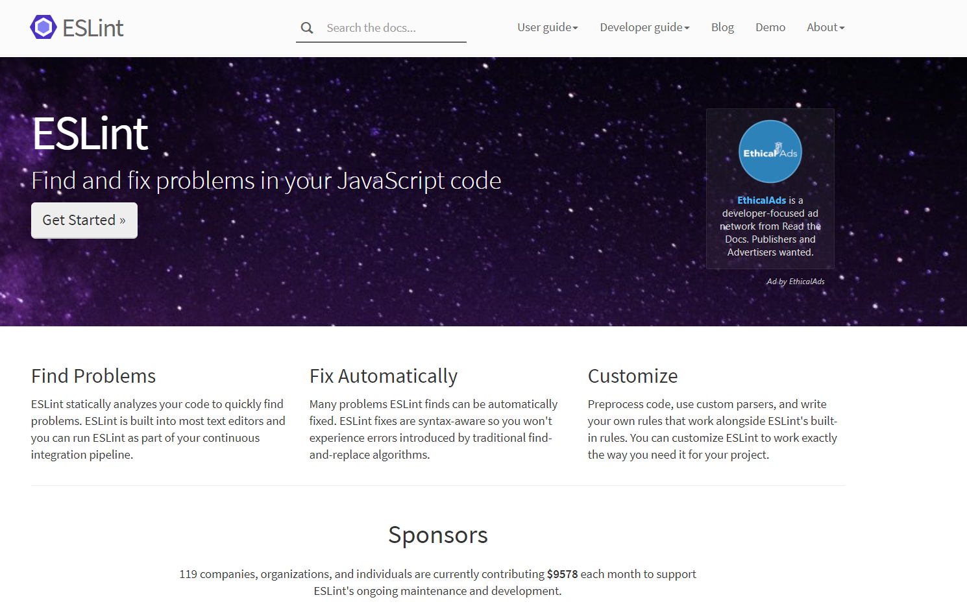

Slide 7
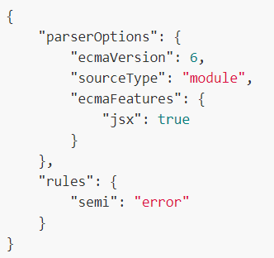
.eslintrc
ecmaVersion - set to 3, 5 (default), 6, 7, 8, 9, 10, 11, or 12 to specify the version of ECMAScript syntax you want to use. You can also set to 2015 (same as 6), 2016 (same as 7), 2017 (same as 8), 2018 (same as 9), 2019 (same as 10), 2020 (same as 11), or 2021 (same as 12) to use the year-based naming.
sourceType - set to "script" (default) or "module" if your code is in ECMAScript modules.
ecmaFeatures - an object indicating which additional language features you'd like to use:
globalReturn - allow return statements in the global scope
impliedStrict - enable global strict mode (if ecmaVersion is 5 or greater)
jsx - enable JSX

Slide 8
Pros
Flexible: any rule can be toggled, and many rules have extra settings that can be tweaked
Very extensible and has many plugins available
Easy to understand output
Includes many rules not available in other linters, making ESLint more useful for detecting problems
Best ES support, and also the only tool to support JSX
Supports custom reporters
Cons
Some configuration required
Slow, but not a hindrance

Slide 9
Pros
Comes configured and ready to go (if you agree with the rules it enforces)
Cons
JSLint doesn’t have a configuration file, which can be problematic if you need to change the settings
Limited number of configuration options, many rules cannot be disabled
You can’t add custom rules
Undocumented features
Difficult to know which rule is causing which error

Slide 10
Pros
Most settings can be configured
Supports a configuration file, making it easier to use in larger projects
Has support for many libraries out of the box, like jQuery, QUnit, NodeJS, Mocha, etc.
Basic ES support
Cons
Difficult to know which rule is causing an error
Has two types of option: enforcing and relaxing (which can be used to make JSHint stricter, or to suppress its warnings). This can make configuration slightly confusing
No custom rule support

Slide 11
My repo on GitHub with eslint
https://github.com/moran711/EXCEL

Slide 12
Userful links
http://linterrors.com/js

Slide 13


