Slide 1
Text Analytics
Sumit Kumar Yadav
Department of Management Studies Indian Institute of Technology, Roorkee - 247667

Slide 2
What is text?
Text is the data present in the form of natural language
The data captured from the native natural language forms a collection of text corpuses
Text data can be represented as :
Readable documents
Audio files
Image

Slide 3
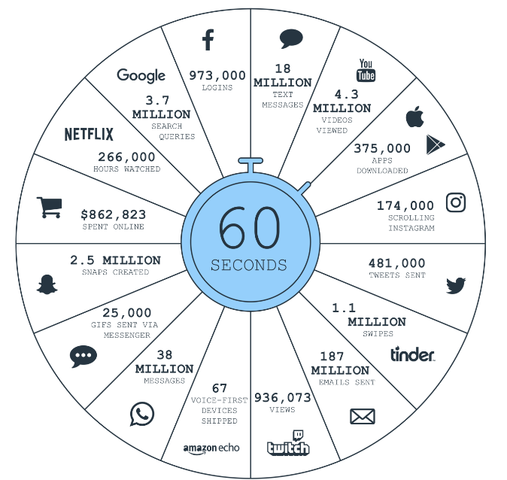
Motivation
Large amount of unstructured text data present almost everywhere
Facebook posts, tweets, status message, etc.
E-commerce websites like Amazon, Flipkart
Customer reviews and Feedback
Youtube, Instagram comments

Slide 4
Challenges
Extracting meaningful information and insights from the large amount of text data
Large number of machine learning and data analysis techniques available, but
Mostly are originally designed for numerical data
Hence, need for specialized NLP techniques, models to interpret and analyse text data
NLP different from programming languages like Python, C++ which are easily understood by machines

Slide 5
Use Cases of Text analytics
Sentiment analysis
Text Classification
Resume Screening
Cluster documents
Competitive Analysis

Slide 6
What is Natural Language?
Language developed by humans like Telegu, Hindi, Sanskrit, Chinese, English etc.
evolved through communication and natural use
Human language is a system specifically constructed to convey the speaker’s meaning
Not just an environmental signal, it is deliberate communication
Using an encoding which kids can learn very, very quickly
Human language is a discrete/symbolic/categorical signaling system
Signals communicate ideas
“Linguistics” is the science of language, and “linguists” are the scientists

Slide 7
What is Text Analytics?
A process to convert the unstructured text data into structured information
Python Libraries
NLTK – Natural Language Tool Kit
Regular Expressions

Slide 8
What is NLP?
Natural Language Processing or NLP gives the machines the ability to read, understand and derive meaning from human languages.
Text mining uses NLP to transform the free text documents into, structured numerical data suitable for analysis or to drive machine learning (ML) algorithms.
Document-1
Feature-1 | Feature-2 | Feature-3 | Feature-4
Document-2
NLP
Document-3

Slide 9
Why NLP is Hard
Who does ‘he’ refer to in the following?
Rahim helped Pooja. He was kind.
Rahim helped Mohan. He was kind.
Rahim helped Kiran. He was kind..
Conclusion : The Language we use to communicate is for our convenience. Its extremely ambiguous

Slide 10
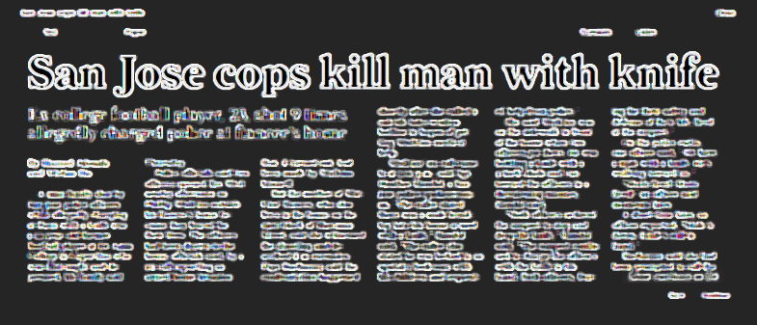
Summarize the news article
Who had the knife?

Slide 11
What makes NLP so hard
Biggest problem is that we humans use language efficiently by not saying most things
We leave out most details, and the user figures out the rest
Minimal messages transmitted, listener fills the rest using his world knowledge, common sense, contextual understanding
We keep a lot of ambiguities, which we assume the hearer/reader knows how to resolve.
Ambiguity is unambiguously problematic!

Slide 12
Regular Expressions
Regex – sequence of characters
Points to a specific search pattern
Used to substitute or match patterns inside a text
Should not be too code intensive
Why to use?
For text processing, some patterns/characters need to be deleted or dealt with differently
Example -
“Federer won his first grand slam in 2003”
How to remove the number??

Slide 13
Why to use Regular Expressions?
“Federer won his first grand slam in 2003”
How to remove the number??
Run a loop through entire sentence
Check if the word/character is a number or not
If yes, delete it
re.sub(r”\d”,””,sentence)
re – regular expression
sub – method of substituting
r is for regular expression, \d is for digit
Replace it with empty string
Regular expressions are faster than normal python code – because they are optimized for handling text

Slide 14
Finding Patterns in Text - match
import re
re.match(r”.*”,sentence)
. means any character, * means 0 or more
This whole sequence matches sequence of characters of length 0 or more
re.match(r”.+”,sentence)
+ means length 1 or more
re.match(r”[a-zA-Z]+”,sentence)
Returns only the first sequence
re.match(r”ab?”,sentence)
b can be 0 or 1, a is fixed

Slide 15
Finding Patterns in Text - search
Match only looks at the first pattern in the whole sentence
re.search(r”[a-zA-Z]+”,sentence)
Starts with –
if re.match(r”^the”, sentence):
Print(“Match”)
Else:
Print(“No match”)

Slide 16
Substitute Patterns
sentence = “Djokovic is the best”
print(re.sub(r”Djokovic”,”Nadal”,sentence)
sentence = “Djokovic is the best among Djokovic”
Global Search and a Global Substitution
print(re.sub(r”[a-z]”,”0”,sentence))
print(re.sub(r”[a-z]”,”8”,sentence,flags=re.I))
print(re.sub(r”[a-z]”,”8”,1,sentence,flags=re.I))
Doesn’t distinguish between “d” and “D”

Slide 17
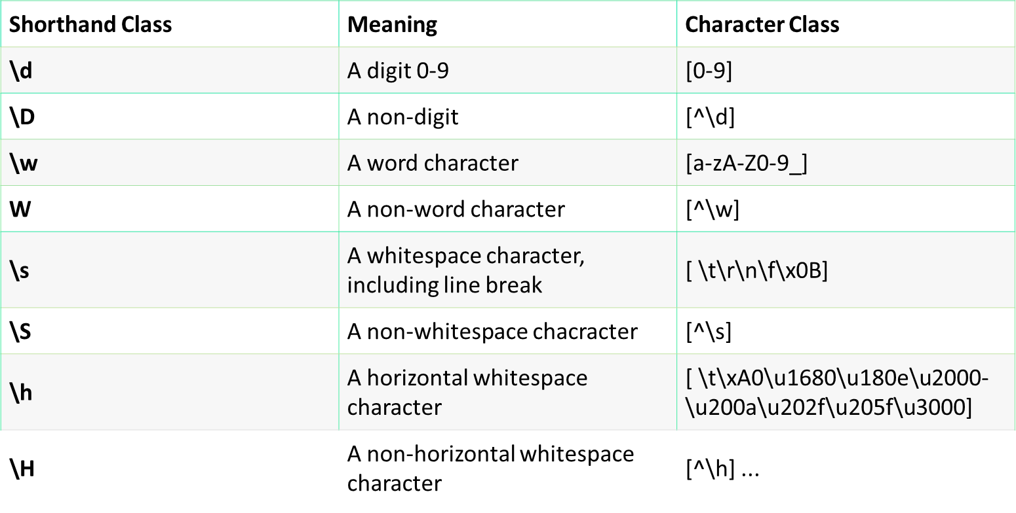
Shorthand Character Classes

Slide 18
Shorthand Character Classes
sen1 = "Wecome to Text Analytics 1"
sen2 = "Hopefully, we will. learn @@ ++ ~~ something in- 2day's session"
sen3 = "I want to play tennis"
sen1_edit = re.sub(r"\d","",sen1)
sen2_edit = re.sub(r"[@~+\-'\.]","",sen2)
sen2_edit = re.sub(r"\w"," ",sen2) #a-zA-Z0-9
sen2_edit = re.sub(r"\W"," ",sen2)
sen2_edit1 = re.sub(r"\s+","-",sen2_edit)
sen2_edit = re.sub(r"\s+[a-zA-Z]\s+"," ",sen2_edit)
sen3_edit =re.sub(r"\s+"," ",sen3)

Slide 19
Preprocessing using Regular Expression
wordlist=["There was a thirsty crow","Thirsty to learn Machine #Learning","It liked tennis","The name f was - Alien a Crow", "121314 random numbers"]
for i in range(0,len(wordlist)):
wordlist[i] =re.sub(r"\W"," ",wordlist[i])
wordlist[i] = re.sub(r"\d"," ",wordlist[i])
wordlist[i] = re.sub(r"\s+"," ",wordlist[i])
wordlist[i] = re.sub(r"^\s","",wordlist[i])

Slide 20
Tokenizing Words and Sentences
nltk.sent_tokenize(paragraph)
words = nltk.word_tokenize(paragraph)
Without using NLTK library
str.split(“ “) or str.split(“.”)

Slide 21
Stemming and Lemmatization
stemming is the process of reducing inflected (or sometimes derived) words to their word stem, base or root form – Wikipedia
“Milkha Singh runs very fast”
“Milkha Singh is running at a high speed”
“All you do is run here and there”
The representation might not have any meaning
Lemmatization – the intermediate representation will have a meaning

Slide 22
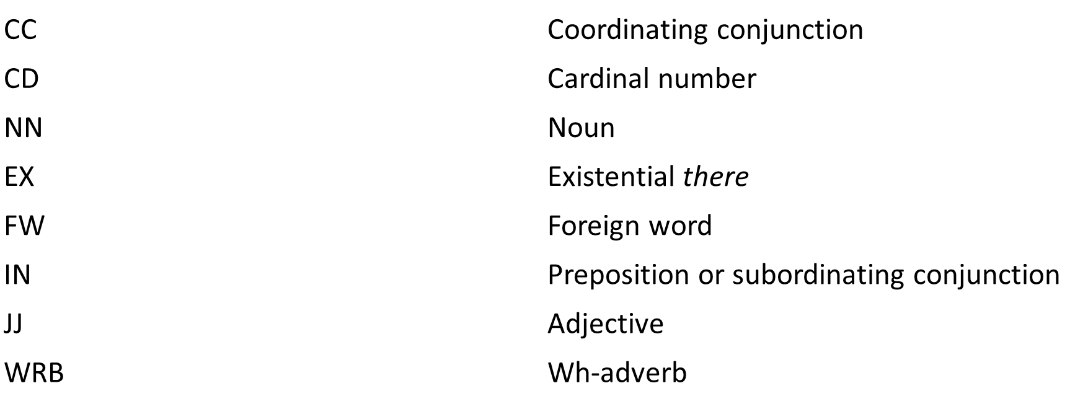
Parts of Speech
Tag Meanings

