Slide 1
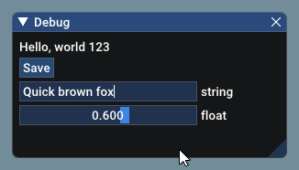

DearQOI
DearIMGUI QOI viewer

Slide 2
Content
QOI
  Mostly stolen from Youtube Video
(Dear)IMGUI
Demo
Conclusion

Slide 3
QOI
Quiet OK Image
Lossless image compression format
Invented on December 2022 by Dominic Szablewski
Based on simplicity

Slide 4
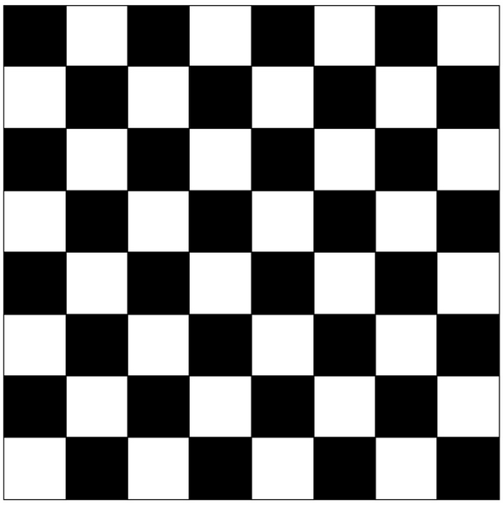
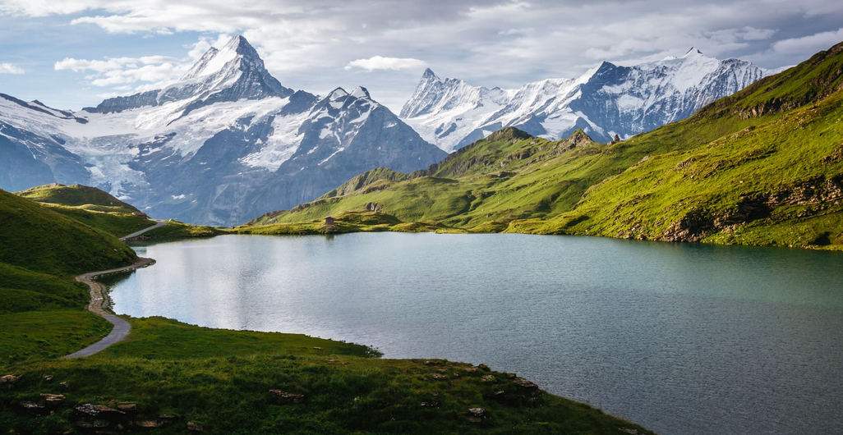
QOI: PNG encoding
Keywords
  Huffman code
  Lempel Ziv
  Filtering (depending on image entropy)

Slide 5
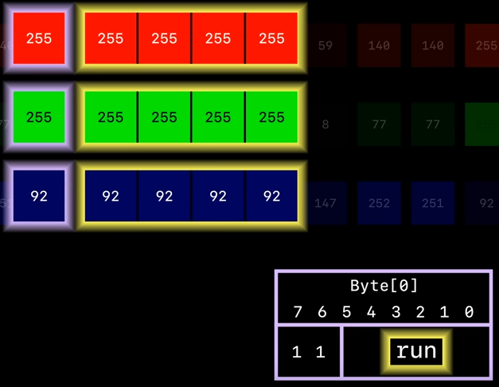
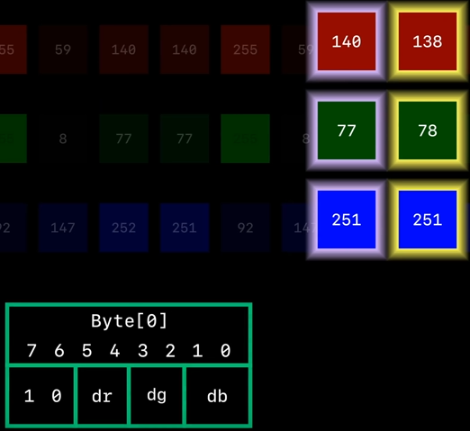
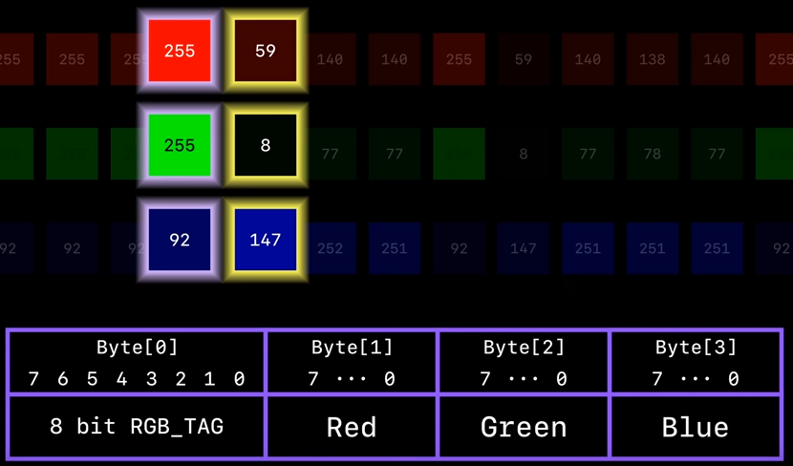
QOI: encoding
https://www.youtube.com/watch?v=EFUYNoFRHQI

Slide 6
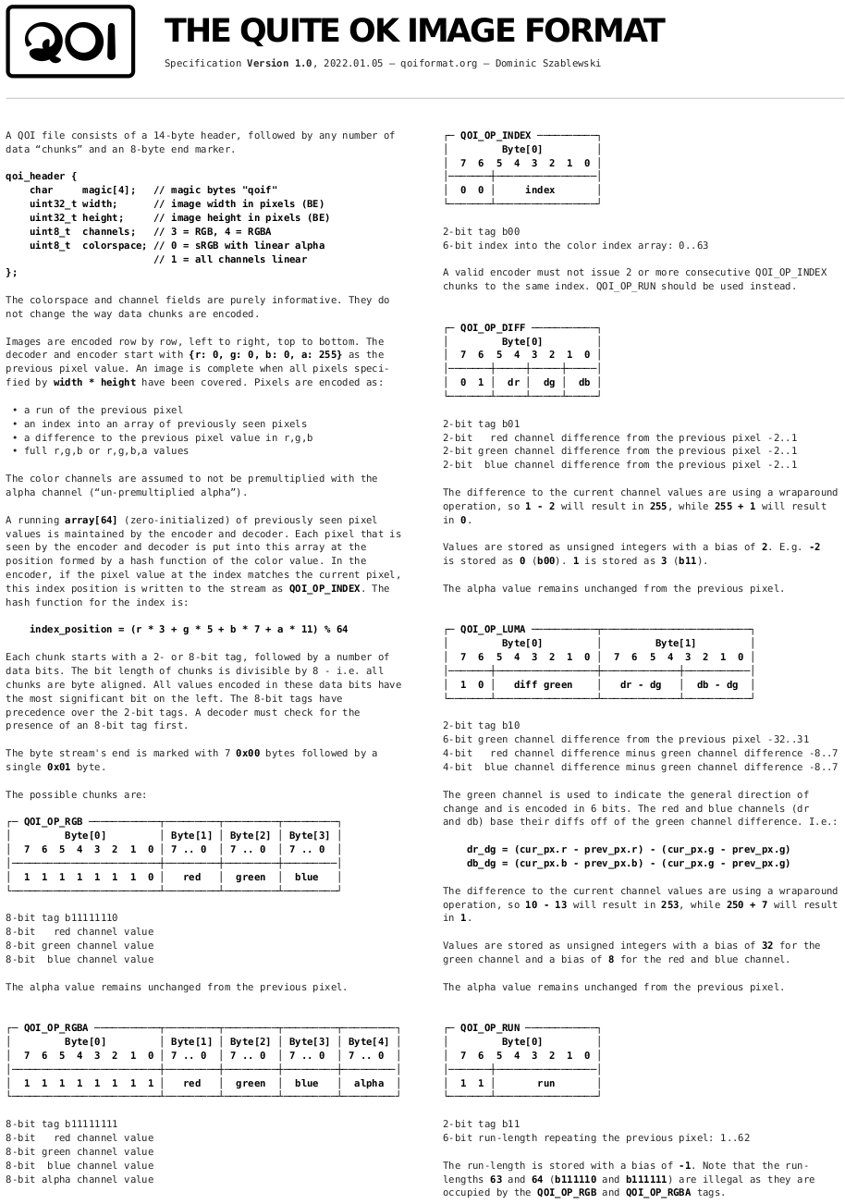
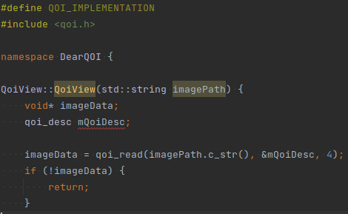
QOI: Specification
Fits on one page
<700 lines C header
  Included comments / doc

Slide 7
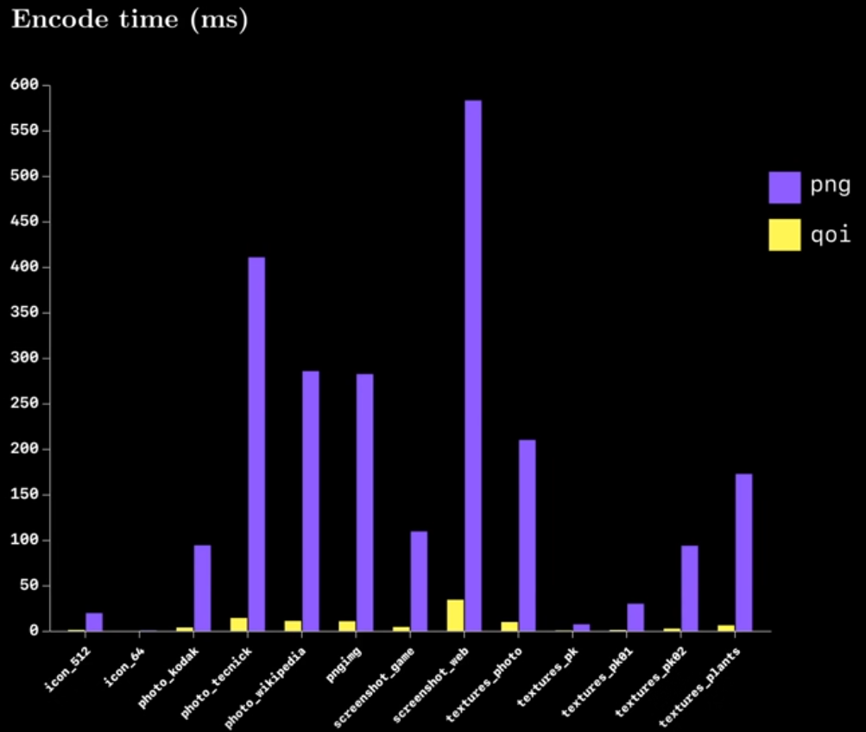
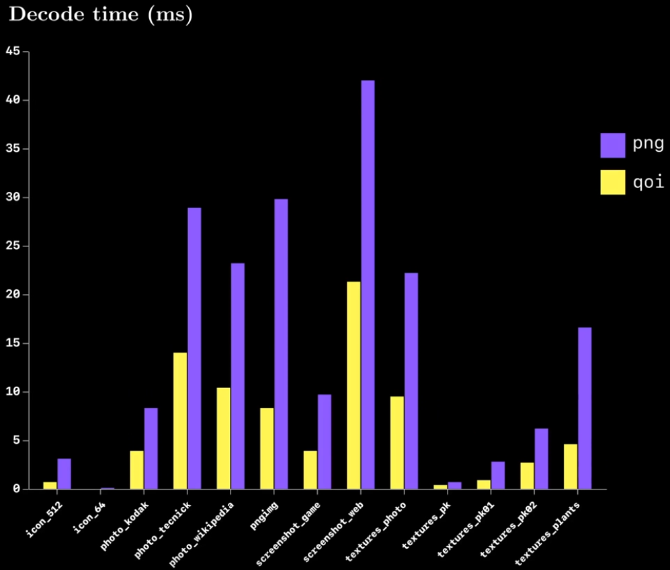
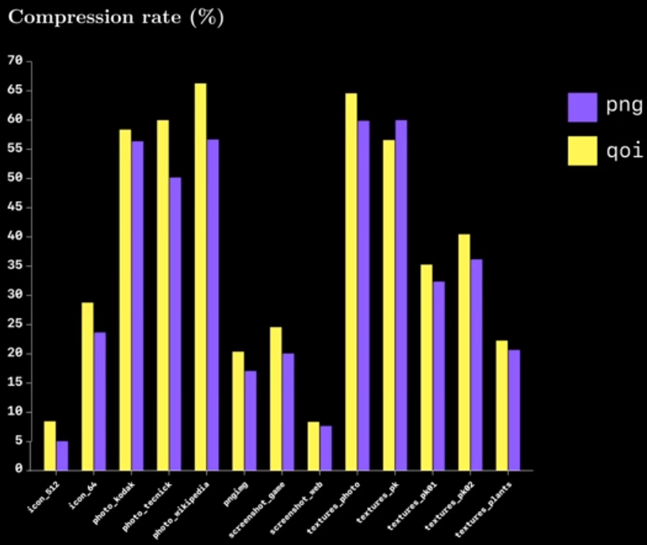
QOI: Benchmarks
https://www.youtube.com/watch?v=EFUYNoFRHQI

Slide 8
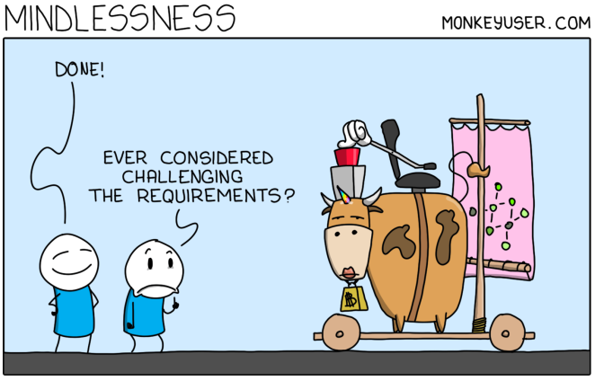
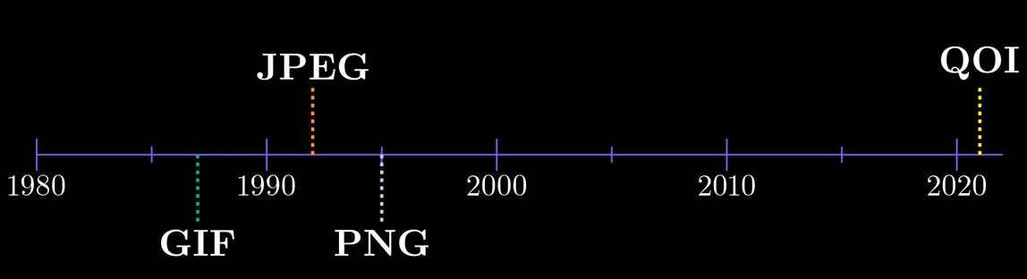
QOI: Final thoughts
Not widely adpted (yet?)
Should be considered where performances matter
  at cost of footprint
https://www.youtube.com/watch?v=EFUYNoFRHQI

Slide 9
IMGUI
Immediat Mode GUI
  In opposition to “retained mode GUI”
Another GUI paradigm
  DearIMGUI is a c++ implementation
Mostly used in gaming industry

Slide 10
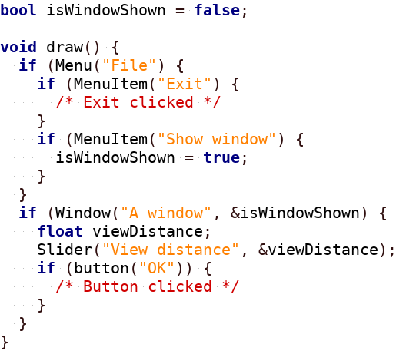
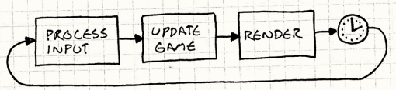
IMGUI: Basics
https://gameprogrammingpatterns.com/

Slide 11
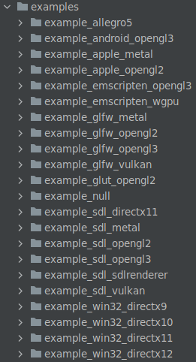
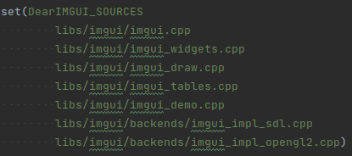
DearIMGUI: Basics
imgui.h and a few .cpp files
Choose a backend
  For this demo: sdl_opengl2
Examples == Documentation

Slide 12
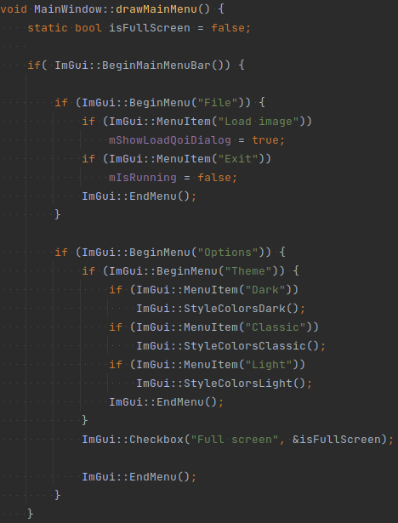


DearIMGUI: examples

Slide 13
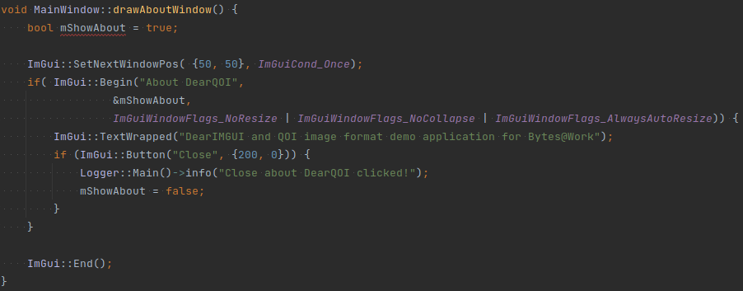
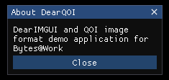
DearIMGUI: examples

Slide 14
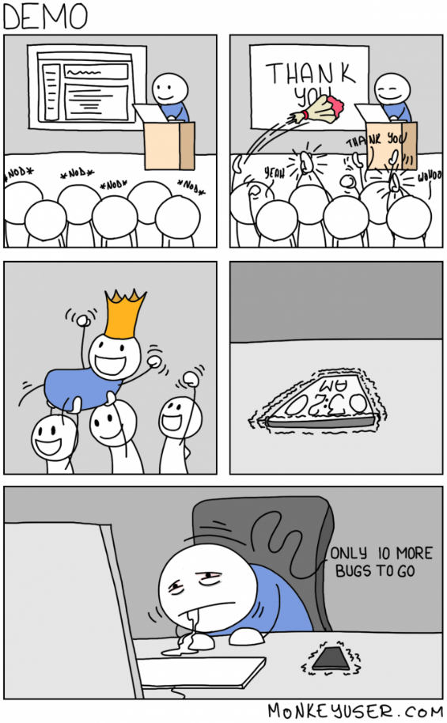

Demo

Slide 15
IMGUI: Final thoughts
Many widgets available out of the box
Easy to integrate with our model
Cannot do everything
  Videos playback, file browser, ...
  Custom styles (themes)
Embedded?
  Framebuffer? Wayland?

Slide 16
Conclusion
It’s always nice to break the bubble and see other approach to solve the same problem.
Finding an understandable and simple solution for difficult problems is the hard part of engineering.
Nice and sexy! Class and style!
(A.K.A. schön und elegant)

Slide 17
Ressources
https://qoiformat.org/
How does PNG work
  https://www.youtube.com/watch?v=EFUYNoFRHQI
IMGUI original idea
  https://youtu.be/Z1qyvQsjK5Y
https://github.com/ocornut/imgui
https://gameprogrammingpatterns.com/
https://github.com/morandg/DearQOI

