Slide 1
DATA SCIENCE & ANALYTICS CAPSTONE
Customer and Sales Intelligence
for a Kenyan Retailer
Who buys what, where and when - which customers are drifting - and what to expect next month
[Your name] | [Programme] | October 2026
Notes:
Introduce the client: Mavuno Mart, a fictional but realistic 20-store Kenyan chain. Explain that the sales data is generated (confidential in real life) while inflation, census and holiday data are real public sources. Today: the questions, the evidence, two models, and five actions.

Slide 2
EXECUTIVE SUMMARY
Six questions from management - and what the data says
1
Are we growing?
2
When do people buy?
Revenue +9.6%, but only +4.8% after inflation.
Payday days +30% revenue; December +41% vs an average month.
3
Where is revenue made?
4
Did promotions work?
Express stores earn the most per sq m (KES 5,086 vs 3,753 for hypermarkets).
Cooking-oil test: +66 pp units (p < 0.001) but lost margin. Personal care: no effect.
5
Who is drifting away?
6
What about October?
Nakuru members lapse at 32% vs 16% elsewhere; churn model AUC 0.907.
Forecast 56,214 units (KES 13.6M), +2% on last October.
Notes:
Answer first, then evidence. Every number on this slide is reproduced by the notebooks and SQL in the repository.

Slide 3
DATA AND APPROACH
Two years of till data joined to real Kenyan context data
M1
Frame
M2
Acquire
M3
Clean
M4
Explore
M5
SQL
M6
Test
M7
Model
M8
Dashboard
Internal (synthetic, documented generator)
External (real, public)
20 stores in 11 counties, 3 formats (one opened Jun 2025)
91 products in 9 categories, KES shelf prices
6,000 loyalty members + walk-in shoppers
334k receipts, 962k lines, Oct 2024 - Sep 2026
M-Pesa, cash, card, Airtel Money; 9 promotions incl. 2 randomised store tests
KNBS CPI inflation by month (via Central Bank of Kenya) -> real revenue, price drift
KNBS 2019 census county population -> market penetration, white space
Gazetted public holidays incl. Idd-ul-Fitr -> calendar effects, forecast features
Stack: pandas, PostgreSQL 16, SciPy, scikit-learn, Excel / Power BI
Notes:
Why synthetic: confidentiality. Realism: real inflation drives prices, real holidays shift demand, and known business events are planted so we can check whether the analysis finds them. Sources and licences are in docs/data_sources.md.

Slide 4
MILESTONE 2 - CLEANING
Real-world dirt was found, fixed or removed - and every step is logged
19,543
6,565
5,774
payment labels standardised
(15+ spellings of M-Pesa, cash...)
dd/mm/yyyy dates parsed
explicitly day-first
missing prices imputed from
product-store-month median
3,238
60
37
duplicate receipts and
lines removed
keying-error quantities (999...)
dropped, not capped
POS test receipts and
year-2031 clock errors removed
Checks after cleaning: unique receipt ids, all dates in range, all stores known, every line priced and categorised, till totals reconcile with line totals for 99.98% of receipts.
Notes:
Principle: fix when the true value is recoverable, drop when it is not and the volume is immaterial. Walk-ins (no customer id) and returns (negative quantity) are kept - they are real business events, not errors.

Slide 5
Q1 & Q7 - PERFORMANCE
Revenue grew 9.6% - but half of that is inflation
KES 154.8M
revenue, last 12 months
+9.6%
nominal growth vs prior year
+4.8%
real growth after KNBS inflation
Notes:
Inflation rose from about 4% to 6.8% in 2026 (KNBS via CBK). Reporting nominal growth alone would overstate performance by half. Receipts grew 3.6% - the real driver.

Slide 6
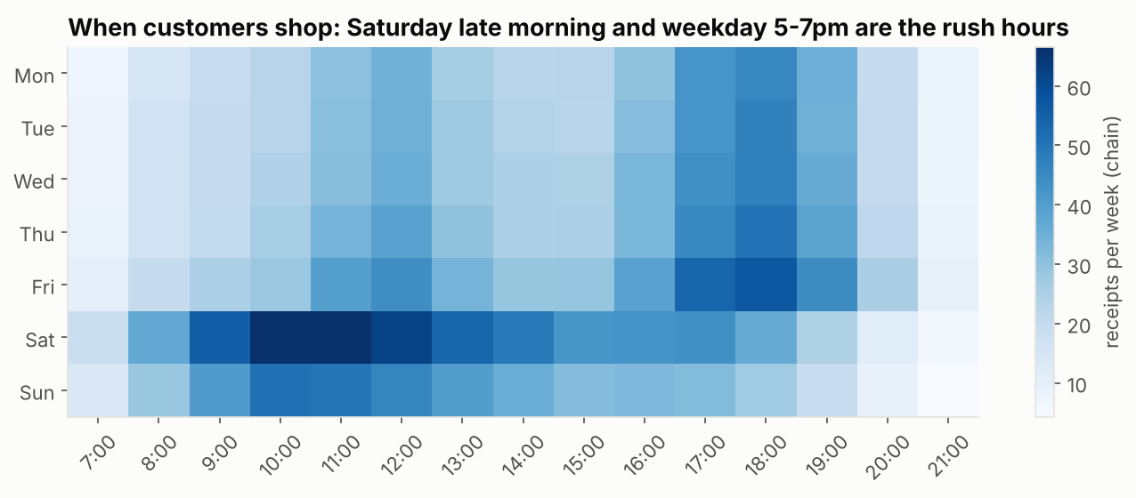
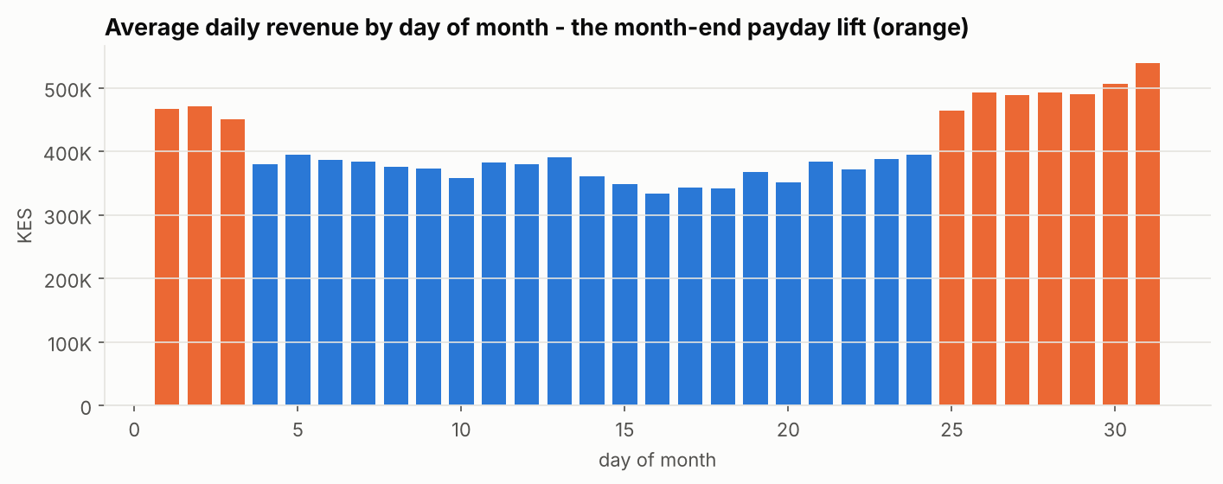
Q2 - TIMING
Demand follows the pay cheque, the weekend and the school calendar
+30%
daily revenue in the payday window (25th - 3rd)
+41%
December vs an average month (January -15%)
Roster extra tills Sat 10am-1pm and weekday 5-7pm
Stock up staples before the 25th
Stationery triples in January, spikes May and Aug-Sep
Notes:
The payday effect is both more shoppers and bigger baskets (H4: +KES 82 per basket, 95% CI 77-88). These patterns become forecast features.

Slide 7
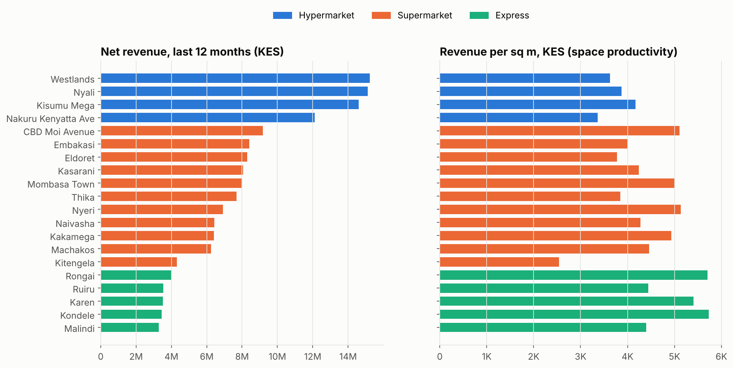
Q1 - WHERE
Small Express stores are the most productive use of space
Hypermarkets make the most shillings, Express the most per sq m
Meru (1.5M people) has no store; Kakamega and Kilifi have 1.4M+ residents per store
Recommendation: next openings = Express format in under-served counties
Notes:
Penetration from SQL q10: revenue per 1,000 residents joins the census. Mombasa and Kisumu lead; Kilifi, Kakamega and Kajiado are low - growth headroom.

Slide 8
Q3 - CUSTOMERS
30% of members bring 79% of member revenue - and they pay with M-Pesa
59.6%
of receipts paid by M-Pesa (up from 55.5%)
+26%
typical card basket vs M-Pesa (Tukey HSD, p < 0.001)
Protect Champions: availability, recognition
Lipa na M-Pesa loyalty points reach most shoppers
Bundle tea+sugar, unga+sukuma, diapers+wipes (lift 3-16x)
Notes:
RFM computed in PostgreSQL with NTILE(5). Basket affinity from a self-join (q13): support, confidence and lift. Payment mix is the same in every format (Cramer's V = 0.008).

Slide 9
Q4 - PROMOTIONS (RANDOMISED STORE TEST)
The cooking-oil promo lifted volume - but gave away more margin than it earned
+66 pp
p < 0.001
diff-in-diff, 95% CI 32 to 100
Welch t-test; permutation test agrees
Stores were randomly assigned, so the uplift is causal
But at 15% off a ~22%-margin staple, volume must ~triple to break even - gross profit fell
Personal-care 5% off: no detectable effect (p = 0.53)
Next test: 7-10% off, success metric = gross profit per receipt, 20+ stores per arm
Notes:
Unit of analysis is the store, avoiding pseudo-replication. Power analysis: with ~10 stores per arm we can only detect ~30% uplifts; 10% needs ~86 per arm - so future tests should run longer or use customer-level holdouts.

Slide 10
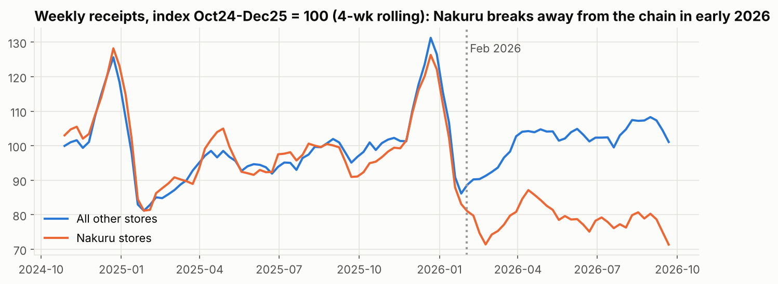
Q5 - AN EARLY WARNING
Nakuru has lost a fifth of its traffic since February 2026
32%
of active Nakuru members lapsed in Q3 2026
16%
lapse rate in the rest of the chain
Difference +16.5 pp (95% CI 11.2 to 21.9), z = 7.3
Nakuru has the highest share of drifting regulars (27.2%, SQL q12)
Timing matches a competitor opening near both Nakuru stores
Action: targeted retention offer + price check vs competitor, weekly tracking
Notes:
The EDA anomaly, the SQL drifting list, the two-proportion z-test and the churn model all point to the same place - triangulation makes the finding credible.

Slide 11
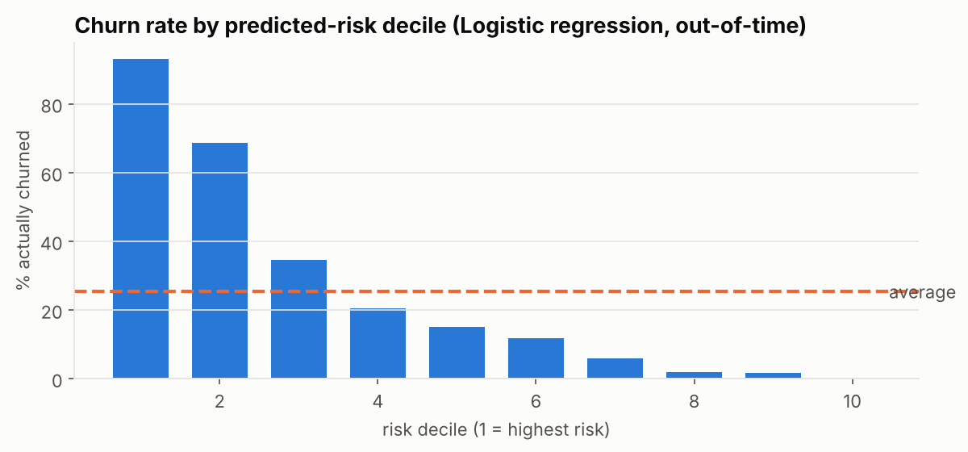
MILESTONE 6B - CHURN MODEL
The model finds 64% of next quarter's churners in the riskiest 20% of members
Model (out-of-time test, Jul-Sep 2026) | ROC-AUC | PR-AUC | Lift top 10%
Baseline: rank by recency | 0.891 | 0.787 | 3.60x
Logistic regression | 0.907 | 0.813 | 3.69x
Gradient boosting | 0.904 | 0.804 | 3.71x
KES 398K
expected net gain: KES 150 offer to 1,271 members picked by the model
Churn = no purchase in next 90 days; features only from before the snapshot
Trained on 3 snapshots, tested on a later, unseen quarter
Recency is a strong baseline; the model adds calibrated probabilities -> a shilling value per customer
Random targeting of the same list would net only KES 135K
Notes:
Success criteria from Milestone 1: AUC >= 0.75 and top-decile lift >= 2.5x - both met. Drivers: recent visit frequency, recency relative to the customer's own rhythm, home county Nakuru. Demographics add nothing. The campaign assumptions (25% save rate) must be validated with a holdout.

Slide 12
MILESTONE 6A - DEMAND FORECAST
October 2026: about 56.2k units, KES 13.6M
33% vs 46%
daily WAPE: model vs seasonal-naive baseline (28% better)
3.1%
average error on monthly category totals (target < 10%)
Gradient boosting (Poisson), store x category x day
Only lags of 35+ days: no look-ahead leakage
Rolling backtest Jul, Aug, Sep 2026
80% ranges per store-category for safety stock
Notes:
Backtest WAPE: seasonal naive 46%, recent weekday average 39%, model 33% - beats the 15%-improvement criterion. Daily store-category counts are noisy, so orders should be placed at weekly/monthly level. Mazingira Day (10 Oct) and Mashujaa Day (20 Oct) are in the features.

Slide 13
RECOMMENDATIONS
Five actions for the next quarter
Action | What | Owner | Success measure
Defend Nakuru now | Retention offer to at-risk Nakuru members + competitor price audit | CRM / Area manager | Nakuru lapse rate back under 20%
Run a model-targeted win-back | KES 150 offer to the 1,271 highest-value-at-risk members, 10% holdout | CRM | Measured save rate, net KES
Re-design promotions | No more 15% staple discounts; test 7-10% with basket GP as the metric | Commercial | GP per receipt vs control
Order to the forecast | Use the October store x category forecast and 80% range for POs | Supply chain | Stock-outs and waste vs last year
Grow with Express stores | Shortlist Express sites in Meru, Kakamega, Kilifi | Strategy / Property | Revenue per sq m >= KES 5,000
Notes:
Each recommendation traces back to a specific piece of evidence and has an owner and a measurable outcome.

Slide 14
Limitations, next steps and reproducibility
Limitations
Reproduce everything
Sales data is synthetic: patterns are realistic, absolute shilling totals are illustrative
Store tests have ~10 stores per arm: only large effects are detectable
Churn cannot see members who shop without scanning their card
Census population is from 2019
python run_all.py - data, cleaning, PostgreSQL, 7 notebooks, dashboard (~3 min)
sql/03_analytics.sql - 15 documented queries
dashboard/ - Excel dashboard + Power BI star schema, DAX and build guide
docs/ - data sources & licences, data dictionary
Asante - questions?
Notes:
Close with the reproducibility story: a reviewer can regenerate every number from one command with a fixed seed.

