Slide 1
Python Introduction
For those who can already code!
Ehsan Moravveji (VSC, KU Leuven)
6th and 7th October 2026

Slide 2
Thank You
Credits: Frank Van Puyvelde
Original repo: https://github.com/franklbvp/python_intro
This repo is forked in September 2025 for some updates
Geert Jan Bex
  https://github.com/gjbex/training-material/tree/master/Python
  https://creativecommons.org/licenses/by/4.0/deed.ast#
New repo for (updated) Slides + demo-files
  https://github.com/moravveji/python_intro_training

Slide 3
What will be covered in this training?

Slide 4
Programming with Python: ingredients
Python Interpreter: the actual program that reads and executes the Python code you write.
Text Editor or Integrated Development Environment (IDE): where you write Python code.
Basic Understanding of Python Syntax: includes knowledge of Python's data types, control flow structures, and functions.
Knowledge of Python Libraries: Python libraries are collections of functions and methods that allow to perform many actions without writing your own code.
Problem Solving Skills: Programming is all about solving problems. Break down complex problems into smaller, more manageable parts.
Patience and Persistence: you will encounter errors and bugs, and things won't work as expected. Debug your code and keep trying until you get it right.
Just do it: the best way to learn Python programming is by doing.

Slide 5
Bonus topics
Hands on exercises
Python programming using AI
Advanced VSC Python trainings

Slide 6
Python basics roadmap
Python basics
Computing environment
Basic syntax
Variables, operators
Data Types
Data structures
Flow control
Conditionals
Loops
Functions
IO
Lists
Tuples
Sets
Dictionaries

Slide 7
Scope
Using bare-metal Python standard library
Getting to know the very basics:
  How to run basic code in Python.
  What are the basic programming blocks in Python?
These sessions won't teach you how to program, how to find algorithms, … that's beyond the scope
  No idea about programming? consider completing
    CodeAcademy
    https://www.codecademy.com/catalog/language/python
    LearnPython
    https://www.learnpython.org/
Taken from GJ Bex

Slide 8
Running Python / Basic Python programming
Running Python from the command line
  goals: run Python scripts in a shell
  prerequisites: IDE (e.g. PyCharm, Spyder, VSCode)
Interactive Python
  goals: using Python for explorative programming using iPython & Jupyter notebooks
  prerequisites: IDE (e.g. PyCharm, Spyder, VSCode)
Core Python programming
  goals: Python syntax & semantics, control flow, data types, functions
  prerequisites: experience in some programming language

Slide 9
Contents
Computing Environment
  Command line
  Visual Studio Code (preferred)
  Notebook
  Slides: Python_intro-userEnvironments

Slide 10
Contents
Installing Python
  Slides: 02-Python_intro-Setup
Basic syntax
  Slides: 03-Python_intro-syntax
Variables and Operators
  Slides: 04-Python_intro-variables_operators
Built-in atomic Data types
  Slides: 05-Python_intro-builtin_datatypes
Data structures (compound data types)
  Lists
  Tuples
  Sets
  Dictionaries
  Slides: 06-Python_intro-datastructures

Slide 11
Contents
Flow control
  Basic flow control commands
    Slides: 07-Python_intro-control_flow
  Functions
    Slides: 08-Python_intro-functions
IO
  Slides: 09-Python_intro-io
[Bonus] Programming with AI
  Slides: 10-Python_intro-programming-with-AI
[Bonus] Python on the HPC platform
[Bonus] Python learning tracks

Slide 12
Using the demo files
Using the demo notebooks
Download the zip file
Unzip the file on a local disk
Run notebook
  Directly in VSCode
py source files
  In VSCode open a terminal
  ‘cd’ to the folder with *.py files
  Run from command line, e.g. python
Notes:
Opstarten Omgeving
Anaconda
Spyder
Anaconda Powershell
Naar folder met vbn
Opstarten Jupyter notebook
Jupyter notebook
Voorbeeld C:\Temp\Develop\PythonDev\infosession\PythonIntro

Slide 13
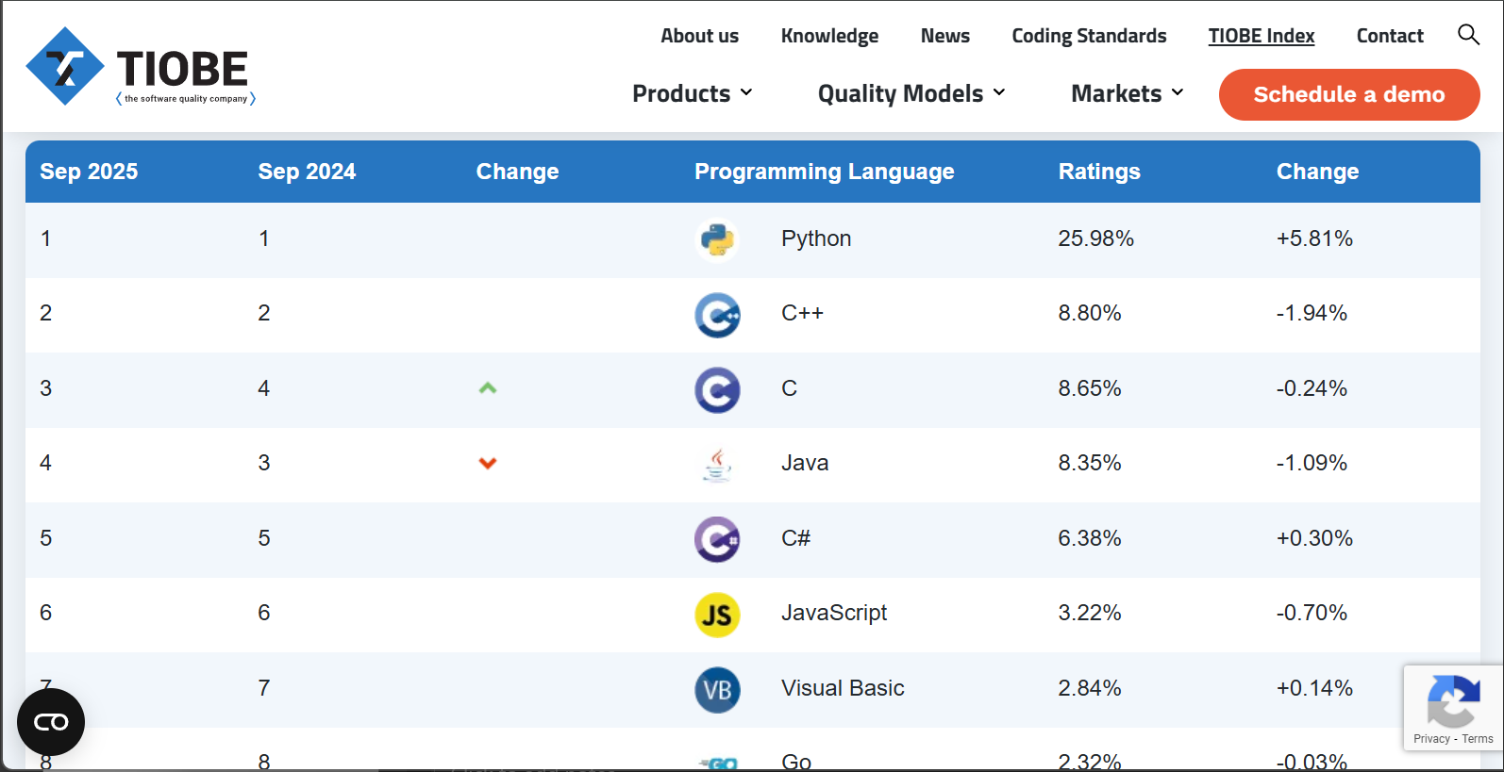
How popular is Python (late 2025)?
Tiobe index
September 2025
General trend (not HPC languages)
Also IEEESpectrum
Also GitHut 2.0
StackOverflow 2025 technologies
Python applications
Notes:
Opstarten Omgeving
Anaconda
Spyder
Anaconda Powershell
Naar folder met vbn
Opstarten Jupyter notebook
Jupyter notebook
Voorbeeld C:\Temp\Develop\PythonDev\infosession\PythonIntro

Slide 14
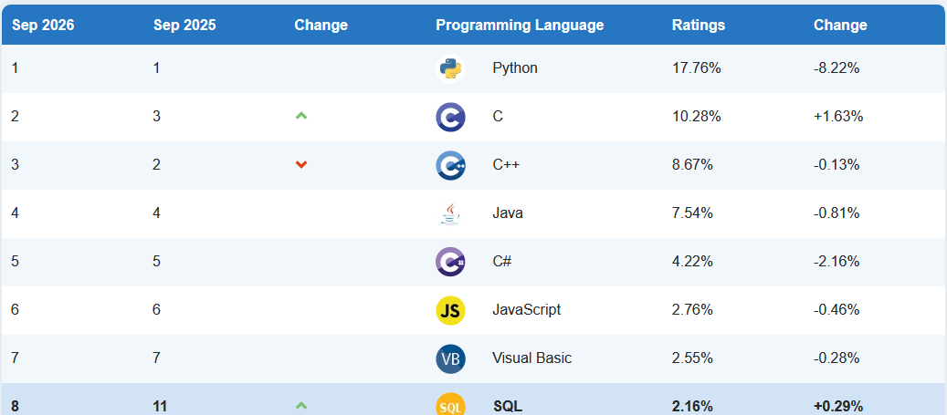
How popular is Python (late 2026)?
Tiobe index
September 2026
Top 10 have stayed
Top 7 kept position
Ratings changed
Notes:
Opstarten Omgeving
Anaconda
Spyder
Anaconda Powershell
Naar folder met vbn
Opstarten Jupyter notebook
Jupyter notebook
Voorbeeld C:\Temp\Develop\PythonDev\infosession\PythonIntro

Slide 15
What else will be covered?

Slide 16
More in other courses
Check https://github.com/gjbex/training-material/tree/master/Python
Object oriented programming
  goals: creating Python classes, inheritance
Functional programming
  goals: creating Python classes, inheritance
Code organization
  goals: organizing code of a non-trivial software project
Documentation
  goals: how to document Python code?

Slide 17
More in other courses
Testing
  goals: tests are integral part of software development
Error handling
  goals: catch & handle runtime errors
Debugging
  goals: using the Python debugger
Profiling
  goals: using the Python profiler to identify optimization opportunities

Slide 18
More in other courses
Command line arguments & configuration files
  goals: handling options, flags specified on command line, reading configuration files
Logging
  goals: writing application events to log files, using log levels
Interacting with the operating system
  goals: file system operations, executing external commands
Web applications
  goals: basic concepts of web application development

Slide 19
More in other courses
Text-based formats
  goals: reading & writing text-based file formats
Scientific file formats
  goals: reading & writing HDF5
Linear algebra, numerical analysis
  goals: various numerical analysis algorithms
Scientific visualization
  goals: creating 2D and 3D plots from Python

Slide 20
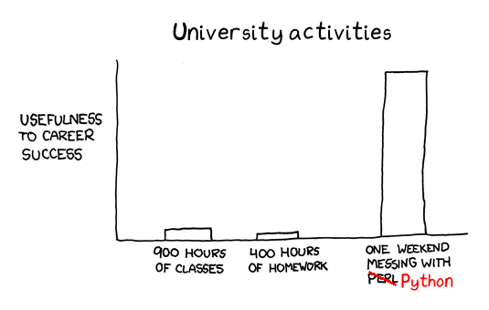
Programming 101
https://fabienmaussion.info/scientific_programming/img/00_messing_python.png

Slide 21
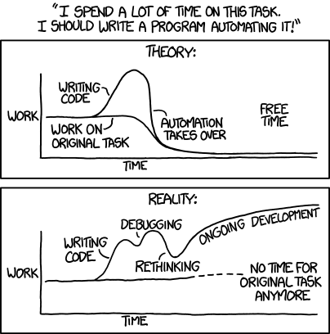
Why programming?
Programming is an integral part of research.
Programming occurs on different levels:
  Write small scripts,
  Write complete projects,
  Need a good understanding of what a software package does.
All programming languages offer to a certain extend the same building blocks.
  Understand the basic building blocks.
  Decompose your problem to fit those blocks.
xkcd 1319: Automation

Slide 22
Why write programs for research?
Scripted research can be tested and reproduced
Programs are a rigorous way of describing data analysis for other researchers, as well as for computers.
Code can be shared
Code is much more easy to understand for a non-author than spreadsheets
http://github-pages.ucl.ac.uk/rsd-engineeringcourse/ch00python/00pythons.html

Slide 23
Programming?
It may be (almost) impossible to solve a problem by executing commands at the command prompt.
What is needed? A sequence of precise instructions that, once performed, will complete a specific task.
Computer programs can’t do that many things, they can:
  Assign values to variables (memory locations).
  Make decisions based on comparisons.
  Repeat a sequence of instructions over and over.
  Call subprograms.

Slide 24
Choosing a programming language
There are many programming languages, with changing popularity
Check the Tiobe Index: https://www.tiobe.com/tiobe-index/
Consider:
  If it is suited to the problem at hand?
  There is an active user community?
  Is it relevant for the job market?

Slide 25
Key concepts in programming
All programming languages use the same basic concepts.
Check Isaac Computer Science: https://isaaccomputerscience.org/topics/programming_concepts?examBoard=all&stage=all
Instructions / Basic Syntax
Data Types
  Classification of the type of data being stored or manipulated within a program.
  Data types are important because they determine the operations that can be performed on the data.
Variables
  Named container, held by the computer in a memory location.
  Has a unique identifier (name) that refers to a value.
Input / Output
Notes:
Almost all programs consist of the same basic 'building blocks', assembled in different ways to achieve a particular goal. Variables, data types, sequence, selection, and iteration are examples of these basic concepts, which all new programmers need to learn. In order to compare and manipulate data, and to make decisions in a program, programmers use a variety of different logical, relational, and arithmetic operators. It is also useful to be able to generate randomness in a program, for example selecting a random number or a random item from a list.
https://isaaccomputerscience.org/topics/programming_concepts?examBoard=all&stage=all

Slide 26
Key concepts in programming
Operators
  Arithmetic
  Comparison
  Logical
Sequence:
statements are written one after another, will be executed one statement at a time in the order that the statements are written in.
Selection:
execute lines of code only if a certain condition is met.
Iteration (loop):
repeat a group of statements .
Subprogram (function):
is a named sequence of statements, can be repeatedly “called” from different places in the program
Notes:
Almost all programs consist of the same basic 'building blocks', assembled in different ways to achieve a particular goal. Variables, data types, sequence, selection, and iteration are examples of these basic concepts, which all new programmers need to learn. In order to compare and manipulate data, and to make decisions in a program, programmers use a variety of different logical, relational, and arithmetic operators. It is also useful to be able to generate randomness in a program, for example selecting a random number or a random item from a list.
https://isaaccomputerscience.org/topics/programming_concepts?examBoard=all&stage=all

Slide 27
And there will be errors…
Syntax error
  A mistake against the language rules
  Program will not run and will return an error message
  -> Easy to spot and fix
Runtime error
  Usually due to some missing variables, modules, files, …
  -> Easy to spot and fix
Semantic error
  A mistake in the reasoning
  Program runs, but produces undesireable/wrong/meaningless results
  -> Difficult to spot and fix!

Slide 28
Python
A quickstart into the very basics
Get to know your Python environment

Slide 29
Thank You
https://github.com/gjbex/training-material/tree/master/Python
Whirlwind Tour of Python by Jake VanderPlas https://jakevdp.github.io/WhirlwindTourOfPython/
https://www.cs.cornell.edu/courses/cs1110/2023fa/materials/python/
https://fabienmaussion.info/scientific_programming/welcome.html
https://justinbois.github.io/bootcamp/

Slide 30
See also
https://fangohr.github.io/teaching/python/book.html
https://patrickwalls.github.io/mathematicalpython/
https://sites.duke.edu/compsci_101l_001_sp24/
https://github.com/parrt/msan501
https://docs.python-guide.org/intro/learning/

Slide 31
Tutorials
https://www.python.org/about/gettingstarted/
https://exercism.org/tracks/python
https://realpython.com/
https://realpython.com/matlab-vs-python/
https://www.learnpython.org/
Cheat sheets
https://www.datacamp.com/community/data-science-cheatsheets

Slide 32
Python: setting the scene
get comfortable within the Python universe

Slide 33
Motivation
Why yet another programming language?
  Programming languages have strong & weak points
  Pick language for task at hand
Why Python?
  Useful for data processing
  Terse language: express a lot in few lines of code
  Short time to solution
  Extensive standard library
  Cross platform
Taken from GJ Bex
Anybody who comes to you and
says he has a perfect language is
either naïve or a salesman.
— Bjarne Stroustrup

Slide 34
What is the playfield?
1
Get data (simulation, experiment, etc.)
2
Manipulate and process data
3
Visualize results
quickly to understand,
high quality figures, for reports or publications
The best way to learn a language is to "get your hands dirty"
Notes:
https://alan-turing-institute.github.io/rsd-engineeringcourse/

Slide 35
What is Python?
From www.python.org:
"Python is an interpreted, object-oriented, high-level programming language with dynamic semantics. Its high-level built in data structures, combined with dynamic typing and dynamic binding, make it very attractive for Rapid Application Development, as well as for use as a scripting or glue language to connect existing components together. Python's simple, easy to learn syntax emphasizes readability and therefore reduces the cost of program maintenance."

Slide 36
Milestones
December 1989: Python’s implementation was started by Guido van Rossum at CWI in the Netherlands
February 1991: Van Rossum published the code (labeled version 0.9.0) to alt.sources. This version already had classes with inheritance, exception handling, functions, and the core datatypes of list, dict, str, etc.
1994: comp.lang.python, the primary discussion forum for Python, was formed1
January 1994: Python reached version 1.0. The major new features included in this release were the functional programming tools lambda, map, filter, and reduce.
October 16, 2000: Python 2.0 was released with many major new features, including a cycle-detecting garbage collector and support for Unicode.
December 3, 2008: Python 3.0, a major, backwards-incompatible release, was released.
Python was named after the BBC TV show Monty Python’s Flying Circus.
Guido van Rossum, Python’s principal author, was given the title “Benevolent Dictator for Life” (BDFL) by the Python community. However, Van Rossum stepped down as leader on July 12, 2018.

Slide 37
What is Python?
  a general purpose interpreted programming language.
  a language that supports multiple approaches to software design, principally structured and object-oriented programming.
  provides automatic memory management and garbage collection
  dynamically typed.
  Brian Gregor (BU): A Brief Introduction to Using Python for Computational Neuroscience

Slide 38
Why Python?
Python is free
Cross-platform (Windows, Mac, Linux)
Has a vibrant user community (StackOverflow)
Rich 3rd party packages, e.g. Conda, PyPI
Python is quick to program in, easy exploration of modeling constructs, and fast analysis of data. (explorative programming)
Python is popular in research, and has lots of libraries for science
  extensive capabilities, documentation, and support
  Access to advanced math, statistics, and database functions
Python interfaces well with faster languages (C/C++, Fortran)
http://github-pages.ucl.ac.uk/rsd-engineeringcourse/ch00python/00pythons.html

Slide 39
Comparison
Interpreted
Compiled
Faster development
Easier debugging
  Debugging can stop anywhere, swap in new code, more control over state of program
(almost always) takes less code to get things done
Slower programs
  Sometimes as fast as compiled, rarely faster
Less control over program behavior
Longer development
  Edit / compile / test cycle is longer!
Harder to debug
  Usually requires a special compilation
(almost always) takes more code to get things done
Faster
  Compiled code runs directly on CPU
  Can communicate directly with hardware
More control over program behavior
  Brian Gregor (BU): A Brief Introduction to Using Python for Computational Neuroscience

Slide 40
How popular is Python (late 2025)?
Tiobe index
September 2025
General trend (not HPC languages)
Also IEEESpectrum
Also GitHut 2.0
What is Python used for?
https://www.python.org/about/apps/
Notes:
Opstarten Omgeving
Anaconda
Spyder
Anaconda Powershell
Naar folder met vbn
Opstarten Jupyter notebook
Jupyter notebook
Voorbeeld C:\Temp\Develop\PythonDev\infosession\PythonIntro

Slide 41
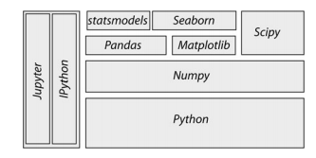
Python ecosystem
Large and active ecosystem
Core Python
  Standard libraries
  third-party packages:
    NumPy for manipulation of homogeneous array-based data,
    Pandas for manipulation of heterogeneous and labeled data,
    SciPy for common scientific computing tasks,
    Matplotlib for publication-quality visualizations,
    IPython for interactive execution and sharing of code, etc. Python versions

Slide 42
Python versions
Current 3.x
  More clean than 2.x
  Python 3.x introduced some backwards-incompatible changes to the language, so code written for 2.7 may not work under 3.x and vice versa.
  Almost all Python libraries supported
Version 2.7.x
  Last of the 2.x releases
  Many Python 3.x features have been retrofitted
  All libraries support it
Taken from GJ Bex
Note: in-application scripting
may be stuck at Python 2.7!
Python 2 is not supported as of 1st January 2020.

Slide 43
Matlab vs Python
  https://realpython.com/matlab-vs-python/
  https://www.enthought.com/white-paper-matlab-to-python-a-migration-guide/

Slide 44
