Slide 1
Python
A quickstart into the key concepts of programming
Basic syntax

Slide 2
Key concepts in programming
Variables (integers, strings, dates, etc.)
Flow control (if then, loop, etc.)
Functions (named list of steps the code will follow, with clear input/output)

Slide 3
Python: basic syntax
basic_syntax.ipynb

Slide 4
Python files
Python scripts are saved with .py
Jupyter notebook files: .ipynb
Naming convention
lowercase, with words separated by underscores as necessary to improve readability
Indentation: 4 spaces (not tabs!)
Max line length: 79 characters
https://peps.python.org/pep-0008/
https://visualgit.readthedocs.io/en/latest/pages/naming_convention.html

Slide 5
Python syntax
Syntax:
refers to the structure of the language
i.e., what constitutes a correctly formed program.
E.g, ‘country’ is correct, but ‘Kountri’ is syntactically wrong
Semantics:
involve the meaning of the statements
E.g., ‘humans swim’ is semantically correct, but ‘humans fly’ is semantically wrong (although syntactically correct!)
Your Python code should be syntactically AND semantically correct (for correct scientific results and reproducibility).

Slide 6
Comment
Comments are marked by #
Anything on the line following the hash sign is ignored by the interpreter
x += 2 # shorthand for x = x + 2
multiline comments:
no syntax out of the box
use consecutive # single-line comments
Python-aware editor can help

Slide 7
Statement
A statement is one complete sentence in the language. It contains one complete instruction.
End-of-Line terminates a statement (no semicolon required)
B = A
surfC = math.pi * r**2
Continuation: continue to the next line, use the \ marker
x = 1 + 2 + 3 + 4\
+ 5 + 6 + 7 + 8
Semicolon can optionally terminate a statement (discouraged)
lower = []; upper = []

Slide 8
Code blocks
newlines and indentation are syntax in python.
Statements can be grouped into blocks
a block of code is a set of statements that should be treated as a unit.
Structures that introduce a block, end with a colon :
Many operations define a code block
Code to run within a loop
Code to run (or not) depending on a logical test

Slide 9
Code blocks
Blocks are indicated by indentation level.
Indentation is mandatory in Python and must be exact.
Python style recommends 4 spaces for indentation
Indent each block by however many spaces (at least 1) you wish to use, but each block level must be indented by exactly the same number.
Do not use tabs, spaces are the preferred indentation method.
Python-aware editors (e.g. Spyder, VSCode, vim) will automatically indent the next statement to the same level as the one before it; so, check your first indent
Check your IDE for defaults

Slide 10
Indentation: Whitespace matters
In C, code blocks are denoted by curly braces:
// C code
for(int i=0; i<100; i++)
{
total += i;
}
In Python, code blocks are denoted by indentation:
for i in range(100):
# indentation indicates code block
total += i
In Python, indented code blocks are always preceded by a colon (:) on the previous line.

Slide 11
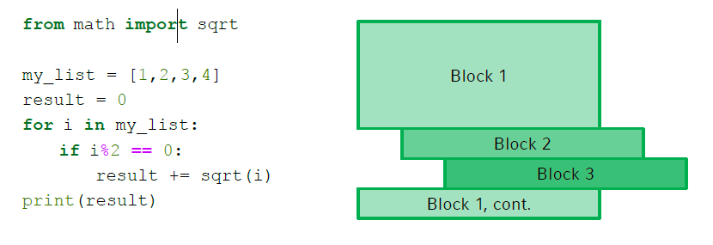
Code blocks
File: block_code.py
http://www.dbs.ifi.lmu.de/Lehre/MaschLernen/SS2017/Orga/U01-Slides.pdf

Slide 12
Indentation
>>> if x < 4:
... y = x * 2
... print(x)
print(x) is in the indented block, and will be executed only if x is less than 4.
File: check_whitespace.py
>>> if x < 4:
... y = x * 2
... print(x)
print(x) is outside the block, and will be executed regardless of the value of x,

Slide 13

Code blocks
There must be at least 1 statement in a block.
You can use pass as a way to make a dummy statement if you really need to.
When you do not know yet what code to write, put a pass at that line.
n = 10
# use pass inside if statement
if n > 10:
pass
print('Hello’)
File: pass_example.py

Slide 14
Whitespace
amount of whitespace used for indenting code blocks is up to the user, as long as it is consistent throughout the script.
Whitespace within lines does not matter
In [4]: x=1+2
x = 1 + 2 # recommended by PEP-8
x = 1 + 2

