Slide 1
Python
A quickstart into the key concepts of programming
Control structures

Slide 2
Thank You
https://github.com/gjbex/training-material/tree/master/Python
Whirlwind Tour of Python by Jake VanderPlas (O’Reilly). Copyright 2016 O’Reilly Media, Inc., 978-1-491-96465-1. https://www.oreilly.com/programming/free/files/a-whirlwind-tour-of-python.pdf
University of Virginia, Advanced Research Computing Services, Python Quickstart https://arcs.virginia.edu/python-quickstart
http://www.cs.cornell.edu/courses/cs1110/2018sp/
https://fabienmaussion.info/scientific_programming/html/00-Introduction.html

Slide 3
See also
https://www.math.ubc.ca/~pwalls/math-python/
http://troll.cs.ua.edu/ACP-PY/index.html
https://data-flair.training/blogs/python-lambda-expressions/
http://pages.physics.cornell.edu/~myers/teaching/ComputationalMethods/GettingStarted.html
https://anh.cs.luc.edu/python/hands-on/3.1/handsonHtml/index.html
https://www2.cs.duke.edu/courses/spring18/compsci101/index.php
https://github.com/parrt/msan501
https://docs.python-guide.org/intro/learning/

Slide 4
Control flow

Slide 5
Control flow
Computer programs can’t do that many things, they can:
Assign values to variables (memory locations).
Make decisions based on comparisons.
Repeat a sequence of instructions over and over.
Call subprograms.

Slide 6
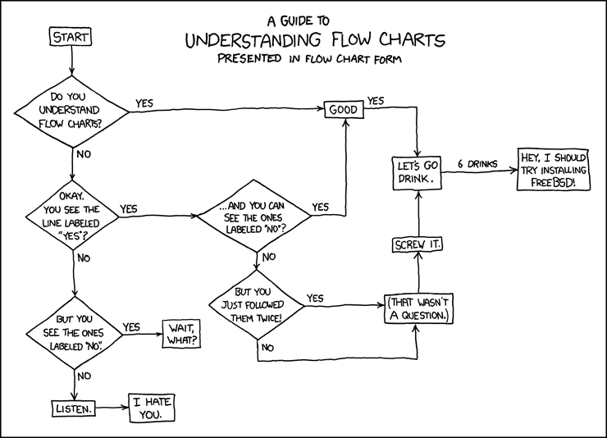
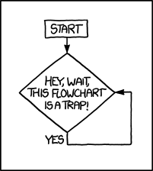
https://xkcd.com/1195/
https://xkcd.com/518/

Slide 7
conditionals
control_flow_conditionals.ipynb

Slide 8
Conditional Statements: if
Syntax:
if condition :
indentedStatementBlock
A group of individual statements, which make a single code block are called suites
If the condition is true, then do the indented statements. If the condition is not true, then skip the indented statements.
if (a<100): print(‘a is less than 100’)
File: if_1.py

Slide 9
Conditional Statements: if else
Syntax:
if condition :
indentedStatementBlockForTrueCondition
else:
indentedStatementBlockForFalseCondition
a = 88
if (a<10):
print('a smaller than 10')
else:
print('a larger than 10')
File: if_else_1.py

Slide 10
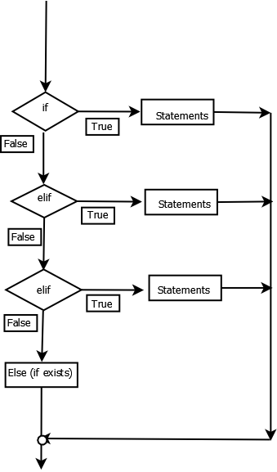
Conditional Statements: chaining if’s
Combine several if statements into one statement using elif
else block at the very end is not required
if x < 0:
print(“negative”)
else:
if x > 10:
print(“large”)
else:
print(“small”)
if x < 0:
print(“negative”)
elif x > 10:
print(“large”)
else:
print(“small”)
cs.uky.edu/~keen/115

Slide 11
Conditional Statements: chaining if’s
There can be zero or more elif parts, and the else part is optional.
The keyword ‘elif’ is short for ‘else if’, and is useful to avoid excessive indentation.
An if … elif … elif … sequence can be sometimes replaced with the Match-Case block (Python >3.10).

Slide 12
Exceptions in Python
Python defines some typical exceptions, e.g. TypeError, ValueError, …
See built-in exceptions: https://docs.python.org/3/library/exceptions.html
3rd party packages might have their own exceptions, e.g. numpy.exceptions.AxisError
If the code does not handle the exception, then execution terminates
If the code properly handles the exception, execution can continue even in case of errors/issues. E.g.: >>> print(1 / 0) Traceback (most recent call last):
File "<python-input-4>", line 1, in <module>
print(1/0)
~^~
ZeroDivisionError: division by zero

Slide 13
Catching (deterministic!) exceptions
Use try-except-else-finally for catching/handling exceptions
https://cvw.cac.cornell.edu/python-intro/control-flow/exception-handling
Syntax
try:
some statements here
except:
exception handling else: statements when try succeeds finally: statements that run regardless
File: try_except_1.py
File: try_except_2.py

Slide 14
Catching Exceptions
var = ‘string’ try:
result = var + 42
except TypeError as e: print(‘Adding an int to a str failed: ’, e)
else:
print(‘I managed to divide a string by int’)
finally:
print(‘This statement always runs’)

Slide 15
Catching Exceptions
Specific error conditions can then be tested for and responded to, using one or more except statements.
First, the code block between the try and except keywords is executed.
If no exception occurs, any except statements and their code blocks are skipped, and execution continues.
If an exception occurs during execution of the try, the rest of the statements in its code block are skipped. Then the except statements are checked one at a time, in order, to see if one matches the specific exception. If there is a match to the exception named after one of the except keywords, the code block following that except is executed, and then execution returns to the try statement and continues from there.
Many of Python’s built-in exceptions are self-explanatory, some of the more commonly encountered ones.
NameError - You probably misspelled a variable or function name, or you otherwise referenced a name that was never defined.
IOError - I/O operation failed.
SystemError - Internal error in the Python interpreter.
ZeroDivisionError - Second argument to a division or modulo operation was zero.

Slide 16
loops
control_flow_loops.ipynb

Slide 17
Loops
for loops are executed a fixed number of iterations. It is possible to exit early but this must be added to the code.
while loops do not have a predetermined number of iterations. They terminate when some condition becomes False.

Slide 18
for loop (basic)
for iterates over the items of any sequence (a list, tuple, string), in the order they appear in the sequence.
The general Python syntax:
for <item> in <iterable object>:
blockToRepeat
File: for_loop_1.py
File: for_loop_change_content.py

Slide 19
for loop (basic)
sum=0
numbers =[1,22,31,458]
for num in numbers:
print(num)
sum=sum+num # check the indentation
avg=sum/len(numbers)
print ('Average:', avg)

Slide 20
for loop
If you need to modify the sequence you are iterating over while inside the loop, it is recommended that you first make a copy.
Iterating over a sequence does not implicitly make a copy. The slice notation makes this especially convenient.
File: for_loop_vanrossum_1.py

Slide 21
iterator
An iterator is a special object that gives values in succession, it implements the next protocol and raises StopIteration when exhausted.
Iterator
range()
enumerate()
zip()
The for loop automatically constructs an iterator from an iterator object, then repeatedly calls next until a StopIteration is raised.

Slide 22
iterator
The benefit of the iterator indirection is that the full list is never explicitly created!
N = 10 ** 12
for i in range(N):
if i >= 10: break
print(i, end=', ')

Slide 23
range
range(start,end,stride) function gives an iterable that enables counting.
As with indexing, range() inclusively starts at zero by default, and the ending is exclusive.
It is often useful to make a list or tuple that has the same entries that a corresponding range object would have, with a type conversion:
>>> vals = list(range(10))
use the range()function along with the len() function

Slide 24
range
What if we need indexes?
Simulate a counter
use range(len(our_list)) and lookup the index:
>>> fruitslist = ['banana', 'apple', 'mango’]
>>> for i in range(len(fruitslist)):
print(fruitslist[i])
Source: http://treyhunner.com/2016/04/how-to-loop-with-indexes-in-python/

Slide 25
enumerate
enumerate returns an iterable where each element is a tuple that contains the index of the item and the original item value.
>>> fruitslist = ['banana', 'apple', 'mango’]
>>> for num, color in enumerate(fruitslist):
print(num, color)
File: for_loop_index
Source: http://treyhunner.com/2016/04/how-to-loop-with-indexes-in-python/

Slide 26
zip
What if we need to loop over multiple things?
zip: allows to loop over multiple lists at the same time
The zip function takes multiple lists and returns an iterable that provides a tuple of the corresponding elements of each list as we loop over it.
>>> fruitslist = ['banana', 'apple', 'mango’]
>>> ratios = [0.2, 0.3, 0.1, 0.4]
>>> for fruit, ratio in zip(fruitslist, ratios):
print("{}% {}".format(ratio * 100, fruit))
Source: http://treyhunner.com/2016/04/how-to-loop-with-indexes-in-python/

Slide 27
reversed
reversed: for giving an iterator that goes in the reverse direction.
>>> count_up = (1, 2, 3, 4, 5, 6, 7, 8 ,9, 10)
>>>> for count in reversed(count_up): print(count)

Slide 28
iter
iter object is a container that gives you access to the next object for as long as it’s valid
>>> I = iter([2, 4, 6, 8, 10])
>>> print(next(I))
2
>>> print(next(I))
4
>>> print(next(I))
6

Slide 29
Comprehension
Comprehension: powerful functionality within a single line of code; provides a compact way to create lists, dictionaries, sets
new_list = [expression for member in iterable]
expression is the member itself, a call to a method, or any other valid expression that returns a value.
member is the object or value in the list or iterable.
iterable is a list, set, sequence, generator, or any other object that can return its elements one at a time.
>>> squares = [i * i for i in range(10)]

Slide 30
for loop: summary
Loop over a single sequence with a regular for-in
Loop over a list while keeping track of indexes with enumerate
Loop over multiple lists at the same time with zip

Slide 31
for loop in other languages: C
#include <stdio.h>
#include <string.h>
/*
loop over a list of colors, the colors are stored in a structure
*/
void display(char *name);
/**************************************************************/
int main ()
{
struct record { char color[20];};
struct record a[5];
int i, ll;
strcpy(a[0].color, "yellow");
strcpy(a[1].color, "blue");
strcpy(a[2].color, "black");
strcpy(a[3].color, "white");
strcpy(a[4].color, "cyan");
ll = sizeof(a) / sizeof(a[0]);
for (i = 0; i <= ll-1; i++){
display(a[i].color);
}
return 0;
}
/**************************************************************/
void display(char *name)
{
printf("color is %s \n", name);
}
Set a counter variable i to 0
Check if the counter is less than the (structure length-1)
Execute the code in the loop or exit the loop if the counter is too high
Increment the counter variable by 1

Slide 32
for loop in other languages: Matlab
cellc = {'yellow', 'blue', 'black', 'white', 'cyan'};
lc = length(cellc);
for (i=1:lc)
fprintf(" color = %s \n", cellc{i});
end
A counter variable i is used
The length of the cell array is calculated

Slide 33
Hands-on
Loop over the first 20 integers (starting at 1) and print each one
Use a loop to sum up the integers: 1, 2, .., 20
Make the program general and use a variable to specify the amount of numbers.

Slide 34
Accumulator pattern
Common programming pattern:
walk through a sequence,
accumulate a value as you go,
at the end of the traversal, have single value accumulated
The anatomy of the accumulation pattern includes:
initializing an “acccumulator” variable to an initial value (such as 0 if accumulating a sum)
iterating (e.g., traversing the items in a sequence)
updating the accumulator variable on each iteration (i.e., when processing each item in the sequence)
http://ice-web.cc.gatech.edu/ce21/1/static/audio/static/pip/Iteration/iteration.html

Slide 35
Accumulator pattern
nums = [1, 2, 3, 4, 5, 6, 7, 8, 9, 10]
accum = 0
for w in nums:
accum = accum + w
print(accum)
File: accum_pattern_single.py
File: accum_pattern_single_text.py

Slide 36
Accumulator pattern
Accumulating multiple results in a dictionary
File: accum_pattern_multiple.py
File: accum_pattern_multiple-scrabble.py

Slide 37
while loop
while loops use a condition to determine when to stop the loop.
The general Python syntax:
while <boolean expression>:
blockToRepeat
else: # optional
blockElse
File: while_loop_1.py

Slide 38
Fine-Tuning Your Loops: break, continue, else
The break statement breaks out of the loop entirely, any else clause will not be executed.
The continue statement skips the remainder of the current loop, and goes to the next iteration
File: while_loop_break_continue.py

Slide 39
for loop: else part
use case: implement search loops, searching for an item meeting a particular condition, and need to perform additional processing or raise warning if no acceptable value is found
Loop should contain break statement.
The statements in the else block will be executed after all iterations are completed (normal termination).
numbers =[1,2,3,4]
for i in numbers:
print(i)
if i > 2.5:
break
else: # Not executed as there is a break
print("No Break")
File: for_loop_else.py

Slide 40
Match-Case
Make decision blocks based on a matching test
Available since Python v.3.10
Syntax: match var: case val1: statement-block-1 case val2: statement-block-2 … case _: default-statement-block

Slide 41
Match-Case
match today: case ‘Monday’ | ‘Wednesday’: print(‘Go to gym’) case ‘Tuesday’ | ‘Thursday’: print(‘Wake up early’)
case ‘Friday’: print(‘Watch movies’) … case _: # for weekend print(‘We up late!’)

