Slide 1
Python
A quickstart into the key concepts of programming
Functions

Slide 2
Thank You
https://github.com/gjbex/training-material/tree/master/Python
Whirlwind Tour of Python by Jake VanderPlas (O’Reilly). Copyright 2016 O’Reilly Media, Inc., 978-1-491-96465-1. https://www.oreilly.com/programming/free/files/a-whirlwind-tour-of-python.pdf
University of Virginia, Advanced Research Computing Services, Python Quickstart https://arcs.virginia.edu/python-quickstart
http://www.cs.cornell.edu/courses/cs1110/2018sp/
https://fabienmaussion.info/scientific_programming/html/00-Introduction.html

Slide 3
See also
https://www.math.ubc.ca/~pwalls/math-python/
http://troll.cs.ua.edu/ACP-PY/index.html
https://data-flair.training/blogs/python-lambda-expressions/
http://pages.physics.cornell.edu/~myers/teaching/ComputationalMethods/GettingStarted.html
https://anh.cs.luc.edu/python/hands-on/3.1/handsonHtml/index.html
https://www2.cs.duke.edu/courses/spring18/compsci101/index.php
https://github.com/parrt/msan501
https://docs.python-guide.org/intro/learning/

Slide 4
functions
functions.ipynb

Slide 5
Functions
A function is a named block of programming statements designed to perform a certain task. Named piece of functionality into which data is passed
Wrap code up in a function, be able to repeatedly use it
A piece of code written to carry out a specified task.
This makes code easier to read, maintain and debug.
Code can be tested separately
The output of the function is stated by “return”
Programming functions (usually) take arguments.
The input comes in parentheses after the function name:
The ordered sequence of variables is strictly speaking, called the argument list in the caller and the parameter list in the function definition.

Slide 6
Why functions?
Name a group of statements, which makes your program easier to read. Don’t Repeat Yourself (DRY principle)
Functions make programs smaller by reusing the same code.
Dividing programs into functions allow for debugging sections at a time. Easier maintenance of the code.
Well defined functions can be used in other programming projects (code refactoring).

Slide 7
How to design a function?
Wishful thinking: Write the program as if the function already exists
Write a specification: Describe the inputs and output, including their types
No implementation yet!
Write tests: Example inputs and outputs
Write the function body (the implementation)
write your plan in words, pseudo-code
then translate to Python
Source: https://courses.cs.washington.edu/courses/cse160/15sp/lectures/04-functions.pptx

Slide 8
Functions and Spyder
https://stackoverflow.com/questions/32051513/calling-python-functions-without-running-from-the-editor
Calling a function in Spyder
if you want to use functions defined in a particular file in Python you need to "import" that file first.
This is similar to running the code in that file.
Matlab doesn't require you to do this because it searches for files with a matching name and automagically reads in the code for you.
myFunction.py is a file containing
def myAdd(a, b):
return a + b
In order to access this function from the Python command line or another file, type
from myFunction import myAdd
And then during this session you can type
myAdd(1, 2)

Slide 9
Functions
Skeleton / syntax
def funcname(p1, p2, ..):
“”” docstring “””
statement 1
statement 2
…
return statement
The def keyword introduces the function.
A colon ‘ : ‘ ends the introduction to the function.
funcname is the name of the function.
parameter list inside ()
Empty parentheses when no parameters are used.
All statements are indented
Usually an (optional) return statement that can return the result to the calling program.

Slide 10
Function Naming rules
Must start with a letter or an underscore( _)
Should be lowercase.
Can contain numbers.
No spaces
Case sensitive
Can be any length (reasonably short), meaningful
Two different functions can’t have the same name
Cannot use any of Python’s keywords

Slide 11
Functions
A function must be called, it does nothing by itself.
The interpreter must see the function definition before it can be called.
Best practice is to put all the functions at the top of a file, right after the main docstring.
End the function with a return statement if the function should output something.
Without the return statement, the function will return an object None.
Return multiple values in a tuple ()
File: function_1.py

Slide 12
function_1.py
def my_func_1 ():
""“ docstring this function writes hello """
print('Hello')
def my_func_2(a, b):
""" parameters:
a: first part of mathematical manip
b: second part in mathematical manip
"""
res = a + b
return (res)
def my_func_3(a, b):
"""
parameters:
a: first part of mathematical manip
b: second part in mathematical manip
"""
res1 = a + b
res2 = a - b
return (res1, res2)
# main part, calling the functions
my_func_1()
my_func_2(5,6) # effect?
a = my_func_2(5,6)
print(type(a))
print(a)
b = my_func_3(5,6)
print(type(b))
print(b)

Slide 13
Functions: how to call a function
Call a function by its name and pass the arguments
Mechanism: call by (object) reference
immutable arguments (i.e. strings, tuples, etc.), the passing acts like call-by-value.
Pass mutable arguments (e.g. lists), consider two cases:
Elements of a list can be changed in place
If a new list is assigned to the name, the old list will not be affected.
Argument lists in the caller and the callee must agree in number and type.
Default arguments
Required arguments
Keyword arguments
Variable number of arguments
File: function_argument_pass_1.py

Slide 14
Optional and keyword arguments
Positional argument
Named argument
An argument may be assigned a default value in the parameter list
If not present in the calling argument list, the default value will be used
Keyword arguments can be passed by keyword, not position.
Keyword arguments (with default values) must all appear at the end of the argument list i.e., after the positional arguments
File: function_optional_arguments.py
def foo(val1, val2, val3, calcSum=True):
# Calculate the sum
if calcSum:
return val1 + val2 - val3
# Calculate the average instead
else:
return (val1 + val2 + val3) / 3
print(foo(10,20,30, True))
print(foo(10,20,30, False))
print(foo(10,20,30))
print(foo(val1=10,val3=20,val2=30,calcSum=True))

Slide 15
Returning from a function
Values are returned by the return statement. It can return an item or an expression.
Return: immediate exit.
Python functions can return only one item but that item can be any object, in particular a tuple, list, or dictionary.
A function may have multiple return statements but only one (the first encountered) will be executed.
Functions always return something. If you do not specify a return value Python returns the special value None.
File: function_return.py

Slide 16
*args and **kwargs
variable length argument lists
*args is used to pass a non-keyworded, variable-length argument list
* before a variable means “expand this as a sequence”
Unpacking operator
**kwargs is used to pass a keyworded, variable-length argument list.
** before a variable means “expand this as a dictionary”
Useful when:
Reduce code rewriting.
Reuse your code
File: function_arg_kwarg_1.py
Source: https://www.saltycrane.com/blog/2008/01/how-to-use-args-and-kwargs-in-python/
https://realpython.com/python-kwargs-and-args/

Slide 17
Passing Arguments by Reference
def myfunction(arg):
print ('value received:',arg,'id:',id(arg))
arg = 8
print ('value changed:',arg,'id:',id(arg))
return
#id() function returns a unique integer corresponding to the identity of an object.
x=10
print ('value passed:',x, 'id:',id(x))
myfunction(x)
print ('value after function call:',x, 'id:',id(x))
File: function_pass_nonmutable.py
def myfunction (seq):
print ("Entering sequence inside a function: ", seq, ' id', id(seq))
seq.append(40)
print ("Modified sequence inside a function: ", seq, ' id', id(seq))
seq = [1, 2, 3]
print ("New sequence inside a function: ", seq, ' id', id(seq))
return
mylist=[10,20,30]
print('mylist before call', mylist, ' id', id(mylist))
myfunction(mylist)
print('mylist after call', mylist, ' id', id(mylist))
File: function_pass_mutable.py

Slide 18
Functions: scope
Functions can be considered as a mini program
Variables can be created inside functions
are considered local to that function.
they only exist within that function.
Objects outside the scope of the function will not be able to access that variable
To create a global variable inside a function, you can use the global keyword.
Be careful with global variables
Variables that are only referenced inside a function are implicitly global. If a variable is assigned a value anywhere within the function’s body, it’s assumed to be a local unless explicitly declared as global.
File: function_scope_5.py
Notes:
Global variables removal
%reset
%reset_selective –f variable_name

Slide 19
Scope
The scope of a variable: all the parts of the program where the variable can be accessed.
In Python, scope is controlled by indentation.
Variables in the main body are global; they are accessible everywhere in the code. If you want to be able to modify the value of such a variable, you must declare it as global within a subblock.
Variables defined in an indented block are accessible only in that block and in its nested blocks.

Slide 20
Functions docstrings
Docstrings describe what the function does. These descriptions serve as documentation for the function
Function docstrings are placed after the function header and are placed in between triple quotation marks.
The docstring must be indented to the level of the function body.
def hello():
""“ Prints "Hello World".
Returns:
None
"""
print("Hello World")
return
print("The docstring of the function hello: " + hello.__doc__)
File: hello.py help(‘hello’)

Slide 21
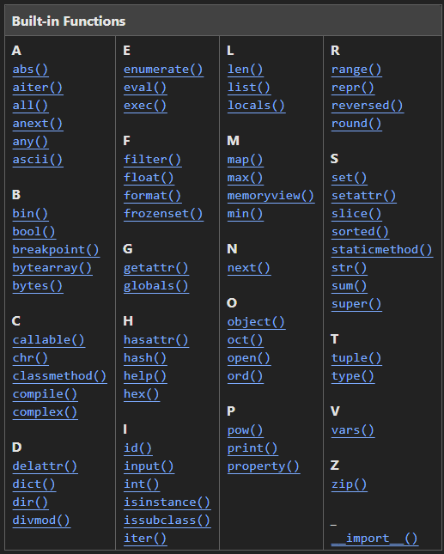
Built-in Functions
The Python interpreter has a number of functions and types built into it that are always available. (https://docs.python.org/3/library/functions.html)

Slide 22
Module
Stepping stones in developing projects:
Start working with Python in notebook or on the interpreter
Write longer programs that need to be executed multiple times: write scripts
The programs grow in size, split it into several files for easier maintenance as well as reusability of the code.
The solution: Modules.
Define most used functions in a module and import it, instead of copying their definitions into different programs.
A module can be imported by another program to make use of its functionality.

Slide 23
Module
Module is a file consisting of Python code. A module can define functions, classes and variables. A module can also include runnable code.
Organize Python code logically. Grouping related code into a module makes the code easier to understand and use.
Modules can be incorporated into other Python modules by importing them through an import statement.
For the Python interpreter to find the functions in an external file, the file must either be in the same directory as the program calling the function, or the file must be located underneath special directories designated by sys.path.
File: support_print.py (module containing the functions)
File: support_print_use.py (program using the functions)

Slide 24
Example straightforward approach
Function definition and function calls in same file
File: greetings_func.py
Function definition in separate file, another program is calling the function
File: greetings_calling.py
Main program
Key feature: import
File: greetings_bucket.py
Function definition

Slide 25
Loading Modules: the import Statement
Explicit module import : Explicit import of a module preserves the module's content in a namespace. The namespace is then used to refer to its contents with a "." between them.
import math
math.tan(math.pi)
Explicit module import by alias
For long module names, use the "import ... as ..."
import matplotlib as mpl
Explicit import of module contents: Sometimes rather than importing the module namespace, just like import a few particular items from the module, use "from ... import ...“
from math import cos, pi
Implicit import of module contents: it is sometimes useful to import the entirety of the module contents into the local namespace. This can be done with the "from ... import *"
from math import *
sin(pi) ** 2 + cos(pi) ** 2
This pattern should be used sparingly, if at all. The problem is that such imports can sometimes overwrite function names that you do not intend to overwrite, and the implicitness of the statement makes it difficult to determine what has changed.
https://nbviewer.jupyter.org/github/jakevdp/WhirlwindTourOfPython/blob/master/13-Modules-and-Packages.ipynb

Slide 26
Terminology
Taken from: https://realpython.com/lessons/scripts-modules-packages-and-libraries/#:~:text=04%3A41%20Packages%20are%20a,Python%20scripts%20without%20any%20issues
A script is a Python file that’s intended to be run directly. When you run it, it should do something. This means that scripts will often contain code written outside the scope of any classes or functions.
A module is a Python file that’s intended to be imported into scripts or other modules. It often defines members like classes, functions, and variables intended to be used in other files that import it.
A package is a collection of related modules that work together to provide certain functionality. These modules are contained within a folder and can be imported just like any other modules. This folder will often contain a special __init__.py file that tells Python it’s a package, potentially containing more modules nested within subfolders Think of packages as the directories on a file system and modules as files within directories.
A library is an umbrella term that loosely means “a bundle of code.” These can have tens or even hundreds of individual modules that can provide a wide range of functionality. Matplotlib is a plotting library. The Python Standard Library contains hundreds of modules for performing common tasks, like sending emails or reading JSON data. What’s special about the Standard Library is that it comes bundled with your installation of Python, so you can use its modules without having to download them from anywhere.

Slide 27
Standard library
Python's standard library contains many useful built-in modules, Python documentation (https://docs.python.org/3/library/)
Batteries included
Any of these can be imported with the import statement
os and sys: Tools for interfacing with the operating system, including navigating file directory structures and executing shell commands
math and cmath: Mathematical functions and operations on real and complex numbers
itertools: Tools for constructing and interacting with iterators and generators
functools: Tools that assist with functional programming
random: Tools for generating pseudorandom numbers
pickle: Tools for object persistence: saving objects to and loading objects from disk
json and csv: Tools for reading JSON-formatted and CSV-formatted files.
urllib: Tools for doing HTTP and other web requests.
https://nbviewer.jupyter.org/github/jakevdp/WhirlwindTourOfPython/blob/master/13-Modules-and-Packages.ipynb

Slide 28
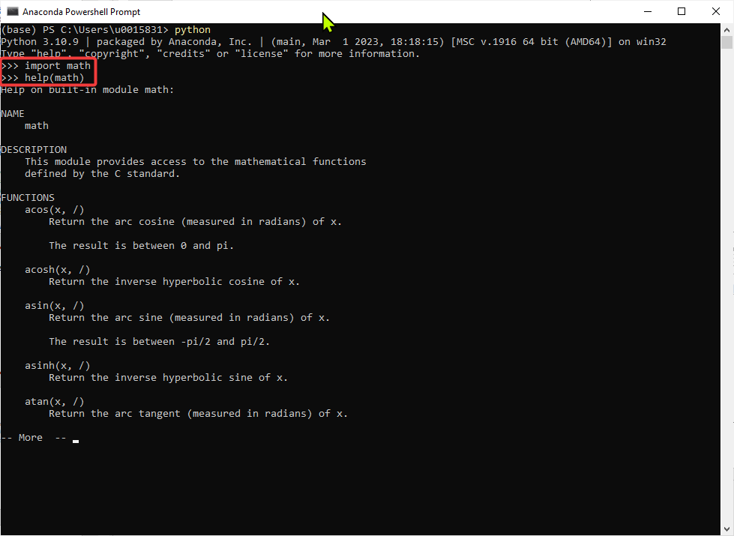
Finding functions in a package
Import the package
help(package_name)

Slide 29
if __name__ == “__main__ “
2 ways of executing code
As main process, execute the file as a Python Script (most common).
Being imported as a module.
Python interpreter sets __name__ depending on how the code is executed.
running the script directly, Python is going to assign “__main__” to __name__
__name__ variable helps to check if the file is being run directly or if it has been imported.

Slide 30
if __name__ == “__main__ “
The main block is only run when the file is run directly by Python. When the file is imported, the main block is not run.
Usage
Reusability: It allows you to reuse the script's functions and classes in other scripts without executing the script's main code.
Testing: It makes it easier to write tests for your code, as you can import the script and test its functions without running the main code.
File: isVow_using.py

Slide 31
name == main block
# -*- coding: utf-8 -*-
"""
@author: u0015831
"""
def print_greet( par ):
print('Greetings My Dear ', par)
return
# test the function
print_greet('all_of_you')
# -*- coding: utf-8 -*-
"""
@author: u0015831
"""
def print_greet( par ):
print('Greetings My Dear ', par)
return
if __name__ == '__main__' : # test the code without if
print_greet('all_of_you')

Slide 32
Lambda expressions
Lambda expressions create anonymous functions
Must be expressible as a single expression (it has to return something)
Arithmetic operations like a+b and a**b
Function calls like sum(a,b)
A print statement like print(“Hello”)
Syntax: lambda [arg1,arg2,..]:[expression]
start with the lambda keyword, then have:
a list of parameters,
a colon,
then a single statement.
Can be assigned to a variable, to call it again later.
File: lambda_func_1.py
Notes:
Based on https://data-flair.training/blogs/python-lambda-expressions/

Slide 33
Lambda expressions
E.g.:
>>> plus1 = lambda x: x + 1
>>> minus1 = lambda x: x – 1 >>> print(’12 +=1:’, plus1(12)) 13 >>> print(’18 -=1:’, minus1(18)) 17
Notes:
Based on https://data-flair.training/blogs/python-lambda-expressions/

Slide 34
Lambdas with In-Built Functions
There are some built-in functions on which we can apply Python lambda expressions to filter out elements from a list.
filter(): Given a Boolean function returning True or False, filter applies it to each element and returns a new sequence consisting of all elements that are true
map(): unlike the filter() function, returns values of the expression for each element in the list.
reduce(): continually applies a function to the sequence seq. It returns a single value
File: lambda_1.py

Slide 35
yield
Yield:
suspends the execution of the function and sends a value back to caller.
Information is retained to enable the function to resume where it is left off.
This allows to produce a series of values over time, rather than computing them at once and sending them back a whole list.
used in Python generators.
A generator is a special function in Python that returns a generator object to the caller rather than a data value.
Generators are iterators, but you can only iterate over them once.
File: nextSquare.py

