Slide 1
Python
Installation, environment and IDE setup

Slide 2
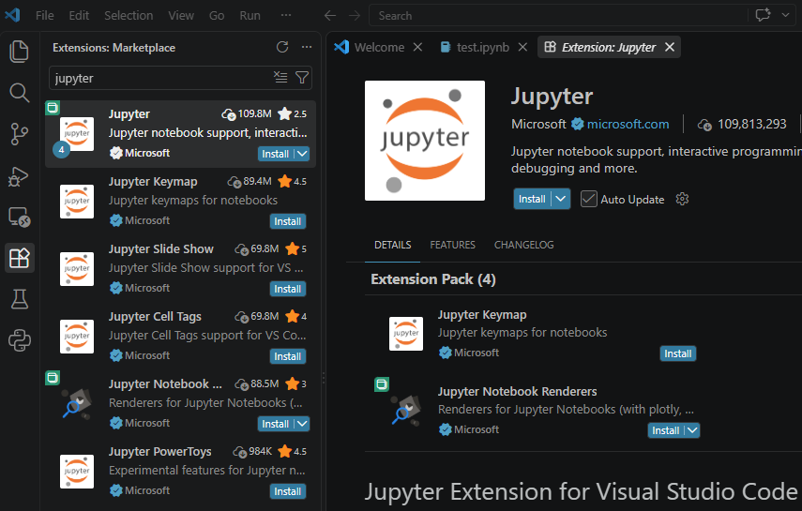
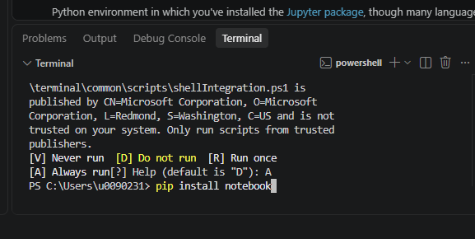
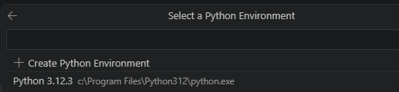
Python Environment
So many ways to setup Python
For this training, we suggest:
- Installing Microsoft Visual Studio Code
- Installing the Jupyter extension (from Microsoft)
- Open the View → terminal
- Check your Python version
$ python --version
- Install notebook
$ pip install notebook
Set PYTHONPATH if needed, e.g.
>PYTHONPATH=c:\users\<user>\appdata\roaming\python\python312\site-packages

Slide 3
Installing Python – Other Approaches
MacOS & Linux: built-in Python 3 from the OS (via terminal)
- you get older versions
- for newer versions: do NOT upgrade your OS Python!
(mini)Conda
(micro)Mamba
pixi
Windows WSL: no Python – Install miniconda/micromamba/pixi
Windows:
- Download Python (only from the official website), or
- Install miniconda/micromamba/pixi (recommended)

Slide 4
Miniconda Installation (MacOS & Linux)
Open your terminal -> cd to a temp directory
wget https://repo.continuum.io/miniconda/Miniconda3-latest-Linux-x86_64.sh
DIR_INSTALL=/path/to/my/local/appdir
bash Miniconda3-latest-Linux-x86_64.sh -b –p ${DIR_INSTALL}
rm –f Miniconda3-latest-Linux-x86_64.sh

Slide 5
Miniconda Installation (Windows)
Open file browser -> go to a temp directory
Right click -> Open in Terminal
In PowerShell:
curl https://repo.anaconda.com/miniconda/Miniconda3-latest-Windows-x86_64.exe -o .\miniconda.exe
.\miniconda.exe
del .\miniconda.exe # delete once done
Choose an installation folder, e.g. C:\Workdir\myapps\miniconda
Choose install options, specially ‘Add Anaconda to my PATH …’

Slide 6
Miniconda Installation (Windows)
Open PowerShell and try: conda –version
if it works: conda init powershell
[Troubleshooting]:
Elevate privileges to administrator
Set-ExecutionPolicy RemoteSigned -Scope CurrentUser
Get-ExecutionPolicy –List
notepad $PROFILE
$env:Path += ";C:\Workdir\myapps\miniconda;C:\Workdir\myapps\miniconda\Scripts;C:\Workdir\myapps\miniconda\Library\bin"

Slide 7
Miniconda Environment Management
You can reproduce your work by using the same environment
You can share your environment with the world to reproduce your results
Create a new environment for a new project
Create a new environment to update package versions
Avoid using the ‘base’ environment
Given your environments informative names, e.g.
Avoid: work, science, project, thesis …
Use: py3.13-pytorch-gpu-2.8, …

Slide 8
Miniconda Environment Creation
Windows: Open PowerShell (as Administrator?)
conda create python==3.13 pandas==2.3.3 \
-p C:\Workdir\myapps\miniconda\envs\py3.13-pd2.3.3
conda activate C:\Workdir\myapps\miniconda\envs\py3.13-pd2.3.3
MacOS/Linux:
$ conda create –n py3.13-pd2.3.3 python==3.13 \
pandas==2.3.3
$ conda activate py3.13-pd2.3.3
$ conda deactivate

Slide 9
Miniconda Environment Usage
Using Conda is OS-agnostic
> conda activate py3.13-pd2.3.3
> python
>>> import pandas as pd
>>> pd.__file__
'C:\\Workdir\\myapps\\miniconda\\envs\\py3.13-pandas2.3.3\\Lib\\site-packages\\pandas\\__init__.py'
>>> pd.__version__
‘2.3.3’
If you succeed up to here … Congratulations then!

Slide 10

Environment: general workflow (CLI)
Activate the Environment:
conda activate py3.13-pd2.3.3
Install additional packages:
conda install matplotlib
Work on Your Project:
With the environment activated, you can run your Python scripts and work on your project. All installed packages will be isolated to this environment.
Deactivate the Environment when done:
conda deactivate
Using environments helps keep your projects organized and ensures that dependencies don't interfere with each other.

Slide 11
Environment: extra (CLI)
Export a current environment to a .yml file:
  conda env export --name py3.13-pd2.3.3> py3.13-pd2.3.3.yml
Create an exact copy of an existing environment:
  conda create –f py3.13-pd2.3.3.yml
List all current existing environments:
  conda env list
List all the packages and their versions installed in your current conda environment.
  conda list
To completely delete an enviroment, use the command:
  conda remove --name ENV_NAME

Slide 12
Running Python Code

Slide 13
Some background
https://docs.anaconda.com/anaconda/getting-started/
https://realpython.com/run-python-scripts/
https://plot.ly/python/ipython-vs-python/
https://yihui.name/en/2018/09/notebook-war/
https://www.theatlantic.com/science/archive/2018/04/the-scientific-paper-is-obsolete/556676/
https://fangohr.github.io/blog/installation-of-python-spyder-numpy-sympy-scipy-pytest-matplotlib-via-anaconda.html

Slide 14
Making it work
Write the code
  Choose a good editor (or integrated development environment - IDE)
    featuring color coding, syntax checks, code completion, function call help, AI integration, Git integration, …
  Code is just a text file
Convert to machine code
  Make sure that you have the right interpreter (or compiler) available
Run the code
  Run interactively on the Python command line (e.g. IPython, Python shell)
  Run in a script mode (e.g. python analysis.py)
  Run in IDE or in Jupyter notebooks

Slide 15
Where to start?
Choose a platform - primary ways to run Python code:
  Terminal
    Python interpreter
    IPython interpreter
    Running scripts
  IDE
    Visual Studio Code (Microsoft)
    Spyder (JetBrains)
  Jupyter notebook / Jupyterlab
Notes:
Python is a flexible language, and there are several ways to use it depending on your particular task. One thing that distinguishes Python from other programming languages is that it is interpreted rather than compiled. This means that it is executed line by line, which allows programming to be interactive in a way that is not directly possible with compiled languages like Fortran, C, or Java. This section will describe four primary ways you can run Python code: the Python interpreter, the IPython interpreter, via Self-contained Scripts, or in the Jupyter notebook.
The Python Interpreter
The most basic way to execute Python code is line by line within the Python interpreter. The Python interpreter can be started by installing the Python language (see the previous section) and typing python at the command prompt (look for the Terminal on Mac OS X and Unix/Linux systems, or the Command Prompt application in Windows):
$ python Python 3.5.1 |Continuum Analytics, Inc.| (default, Dec 7 2015, 11:24:55) Type "help", "copyright", "credits" or "license" for more information. >>>With the interpreter running, you can begin to type and execute code snippets. Here we'll use the interpreter as a simple calculator, performing calculations and assigning values to variables:
>>> 1 + 1 2 >>> x = 5 >>> x * 3 15
The interpreter makes it very convenient to try out small snippets of Python code and to experiment with short sequences of operations.
The IPython interpreter
If you spend much time with the basic Python interpreter, you'll find that it lacks many of the features of a full-fledged interactive development environment. An alternative interpreter called IPython (for Interactive Python) is bundled with the Anaconda distribution, and includes a host of convenient enhancements to the basic Python interpreter. It can be started by typing ipython at the command prompt:
$ ipython Python 3.5.1 |Continuum Analytics, Inc.| (default, Dec 7 2015, 11:24:55) Type "copyright", "credits" or "license" for more information. IPython 4.0.0 -- An enhanced Interactive Python. ? -> Introduction and overview of IPython's features. %quickref -> Quick reference. help -> Python's own help system. object? -> Details about 'object', use 'object??' for extra details. In [1]:The main aesthetic difference between the Python interpreter and the enhanced IPython interpreter lies in the command prompt: Python uses >>> by default, while IPython uses numbered commands (e.g. In [1]:). Regardless, we can execute code line by line just as we did before:
ipython In [1]: 1 + 1 Out[1]: 2 In [2]: x = 5 In [3]: x * 3 Out[3]: 15Note that just as the input is numbered, the output of each command is numbered as well. IPython makes available a wide array of useful features; for some suggestions on where to read more, see Resources for Further Learning.
Self-contained Python scripts
Running Python snippets line by line is useful in some cases, but for more complicated programs it is more convenient to save code to file, and execute it all at once. By convention, Python scripts are saved in files with a .py extension. For example, let's create a script called test.py which contains the following:
# file: test.py print("Running test.py") x = 5 print("Result is", 3 * x)
To run this file, we make sure it is in the current directory and type pythonfilename at the command prompt:
$ python test.py Running test.py Result is 15For more complicated programs, creating self-contained scripts like this one is a must.
The Jupyter notebook
A useful hybrid of the interactive terminal and the self-contained script is the Jupyter notebook, a document format that allows executable code, formatted text, graphics, and even interactive features to be combined into a single document. Though the notebook began as a Python-only format, it has since been made compatible with a large number of programming languages, and is now an essential part of the Jupyter Project. The notebook is useful both as a development environment, and as a means of sharing work via rich computational and data-driven narratives that mix together code, figures, data, and text.

Slide 16
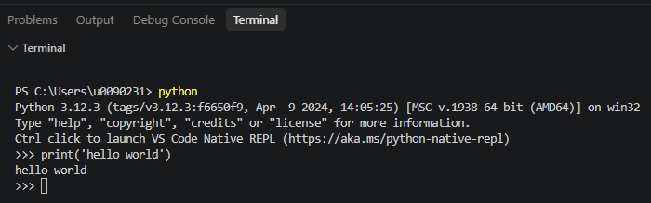
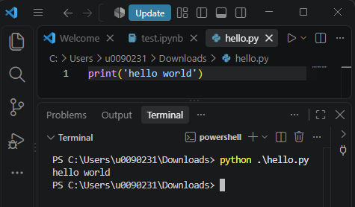
Hello World
Interactively:
VSCode → Terminal
> python
>>> print(‘Hello World’)
Run in command line:
> python hello_world.py
Run in IPython (optional)
  %run hello_world.py
Run in Jupyter notebook (next slides)

Slide 17
Python interpreter
https://realpython.com/run-python-scripts/

Slide 18
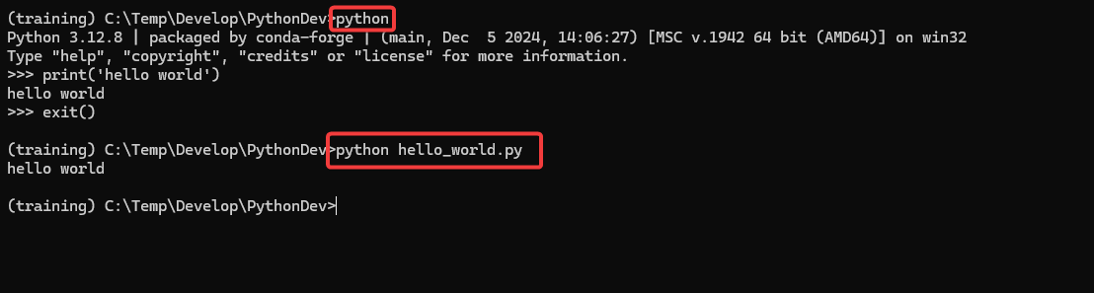
Python interpreter
The interpreter is able to run Python code in two different ways:
  As a piece of code typed into an interactive session
  As a script or module

Slide 19
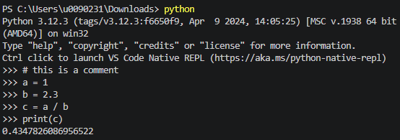
Python interpreter
The most basic way to execute Python code is line by line within the Python interpreter (interactive session).
The Python interpreter can be started by typing: python
  Windows WSL, MacOS/Linux native terminal
  Command prompt application in Windows
  Default chevron: >>>
  Comment character: #
Notes:
Taken from http://www.oreilly.com/programming/free/files/a-whirlwind-tour-of-python.pdf

Slide 20
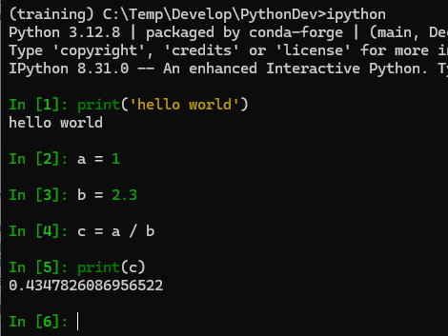
IPython interpreter
Enhanced Interactive shell
Enhancements to the basic
Python interpreter
Start with: ipython
Compare Python vs IPython
We skip IPython:
There exists no official VSCode extension from a trusted vendor (yet)

Slide 21
IPython interpreter
IPython is an enhanced version of python that makes interactive python more productive.
  Tab autocompletion (on class names, functions, methods, variables)
  More explicit and color-highlighted error messages
  Better history management
  Basic UNIX shell integration (run simple shell commands such as cp, ls, rm, cp, etc. directly from the IPython command line)
  Nice integration with many common GUI modules (PyQt, PyGTK, and tkinter)
  https://www.quora.com/What-is-the-difference-between-IPython-and-Python-Why-would-I-use-IPython-instead-of-just-writing-and-running-scripts

Slide 22
Magic commands
https://ipython.readthedocs.io/en/stable/interactive/magics.html
An enhancement in IPython known as magic commands
Get more information: %magic
Information of a specific magic function is obtained by %magicfunction?
Quick list of all available magic functions: %lsmagic

Slide 23
Magic commands
Designed to solve various common problems in standard data analysis.
2 types
  Line magics
    They are similar to command line calls. They start with % character. Rest of the line is its argument passed without parentheses or quotes.
  Cell magics
    They have %% character prefix. Unlike line magic functions, they can operate on multiple lines below their call.

Slide 24
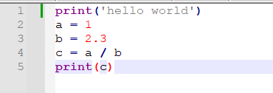
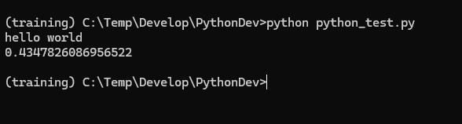
Python scripts
Think of reproducible science!
Programs: save code to file, and execute it all at once.
  Script: A plain text file containing Python code that is intended to be directly executed by the user
  By convention, Python scripts are saved in files with a .py extension.

Slide 25
Run Python script
Linux
Write script in editor
Add shebang on line 1:
#!/usr/bin/env python3
Run script using Python interpreter
python hello_world.py
Make script executable
chmod u+x hello_world.py
Run script directly
./hello_world.py
Windows
Write script in editor
Run script using Python interpreter
python hello_world.py
Run script directly
hello_world.py

Slide 26
Python scripts
Linux
#!/usr/bin/env python3
  determines the script's ability to be executed like a standalone executable without typing python in the terminal
  double clicking it in a file manager (when configured properly).
Notes:
In computing, a shebang (also called a hashbang, hashpling, pound bang, or crunchbang) refers to the characters "#!" when they are the first two characters in an interpreter directive as the first line of a text file. In a Unix-like operating system, the program loader takes the presence of these two characters as an indication that the file is a script, and tries to execute that script using the interpreter specified by the rest of the first line in the file.

Slide 27
File types
https://stackoverflow.com/questions/8822335/what-do-the-python-file-extensions-pyc-pyd-pyo-stand-for
py: This is normally the input source code that you've written.
.pyc: This is the compiled bytecode. If you import a module, python will build a *.pyc file that contains the bytecode to make importing it again later easier (and faster).
.pyo: This was a file format used before Python 3.5 for *.pyc files that were created with optimizations (-O) flag. (see the note below)
.pyd: This is basically a windows dll file. http://docs.python.org/faq/windows.html#is-a-pyd-file-the-same-as-a-dll

Slide 28
Visual Studio Code
Another IDE

Slide 29
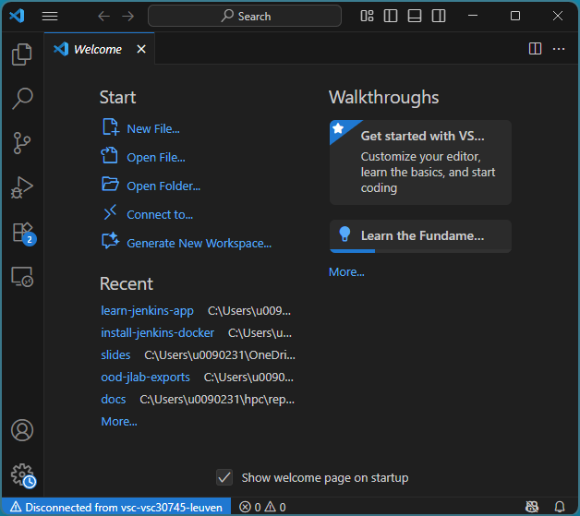
IDE: Visual Studio Code (VSCode)
VSCode integrates different aspects of programming and running code.
Microsoft & 3rd party:
Support for extensions (e.g. Python, C/C++, Java, Julia …, Git, Docker, …)
Github Copilot integration
Notes:
Update spyder within anaconda
Execute it in command window (run it as administrator)
conda update conda
conda update anaconda
conda update spyder
You can easily install this version if you use Anaconda by closing Spyder and then running the following commands in a system terminal (cmd.exe on Windows, xterm on Linux or Terminal.appon macOS):
conda update qt pyqt
conda update spyder

Slide 30
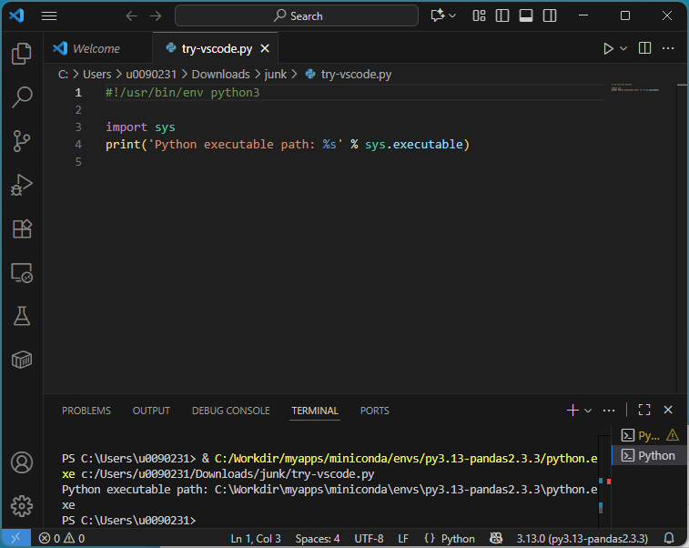
Setup
Install Python extension from Microsoft (and restart VSCode)
Choose Python interpreter (bottom right tray) and Pick e.g. your Conda env
Click on the Play button (top right), or
choose lines -> Shift+Enter
Notes:
Update spyder within anaconda
Execute it in command window (run it as administrator)
conda update conda
conda update anaconda
conda update spyder
You can easily install this version if you use Anaconda by closing Spyder and then running the following commands in a system terminal (cmd.exe on Windows, xterm on Linux or Terminal.appon macOS):
conda update qt pyqt
conda update spyder

Slide 31
Spyder
Another IDE
Optional material

Slide 32
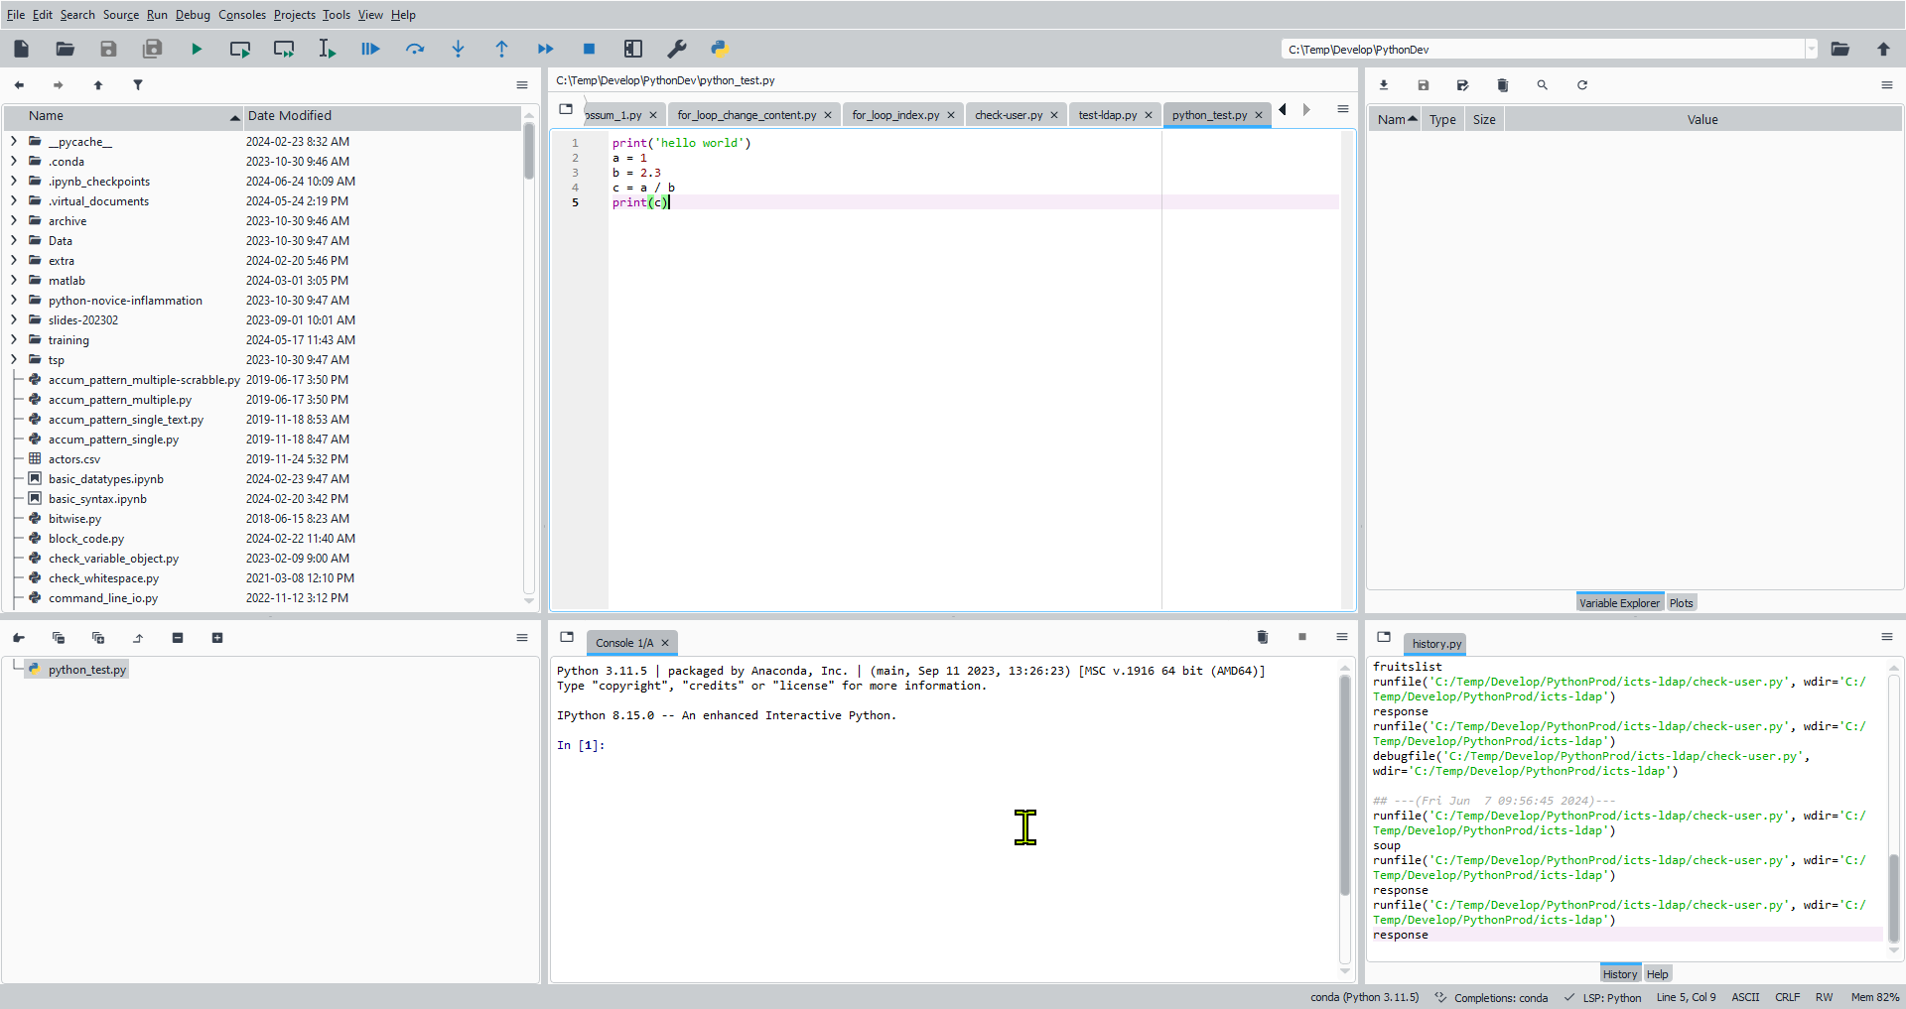
IDE: Spyder
Integrate different aspects of programming and running code.
SPyDER: "Scientific Python Development EnviRonment“
https://www.spyder-ide.org/
Several tools in one integrated environment (cfr MATLAB desktop)
  a code editor
  IPython interpreter / console
  variable inspector
  control icons
Documentation: https://docs.spyder-ide.org/current/index.html
Notes:
Update spyder within anaconda
Execute it in command window (run it as administrator)
conda update conda
conda update anaconda
conda update spyder
You can easily install this version if you use Anaconda by closing Spyder and then running the following commands in a system terminal (cmd.exe on Windows, xterm on Linux or Terminal.appon macOS):
conda update qt pyqt
conda update spyder

Slide 33
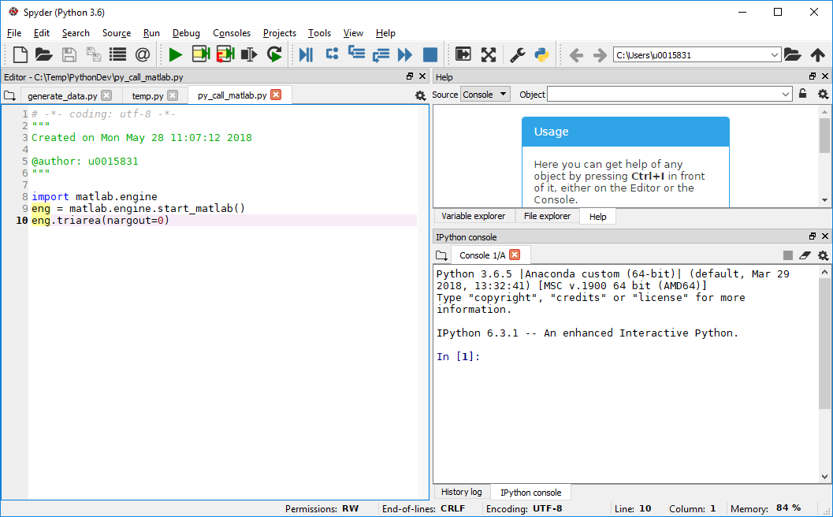
IDE: Spyder
Spyder for code development.
  Command window: spyder
Magic commands apply
  Clear Console:
    %cls
  Clear all variables from
  Variable Explorer (reset the namespace):
    %reset
  With automagic on, % prefix not needed

Slide 34
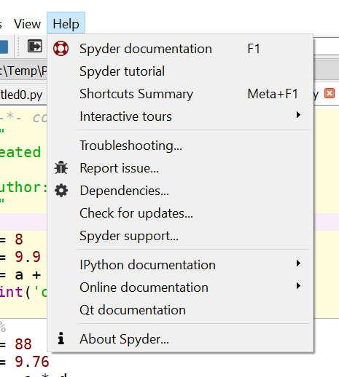
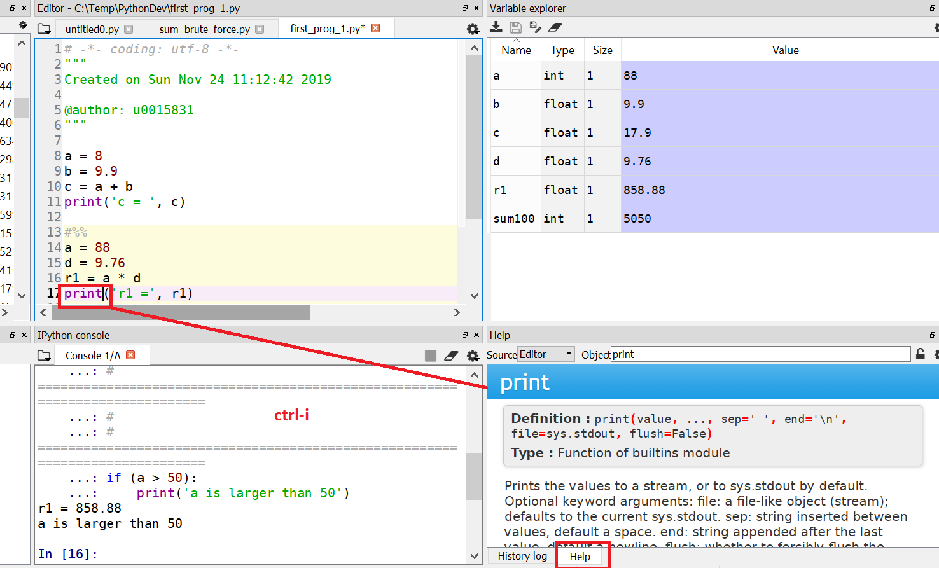
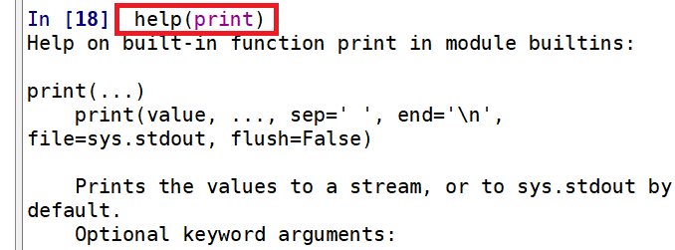
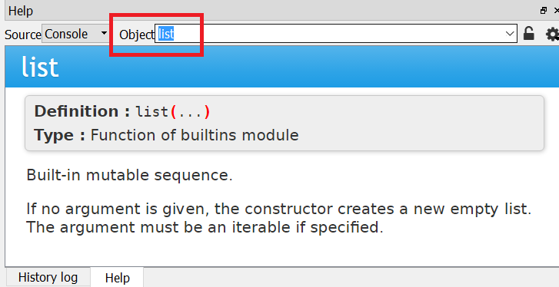
Spyder Help
Help on Spyder from Help menu
Help related to Python
  Select a command and press ctrl-I
    Information opens in help window
  Enter object in help window
help(command) in console

Slide 35
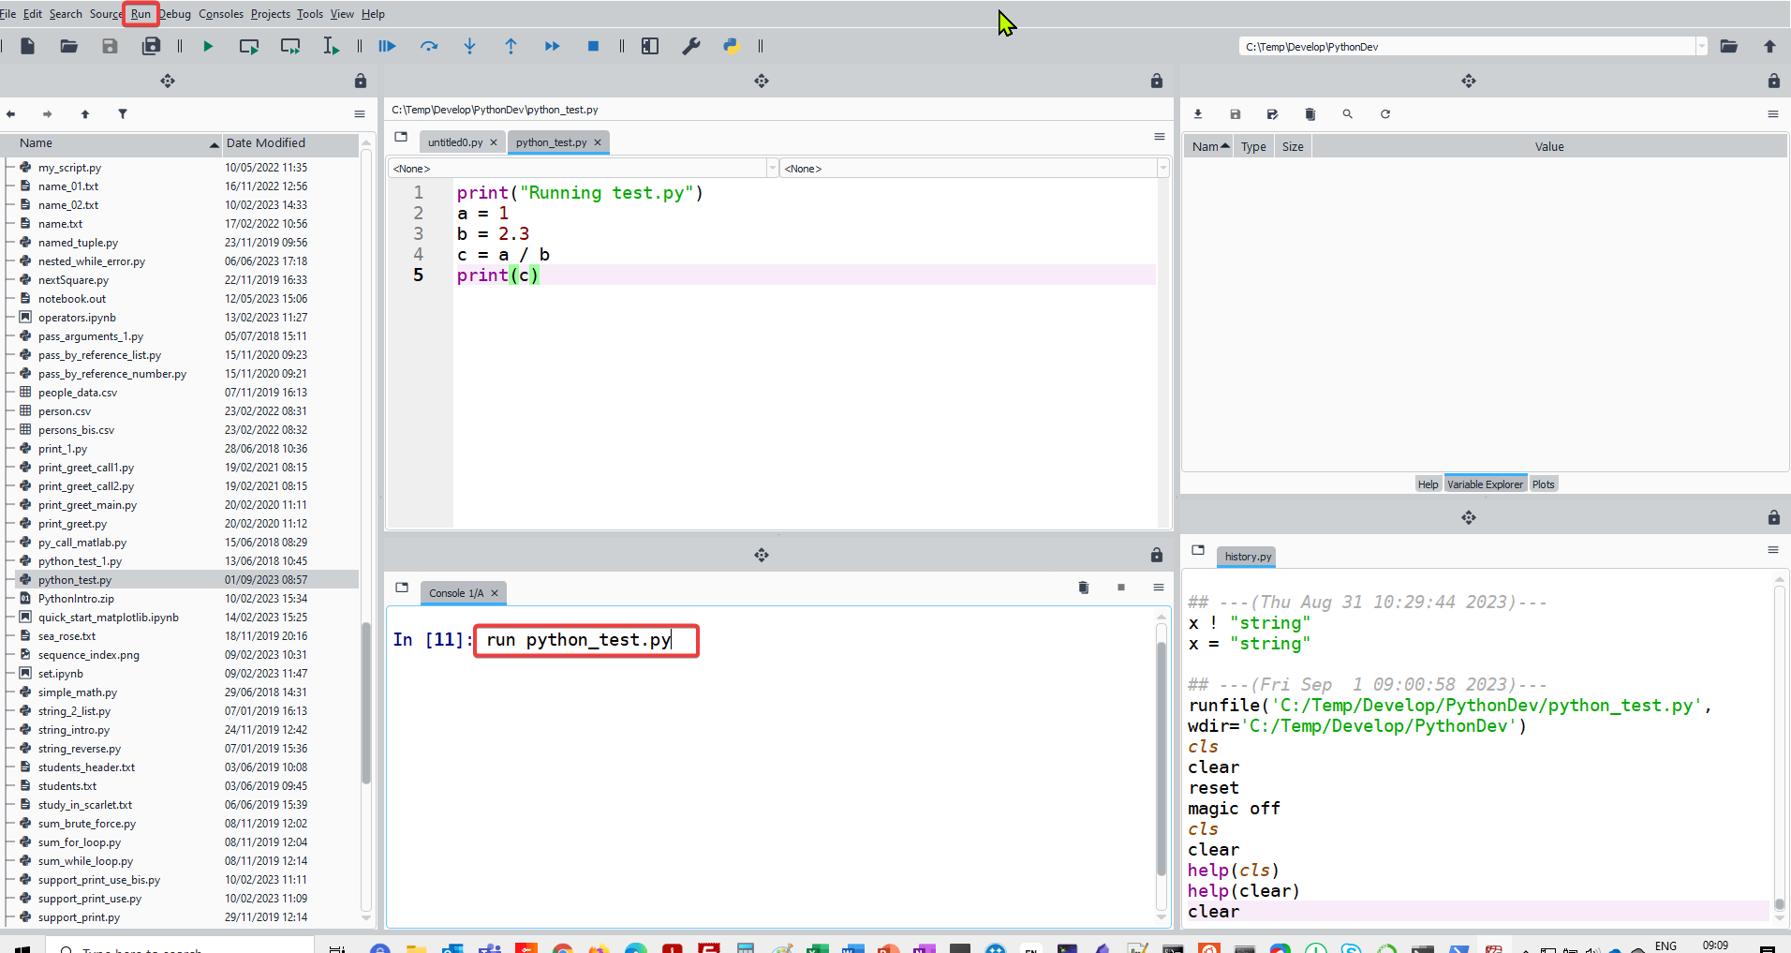
Running scripts in Spyder console
Run a .py file from the console
  run script.py
Tab autocompletion works!

Slide 36
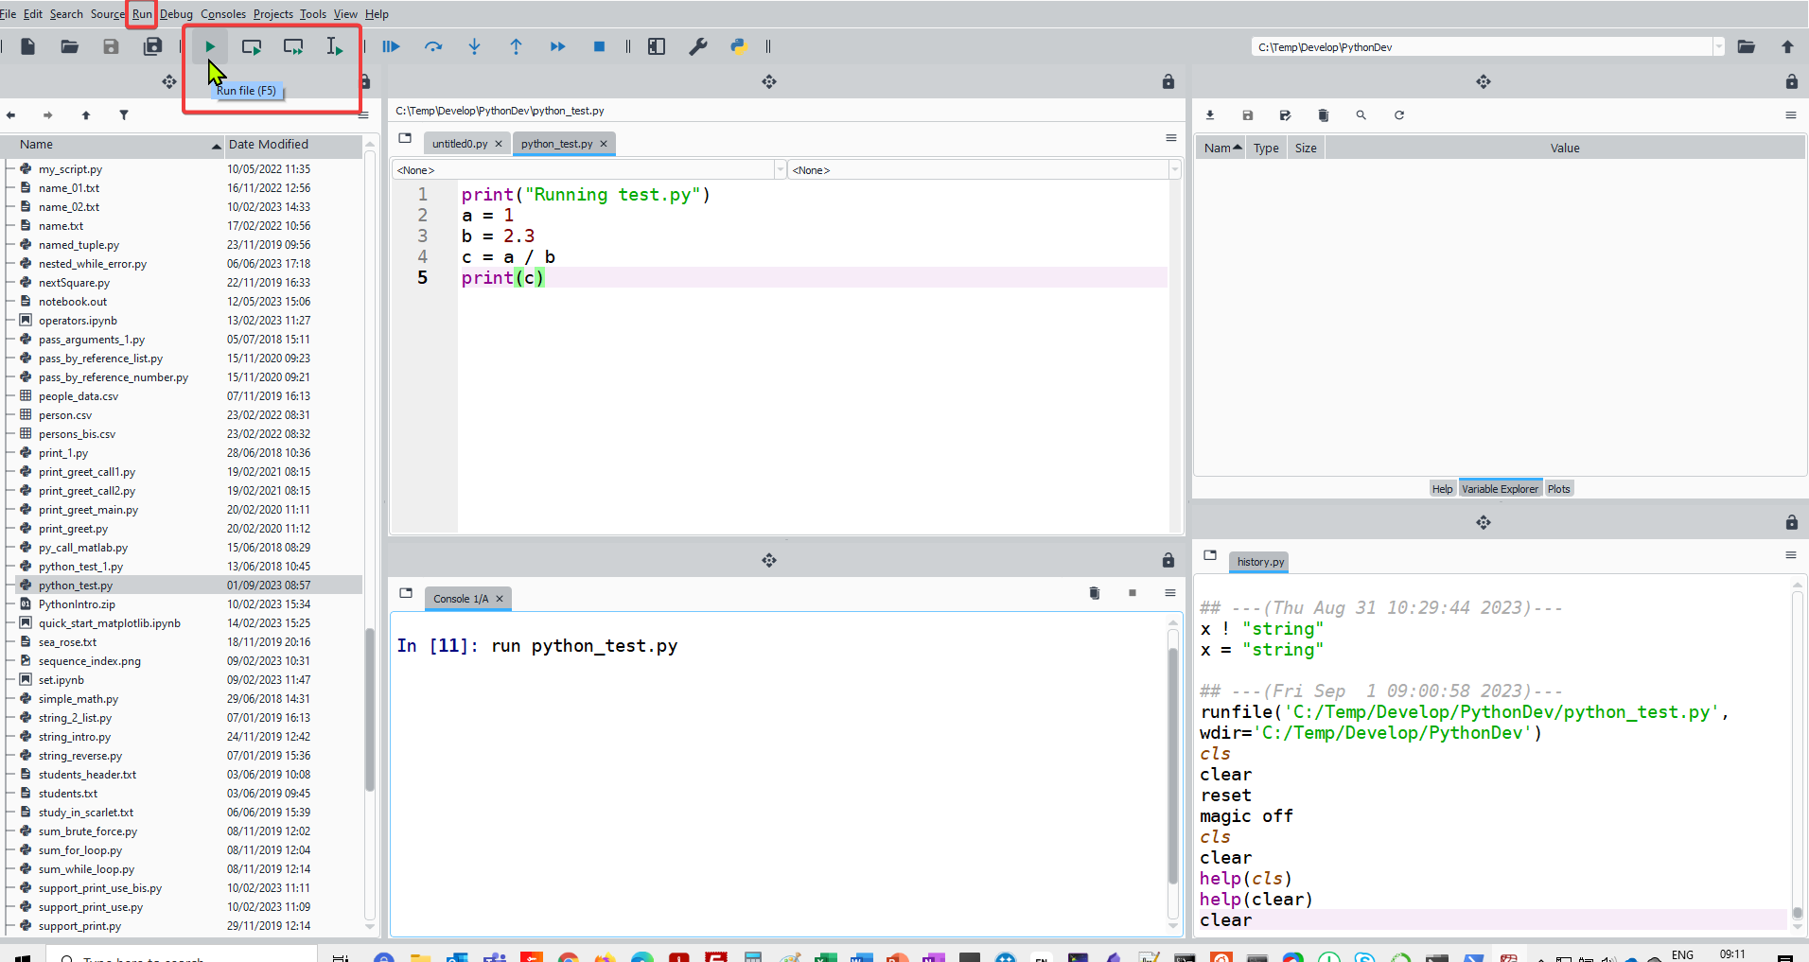
Running scripts in Spyder
Run scripts either using the icons or through the Run menu.
Run selection or current line will run a highlighted portion of the script.
Create cells by enclosing chunks of code with lines consisting of
#%%
Run cell/green arrow with a box runs the cell.
File: first_prog_1.py

Slide 37
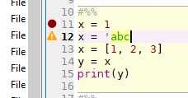
Running scripts in Spyder
A yellow triangle beside a line indicates a syntax error or potential problem.
Tab completion for names familiar to it. It can show a list of members of a package for your selection, and when you have chosen a function it can show you a list of its arguments.

Slide 38
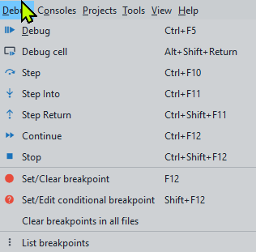

Debugging in Spyder
Debugging tool
  The Debug menu at the top contains a list of all the options for debugging
  The navigation bar also has the icons associated with those tasks.

Slide 39
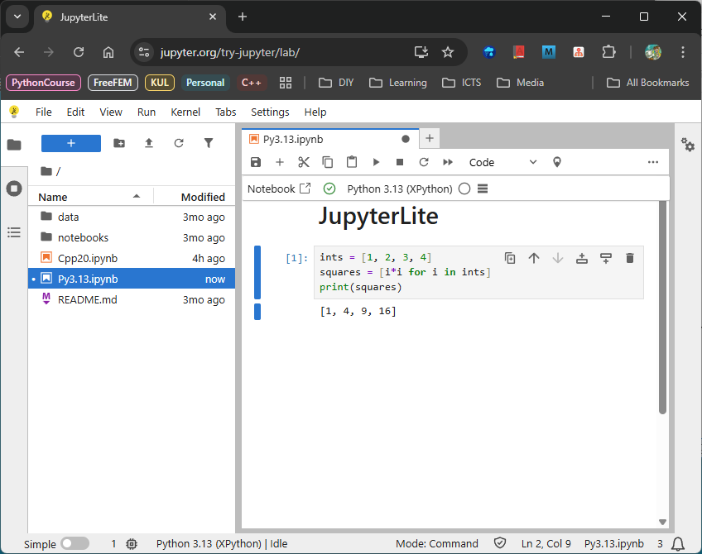
Backdoor:
Python Environment
Jupyterlite: https://jupyter.org/try-jupyter/lab/
JupyterLab in the browser
Choose the ‘Python 3.13 (XPython)’ kernel
Download your *.ipynb notebooks before closing

Slide 40
Jupyterlab / Jupyter notebook
getting_started_jupyter.ipynb

Slide 41
(Jupyter) notebook
A nice idea popularized by Mathematica is a “notebook” interface, where you can run and re-run commands
Easily mix code with text, comments, and mix code with the results of that code; including graphics, …
https://realpython.com/jupyter-notebook-introduction/
https://docs.anaconda.com/ae-notebooks/4.2.2/user-guide/basic-tasks/apps/jupyter/
Notes:
https://www.datacamp.com/community/blog/ipython-jupyter#gs.7GI56Os
https://jupyter4edu.github.io/jupyter-edu-book/
Dam Toomey, Learning Jupyter, Packt Publishing, 2016

Slide 42
(Jupyter) notebook
Excellent for
  Explorative programming
  Data exploration
  Communication, especially across domains
  Combine code, graphs, results and text for education
Problems?
  What was (re-)executed, what not?
  Version control: not straightforward
https://github.com/gjbex/training-material/blob/master/Python/python_intro.pptx

Slide 43
Jupyter notebook vs Jupyterlab
JupyterLab and Jupyter Notebook serve as interactive computing environments, they differ in their user interface, functionality, and flexibility.
Jupyter Notebook has a simpler, more lightweight interface.
JupyterLab offers a more versatile and feature-rich interface , it gives a more IDE-like experience.

Slide 44
JupyterLab
Interactive Development Environment for working with notebooks, code and data.
Next-generation user interface for Project Jupyter.
It offers all the familiar building blocks of the classic Jupyter Notebook (notebook, terminal, text editor, file browser, rich outputs, etc.) in a flexible and powerful user inteface.
Eventually, JupyterLab will replace the classic Jupyter Notebook.
  File support: JupyterLab provides built-in support for a wider range of file formats and includes integrated terminals and code consoles.
  Extensibility: JupyterLab is designed to be extensible, enabling users to install additional extensions and customize the environment to meet their specific needs.
  Compatibility: JupyterLab is compatible with existing Jupyter Notebook files and kernels, allowing users to transition smoothly between the two interfaces.
https://realpython.com/using-jupyterlab/
https://saturncloud.io/glossary/jupyter-notebook-vs-jupyterlab/
https://www.youtube.com/watch?v=yjjE-MJD5TI (Cornell CAC JupyterLab tutorial)

Slide 45
JupyterLab: how to launch?
VSCode natively supports Jupyter Notebook files *.ipynb
Install JupyterLab in conda:
conda install jupyterlab –c conda-forge
Anaconda Navigator:
  Start menu
  Launch JupyterLab
Anaconda prompt
  Open terminal and navigate to the directory where you would like to save your notebook
  Note: JupyterLab treats the directory from which it is launched as the top-level directory
  jupyter lab
  Options possible jupyter lab --browser=firefox

Slide 46
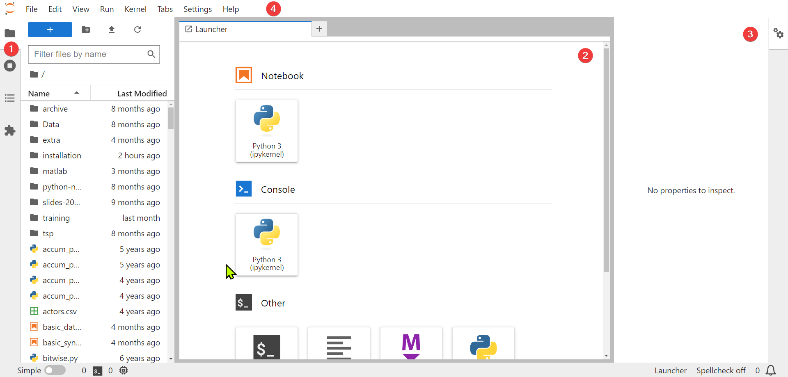
Jupyterlab interface
https://jupyterlab.readthedocs.io/en/stable/user/interface.html
Interface can be tweaked
Left panel:
  File browser
    New launcher
    New folder
    Upload files
  Running terminals and kernels
Center panel: main work area containing tabs of documents and activities
Right panel: shows various properties

Slide 47
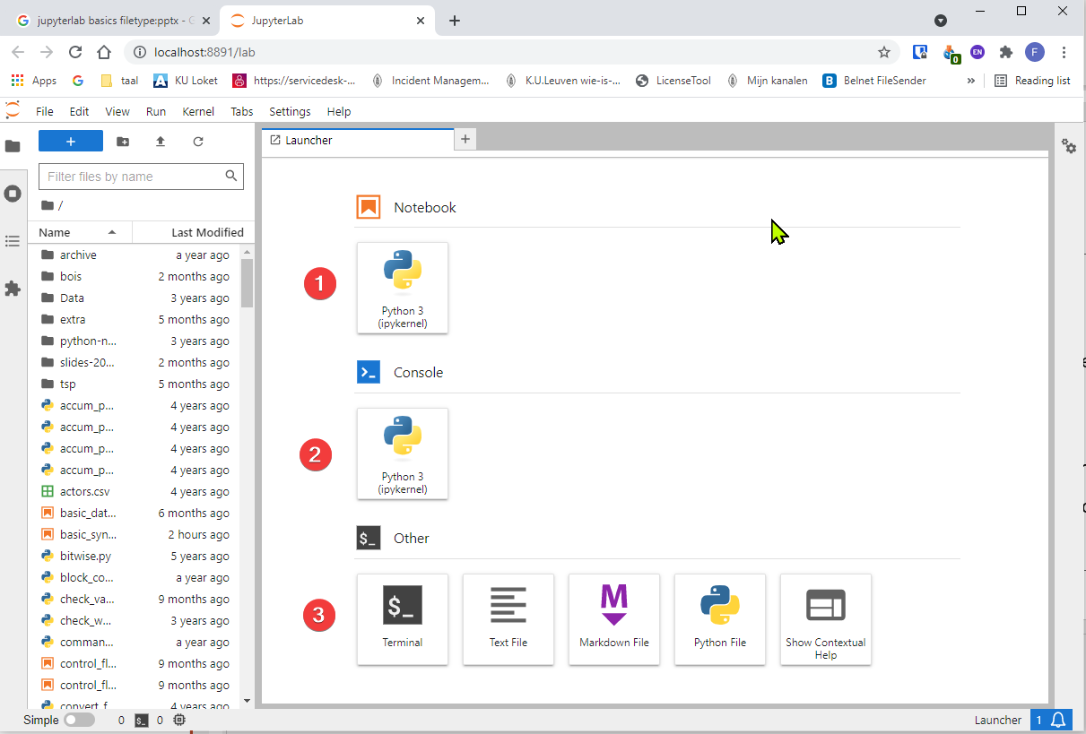
JupyterLab interface
Launch your notebook
Launch Python kernel
Launch another application (i.e. terminal)

Slide 48
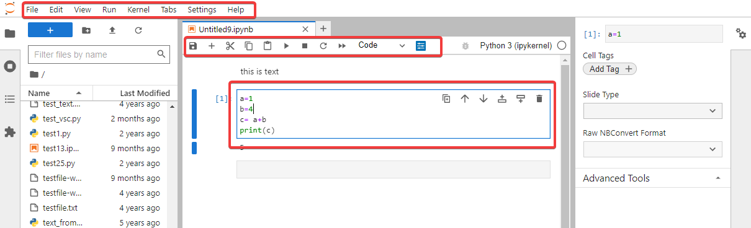
JupyterLab interface
Menu bar: different options that may be used to manipulate the way the notebook functions.
Toolbar: a quick way of performing the most-used operations within the notebook.
Cell: the notebook cell.

Slide 49
JupyterLab Notebook
The notebook consists of a sequence of cells.
  A cell is a multiline text input field
  The execution behaviour of a cell is determined by the cell’s type.
3 types of cells:
  Code cells allow you to edit and write new code, with full syntax highlighting and tab completion. The programming language depends on the kernel chosen.
  Markdown cells allow to alternate descriptive text with code
  Raw cells provide a place in which you can write output directly. Raw cells are not evaluated by the notebook.

Slide 50
JupyterLab shortcuts
The essential shortcuts:
Shift-Enter: run cell and move to the next
  Execute the current cell, show any output, and jump to the next cell below. If Shift-Enter is invoked on the last cell, it creates a new cell below.
  This is equivalent to clicking the Cell, Run menu item, or the Play button in the toolbar.
Ctrl-Enter: run cell and stay in that cell
  Execute the current cell, show any output.
Esc: Command mode.
  In command mode, you can navigate around the notebook using keyboard shortcuts.
Enter: Edit mode.
  In edit mode, you can edit text in cells

Slide 51
Jupyterlab shutdown
Make sure everything is saved
Download your notebook(s) if needed
Use File → Shut Down to close the application
Close the browser (tab)

Slide 52
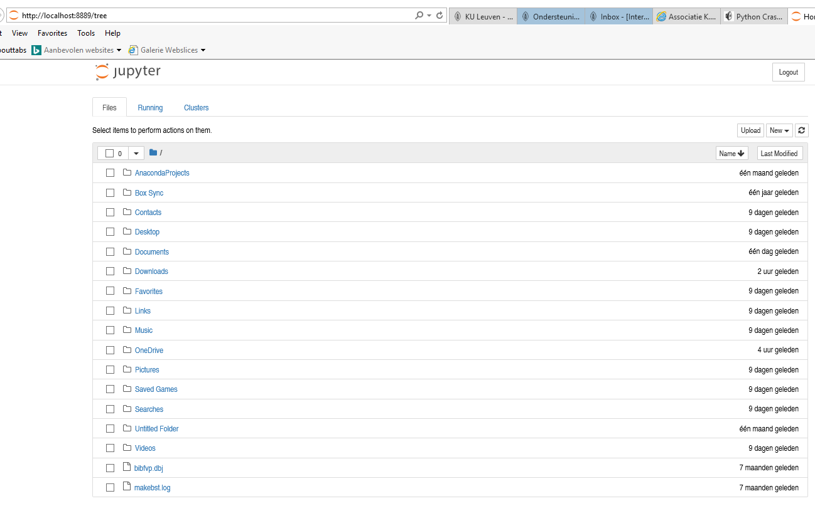
Jupyter notebook
Notebook Dashboard, specifically designed for managing your Jupyter Notebooks.
Use it as the launchpad for exploring, editing and creating your notebooks.
Notes:
ToDo: hoe oproepen in een specifieke browser
https://www.dataquest.io/blog/jupyter-notebook-tutorial/

Slide 53
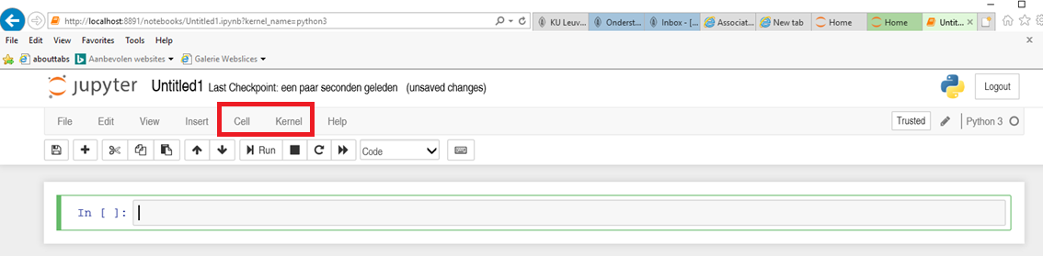
Jupyter notebook
Jupyter is essentially an advanced word processor.
A kernel is a "computational engine" that executes the code contained in a notebook document.
A cell is a container for text to be displayed in the notebook or code to be executed by the notebook's kernel.

Slide 54
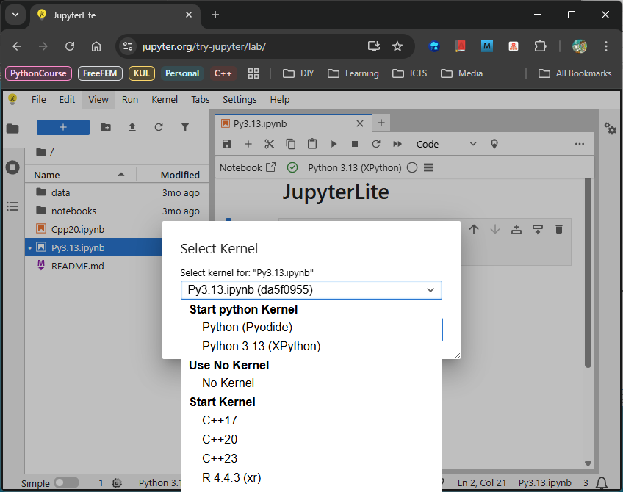
Jupyter notebook
Browse to the folder in which you would like to create your first notebook,
Click the "New" drop-down button in the top-right and
Select "Python 3.13" (or the version of your choice).

Slide 55
Jupyter: basics of editing
Jupyter notebook: sequence of cells
  Code
    Label “In [ ]” in front of the code
    a * will appear when executing
    replaced by a number that always increases by one with each cell execution. This allows for keeping track of the order in which the cells in the notebook have been executed.
  Markdown
Important shortcut: ctrl+Enter (execute cell)
Color code
  Blue bar on the left: active cell in command mode
  Click in cell, changes in edit mode – Green bar
Jupyter will periodically autosave the notebook
Notes:
https://www.e-education.psu.edu/geog489/node/2204

Slide 56
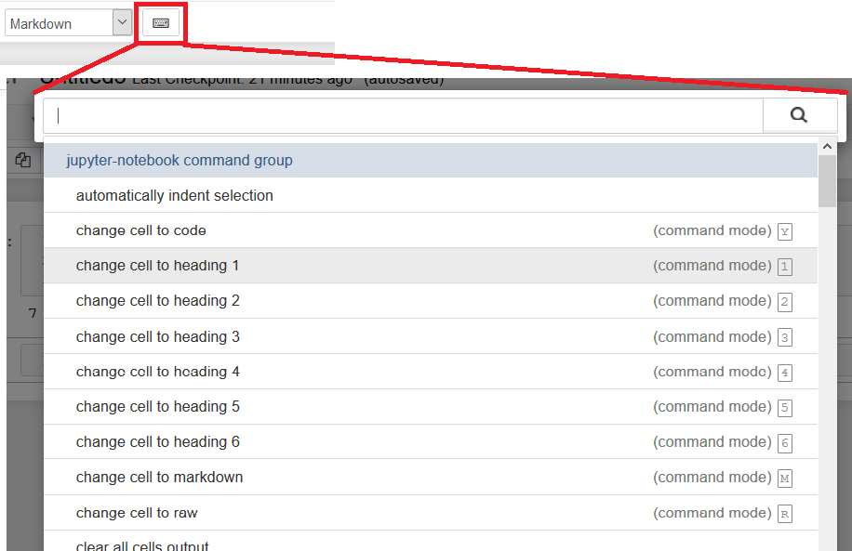
Jupyter: basics of editing
try to know the basic shortcuts
Command mode shortcuts:
  Basic navigation: enter, shift-enter, up/k, down/j
  Saving the notebook: s
  Change Cell types: y, m, 1-6, t
    m to change the current cell to Markdown,
    y to change it back to code
  Cell creation: a, b
    a to insert a new cell above the current cell,
    b to insert a new cell below
  Cell editing: x, c, v, d, z
    c copy selected cells
    x cut selected cells
    v paste copied cells
    d + d (press the key twice) to delete the current cell
    z undo cell deletion

Slide 57
Jupyter: basics of editing
Raw nbconvert cells
  only of any use if you intend to use the command line tool nbconvert to convert the notebook to another format (such as HTML or Latex). When you do, cells marked as Raw NBConvert Format will be converted in a way specific to the output you're targeting.
https://www.codecademy.com/articles/getting-started-with-jupyter
Notes:
https://stackoverflow.com/questions/47852733/what-are-raw-cells-in-jupyter-notebook

Slide 58
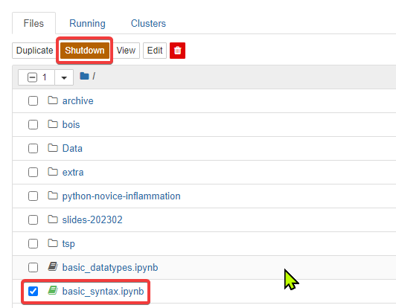
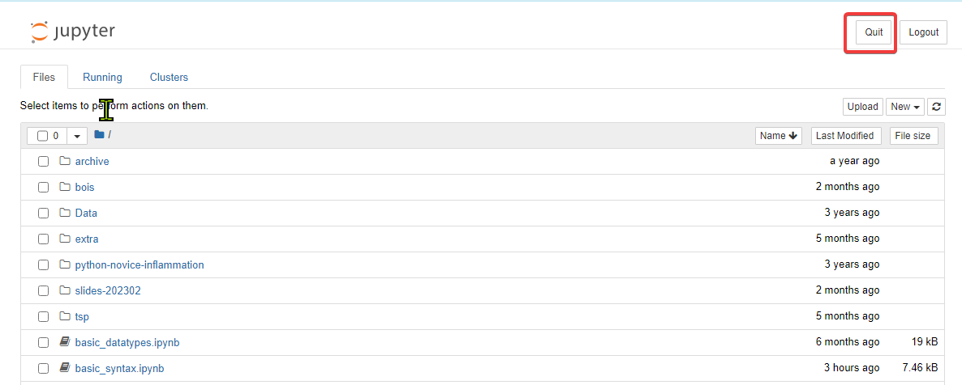
Close and Shutdown Jupyter Notebook
Close Jupyter Notebook files
  Close the browser tab displaying the notebook, but you still need Shutdown the notebook from the dashboard.
  To Shutdown a Jupyter Notebook file (.ipynb), click in the checkbox to left of the filename. An orange button (Shutdown) appears in the dashboard menu; click on it to Shutdown any file that is checked in the list.
Shutdown the Jupyter Notebook Local Server
  After all of your notebooks are closed and shut down, you can end your Jupyter Notebook session by clicking on the Quit button at the top right of the dashboard.
  Close the terminal by typing the command exit

Slide 59
Jupyter: some tips
Run a notebook on the command line with ipython
Jupyter notebook tips
https://www.dataquest.io/blog/jupyter-notebook-tips-tricks-shortcuts/
https://www.dataquest.io/blog/jupyter-notebook-tutorial/
https://jupyter4edu.github.io/jupyter-edu-book/
https://reproducible-science-curriculum.github.io/workshop-RR-Jupyter/
Change the default startup directory
  https://stackoverflow.com/questions/35254852/how-to-change-the-jupyter-start-up-folder
Change the default browser
  https://support.anaconda.com/customer/en/portal/articles/2925919-change-default-browser-in-jupyter-notebook

Slide 60

See also
Create presentations from a notebook
  https://dzone.com/articles/creating-presentations-with-jupyter-notebook
  https://medium.com/@mjspeck/presenting-code-using-jupyter-notebook-slides-a8a3c3b59d67
  https://janakiev.com/til/creating-slides-with-jupyter-notebook/
  https://medium.com/learning-machine-learning/present-your-data-science-projects-with-jupyter-slides-75f20735eb0f
  https://www.blog.pythonlibrary.org/2018/09/25/creating-presentations-with-jupyter-notebook/
Turn it into an actual slideshow:
  save your Notebook
  shut down the Jupyter Notebook server.
  run the following command:
  jupyter nbconvert slideshow.ipynb --to slides --post serve

Slide 61
Google Colab
Have your notebook on the web - connected with your Google account
  Have your notebook on Google drive
https://www.geeksforgeeks.org/how-to-use-google-colab/
https://towardsdatascience.com/getting-started-with-google-colab-f2fff97f594c

Slide 62
Scripts vs Notebooks

Slide 63
Scripts vs notebooks: script
Python script:
  Plain text file ending with the .py extension containing the program
  Created in editor, IDE
  Executed from the command line
Jupyter Notebook:
  Stored in notebook files, having the .ipynb extension.
  Multiple cells. Each cell can contain either a block of Python code or plain text.

Slide 64
Scripts vs notebooks: script
Pros:
  Scripts are reliable and the most common way to write Python code.
  Top-down execution makes it less confusing to debug and reason through the code.
  Scripts support modularity. Variables and functions inside a Python script can be imported.
  Can be placed in version control
  Minimal setup is required (you only need a text editor).
  There are many text editors and IDEs with tons of features to choose from.
Cons:
  Scripts are plain text files. Formatted text or figures cannot be added to them.
  No output is saved anywhere. The script must be executed to see messages, outputs, and results.

Slide 65
Scripts vs notebooks: notebook
Pros:
  Code blocks can be surrounded by helpful notes, figures, and links.
  Notebooks provide unordered execution. Code cells can be run independently from one another.
  Output (messages, plots, etc.) appear automatically under each cell
  Exploratory computing, prototyping
  Sharing results
Cons:
  ‘Unordered’ execution can make debugging confusing, especially if you lose track of which cells were executed or not.
  Version control is daunting
  Require installing the jupyter-notebook package (relatively heavy)
  Notebooks must be served and accessed through a web browser, making them slightly harder to use than scripts.

Slide 66
What to use?
Compromise between Python scripts and Jupyter Notebooks
Start out with a Notebook: explore ideas and get a clearer picture of what is needed.
As the ideas grow clearer:
  Convert your notebook to .py script:
  e.g. in JupyterLab:
  Files → Save and Export Notebook As → Executable Script
  Put effort in using functions, modules

Slide 67
Getting Help

Slide 68
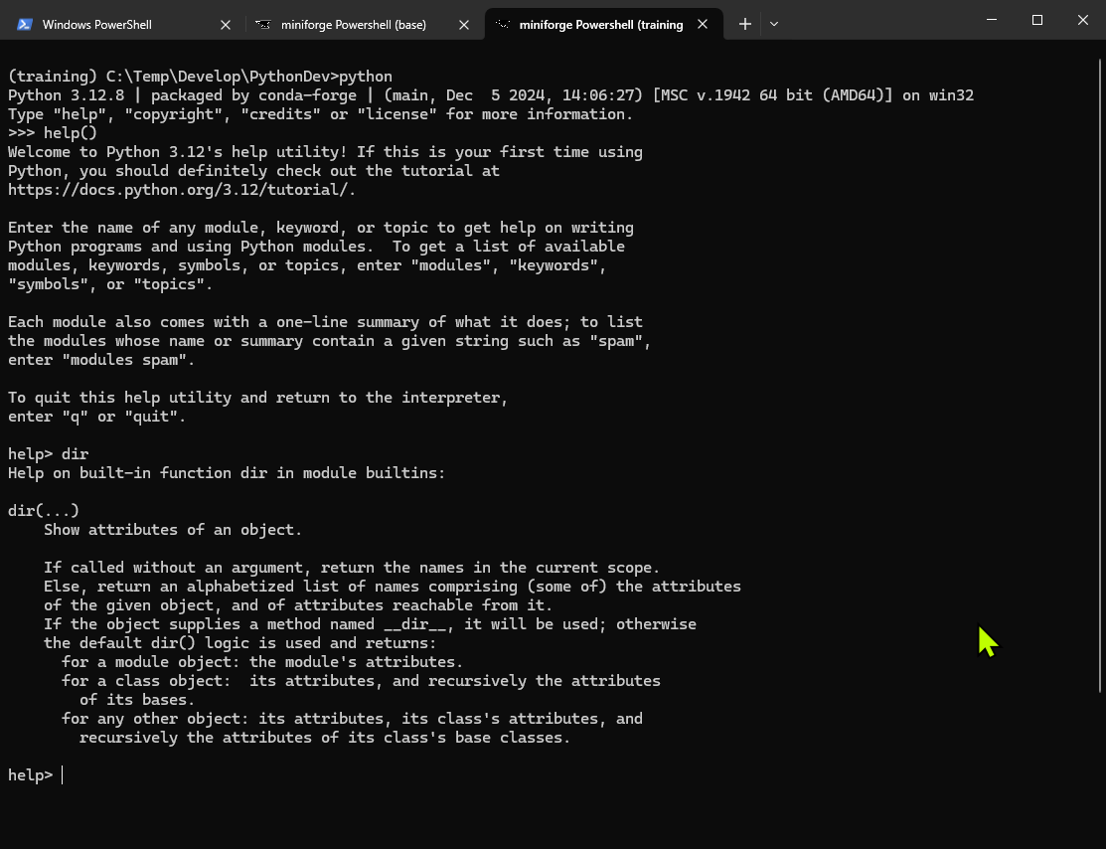
Getting Help
Python comes with a built-in help system. This means that you don't have to seek help outside of Python itself.
help(): running the function without an argument, the interactive Python's help utility will be started
  q to quit
  Type the command to get the help information

Slide 69
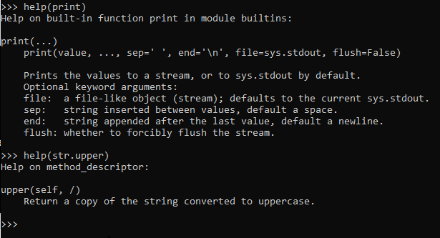
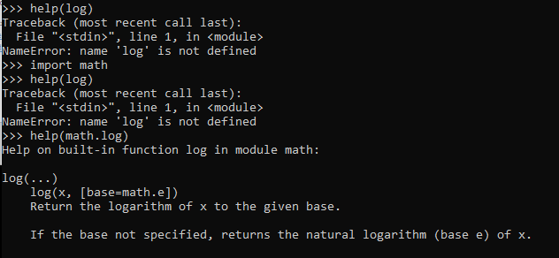
Getting Help
Passing an Object to help()
  help(print)
  help(str.upper)
Passing a string to help()
  pass a string as an argument, the string will be treated as the name of a function, module, keyword, method, class, or a documentation topic and the corresponding help page will be printed.
When needing help about a function from a certain Python library:
  First import the library.
  Ask to get the documentation for the function defined in the Python library.

Slide 70
Getting Help
Python website provides in depth online documentation: https://docs.python.org/3/index.html
Python website provides a comprehensive tutorial that has many examples: https://docs.python.org/3/tutorial/index.html

Slide 71
Online help, help(), and dir()
How do I call this function? What arguments and options does it have?
What does the source code of this Python object look like?
What is in this package I imported? What attributes or methods does this object have?
Google search, starting with the word "python", like "python loop" or "python string lowercase".
The official Python docs site: https://docs.python.org/3/
Many questions (and answers) can be found on StackOverflow
Use the help() and dir() functions (help(‘math’))
https://jakevdp.github.io/PythonDataScienceHandbook/01.01-help-and-documentation.html

