Slide 1
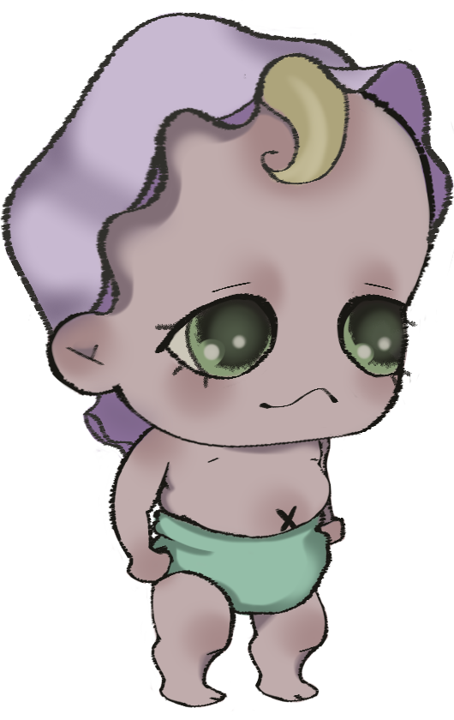
Eva Lucija
Game pitch

Slide 2
2D platformer with 3 levels
baby evolving by item collection
interesting lore

Slide 3
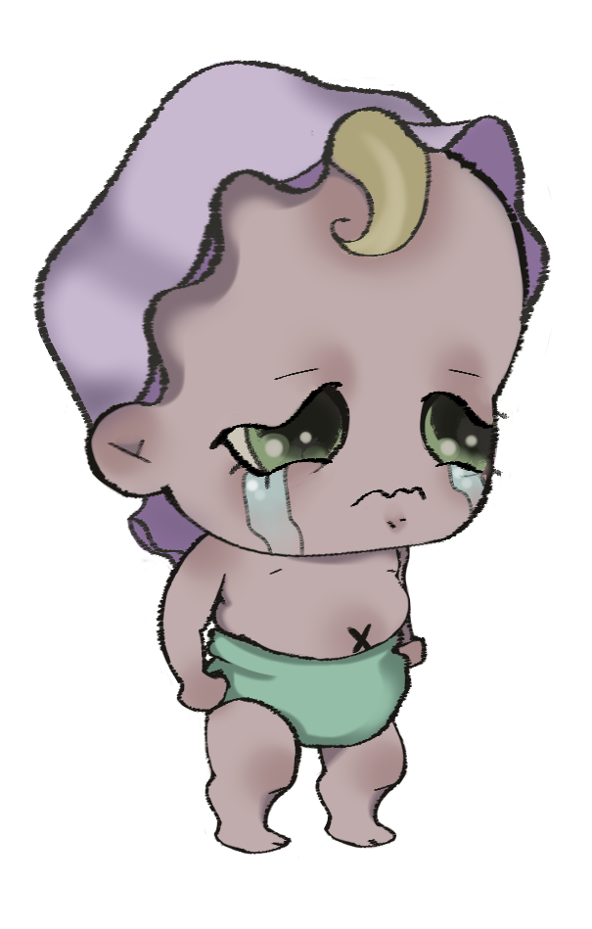
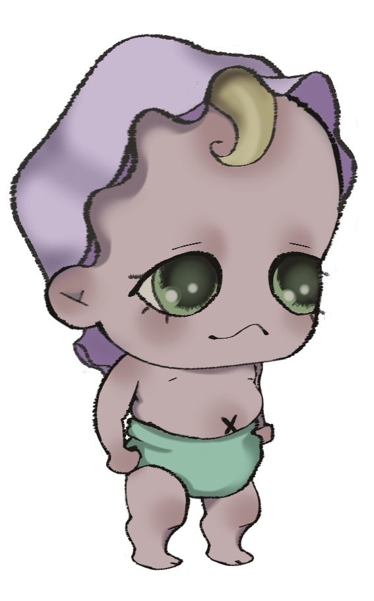
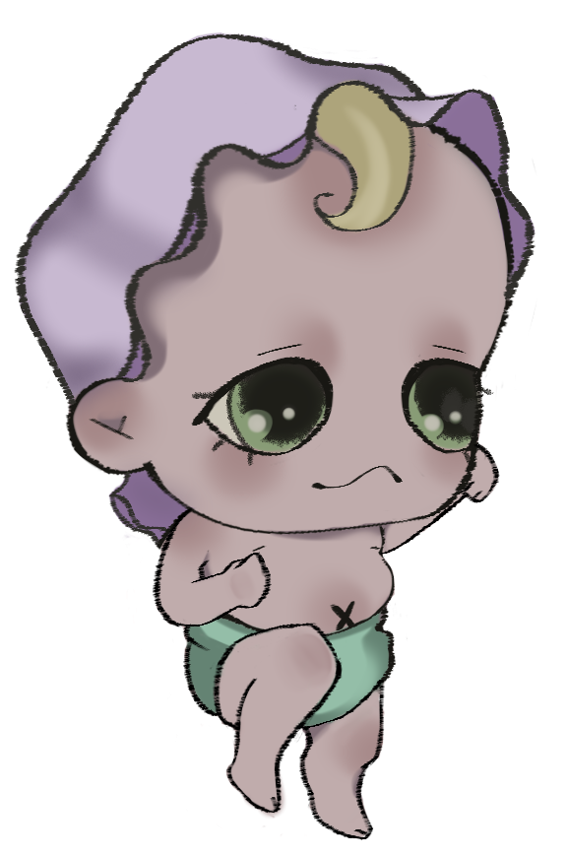
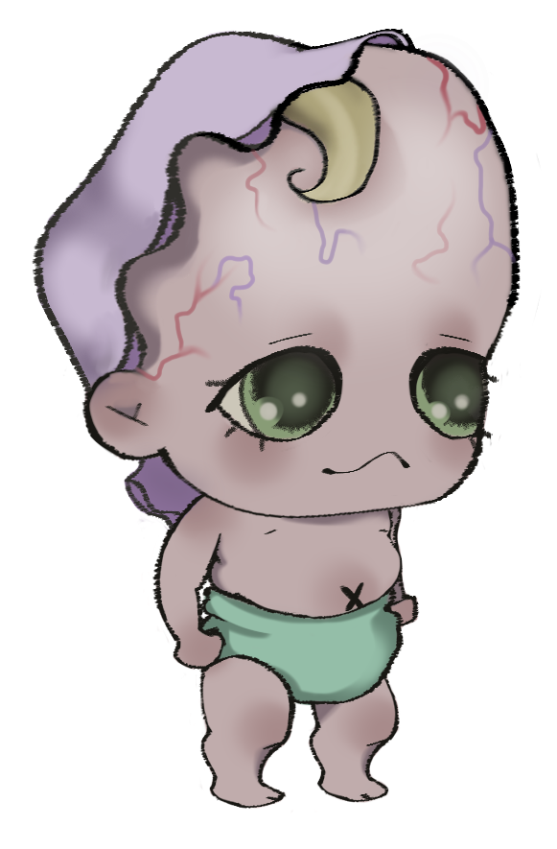
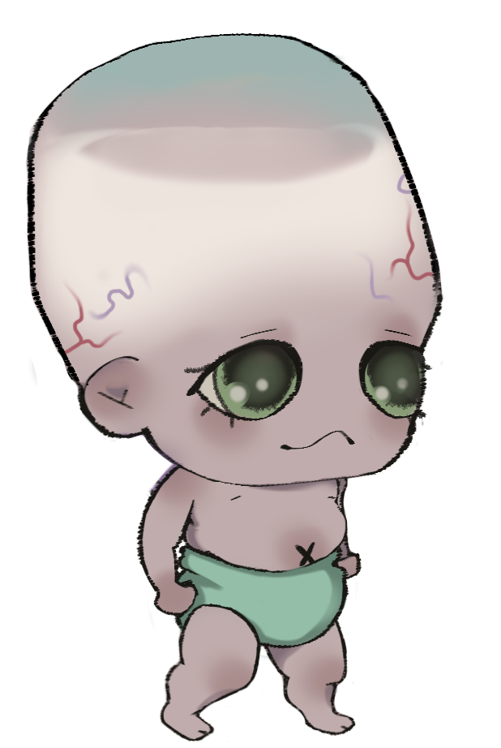
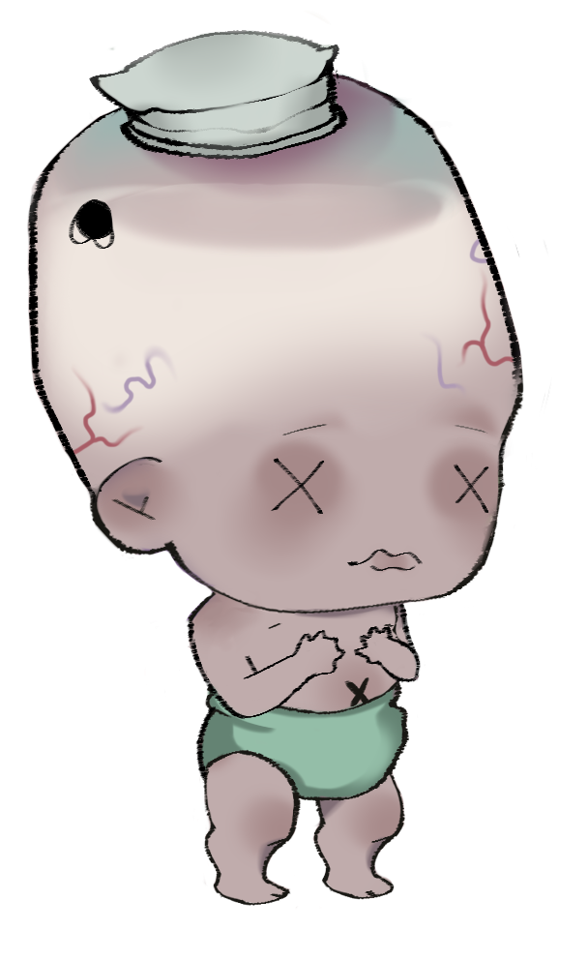
BABY EVOLUTION!

Slide 4

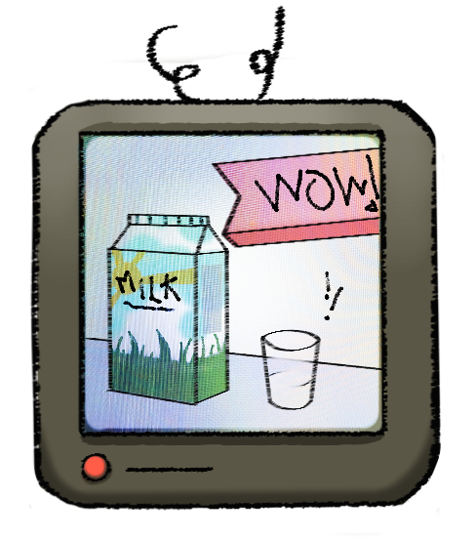


Evolution Mechanics Fun additions!
Jumping
Punching
Double jumping
Pushing
Voice acting
For the Colorblind
For the Blind
For the Deaf

Slide 5
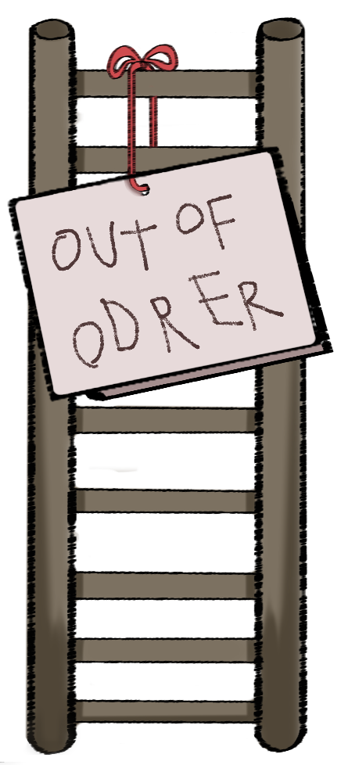
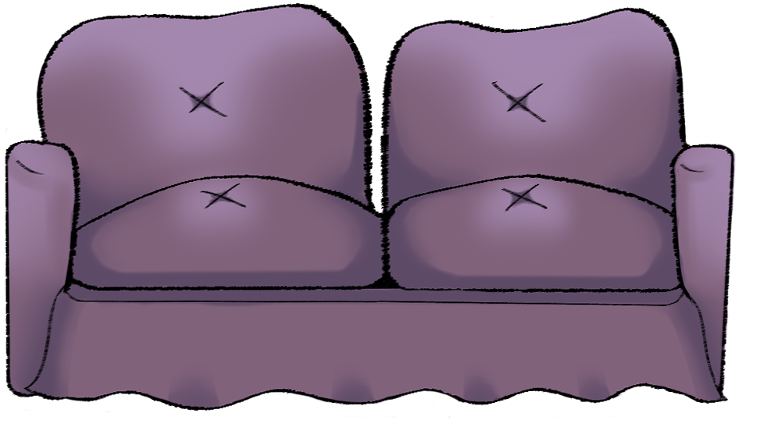
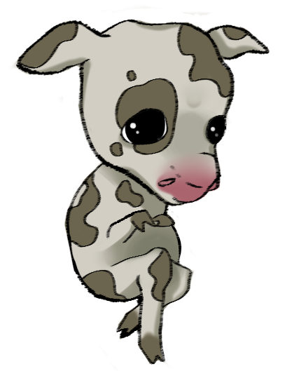
THIS GAME IS ACTUALLY A CONCEPT OF A GAME!
It is by no means finished or implemented correctly!
In the mean time, enjoy some more of our art~

Slide 6
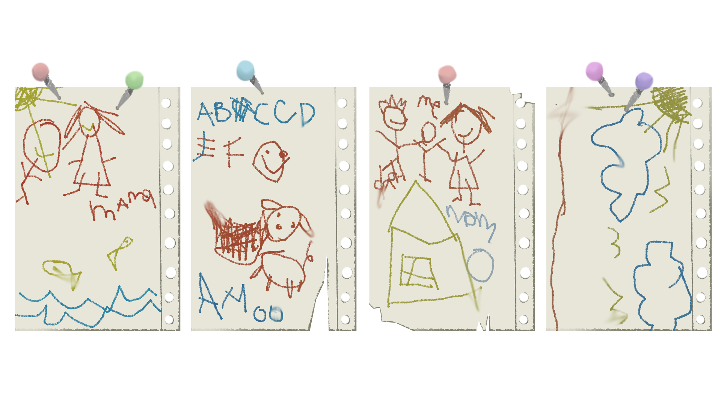

Slide 7
HVALA NA PAŽNJI!
THANK YOU FOR YOUR CONSIDERATION!
Your team a10 victims

