Slide 1
How to utilize Slice fast path to Connect Lut’s in Versal Architecture
The fast inter lut connect in Versal is called cascade (line)
It replaces the fast carry chain from 7-Series FPGA’s
Central to it is the new LOOKAHEAD8 module which now sits at the middle of each Slice
To convince the synthesizer to map your design on the fast path instead of some horrible long reroute you must incorporate LOOKAHEAD8!
But dont worry, designs which cannot or want not use carry lookahead functionality can still use the cascade fast path as the lookahead can be configured to basically let the cascade inputs simply pass through it without applying any logic on them (see lookahead primer for more details on this)
They are more constrains to convince the synthesizer your design is worthy of the fast path, we will illustrate them in detail on the following pages by virtually zooming into the layout of the first three luts of a slice from a versal fpga

Slide 2
CYD
*: Calling lut inputs A1 to A6 is a new nomenclature introduced with Versal architecture, but often in documents (and also in component interfaces) you can still find the classical naming scheme of i0 to i5
LUT6 C
CYC
COUTD
A6/i5
**
o6
LOOKAHEAD8
A5/i4
prop
PROPC
...
**
*
o5
A1/i0
CYB
PROPB
COUTB
LUT6 B
CYA
A6/i5
**
o6
PROPA
A5/i4
prop
**: Since Versal you can also find outputs declared as o5_1 and o5_2 instead, how they map to o6 depends actually on the value of input A6 which muxes o6 output between the two
...
**
*
o5
CIN
A1/i0
LUT6 A
A6/i5
**
o6
A5/i4
prop
...
**
*
o5
A1/i0

Slide 3
CYD
LUT6 C
CYC
COUTD
A6/i5
**
o6
LOOKAHEAD8
A5/i4
prop
PROPC
...
**
*
o5
A1/i0
CYB
PROPB
COUTB
LUT6 B
CYA
A6/i5
**
o6
PROPA
A5/i4
prop
...
**
*
o5
CIN
A1/i0
LUT6 A
A6/i5
**
o6
A5/i4
prop
...
**
*
o5
A1/i0

Slide 4
CYD
Input A5 is double purposed as input pin for previous lut fast path output
This means that you must connect your carry signal (or whatever signal you want to cascade) to A5 inport of the next lut
LUT6 C
CYC
COUTD
A6/i5
**
o6
LOOKAHEAD8
A5/i4
prop
PROPC
...
**
*
o5
A1/i0
CYB
PROPB
COUTB
LUT6 B
CYA
A6/i5
**
o6
PROPA
A5/i4
prop
...
**
*
o5
CIN
A1/i0
Connect your global carry / cascade in here (or connect your previous slice here when your operation spans
multiple slices)
LUT6 A
A6/i5
**
o6
A5/i4
prop
...
**
*
o5
A1/i0

Slide 5
CYD
LUT6 C
A6 must be constantly driven high
This means for the lut outport mapping, in our case: o6 == o52
CYC
COUTD
A6/i5
**
o6
LOOKAHEAD8
A5/i4
prop
PROPC
...
**
*
o5
A1/i0
CYB
PROPB
COUTB
LUT6 B
CYA
A6/i5
**
o6
PROPA
A5/i4
prop
...
**
*
o5
CIN
A1/i0
LUT6 A
A6/i5
**
o6
A5/i4
prop
...
**
*
o5
A1/i0

Slide 6
Important conclusions so far
From the 6 theoretically available lut inports we have “lost” so far two for “internal housekeeping”
If versal fast path / cascade line is planed to be used, only 4 lut inputs can be used freely for implementing the actual design functionality

Slide 7
CYD
Each slice has 8 luts, arranged as 4 pairs, where each pair builds a lookahead subgroup
LUT6 C
CYC
COUTD
A6/i5
**
o6
LOOKAHEAD8
A5/i4
prop
PROPC
...
**
*
o5
A1/i0
CYB
PROPB
COUTB
LUT6 B
CYA
Between both luts inside such a pair there runs a direct cascade fast lane between first lut ouput o6 and 2nd lut input A5
A6/i5
**
o6
PROPA
A5/i4
prop
...
**
*
o5
CIN
A1/i0
LUT6 A
A6/i5
**
o6
A5/i4
prop
...
**
*
o5
A1/i0

Slide 8
CYD
LUT6 C
CYC
COUTD
A6/i5
**
Between different subgroups the fast lane / cascade goes indirectly over the lookahead module
o6
LOOKAHEAD8
A5/i4
prop
PROPC
...
**
*
o5
A1/i0
CYB
PROPB
COUTB
LUT6 B
CYA
A6/i5
**
o6
PROPA
A5/i4
prop
...
**
*
o5
CIN
A1/i0
LUT6 A
A6/i5
**
o6
A5/i4
prop
...
**
*
o5
A1/i0

Slide 9
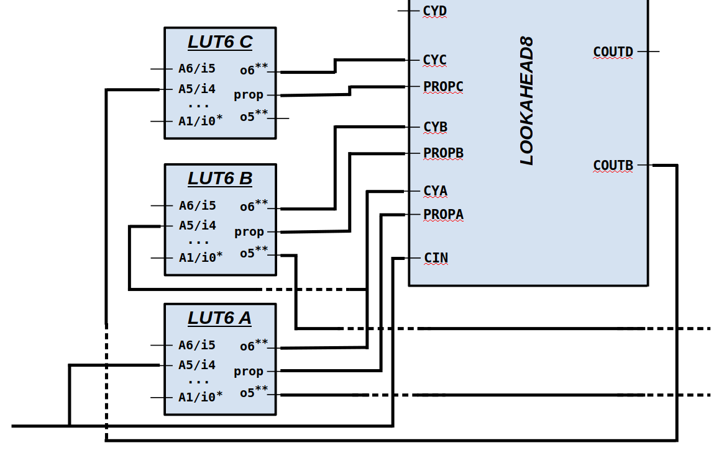
Things always to do when building any kind of fast path cascade logic
Use o6 / o52 for cascading output (e.g.: carry) and connect it to the lookahead module
Use A5 as cascade input
  connect it directly to o6 of the previous lut for an A-B transition
  connect it to lookahead outpin for a B-C transition
drive A6 constant high
connect prop(agate) ports between luts and lookahead even if you have no intention to use this signal properly the connection must still be there for the synthesizer to produce a proper layout

Slide 10
Additional things to do when building a fast adder with carry lookahead
Map adder sum outputs to o5 / o51
Obviously one must utilize some part of each lut mem for properly computing propagate signal now as it is needed for proper lookahead
carry out port (o6) will double function as lookahead generate signal
dont forget to configure the lookahead module to active lookahead mode per generics
(see lookahead primer docu for more details)

Slide 11
Additional things to do when building a fast adder without lookahead
Map adder sum outputs to o5 / o51
Set lookahead generics to passthrough mode
As previously said it is still mandatory to properly connect the propagate lanes to get the fast layout, but as lookahead module totally ignores its input in passthrough mode they can be safely ignored in designing the lut function
Carry will now traditionally ripple through from lut to lut, but will
use the fast line for it
This blue print should also be usable for any other custom design

Slide 12
The Code perspective: Which design patterns and design elements will work
We will examine this based on a simple example:
Creating a standard ripple-carry adder (which obviously should use cascade fast lane)
There are multiple different ways to describe such a design in VHDL code
Symbolically / Abstract (letting the synthesizer choose freely which it deems is the best way to implement this*):
Explicitly instantiating primitives (but they are multiple candidates which theoretically could fit the bill here):
    Classic LUT6_2 component
    CFGLUT5
    LUT6CY newly introduced with Versal
sum <= std_logic_vector(signed(a) + signed(b));
*: Actually one might expect that for an architecture where a lookahead module is builtin in every slice that this would be implemented even as lookahead adder, which would be also acceptable for this case

Slide 13
We examined the following designs to see which would be fast-path compatible
Symbolic / Abstract
Classic LUT6_2 directly chained together
LUT6_2 together with LOOKAHEAD8
CFGLUT5 + LOOKAHEAD8
LUT6CY + LOOKAHEAD8

Slide 14
We examined the following designs to see which would be fast-path compatible
Symbolic / Abstract (TODO: more tests)
Classic LUT6_2 directly chained together
LUT6_2 together with LOOKAHEAD8
CFGLUT5 + LOOKAHEAD8
LUT6CY + LOOKAHEAD8

Slide 15
We examined the following designs to see which would be fast-path compatible
Symbolic / Abstract
Classic LUT6_2 directly chained together
LUT6_2 together with LOOKAHEAD8
CFGLUT5 + LOOKAHEAD8
LUT6CY + LOOKAHEAD8
As said before using LOOKAHEAD8 is mandatory
This one is interesting because in theory this could work as all necessary ports can be connected as necessary, well except for propagate which we technically don’t need in passthrough mode, so could simply be set to constant ‘0’, but as said earlier, the current version of the synthesizer does not like it
See (3), this means that atm using reconfiguration together with the fast path is not possible in versal!
This is the one and only one of our test designs we found to be synthesized properly so far

Slide 16
Disclaimer
Note that we tested only some very basic example designs without any proper outside
connections and constrains found in real world designs (like clock cycle time). So it
might still be possible when applying “pressure” on the synthesizer with “hard” timing
constrains that it might reconsider for the designs not working in our tests to switch to the
fastpath instead of the horrible long winded reroutes it did when we tested it.
But the author of this lines is highly sceptical, thinking that when the synthesizer deems
fastpath usage possible it would always go for it independent of constrains as it already
does for our last test case.

Slide 17
Summarizing the Key take away points
For luts LUT6CY must be used together with LOOKAHEAD8 connected together in the right way (see previous pages)
Only 4 of the 6 lut ports are free to use at leisure (the other two are needed for “internal housekeeping”)
propagate must be properly connected between luts and lookahead even when not used
Using runtime reconfiguration together with fast path seems atm not possible

