Slide 1
Introduction to the Versal Lookahead Primitive
Disclaimer
This document assumes the reader is familiar with
the concept of carry lookahead for adders in general
and does not explain it, but you should have no trouble
finding a source to learn about it on the web if you are
new to it or think you need a refresher

Slide 2
Introduction to the Versal Lookahead Primitive
generic map (
LOOKB => "TRUE",
LOOKD => "TRUE",
LOOKF => "TRUE",
LOOKH => "TRUE"
)
Replaces the Fast Carry Chain avaible in
7-Series FPGA’s
Actually supports two different operation modes which can be set for each outport individually per generics:
    proper lookahead like the name promises
    but also a “passthrough” mode where lut carry outputs are directly routed through to outports
generic map (
LOOKB => "FALSE",
LOOKD => "FALSE",
LOOKF => "FALSE",
LOOKH => "FALSE"
)

Slide 3
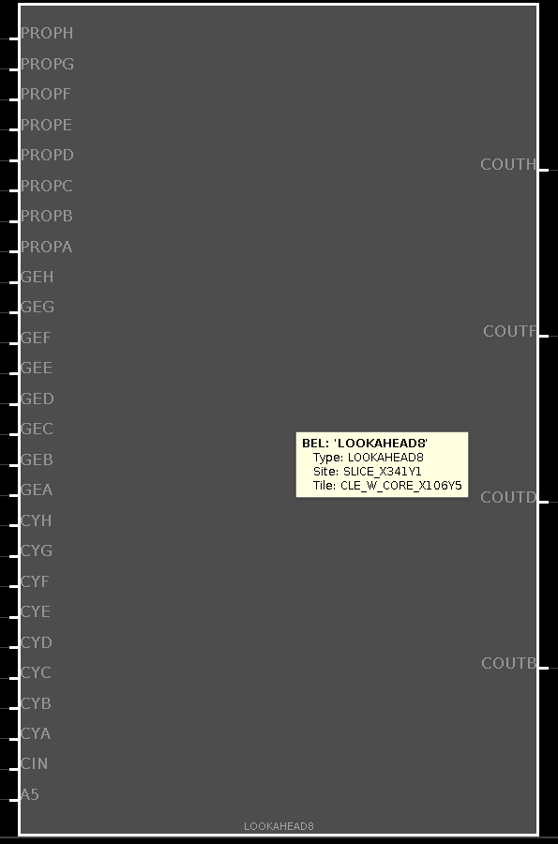
Introduction to the
Versal Lookahead Primitive: The Ports
Propagate Ports:
Used in lookahead mode for propagation inputs
ignored in passthrough mode

Slide 4
Introduction to the
Versal Lookahead Primitive: The Ports
GE-X Ports:
Totally ignored in any case and also currently undocumented (at least in the atm latest library guide for Versal), but still must be connected to avoid synth/simu errors
maybe a relic of an earlier now deprecated concept? (GE == Generate?)

Slide 5
Introduction to the
Versal Lookahead Primitive: The Ports
Carry Ports:
connected to lut based adder level carry out pins
used as generate inputs in lookahead mode
in passthrough mode half of them are simple ignored while the other half is directly passed through to output

Slide 6
Introduction to the
Versal Lookahead Primitive: The Ports
global (slice) carry in

Slide 7
Introduction to the
Versal Lookahead Primitive: The Ports
Undescribed internal port
not part of official component interface
can be safely ignored

Slide 8
Introduction to the
Versal Lookahead Primitive:
Lookahead Mode
connect previous slice COUT or global CI to CIN
connect propagate inports to lut propagate pins
    in general propagate signal can be computed either by an “OR” or by an “XOR”, but here it MUST BE XOR (see below for reason)
connect CY-X ports to lut carry outports, they will be used as GENERATE
    note that technically using the carry out of a full adder as generate is not 100% correct as generate is nominally “A AND B” (where A,B are our addition inputs) which is a subset but not identical to the carry out function of a full adder
    however because of the special way the lookahead module is built up internally it works here if propagate is only true for “XOR” and not for “OR”

Slide 9
Introduction to the
Versal Lookahead Primitive:
Lookahead Mode
Like COUTB for LUTS C and D + checking generate / propagate status of previous AB subgroup
Will be ‘1’ when:
LUT-B generates
Or: LUT-A generates / CIN is set and we have a closed propagate chain

Slide 10
Introduction to the
Versal Lookahead Primitive:
Lookahead Mode
Logic Implementation for 1st Output (*)
CYB
&
PROPB
≥1
COUTB
CYA
&
&
≥1
PROPA
&
CIN
*: Actual logic is a bit more complex to handle mode switch, see Annex

Slide 11
Introduction to the
Versal Lookahead Primitive:
Lookahead Mode
Logic Implementation for 2nd Output: Part A
PROPD
&
PROP-CD
PROPC
PROPB
&
PROP-AB
PROPA

Slide 12
Introduction to the
Versal Lookahead Primitive:
Lookahead Mode
Logic Implementation for 2nd Output: Part B
CYD
&
PROPD
CYC
&
&
COUTB
&
≥1
≥1
COUTD
PROPC
&
PROP-CD
&
PROP-AB
CIN

Slide 13
Introduction to the
Versal Lookahead Primitive:
Passthrough Mode
2nd, 4th, 6th and 8th lut carry out are directly routed through (*)
All other inports are ignored
*: Actual logic is a bit more complex to handle mode
switch, see Annex

Slide 14
Introduction to the
Versal Lookahead Primitive: Annex
Complete Logic Implementation for 1st Output including
mode switch (lookahead <=> passthrough, *)
CYB
&
≥1
PROPB
&
LOOKB (**)
≥1
COUTB
CYA
&
&
≥1
PROPA
&
CIN
*: based on Vivado 2021 Verilog simulation architecture, for more details see there
**: remember this is actually not a real port / signal but a generic
(TRUE => ‘1’, FALSE => ‘0’)

