Slide 1
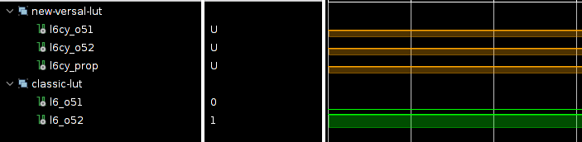
Simulation Issues with newer Xilinx Primitives (Versal)
Depending how you setup your Vivado Project you might run into issues that your new Versal introduced library primitive mysteriously only shows ‘U’ in simulation although all inports are properly driven
Compare
New Versal
LUT6CY
VS
Classic
LUT6_2

Slide 2
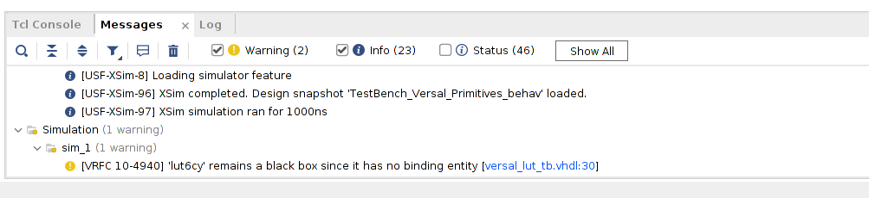
Simulation Issues with newer Xilinx Primitives (Versal)
Also check your messages, there should be a warning like this:

Slide 3
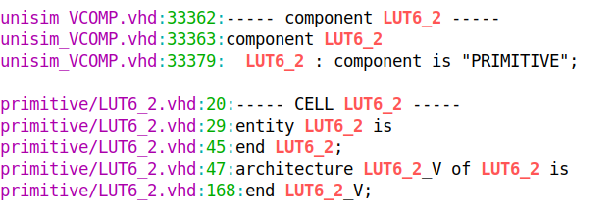

Simulation Issues: Explanation
For Versal components you will only find the component definition in Xilinx VHDL lib, no architecture implementation:
Component Declaration
Missing!
Architecture Implementation

Slide 4
Simulation Issues: Explanation
This is no accident or bug! Xilinx decided to only create verilog implementations for its newly created lib modules starting with Versal
Does not mean you cannot do a “pure” vhdl design anymore, this is still possible, but one must apply the known methodology of mixed language interfacing to interact with the Xilinx primitives
=>>
https://support.xilinx.com/s/article/76496?language=en_US

Slide 5
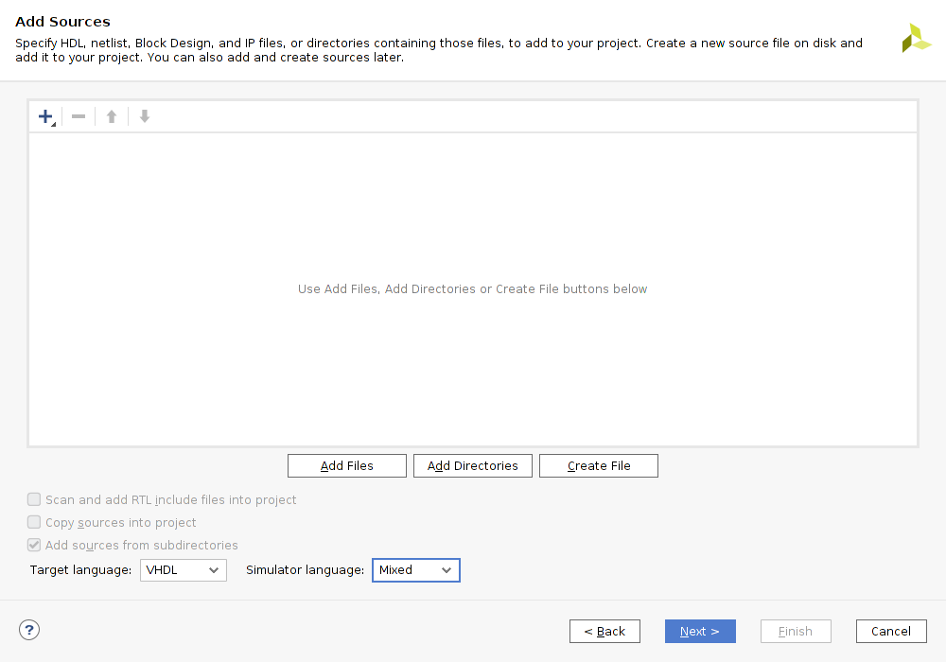
Simulation Issues: Solution A
This means when creating a new project it becomes mandatory to set simulator language field to Mixed, even when you don’t plan to use verilog modules yourself
If your selected device/part/board is also of type Versal, for example:
“Versal VCK190 Eval Platform”
than simulation should work again without any further action necessary

Slide 6
Simulation Issues: Alternative Solution B
If you want to use the modules for a non Versal target for some reason or the previous solution does not work for you for some other reason there is an alternative approach which should “force” the correct use of the correct verilog lib
First one must execute following command in the tcl console:
set_property force_compile_glbl 1 [current_fileset -simset]

Slide 7
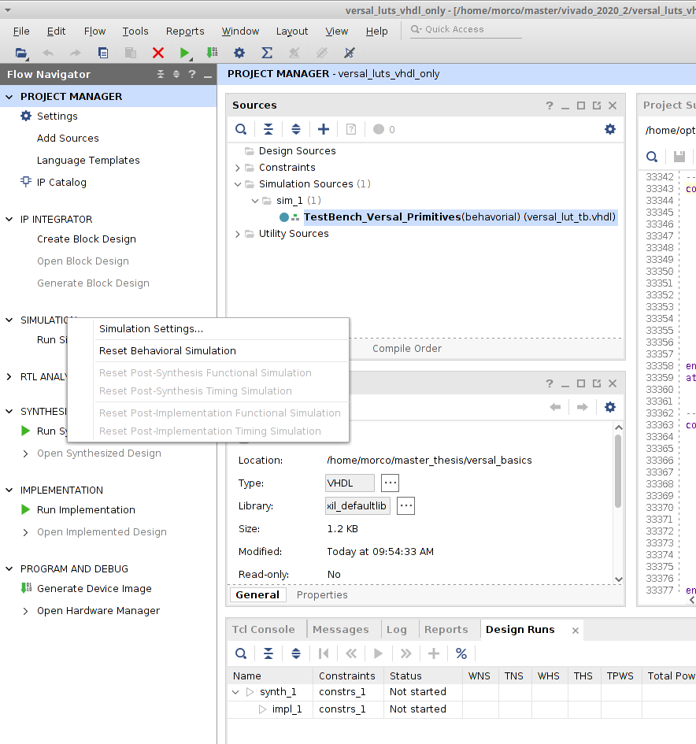
Simulation Issues: Alternative Solution B
Secondly one must add the following to ones simulation settings (Vivado xsim):
xsim.elaborate.xelab.more_options → -L unisims_ver
Choose This
Right-Click Here

Slide 8
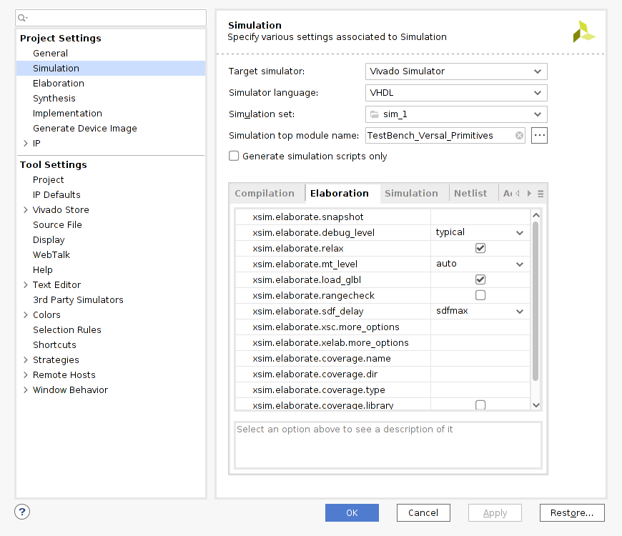
Simulation Issues: Alternative Solution B
Secondly one must add the following to ones simulation settings (Vivado xsim):
xsim.elaborate.xelab.more_options → -L unisims_ver
For more details and handling other simulators than vivado builtin xsim see:
https://support.xilinx.com/s/article/76496?language=en_US

