Slide 1

Junit 5 actually has a feature that helps us to write all these tests!

Slide 2
The total is higher than the amount of small and big bars.
Ex: small = 1, big = 1, total = 10
small = 1, big = 1, total = 5, = 0
small = 1, big = 1, total = 6, = 1
small = 1, big = 1, total = 7, = -1
small = 1, big = 1, total = 8, = -1

Slide 3

@Test public void totalIsTooBig_boundary1() {}
@Test public void totalIsTooBig_boundary2() {}
@Test public void totalIsTooBig_boundary3() {}
@Test public void totalIsTooBig_boundary4() {}

Slide 4
public void totalIsTooBig() {
ChocolateBags bags = new ChocolateBags(); int result =
bags.calculate(??, ??, ??);
assertEquals(??, result); }

Slide 5
public void totalIsTooBig(int small, int big, int total, int expected) { ChocolateBags bags = new ChocolateBags(); int result =
bags.calculate(small, big, total);
assertEquals(expected, result); }

Slide 6
"1,1,5,0”
public void totalIsTooBig(int small, int big, int total, int expected) { ChocolateBags bags = new ChocolateBags(); int result =
bags.calculate(small, big, total);
assertEquals(expected, result); }

Slide 7
"1,1,5,0”, "1,1,6,1"
public void totalIsTooBig(int small, int big, int total, int expected) { ChocolateBags bags = new ChocolateBags(); int result =
bags.calculate(small, big, total);
assertEquals(expected, result); }

Slide 8
{ "1,1,5,0”, "1,1,6,1",
"1,1,7,-1", "1,1,8,-1" } public void totalIsTooBig(int small, int big, int total, int expected) { ChocolateBags bags = new ChocolateBags(); int result =
bags.calculate(small, big, total);
assertEquals(expected, result); }

Slide 9
@CsvSource({ "1,1,5,0”, "1,1,6,1",
"1,1,7,-1", "1,1,8,-1" }) public void totalIsTooBig(int small, int big, int total, int expected) { ChocolateBags bags = new ChocolateBags(); int result =
bags.calculate(small, big, total);
assertEquals(expected, result); }

Slide 10
@ParameterizedTest @CsvSource({ "1,1,5,0”, "1,1,6,1",
"1,1,7,-1", "1,1,8,-1" })
public void totalIsTooBig(int small, int big, int total, int expected) { ChocolateBags bags = new ChocolateBags(); int result =
bags.calculate(small, big, total);
assertEquals(expected, result); }

Slide 11
@ParameterizedTest @CsvSource({ "1,1,5,0", "1,1,6,1",
"1,1,7,-1", "1,1,8,-1" }) public void totalIsTooBig(int small, int big, int total, int expected) { ChocolateBags bags = new ChocolateBags(); int result =
bags.calculate(small, big, total);
assertEquals(expected, result); }

Slide 12
@Test public void totalIsTooBig() { ChocolateBags bags = new ChocolateBags(); int result =
bags.calculate(1, 1, 5);
assertEquals(0, result); }

Slide 13
@ParameterizedTest @CsvSource({ "1,1,5,0", "1,1,6,1",
"1,1,7,-1", "1,1,8,-1" }) public void totalIsTooBig(int small, int big, int total, int expected) { ChocolateBags bags = new ChocolateBags(); int result =
bags.calculate(small, big, total);
assertEquals(expected, result); }
4 tests!

Slide 14
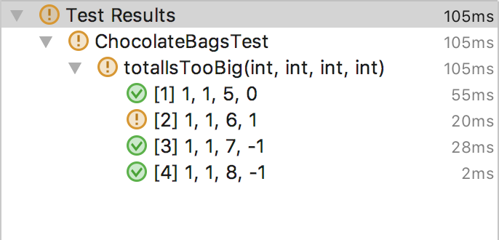

Slide 15
Only big bars.
Ex: small = 5, big = 3, total = 10
small = 5, big = 0, total = 10, = -1
small = 5, big = 1, total = 10, = 5
small = 5, big = 2, total = 10, = 0
small = 5, big = 3, total = 10, = 0

Slide 16
@ParameterizedTest @CsvSource({ "4,0,10,-1", "4,1,10,-1", "5,2,10,0", "5,3,10,0" }) public void onlyBigBars(int small, int big, int total, int expected) { ChocolateBags bags = new ChocolateBags(); int result =
bags.calculate(small, big, total);
assertEquals(expected, result); }

Slide 17
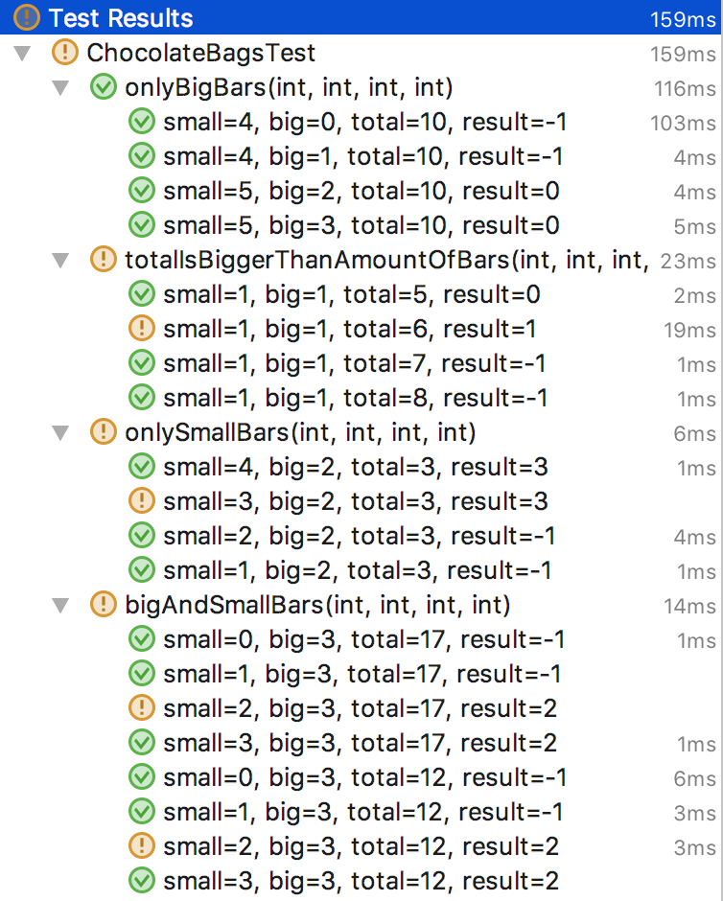

Slide 18
public class ChocolateBags { public int calculate(int small,
int big, int total) { int maxBigBoxes = total / 5; int bigBoxes = maxBigBoxes < big ?
maxBigBoxes : big;
total -= (bigBoxes * 5); if(small <= total) return -1; return total; } }

Slide 19
public class ChocolateBags { public int calculate(int small,
int big, int total) { int maxBigBoxes = total / 5; int bigBoxes = maxBigBoxes < big ?
maxBigBoxes : big;
total -= (bigBoxes * 5); if(small < total) return -1; return total; } }

Slide 20
